Slide 1
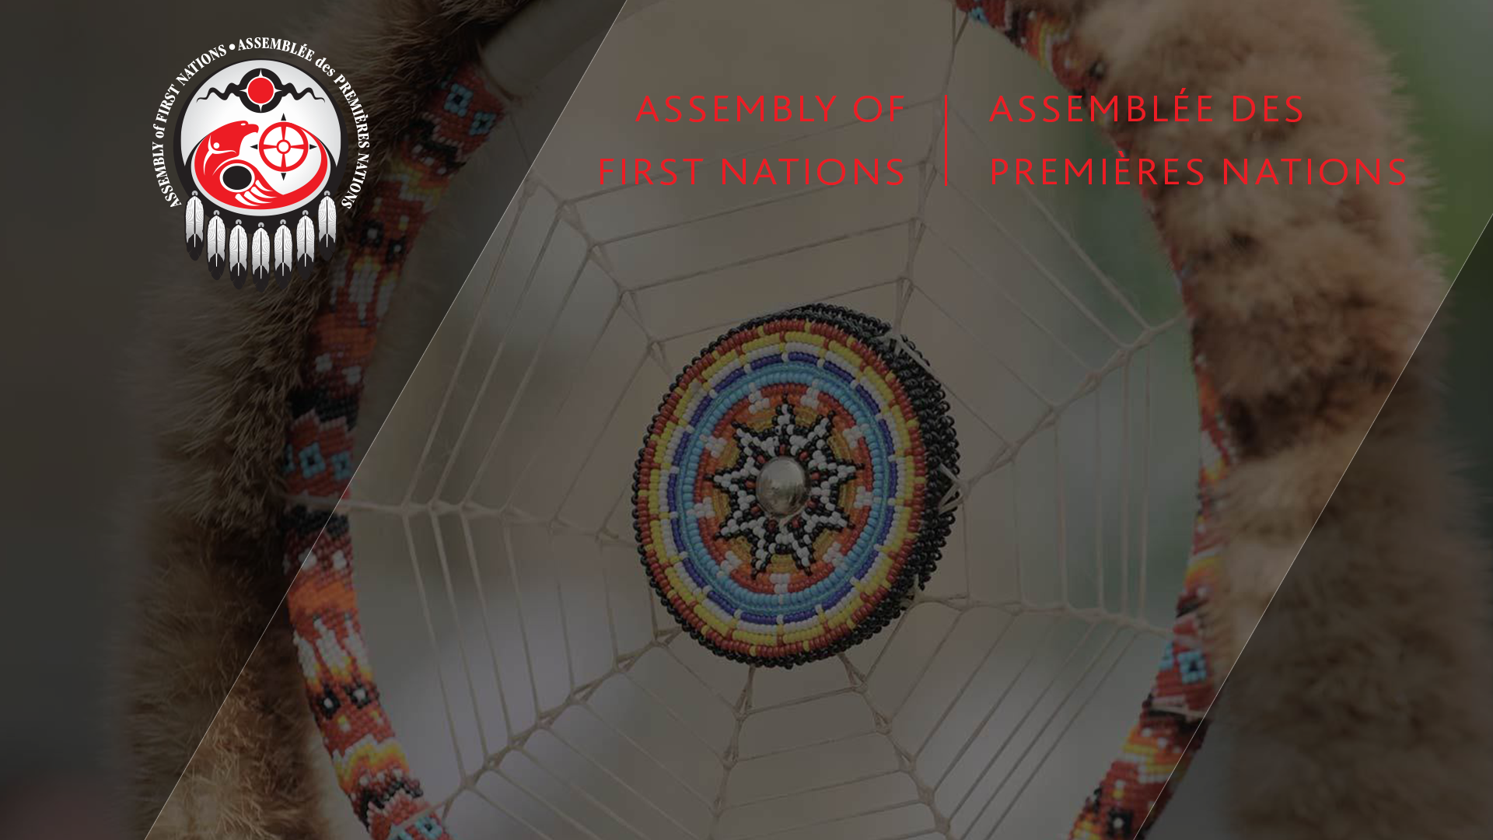
The Convention on Biological Diversity (CBD)
An Introduction to CBD and its Implication on Halting
Biodiversity Loss

Slide 2
What is Biodiversity?
  Biodiversity is the web of life constituted by all species, their genetic diversity and the ecosystems which they form, including US as we see ourselves and our plant and animal relatives and the things we cannot see.
  All of this is interconnected and interdependent in an inexhaustible web of complex and diverse ecological interactions and relationships.
  This web is in constant change, evolving through time in a dynamic way, but maintaining, at the same time, the integrity of this system, which is responsible to provide all the essential services that are necessary for all living organisms to thrive on this planet.

Slide 3
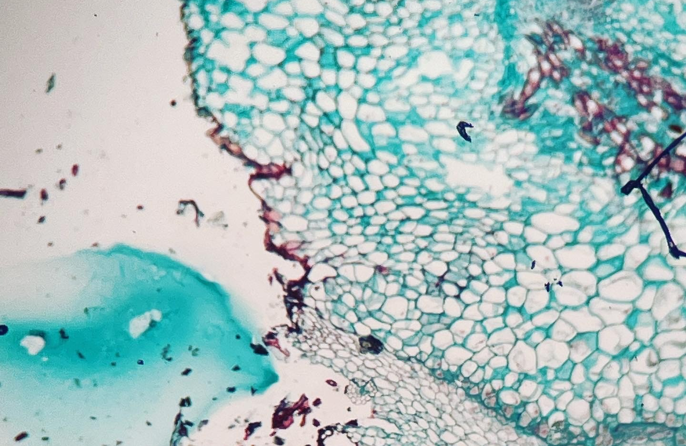
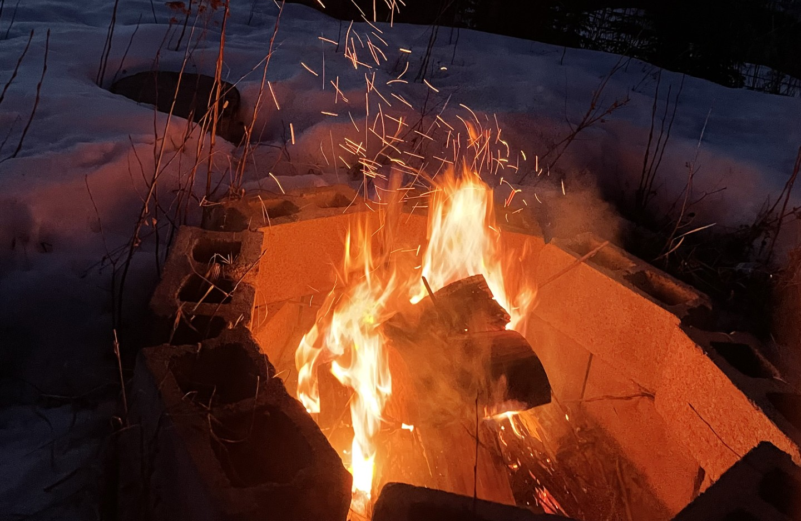
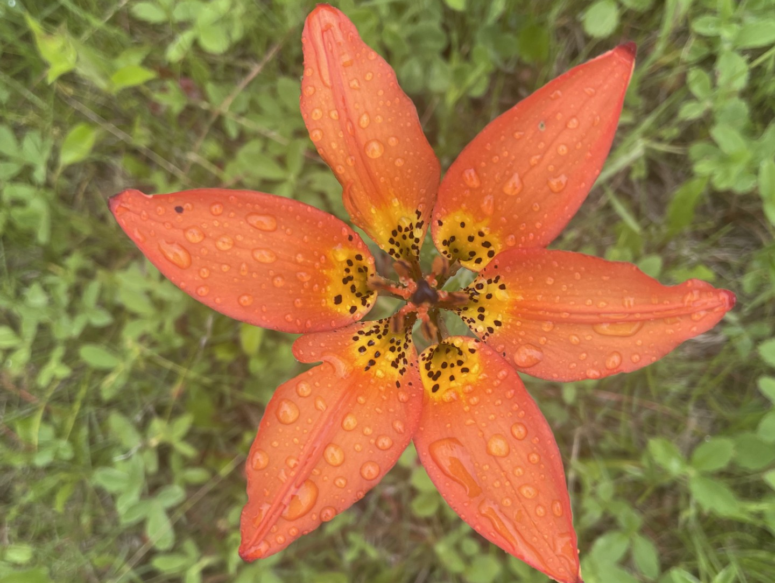

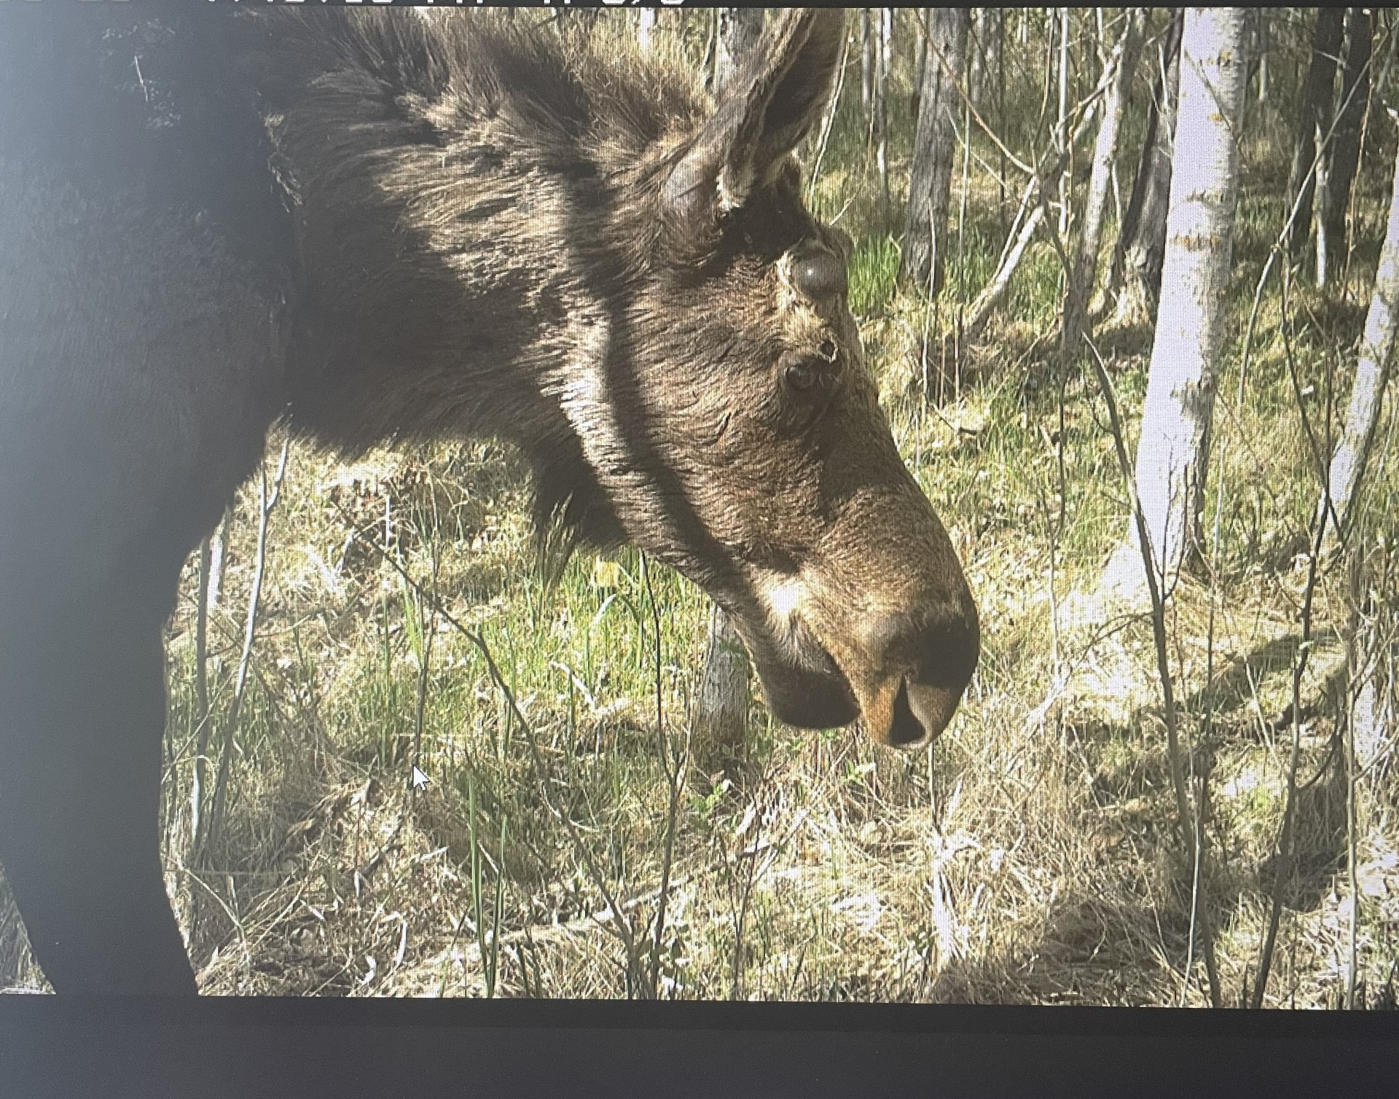

Slide 4
Why Protect Biodiversity?
Environmental Issues
  Major pollution problems
  Human Health Issues
  Over exploitation of Mother Earth
  Public outcry
  Transboundary challenges: think locally, act globally

Slide 5
Global Response
In 1972, world leaders from 113 countries convened in Stockholm, Sweden for the first UN environmental conference.
The United Nations Conference on the Human Environment (UNCHE) marked the first time that countries came together to collaborate on a plan to manage environmental issues.
At the conference, world leaders agreed on the need for “an international entity to catalyze the necessary environmental action at the international level, and this led to the creation of the United Nations Environment Programme (UNEP)”.

Slide 6
United Nations Environment Programme (UNEP)
Treaties were created between Governments.
Multilateral Environmental Agreements (MEAs)
  MEAs are international agreements that focus on environmental issues. They are legally binding agreements between several states. Since the United Nations Conference on the Human Environment in 1972, many MEAs have been created to deal with specific aspects of the environment.

Slide 7
Earth Summit Rio 1992
In June 1992, the United Nations Conference on Environment and Development, also known as the Rio “Earth Summit” was held in Rio de Janeiro, Brazil.
The conference brought together over 178 States including 118 heads of state, nearly 1400 NGOs, which included representatives of Indigenous groups, women’s groups, environmental groups and activists to discuss the environment.
The Earth Summit was the largest intergovernmental gathering in history dedicated to environmental issues. This generated profound impacts in international policy as well as civil society mobilization.

Slide 8
Main outcomes of the Earth Summit
• Rio Declaration on Environment and Development
• Agenda 21 and the creation of the Commission on Sustainable Development
• Forest principles – a non-binding set of principles for forest management
Environmental treaties (MEAs) – Today called the Rio Conventions
    Convention on Biological Diversity
    UN Convention to Combat Desertification
    UN Framework Convention on Climate Change

Slide 9

The Creation of the CBD
Ad Hoc Working Group of Experts on Biological Diversity were tasked to explore synergies between existing biodiversity treaties.
In 1988, it was agreed upon to start preparations for the creation of a legally binding agreement on biodiversity.
In 1989 an Ad Hoc Working Group of Technical and Legal Experts was created to develop a UN Convention on biodiversity.
In 1991 the Ad Hoc Working Group evolved into the Intergovernmental Negotiating Committee (INC).
On May 22, 1992, the INC concluded with the adoption of a legally-binding CBD text, resulting in the International Day of Biological Diversity.

Slide 10
CBD Definition on Biodiversity
The Convention on Biological Diversity (CBD) officially defines biodiversity as, “The variability among living organisms from all sources including, inter alia, terrestrial, marine and other aquatic ecosystems and the ecological complexes of which they are part; this includes diversity within species, between species and of ecosystems.”
The objective of the CBD is the conservation of biological diversity, the sustainable use of its components, and the fair and equitable sharing of the benefits arising from commercial and other uses of genetic resources.

Slide 11
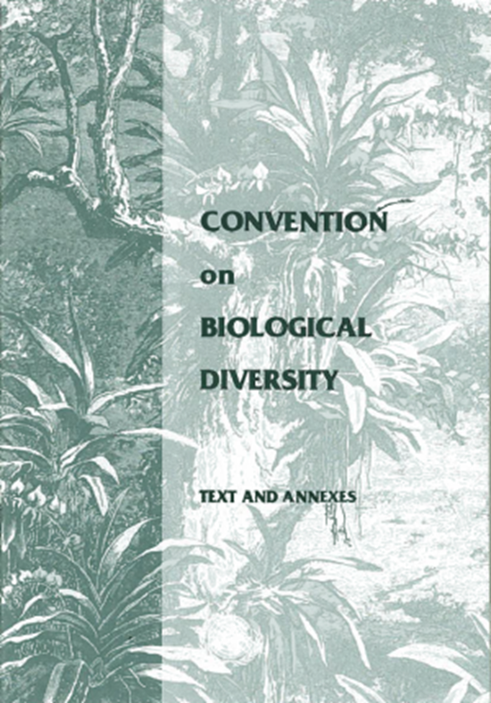
The Convention Text
The Preamble
  A legal agreement where the Parties set out their concerns and motivations.
  For example, it is in the preamble of the CBD that the Parties affirm “that the conservation of biological diversity is a common concern of humankind” and are “determined to conserve and sustainably use biological diversity for the benefit of present and future generations”.

Slide 12
Institutional Arrangements
The Convention establishes institutional arrangements which provide a mechanism for further development and monitoring the implementation of the Convention through meetings, work programmes, reviews and negotiations;
  Financial Mechanism
  Secretariat
  Conference of the Parties Reports
  Relationship with Other International Conventions
  Subsidiary Body on Scientific, Technical and Technological Advice (SBSTTA)
Treaty Mechanisms and its Annexes
  Sets out the operation of the convention and its annexes (protocols).
  19 in total

Slide 13
Conference of the Parties (COP)
Convention is the main governing body, many of its provisions require further elaboration.
Guides States and stakeholders in their management of biodiversity, developed through decisions made by COP Decisions.
Convene every two years, or as needed.

Slide 14
Main Functions of COP
Developing rules of procedures for the Convention and its bodies
Adoption of the budget and development of guidance to the financial mechanism
Creation of subsidiary bodies or expert groups to support the implementation of the Convention or advise the COP
Adoption of protocols or annexes
Adoption of Programmes of Work
Consideration of national reports
Provide policy guidance
Steer the implementation of the Convention and keep it under review
Main decision-making body

Slide 15
The Governing Body
COP Bureau
COP Presidency
  Filled by the Environment Minister of the hosting country
  Leads negotiations and Subsidiary Bodies
  Rules on Points of Order
Secretariat
  Arrange meetings and provide reports

Slide 16
COP Participants
Parties
  Countries that have signed and ratified a treaty receives full voting rights in all processes but also commits itself to implement the convention at the national level.
  196 countries are parties to the CBD, making it one of the few multilateral environmental agreements that has been ratified by almost every country in the world.
Non-parties
  Not ratified the CBD, no voting rights
Observers
  No voting rights
  Indigenous Peoples and Local Communities (IPLCs)
  Non-Governmental Organizations(NGOs) and Intergovernmental Organizations (IGOs)
  Business and the Private Sector
  Youth
  Education/University
  UN Organisations

Slide 17
Civil Society Participation
Stakeholders can take part in CBD meetings as Observers.
Their participation is being governed by rules 7 and 29 of the rules of procedures that have been adopted by the COP.
  Rule 7.1 specifies that observers shall be notified by the Secretariat of any meeting of the COP.
  Rule 7.2 determines that observers may participate in COP-meetings without any voting rights. Observers can be stripped of their right to participate if at least one third of all Parties objects to their admission.
Must receive Accreditation
  Send an official letter addressed to the Executive Secretary requesting accreditation for the respective CBD meeting.
  Attach relevant information that proves that your organization exists/is legally registered, e.g. statute/by-laws of your organization, documents of establishment.
  Attach relevant information that demonstrates your organization's qualification in the field of Biodiversity (e.g. brief information/overview about relevant projects/ activities on Biodiversity, articles in media and press).

Slide 18
CBD Process
Negotiations – Rules and Protocols
Where all parties come together to negotiate and agree on a set of commitments that should be implemented by every country at the national level
Intersessional Periods
  Implementation of commitments made at previous meetings
  Preparation of the negotiations in upcoming meetings
  Meetings of Subsidiary Bodies, Working Groups, Regional Consultations and other official expert groups

Slide 19
Role at CBD
Determine your Role and plan strategically on which actions you will need to carry out to achieve your goals.
As a party delegate you will have a very specific role in line with the strategy adopted by the party and will be given specific instructions and guidelines.
If not a party delegate, there are additional opportunities to enhance your work:
  Lobbying
  Partnerships and increase visibility of your organization
  Increase knowledge
  Fundraise
  Reporting back to your organization

Slide 20
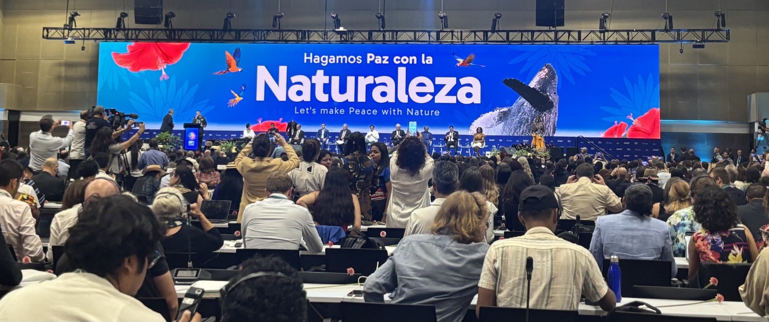
Preparing for the CBD Meeting

Slide 21
Accreditation
Registration
Review of pre-sessional and meeting documents
  Convention on Biological Diversity
Provisional agenda and Provisional Annotated Agenda are set by the CBD Secretariat
  Introduces the main issues and the order in which they will be negotiated during the meeting.
  Includes Organizational matters, Issues, Reports and Closing (Adoption of the reports).

Slide 22
The Meeting
Daily Schedule
Negotiations are done in Plenary and Working groups
Plenary
  Main meeting format
  To Report and approve decisions or recommendations
  Negotiation of text
  Interventions

Slide 23
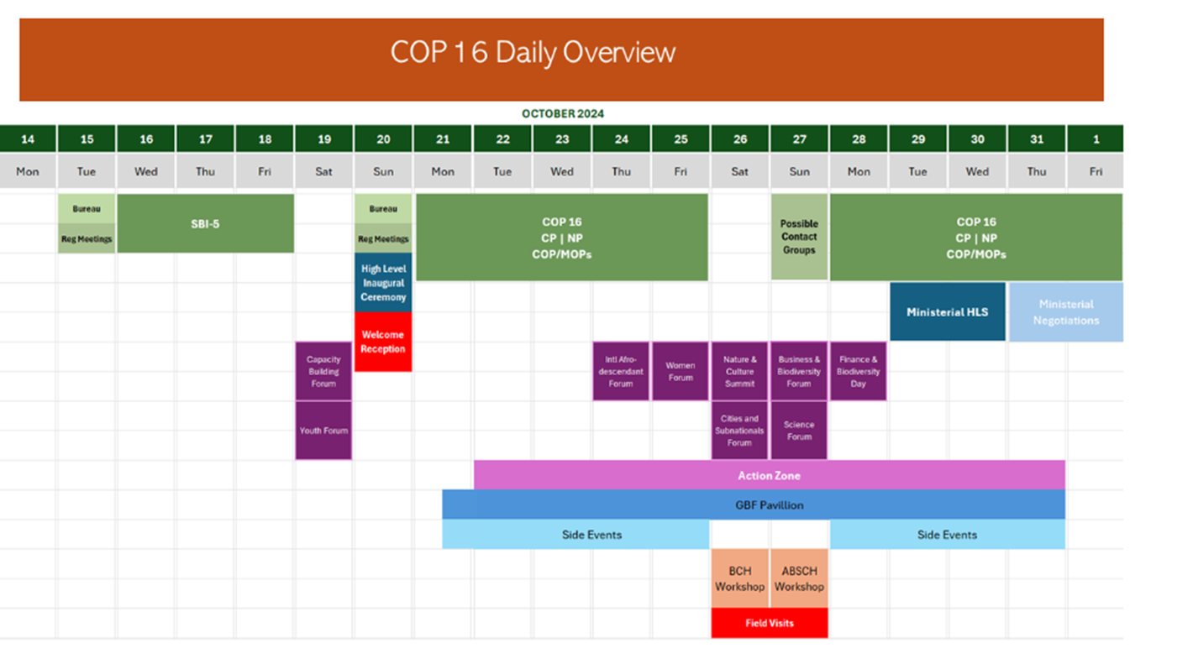

Slide 24
Subsidiary Bodies and Working Groups
Subsidiary body is a permanent body. The COP can also establish other ad-hoc bodies, such as working groups, expert groups and committees.
Working Group on Article 8J (Adopted at COP16)
  Parties are encouraged to respect, preserve and maintain indigenous and local communities, whilst at the same time engaging with these communities to promote their knowledge.
The Subsidiary Body on Scientific, Technical and Technological Advice (SBSTTA)
  Advice on scientific programmes and international cooperation in research and development related to biodiversity.
  Assessments on the status of biodiversity.
The Subsidiary Body on Implementation
  Develop recommendations on how obstacles to the CBD’s implementation can be overcome and how mechanisms that support the CBD implementation can be strengthened.

Slide 25
Amendments of the Convention
Adoption of amendments and protocols
Cartegena Protocol on Biosafety
  Biosafety refers to efforts to reduce and eliminate potential risks to biodiversity and human health resulting from biotechnology, and relies deeply on the precautionary approach.
Nagoya Protocol on Access and Benefit-sharing
  Genetic resources
  Including medicinal plants
  Prior and informed consent
  Fair and equitable sharing of the genetic resources
    High biodiversity, low benefits

Slide 26
Main Outcomes
To further advance negotiations between the parties of the CBD on issues that are relevant to the implementation of the three objectives of the Convention.
An agreement from the parties setting out guidelines and actions to be implemented by the parties at the national level with the assistance of the Secretariat.
COP-Decisions are official texts that can contain concrete action plans, specific targets and other commitments that CBD member states need to implement on the national level.
Closure of the Meeting.

Slide 27
Implementation of CBD
5 Strategic Goals
23 Targets
Kunming-Montreal Global Biodiversity Framework
  National Biodiversity Strategies and Actions Plans (NBSAPs)
    All parties have agreed
    National Reports on the measures that they have taken to implement the Convention on a frequent basis.
    Canada has submitted and also introduced The Nature Accountability Act (C-73)

Slide 28
Questions and Comments
Marsi cho
Thank you
Assembly of First Nations
Kuni Albert, Senior Policy Advisor
Environment, Land and Water Branch
Email: Kalbert@afn.ca

