Slide 1

Benefits for All Canadians (Part 1): Economic Impact of Closing the Infrastructure Gap
The report was produced by the Conference Board of Canada and commissioned by the Assembly of First Nations (AFN).

Slide 2







Special Contributions
The information prepared in the report was based on the Closing the Infrastructure Gap Report produced by a multidisciplinary team led by the Assembly of First Nations with support from Indigenous Services Canada. We would like to acknowledge the contributions of the First Nations Engineering Services, BTY Group, Associated Engineering, Planetworks Consulting, and Yalleedesigns for their contributions to the development of the information and reports associated with this presentation.

Slide 3
Summary Recap of CTIG
The Assembly of First Nations (AFN) “Closing the Infrastructure Gap (CTIG) by 2030” Report estimated that $349.2 billion is required to close the infrastructure gap for First Nations.
This estimate, developed in 2022, with an assumed start date in the 2023-24 fiscal year, will continue to increase as time passes without action.
These investments are crucial for building and maintaining infrastructure related to clean drinking water, all-season road access, climate adaptation, net zero carbon emissions, digital connectivity, housing, education, accessibility, and other essential community assets.
Benefits for All Canadians (Part 1): Economic Impact of Closing the Infrastructure Gap

Slide 4
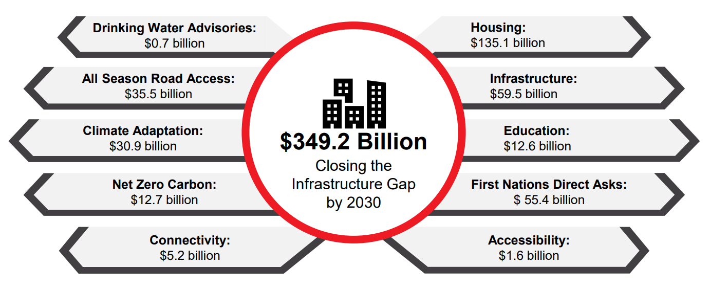
Summary Recap of CTIG
Benefits for All Canadians (Part 1): Economic Impact of Closing the Infrastructure Gap
Benefits for All Canadians (Part 1): Economic Impact of Closing the Infrastructure Gap

Slide 5









Summary Recap of CTIG
Closing the Infrastructure Gap 2030
An Infrastructure Needs Report to Build Towards Reconciliation, Resilience, Achieving Net-Zero Goals, Connectivity, and Unlocking First Nation Economic Capacity.
Participation from 401 First Nations communities.
Creates economic opportunities for First Nations and non-Indigenous workers and businesses.
Promotes a self-governed asset management approach by First Nations to Close the Infrastructure Gap by 2030.
A collaborative and historic attempt to quantify the infrastructure and housing gap with the co-operation of the Assembly of First Nations and Indigenous Services Canada.
Advances First Nations’ socioeconomic outcomes by fulfilling the Government of Canada's existing fiduciary, legal, and public commitments to First Nations.
Benefits for All Canadians (Part 1): Economic Impact of Closing the Infrastructure Gap

Slide 6
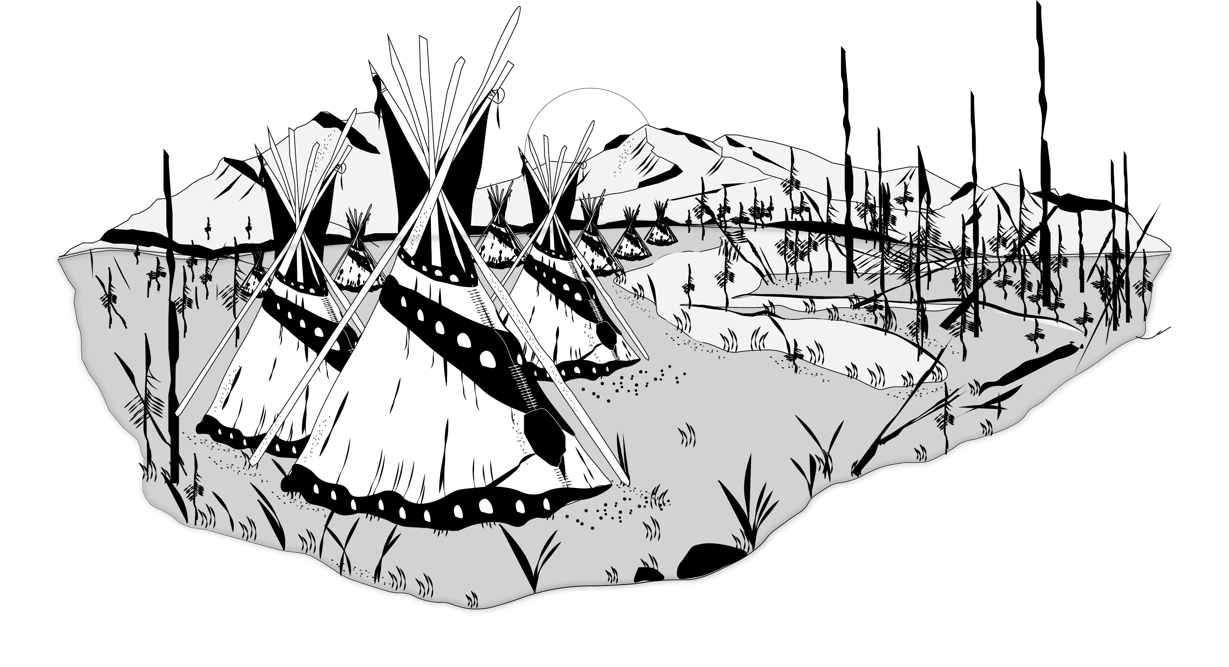
Rationale
What Is The Gap and Why Do We Need To Close It?
Canada’s federal government has a legal and fiduciary responsibility to First Nations peoples
Canada already supports infrastructure investments in non-Indigenous regions
Access to safe water: long- and short-term drinking water advisories and insufficient pressure
Emergency facilities: First Nation children 86 times more likely to die in a fire
Social service facilities: 53.8% of children in public care are First Nation or Indigenous
Education facilities: First Nations in their early 20s (on IR) - 48% high school & 10% bachelors
Care home facilities: Elders travel hundreds of kilometers away from their homes and families
Housing: Some regions report 68% of shelter users are First Nation or Indigenous
First Nation Girls: Make-up 62% of the Indigenous youth in custody
First Nation suicide and overdose rates are 3-6x & 5-9x higher
More Access to Essential Infrastructure Services
Benefits for All Canadians (Part 1): Economic Impact of Closing the Infrastructure Gap

Slide 7
Economic Benefits of CTIG
Further to the “Closing the Infrastructure Gap by 2030” Report, the Conference Board of Canada (CBoC) presents the economic benefits of closing the First Nations infrastructure gap in terms of economic output, gross domestic product (GDP), employment, labour income, and government revenues (i.e., taxes).
These benefits only represent the tip of the iceberg of the broader socio-economic benefits expected to arise from closing the infrastructure gap.
Further discussion about the wider socio-economic benefits will be presented in a forthcoming report, “Benefits for All Canadians (Part 2): Long-term Socio-economic Impacts of Closing the Infrastructure Gap.”
Benefits for All Canadians (Part 1): Economic Impact of Closing the Infrastructure Gap

Slide 8
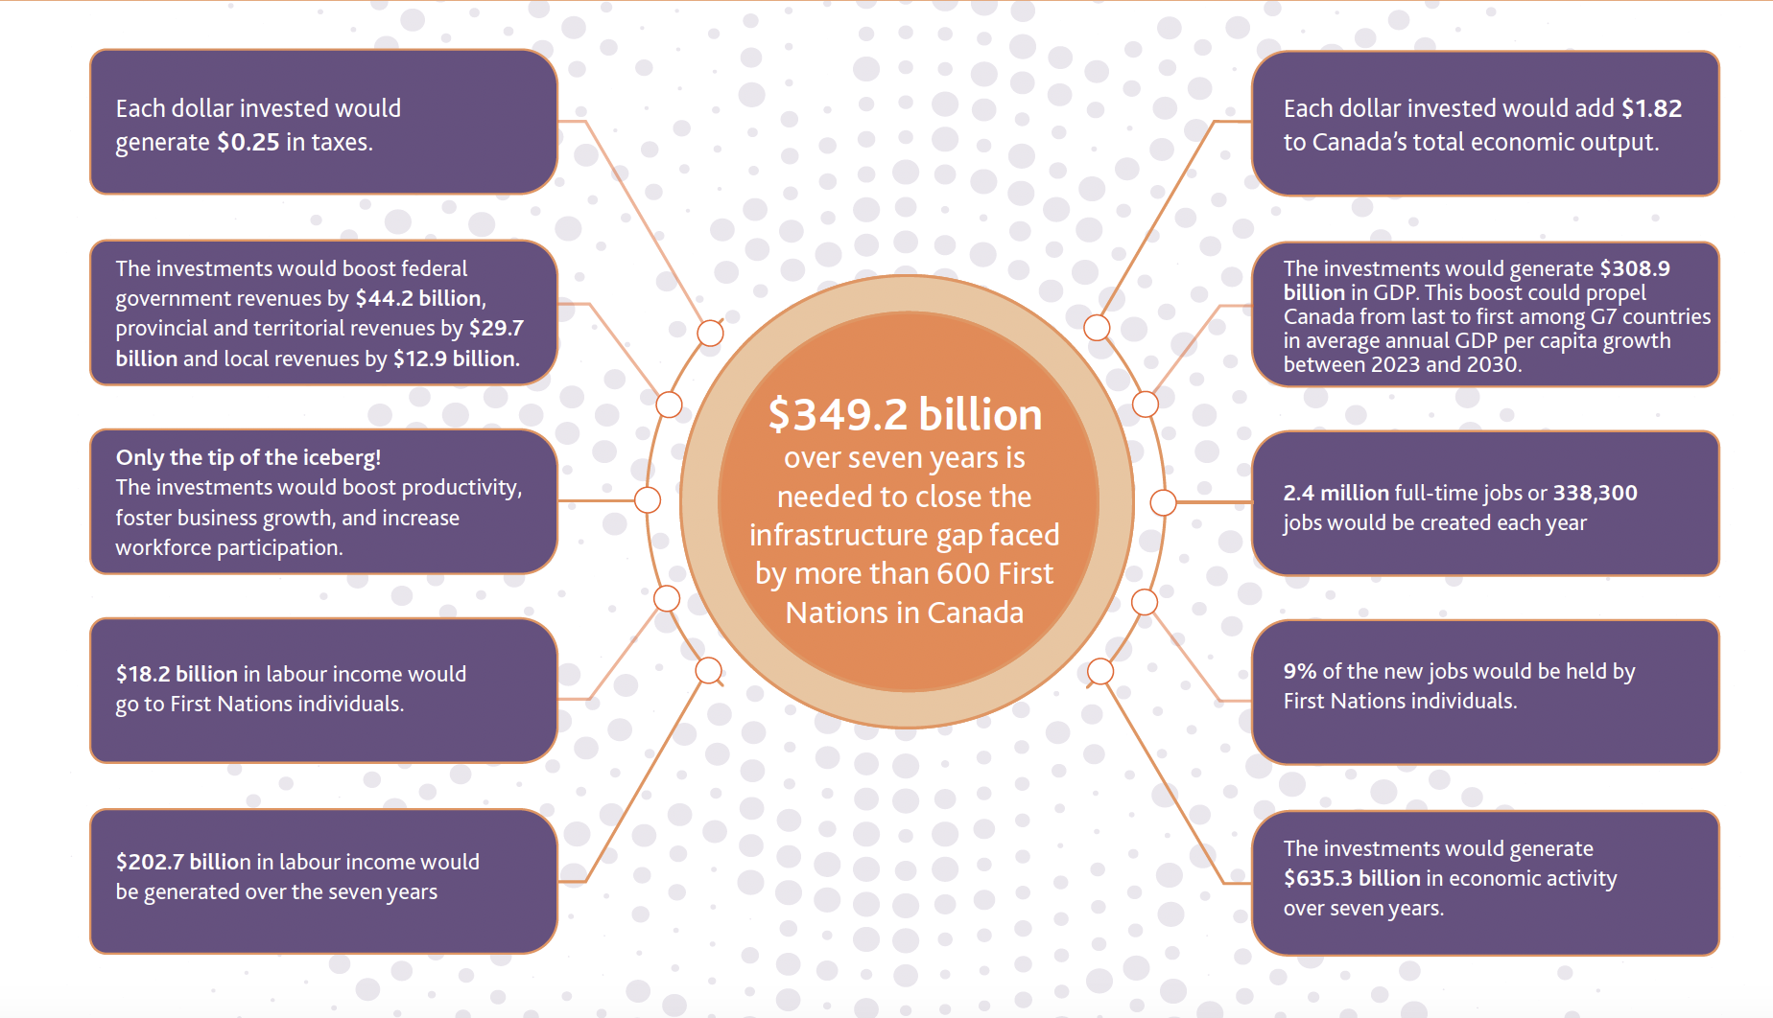
Key Findings
Benefits for All Canadians (Part 1): Economic Impact of Closing the Infrastructure Gap

Slide 9
Economic Impact Assessment
The Conference Board of Canada’s Economic Impact Assessment (EIA) model was used estimate the total, direct, indirect, and induced impacts of closing the infrastructure gap across five economic variables: economic output, GDP, employment, labour income, and government revenues (i.e., taxes).
This study incorporates three key expenditure conditions:
Timing: Investments in the capital and operational phases occur over seven years between fiscal years 2023-2024 and 2029-2030.
Taxes: A significant amount of economic activity would occur on reserves, resulting in tax exemptions for First Nations’ employees and businesses.
Leakages: In a small open economy like Canada, some spending would be diverted towards products (goods and materials) made outside of the country (international imports), as is typical for modern supply chains.
Benefits for All Canadians (Part 1): Economic Impact of Closing the Infrastructure Gap

Slide 10
Economic Output
Closing the infrastructure gap has the potential to generate $635.3 billion (in 2023 dollars) in economic output in Canada over the next seven years.
This means that every dollar spent would contribute $1.82 in economic activity to Canada. An output multiplier above one represents a positive return on investment.
Economic output represents the total value of all economic activity, including the buying and selling of intermediate goods.
Benefits for All Canadians (Part 1): Economic Impact of Closing the Infrastructure Gap

Slide 11
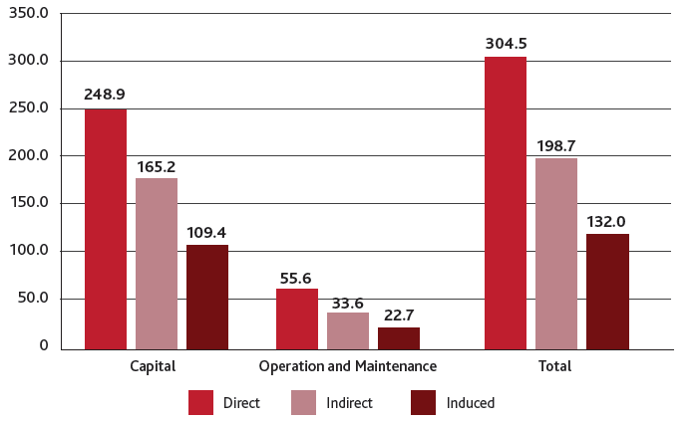
Economic Output
Closing the First Nations infrastructure gap would yield $305 billion in direct economic output.
(Economic output contributions, 2023 $ billions, 2023 – 2030)
Benefits for All Canadians (Part 1): Economic Impact of Closing the Infrastructure Gap
Notes:
Closing the infrastructure gap has the potential to generate $635.3 billion (in 2023 dollars) in economic output in Canada over the next seven years. This means that every dollar spent would contribute $1.82 in economic activity to Canada. An output multiplier above one represents a positive return on investment.
Output multiplier = Total Economic Output Impact/Total Investment.
While investments to close the infrastructure gap have the potential to generate $635 billion in economic output, there would be additional economic benefits beyond what the EIA captures. For example, the construction of all-season roads would unlock further economic impacts, such as improving access to critical mineral mines in Northern Ontario, which could advance the province’s electric vehicle supply chain. Overall, the improved infrastructure would stimulate local economies, enhance trade and tourism opportunities, and drive additional productivity gains, which extend beyond our estimates.

Slide 12
Gross Domestic Product
Closing the infrastructure gap has the potential to generate $308.9 billion (in 2023 dollars) in GDP in Canada over the next seven years.
This means that every dollar spent would contribute $0.89 to Canada’s gross domestic product. A GDP multiplier above zero represents a net economic gain because GDP measures the net value added to an economy.
Over 80 per cent of GDP would be generated during the capital phase.
Benefits for All Canadians (Part 1): Economic Impact of Closing the Infrastructure Gap
Notes:
Unlike output, GDP measures the net value-add of all final goods and services produced in a country, excluding intermediate goods and services to avoid double counting. It is estimated that the infrastructure spending would generate $308.9 billion in GDP for Canada over the next seven years. To put the size of this impact into context, this level of GDP represents 2 per cent of the country’s total GDP in 2023. Intermediate goods and services are goods and services used as inputs in the production of other goods and services.

Slide 13
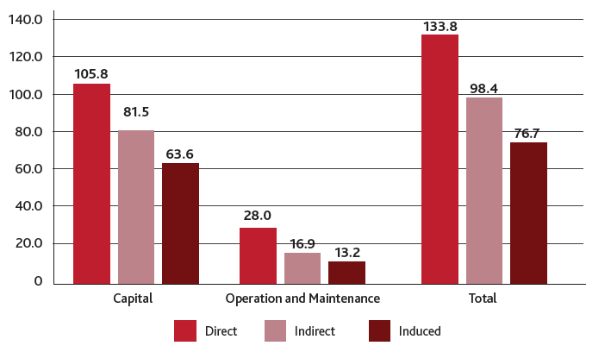
Gross Domestic Product
Closing the First Nations infrastructure gap would generate nearly $134 billion in direct GDP.
(GDP contributions, 2023 $ billions, 2023 – 2030)
Benefits for All Canadians (Part 1): Economic Impact of Closing the Infrastructure Gap

Slide 14
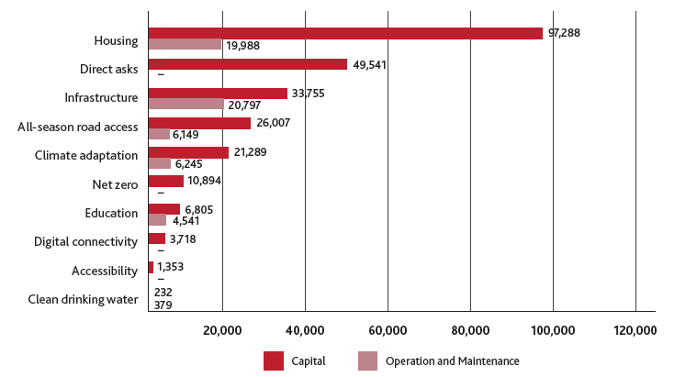
Gross Domestic Product
Housing investments would be the largest contributor to GDP.
(GDP contributions, 2023 $ millions, 2023 – 2030)
Benefits for All Canadians (Part 1): Economic Impact of Closing the Infrastructure Gap
Notes:
The housing ($117.3 billion), infrastructure ($54.6 billion), and direct asks ($49.5 billion) infrastructure areas are projected to have the greatest GDP impacts across both the capital and O&M phases. (See Chart 5.)
In terms of provincial impacts, Ontario would lead the way, generating $71.6 billion in GDP, while British Columbia and Alberta would trail closely behind, generating $61.7 billion and $50.6 billion, respectively. (See Appendix C: Table C17 for the full provincial breakdown.) Similar to the share of spending, the share of GDP generated for each region of the country would be proportional to the region’s First Nations population.

Slide 15
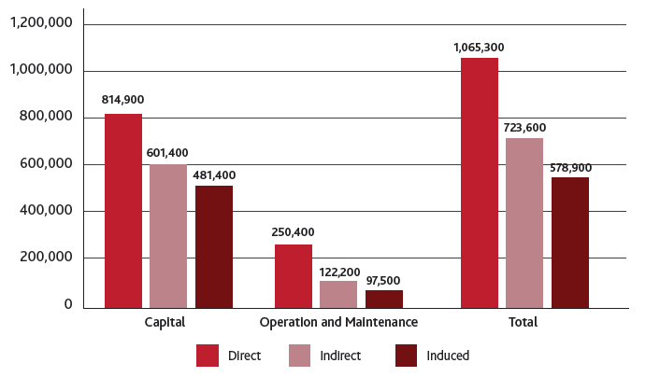
Employment
Closing the First Nations infrastructure gap would support nearly 2.4 million jobs over the next seven years.
(Employment contributions, full-time, full-year jobs, 2023 – 2030)
Benefits for All Canadians (Part 1): Economic Impact of Closing the Infrastructure Gap
Notes:
This includes nearly 1.9 million full-time, full-year jobs (271,100 jobs per year) from the capital phase and roughly 470,000 full-time, full-year jobs (67,200 jobs per year) from the O&M phase. The direct impact on employment is projected to equal almost 1.1 million full-time, full-year jobs (152,200 jobs per year), with nearly 814,900 jobs (116,400 jobs per year) in the capital phase and 250,400 jobs (35,800 jobs per year) in the O&M phase.

Slide 16
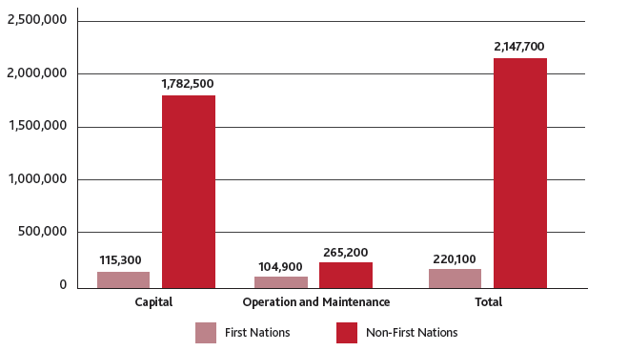
Employment
An estimated 220,100 full-time, full-year jobs (31,400 jobs per year) would be created for First Nations individuals.
(Employment contributions, full-time, full-year jobs, 2023 – 2030)
Benefits for All Canadians (Part 1): Economic Impact of Closing the Infrastructure Gap
Notes:
Closing the infrastructure gap is projected to generate nearly 2,147,700 full-time, full-year jobs for non-First Nations individuals, accounting for 90.7 per cent of total employment. Additionally, an estimated 220,100 full-time, full-year jobs (31,400 jobs per year) would be created for First Nations individuals, representing 9.3 per cent of total employment.
First Nations individuals would play a crucial role in the longer-term O&M of the infrastructure projects, ensuring their success.

Slide 17
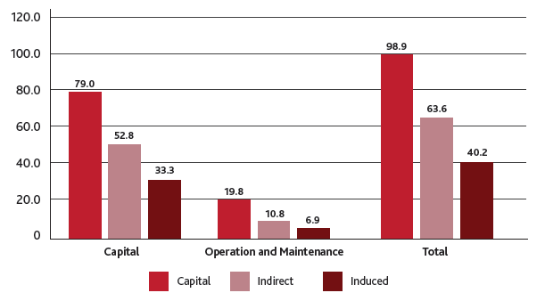
Labour Income
Closing the First Nations infrastructure gap would generate nearly $203 billion in labour income.
(Labour income contributions, 2023 $ billions, 2023 – 2030)
Benefits for All Canadians (Part 1): Economic Impact of Closing the Infrastructure Gap
Notes:
The investment required to close the infrastructure gap has the potential to generate $202.7 billion in labour income. Of this, $165.2 billion would be generated from the capital phase and $37.4 billion from the O&M phase. The cumulative investment across the ten infrastructure areas would generate $98.8 billion in terms of direct impact, with 80 per cent concentrated in the capital phase of the project. (See Chart 9.) Moreover, $18.2 billion in labour income would go to First Nations individuals, while the remaining $184.4 billion would go to non-First Nations individuals.

Slide 18
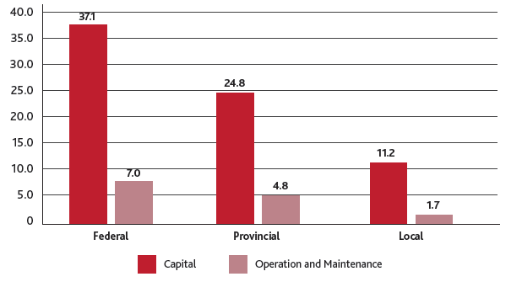
Government Revenues
Nearly $87 billion would be generated in federal, provincial, and municipal taxes.
(Government revenue contributions, 2023 $ billions, 2023 – 2030)
Benefits for All Canadians (Part 1): Economic Impact of Closing the Infrastructure Gap
Notes:
The infrastructure spending would result in substantial fiscal impacts. We estimate that $86.7 billion would be generated in government revenues over the next seven years. This includes $73.2 billion from the capital phase and $13.5 billion from the operational phase. A further breakdown reveals that $44.2 billion would be added to federal taxes, $29.7 billion to provincial taxes, and $12.9 billion to local taxes.

Slide 19
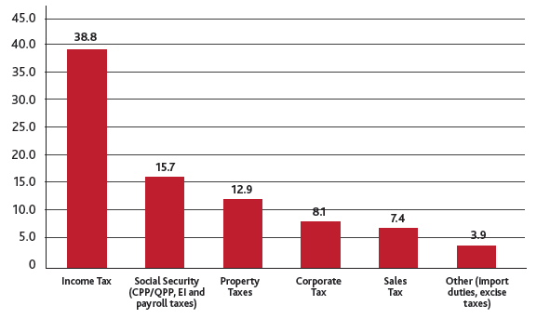
Government Revenues
Almost $40 billion would be generated through income taxes.
(Government revenue contributions, 2023 $ billions, 2023 – 2030)
Benefits for All Canadians (Part 1): Economic Impact of Closing the Infrastructure Gap
Notes:
The overall contribution to government revenues would equate to $0.25 in tax revenues for every dollar invested in the infrastructure areas.
Local taxes, for the purposes of this economic impact study, include taxes paid to municipal governments as well as First Nations imposed property taxation for land use.

Slide 20
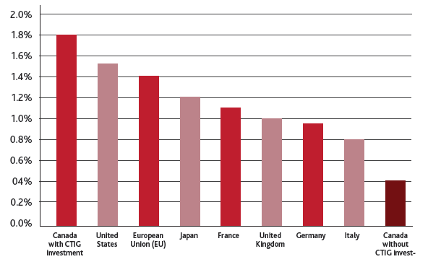
International Competitiveness
Closing the First Nations infrastructure gap would increase Canada’s GDP per capita growth, leading the G7 and the EU.
(Average annual growth rate of GDP per capita, 2023-2030)
Benefits for All Canadians (Part 1): Economic Impact of Closing the Infrastructure Gap
Notes:
Excluding investments to close the First Nations infrastructure gap, Canada ranks last among the G7 countries and the economy of the European Union in terms of the average annual growth rate of GDP per capita between 2023 and 2030. Canada also ranks 36th out of the 38 advanced economies. If the investments to close the infrastructure gap are all net new and the economy has the capacity—both physical and labour—with no crowding out effects, Canada’s average annual GDP per capita growth rate will rise to 1.76 per cent between 2023 and 2030.
To put this impact into context, this would place Canada first among the G7 countries and the economy of the European Union, assuming all else remains constant in other countries.
The investments would also elevate Canada to 15th place among the 38 advanced economies, again assuming no changes in other countries.

Slide 21
Construction Capacity
To directly build and maintain the infrastructure projects across the ten areas, the construction sector would need an average of 127,300 full-time workers per year for the next seven years.
Strategies to address the supply of workers in the construction sector:
Expand support for training programs and apprenticeships.
Targeted immigration
Partnering with First Nations
Tax incentives
Retaining talent
Benefits for All Canadians (Part 1): Economic Impact of Closing the Infrastructure Gap
Notes:
Support for Training and Apprenticeships
This could include streamlining trades training, building connections between training programs and employers, and leveraging digital technology in training.
Targeted Immigration
By adjusting immigration policies to prioritize skilled tradespeople and other construction occupations, Canada can attract experienced workers from abroad to fill immediate labour gaps. This could involve reducing barriers to licensing in regulated occupations and working with employers to improve credential recognition. Current immigration programs working towards increasing workers in trades and construction occupations include the Category-Based Selection program and pilot program for out-of-status construction workers Dennler, Forge, and Craft, “Work in Progress: How Immigration Can Address Labour Shortages in Residential Construction.”
Ibid.
Partnering with First Nations
Equipping the First Nations workforce with the required skills will require specialized training programs developed in collaboration First Nations. Additionally, establishing partnerships between construction firms and First Nation organizations can facilitate job placements and ensure that projects benefit from local talent Santoro and Walsh, “The Readiness and Resilience: Mapping the Contours of the Indigenous Skills and Employment Ecosystem in Canada.”
Tax Incentives
Alberta recently offered a tax credit intended to attract 2,000 tradespeople to their province. Tax incentives could include additional tax credits or deductions for tradespeople and construction workers who work on rural infrastructure projects for First Nations, beyond the Labour Mobility Deduction currently in place. Such incentives could help attract talent from other regions of the country, expanding the available pool of skilled workers and ensuring that First Nations projects have the skilled labour necessary to succeed.
Retaining Talent
The Residential Construction Council of Ontario recommends several strategies to address this, including improving on-site conditions, especially during winter; formalizing career pathways; expanding opportunities for skills development and training; centralizing industry resources and communication; fostering a sense of community in the voluntary trades; helping workers plan for seasonal work; and enhancing communication and transparency in scheduling. To better retain First Nations workers, the sector should also implement meaningful inclusion practices, mandate cultural awareness training, accommodate cultural traditions, and offer professional development and mentorship programs. Residential Construction Council of Ontario, “Retaining Employees in the Skilled Trades.”

Slide 22



Next Steps
Budget advocacy initiatives prior to Budget 2023/2024
Move away from a federal year-to-year, pay-as-you-go, approach to First Nations infrastructure funding programs. Infrastructure projects are complex and require significant capital investments with rolling budgets to drive progress through multi-year planning, design, and construction phases.
Policy reform: co-development between AFN, ISC, and First Nations to improve access to capital by methods such as a First Nation Infrastructure Fund; a First Nation Infrastructure Bank; and/or an expanded Government Backed Loan Guarantee.
Implementation: The AFN Infrastructure and Housing Sectors, with support from other AFN Sectors, are developing a Closing the Infrastructure Gap Implementation Plan which will support a joint Memorandum to Cabinet on options for Closing the First Nation Infrastructure Gap.
Simple short-term solution: have the Government of Canada renew funding supports to expiring and exhausted programs that were successful
Monitor and track: measure the in-road to closing the infrastructure gap
Benefits for All Canadians (Part 1): Economic Impact of Closing the Infrastructure Gap

Slide 23
Closing the Infrastructure Gap by 2030: A Government of Canada Mandate
“Let’s close the gap together… Anookeetaa!”

Slide 24
Q&A
Email: infrastructure@afn.ca

