Slide 1


Regional Education Agreement Costing Tools
Presented by: Bram Lerat, Khrystyna Orobets & Ronda Ziakris
Prepared for the Assembly of First Nations
February 27, 2024

Slide 2
Agenda
1
MNP & AFN Introductions
2
Background
3
Tools Available for First Nations
4
Key Elements of Cost Studies
5
Inclusive Education Cost Study
6
Transportation Cost Study
7
Using the Models

Slide 3
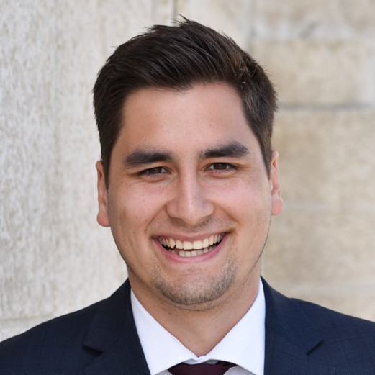


MNP & AFN Introductions
Bram Lerat
Special Advisor, Language & Learning, AFN
Khrystyna Orobets
Senior Manager, Indigenous Services, MNP
Ronda Ziakris
Manager, Indigenous Services, MNP
3

Slide 4
Background
AFN Resolution 2019-34, First Nations Education Infrastructure Review
AFN retained MNP to conduct a Transportation Assessment
Country-wide First Nations Education Transportation Needs Assessment
Transportation Cost Model
Tools Available for First Nations
AFN Resolution 2017-65 and need for review of HCSEP review and costing
AFN retained MNP to conduct an Inclusive Education Analysis
Inclusive Education Analysis
Inclusive Education Cost Model
Notes:
Bram

Slide 5

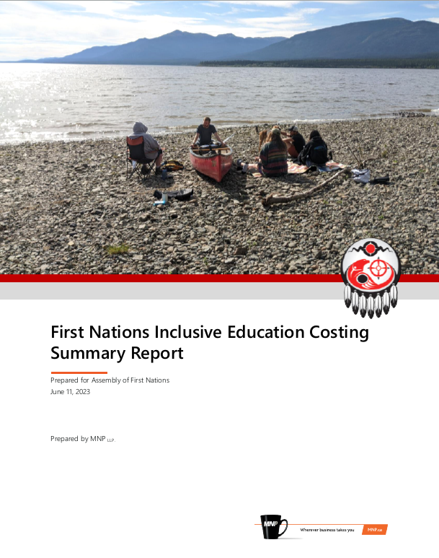
Tools Available to First Nations
Excel cost models and reports are available for First Nations to use as part of their REA negotiations.
5
Notes:
Bram

Slide 6
Key Elements of Cost Studies
1
2
3
4
Engagement with First Nations
Secondary Research
Analysis and Cost Drivers
Results Reporting and Cost Modelling
Notes:
Bram

Slide 7
Inclusive Education Cost Study

Slide 8
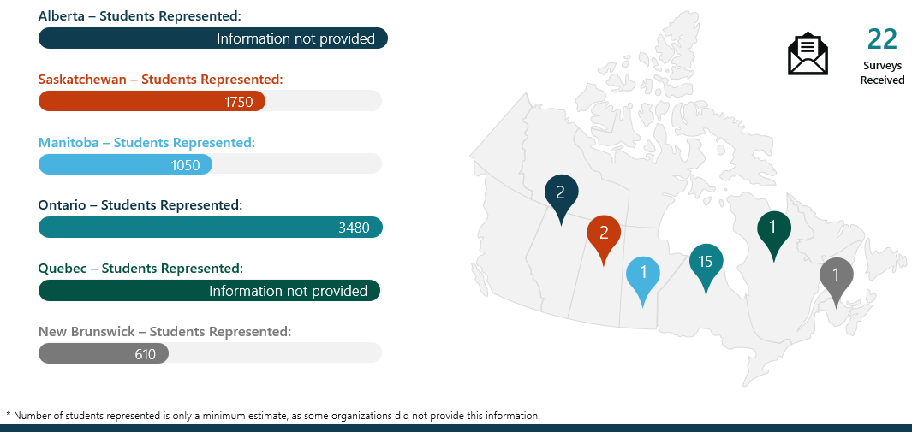
Overview of Data Collection Activities
Survey Overview
First Nation Interview Overview
Manitoba | 1
Alberta | 4
New Brunswick | 1
Ontario | 1
Atlantic Region | 1
Yukon | 1
Saskatchewan | 1
Total | 10
Interviews were also conducted with:
School Boards
Provincial School Providers
Subject Matter Experts
8

Slide 9
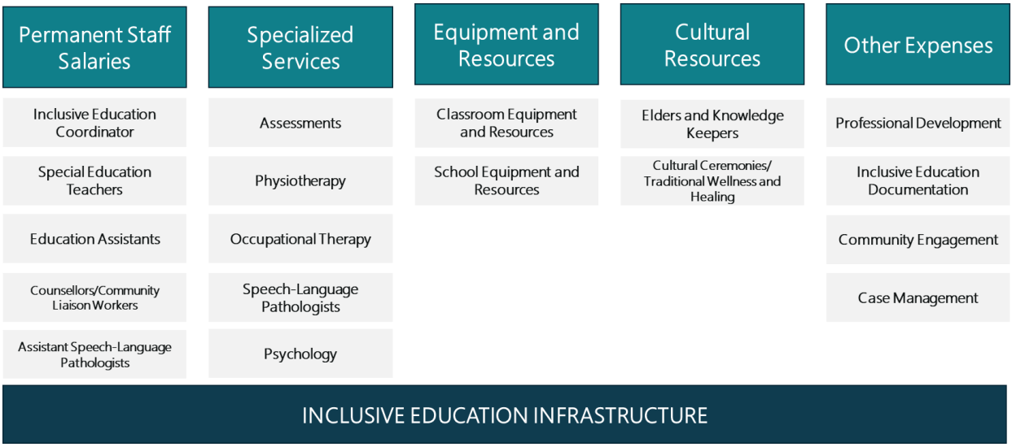
Inclusive Education Cost Structure

Slide 10





Cost Drivers
Location
(province)
Remoteness (proximity to urban centre)
Incidence of students with special needs
Student enrolment
Number of schools/communities

Slide 11
Cost Comparison
First Nation | Small Fly-in First Nation in Ontario | Small Fly-in First Nation in Ontario | Large Remote First Nation Education Authority in Alberta | Mid-sized First Nation close to a major urban centre in Alberta
INPUTS
Cost Adjustment Factor Based on Remoteness | 126.1% | 126.1% | 40.3% | 7.6%
Number of Students in Kindergarten to Grade 6 | 130 | 130 | 640 | 231
Number of Students in Grade 7 to Grade 12 | 26 | 26 | 598 | 192
Number of Students with Mild/Moderate Special Needs | 31 | 31 | 248 | 85
Number of Students with Severe/Profound Special Needs | 8 | 8 | 62 | 21
Number of Schools | 2 | 2 | 5 | 3
RESULTS
Model Generated Costs Per Student | $22,148 |  | $10,911 | $9,206
Current Funding Per Student | $4,675 |  | $2,938 | $3,445

Slide 12
Conclusions
Costs range from $9,206 per FTE for a First Nation close to a major urban centre to $22,148 per FTE for a small fly-in community.
Current funding is approximately 2.5-5 times lower than the model-generated costs.

Slide 13





Considerations
  Additional proposal-based funding
  Ongoing updates
  Incorporating students awaiting assessment
  Capital infrastructure
  Funding for First Nations without schools

Slide 14
Transportation Cost Study

Slide 15
Overview of Data Collection Activities
Community Engagement Overview
Interview Overview
BC | 4
Alberta | 4
Saskatchewan | 5
Manitoba | 3
Ontario | 5
Quebec | 1
Nova Scotia | 2
Total | 24
  7 provinces
Interviews were also conducted with:
School Boards
Provincial School Providers
Subject Matter Experts
18
First Nations and First Nation Education Organization Participants
  3 geographical zones
  1-6 school range
  47-1,842 enrolment range
  3 fly-in communities

Slide 16
Transportation Cost Structure
Capital Costs
Direct Operating Costs
Indirect Operating Costs
  Bus replacement
    School bus purchase costs
    Costs of bus equipment/ peripherals
    (GPS, camera, winter tires etc.)
  Other capital costs
    Bus garage, bus shop
  Bus driver wages
  Maintenance
    Inspections
    Other routine and emergency maintenance
  Fuel
  Insurance and registration
  Bus driver training
  Administration
    Salaries of admin. staff
    Software (route planning)
16

Slide 17


Cost Elements
Lack of economies of scale
Remoteness
Higher student needs
Poor road conditions
Increased scope of transportation services

Slide 18
Summary of Cost Drivers Specific to First Nations
The following table summarizes the negative impact of each cost driver on transportation cost elements:
Cost Element | Lack of Economies of Scale | Increased Scope of Transportation Services | Remoteness | Poor Road Conditions | Higher Student Needs
Bus Driver Wages |  | ✓ | ✓ |  | ✓*
Bus Replacement | ✓ | ✓ |  | ✓ | ✓**
Maintenance | ✓ | ✓ | ✓ | ✓
Fuel | ✓ | ✓ | ✓ | ✓
Insurance & Licensing |  | ✓
Administration | ✓ | ✓ | ✓
Bus Driver Training | ✓ | ✓ | ✓***
*In addition to employing bus drivers, First Nations require Bus Monitors to supervise students.
**Students with disabilities require wheelchair-accessible buses.
***Total costs include travel expenses for bus drivers and/or training instructors and, therefore, are impacted by geography.

Slide 19
Cost Comparison (2021/22)
Comparison of Costs Generated by the Model with Costs Incurred by a Provincial School Jurisdiction and a Bus Operator in Alberta.
Cost Category | Costs per School Bus, Alberta
 | Remote First Nation School Jurisdiction with 15 routes (generated by the model) | Northern Provincial School Jurisdiction with 45 routes | Third-Party Bus Operator with 285 routes across Alberta
Bus Driver Wages | $44,470 | $25,000 | $21,500
Bus Replacement Costs | $16,632 | $7,500 - $11,500 | $6,800
Maintenance Costs | $7,737 | $5,500 | $6,500
Fuel | $6,009 | $7,000 | $ 4,700
Administration | $8,207 | $3,000 | $ 3,000
Licensing/Insurance | $1,606 | $2,150 | $ 1,340
Training* | $1,170 | Not provided | $ 1,440
SUBTOTAL | $85,831 | $50,150 - $54,150 | $45,280
Bus Monitor Wages | $24,153 | N/A | N/A
TOTAL | $109,984 | $50,150 - $54,150 | $45,280
*This estimate includes training and other costs not captured in other cost categories (e.g. marketing of transportation services, IT-related expenses etc.).

Slide 20
Updates
MNP will be updating the costs in the coming months to reflect the current economic conditions.

Slide 21
Cost Model
Bus Driver Wages
Maintenance
Bus Replacement
(incl. peripherals & modifications)
Fuel
NEW
Fuel Escalator
Administration Salaries
Cost Adjustment Factor Based on Remoteness
Insurance and Licensing
Bus Monitor Wages
Bus Driver Training
Extracurricular Activities
* Fuel escalator is to be added on top of the calculations to address fluctuations in fuel prices. For example, in Alberta’s public-school boards, the escalator kicks in when average diesel prices are in excess of $1.25 per litre.

Slide 22
Conclusions
Transportation costs on a per-bus basis are much higher than the benchmark transportation costs incurred by the provincial counterparts.
Current funding is $40,00 - $60,000 in the provincial system compared to $95,00 - $115,000 in the model-generated cost.

Slide 23






Considerations
  Bulk purchasing programs
  Bus driver training
  Route planning
  Extracurricular transportation
  School transportation infrastructure
  On-reserve students transported by provincial school jurisdictions

Slide 24
Using the Models

Slide 25
Using the Models to Develop Budget Asks
The presented models can be applied to any First Nation across Canada and used as a tool for First Nations and First Nations Education Organizations to negotiate enhancements to transportation and special education funding through Regional Education Agreements and technical table discussions.
Budget Ask
Costs generated by Model
Funding provided through formula

Slide 26
Thank You

