Slide 1
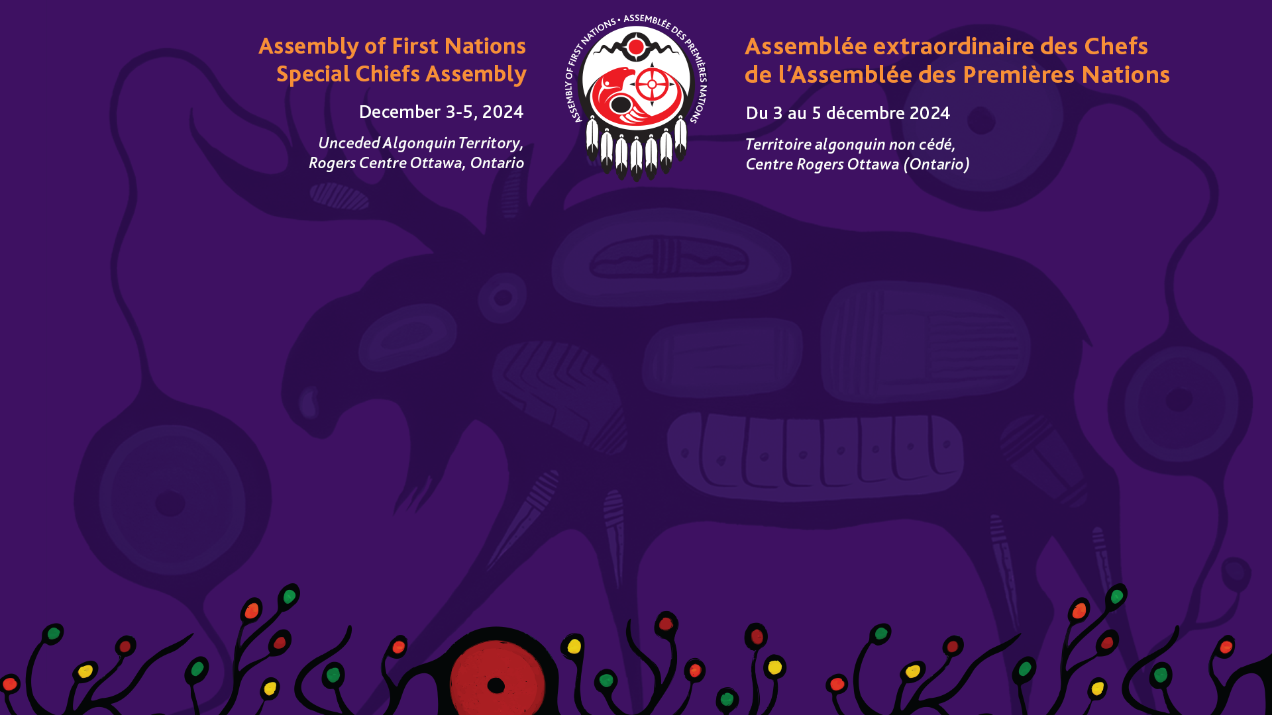
Progress and Pathways: Advancing First Nations Roles in Water Protection and Marine Conservation
Dialogue Session
December 2, 2024

Slide 2
Agenda
Opening Prayer
Welcome and Opening Remarks
The Canada Water Agency and the Canada Water Act
Bill C-61, First Nations Clean Water Act
Marine Indigenous Protected and Conserved Areas (Marine IPCAs)
Open Discussion
Closing Prayer

Slide 3
The Canada Water Agency and the Canada Water Act

Slide 4
Canada Water Agency’s (CWA) Mandate
Improve freshwater management
Coordinate/collaborate with provinces, territories, and Indigenous Peoples to proactively address national and regional transboundary freshwater challenges and opportunities.

Slide 5
CWA Timeline
Bill C-59 (44-1) – An Act to implement certain provisions of the fall economic statement
  Tabled in the fall of 2023
  Royal Assent on June 20, 2024
Standalone agency
  Under the Minister of Environment and Climate Change portfolio
Headquartered in Winnipeg, MB
  Launched in the fall of 2024

Slide 6
CWA Current Initiatives
Modernization of the Canada Water Act
  Proclaimed in 1970
  2021 mandate letter to modernize the Act to include climate change and Indigenous rights.
  Reaffirmed commitment to the 2023-2028 Action Plan for UNDRIP
  Some pre-engagement
National freshwater data strategy
  Guidelines/principles of how freshwater information should be organized, stored and shared.
  Discussion paper July 26, 2024 – comments to Sept 15, 2024
  Workshops Sept 25-26, 2024, to develop an outline/path forward.

Slide 7
Partnering with Indigenous Peoples
Respect the rights of First Nations and support the implementation of the United Nations Declaration on the Rights of the Indigenous Peoples Act
Honour existing treaties and agreements
Recognize First Nations knowledge systems and data sovereignty
Work to advance reconciliation

Slide 8
53/2023, First Nations-led Process for National Water Stewardship and the Canada Water Agency
Direct the Assembly of First Nations (AFN) to call on Canada to halt the creation of the Canada Water Agency until First Nations concerns are addressed, and First Nations Treaty and rights holders are meaningfully engaged, ensuring that the Agency adheres to Treaty and the standards of the UN Declaration, including the principles of free, prior, and informed consent (FPIC) and protections under the Constitution Act, 1982.
Direct the AFN to call on Canada to fund the creation of a national First Nations-led water stewardship task force, under the guidance and meaningful participation of the Advisory Committee on Climate Action and the Environment (ACE) and the Chiefs’ Committee on Housing and Infrastructure (CCOHI), to inform the implementation and co-development of any such agency, including related legislation, policies, and initiatives with AFN reporting back to the First Nations-in-Assembly at the next General Assembly.
Direct the AFN to call upon the Minister of Environment and Climate Change Canada (ECCC) to dedicate funding and resources for the meaningful and sustained engagement and participation of First Nations across Canada, and adequate funding for the creation of First Nations-led institutions that can support a whole-of-Canada approach to water stewardship and source water protection.

Slide 9
AFN Timeline
Regional Chief Ghislain Picard met with Minister of Environment and Climate Change Canada (ECCC), Steven Guilbeault on November 23, 2023.
  Reaffirmed obligations/responsibilities under UNDRIP
  Spoke about 53/2023 call on Canada to halt the creation of the CWA
  Expressed concerns with the engagement process, lack of funding, resources, co-development, and transparency
  Asked Canada to commit to funding establishing a national First Nations water stewardship task force.

Slide 10
AFN Timeline Continued
Interim National Chief, Joanna Bernard sent a letter on November 28, 2023, asking Minister Guilbeault to commit in writing:
  Summary of the purpose and objectives of the pending CWA legislation
  Uphold First Nations rights, specifically inherent and Treaty rights to water
  Respect UNDRIP and carry out relevant action plan measures (APMs)
  Identify opportunities and mechanisms for collaboration between First Nations and the CWA
  Long-term funding to establish a First Nations water stewardship task force

Slide 11
AFN Timeline Continued (2)
Regional Chief Kluane Adamek met with the Special Advisor to the Prime Minister on water, Terry Duguid on March 19, 2024.
  Funding required for a respectful engagement process
  Seeking timelines and processes for the modernization of the Canada Water Act
  Confirmation that engagement with First Nations will result in legislative amendments
  Commitment to long-term funding for First Nations

Slide 12
First Nations Views
Canada Water Agency
  Genuine engagement and co-development
    First Nations as equal partners in all decision-making processes
    Respecting First Nations governance structures
  First Nations rights and jurisdiction
    Complex authoritative structure of the CWA
    Uphold water rights and jurisdiction
    Align with First Nations laws, self-government agreements, UNDRIP and reconciliation
  First Nations knowledge
    Integrate First Nations knowledge and value equally
  Funding and Capacity Building
    Lacks adequate funding/capacity building
  Collaborative governance and co-management
    That ensures shared decision-making authority

Slide 13
First Nations Views
Modernization of the Canada Water Act
  First Nations rights
    Recognize water rights and align with UNDRIP
    Equal partners in water management
  Jurisdictional conflicts and co-governance
    Address jurisdictional conflicts and provide clear guidelines for co-governance
  First Nations-led water stewardship
    Provisions and funding to support
  First Nations knowledge and practices
    Incorporate knowledge and practices that recognize cultural and spiritual significance
  Consultation
    Robust/continuous consultation during the modernization

Slide 14
Initial Concerns With the Canada Water Act
Includes First Nations views, and also:
Generate measurable improvements to environmental, social, and economic realities in Canada’s watersheds
Consider the impacts of climate change and include infrastructure investments, disaster planning, and insurance programs.
Stricter water quality standards to protect ecosystems and human health.
Integrate modern water monitoring, data analytics, and modeling to enhance water resource monitoring and decision-making

Slide 15
Next Steps
Continue to meet with the CWA
Modernization of the Canada Water Act in 2025
Establishment of the First Nations Water Stewardship Task Force
  Focus will be on:
    Canada Water Act
    National Freshwater Data Strategy
    Other priorities as determined by First Nations

Slide 16
Bill C-61, First Nations Clean Water Act (Julie to insert here)

Slide 17
Marine Indigenous Protected and Conserved Areas (Marine IPCAs)

Slide 18
What are IPCAs
Indigenous Protected and Conserved Areas (IPCAs):
Indigenous-led,
Represent a long-term commitment to conservation,
Elevate Indigenous rights and responsibilities (ICE 2018)
Founded on First Nations laws, culture, language, governance, and knowledge.
Modern expression of our inherent rights, responsibilities, and relationships to the lands and waters.

Slide 19
Need for IPCAs
Decline in biodiversity
Impacts of climate change
Successes of First Nations governance to biodiversity
Effective and socially just tools for conservation while elevating rights and responsibilities
Indigenous Circle of Experts (2018) – We Rise Together
  28 recommendations
National Advisory Panel on Marine Protected Area Standards (2018)
  IPCAs included in Crown-Indigenous recommendations to the DFO Minister
Gap in progress of IPCAs on land vs. coastal and marine waters

Slide 20
AFN Resolution 41/2021 Marine IPCAs
Directs AFN to advocate for:
Whole-of-government approach to support and recognize IPCAs in marine and coastal waters
The full and effective participation of First Nations in decision-making related to Canada's Nature Agenda
Dedicated long-term, stable funding

Slide 21
Resolution 41/2021
Past work and key achievements
Marine IPCA Virtual Webinar Series (2021 – 2022)
Established the Marine IPCA Sub-working Group (2022)
National Marine Conservation Area (NMCA) Policy (2022)
Marine Sub Working Group Strategic Plan (2023)
AFN Report on Marine IPCAs (2023)
UNDA APM 38 and 42 (2023)
Draft AFN-DFO Scoping Paper (2023-2024)
DFO commitment to collaborate on Marine IPCA Report recommendations and develop an implementation plan for UNDA APM 42 (2024)

Slide 22
Marine IPCA Sub-working Group
Established in Feb 2022 to support the AFN in implementing Resolution 41/2021
Created under the Advisory Committee on Climate Action and the Environment (ACE)
Regionally representative group of First Nation organization representatives and technical experts
An advisory and First Nations capacity-building forum

Slide 23
AFN Marine IPCA Report
Background
Gap in progress of IPCAs on land vs. coastal and marine waters
AFN-DFO scoping paper (2019-2020;2023-2024)
AFN Resolution 41/2021
  Securing a commitment for a whole-of-government approach to support and recognize IPCAs in marine and coastal waters
Guided by AFN’s Advisory Committee on Climate Action & the Environment (ACE) & Marine IPCA Sub-Working Group
First Nations engagement - 2022, 2023, 2024

Slide 24
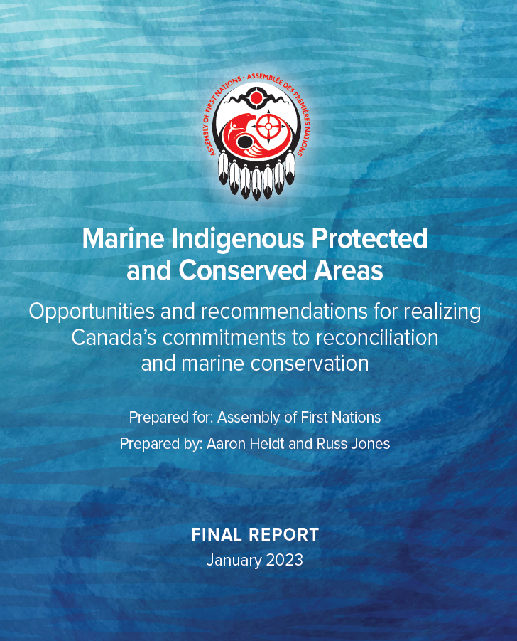
Recommendations
Provides recommendations to Canada on how to support First Nations in establishing IPCAs
DFO to commit to the short-term recommendations and provide the mandate and direction required to
ensure the meaningful advancement of IPCAs across coastal and marine waters
21 Recommendations
13 Short-term - DFO
8 Long-term – DFO, ECCC, PCA

Slide 25
Outcomes and Next Steps
United Nations Declaration on the Rights of Indigenous Peoples Act – Action Plan
  Marine IPCA-specific Action Plan Measure (DFO), Action Plan Measure 42
    DFO to advance marine IPCAs through meaningful consultation, collaboration, and partnerships
  Action Plan Measures (DFO) that address constraints
    Legislation, regulation, and policy reform
    Collaborative tools, agreements, and co-governance
    Predictable and flexible funding – First Nation participation & fisheries guardians
    Indigenous Knowledge mechanisms
AFN works to advocate policy and legislative change, enhance awareness, and increase support through capacity building

Slide 26
UN Declaration Action Plan Measures
APM 42: Through meaningful consultation and collaboration and partnerships with Indigenous governments, organizations, communities and other partners, advance marine Indigenous Protected and Conserved Areas to support Canada’s commitments to reconciliation and marine conservation (DFO).
APM 38: Provide predictable and flexible funding to ensure Indigenous nations and organizations have the capacity to meaningfully participate in advisory, co-management, and decision-making processes tied to aquatic resources and oceans management (DFO).

Slide 27
Advancing Resolution 41/2021
Challenges
Departmental siloing
Leadership participation
Crown processes
Funding
LIMITED PROGRESS

Slide 28
Advancing IPCAs: Marine Context
Challenges
Long-term sustainable funding
Legal and policy Frameworks
Jurisdictional complexity
Rights Recognition
Crown relationships
Crown governance structure
Education and training
Knowledge sharing

Slide 29
DR-03/2024: Advancing First Nations-Led Marine Conservation and IPCAs
Call on DFO to:
Fully commit to implementing the Marine IPCA Report recommendations
Provide predictable and flexible funding
Commit to advancing First Nations-led marine IPCAs through consultation, collaboration, and partnerships
Develop a cross-departmental leadership committee
Direct the AFN to:
Seek resources to develop capacity-building tools to support First Nations-led conservation

Slide 30
DR03: Advancing First Nations Marine Conservation and IPCAs
Direct the Assembly of First Nations (AFN) to continue to collaborate with the department of Fisheries and Oceans Canada (DFO), to ensure that the 21 recommendations listed in the 2023 Marine Indigenous Protected and Conserved Areas Report are fully implemented.
Urge the DFO to fully implement the 21 recommendations from the 2023 Marine Indigenous Protected and Conserved Areas Report, with predictable and flexible funding to empower First Nations in advisory, co-management, and decision-making processes related to fisheries, aquatic resources, and ocean management; and to advance these protected areas through meaningful consultation, collaboration, and partnerships with First Nations, in support of Canada’s commitments to reconciliation and marine conservation.

Slide 31
DR03: Advancing First Nations Marine Conservation and IPCAs
Call on the DFO to create a cross-departmental leadership committee, including representatives from DFO fisheries management and marine conservation, operations, science, and policy and the AFN, to support the implementation of the 2023 Marine IPCA Report recommendations, DFO-directed United Nations Declaration on the Rights of Indigenous Peoples Act Action Plan Measures, and ensure that First Nations perspectives actively inform marine conservation programs, policies, and legislation.
Direct the AFN to develop capacity-building tools related to First Nations-led conservation that are reflective of the diversity of Nations from coast to coast to coast with the guidance of the Chiefs Advisory Committee on Climate Action and the Environment and other technical bodies as required

Slide 32
Open Discussion

Slide 33
Thank you
AFN Water Sector AFN Infrastructure Sector
Jamie Lavigne, Director Julie Pellerin, Senior Director
jlavigne@afn.ca jpellerin@afn.ca

