Slide 1
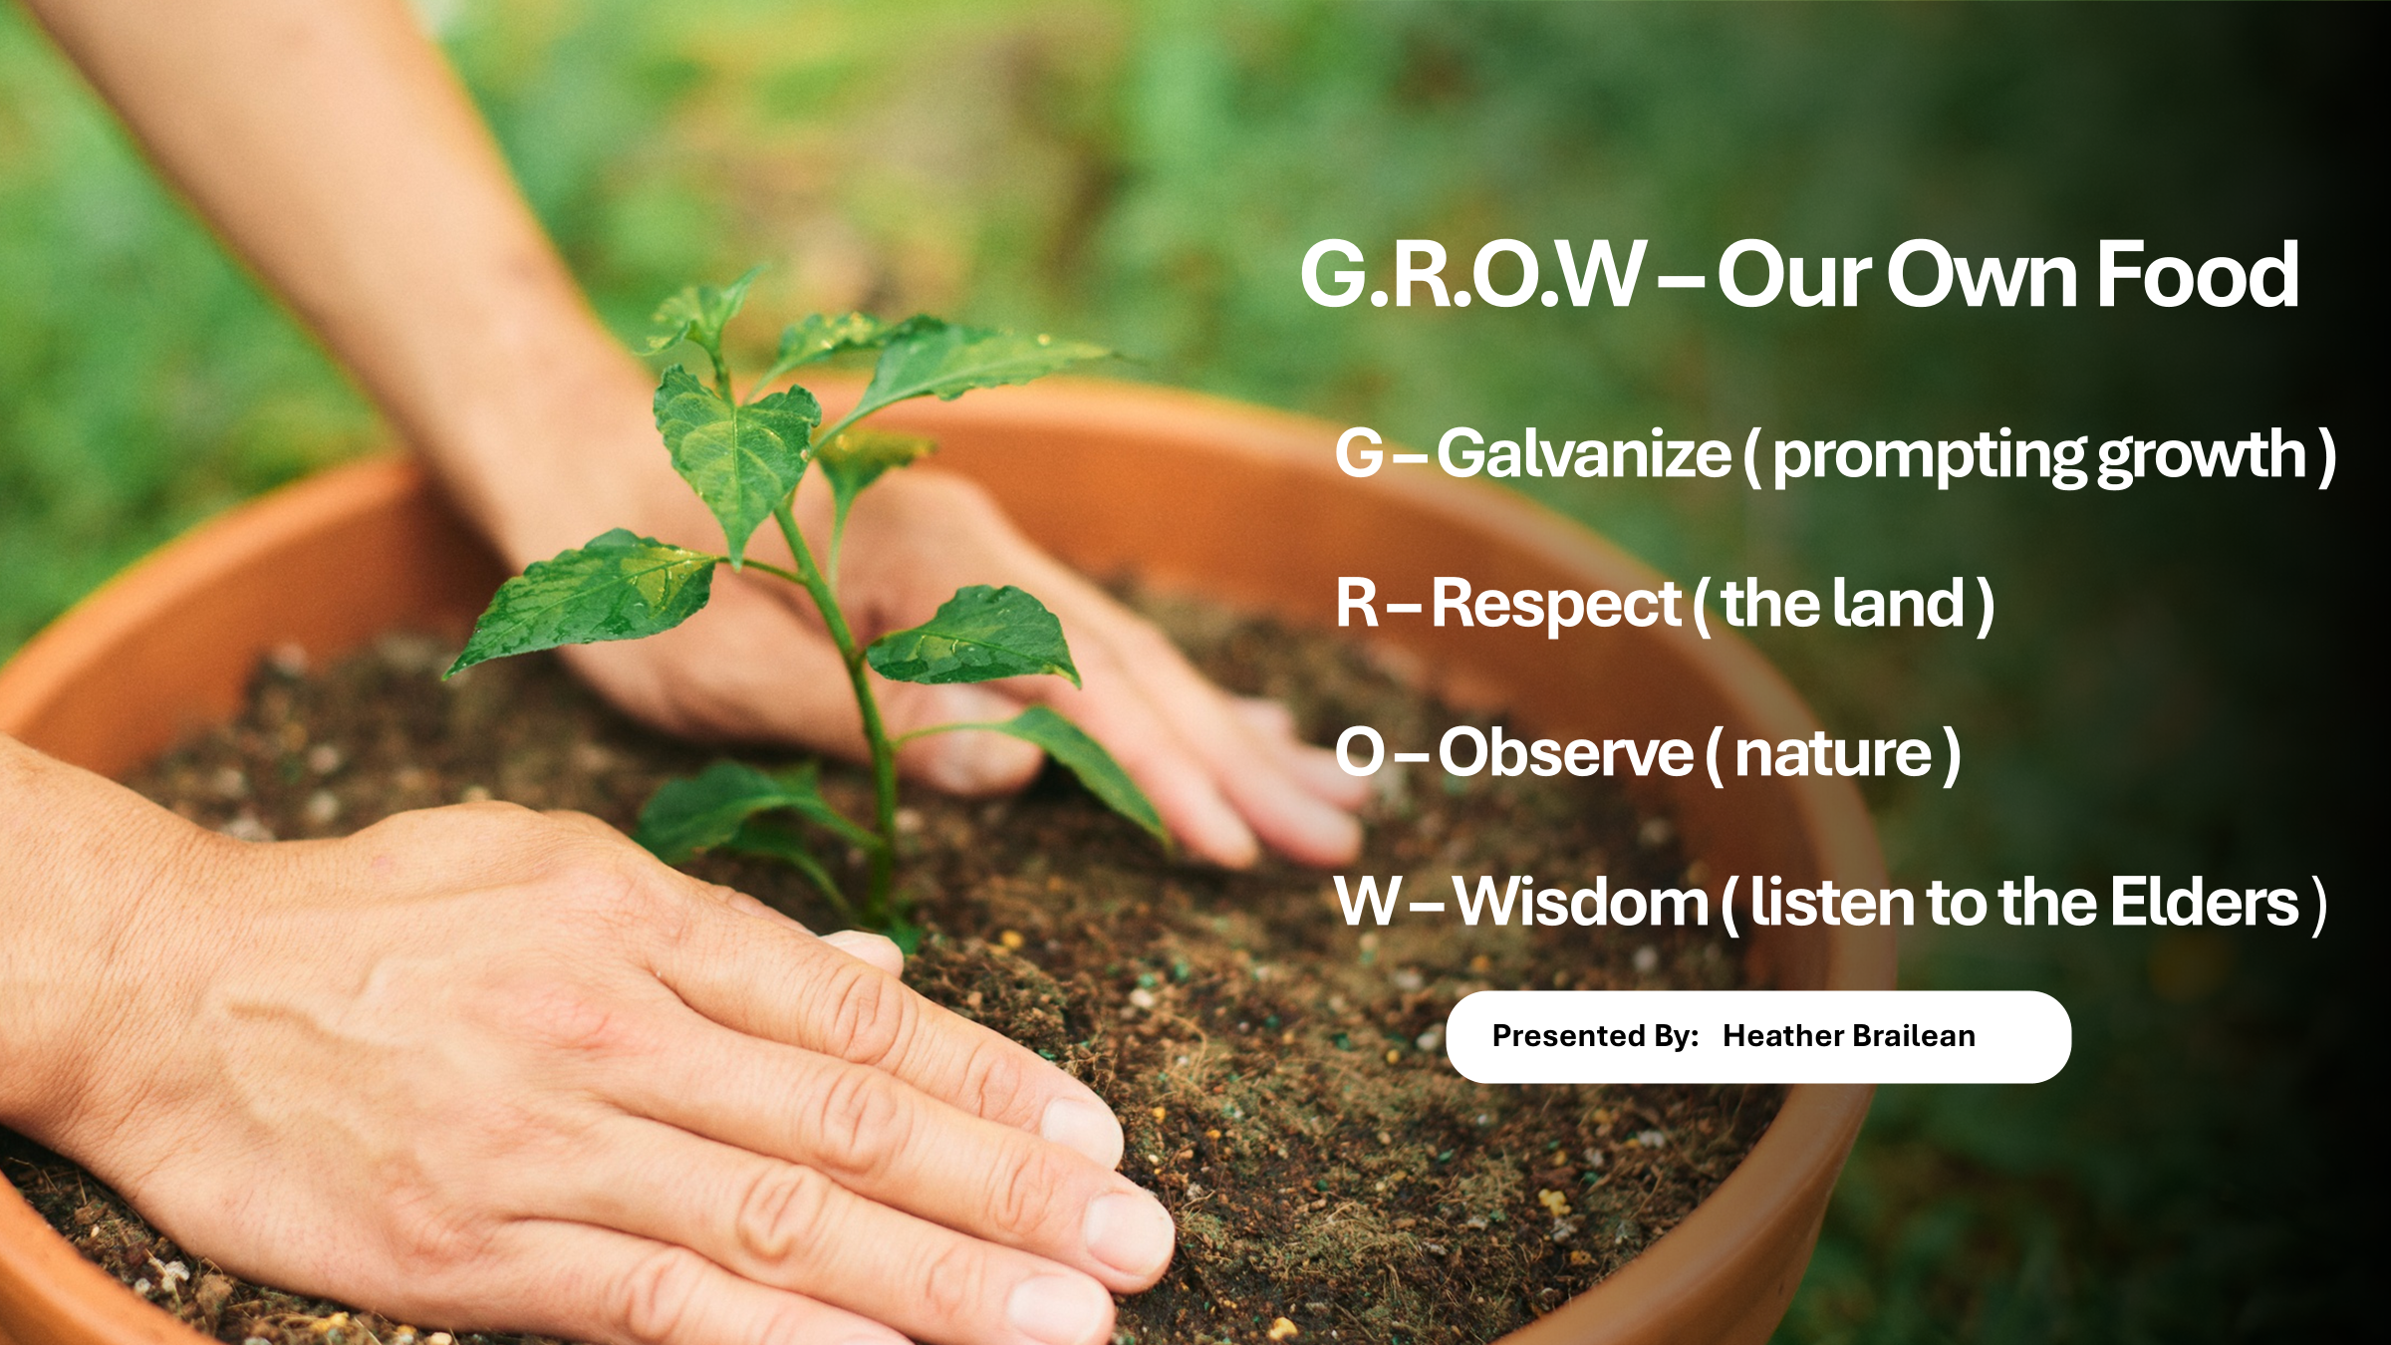

Slide 2
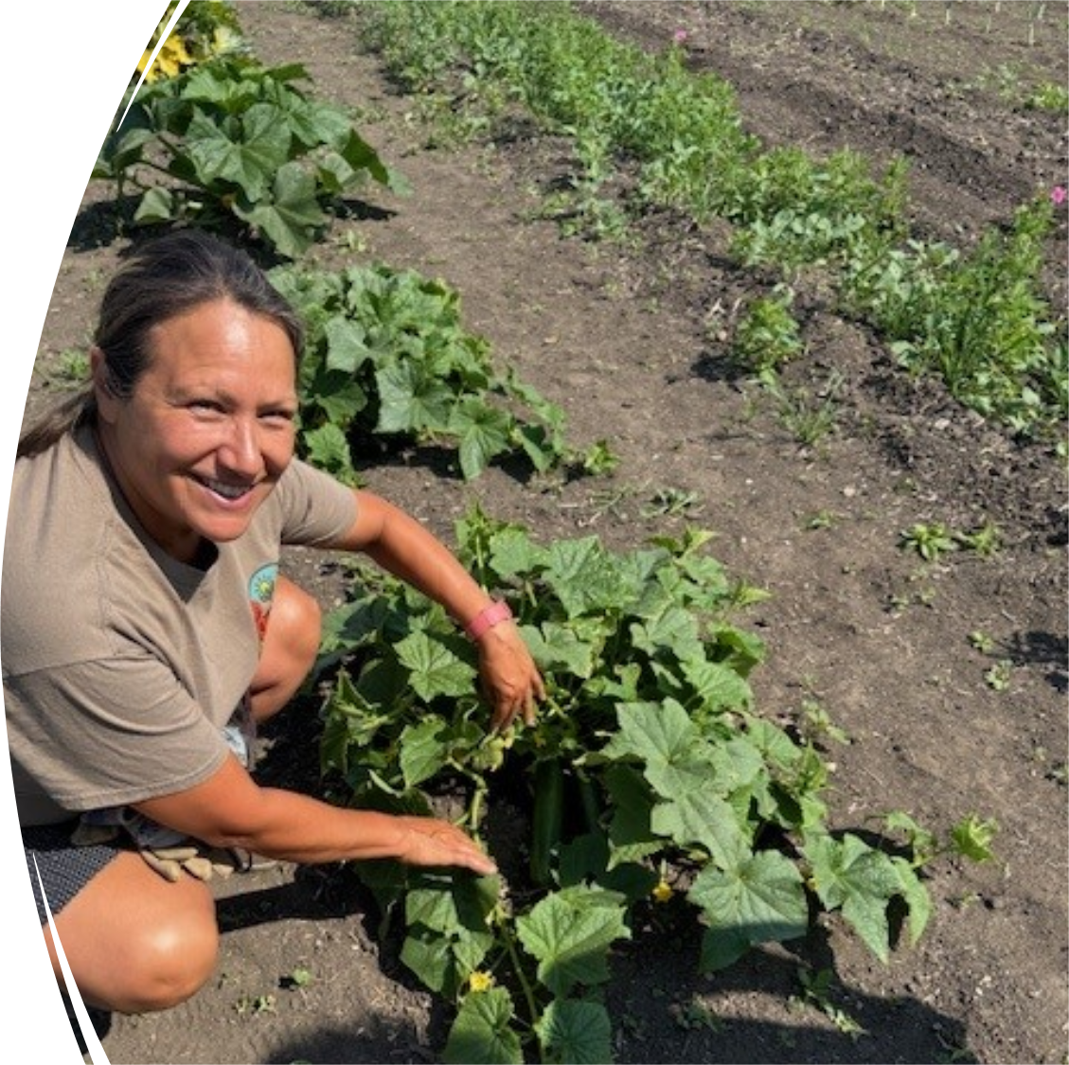
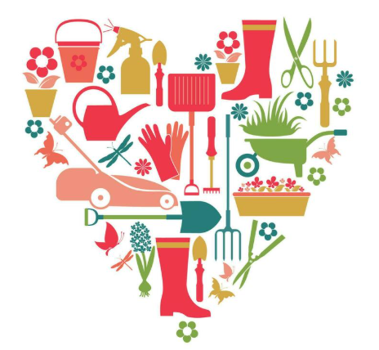

About Me
Band member of Pasqua First Nation
Bachelor’s Degree in Education
Certificate in Intro to Organic Soil and Gardening
Strong commitment to Food Sovereignty
Deep passion for Gardening
About Pasqua First Nation

Slide 3
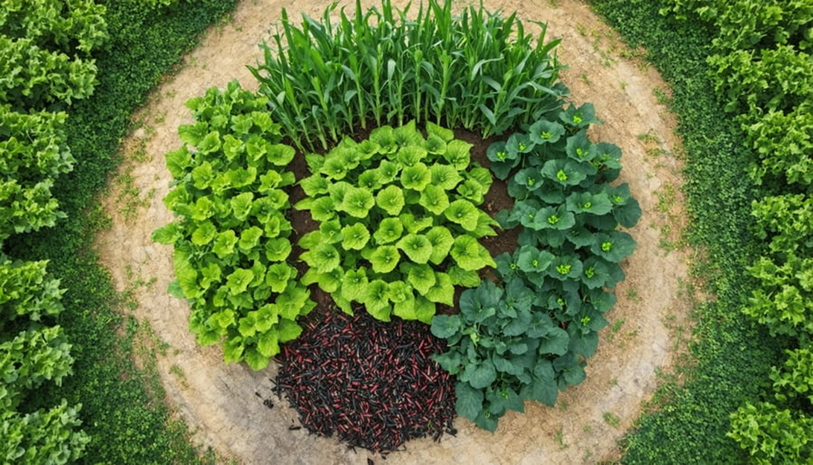
Restores Control Over Traditional Lands and Food Systems
Food sovereignty helps reclaim the right to use land and resources for traditional food practices.
It promotes self-determination by empowering people and communities to make decisions about their own food systems.

Slide 4
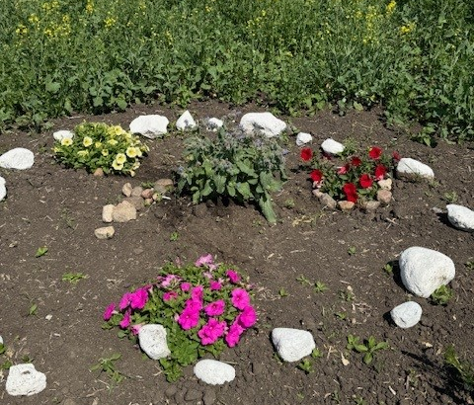
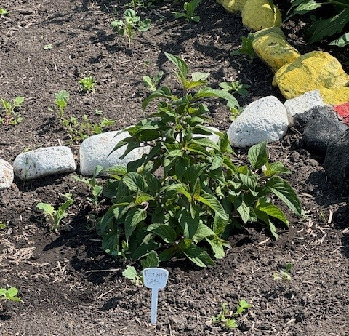
Improves Health and Wellbeing
Reclaims traditional diets that can reduce rates of diabetes, heart disease, and food insecurity.
Traditional foods are often more nutritious and locally adapted.
It supports both physical health and mental/spiritual wellbeing.

Slide 5
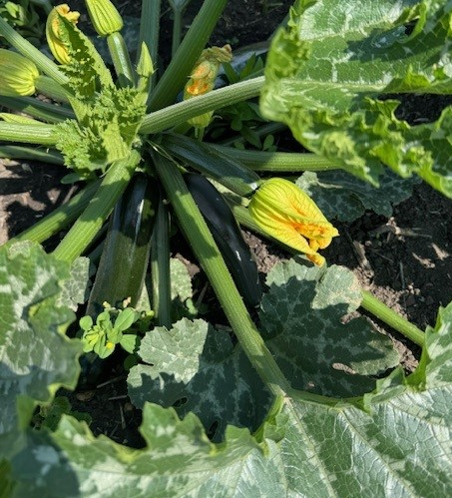
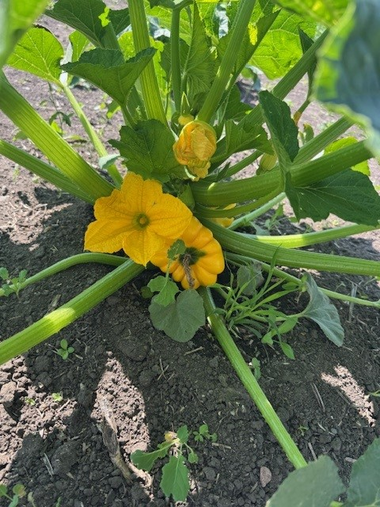
Strengthens Environmental Stewardship
Practices emphasize sustainability, balance, and long-term care of ecosystems.
Food sovereignty supports traditional ecological knowledge, which helps protect biodiversity and adapt to climate change.
It reinforces the role of Indigenous peoples as stewards of the land.

Slide 6
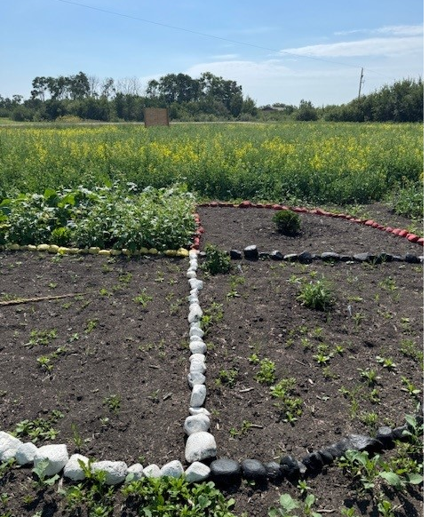
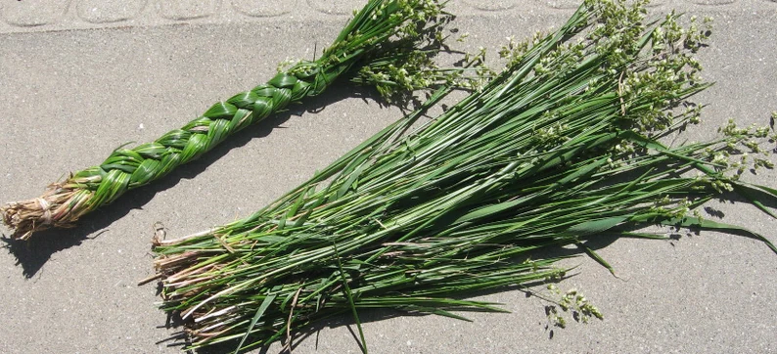
Protects Cultural Identity and Traditions
Traditional foods (wild game, fish, berries, plants) are deeply connected to language, stories, and spirituality
Knowledge of harvesting, preparing, and sharing food is passed down through generations, these practices strengthen intergenerational relationships and preserve cultural identity

Slide 7
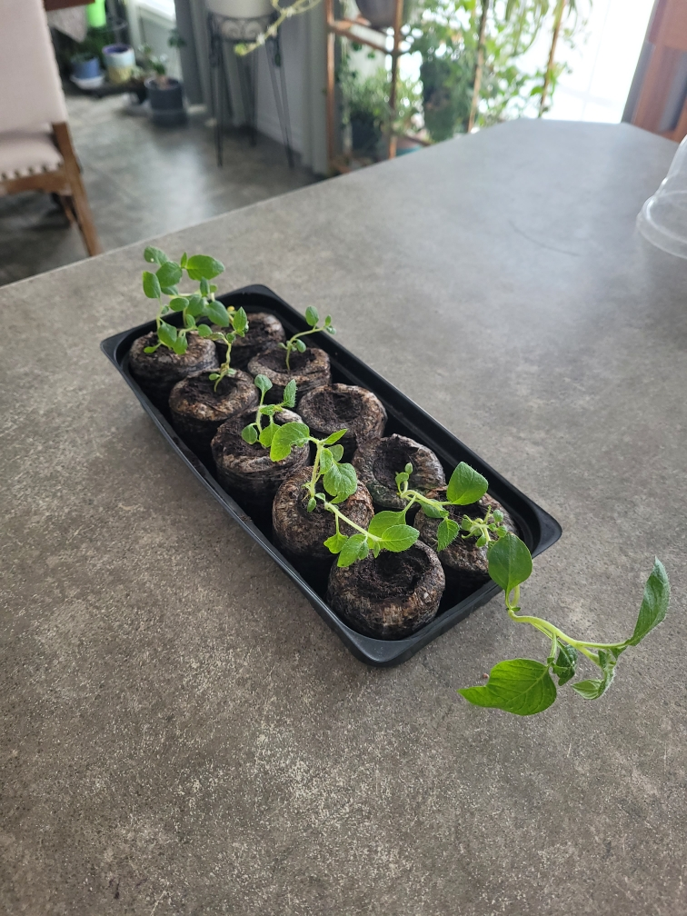
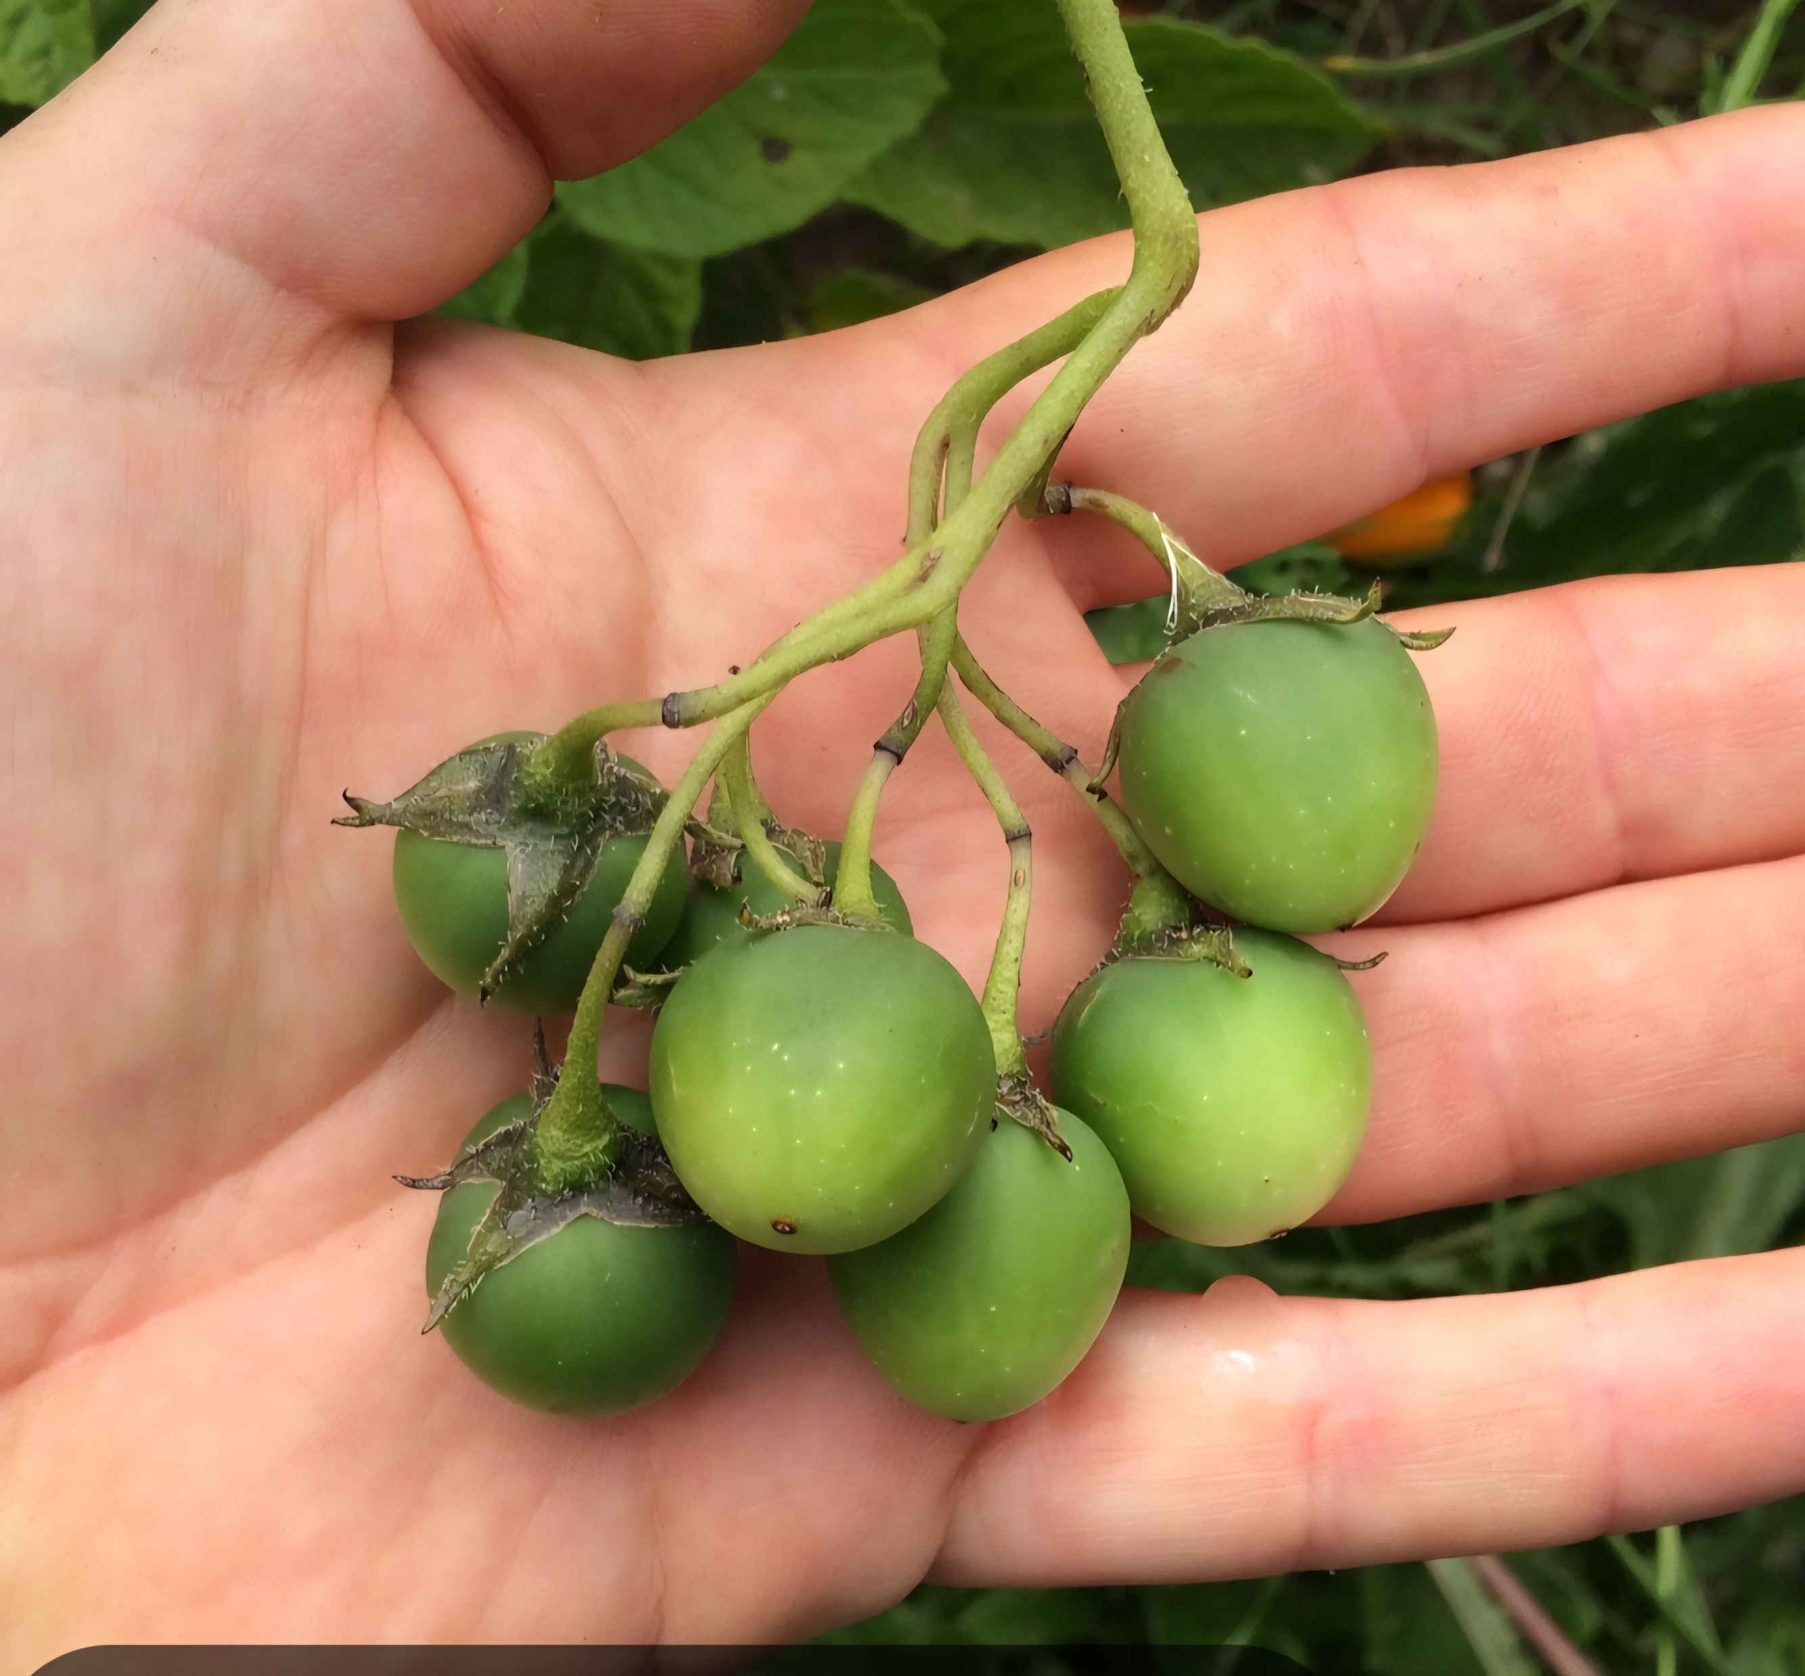

Slide 8
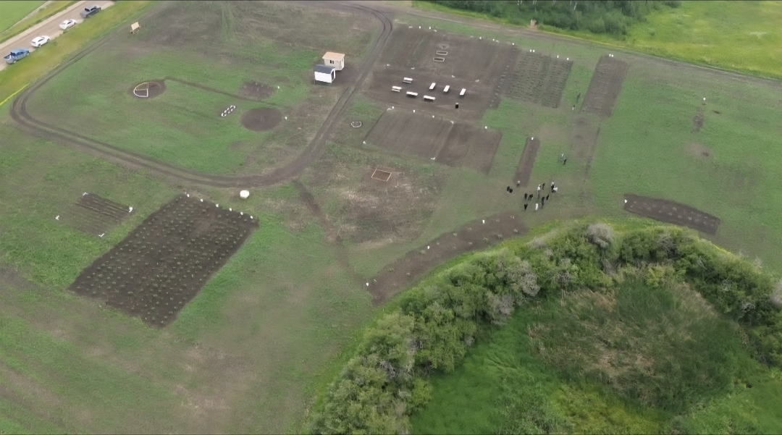

Slide 9


