Slide 1
Guaranteed Liveable Income and First Nations Perspectives
Assembly of First Nations’ National Forum on Income Assistance February 3–5, 2026, Richmond, British Columbia.

Slide 2
Background
14 participants: Ontario, Manitoba
ONWAA hosted five (5) Designing Culturally Appropriate Income Assistance Program workshops.
Winnipeg: 14 participants: Ontario, Manitoba
Toronto: 18 participants: Ontario, Manitoba & AFN Analyst
Ottawa: 14 participants: Ontario, Nova Scotia, New Brunswick
Toronto: 19 participants: Ontario, New Brunswick, ISC
ONWAA Fall Assembly: 40 participants from various First Nations

Slide 3
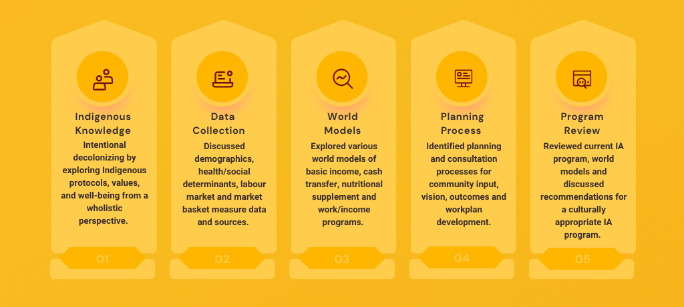
Designing Culturally Appropriate Income Assistance Program Workshop

Slide 4

Model Comparison
Many models have similar eligibility criteria connected to residency, income testing and access to disposable assets.
Universal Basic Income
Means Testing
Cash Transfer
Subsidy Programs
Finland, China, Iran, Brazil, Norway, New Zealand, United States.

Slide 5
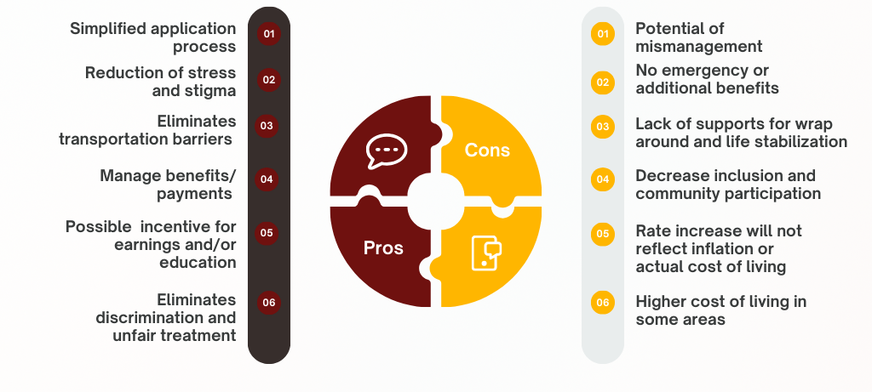
Basic Income Review

Slide 6
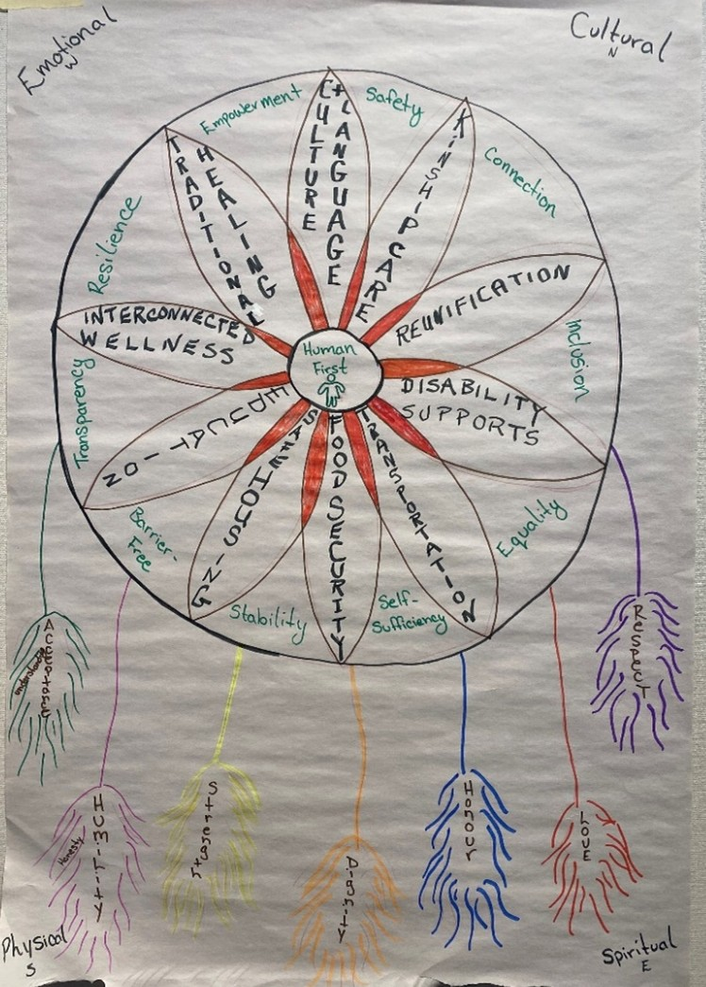
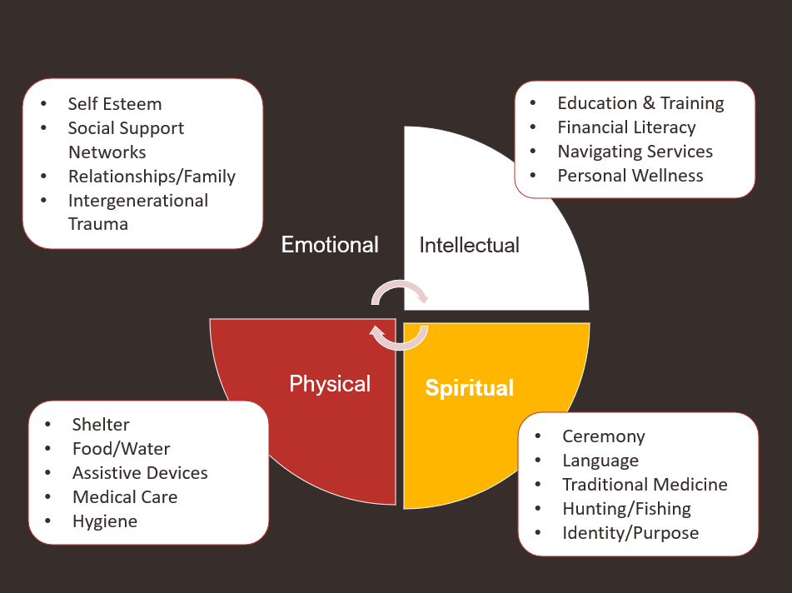
Wholistic Models

Slide 7


Onsite Training
Community Presentations
staci.williams@onwaa.ca
or
info@onwaa.ca
1-877-291-7542
Regional Training Sessions
Local Policy Development
Resource Development
Webinars
Policy Analysis
Notes:
**Slides will move on own, showing Questions? At the end of the transition
**No need to click as they are to go automatically from here to the end ☺
Languages : Ojibway, Mohawk, Cree & English

