Slide 1




Nourishing Communities:
A Guide to School Food Program Development
Department of Community Health & Epidemiology
University of Saskatchewan
Rachel Engler-Stringer & Stefanie Foster
Contact: rachel.engler-stringer@usask.ca

Slide 2

Land Acknowledgement
As we gather here today, we acknowledge we are on Treaty 6 Territory and the Homeland of the Métis. We pay our respect to the First Nations and Métis ancestors of this place and reaffirm our relationship with one another.

Slide 3

Backstory
Our USask team has been working in school food research for 10+ years
Funded by a SSHRC Connection Grant led by Dr. Rachel Engler-Stringer (PI), Dr. Amberley Ruetz (Co-PI) and Debbie Field (Collaborator).
School food through a population health lens – community and individual wellbeing
An integrated view of school food – meals and snacks but also LEARNING
Brought together experts from around the country to help us in developing a series of free how-to guides to support schools and school divisions in launching new and developing existing school food programs
Developed with the understanding that many school food programs are ad hoc, patch-work funded, with limited long-term planning in place

Slide 4
Evidence-based
Evidence-based program development helps make programs more effective and sustainable, encourages accessibility and destigmatization, & saves time and money in the long-run
Recommendations and resources in our guides come from:
  Academic and community research conducted in Canada and internationally
  Lessons learned directly from our team’s school food research projects with Saskatoon Public Schools and Meadow Lake Tribal Council and the projects of our academic collaborators
  School Food Agencies and Organizations from around the country – Coalition for Healthy School Food, Nourish Nova Scotia, Canadian Feed the Children/Kinvia, The Indigenous School Food Circle, Farm to Cafeteria Canada, Feeding Futures, etc.
  Schools and divisions around Canada with innovative school food programs

Slide 5
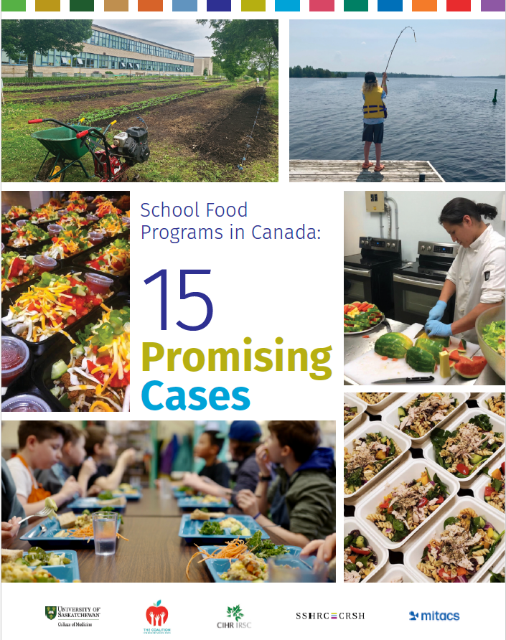
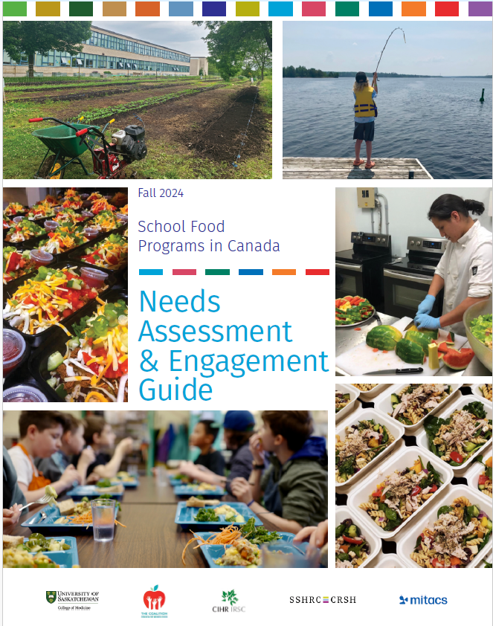

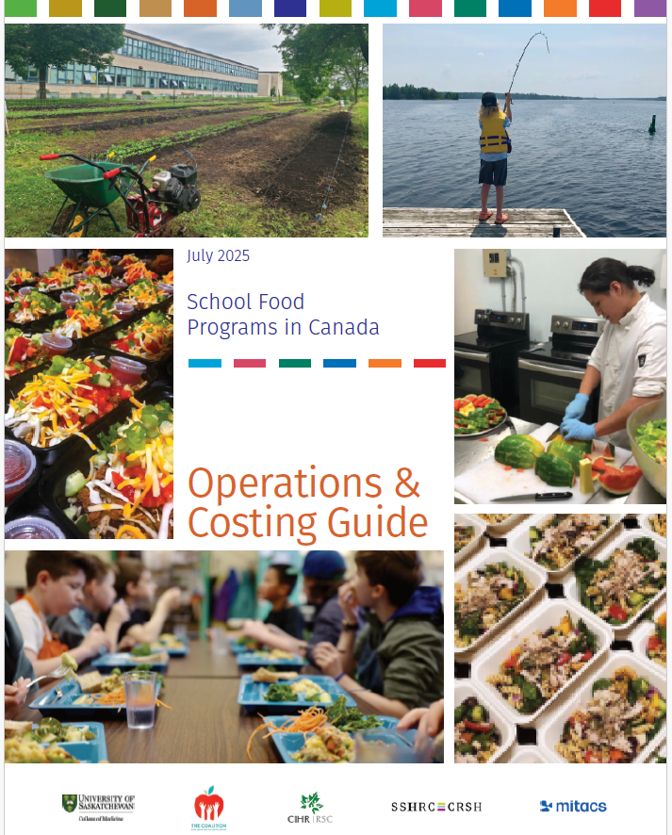
The Guides
FREE ONLINE RESOURCE (with many links to alternate tools and frameworks)
Part One: 15 Promising Cases
Part Two: Needs Assessment and Engagement Guide
Part Three: Food Literacy Guide Bonus Guide: Incorporating Food Literacy into Indigenous Cultural Education
Part Four: Operations and Costing Bonus Guide: School Food Operational Models
Part Five: Evaluation and Monitoring Guide

Slide 6
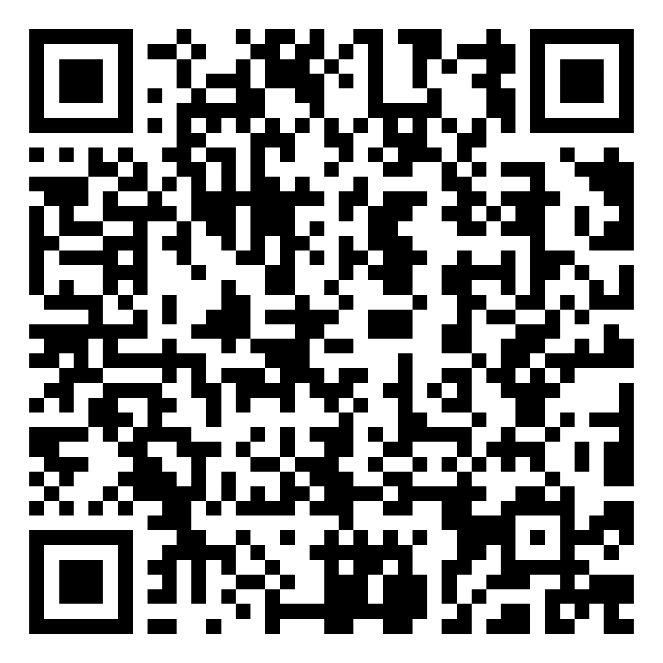
Follow the QR Code
SPHERU.CA --- School Food How-To Guide Series

Slide 7

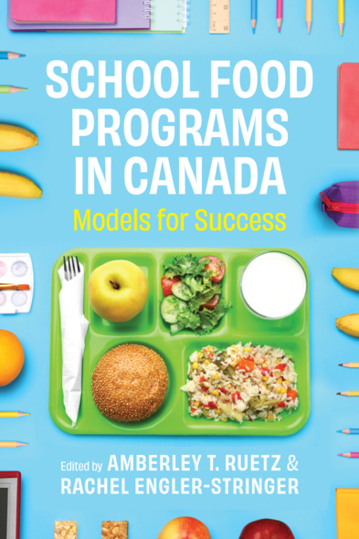
Part One: 15 Promising Cases
Short ~4-page operational summaries designed to offer program models for emulation and inspiration
Profiles effective, sustainable programs from every province and territory in Canada
Mix of urban, rural and remote contexts
Showcases different procurement, production, service and payment models from programs that have varying degrees of “independence” in their operations
Expanded case studies now available in an edited book by Ruetz and Engler-Stringer, now available for purchase from UBC Press!

Slide 8
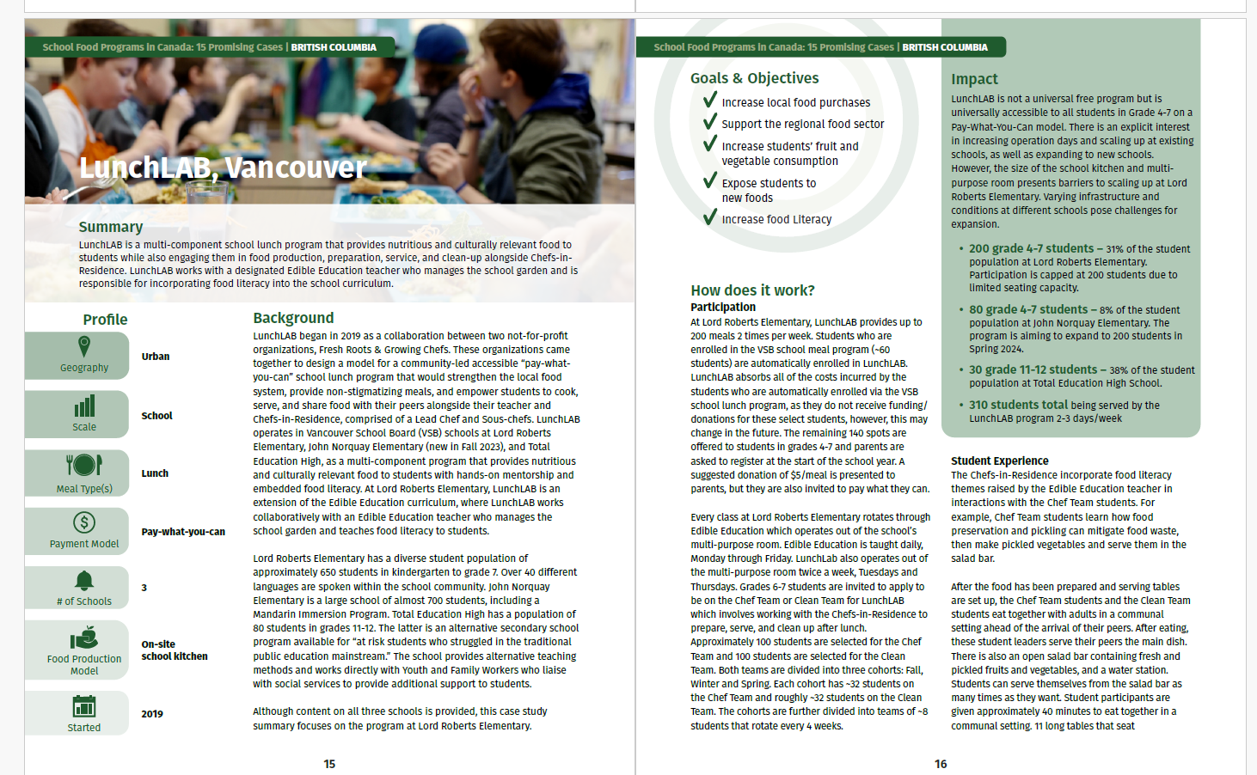
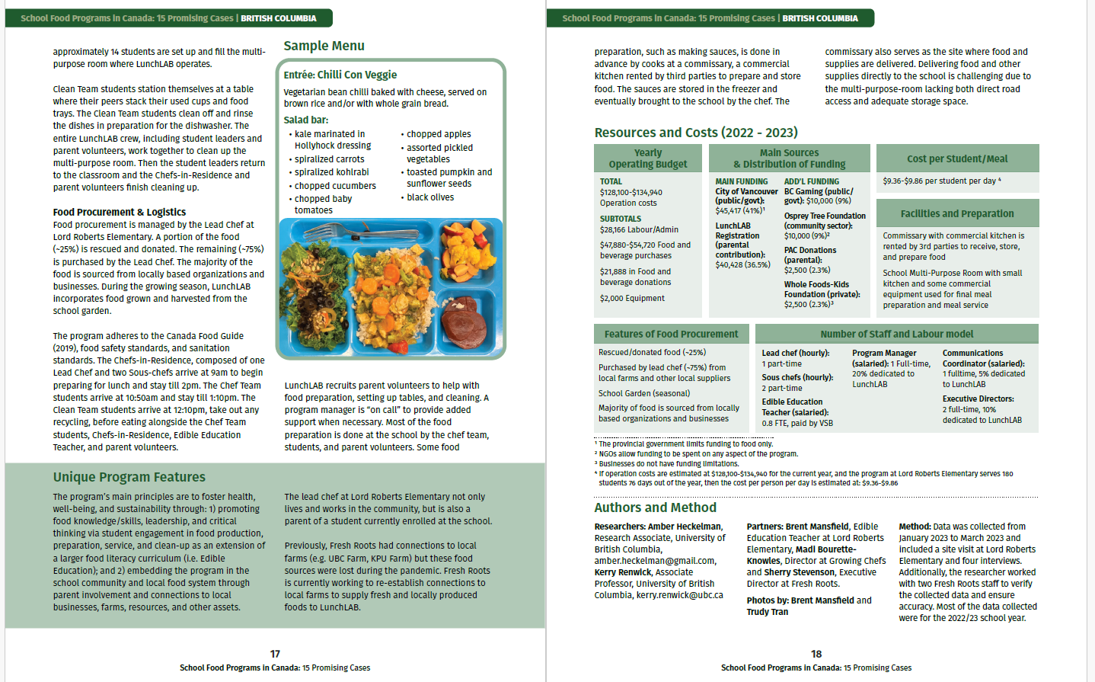

Slide 9
Part Two: Needs Assessment & Community Engagement Guide
Resources and recommendations for school food programming planning and community engagement
For new OR growing programs
Encourages community collaboration
Offers a basic three-part framework:
    Pre-Assessment – create a team, gather available documentation, determine your current context
    Assessment – gather further data & resources, engage community & build relationships, determine needs & wants
    Post-Assessment – mission & vision statements, make a plan for moving forward

Slide 10
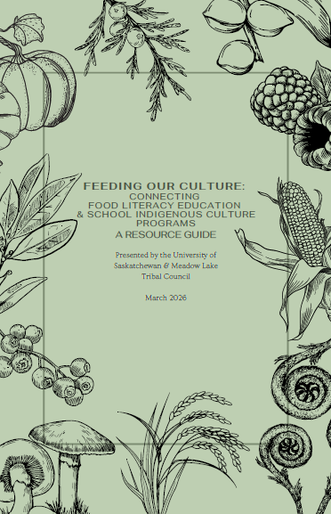
Part Three: Food Literacy Guide
Great school food programs include curricula-integrated food literacy learning for students
Hands on learning – cooking, gardening, composting, land-based education
Incorporating food-based learning into traditional academic subjects: math, science, social studies, language arts
Encourages nutrition education that is focused on balance and wellbeing rather than dichotomizing foods (healthy/unhealthy; good/bad)
Bonus Guide: Feeding Our Culture: Connecting Food Literacy to Indigenous Culture Education Programs

Slide 11
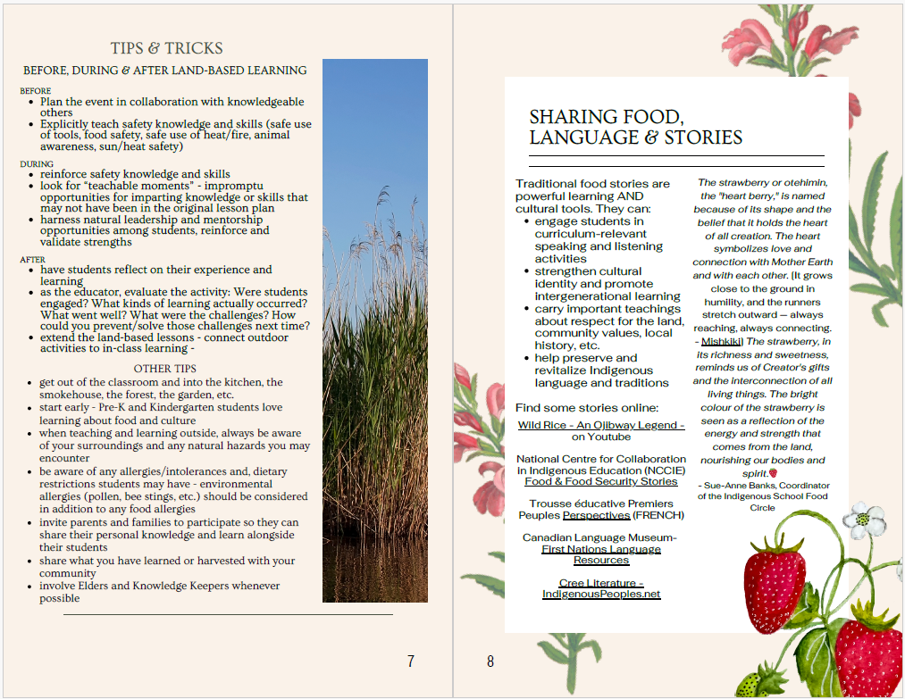
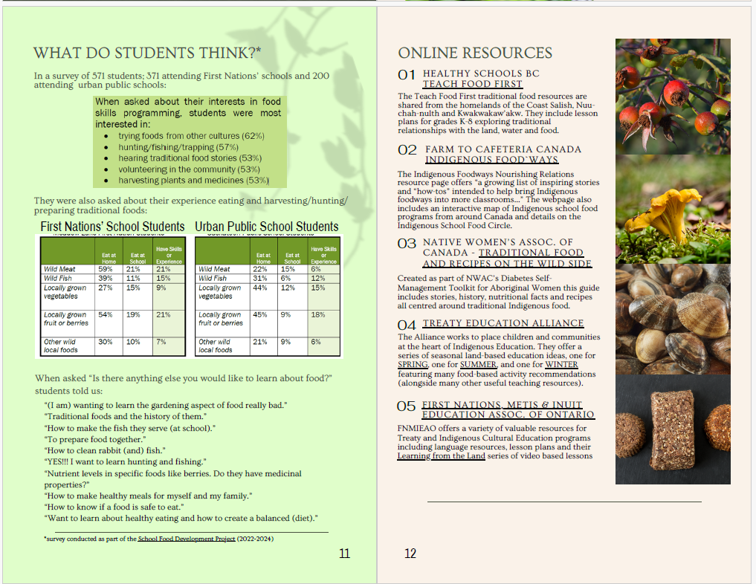
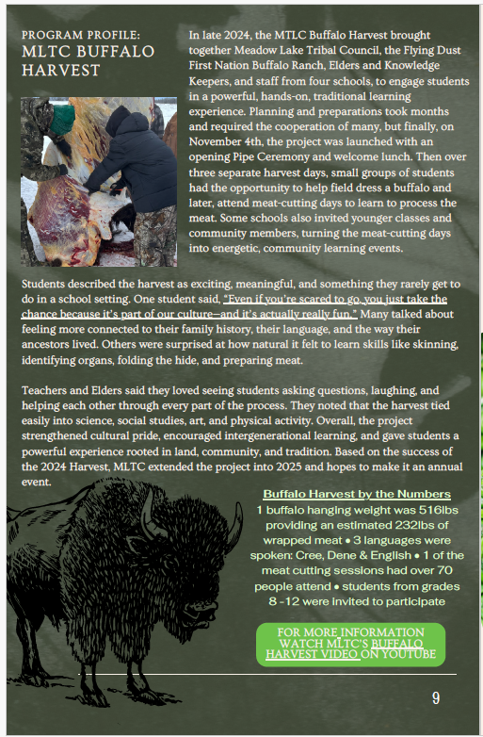

Slide 12
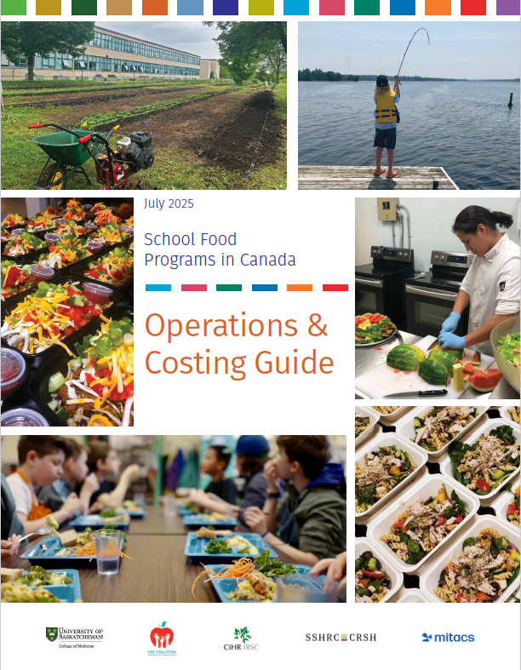
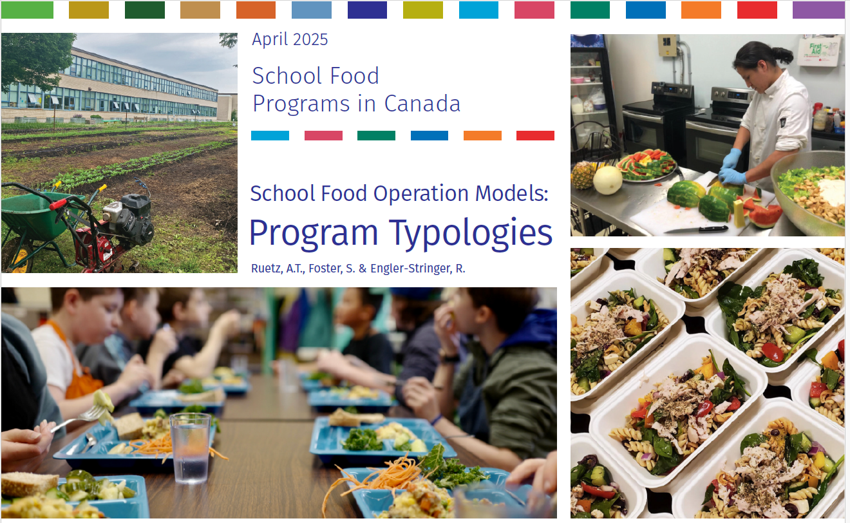
Part Four: Operations & Costing Guide
Includes recommendations and resources for:
  Human Resources
  Program Logistics – SOPs, procurement, food handling, salad bars, equipment, etc.
  Local Food Procurement
  Menu Resources
  Budgets & Costing
  Bonus Guide: School Food Operations Models: Program Typologies – provides common language and definitions for key school food terms; reviewed 38 programs from around Canada to provide standardized profiles of different procurement, preparation and food service/dining models

Slide 13
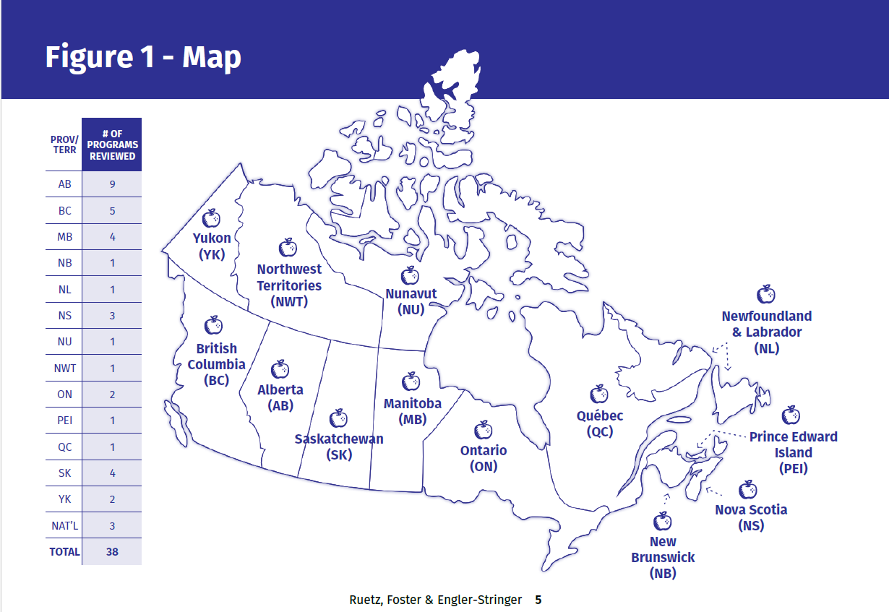
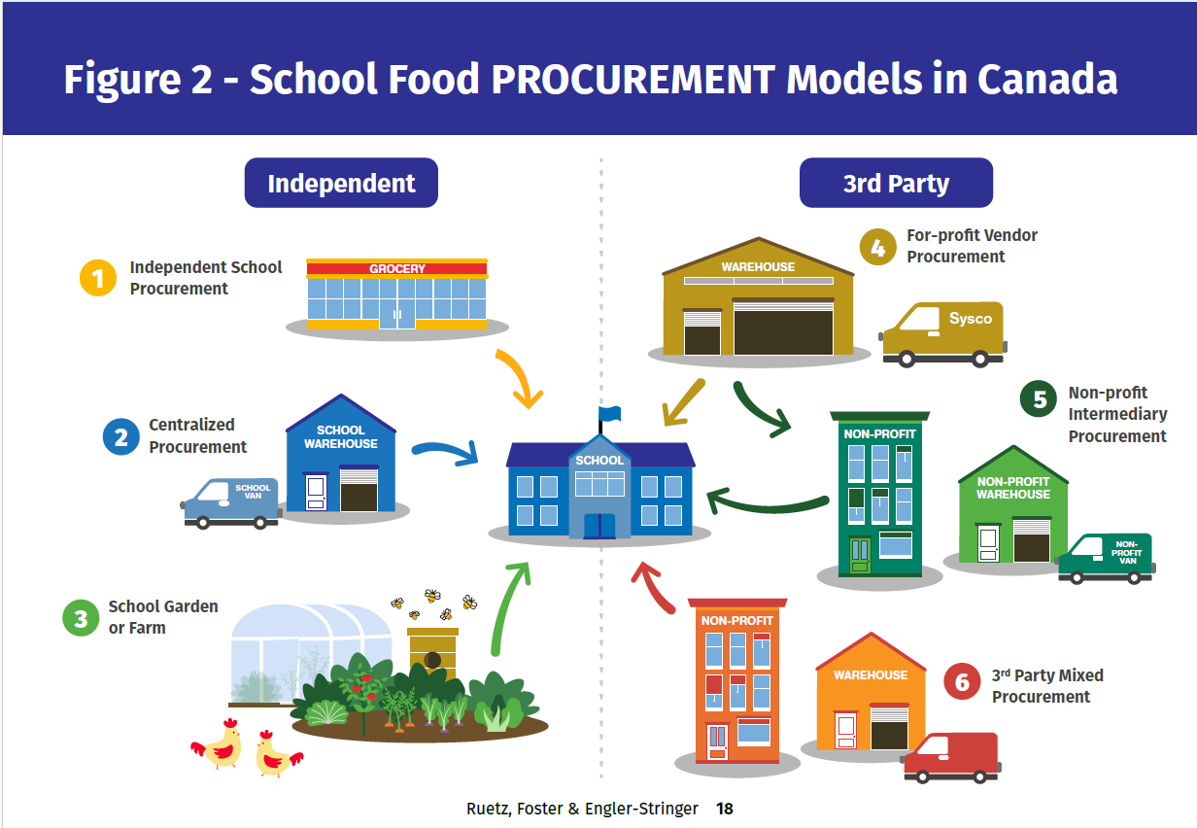

Slide 14

Part Five: Evaluation & Monitoring Guide
Breaks school food evaluation into three distinct levels based on “difficulty”
Level One recommendations are designed to keep programs aligned with National School Food Program reporting requirements
Promotes partnering with academic researchers to do more extensive evaluation
Offers a glossary of standardized terms

Slide 15
Follow the QR Code
SPHERU.CA --- School Food How-To Guide Series

