Slide 1

AFN at CBD COP 16 Advancing First Nations-led Conservation Priorities, Outcomes, and Next Steps
AFN Environment Sector Webinar Series Jan 31, 2025

Slide 2
Background
AFN undertakes work in international fora on international mechanisms by elevating domestic priorities – First Nations leadership in conservation as affirmed by Resolution (27/2024)
Resolutions passed by First Nations-in-Assembly mandating AFN participation at the CBD (03/2019 and 07/2019), an opportunity to influence decisions that shape Canada’s conservation policies, customary sustainable use of resources, and the related use of traditional knowledge (Article 8j).
AFN actively involved in development of Kunming-Montreal Global Biodiversity Framework (KM-GBF) since 2018 through our advocacy with Canada and the international Indigenous Forum on Biodiversity (IIFB) - secured strong language on protecting the rights of Indigenous Peoples in the KM-GBF; finalized at COP 15 in Montreal in December 2022.

Slide 3
AFN Priorities at COP-16
COP 16 (Cali, Colombia from Oct 21-Nov 1) was first opportunity for Parties to report on progress of achieving the targets and goals of the GBF to halt and reverse biodiversity loss.
Ongoing priorities at CBD are to:
uphold First Nations rights, governance, knowledge systems;
support First Nations-led conservation within sub-national, national, and international biodiversity policy; and
ensure the full and effective participation of First Nations, and by extension Indigenous Peoples, in all areas of the CBD
AFN Knowledge Keeper Sempulyan Gonzales, Kuni Albert (International Indigenous Forum on Biodiversity, North America Regional Coordinator/observers); Wanli Ou (Canada/Party)

Slide 4
AFN Priorities
AFN ongoing priorities informed development of Position Paper (driven by AFN Resolutions)
New Programme of Work and Institutional Arrangements on Article 8J
Implementation and Preparation of National Biodiversity Strategies and Action Plans, incl. Monitoring Framework
New Multilateral Mechanism for Benefit Sharing from the use of Digital Sequence Information of Genetic Resources

Slide 5
Article 8(j) of the Convention
Each contracting Party of the Convention on Biological Diversity shall, as far as possible and as appropriate, subject to national legislation, respect, preserve and maintain knowledge, innovations and practices of indigenous and local communities embodying traditional lifestyles relevant for the conservation and sustainable use of biological diversity and promote their wider application with the approval and involvement of the holders of such knowledge, innovations and practices and encourage the equitable sharing of the benefits arising from the utilization of such knowledge innovations and practices.

Slide 6
New Programme of Work and institutional arrangements on Article 8j
Work at the CBD relating to Indigenous Peoples had occurred through an Ad-hoc Working Group on Article 8J over 26 years
Under-resourced, advice to the COP through CBD’s Subsidiary Bodies, could end at any time
Rights-based approach of new biodiversity framework meant increased involvement of Indigenous Peoples in implementation
Tasks within a new programme of work that deal with conflation of the CBD terminology “indigenous peoples and local communities” – Consensus amongst NIOs
Recommendation to the COP to adopt a Subsidiary Body to formalize this platform for Indigenous Peoples on biodiversity --- Canada as one of the main supporters

Slide 7
COP 16 Outcomes – Article 8j
COP Decision 16/5 to establish the Subsidiary Body on Article 8j with mandate to provide advice to COP and other subsidiary bodies
COP Decision 16/4 Tasks within a new programme of work that deal with conflation of the CBD terminology “indigenous peoples and local communities”
10. Also requests the Executive Secretary, subject to the availability of resources, to collaborate with other relevant global processes and mechanisms to facilitate an exchange in relation to decision 15/21 of 10 December 2022 and the implementation of Article 8(j) and other provisions of the Convention related to indigenous peoples and local communities, taking into account national legislation and international instruments.
Task 5.4 Review and update, as needed, the Voluntary Glossary of Key Terms and Concepts Within the Context of Article 8(j) and Related Provisions of the Convention in the light of the adoption of the Kunming-Montreal Global Biodiversity Framework.

Slide 8

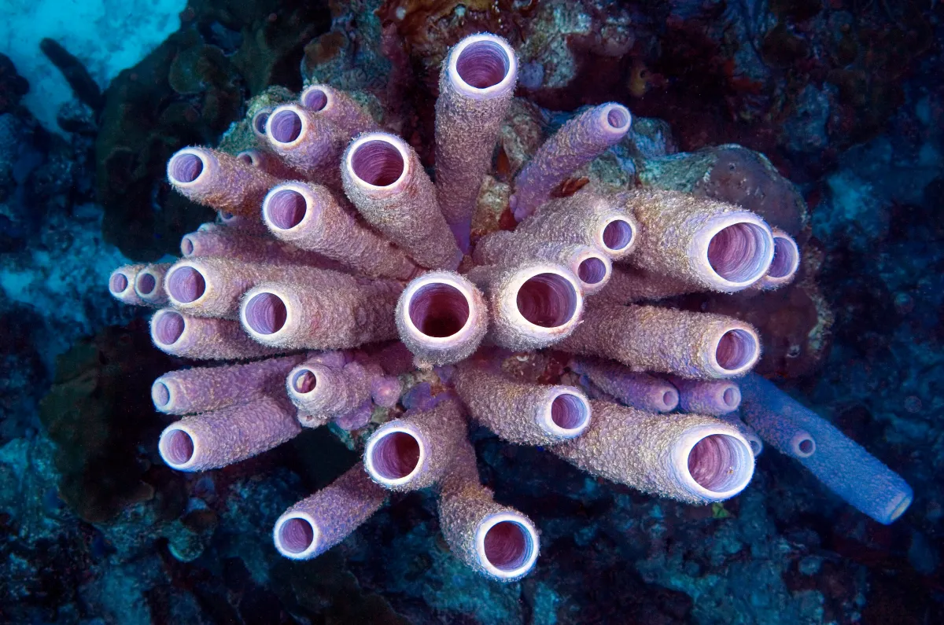
New Mechanism for Sharing Benefits from Use of Genetic Sequence Data
Genetic sequence data – digitally sequenced information taken from genetic resources
e.g. 70 percent of antibiotics and cancer treatment drugs rooted in natural organisms
Who should benefit from the economic revenue created? Who should contribute? Who should govern? Who hosts the fund? What should fund be used for?
Current funding mechanisms (e.g. Global Environment Facility) functions on a framework of developed donor country to developing recipient country
Indigenous Peoples globally should be main recipients of this new fund in recognition of the critical role and knowledge systems of Indigenous Peoples to conserve nature

Slide 9
COP16 Outcomes – Genetic Sequence Data
COP Decision 16/2 to establish a multilateral mechanism including a global fund – known as the Cali Fund for the Fair and Equitable Sharing of Benefits from the Use of Digital Sequence Information on Genetic Resources
Pessimism on how much Private sector will be incentivized to contribute to UN Multi-Partner Trust Fund, and whether First Nations will be prioritized, but ability to access was secured. 18. Funding should support the realization of the objectives of the Convention in developing country Parties …especially the conservation and sustainable use of biodiversity, including through the delivery of activities described in national biodiversity strategies and action plans; contribute to scientific research on biodiversity; benefit indigenous peoples and local communities, including women and youth within those communities…Funding will also be available for those purposes to indigenous peoples and local communities in developed countries, where appropriate…
21. Where appropriate, and subject to national circumstances and national legislation, at least half of the funding of the global fund should support the self-identified needs of indigenous peoples and local communities, including women and youth within those communities, through government authorities or by direct payments through institutions identified by indigenous peoples and local communities.

Slide 10
Other COP 16 Outcomes
Discussions on resource mobilization and other issues – developing countries likely to push for a separate Global Biodiversity Fund. Criticisms about current mechanism and lack of direct access for Indigenous Peoples in developing countries.
New COP Decision to improve coherence on biodiversity and climate change policy and integrate nature and climate actions
Monitoring framework with new indicators on traditional knowledge recommended but not adopted – to be continued in COP 16.2 (Feb 2025)
Land use and tenure indicators to protect traditional knowledge
Challenging negotiation dynamics
Colombian COP Presidency – ‘la COP de la gente’, inclusion of Afro-descendants
IPLC terminology

Slide 11
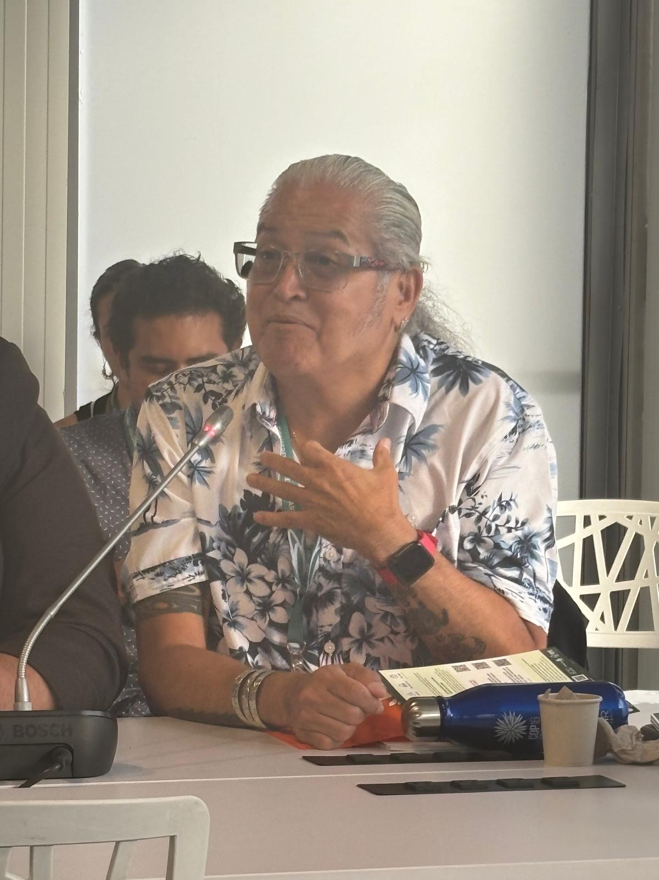
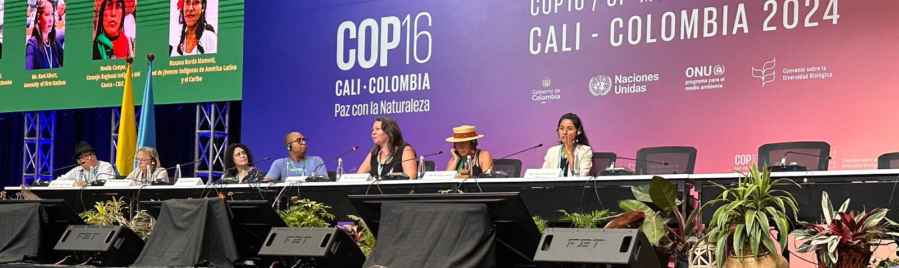
COP16 Outcomes – AFN participation at side-events
AFN participation at events and side-events at COP16 contributed to highlighting our priorities and recommendations
Panel at the CBD's Nature and Culture Summit
Upholding Human Rights: Empowering Indigenous women in stewarding traditional knowledge
Panel with the Commission for Environmental Cooperation
Inclusive Strategies for Biodiversity Conservation: From Community Leadership to Governmental Policy-making

Slide 12
Next Steps
Challenging negotiation dynamics to address IPLC terminology within CBD – tasks for SB8J
International Indigenous Forum on Biodiversity
Preparation for the first SB8J – agreement on issues to finalize terms of reference of the body and prioritization of work

Slide 13
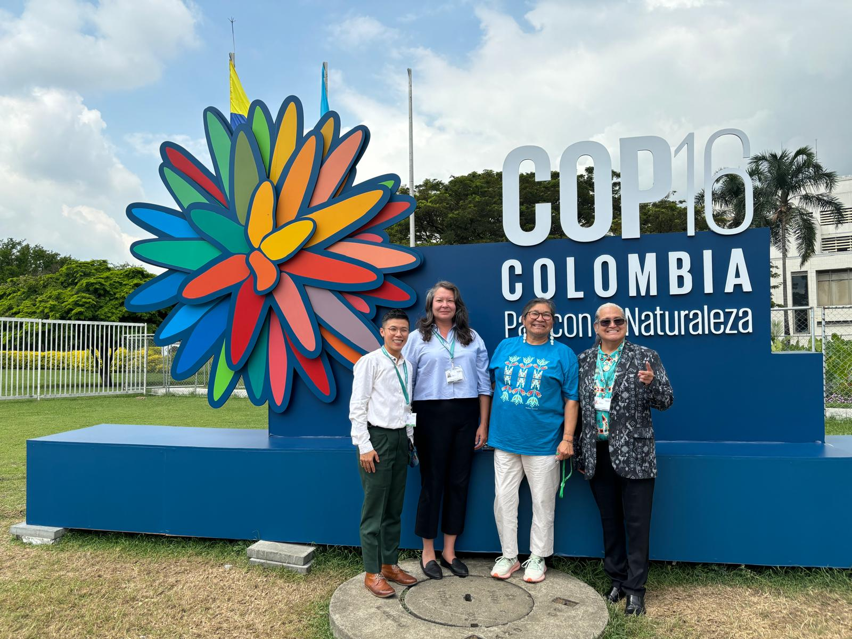
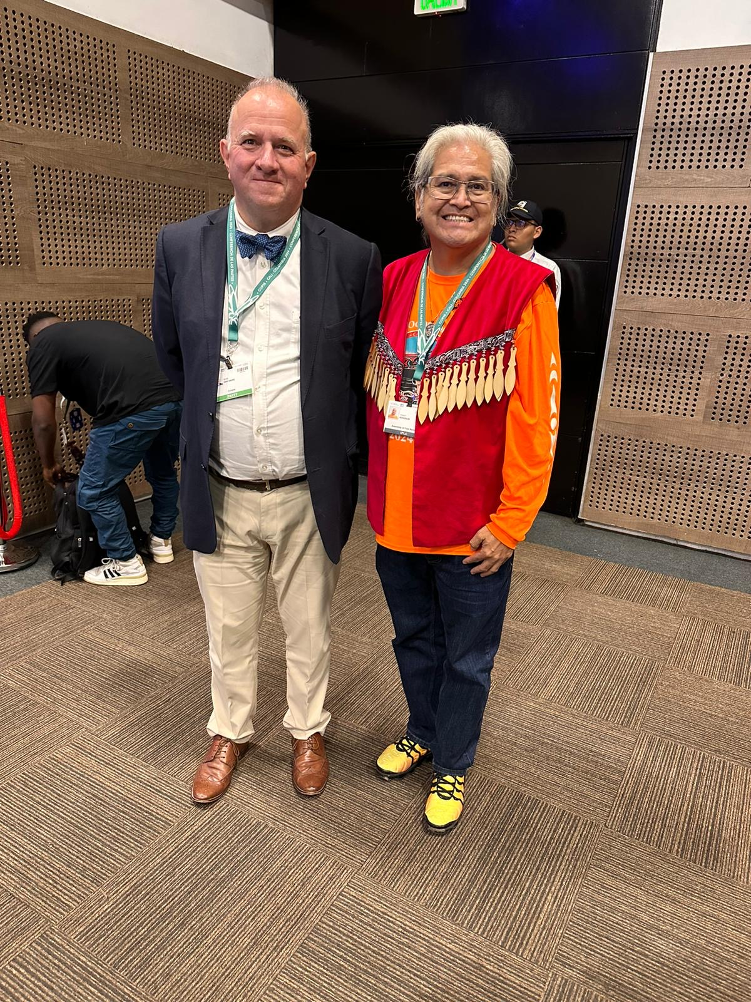
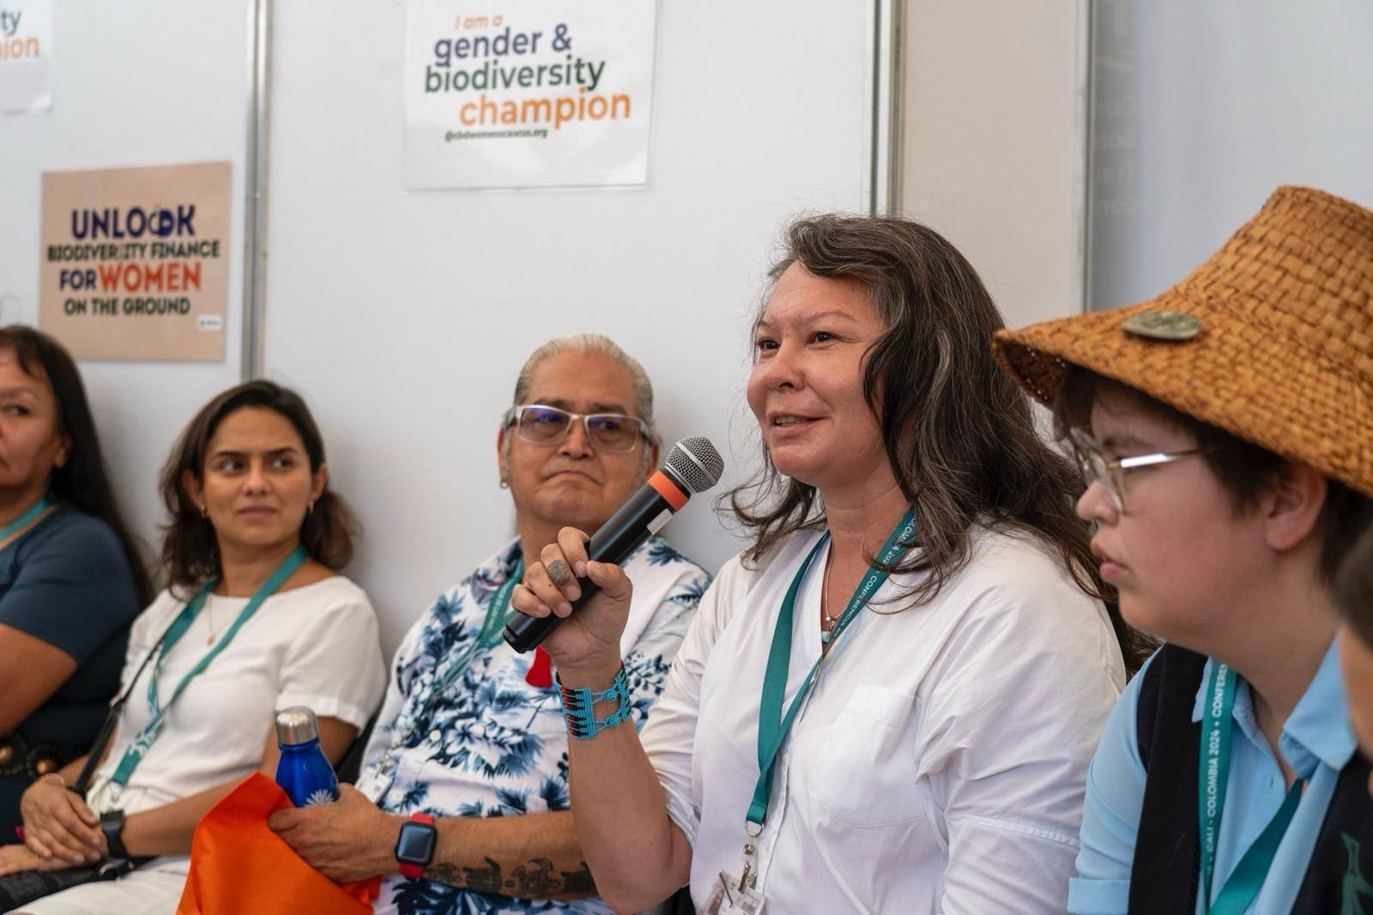
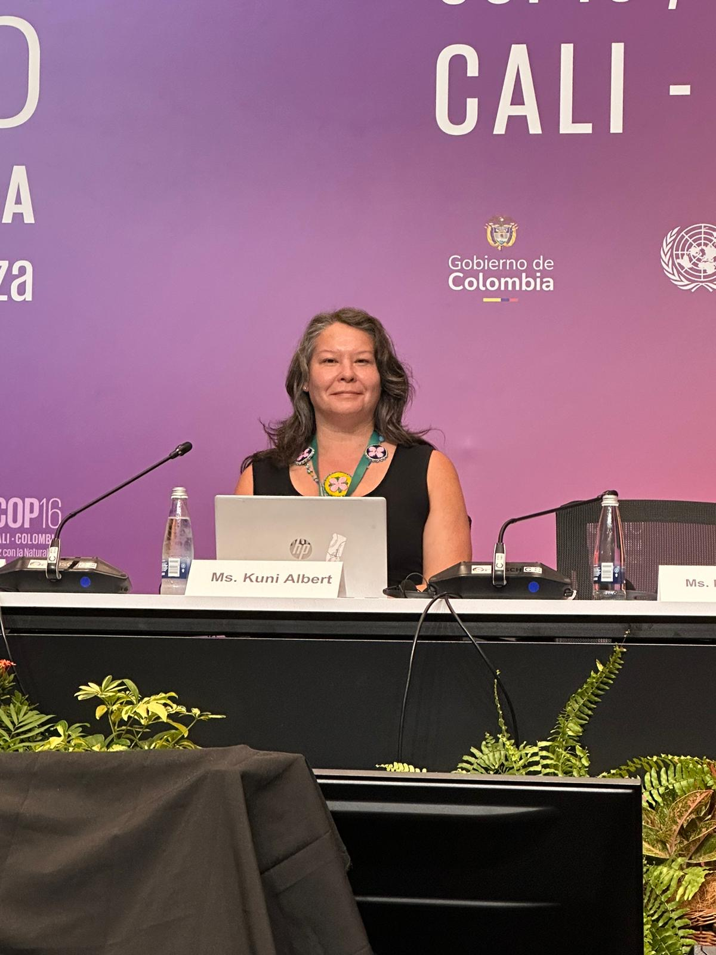
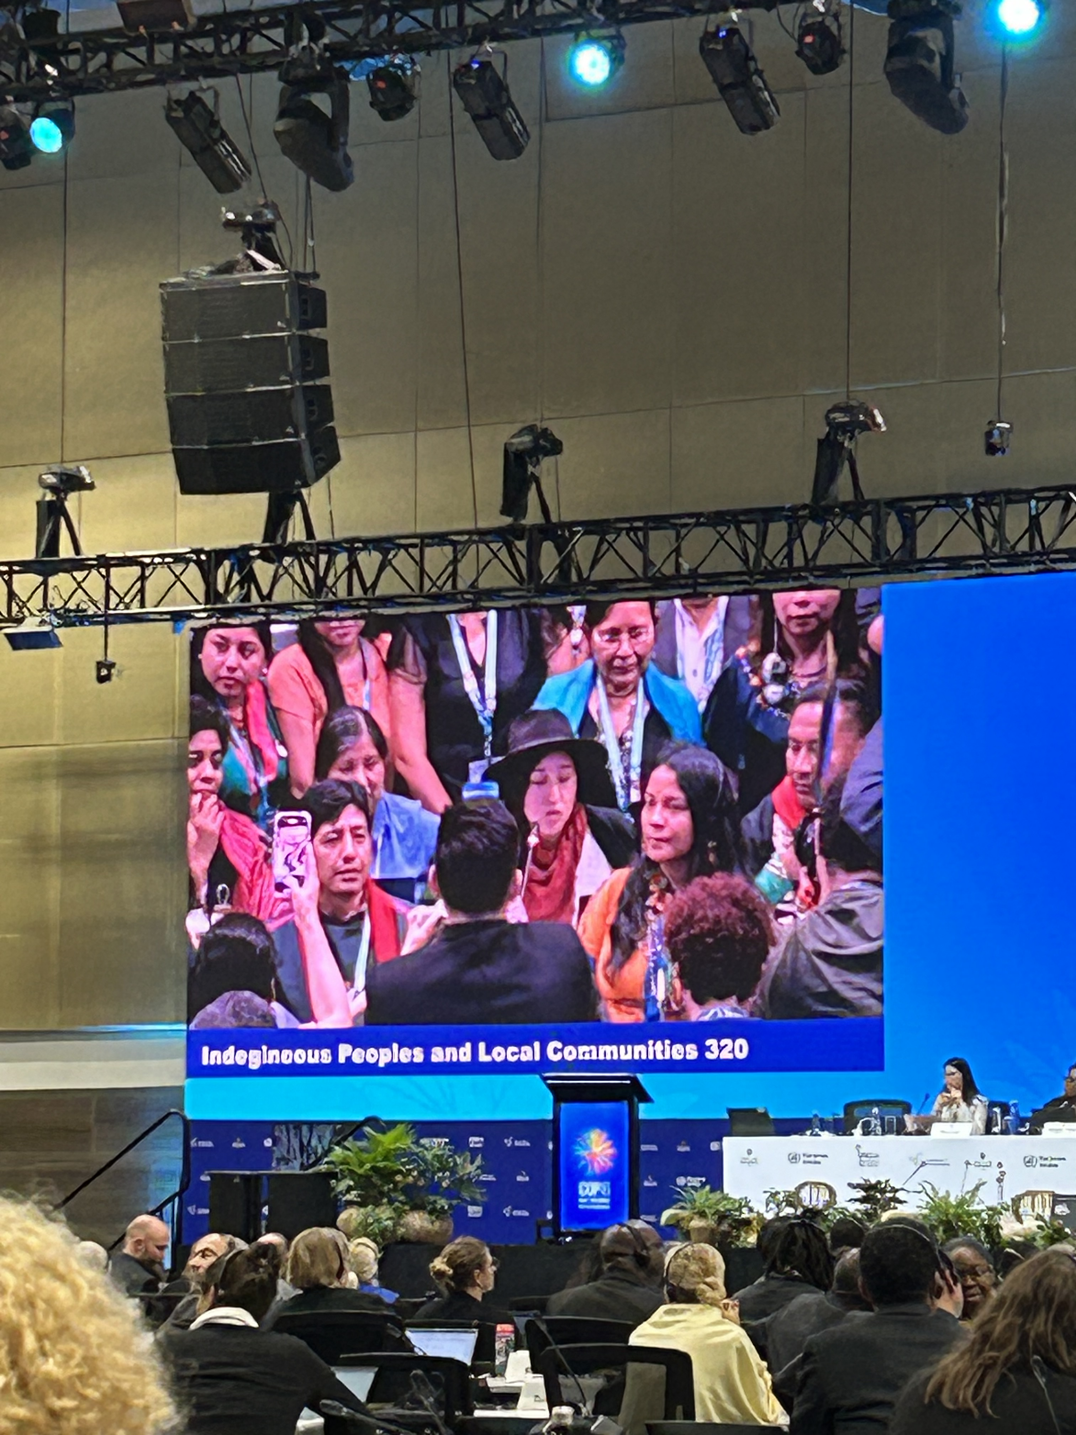
Thank you

