Slide 1
BC First Nations Tripartite Post-Secondary Education Model
Languages and Learning Forum:
Exploring First Nations Education and Linguistic Connections
February 27 – 29, 2024

Slide 2
Recognition of the Territory

Slide 3
Agenda
About the First Nations Education and Steering Committee and Indigenous Adult and Higher Learning Association
Contextualizing the BC First Nations Tripartite Post-Secondary Education (PSE) Model
Overview of the BC First Nations Tripartite PSE Model
Recent Developments
Next Steps and Closing

Slide 4
First Nations Education Steering Committee (FNESC)
The First Nations Education Steering Committee (FNESC) was founded in 1992 by participants at a provincial First Nations education conference at the Vancouver Friendship Centre. That visionary group of people determined the need for a First Nations-controlled collective organization focused on advancing quality education for all First Nations learners.
FNESC is committed to supporting First Nations in their efforts to improve the success of all First Nations students in BC. FNESC currently has approximately 130 Board members, representing First Nations and Tribal Councils from across the province.
FNESC has a formal protocol with the First Nations Leadership Council that recognizes FNESC as the lead policy and advocacy body, as directed by First Nations governments, working to advance quality education, improved accountability, and improved education outcomes for all First Nation learners in British Columbia.

Slide 5
Indigenous Adult and Higher Learning Association (IAHLA)
Established in 2003, the Indigenous Adult and Higher Learning Association (IAHLA) is the lead advocacy and support organization for Indigenous-controlled post-secondary and training institutes in BC.
IAHLA supports its member institutes by:
  Providing professional development opportunities,
  Advancing strategic partnerships,
  Conducting projects that build Indigenous institute capacity, and
  Serving as a voice for Indigenous controlled institutes.
IAHLA’s vision is to support quality post-secondary educational institutes that leverage Indigenous language, culture and knowledge to create adaptable and competent, skilled citizens who are able to contribute to local, provincial and national advancement.
FNESC provides staff support to IAHLA to implement initiatives.

Slide 6
Contextualizing the BC First Nations Tripartite Post-Secondary Education Model

Slide 7
United Nations Declaration on the Rights of Indigenous Peoples
First Nations have unique, constitutionally recognized rights that include post-secondary education.
Both Canada and BC have made a commitment to fully adopt and implement the United Nations Declaration on the Rights of Indigenous Peoples (UN Declaration), which includes the following articles:
  Article 14.1 of the Declaration states that, "Indigenous peoples have the right to establish and control their educational systems and institutions providing education in their own languages, in a manner appropriate to their cultural methods of teaching and learning.”
  Article 14.2 states that, “Indigenous individuals particularly children have the right to all levels and forms of education of the State without discrimination.”
  Article 14.3 states that, “states shall, in conjunction with indigenous peoples, take effective measures, in order for indigenous individuals, particularly children, including those living outside their communities, to have access, when possible, to an education in their own culture and provided in their own language.”

Slide 8
BC Declaration Act Action Plan
On November 26, 2019, Bill 41 – the Declaration on the Rights of Indigenous Peoples Act was passed unanimously in the BC Legislature.
Section 3 of the Declaration Act requires that the Province “in consultation and cooperation with Indigenous Peoples” take “all measures necessary” to ensure consistency between the laws of British Columbia and the UN Declaration.
On March 30, 2022, the Ministry of Indigenous Relations and Reconciliation (MIRR) published the final Declaration Act Action Plan (Action Plan), which includes eight post-secondary education and training-specific actions.
In October 2022, the Province released the Interim Approach to Implementing the Requirements of Section 3 of The Declaration Act, which provides interim guidance for implementing section 3 of the Declaration Act and, in particular, regarding approaches for involving Indigenous Peoples in policy and legislative development.

Slide 9
Declaration Act Action Plan – Post-Secondary Education and Training Actions
Action 1.8 | Recognize the integral role of Indigenous-led post-secondary institutes as a key pillar of B.C.’s post-secondary system through the provision of core funding, capacity funding and the development of legislation.
Action 3.3 | Conduct an external review of Indigenous-specific racism in the public education system.
Action 4.18 | Co-develop and implement measures to support improved education outcomes of current and former First Nation children and youth in care.
Action 4.29 | Establish an Indigenous-led working group to develop a strategy for the revitalization of Indigenous languages in B.C., including potential legislative supports.
Action 4.30 | Support Indigenous language revitalization through sustainable funding.
Action 4.2 | Develop and implement an effective recruitment and retention strategy to increase the number of Indigenous teachers in the K-12 public education system.
Action 4.5 | Co-develop a policy framework for Indigenous post-secondary education and skills training (to include measures for PPSIs to be more culturally relevant and responsive, expansion of Aboriginal Service Plan, access to student housing, involved in decision-making at PPSIs, Indigenous representations on PPSI Boards).
Action 4.41 | Work with First Nations to provide funding for self-determined, community-led programs for Indigenous Peoples to upgrade skills, obtain credentials, secure employment, and develop and support community economies.

Slide 10
Policy and Legislation Tables
FNESC participates in policy and legislation tables with the Ministry of Education and Child Care (ECC) and the Ministry of Post-Secondary Education and Future Skills (PSFS) for K-12 and post-secondary education, respectively.
The tables are developing terms of reference (TOR) to formalize consistent processes for each table, to be included as part of updating the bilateral protocols between FNESC and each ministry.
The TOR will include how FNESC and the ministries will jointly report on progress toward education actions in the Declaration Act Action Plan.
FNESC and IAHLA are meeting regularly with the PSFS through the PSE Policy and Legislation Table to advance development of legislation that will recognize and commit funding for First Nations-mandated institutes (DRIPA Action 1.8).

Slide 11
Background on the BC First Nations Tripartite PSE Model
In 2018 FNESC worked with First Nations across Canada through the Assembly of First Nations (AFN) to develop a PSE Policy Proposal that called for:
  A national investment of $544 million in 2019-2020, with further investments in following years for federal PSE programs; and
  The authority to support First Nations and Indigenous Services Canada (ISC) to co-develop regional funding models.
The proposal was appended to a Memorandum to Cabinet, which was approved in June 2019. However, funding was not approved.
The proposal resulted the provision of $7.5M nationally for 3 years for regional model engagement, of which FNESC has received funding to support the development of a BC PSE Model, including funding for engagement with First Nations.

Slide 12
Background on the BC First Nations Tripartite PSE Model
This work has resulted in the development of the draft BC First Nations Tripartite PSE Model (BC PSE Model).
As engagement with BC First Nations highlighted priority areas that needed to be addressed, four pillars were developed to be the framework for the BC PSE Model:
  First Nations Learners
  First Nations-Mandated Post-Secondary Institutes
  Community-Based Program Delivery
  Respectful and Responsive Public Post-Secondary System

Slide 13
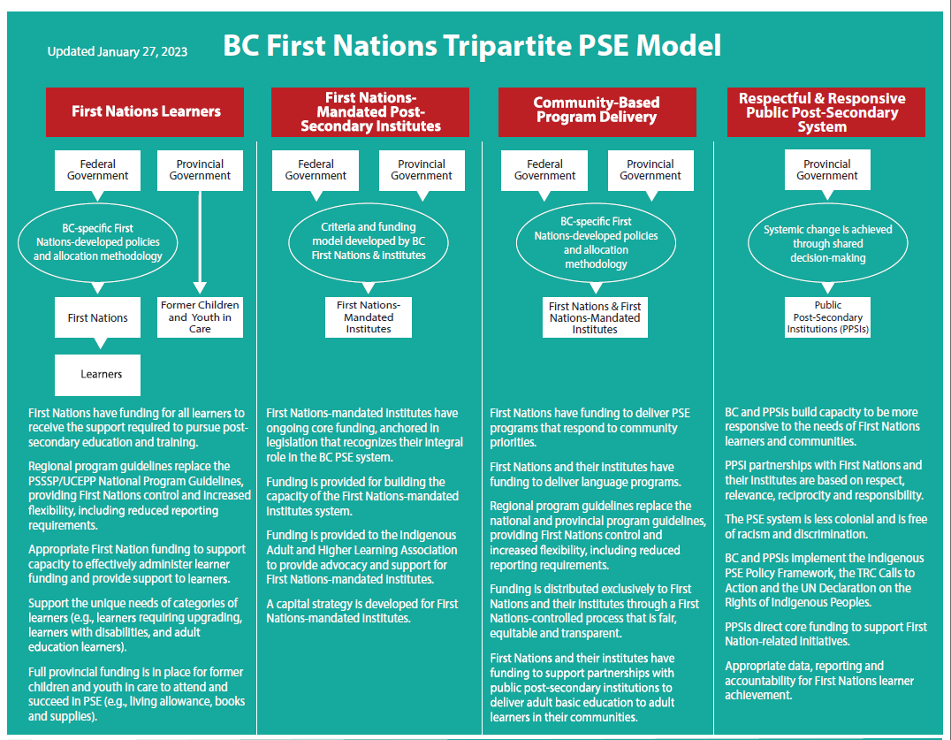

Slide 14
First Nations Leadership Resolutions
As this work has progressed, FNESC and IAHLA have sought support from First Nations leadership through resolutions to ensure the BC PSE Model is developed under their direction and their vision for First Nations post-secondary education.
In spring 2022, the First Nations Summit (FNS), the British Columbia Assembly of First Nations (BCAFN), and the Union of British Columbia Indian Chiefs (UBCIC) passed resolutions supporting the continued development of the BC PSE Model.
These resolutions confirmed First Nations leadership’s support for the BC PSE Model’s four pillars, recognizing that the BC PSE Model will evolve as further direction is received from First Nations.
These three political organizations represent First Nations leadership in BC and provide direction to FNESC on education matters.

Slide 15
First Nations Leadership Resolutions
In Fall 2023, FNESC and IAHLA submitted resolutions seeking support from First Nations leadership to:
  Call on the province of British Columbia to commit stable and predictable multi-year funding that meets the need for community-based delivery of post-secondary programs in First Nations communities, to be administered through a First Nations-controlled process that is equitable, accountable and transparent;
  Call on FNESC to develop regional policy and guidelines, under the direction of First Nations, for the administration of both federal and provincial funding for First Nations community-based delivery of post-secondary programs that will supersede existing policies and guidelines established by the federal and provincial governments;

Slide 16
First Nations Leadership Resolutions
  Call on the province of British Columbia to provide increased and ongoing funding for the Indigenous Language Fluency Degree to implement DRIPA Action 4.30 and meet the urgent need to address language revitalization and the need for fluent language speakers;
  Call on the provincial government to provide increased and ongoing funding for teacher education programs, consistent with DRIPA Action 4.2 to be delivered in First Nations communities to meet the immediate and urgent need for First Nations teachers and First Nations language teachers to be administered through a process jointly determined with First Nations.
These resolutions have been passed by BCAFN, UBCIC, and FNS.

Slide 17
Ongoing First Nations Direction and Involvement
Work on the development of the BC PSE Model continues to be informed by engagement and direction from First Nations and meetings with First Nations-mandated institutes, including at the following sessions:
  Provincial PSE Gathering (2018, 2023, and upcoming in 2024)
  Annual Post-Secondary Education Coordinator Regional Workshops
  Annual FNESC Regional Sessions
  IAHLA’s Annual General Meetings and Conferences
  FNESC Board of Directors Meeting specific to post-secondary education (2023)

Slide 18
Overview of the BC First Nations Tripartite PSE Model

Slide 19
Pillar One: First Nations Learners
The vision under the First Nations Learners pillar is that:
First Nations have funding for all learners to receive the support required to pursue post-secondary education and training.
Appropriate First Nation funding to support capacity to effectively administer learner funding and provide support to learners.
Regional program guidelines that replace the PSSSP/UCEPP National Guidelines, providing First Nations control and increased flexibility, including reduced reporting requirements.
Support for the unique needs of categories of learners (e.g., learners requiring upgrading, learners with disabilities, and adult education learners).
Full provincial funding in place for former children and youth in care to attend and succeed in PSE (e.g., tuition living allowance, books and supplies).

Slide 20
Pillar Two: First Nations-Mandated Post-Secondary Institutes
The vision under the First Nations-Mandated Post-Secondary Institutes pillar is that:
First Nations-mandated Institutes have secure and ongoing core funding from the Province, anchored in legislation that recognizes the integral role of First Nations-mandated institutes in the BC PSE system.
Funding for building the capacity of First Nations-mandated institute system.
Funding for IAHLA to continue its advocacy and support for First Nations-mandated institutes.
Development of a capital strategy for First Nations-mandated institutes.

Slide 21
Pillar Three: Community-Based Program Delivery
The vision under the Community-Based Program Delivery pillar is that:
First Nations and their institutes have funding to deliver PSE programs that respond to community priorities, in particular adult basic education and language programs.
First Nations and their institutes have funding to support partnerships with public post-secondary institutions to deliver adult basic education to adult learners in their communities.
Funding is distributed exclusively to First Nations and their institutes through a First Nations-controlled process that is fair, equitable and transparent.
Regional program guidelines replace the national and provincial program guidelines, providing First Nations control and increased flexibility, including reduced reporting requirements.

Slide 22
Pillar Four: Respectful and Responsive Public Post-Secondary System
The vision under the Respectful and Responsive Public Post-Secondary System pillar is that:
BC and public post-secondary institutes build capacity to be more responsive to the needs of First Nations learners and communities.
Partnerships between public post-secondary institutes and First Nations and their institutes are based on respect, relevance, reciprocity, and responsibility.
The PSE system is less colonial and free of racism and discrimination.
BC and public post-secondary institutes implement and Indigenous PSE Policy Framework, the Truth and Reconciliation Calls to Action, and the UN Declaration on the Rights of Indigenous Peoples.
Public post-secondary institutes direct core funding to support First Nations-related initiatives.
Appropriate data, reporting and accountability for First Nations learner achievement.

Slide 23
Recent Developments

Slide 24
First Nations Children and Youth in Care Protocol
In 2020, the First Nations Children and Youth in Care (CYIC) Protocol was signed between First Nations Leadership Council, FNESC, and the provincial government, and commits the signatories to work together to advance and improve the education experiences and outcomes for all current and former First Nations children and youth in care in the K-12 and post-secondary system through legislative, policy, and practice reform.
The CYIC Protocol Working Group developed a workplan, which has been approved by the Oversight Table (consisting of First Nations Leadership and Provincial Ministers).
FNESC is advocating for change, including:
  Robust data collection, monitoring, and public reporting.
  Dedicated K-12 funding for children and youth in care.
  Full post-secondary funding, including expanding the Provincial Tuition Waiver Program, and prioritizing student housing beds.
  Legislative and policy reform.

Slide 25
Core and Capacity Funding
In March 2021, the Ministry of Post-Secondary Education and Future Skills provided $4 million in one-time core-funding out of 2021-22 surplus funding. In March 2022, the Ministry once again provided $4 million in one-time core funding for 2022-23.
FNESC, working with IAHLA and the Ministry, administered this funding to institutes that met agreed-upon eligibility criteria.
In May 2023, the Province committed $6 million in core funding annually for eligible First Nation-mandated institutes and $450,000 per year to provide capacity funding.
However, this commitment is inadequate to respond to the needs of First Nations. Funding must increase over time as the First Nations-mandated institutes system develops, as more institutes become eligible for funding, and as the cost of providing the full breadth of programs and services is determined.
FNESC and IAHLA anticipate bringing forward provincial legislation this spring to fulfil the government's current mandate (DRIPA Action 1.8).

Slide 26
Indigenous Language Fluency/Proficiency Degree
In 2011, Dr. Jeannette Armstrong completed A Discussion Paper: A First Nation Language Fluency Degree (Discussion Paper), which set out a framework for a new degree program that would create fluent speakers of First Nations languages and support language revitalization.
In 2019 and 2022, FNESC received funding from the Ministry of Post-Secondary Education and Future Skills to administer to six First Nations and First Nations institutes that were developing and delivering programing aligning with the framework.

Slide 27
Bachelor of Nsyilxcn Language Fluency
In June 2023, the first cohort of 8 learners who completed the Bachelor of Nsyilxcn Language Fluency had their graduation ceremony. They were also the first cohort of students to complete the full degree program under the framework.
Two more language fluency degrees, the Bachelor of Nłeʔkepmx Language Fluency and the Bachelor of St’át’imc Language Fluency Degree, have received Ministerial approval. The final two years of the program commenced in the Fall of 2023 at UBC Okanagan.
Other BC First Nations have expressed interested in implementing this program.

Slide 28
Indigenous Teacher Recruitment and Retention
Approximately 5,500 Indigenous teachers are needed to be proportional with the number of Indigenous students in BC public schools. It is estimated that only about 500 Indigenous teachers are working in public schools.
FNESC is currently working with the Ministries of Education and Childcare, and Post-Secondary Education and Future Skills to develop an Indigenous teacher recruitment and retention strategy.
FNESC is advocating for funding for community-based delivery of teacher education programs.

Slide 29
External Review of Anti-Indigenous Racism
Public post-secondary campuses and BC public schools continue to fall short of providing First Nations students with safe, welcoming and nurturing learning environments.
As part of the Declaration Act Action Plan, the Ministries of Education and Child Care and Post-Secondary Education and Future Skills will conduct an independent external review of Indigenous-specific racism and discrimination in the public education system and create a strategy, including resources and supports, to address findings.
The commitment is supported by resolutions passed in 2021 by the Union of BC Indian Chiefs, First Nations Summit and BC Assembly of First Nations.
First Nations leadership and Provincial Ministers met on November 23, 2023. A technical table was established to support leadership to implement this review.

Slide 30
Indigenous-Focused Graduation Requirement
Starting in the 2023-24 school year, all secondary students will be required to complete 4 credits of Indigenous-focused coursework in order to graduate.
The change to the graduation program represents a systemic shift in education and a meaningful step toward reconciliation. The requirement is also an important component of a wider strategy to address racism in public institutions.
First Nations and FNESC have been advocating for this important change for a number of years, with formal support from the BC School Trustees Association, the BC Teachers’ Federation, the BC Association of Institutes and Universities, and the First Nations Leadership Council.

Slide 31
Bill 40
On October 25, 2023, BC announced new legislation that supports the implementation of key commitments included in the Declaration Act Action Plan and the BC Tripartite Education Agreement.
Co-developed with FNESC, the amendments to the BC School Act are aimed at improving First Nation student learning outcomes through effective relationships and processes that respect the inherent authority and role of First Nation governments, parents and communities in the education of their children and youth.
The amendments to the School Act have three main elements:
  Local Education Agreements
  Indigenous Education Councils
  First Nations Schools of Choice

Slide 32
Next Steps

Slide 33
Next Steps – Provincial Post-Secondary Education Gatherings and Beyond
On March 10 2023, FNESC hosted a provincial Post-Secondary Education (PSE) Gathering in which 116 participants from 64 First Nations in BC attended to discuss legislative, policy and funding considerations related to all four pillars of the BC PSE Model.
FNESC is planning the next PSE Gathering to be held this year which we will continue to advance the discussions related to the BC PSE Model and discuss legislative, policy and funding considerations related to the Model.
FNESC will continue to work collaboratively with the province to implement commitments under the Declaration Act Action Plan, including co-development of policy and legislation.
FNESC will also continue to work with BC First Nations on the development and implementation of the BC specific PSE Model.

Slide 34
Questions and Comments

Slide 35
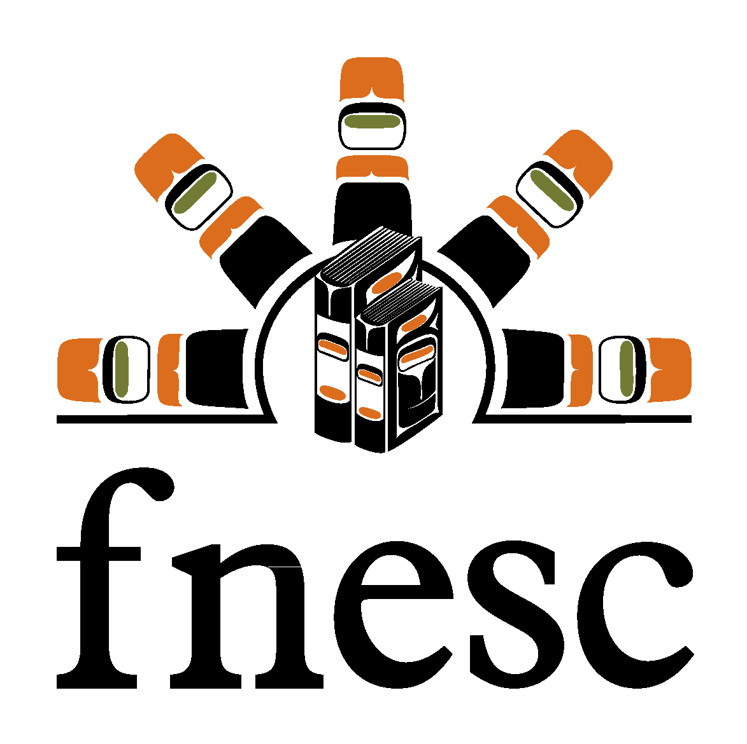
Contact
First Nations Education Steering Committee
113-100 Park Royal South, West Vancouver
info@fnesc.ca
1-877-422-3672 / 604-925-6087
Thank you for your commitment to
First Nations education.

