Slide 1
Nanâtohk Mîciwin
Universal
School Food Strategy
A successful model
Brady Weiler
Vern Sylvester

Slide 2

Community Engagement Dialogue Tables
Maskwacîs
4 nations; Montana, Louis Bull, Samson and Ermineskin
Approximately 17,000 band members.
Notes:
Events at MCC Book Day & Treaty Day Celebrations

Slide 3
Formation of Maskwacis Education Schools Commission (MESC)
2018
Maskwacis Education Schools Commission was Formed
The Four Nations agreed to form a Single Schools Commision to operate at arm's length from local government.
Formed with the Combined Strength and Cooperation of all Four Nations
Common goal of customizing education to meet the need to nurture and protect Cree language and culture.
Curriculum launched in all Schools for the 2018-19 School year

Slide 4
4 Nations
10 Schools
1 Vision
Maskwacis Cree High School
Maskwacis Cree Jr High School
Nipisihkopahk Elementary School
Grace Marie Swampy Primary School
Theresa C. Wildcat Early Learning Centre
Ermineskin Elementary School
Maskwacis Outreach School
Kisipatinahk School
Mimiw Sakahikan School
Meskanahk Ka Nipa Wit School

Slide 5
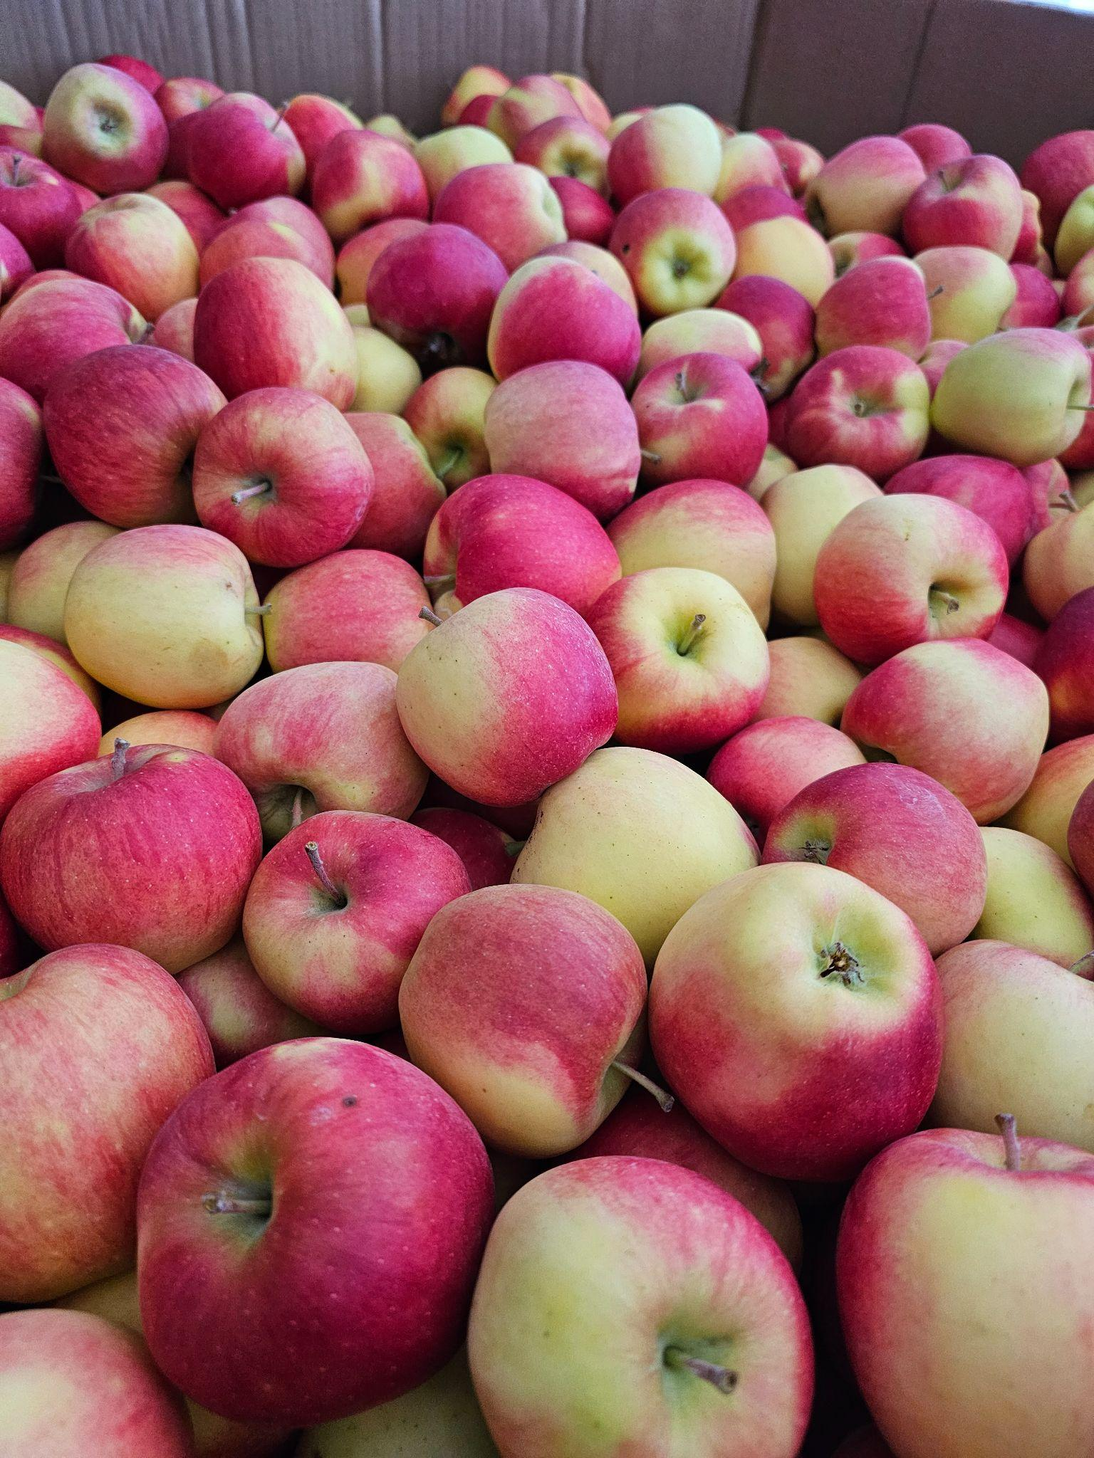
Need for Nutrition
2012
2018
Principal and the Superintendent identified the need for school food program
An Ambitious Foods Teacher with 32 students and two staff successfully fed 315 students daily breakfast/lunch/snacks.
Transitioned to prepare and serve breakfast/lunch/snacks to an additional 425 students at the neighbouring elementary school.
Efficiencies were made.
Eliminated the availability of unhealthy food and beverages
Nanatohk Miciwin Universal School Food launched in all schools for all students.
Notes:
Jonas Applegarth Theatre

Slide 6
Vision
School food program that meets essential nutritional needs of all students from k-12
Celebrate Nehiyaw culture and values
Facilitate career pathways of culinary students
Build and maintain a sustainable local food system with food producers
Contribute to community food security
Notes:
Jonas Applegarth Theatre

Slide 7
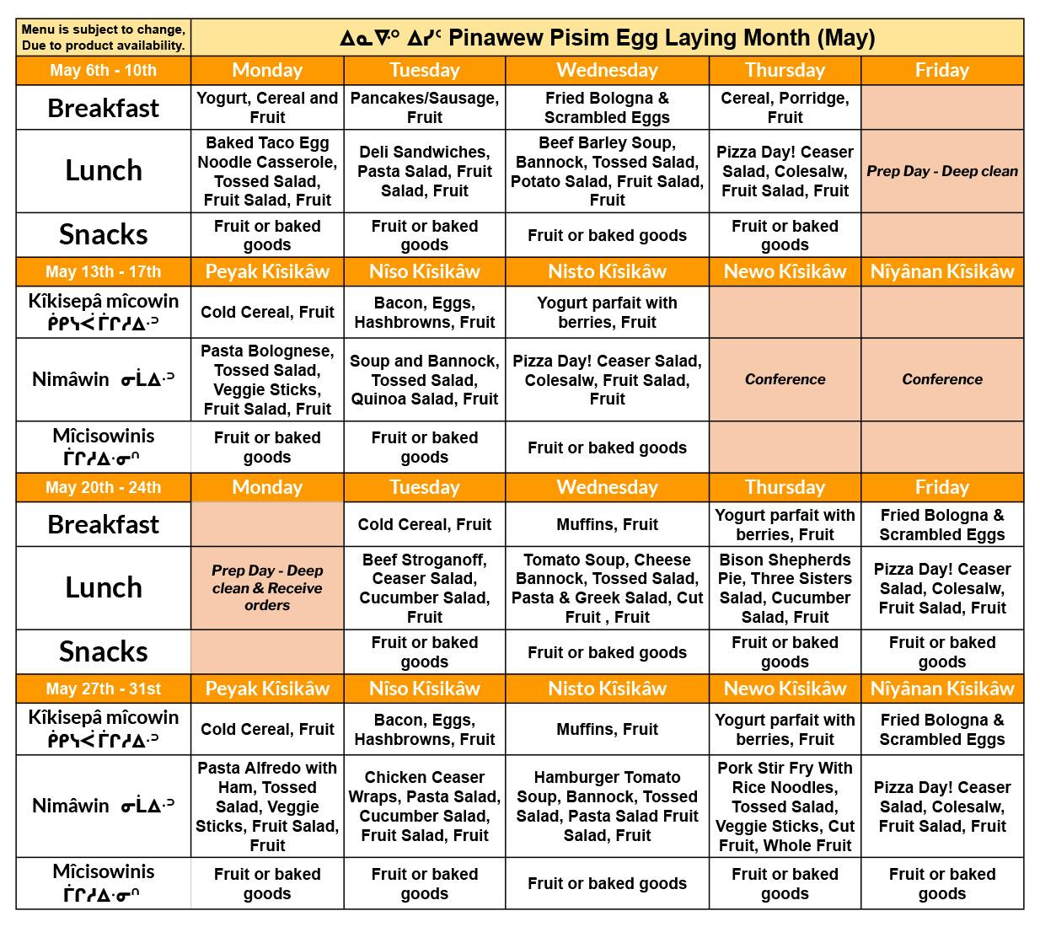
Today
Over 2300 students and over 500 staff members
Healthy nutrient dense, scratch made food choices are available in abundance to all 2300 students K-12 in all 10 Schools.
90% of the Nanatohk Miciwin team of 31 are Indigenous peoples.
Approximately 25% of our team are students that have participated in Nanatohk Miciwin and have returned to work with us in full time positions with full benefits and a living wage.
Apprenticeship opportunities and support offered to our team.

Slide 8
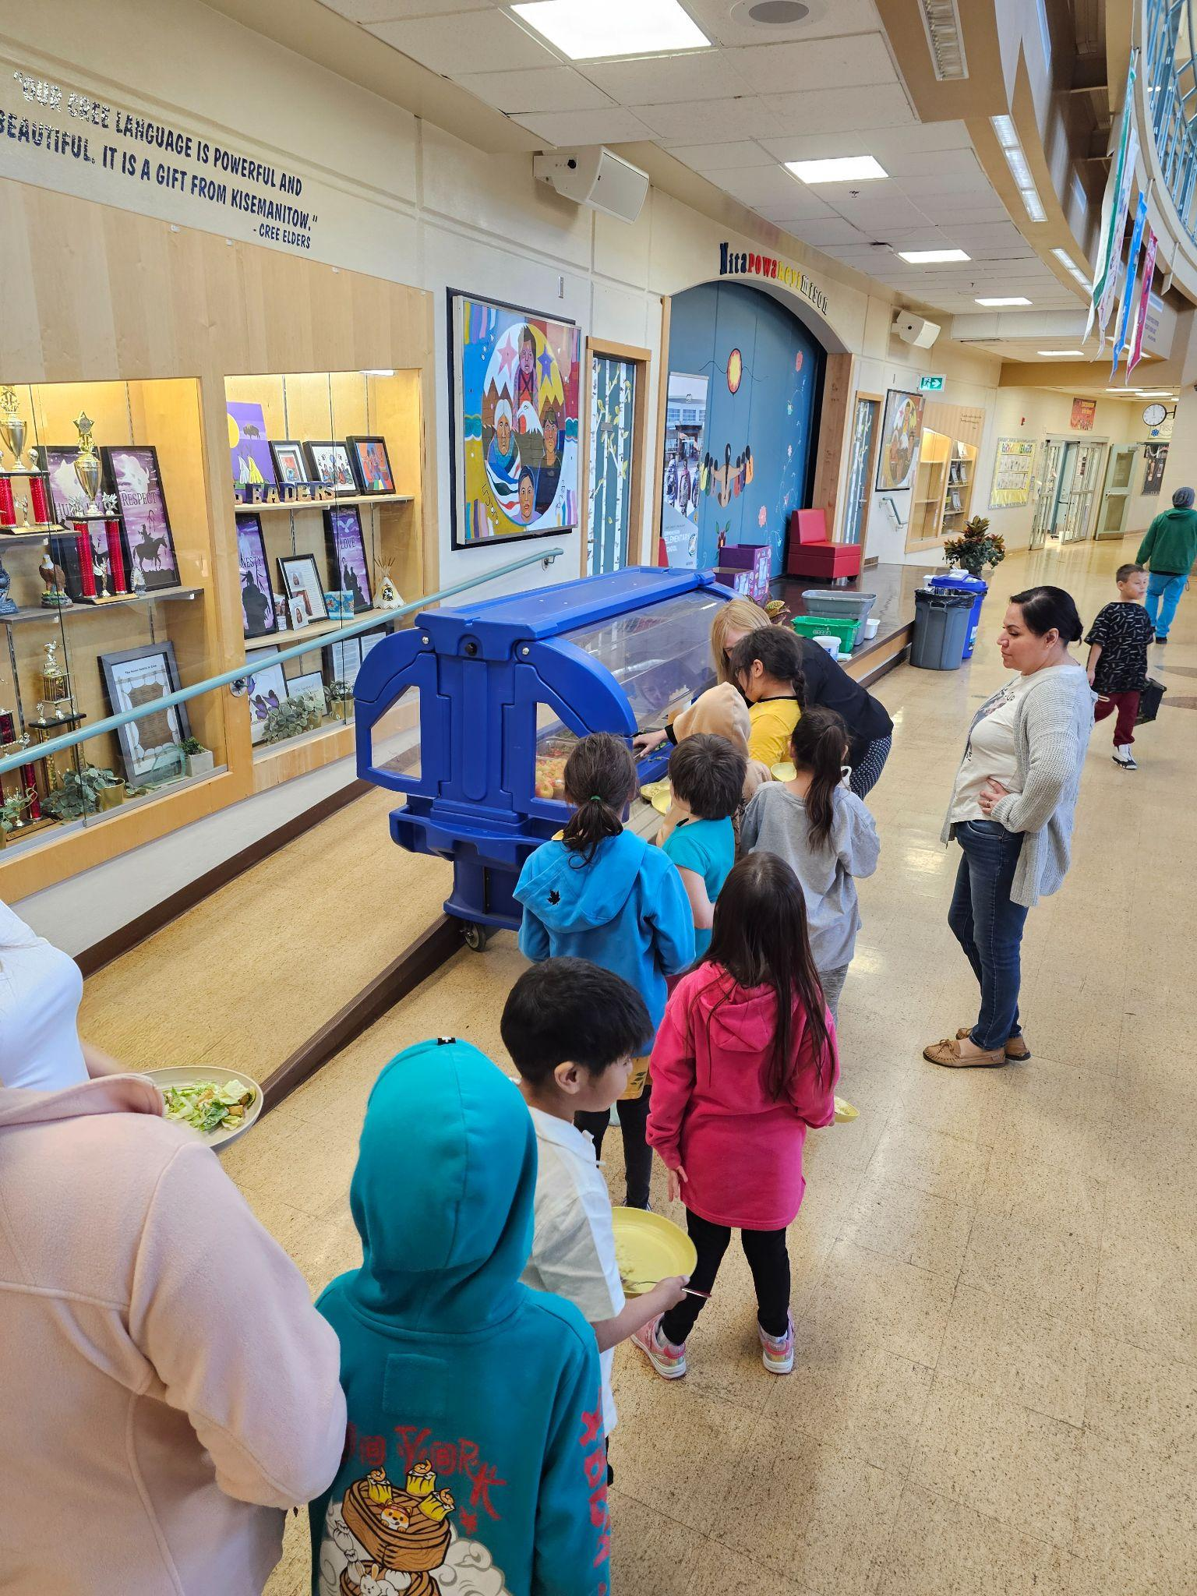
More than a meal…
Mealtime is a daily opportunity to practice “Wahkohtowin” - the the spirit of kinship
The blessings and prayers that come with the food gifted from mother earth are shared with those who prepare it and receive it.
Sharing meals is also recommendation of the Canada Food Guide

Slide 9
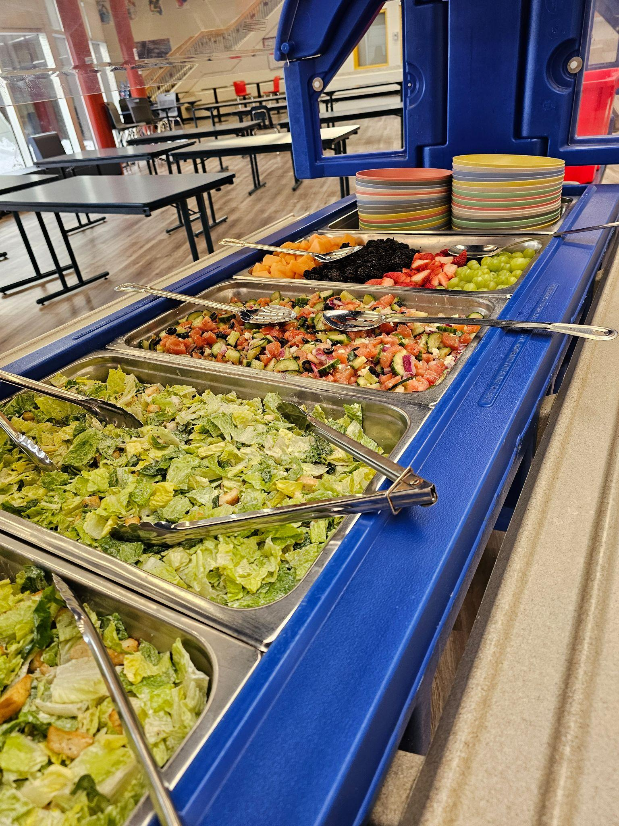
Shared mealtimes with students in school offer substantial benefits for their social, emotional, and educational development, as well as promoting healthier eating habits and a stronger sense of community..
Shared Meals are a great way to share food traditions
and create new ones.

Slide 10
Social and Emotional Growth
Shared meals foster social skills, empathy, and communication.
Students practice patience, cooperation, and respectful conversation, which helps build emotional intelligence and stronger interpersonal relationships.
Eating together supports relationship-building, a sense of belonging, and community within the school environment.

Slide 11
Healthy Eating Habits
Sharing meals encourages students to try new, healthy foods as they observe their peers making positive choices.
Group mealtimes are linked to more balanced diets, increased fruit and vegetable intake, and the reduction of picky eating behaviors.
Family-style or communal meals allow students autonomy in food choices, helping establish lifelong healthy eating patterns

Slide 12
Improved Academic Performance
Students who receive nutritious meals tend to have better attention spans, memory, and problem-solving skills in class.
Reducing food insecurity and hunger helps students concentrate and fully engage with schoolwork.
Improved Focus and Cognitive Function
Higher Grades and Achievement
Increased Attendance and Reduced Absenteeism
Emotional and Social Stability

Slide 13
Behavioral and Attendance Effects
Shared meals foster routines and positive behaviors, such as self-regulation and cooperation, while also increasing attendance and participation in class activities.
Students who regularly participate in communal meals demonstrate fewer behavioral problems and greater classroom engagement.

Slide 14
Key Components of Our Success
Foodservice Industry Professionals
2 homegrown Journeyman Cooks Graduated June 2024!
3 more staff will complete 2nd year cook apprentice training( June-26)
Central Warehousing and Distribution
Dedicated logistics team
7500 Square foot warehouse with dock level access
Up to 12 pallets (6 tonnes) of Fresh Produce and Dairy products
Freezer space for up to 2 tonnes of Frozen Proteins(meat), frozen fruit and vegetables
Fleet of 6 vehicles for pickup and delivery of food to each kitchen and transporting food to neighbouring schools from hub kitchens
Maintain relationships with local farmers to support a Local Food System

Slide 15
Key Components of Our Success
Transportation Department
Our greatest support!
Our transportation team provides essential professional service and maintenance of our fleet
They are a key factor in our ability to keep our program running smoothly.
Nanatohk Miciwin would not be nearly as reliable without them.

Slide 16
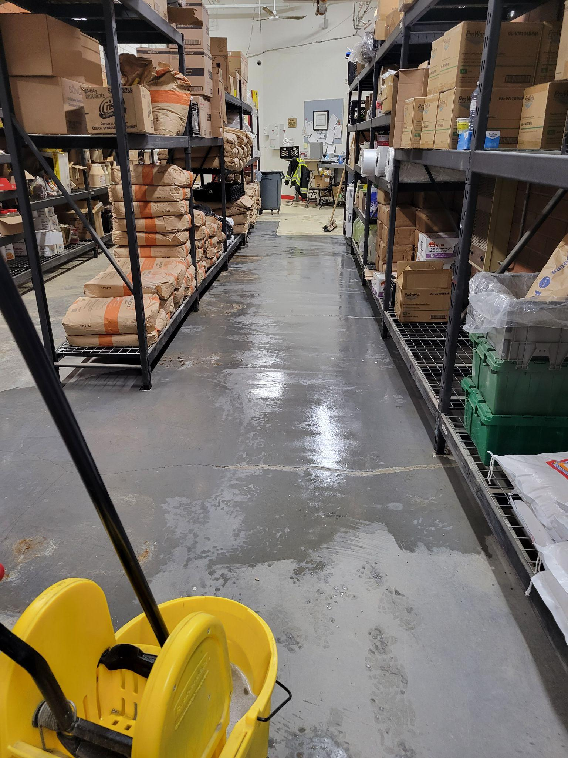
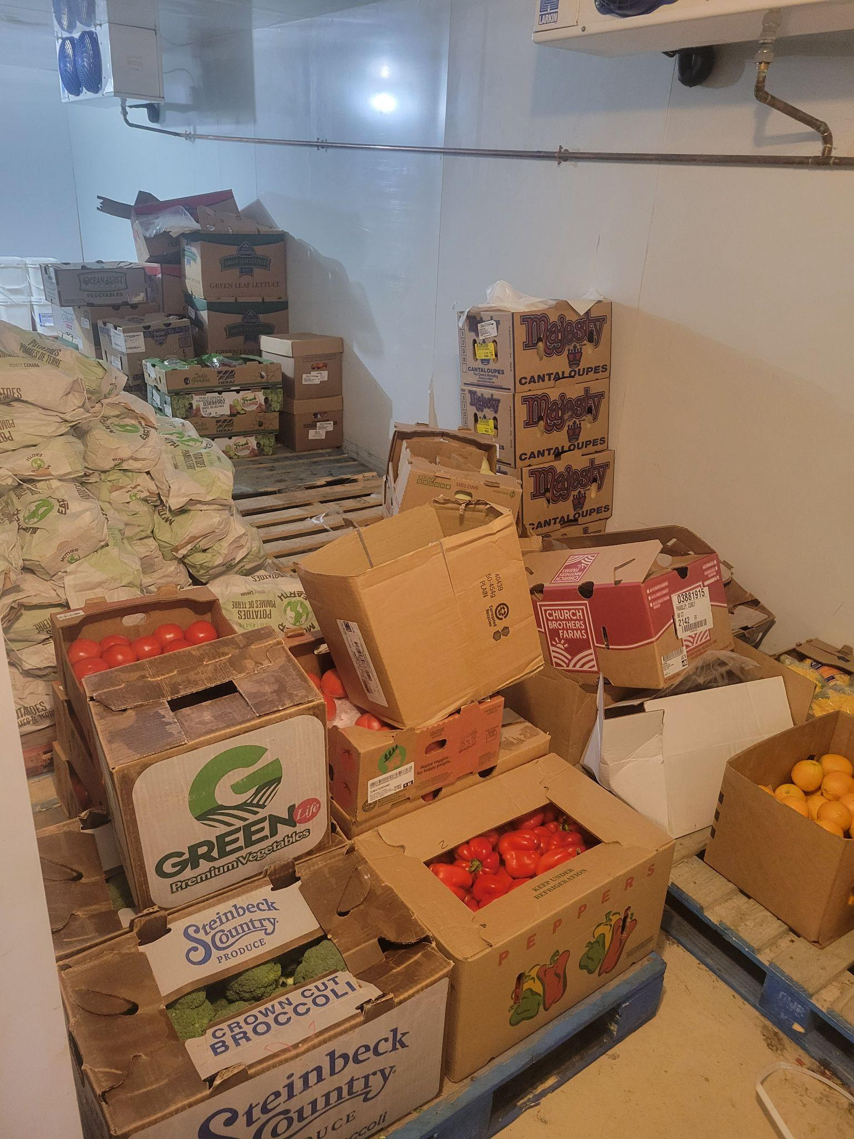
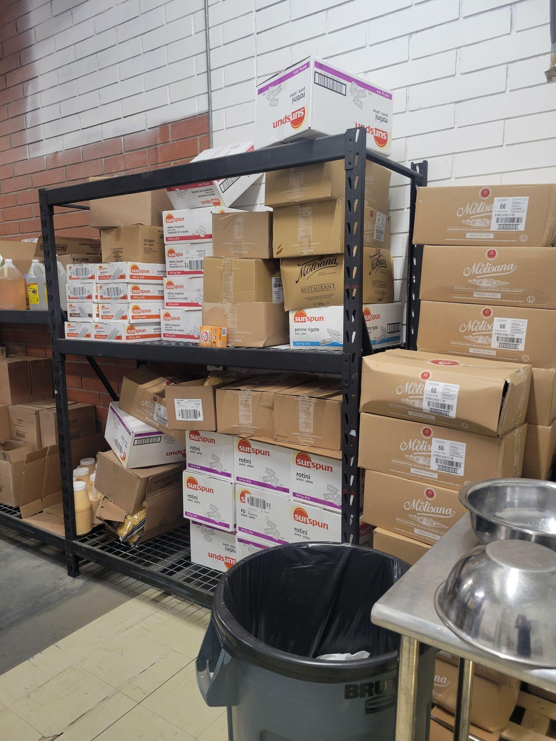
Central Warehouse

Slide 17
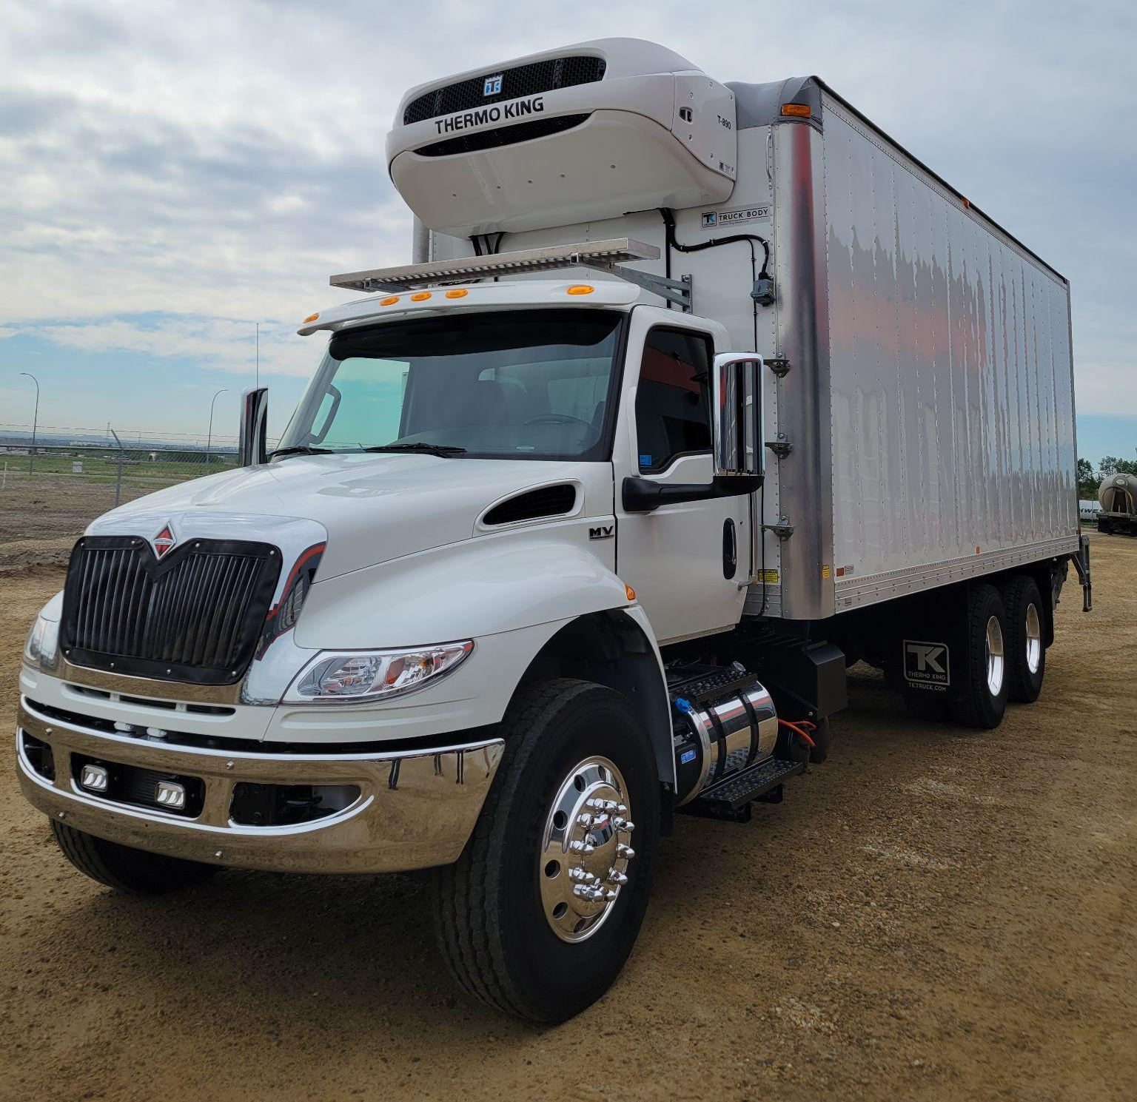
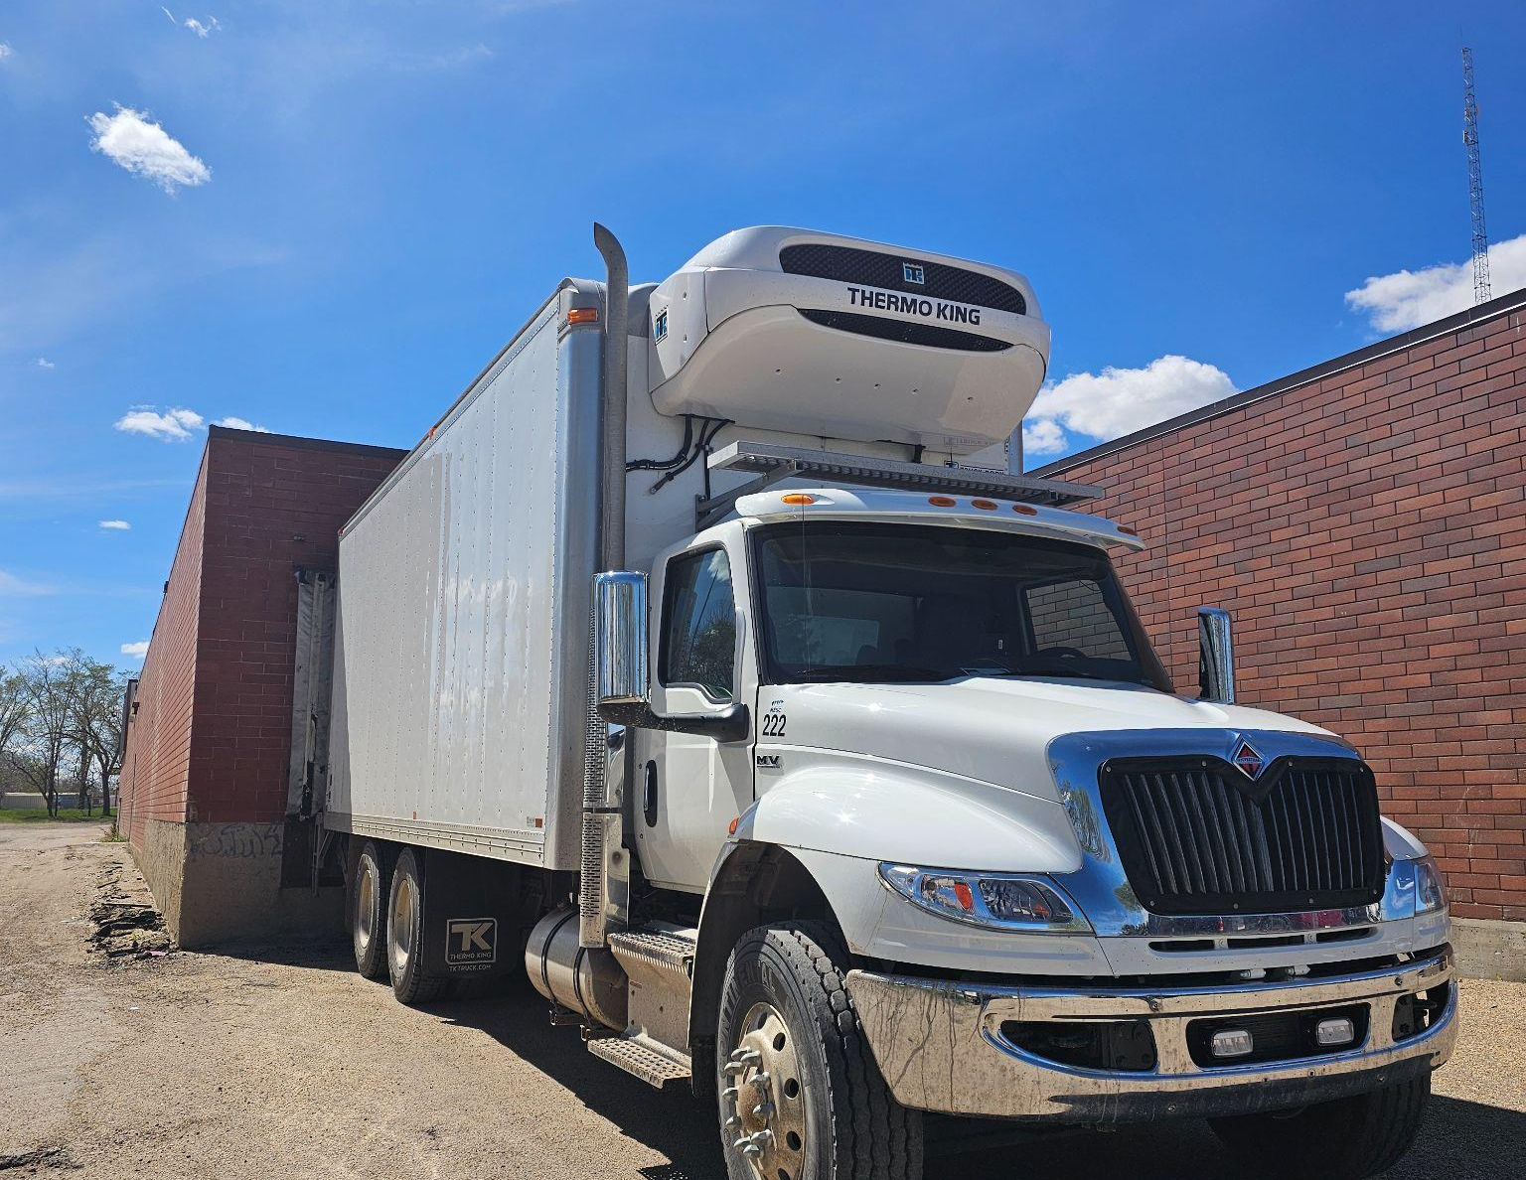
Pick up and Delivery of Foodstuffs

Slide 18


Average cost:
per person per day 2025-2026
school year
Food cost = $1.84
All in cost - $5.95
Less than the cost of a cup of fancy coffee

Slide 19
Canadian Malnutrition Task Force: Home - CMTF
Canadian Malnutrition Task Force
https://nutritioncareincanada.ca
In primary care, 1 dollar spent on nutrition interventions can save up to 99 dollars by reducing medication use, hospitalizations and freeing up physician time.
Each dollar spent on kids' nutrition can yield more than ...
University of Waterloo
https://uwaterloo.ca › public-health-sciences › news › e...
“Over an adult's working life, we can expect that one dollar spent on early childhood nutrition will on average have $45 worth of benefits in low and middle- ...
Federal budget pledges a Canadian school food program ...
Dalhousie University
https://www.dal.ca › News & Events › March 2019 › 25
Mar 25, 2019 — Internationally, school food programs have an impressive return on investment — three dollars to $10 for every dollar invested — including the ...
Nutrition in developing countries
Affaires mondiales Canada
https://www.international.gc.ca › world-monde › nutriti...
Dec 3, 2021 — It is estimated that every dollar spent on nutrition for a child sees an average return of $30 over their adult life.

Slide 20
A few facts
On average the program provides up to 5000 meals and 4000+ snacks per day, that’s about 25,000 meals and snacks each per week.
Thats 1,000,000 meals /year
Nanatohk Miciwin is maintained with school funds within the operating budget. We do not solicit donations . We have a budget and work hard to stay within it while providing the best and freshest nutrient dense foods available
The majority (90%) of the foodservice team are from the four nations of Maskwacis
Approximately 25% of those staff are former students that have come to work with us.
There are eight (8) kitchens with thirty (30) full time staff serving all 10 schools

Slide 21
What else do we do?
Additional services provided by Nanatohk Miciwin:
Approximately 8000 bag lunches for field trips provided to students
Provide food service for Grad and Pow Wow
Support off campus Cultural Camps with food service
Support on campus Literacy Camps in the summer months
We provide fruit, and healthy snacks for offices and transportation dept
Fill hamper requests from school counselors for at risk students.
Collect, compact and recycle approximately 1.5 tonnes of Cardboard per month
Provide food service for smaller meetings and events within MESC.

Slide 22
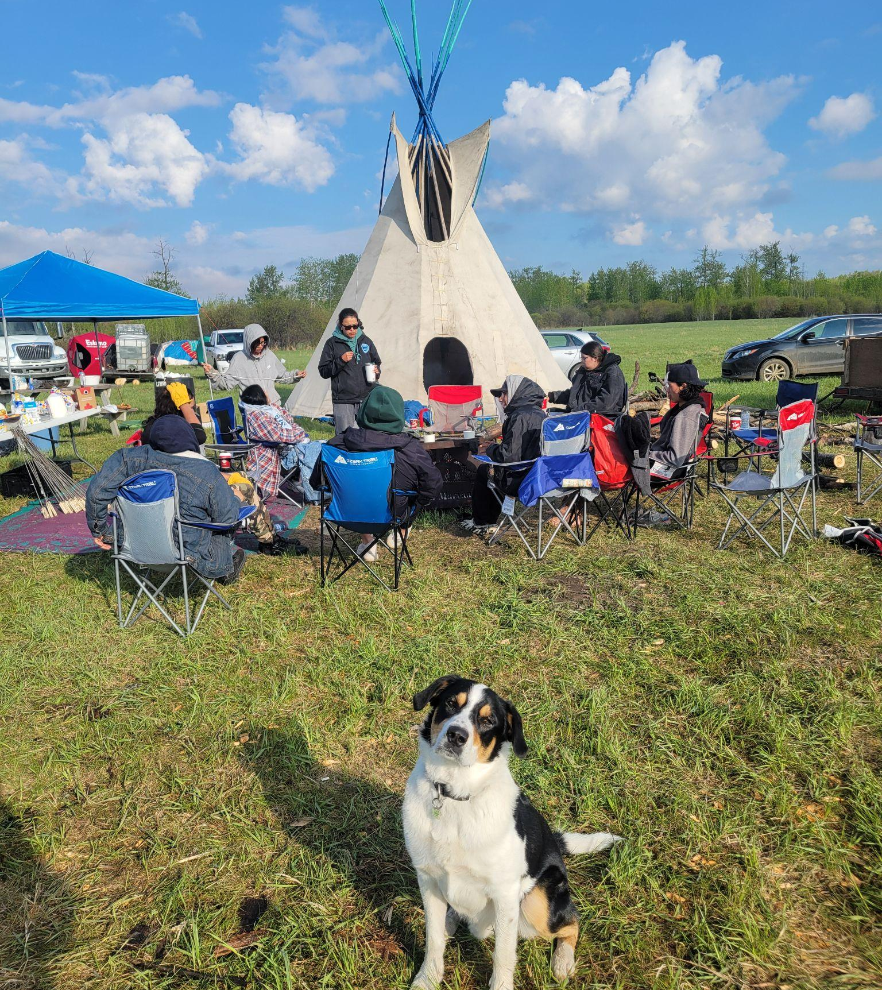

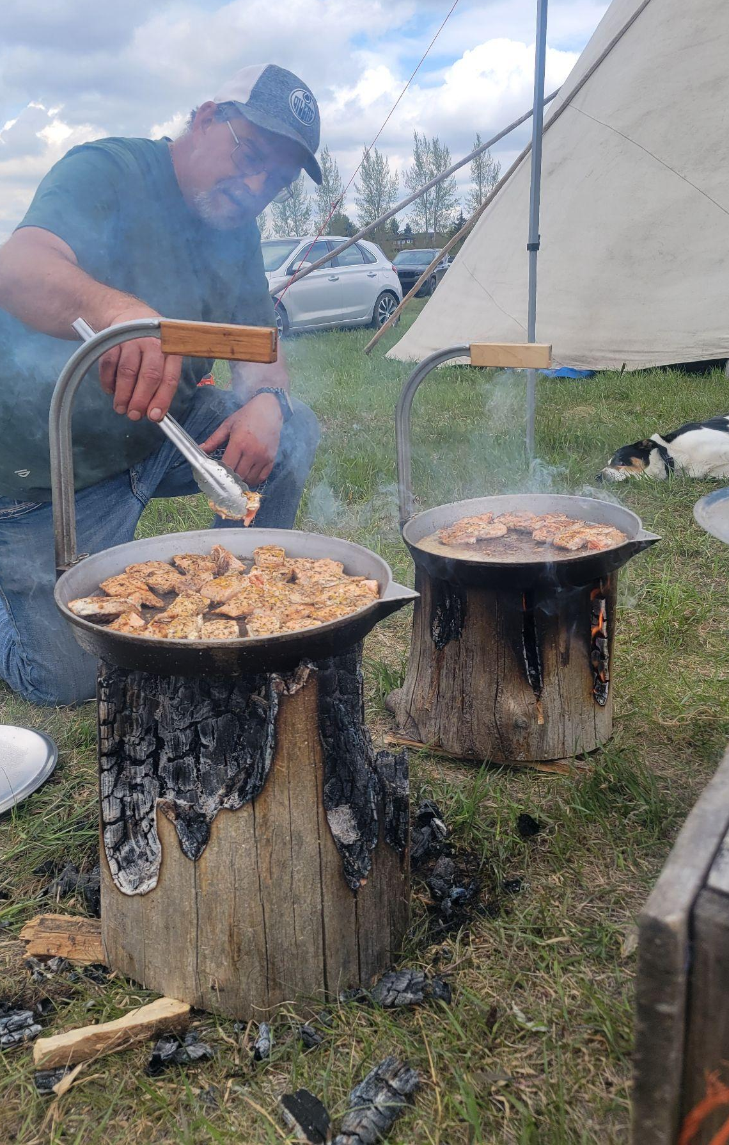
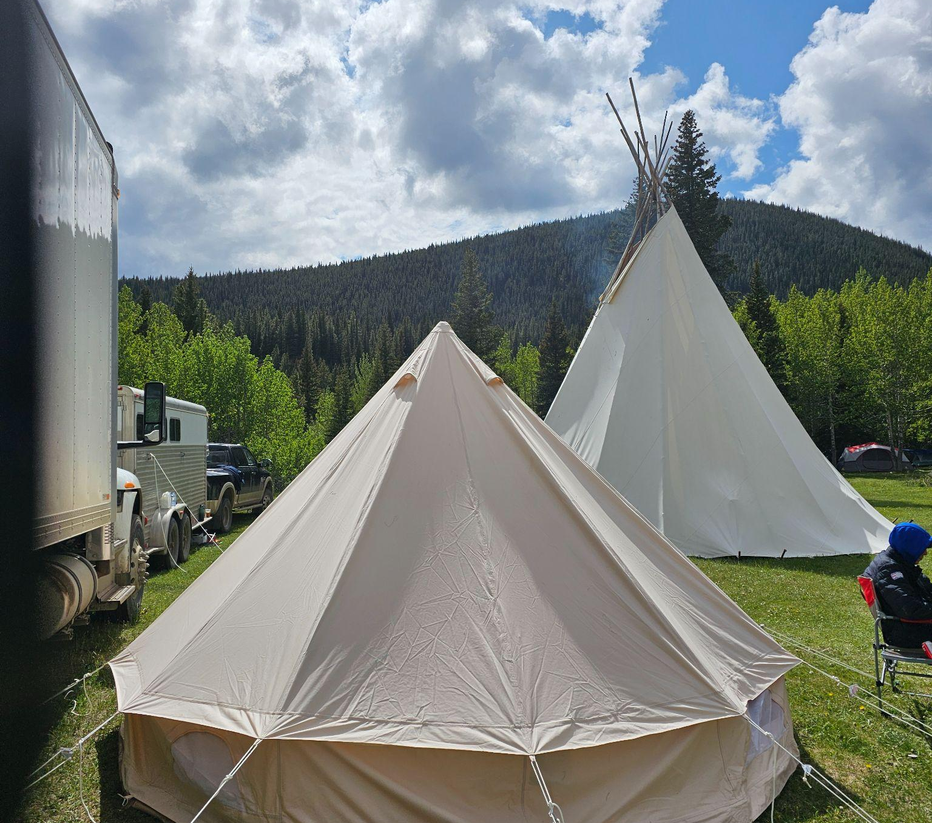
Notes:
Jonas Applegarth Theatre

Slide 23
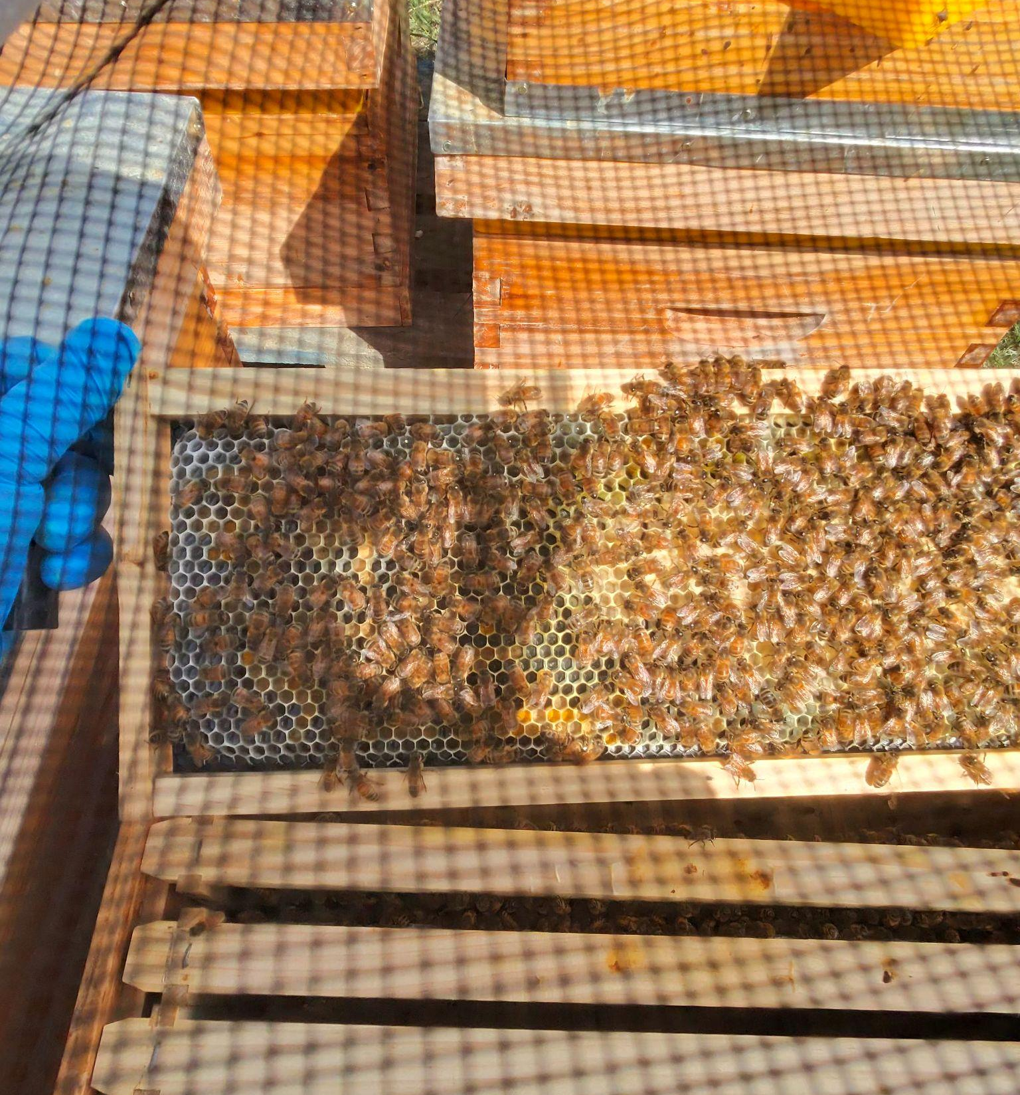
âmômey ᐋᒨᒣᕀ honey
2023 - 10 Hives introduced with a consultant - approx 400Kg of honey produced.
2024- We set out 14 hives in Maskwacis with the hope of harvesting 1.5 tonnes of honey this year. (note: we did not achieve this)
2025 - set up 20 hives and equipment to manage, harvest, and package up to 2 tonnes of honey per year. ( more learning) approx 300 lbs harvest. (Apiary devastated by EFB)
We have started a bee club and hope to entice staff and students to participate in the extraction and packaging process.
When our goal is met we will replace 50 - 70% of refined sugars used in the kitchens.
Honey is medicine Culturally and Scientifically.

Slide 24
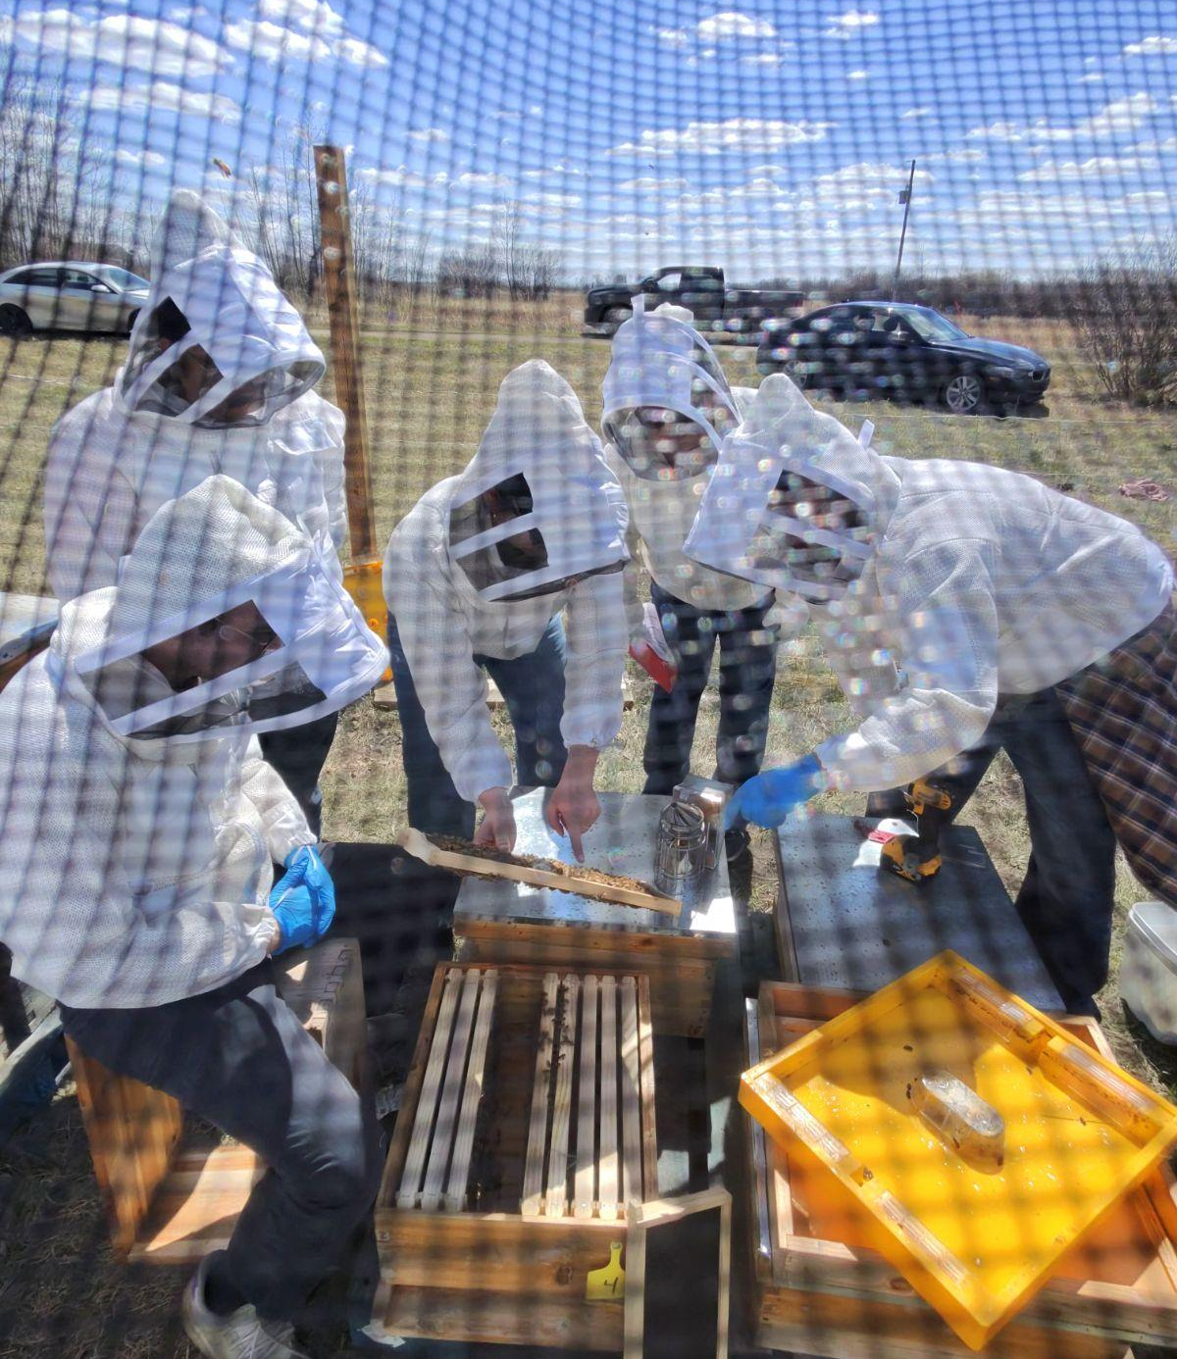
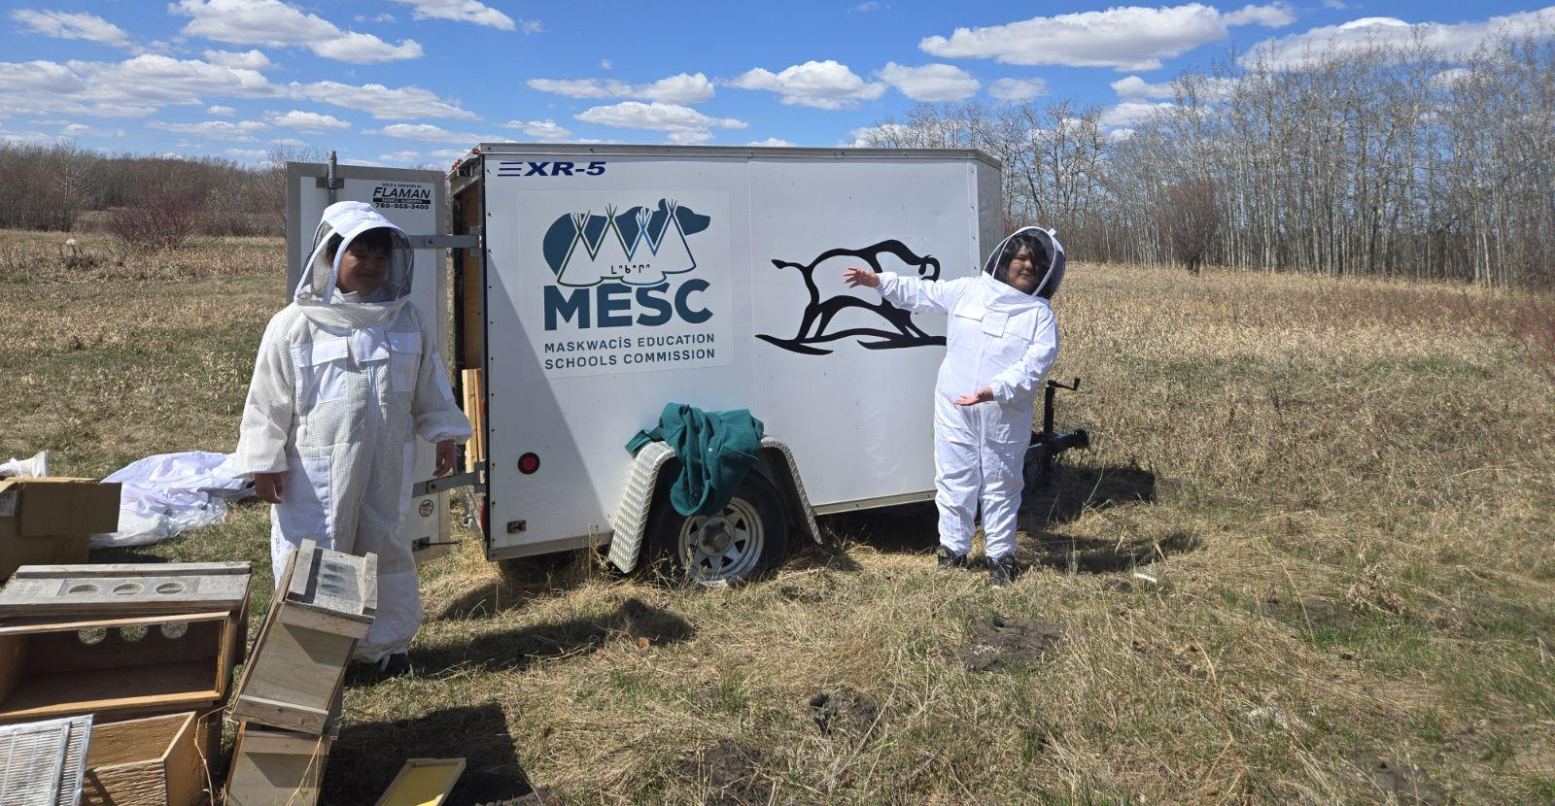
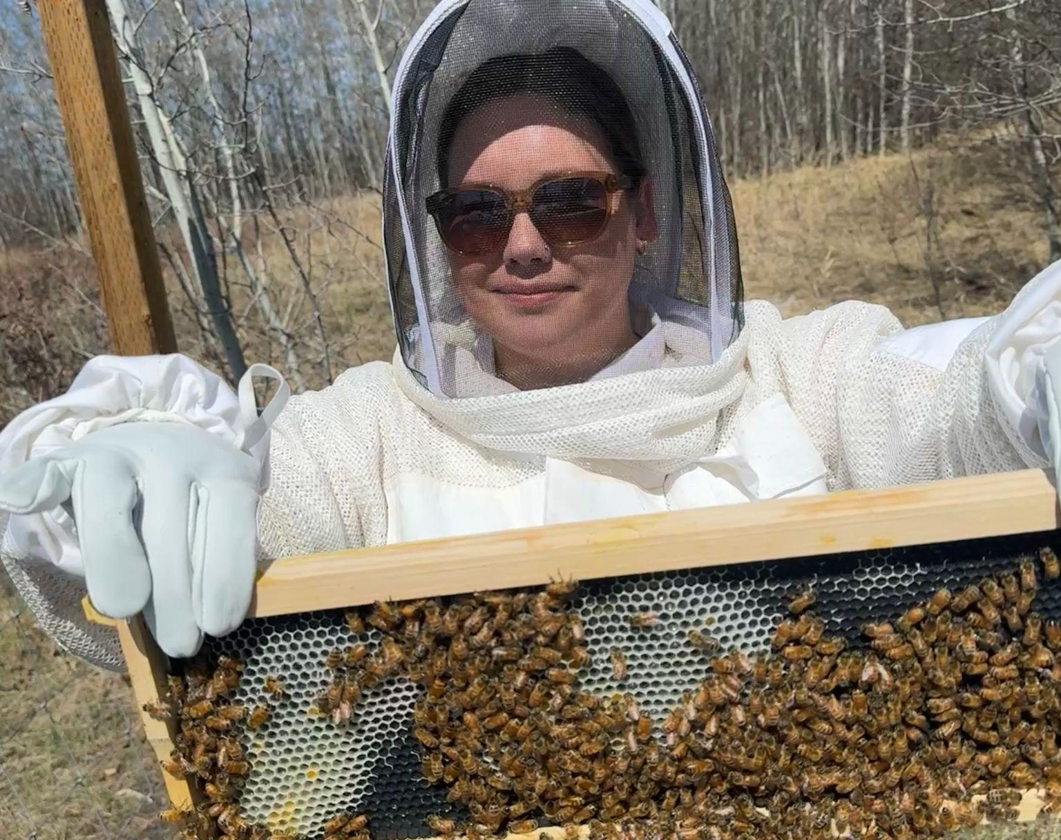

Slide 25
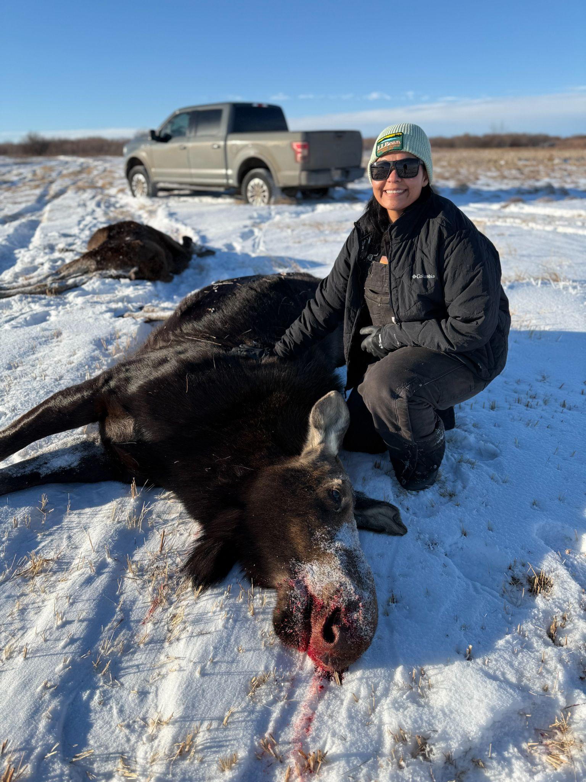
Wild Meat Program - Steps
Written consent From the MESC Circle of Elders
Presentation to the MESC Board
Acceptance of the Wild Meat Initiative
Presentation to school Principals and Head Cooks
Written parental consent for students who are minors to participate in the preparation, serving and consumption of wild meat
Information and training of Nanatohk Miciwin staff on the handling and preparation of wild meat
Information and training provided to selected hunters
First hunt
Storage facilities, kitchens and protocol meet and/or exceed inspection requirements for the processing and preparation of wild meat.
(Facilities inspected by invitation. )
Distribution, preparation and service of cooked wild meat to students and staff in a culturally appropriate and familiar way.

Slide 26
Food Security
has been addressed within
MESC Schools
Now we are taking steps towards
Food Sovereignty

Slide 27
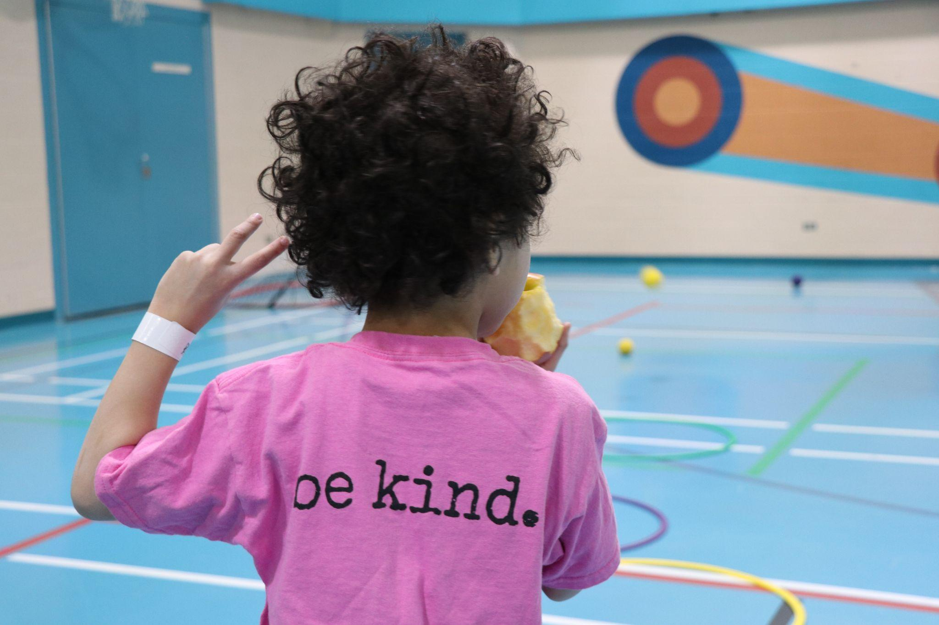
Thanks for Listening

Slide 28
Brady Weiler
Director
Nanâtohk Mîciwin
Universal School Food Strategy
Corporate Services
bradyweiler@maskwacised.ca
Schoolfood.ca

