Slide 1

Mi’kmaw Kina’matnewey
Mi’kmaw Language Plan

Slide 2
Who Are We?
-self-governing education authority delivering services to 12 First Nation communities in Nova Scotia for more than 20 years
-leading the country in graduation, retention, and success in education
- have mandate to protect, promote, and revitalize the Mi'kmaw Language in Nova Scotia
-with our Board of Directors (Chiefs of each member community), we lead in good practice and are driven by a collective language plan for service delivery in Nova Scotia
Since 2018, MK has been involved in revitalization to better meet the needs of our member communities. A new strategic plan is in place and has resulted in a revisioning, updated mission and the establishment of 4 new strategic goals and 26 recommendations:
Nurturing the spirit of all learners;
Serving our communities;
Revitalize MK to achieve our strategic goals
Language & Culture: Ta’n Teli L’nuimk.

Slide 3
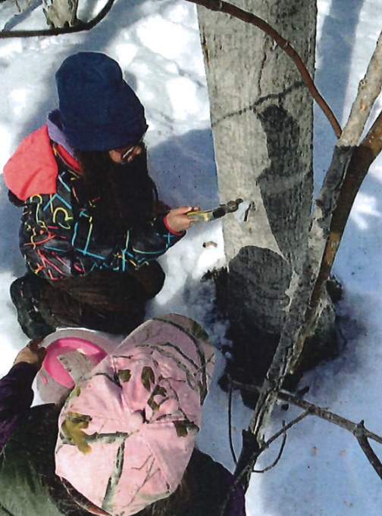
To assist and provide services to individual bands in the exercise of their jurisdiction over education.
Notes:
What do we do?

Slide 4
The objectives of Mi'kmaw Kina’matnewey are:
- To assist and provide services to individual bands in the exercise of their jurisdiction.
- To assist individual bands in the administration and management of education for the Mi'kmaq Nation in Nova Scotia.
-To provide the Mi'kmaq Nation in Nova Scotia a facility to research, develop and implement initiatives and new directions in education of Mi'kmaw people.
-To coordinate and facilitate the development of short and long-term education policies and objectives for each Mi'kmaq community in Nova Scotia, in consultation with communities.
Notes:
Who are we?

Slide 5
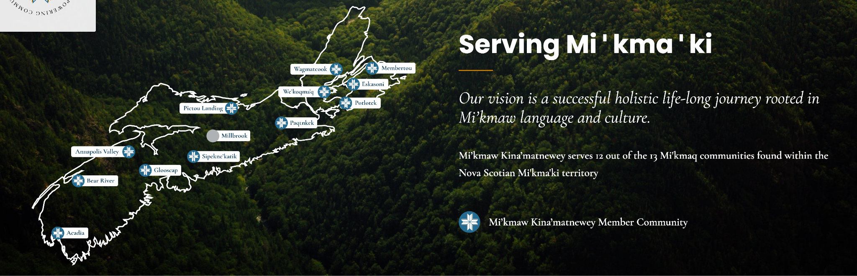
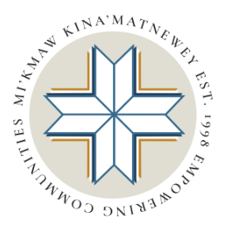
Place Holder Title of Doc
Information Governance & Data Projects

Slide 6
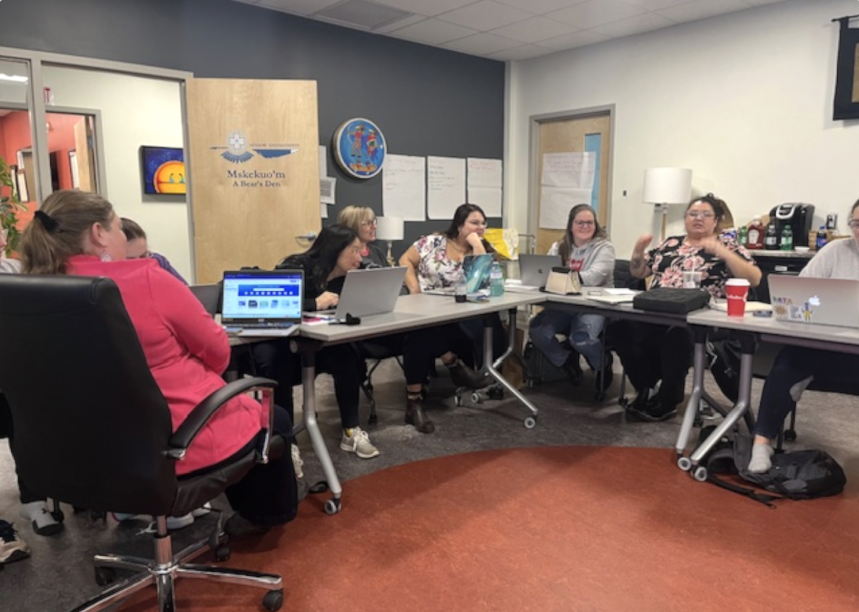
Research based, long-term strategic language plan
Notes:
The success Mi’kmaw Kina’matnewey (MK) has achieved over the past twenty years is broadly celebrated. It provides an incredible foundation on which to build. While that recognition is acknowledged and appreciated, it is noteworthy for another important reason. This success was achieved only when Mi’kmaq leadership took ownership and control over the education of Mi’kmaw youth in the twelve communities in Nova Scotia. This observation underscores the importance of First Nations leadership in creating pride and accomplishment in our language, culture and ways of living. It has been a confidence builder for our youth and stands as a national testament to the importance of Indigenous ownership and control over its institutions and processes. Has it been easy? No.
Is it finished? Absolutely not.
In fact, an emerging body of knowledge over the past twenty-years reinforces the point that harm reduction and building confidence in new generations of Mi’kmaw youth still constitutes an urgent agenda. Slowly, societal awareness around some of these truths are finding fertile ground and deeper acknowledgement and understanding. The ‘reconciliation’ process and the TRC Calls to Action have heightened awareness of the need for Indigenous self-determination. There is a deeper and growing understanding of what decolonization means and a greater respect and recognition of the fundamental importance of Indigenous knowledge – the understandings, skills and philosophies developed by societies with long histories of interaction with their natural surroundings. These are foundational to the education enterprise of which Mi’kmaw Kina’matnewey is an important steward. Ultimately, it is against this promising, yet challenging, backdrop that the Mi’kmaw Kina’matnewey strategic plan has been developed and launched. It enshrines our ‘call to action’ to continue to work on improving the quality of education for our people, while remaining vigilant in maintaining and revitalizing our Mi’kmaq language.

Slide 7
Sections 8 & 9
Notes:
The success Mi’kmaw Kina’matnewey (MK) has achieved over the past twenty years is broadly celebrated. It provides an incredible foundation on which to build. While that recognition is acknowledged and appreciated, it is noteworthy for another important reason. This success was achieved only when Mi’kmaq leadership took ownership and control over the education of Mi’kmaw youth in the twelve communities in Nova Scotia. This observation underscores the importance of First Nations leadership in creating pride and accomplishment in our language, culture and ways of living. It has been a confidence builder for our youth and stands as a national testament to the importance of Indigenous ownership and control over its institutions and processes. Has it been easy? No.
Is it finished? Absolutely not.
In fact, an emerging body of knowledge over the past twenty-years reinforces the point that harm reduction and building confidence in new generations of Mi’kmaw youth still constitutes an urgent agenda. Slowly, societal awareness around some of these truths are finding fertile ground and deeper acknowledgement and understanding. The ‘reconciliation’ process and the TRC Calls to Action have heightened awareness of the need for Indigenous self-determination. There is a deeper and growing understanding of what decolonization means and a greater respect and recognition of the fundamental importance of Indigenous knowledge – the understandings, skills and philosophies developed by societies with long histories of interaction with their natural surroundings. These are foundational to the education enterprise of which Mi’kmaw Kina’matnewey is an important steward. Ultimately, it is against this promising, yet challenging, backdrop that the Mi’kmaw Kina’matnewey strategic plan has been developed and launched. It enshrines our ‘call to action’ to continue to work on improving the quality of education for our people, while remaining vigilant in maintaining and revitalizing our Mi’kmaq language.

Slide 8
UNDRIP: 2, 3, 5, 13, 14, 31 MMIWG: 2.1, 2.2, 2.3 TRC Calls to Action: 10, 13, 14
Our proposed activities and objectives on the language work that we do directly respond to the calls to actions outlined above. We believe that at the time of birth, each child has a right to be spoken to and greeted in the Mi'kmaw language. Our activities contribute to that vision by providing strategic activities that allow us to truly understand the level of proficiency on the Mi'kmaq language in Nova Scotia and implement doable activities that begin to do the layers of work that need to be done.
Nova Scotia has passed the Mi'kmaq Language
Act effective October 1st, 2022

Slide 9
Funding Process
-applications for Section 8 & 9 funding were accepted on an ongoing basis
-Canadian Heritage ILC prioritized projects in relation to the funds available, until all funding was allocated
-MK submitted our application on May 15, 2023
-we received a decision letter on September 29, 2023
-the contribution agreement was fully signed on October 17, 2023
-over two fiscal years, Mi’kmaw Kina’matnewey will develop a common language plan and individual plans for 14 Mi’kmaw communities in Nova Scotia, as well as develop languages projects: land and sea-based training and language and culture curriculum and resources

Slide 10
Objective 1:
Language plans for 14 Mi’kmaw communities
-Language Study
-Language Plans for Individual Communities

Slide 11
Action: Language Study
-including a language assessment survey, and language attitudes survey language learning interest survey
-to determine the status of the Mi'kmaq language in Nova Scotia
-to document current human, cultural, institutional, technical, material and financial resources that support the Mi'kmaq language
-to discover language attitudes and goals of Mi’kmaw individuals
To know the status of the Mi'kmaq language across Nova Scotia and 13 Mi’kmaw communities

Slide 12
Action: Language Plans for Individual Communities
-to support planning and implementation of language projects
-to set language goals for individual communities
-to establish realistic goals and activities based on the language situation in each individual community
-a list of community goals for language development produced and an implementation plan developed
To increase the number of Mi'kmaw individuals who speak their language by increasing the opportunities to learn their
language

Slide 13
Objective 2:
Language Projects
-Land and Sean Based Training
-Language and Culture Curriculum and Resources
-Youth Empowered Speakers Program

Slide 14
Action: Land and Sea Based Training
-specialized teacher training, capacity building and professional development
-land and sea based learning resource database
-summer institutes for Educators
-to incorporate land based learning into the current curriculum
To increase the domain of Mi’kmaw
language use

Slide 15
Action: Language and Culture Curriculum and Resources
-the digitization and documentation of existing files and archives
-recording of Elders/speakers on audio and video
-general resource creation (e.g.,handbooks/videos/teaching materials)
-app, website and database creation
Language learners are using the resources
created

Slide 16
Action: Youth Empowered Speakers Program
-for youth to learn their language while preparing for a career in language revitalization
-to engage all speakers/voices in advancing language revitalization
-combining menor-apprentice learning and funding for post-secondary education.
-youth who demonstrate community involvement through language projects, cultural events or other initiatives
Youth who demonstrate a commitment to their language that extends
beyond this program

Slide 17
Wela'lioq

