Slide 1
Advancing Indigenous Higher Education and Training in Ontario through Accreditation and Credentials
Assembly of First Nations Education Forum “Reigniting the Flames of our Ancestors,” February 20, 2025
Notes:
Slide 1 - Introduction
Good morning [Greeting in language]
Thank you for the invitation to meet with you and present at the Assembly of First Nations “Reigniting the Flames of our Ancestors,” Education Forum
My name is Stephanie Roy and I am the Director of Innovation, Development and Research at the Indigenous Advanced Education and Skills Council or IAESC.
I would also like to introduce you to my colleague Sue Eckenswiller who is joining me today. Sue works with us at the council as the Senior Quality Assurance Adviser.
I am honoured to be here at the conference and learn more about the many achievements and hear about the interests and goals in education on behalf of our people.
I am here today to tell you a bit about our council and the legislation that we fall under. I am very pleased to have this opportunity to share some of the exciting work that is taking place at IAESC and the Indigenous Institutes in Ontario.

Slide 2
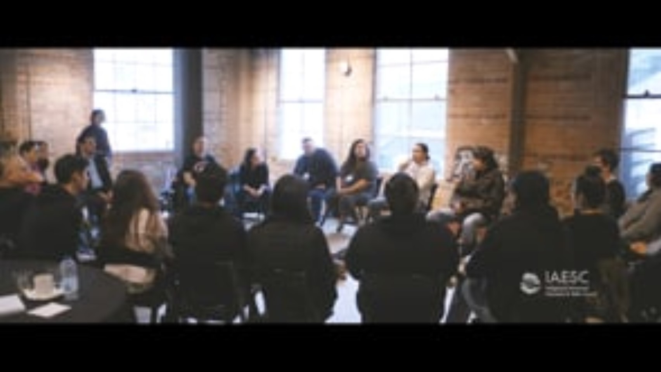

Slide 3
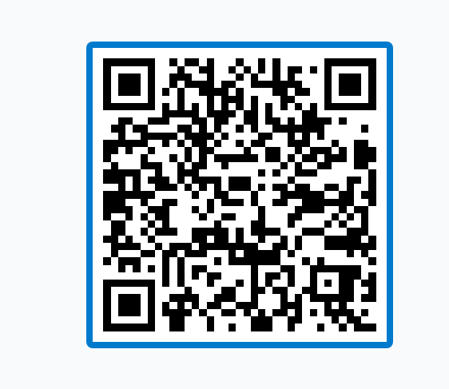
Poll Everywhere
https://PollEv.com/discourses/GPMVSTbeCfe9t32mI05qy/respond
What is one question or comment you have before we start our presentation?

Slide 4

The Journey to Today
    1972
Indian Control of Indian Education laid foundational concepts igniting future policy development in the Indigenous Institutes pillar.
    1996
The Royal Commission on Aboriginal Peoples (RCAP) reinforced that education is central to the well-being of Indigenous Peoples in Canada.
    The Truth and Reconciliation Commission of Canada (TRC) emphasized the necessity of Indigenous education to help redress the legacy of residential schools and advance reconciliation.
    2015
    2016
    In 2016, the United Nations Declaration on the Rights of Indigenous Peoples, 2007 was adopted by Canada.
Notes:
Slide 4 – The Journey to Today
How did we arrive here?
The path to legislation has been a long one, built on the work and ideas of countless Indigenous thinkers, leaders and scholars.
It was also built on the experiences of our peoples in education.
We as Indigenous Peoples have never quit. We have not laid down our arms.
We have had leaders and thinkers and people who have stood up and kept our light burning.
It is on those shoulders that today we stand. That I stand. That this Council stands.
[1972 Policy Paper]
Of the many key leaders and moments that we can point towards, I would like to highlight the policy paper called Indian Control of Indian Education.
This policy paper, written in our lifetime continues to guide the way forward in education.
This policy paper helped shape the work we undertook in Ontario along with some other important public documents like the Royal Commission on Aboriginal Peoples, the final report of the Truth and Reconciliation Commission and the Calls to Action of that report.
The Royal Commission on Aboriginal Peoples (RCAP) represented a shift in the tide in the conversation surrounding Indigenous control of education, as a large number of First Nations came out to participate in the hearings.
Many of us remember Oka, the terrible stand-off between Mohawk people and the Quebec provincial police in the summer of 1990. One of the outcomes of that time was a commitment to work together to carry out RCAP, which incidentally was not brought out till 1996. The participation rate was very high because people wanted to come together to see a better tomorrow.
Then we have the Truth and Reconciliation Commission of Canada work that happened over several years, and when it released its Final Report in 2015, it recommended 94 Calls to Action for the Canadian government to right horrifying wrongs and started the attempts to dismantling the systemic racism devastating Indigenous Peoples in Canada.
The Indigenous Institutes Act which I will speak to in a minute responds to many calls to action especially call number 10 and call number 16. (IF WE HAVE THE TRC BOOKS THEY CAN LOOK UP 10 and 16)
and it also responds to the United Nations Declaration of the Rights of Indigenous Peoples (articles 14, 15, 16)

Slide 5
United Nation Declaration on the Rights of Indigenous Peoples, 2007
​UNDRIP is a universal framework that sets out the minimum individual and collective rights of Indigenous Peoples.
Bill C-262 passed on May 30, 2018, requiring that the Government of Canada take all measures necessary to ensure that the laws of Canada are in harmony with UNDRIP.​
Adopted by the United Nations General Assembly in 2007 as a result of more than two decades of consultation and dialogue among Indigenous Peoples and governments worldwide.
Internationally, the United Nations Declaration on the Rights of Indigenous Peoples, 2007, which was adopted by Canada in 2016, affirms and recognizes the right to establish and control education systems and institutions and the individual and collective rights of Indigenous peoples, notably rights of Indigenous individuals and people to protect their culture through practices, languages, and education (Articles 14 and 15).
Notes:
Slide 5- UNDRIP
Most of us know about UNDRIP and that Internationally, UNDRIP is an instrument adopted by the United Nations General Assembly in 2007 to enshrine the rights that “constitute the minimum standards for the survival, dignity and well-being of the Indigenous Peoples of the world.”
The uniform framework that UNDRIP provides sets out the minimum protection for the collective rights of Indigenous People that may not be addressed in other human rights charters.
This shift in Canada in the last decade has been very important for education rights. Articles 14 and 15 in UNDRIP affirm and recognize Indigenous Peoples right to establish and control education systems and institutions; and the right to dignity and diversity of their cultures, traditions, histories and aspirations, which should be reflected in education and public information.
In Canada, the UNDRIP ACT was passed in 2021, and following that was the development and launch of the UNDRIP ACTION PLAN 2023
The United Nations Declaration on the Rights of Indigenous Peoples (UNDRIP) is the platform on which the work at IAESC stands.
At IAESC we strive to fulfill the mandates of the UNDRIP that relate to the rights of Indigenous people to control the development and transmission of their education and culture, examples of which are Article 14 and 15 which affirm and recognize the rights to establish and control education systems and institutions and the individual and collective rights of Indigenous peoples, notably rights of Indigenous individuals and people to protect their culture through practices, languages, and education.
The UNDRIP also expands our horizon on the international scene. It provides IAESC the opportunity to invite many other partners with similar mandates, to work with us on an international stage.

Slide 6
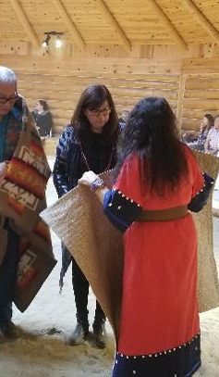

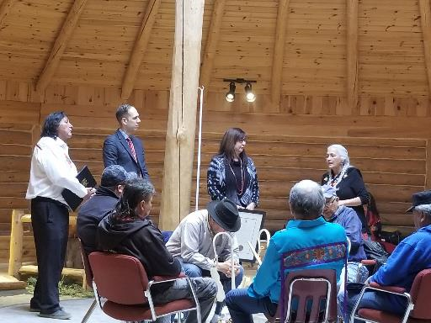
Progress in Ontario
Since time immemorial Indigenous Peoples have known the value of education in ensuring that future generations have the tools, traditional knowledges and spiritual foundation to move through the world.
Through the Policy Co-Creation Table, the Indigenous Institutes and the Ministry of Advanced Education and Skills Development developed a legislative framework to formally recognize Indigenous governance and control of the sector.
The Indigenous Institutes Act, 2017 received Royal Assent on December 14, 2017.
Through ceremony the Act was acknowledged on March 28, 2018, to help build this recognized pillar of Indigenous postsecondary education and training in Ontario.
Policy Co-Creation Table
Notes:
Slide 6 – Progress in Ontario
In recognition of the need to create a new path in Ontario’s postsecondary education and training framework to respond to the needs of Indigenous students, Indigenous communities as representatives by Indigenous Institutes and the Government of Ontario as represented by the Ministry of Advanced Education and Skills Development formed a Policy Co-Creation Table a few months before spring 2017.
This table committed to the principles of mutual respect and trust, setting the stage for innovative thinking on how to develop a policy framework to recognize Indigenous Institutes. This table sought to co-develop, to co-create…..share the pen.
Discussions and dialogue ensued and very quickly into the process, in June 2017, the Policy Co-Creation Table members agreed that the province should move forward with legislation to recognize Indigenous Institutes.
One of the lawyers that was heavily involved in the drafting of the act is Cree person from Saskatchewan, educated firstly in his language and Indigenous ways and knowing and secondly as in the law.
Both sides agreed that the legislation should ensure the potential for institutes to grow and become the kind of institute that they might like to be.
Those thoughts led to the agreement that an independent and impartial academic governing body would be required. A body that would oversee quality assurance and credential granting, this body became the Indigenous Advanced Education and Skills Council.
The Act recognizes Indigenous ownership of the Institutes. Though legally the Federal Government has a fiduciary responsibility and obligations to Indigenous Peoples on turtle island, recognition from the province is an amazing step as we try to continue to move things forward.
I always like to offer this perspective on the legislative development. It took one season, well actually less than one season to get the bill drafted.
You see, the decision to advance legislation was made days after the summer solstice and the final verbal agreements were landed on the day of the fall solstice (should this be equinox?). The Indigenous Institutes Act was introduced on November 14th as part of a larger bill and it received Royal Assent on December 14th, 2017 - just one month later.
The board of IAESC arranged a second recognition of the Act. A ceremony was held to introduce the Act to creation, to the Spirits and our ancestors. The ceremony was held in a roundhouse in Treaty # 3 territory. The ceremony was led by Elder Fred Kelly who brought with him the Treaty # 3 drum.
The pictures you see on this slide are some from of the moments in the ceremony.
To the indigenous community, this ceremony represented the real royal assent of the act.
The province participated in our celebration just as we joined them in their celebration.

Slide 7
Indigenous Institutes Act, 2017
The legislation recognizes and defines many important aspects of the Indigenous Institutes pillar:
    Affirms Ontario’s commitment to reconciliation and the right of Indigenous peoples to establish control of their education systems and institutions set out in UNDRIP.
    Recognizes nine Indigenous Institutes and an Indigenous controlled and governed Council in regulation.
    Highlights the unique role of Indigenous Institutes in Ontario’s postsecondary education and training system.
    Defines Indigenous Institutes as community-based education institutions that are mandated by and accountable to Indigenous communities to provide accessible postsecondary education and training.
    Entrenches mutual respect and accountability between the Government of Ontario and Indigenous Institutes to enhance educational opportunities for Indigenous students and to promote the revitalization of Indigenous knowledge, cultures and languages.
Notes:
Slide 7 - The Indigenous Institutes Act, 2017
I can share a bit about the key components of the Indigenous Institutes Act.
The preamble sets the stage to realize Indigenous Control of Indigenous Education.
Firstly, it affirms Ontario’s commitment to reconciliation with Indigenous Peoples; and it acknowledges the United Nations Declaration on the Rights of Indigenous Peoples (UNDRIP). This means that our collaborative work going forward, is from a place where Indigenous Peoples’ rights have already been agreed to.
The Act also recognizes Indigenous Institutes as a pillar in Ontario’s postsecondary education and training system. This statement acknowledges that Indigenous Institutes did not come into being with the passage of legislation on December 14, 2017, rather they are recognized as being owned and controlled by their communities. Indigenous Institutes are the third pillar in Ontario’s post-secondary landscape along with Universities and Colleges.
The legislative structure recognized the need for the establishment of an independent, Indigenous governed and controlled body, that will be responsible for accreditation and quality assurance. This body became IAESC (and it is also referred to as “The Council” in this presentation and in our documents)

Slide 8

The Council – Implementing the TRC Calls to Action
Work with Indigenous Institutes to promote revitalization of Indigenous knowledge, cultures and languages
10)iii) Developing culturally appropriate curricula.
10)ii) Improving education attainment levels and success rates.
10)iv) Protecting the right to Aboriginal languages, including the teaching of Aboriginal languages as credit courses.
10)v) Enabling parental and community responsibility, control, and accountability.
Recommend Indigenous Institutes for regular and ongoing funding
Indigenous Institutes
and Communities
Quality assurance of Indigenous Institutes’ programs
14) The preservation, revitalization, and strengthening of Aboriginal languages and cultures are best managed by Aboriginal people and communities.
10) Aboriginal education legislation with the full participation and informed consent of Aboriginal peoples.
Recommendations on use of the term “university”
Statements: Truth and Reconciliation Canada. (2015). Honouring the truth, reconciling for the future: Summary of the final report of the Truth and Reconciliation Commission of Canada. Winnipeg: Truth and Reconciliation Commission of Canada.
10)i) Providing sufficient funding to close identified educational achievement gaps within one generation.
16) We call upon post-secondary institutions to create university and college degree and diploma programs in Aboriginal languages.
Notes:
Slide 8- The Council is Indigenous governed and Indigenous run- NOTE to speaker - for part 2 of this slide has the fly in animations for the TRC calls to action parts (there are 8 flyins)
PART 1
IAESC is a legal entity that is federally incorporated. It assisted the development of a new pillar in Ontario’s post-secondary landscape and ensures that this pillar is supported by a non-political, independent quality assurance body. IAESC is A full and equal member in the postsecondary landscape in Ontario.
[starting at the eastern box of the slide:]
We have established standards and benchmarks that are grounded Indigenous languages, knowledge systems and other ways of knowing, and through the developed quality assurance process, IAESC may approve an Indigenous Institute to grant a diploma, certificate or degree, based on the standards and benchmarks established by the Council.
[in the southern box of the slide]:
We also work with the Ministry of Colleges and Universities to determine the use of the term university and affirm students interests and by extension, the interests of the Indigenous Communities they are from, through the development of standards and benchmarks that ensure credentials can be transferred across the country and internationally.
[in the western box of the slide]
At IAESC we make recommendations to the Ministry of Colleges and Universities for funding based on our program approvals that we do with Indigenous Institutes
[Northern Box]:
The Council offers quality assurance and credential granting in a process that is grounded in Indigenous languages, knowledge systems and other ways of knowing, and does so, to the highest standards of independence and transparency.
PART 2 (Note to speaker are the flyins….)
We touched on this earlier, but the Indigenous Institutes Act responds to many TRC calls to action and IAESC does the work of implementing them – particularly CTA 10, 14, and 16.
Lets look a little closer at how IAESC implements these CTAs in its work:(IF WE HAVE THE TRC BOOKS THEY CAN LOOK UP 10 and 16)
Flyin 1 Aboriginal education legislation with the full participation and informed consent of Aboriginal peoples.[northern box]
Flyin 2 Providing sufficient funding to close identified educational achievement gaps within one generation [western box]
Flyin 3 Improving education attainment levels and success rates [eastern box]
Flyin 4 Developing culturally appropriate curricula [northern box]
Flyin 5 Protecting the right to Aboriginal languages, including the teaching of Aboriginal languages as credit courses[northern box]
Flyin 6 Enabling parental and community responsibility, control, and accountability. [all boxes]
Flyin 7 The preservation, revitalization, and strengthening of Aboriginal languages and cultures are best managed by Aboriginal people and communities all boxes]
Flyin 8 We call upon post-secondary institutions to create university and college degree and diploma programs in Aboriginal languages. [northern box and southern box]
Reminder, IAESC also works to implement United Nations Declaration of the Rights of Indigenous Peoples (articles 14, 15, 16)
Summary statements for this slide:
We recognize that our standards and procedures will continue to evolve to ensure that we continue to achieve our mandate.
We also recognize that during conversations with knowledgeable educators and Indigenous communities and organizations, we will become aware of new areas we need to explore in the accomplishment of our goals.
Finally, the Council has entered into a Memorandum of Understanding with the Ministry of Colleges and Universities to consider all other matters that may arise as this pillar develops and evolves.
The legislation will be implemented through the Council in a way that acknowledges the diversity of Indigenous Institutes aspirations.
We will take a role in transforming the landscape of postsecondary education by recognizing Indigenous knowledge, wisdom and traditions and ensuring that Indigenous world views are at the base and core of programming and programs in Indigenous Institutes.

Slide 9







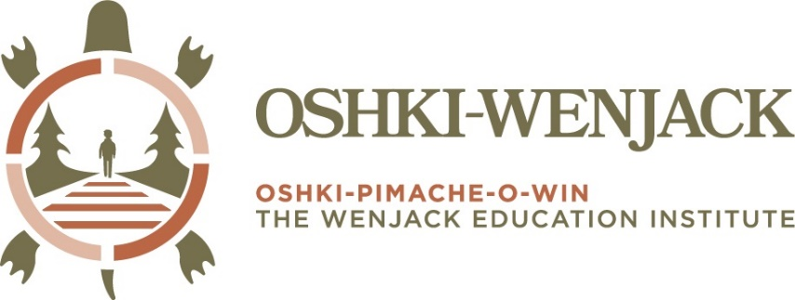

Indigenous Institutes in Ontario
Notes:
Slide 9 - Indigenous Institutes in Ontario
I think it may be helpful to share information on the role of Indigenous Institutes in Ontario.
At the heart of it, and in this contemporary moment - they are First Nation owned and controlled post secondary education and training institutions in First Nations communities.
The first Indigenous Institutes in Ontario were formally established in the mid 1980s and nine are currently recognized in legislation.
Indigenous Institutes offer programs and courses that have been largely owned by the colleges and universities that they formed partnerships with and relate to the needs and developments of their communities. Amendments to some of the programs that may have been made lie with the partner institution.,
This is what this Act changes, these Institutes can now develop, own and control their own programs.
It is important to note that though the Act provides the opportunity for them to do this, they are not required to create their own programs.
The idea behind the Act was to create the framework for the development of postsecondary education and training through an Indigenous lens. To produce graduates that are given the tools to be assets to their communities. The Indigenous Institutes finally have the recognition to write the history of Indigenous education in Ontario.

Slide 10
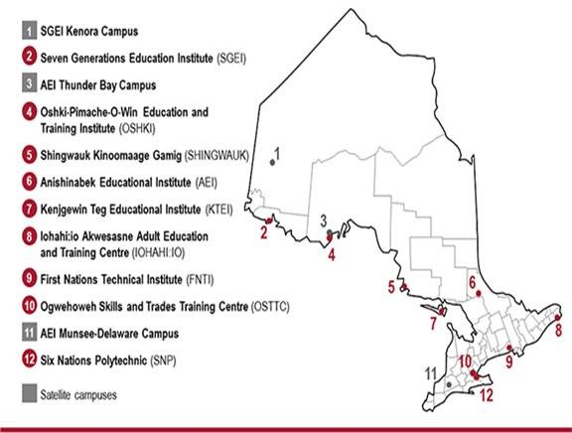
Indigenous Institutes in Ontario
Notes:
Slide 10
Indigenous Institutes are Indigenous governed and operated community-based education institutions that are mandated by and accountable to Indigenous communities.
Nine Indigenous Institutes serve more than 133 communities across the province, providing improved post-secondary education access to Indigenous peoples in culturally-enriched learning environments.
The Institutes collectively offer over 70 programs at the certificate, diploma, advanced diploma post-graduate-certificate, degree, and graduate degree level in addition to skilled trades, micro-credentials and educational programing.
There are Benefits to attending an Indigenous Institute and there many things they do very well
For example
1.The programs offered at IIs are created and delivered in response to community employment, education and training needs They meet community needs.
2.They have a very good success rate. In the academic year 2022 to 2023 the graduation rate of Indigenous Institutes was 79% (MCU, IEB stat ) as compared to the Community Colleges of Applied Arts and technology in Ontario at 65% (Colleges Ontario stat):
3. Part of the high student success rate is due to the Great student supports at IIs (this includes Mental, Spiritual, Physical and Emotional) There are many cultural supports and programs, community and social events, Elder support, etc.
4. The mode of delivery increases access for learners (in community in many cases, but also hybrid, concentrated onsite +online, and online, flexible scheduling, etc)
5. Small class sizes and education and training is delivered through an Indigenous lens.
6. Grounded in Indigenous pedagogy and because they embed culture into what they do, in the curriculum, and ways of working, etc. they produce graduates who are grounded in Indigenous ways and knowledge. This empowers both the learner and the community
7. Allows for quality language (and culture) embedded which helps with learner identity, , sense of self, and increases confidence which equals student success, and academic success- this addresses and overcomes the barriers in a mainstream post institution- Allows for quality language and culture in all the programs – language fills what is missing in us. Language is the severed link and a way to return to self in a wholesome way but on our terms.
8. Supports Indigenous knowledge sovereignty- there has been a history of Indigenous Knowledge being appropriated by mainstream post-secondary
9. produce graduates that are given the tools to be assets to their communities. They directly serve the needs of the community and engage with them to understand needs.
10. The Indigenous Institutes finally have the power to rewrite the history of indigenous education in Ontario.
[Need to destigmatize II- build this case (racism, oppression is leading ppl to believe it is a lesser PSE]
In addition to working with the 9 Indigenous Institutes, IAESC also works in partnership with other Indigenous and non-Indigenous organizations and government agencies to support its mandate

Slide 11

Council Board Members
Council Board members are independent members of the Indigenous community, academic and sector leaders who reflect the principles of independence, accountability, impartiality and transparency.
Notes:
Slide 11 – Council Board Members at IAESC
At its full complement, the Board Council are members of the Indigenous communities with diverse backgrounds in leadership and
from the post secondary sector
Their role is to give final approval based on recommendations from IIQAB (which we will talk more about in a min), set out strategic direction, approve budget, etc.
A critical element at the Council is that it is modelled on the highest standards of independence, credibility, transparency and accountability.
By independence, I mean independence from government, political involvement, and the institutes that we support.
This independence serves to create a foundation of confidence in the Council Board with the Institutes and the broader sector, but most importantly with the students.
We will ensure that their credentials are recognized and transferable across the sector.

Slide 12

Indigenous Institutes Quality Assessment Board (IIQAB)
Independent experts that uphold IIQAB’s values of objectivity, high ethical standards, respecting, promoting and privileging Indigenous world views, knowledge, cultures, languages and traditions.
Seven members appointed by the Council
Meet bi-monthly to review and make recommendations on: approval of applications from Indigenous Institutes, QA process, standards and benchmarks and other matters.
Committed to a quality assurance process that builds partnerships between IIQAB and Indigenous Institutes.
‹#›
Notes:
Slide 12 - IIQAB
In order to ensure an arms length relationship between the Council Board and the quality assurance process, at IAESC we have the Indigenous Institutes Quality Assessment Board which is made up of independent experts. Members are highly credentialled including being grounded in community context and indigenous worldviews.
The organization review panel
We also assemble and Organization Review Panel comprised of individuals with experience in post secondary education (curriculum, leadership, Indigenous worldviews and pedagogy, etc.)
Under the coordination of the Panel Chair, the Organization Review Panel is used to develop a report that includes the following information:
• An assessment of the application against each of the IIQAB’s standards and benchmarks
• An assessment of the sufficiency, reliability, and validity of the evidence provided by the applicant
• An assessment of evidence found during any site visit(s)
• An evaluation, with reasons, of whether the proposed organization meets the IIQAB’s criteria
The IIQAB’s organization review process results in a recommendation to Council’s Board of Directors for:
• Approval
• Provisional approval (e.g, approval with conditions)
• Re-submission required with rationale and identification of improvements to be addressed for any future reapplication
As an organization with a separate board (ie IIQAB) for quality assurance, IAESC is consistent with other partners such as the Ontario Postsecondary Education Quality Assessment Board (PEQAB). Our board meets Bi-monthly and makes recommendations on approval of applications from Indigenous Institutes to grant credentials.

Slide 13
Quality Assurance is…
    The Council developed its quality assurance process that brings together two systems of education side-by-side to support future generations.
    To achieve this, the process is centered on reflecting Indigenous ways of being, knowledge, cultures and languages taught at Indigenous Institutes, while supporting the transferability of these credentials across Ontario.
    The quality assurance process involves two phases:
      An Organization Review to review the Indigenous Institute’s philosophies, organizational authority and structure, academic policies and general operations.
      A Program Review for each credential the Indigenous Institute plans to deliver to assess program policies and procedures, learning outcomes and alignment with the Ontario Qualifications Framework (OQF).
Notes:
Slide 13 – Quality Assurance
We are the only Indigenous Quality assurance organization of its kind for indigenous Institutes in the country
The Council’s quality assurance process is grounded in respecting, promoting and reflecting Indigenous ways of being, knowledges, cultures and languages and supporting the transferability of credentials across Ontario.
There are other Quality assurance organizations, and one we looked at was WINHEC and we collaborated with them as we got started in the early development of the council-
IAESC took the WINHEC review process as the base of the organizational review process that we see today
Our handbook outlining the process for completion of an application for an organization review is provided on our website for anyone to view.
The quality assurance process involves two phases:
An Organization Review to review the Indigenous Institute’s philosophies, organizational authority and structure, academic policies and general operations.
A Program Review for each credential the Indigenous Institute plans to deliver to assess program policies and procedures, learning outcomes and alignment with the Ontario Qualifications Framework (OQF).

Slide 14
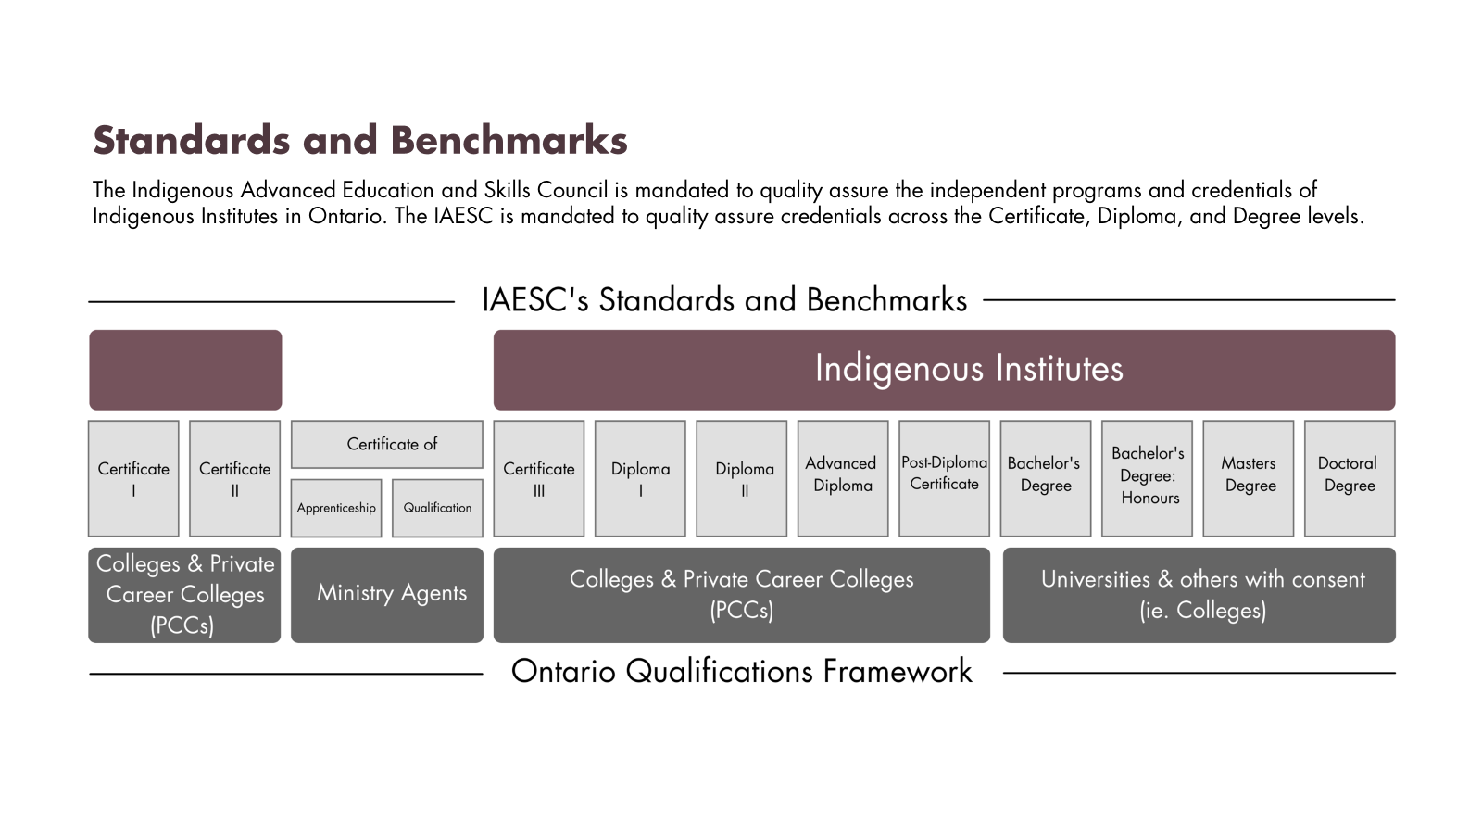
Notes:
Slide 14 Credential Framework in Ontario
The Council’s QA process is also informed by the Ontario Qualifications Framework or OQF – which outlines which types of institutions may grant certificates, diplomas and degrees.
You can see on this diagram that private career colleges, colleges and universities are only providers of certain program types on the OQF. With the policy work that accompanied the legislation, Indigenous Institutes are the only postsecondary institutions that are providers of ALL the postsecondary certificates, diplomas and degrees in this framework.
Students can take the credentials they earn at these Institutions and still attend a college or university, if their learning journeys take them there.
It won’t just be about checking a box, but these credentials from Indigenous Institutions are proven to be of high-quality and are transferrable.
Effective April 24, 2018, Indigenous Institutes have been added as providers across the full spectrum of the Ontario Qualifications Framework (OQF):

Slide 15

Organization Review Process
Review Process
Step 1
Preparation and Submission of Application
Step 7
Communication of Decision
Step 2
Preliminary Assessment
Step 6
Board of Directors Decision:
Step 3
Overview Presentation to IIQAB
Provides recommendation to Board Council for:
• Approval
• Provisional approval
• Re-submission
Step 5
Indigenous Institute Quality Assessment Board (IIQAB) Recommendation
Step 4
Organization Review Panel and Site Visit
Notes:
Slide 15
This is our Organization Review Process in a simplified version. Give example of who went thru Iohahi:io Kenjgewin Teg, SNP, FNTI Seven Generations, Oshki-Wenjack
In this process We have chosen to take a step back and take a little more time. instead of repeating mainstream processes. I will go into further details about the Council’s approach here in this slide and the next.
Prior to undergoing an Organization Review with IAESC, an Indigenous Institute would have to deliver programs in partnership with another post-secondary institution such as a university or College of Applied Arts and Technology
So, it is It is through this process (the Organization Review with IAESC) that an Indigenous Institute will be positioned to offer programs autonomously.
We use the established standards and benchmarks that are grounded Indigenous languages, knowledge systems and other ways of knowing
As you can see from the slide here it is a very robust process, that involves several steps and people including:
THE IAESC QA Advisors who support the entire process and offer a preliminary assessment of the application from the Indigenous Institute
The Organization REVIEW PANEL who are not IAESC staff, but who are members from Indigenous Communities who have experience in the post secondary sector who review the application submitted by the Indigenous Institute, and conduct a site visit of the Indigenous Institute
the Indigenous Institutes Quality Assessment Board (IIQAB), who reviews the application and the recommendations from the Organization Review Panel to issue a recommendation to the IAESC BOard where there are 3 possible outcomes:
Approval
• Provisional approval (e.g, approval with conditions)
• Re-submission required with rationale and identification of improvements to be addressed for any future reapplication
and
the Council Board who issue the final decision on the application (which is approval, provisional approval or re-submission
Once an Indigenous Institute has gone through the process and gained an organization approval, are posted on our website, and the Indigenous Institute are in a position to apply for program approval that enables them to offer programs independent of a partner post-secondary institution

Slide 16


Program Review Process
Following communication to the II, the Council’s final decision is posted to the IAESC website
IAESC Council
Reviews IIQAB’s recommendation and determines whether to approve the II’s application
Indigenous Institute (II)
Prepares application for program review
Receives support and guidance on best practise from IAESC QA Advisors
Provides recommendation to Board Council for:
• Approval
• Provisional approval
• Re-submission
IIs
QA Advisors:
IIQAB
Council
IIQAB
Reviews the application, report by PRP, response from the II, and any other relevant documentation
Provides a recommendation to the IAESC Council
IAESC QA
Collaborates with II, providing support and partnership during preliminary assessment of application
Manages quality assurance process and prepares preliminary report
Program Review Panel (PRP)
Reviews the application against IIQAB standards and benchmarks
Conducts a site visit
Submits a report to QA Advisors
IIQAB
Conducts initial review of the submission after presentation by II
Selects a Program Review Panel (PRP)
Notes:
Slide 16
The Council’s quality assurance process as described in the last slide was developed to work with and support Indigenous Institutes to make their program goals become realities.
This slide outlines our process to for PROGRAM approvals once the Organization Review has been completed.
IAESC approves certificate, diploma, post-diploma certificate, degree, and graduate degree programs and similar to the organization review, the standards and benchmarks in the process that are grounded Indigenous languages, knowledge systems and other ways of knowing
We can walk through this quickly as it is similar to the Organization Review process and is robust with several steps and people involved once the program application has been submitted by the applicant II
THE IAESC QA Advisors who support the entire process and offer a preliminary assessment of the program application from the Indigenous Institute
The Program REVIEW PANEL who are not IAESC staff, but who are members from Indigenous Communities who have SUBJECT Matter expertise (eg Social Work would be used in a Social Service worker program), and experience in the postsecondary sector, who review the program application submitted by the Indigenous Institute, and conduct a site visit of the Indigenous Institute if required
the Indigenous Institutes Quality Assessment Board (IIQAB), who reviews the program application and the recommendations from the Program Review Panel to issue a recommendation to the IAESC BOard where there are 3 possible outcomes:
Approval
• Provisional approval (e.g, approval with conditions)
• Re-submission required with rationale and identification of improvements to be addressed for any future reapplication
and
the Council Board who issue the final decision on the application (which is approval, provisional approval or re-submission
Finally, the approved program is posted on our webiste
The process will be continuously improved on and we are examining the standards and benchmarks rights now to ensure they are grounded in Indigenous principles and practices.

Slide 17
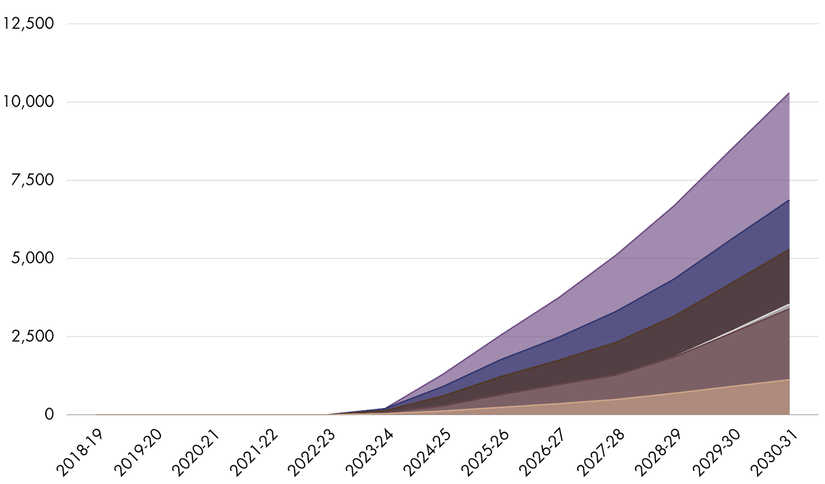
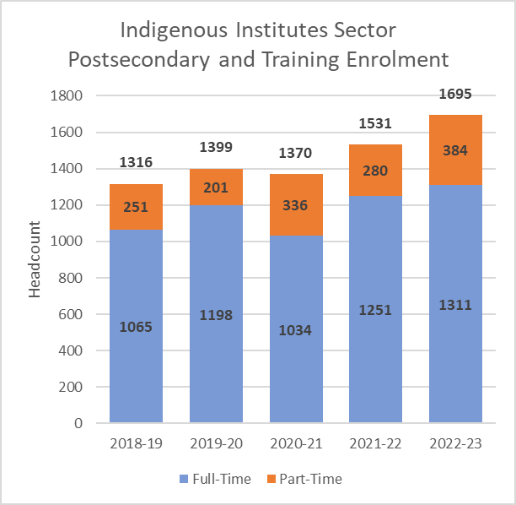

Student Enrolment Projections: Indigenous Institutes Standalone Programs 2022-2031
Assumptions
Once approved, programs are offered continuously
Enrolment remains constant over the years
Number of Students
Bachelor’s with Honours
Bachelor’s
Post-Diploma Certificate
Diploma
Certificate
Micro-Credential / Other
Year
5
Notes:
Slide 17
Growth
When we look at the aspirations of the IIs that we work with and the MCU, and the important work that is before us, we can see that the numbers will increase over time, over the next 10 years
Numbers are increasing in student enrolment - In the year 2022-2023 there were 1695 students enrolled in post-secondary and training programs
Diploma and degree programs appear to have the most growth in enrollment since 2018-2019
Types of programs:
We have mentioned previously, Indigenous Institutes offer Certificate, Diploma, Post-diploma certificate, degree and graduate degree programs, as well as adult upgrading, postsecondary education bridging programs, professional development and trades programs
The greatest number of students are in diploma programs
Institute program offerings respond to community priorities and regional labour market shortages.
Due to this, Most Institutes deliver programs that train
early childhood educators,
social service workers,
mental health workers,
nurses and
personal support workers.

Slide 18
Opportunities and Growth
    Continuing to develop a quality assurance process that supports Indigenous communities’ work to revitalize and promote their languages, cultures and knowledge.
    Promoting transferability of credentials to other postsecondary education and training systems.
    Supporting Indigenous-centered employment and training opportunities in Indigenous communities.
    Examining protection of Indigenous knowledge and intellectual property of Indigenous communities.
    Continue to uphold the established criteria to:
      Define an Indigenous Institute
      Recognize an Indigenous Institute as a university
      Recommend an Indigenous Institute for regular and ongoing government funding
Notes:
Slide 18 – Opportunity and Growth
Ontario has had universities for over 150 years and the college system for over 50 years, but Indigenous teachings and communities have been here a lot longer.
What are the top 3 points here:
It will take imagination and will power to take the next necessary steps and find the way forward so that the vision of Indigenous education is officially upheld.
It is now the time, for the development of programs that would portray the beauty and innovation of our indigenous culture, language, ways and history.
The environment has changed, Indigenous Institutes are now better equipped to serve the needs of the communities.
Indigenous communities and nations can now explore the development of programs either in partnership with existing Indigenous Institutions or perhaps through the establishment of new Institutions, tailored to the needs of the communities.
The possibilities are endless, only limited by our imaginations and our ability to walk hand in hand on this journey. Perhaps you can yourselves questions like: How can new curriculum, including language programs unique to your nations and communities, be developed? Who will facilitate this development? And are there additional or alternative resources?
We are not just talking about money, your language holders and knowledge keepers – they are the GREATEST resource. They are your libraries. They are your fountains of knowledge and there is a lot of work ahead to gather the water from those mountains and take care of it – for the future generations.
You will have the opportunity, now that some legal barriers have been moved out of the way, to develop and examine the best ways to educate your children… You are now in a pillar of Indigenous postsecondary education where things can innovate and change at every level, from the physical maintenance and space of your buildings, to your programs, to the support you provide your students that has gone above and beyond curriculum.
These continued developments can be geared to the wellbeing of the students of today and tomorrow, and to honour those who had a different experience, but deserved a bright future too.

Slide 19
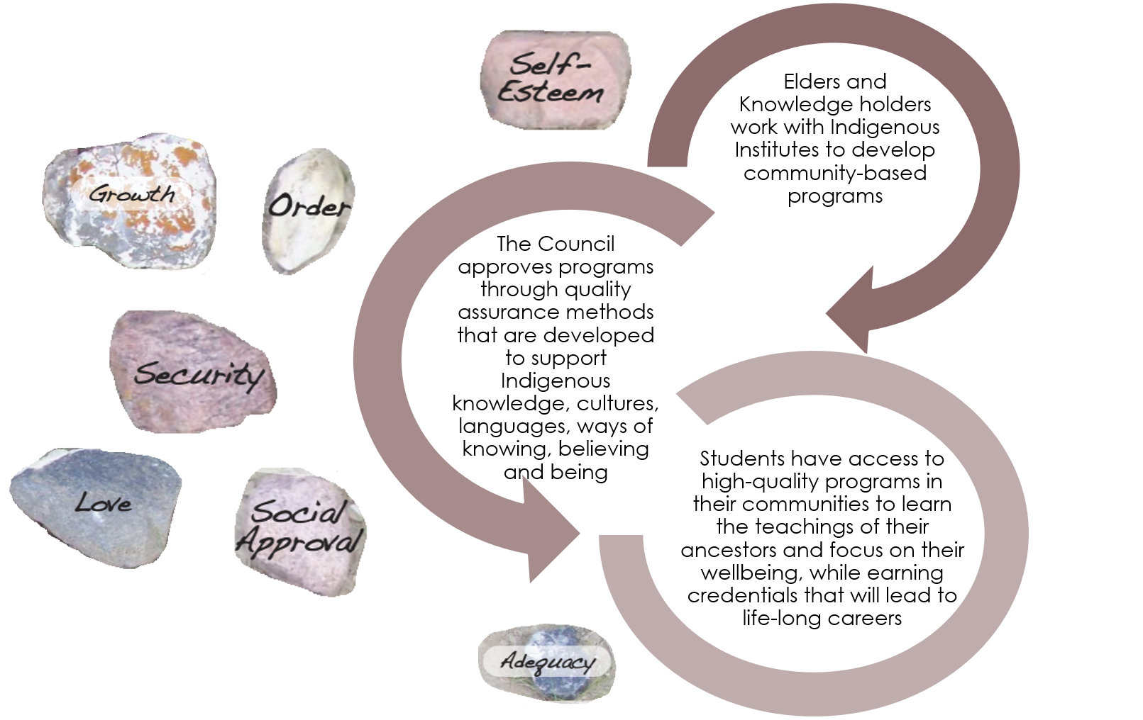
The Future of Indigenous Postsecondary Education
Notes:
Slide 19 – The Future of Indigenous Postsecondary Education
There is a lot of work to do beyond quality assurance, which we have seen outlined in legislation and even more beyond what has been written.
Perhaps we can examine the best ways to support Indigenous learners who are seeking employment and training programs that will lead to the same positive outcomes that we are seeking for students in postsecondary education programs.
Indigenous communities have fought long and hard to keep their knowledge, languages and cultures alive. However, many existing partnerships have resulted in the appropriation of knowledge for profit or other uses, which can continue to be a challenge for communities looking to safeguard their teachings for future generations.
I would like to leave you with a vision, a place that we can arrive at someday, the vision is that one day Indigenous communities everywhere will be able to work with Elders and Knowledge holders to contribute to building a high-quality system of education that is your own, while acknowledging what has already been. Where students will be able to learn what their ancestors knew and focus on their wellbeing without sacrificing who they are, gain credentials. The credentials they earn will lead to life-long learning and contributions we can’t yet imagine, but most importantly they must adapt this knowledge to the contemporary world we live in today.

Slide 20
Questions and Answers
Open Discussion and Closing (10 minutes)
Thank you very much for your time and contributions!

Slide 21
Miigwech!
For general inquiries:
info@iaesc.ca
1-800-25-IAESC
Notes:
Slide 21 – Miigwech!
Stephanie to add exit ticket-
Miigwech for extending the opportunity to share some information about the Council, about the Act and about our work. However, we can’t do this work alone – the Council encourages the development of innovations and partnerships to increase opportunities for Indigenous students to access postsecondary education and training.
Together with our partners, this revolutionary approach to Indigenous postsecondary education and training may expand to other jurisdictions in Canada and around the world.
I very much look forward to learning more from you about your goals.

