Slide 1
Economic Prosperity for First Nations
Virtual Town Hall on
First Nations-First Ministers’ Meeting
April 2026

Slide 2
Context - AFN Mandates
06/2025, Treaty and Inherent Rights to Trade
07/2025, Advancing First Nations Trade and Economies Through a First Nations Trade Strategy
08/2025, Advancing Nation-to-Nation Trade
56/2025, First Nations-led Critical Minerals Strategy
71/2025, European Union Ban on Seal Products
23/2024, First Nations Wild Atlantic Salmon Conservation Approaches
24/2024, Treaty-protected Rights Based katiyik / katew (glass eel) Fishery Governance
64/2024, First Nations Labour Market Information
72/2023, First Nations-Led Procurement Organization and the National Benefits Sharing Agreement
26/2021, Support for Closing the Infrastructure Gap by 2030

Slide 3
Context – Jurisdiction
Core tension:
First Nations → Rights holders with Inherent, Treaty, and constitutional (section 35) rights, title and jurisdiction, and sacred roles as stewards of our lands and waters.
Canada, provinces and territories → Operate in divided Crown jurisdiction (Constitution Act, 1982 sections 91 and 92).
Canada not respecting its own laws to recognize and uphold First Nations rights, like UN Declaration Act. No mechanism to ensure provinces and territories cooperate.
Specific to natural resources development and stewardship: Article 32 of the UN Declaration.

Slide 4
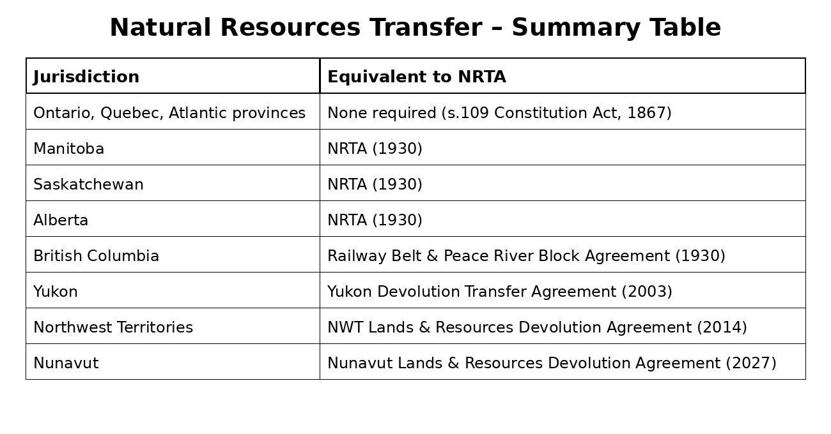
Context - Provinces and Territories
In May 2025, the AFN National Chief issued a letter to Prime Minister Carney reiterating the call for a constitutional review of the Natural Resources Transfer Agreements (NRTAs) for Section 35 compatibility.

Slide 5
Context - Provinces and Territories
Seven Regional Development Agencies in Canada. Each identified key priorities in their 2026-2027 departmental plans.
Common focus on technology and AI adoption, and growing strategic sectors such as defence, critical minerals and cybersecurity.
Only two, FedNor and CanNor, include Indigenous-specific key priorities.
FedNor (Northern Ontario):
Strengthen and expand strategic partnerships with Indigenous communities to foster collaboration and improve service delivery in support of key priorities such as Indigenous economic participation and clean growth. Focus on advancing development of critical minerals and enhancing strategic infrastructure, generating long-term benefits for the region.

Slide 6
Context - Provinces and Territories
CanNor (Yukon, Northwest Territories, Nunavut):
Advance Indigenous economic participation and reconciliation: Support Indigenous governments, organizations, and businesses to increase participation and equity in economic development, strengthening Indigenous ownership, workforce readiness, and long-term community capacity.
Align capital and strengthen northern supply chains, including food systems: Strengthen northern food systems by supporting Indigenous and northern entrepreneurs across food production, fisheries, and harvesting value chains, processing and preparation capacity, and logistics to build local capacity and improve long-term affordability.

Slide 7
Engagement Questions on Economic Development
What are your top priorities with respect to economic development?
How are these priorities aligned or misaligned with federal and provincial priorities?
What are the key barriers to advancing your priorities in this space?
What do you need from the federal government?
What do you need from the provinces and territories?
What do you need from the AFN?
What is the number one commitment you would seek from the Prime Minister and Premiers

