Slide 1
Aligning Indigenous skills training, procurement, and workforce development
ISET / MAJOR PROJECTS WORKFORCE DEVELOPMENT
Max Skudra & Jesse McCormick
AFN ISET National Annual Meeting 2026 // Calgary // Sept. 3
mokwateh.com
Notes:
Preparing Indigenous Workforces for Major Project Opportunities
Aligning skills, procurement and economic development to capture long-term value

Slide 2
Today’s conversation
A presentation-led discussion with space for practical questions.
01
Intro
05
Toolbox
Building Repeatable Models Approach
Forecasting demand
02
The Opportunity
06
Practical Experience
03
Where participation breakdown
Case Studies: Cameco, CBTU, COTTFN Trade School
Focus and Value Statement
Gaps and barriers
07
Discussion
04
Strategy – Aligning Partners
Procurement
Types of Agreement
Building Bridges | Catalyzing Change
3
Notes:
Storyline: Opportunity → Gap → Forecast → Align → Build → Repeat → Examples → Action
Today’s conversation - session roadmap:
The opportunity
The gaps and barriers
Procurement and workforce development
A repeatable planning framework
Examples and practical actions
Discussion
Speaker: Jesse

Slide 3
About Mokwateh
Notes:
About Mokwateh and the presenters
A short introduction to:
Mokwateh’s work
Jesse’s relevant experience
Max’s relevant experience in procurement, business, and economic development
How the presentation draws on both workforce and economic-development perspectives
Keep biographies to two or three bullets each.
Speaker: Jesse, then Max

Slide 4
A Bridge-Building Consultancy
Finding common ground and creating common good in the Indigenous Economy. Our service offerings meet the needs of industry, government, and community.
Leading Clients Forward in the Expansive Indigenous Economy
Bespoke Solutions: Rooted in Respect,
Designed for Sustainable Results
A Network of Talent & Trusted Relationships that Runs Wide and Deep
When what stands in the way is a viable bridge, Mokwateh will help you build it.
We break down complexities and thoughtfully rebuild them into something vibrant: sustainable partnerships, equitable opportunities, and shared prosperity.
We are your strategic way finder.
Coast to coast and across all sectors, we bring insightful solutions to clients at any stage in their journey.
Our team is authentically connected within the landscape of commerce and communities.
Mokwateh’s experts focus your efforts where it matters most.
Together we are growing the Indigenous Economy, Canada’s competitive edge.
Building Bridges | Catalyzing Change
Notes:
Indigenous-led advisory work at the intersection of major projects, economic development and workforce participation.
Works with First Nations, industry and government to align training, procurement and long-term community benefit.

Slide 5

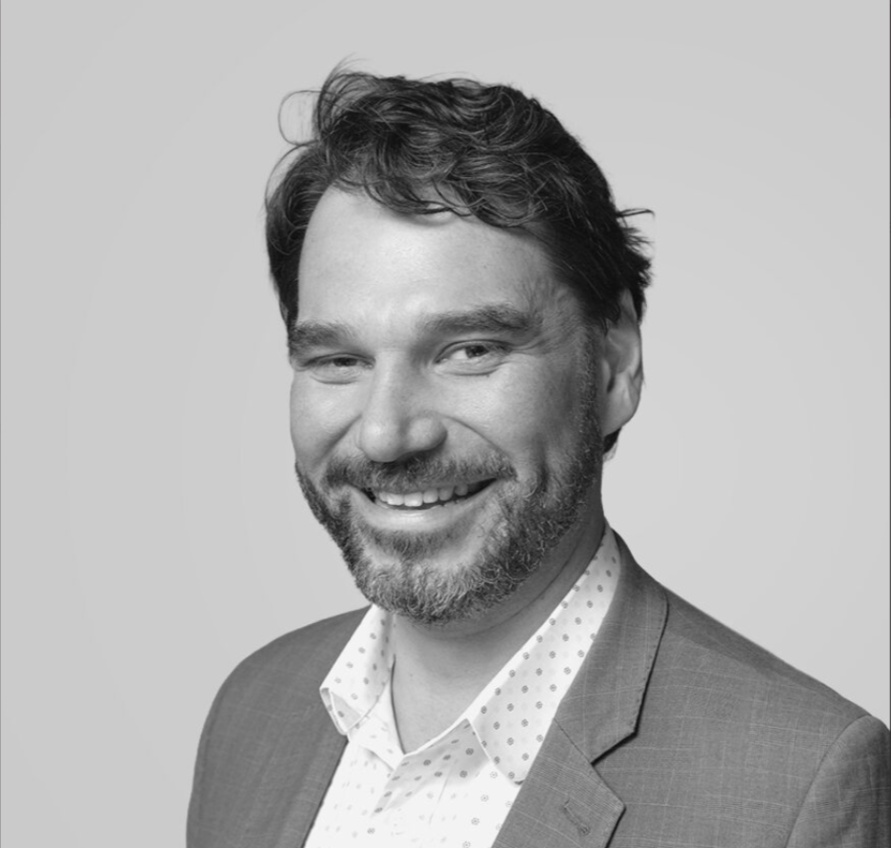
Presenters
MS
JM
Max Skudra
Jesse McCormick
Economic development, procurement and Indigenous business participation
Legal, policy and major-project context
Focus on procurement, business growth and Indigenous economic development strategy.
Brings the procurement, joint-venture and long-term participation lens to this presentation.
Legal, policy and major-project background, with a focus on agreements and workforce commitments.
Brings the workforce-systems and program-design lens to this presentation.
5
Building Bridges | Catalyzing Change
Notes:
Replace placeholder credentials with final approved bios/photos.

Slide 6
WHY THIS MATTERS
SETTING THE STAGE
Notes:
First Nations workforce participation is not a side benefit of major projects — it is the difference between a project that passes through a community and one that builds it.

Slide 7
The Core Message
Major projects can create real Indigenous economic opportunity, but participation needs to be planned before demand arrives.
Opportunity
Preparation
Participation
Long-Term Value
7
Building Bridges | Catalyzing Change
Notes:
This is the throughline for the presentation – when exploring the opportunity, barriers, tools and strategies, this is the bottom line. The jump from Opportunity to Long-Term Value it built on a foundation of strong preparation which enables participation, in turn continuing to refine and build to unlock those long-term values.
Today’s seedlings growing into tomorrow’s forest.
Bigger picture – this isn’t just aspiration; the Government of Canada recognizes that Indigenous participation is a must-have, not a nice-to-have:
“Indigenous labour market participation and sustained attachment are critical to the success of nation-building projects.”
Sept 2025 -Question Period Note: MAJOR PROJECTS WORKFORCE (Government of Canada) https://search.open.canada.ca/qpnotes/record/esdc-edsc%2CEF_070_20260105

Slide 8
The Opportunity
Major projects can create several types of value at once.
1
2
3
4
Employment
Procurement
Revenue
Capability
Jobs, apprenticeships, supervisory pathways
Contracts, JVs and business capacity
Benefits, equity, royalties and own-source revenue
Transferable skills for future projects
The goal is not only access to a single project. It is durable participation that keeps compounding.
8
Building Bridges | Catalyzing Change
Notes:
Set an optimistic starting point: the opportunity is real, broad and worth preparing for.

Slide 9
Why It Matters
Communities Benefit
Industry Needs It
Nations Lead It
Major projects bring years of steady, well-paid work. When local people fill those roles, wages, skills, and experience stay in the community instead of flowing out with a rotating outside workforce.
Proponents face real labour shortages and increasing expectations — from lenders, regulators, and their own partners — to demonstrate local and Indigenous hiring. A trained, ready workforce is a competitive advantage, not a favour.
ISET puts First Nations in the driver's seat: design and deliver the training your community needs, on your terms, rather than receiving a one-size-fits-all federal program.
9
Building Bridges | Catalyzing Change
MOKWATEH
Notes:
Community benefits
Industry needs it – often the sensible/logical outcome too. If major projects are happening closer to Indigenous communities, then cost/benefit of accommodating the workforce travelling in (potentially straining housing capacity) vs sourcing labour from within the community.
Nations lead it – Nations will know what will work for their communities

Slide 10
Why Opportunities Are Still Missed
The project timeline and the training timeline often do not match.
What Happens on Projects
What Communities Need
Projects move from concept to procurement quickly
EPC teams line up labour and subcontractors early
Hiring demand can arrive before training is complete
Communities are asked to respond reactively
Earlier visibility into the project pipeline
Training opportunities aligned to specific occupations
Procurement commitments tied to workforce outcomes
Time to build supports and partnerships
Flexibility to design and adjust programs
10
Building Bridges | Catalyzing Change
MOKWATEH
Notes:
Highlight the urgency of thinking about this now. The problem is not lack of interest; it is timing and alignment.
Needs:
Earlier visibility into the project pipeline – planning amongst other community pressing needs
Training opportunities aligned to specific occupations – requires time to develop. May require apprenticeships and even pre-apprenticeship training
Procurement commitments tied to workforce outcomes – proponents willing to make that space
Time to build supports and partnerships – not every community starting at the same point

Slide 11
Where participation CAN break down

Slide 12
Barrier 1: Training and Opportunity Are Disconnected
Common gaps that separate training from real jobs.
Getting to the job is often harder than doing the job
      Distance and transportation — many projects sit far from home communities, with limited or no reliable transit to site.
      Rotation schedules (fly-in/fly-out, camp-based work) that are difficult to sustain without support at home.
      Housing and accommodation gaps near project sites, for workers who cannot commute daily.
Potential disconnection points:
      Training providers and employers
      Workforce teams and economic-development teams
      Community planning and project schedules
      Available programs and actual qualifications required
12
Building Bridges | Catalyzing Change
Notes:
Speaker: Jesse.

Slide 13
Barrier 2: Wraparound Support
A person can be technically qualified and still face practical barriers to participation. Participation Requires More Than Technical Training.
Transportation & accommodation: Reliable transportation to site or camp and accommodation, factored into program design from the outset, not added after people start dropping out.
Driver’s License: should the cost of getting a license really prevent a pathway?
Childcare: Accessible, affordable childcare options that work with shift and rotation schedules.
Cultural and Community Commitments: Systems that let people be full participants in the workforce and in their community and culture. A harvest, a hunt, a funeral or a ceremony should not force a choice between culture and a paycheque
Skills Mismatch: or perceived skills mismatch, including limited career exposure for youth
Tool & Safety Equipment: Ease of access (low/no-cost, financial supports) to required tools and equipment
The practical question: which barriers can ISET influence directly, and which must be raised with industry, leadership or government?
13
Building Bridges | Catalyzing Change
Notes:
Speaker: Jesse.
Re: perceived skills mismatch – Indigenous ways of life have more transferable skills to western/colonial working models than people may realise. E.g. relocating a trapline not dissimilar to transitioning to a new worksite when a project is completed.
Another point that came up from CBTU:
- Need for flexibility re: any probation requirements, and

Slide 14
Barrier 3: Short-Term Programs Do Not Automatically Create Careers
One-Time Job Placement
Long-Term Workforce Development
Immediate vacancy
Limited progression
Project-specific
Ends with the contract
Skills progression – continual up-skilling
Certifications and apprenticeships
On-site support
Mentoring
Multiple projects and employers
Leadership and business ownership opportunities
14
Building Bridges | Catalyzing Change
Notes:
Speaker: Jesse.

Slide 15
The Workforce-Development Timing Gap
Workforce planning often starts after procurement and mobilization decisions have already been made.
Project Timeline
Project Identified
›
Agreements Negotiated
›
Contractors Mobilized
›
Construction Begins
Workforce Timeline
Demand Forecasting
›
Program Design
›
Recruitment
›
Training
›
Certification
›
Work Readiness
Leading practice: ECI
Early Contractor Involvement (ECI) enables contractors to be engaged in the early stages of project development
Allows for additional planning, collaboration and innovation on a project. Can enable First Nations to harness opportunities.
E.g. Hydro One Waasigan Transmission Line project. ECI signed in March 2021, ground broken in November 2024.
15
Building Bridges | Catalyzing Change
Notes:
Speaker: Jesse. (note: ECI box will fade in on click – after contrasting Project vs Workforce timeline)
Emphasize that workforce planning often starts after procurement and mobilization decisions have already been made.
Sometimes – through other factors – models demonstrate what is possible. E.g. mining sector with long (5-10y) permitting processes can enable the proponent to have conversations with communities about their desired involvement in the eventual operation. If its employment beyond entry-level work, there’s a long enough time lag for scholarships that mean when the mine is operational, community members can have 5-years of post-graduation experience under their belt. The challenge is how to make this sort of model work where there isn’t a near decade-long permitting cycle.

Slide 16
The Cost of Starting Too Late
Qualified workers are unavailable when hiring begins
External contractors fill positions
Training is disconnected from actual jobs
Communities repeatedly create one-off programs
Equipment and training investments cannot be reused
Entry-level jobs do not develop into careers
Economic benefits leave the community
What would change if workforce planning began two or three years earlier?
16
Building Bridges | Catalyzing Change
Notes:
Speaker: Jesse.

Slide 17
The Gap We Keep Seeing
The problem is rarely a lack of will. It is timing.
A major project — a mine, a transmission line, a dam — shows up, ramps up, and by the time it reaches construction, the engineering and procurement contractor is already staffing the job.
There is very little runway left, at that point, to move from "we should build local capacity" to a trained, certified, job-ready workforce.
The result: real economic opportunity arrives on the community's doorstep, and the workforce isn't ready to fully capture it. That is a lost opportunity, not a failure of effort.
The fix is not working harder once the project shows up. It is starting the workforce planning years before it does.
17
Building Bridges | Catalyzing Change

Slide 18
Forecast the Skills Before Demand Arrives
Translate projects into training decisions.
1
2
3
4
5
6
Project
Pipeline
›
Occupation
Demand
›
Credential
Requirements
›
Training
Duration
›
Intake
Timing
›
Support
Needs
Example: if a role needs a multi-year apprenticeship, the training decision cannot wait until construction starts.
18
Building Bridges | Catalyzing Change
Notes:
Will walk through these steps over the next few slides

Slide 19
Step 1: Forecast What Is Coming
Workforce strategy should begin with a regional opportunity scan.
Questions to Ask
Potential Information Partners
Which projects are proposed in the region?
Which projects are likely to proceed?
When will procurement and hiring begin?
Which sectors are expected to grow?
What skills will contractors need?
What training lead times are required?
What Procurement or IBA Levers Exist?
Which Employers or Unions Control Entry Points?
What Supports Will People Need to Stay?
Economic-development teams
Political leadership
Industry and contractors
Governments and regulators
Unions and training institutions
Ask first: what major projects, sectors and employers are likely to shape demand in the next 1–5 years?
19
Building Bridges | Catalyzing Change
Notes:
Speaker: Max
This slide should feel immediately useful. It turns "capacity" into specific questions.

Slide 20
Steps 2–3: Map Demand and Assess Gaps
A suggested workforce map — a model rather than a completed assessment.
Future Role | Workers Needed | Current Capacity | Qualification Gap | Training Lead Time
Electricians | — | — | — | —
Heavy-Equipment Operators | — | — | — | —
Drivers | — | — | — | —
Environmental Monitors | — | — | — | —
Administration | — | — | — | —
Technicians | — | — | — | —
Communities and ISET organizations can adapt this table with their own project and occupation data.
20
Building Bridges | Catalyzing Change
Notes:
Speaker: Jesse. The table is a model rather than a completed assessment.

Slide 21
Steps 4–5: Align Partners and Deliver
Each partner's role in the cycle.
Leadership
ISET Organizations
Economic Development
Establish priorities and negotiate commitments. What is the long-term vision? What is within the realm of possibility?
Design and coordinate training that works on the ground, for the community.
Connect projects, businesses and demand. Grab opportunities to scale businesses.
Industry
Unions & Institutions
Community Organizations
Define job requirements and provide placements. Create flexible, culturally respectful worksites
Deliver credentials and apprenticeships. Develop mentoring systems.
Support recruitment, retention and wraparound needs.
21
Building Bridges | Catalyzing Change
Notes:
Speaker: Jesse.
In Mokwateh’s 2021 report “Lighting the Path: Labour Market Dynamics in the Energy Transition of Indigenous Communities” - with Electricity Human Resources Canada (EHRC) the key determinants of success from successful renewable energy projects were:
Leadership
Community Engagement, Communication and Support
Partnerships
Capacity Building and Technical Training
Strategic Funding and Finances
Relevant anecdote from CBTU IRAP development – we heard about a two-week pre-apprenticeship program for plumbers in one First Nation, where as part of the program they upgraded the community centre to new high-efficiency system. Not only trained members of that community for careers in the trades, but left the community with a tangible benefit from the training program.
https://www.hpacmag.com/heating-plumbing-air-conditioning-general/iwsh-and-ua-canada-team-up-to-provide-plumbing-training-and-infrastructure-upgrades-in-walpole-island-first-nation/1004147889/

Slide 22
Step 6: Measure What Remains After the Project
Suggested indicators.
People Trained & Certified
Indigenous Hires & Retention
Apprenticeships Completed
Career Progression
Procurement to Indigenous Businesses
New Community-Owned Assets
Training Models Reused
Supervisory & Ownership Roles Created
22
Building Bridges | Catalyzing Change
Notes:
Speaker: Max.

Slide 23
Move Beyond “Our Name on the Contract”
A joint venture should create increasing Indigenous participation and capability — not only an Indigenous name attached to work delivered by somebody else.
Who will be hired?
Who will be trained?
What qualifications will they gain?
How will Indigenous participation increase over time?
What capacity will remain after the project?
How will progress be measured?
23
Building Bridges | Catalyzing Change
Notes:
Speaker: Max. These are the questions to ask when designing a JV.

Slide 24
Connect Procurement Commitments to People
Procurement arrangements can include:
Indigenous hiring targets
Apprenticeships and training commitments
Career-progression requirements
Mentorship and knowledge transfer
Reporting and accountability
Community-specific workforce plans
24
Building Bridges | Catalyzing Change
Notes:
Speaker: Max.

Slide 25
Procurement Can Create More Than Contracts
A procurement commitment can also become a training and career pathway.
Weak Version
Stronger Version
Indigenous name on a contract – a box successfully ticked
Work delivered mostly by existing non-Indigenous workforce
Limited skills transfer
Short-term project benefit
JV includes hiring and training commitments
Apprenticeships and progression targets are defined
Indigenous business capacity grows over time
Skills remain useful after the project
25
Building Bridges | Catalyzing Change
Notes:
This is a strong Max slide. Keep the contrast sharp.

Slide 26
PROCUREMENT MEETS WORKFORCE
Every joint venture and impact-benefit agreement is a chance to build training and hiring commitments directly into the deal.
Notes:
Every joint venture and impact-benefit agreement is a chance to build training and hiring commitments directly into the deal.

Slide 27
From Joint Venture to Job
A joint venture that stops at "we'll paper an agreement and the outside company does the work" leaves most of the value on the table.
The stronger model: a JV where the non-Indigenous partner doesn't just perform the work under the community's name - they commit to hiring and training a forklift operator, truck drivers, and other roles from the community as part of the deal.
That is the difference between procurement as a paperwork exercise and procurement as a workforce development tool.
This is where Indigenous businesses and Nations have real leverage: at the negotiating table, before the contract is signed — not after.
Moving Beyond the JV Logo
It is not enough for an outside company's name to appear next to a First Nation's on a bid.
27
Building Bridges | Catalyzing Change

Slide 28
Building Representation Over Time
You will not have 100 people ready to start on a project this afternoon. That is not the measure of success.
The measure of success is what you put in place today so that next year you graduate five more trained people, and the year after that, five more - building toward meaningful representation over several years.
Early-stage joint ventures will often be majority non-Indigenous employment. That is expected. What matters is the trajectory: is Indigenous representation growing year over year, or staying flat?
This reframes the conversation with industry and government away from "can you deliver a workforce today" and toward "what are we building together over the life of this project."
28
Building Bridges | Catalyzing Change

Slide 29
The Workforce Opportunity Cycle
A repeatable six-step framework.
1
2
3
4
5
6
Forecast
Upcoming Projects
›
Map Jobs,
Qualifications & Timelines
›
Assess Gaps
in Capacity
›
Align
Partners
›
Deliver Training
& Supports
›
Measure &
Adapt
29
Building Bridges | Catalyzing Change
Notes:
Speaker: Jesse.

Slide 30
Measure Progress Over Time
An illustrative progression — the exact path will vary by community and sector.
Year 1
Year 2
Year 3
Year 4
Year 5
Entry-level participation
Certified workers and apprentices
Supervisors and specialized roles
Management and expanded business capacity
Sustainable Indigenous workforce and ownership
30
Building Bridges | Catalyzing Change
Notes:
Speaker: Max. Clarify that the exact progression will vary by community and sector.

Slide 31
A REPEATABLE MODEL
The strongest agreement holders do not solve this project by project. They build one approach and reuse and refine it.
Notes:
Every joint venture and impact-benefit agreement is a chance to build training and hiring commitments directly into the deal.

Slide 32
Build Capacity Once. Deploy It Repeatedly.
Move away from rebuilding from scratch project by project.
Project-by-Project Approach
Repeatable Capacity Model
New scramble each time
Training and tools purchased for one project
Lessons are not institutionalized
Benefits are harder to compound
Reusable training pathways – continual improvement and refinement
Strong administrative systems – opportunities aligned with community members (dedicated staff, strong internal systems, job postings)
Tools and systems sized for a pipeline – planning and looking beyond current project
Partnerships renewed across projects – success breeds success
Capacity grows with each opportunity – lessons are learned and integrated, skills grow
32
Building Bridges | Catalyzing Change
Notes:
This is the repeatable model point.

Slide 33
A Four-Step Framework
1. Forecast
2. Build Relationships
3. Align Training
4. Reuse & Reinvest
Map the major projects and industries likely to be active in your territory over the next 3–5 years, in conversation with industry, economic development, and political leadership.
Establish standing relationships with unions, employers, and government well before a project reaches construction — not after a proponent shows up.
Design intake streams and training timelines around when projects will actually need workers, factoring in real lead times for trades and certifications.
Carry tools, relationships, and trained capacity from one project into the next, instead of rebuilding from zero every time.
Opportunity
Preparation
Participation
Long-Term Value
33
Building Bridges | Catalyzing Change
Notes:
This is an implementation of the ‘core model’ which will fade in on a click
Opportunity
Preparation
Participation
Long-Term Value

Slide 34
Commitment Over Time
Success may look incremental before it looks transformational.
Year 1
Year 2
Year 3
Year 5+
5 workers trained / placed
10 workers and first apprentices
Supervisors, mentors and retention focus
Standing workforce and business capacity
Do not treat “we cannot supply everyone today” as failure. Treat it as the starting point for a capacity plan.
34
Building Bridges | Catalyzing Change
Notes:
The point is to defend incremental, compounding progress.

Slide 35
ISET's Role: First Nations-Led Design
ISET was built to put First Nations in charge of workforce training - not to hand down a template from Ottawa.
Every organization in this room already carries that responsibility for its community. The opportunity is to point that authority deliberately at the major projects and industries coming to your territory.
That means building relationships with the industries prominent in your region, and aligning trades and skills development to what they will actually need.
It means working with your economic development and prosperity teams so there is no gap between the job training side of the house and the impact-benefit agreements and joint ventures being negotiated.
And it means leadership treating this as a stated political priority in relationships with industry and government - not an assumption that goes unsaid.
35
Building Bridges | Catalyzing Change

Slide 36
Design Training Around Real Opportunities
Programs should be employer-informed, timed and pathway-based.
Employer-Informed
Timed to Milestones
Pathway-Based
Designed around actual job roles, credentials and hiring gates.
Intakes planned backward from likely procurement and construction windows.
Exposure → training → placement → apprenticeship → advancement.
36
Building Bridges | Catalyzing Change
Notes:
Keep this practical and prescriptive.

Slide 37
Expose Youth Before Career Decisions Are Made
Many young people are not exposed to the real economy early enough to see where they could fit.
Site Visits
Paid Pre-Training
Mentorship
Industry Days
Summer Programs
School Partnerships
Career awareness is part of long-term workforce planning.
37
Building Bridges | Catalyzing Change
Notes:
Max can speak to exposure and self-direction toward industries where jobs exist.

Slide 38
WHAT THIS LOOKS LIKE IN PRACTICE
PROOF POINTS
Notes:
A few examples of standing capacity built ahead of the opportunity.

Slide 39
Standing Capacity in Practice
These are illustrative examples, not an exhaustive list — many Agreement Holders in this room are already doing versions of this work.
OYEP / Outland Camps
Chippewas of the Thames
Squamish (Ch'nook / Polytechnic)
A pre-training, gap-year style program bridging high school and post-secondary — building foundational readiness before formal trades or college training begins.
Development of a trade school to build standing local training capacity, reducing reliance on sending community members away for skilled trades education.
Community-based post-secondary and polytechnic partnerships creating accessible, locally rooted pathways into skilled and technical careers.
39
Building Bridges | Catalyzing Change

Slide 40

Case Study: Saskatchewan Uranium Mining
Northern Saskatchewan First Nations, working with Cameco and other operators, began building workforce capacity roughly ten years ahead of major uranium mining opportunities in the region.
That early start meant that when the economic opportunity materialized, communities had a trained, ready workforce in place — rather than scrambling to catch up once contracts were already being awarded.
The lesson generalizes well beyond mining and beyond Saskatchewan: long-horizon capacity building consistently outperforms a rushed response.
Northern Saskatchewan Operations (2025 Sustainability Report)
Indigenous employees in all positions– 49% (unchanged)
Indigenous employees in management positions - 21% (up from 16% in 2023)
Saskatchewan
& Cameco
Roughly a decade of lead time
40
Building Bridges | Catalyzing Change

Slide 41
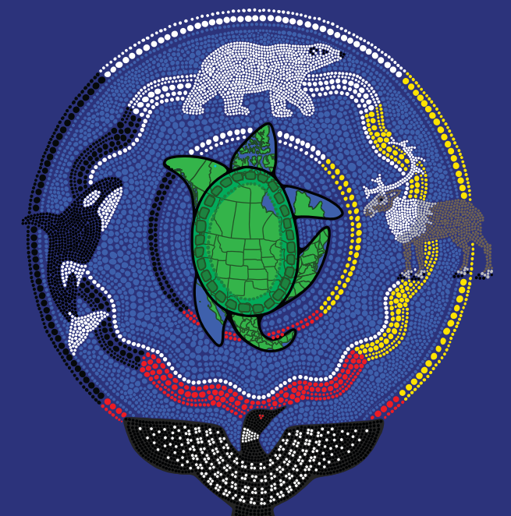

Example: Building the Bridge Into Employment
Canada’s Building Trades Unions (CBTU) released an Indigenous Reconciliation Action Plan (IRAP) in May 2026
Relevant Commitments & Actions:
“Expand locally anchored Indigenous workforce development opportunities by sharing and supporting successful training and partnership models with potential for replication or expansion.” (Pillar 1- Commitment 1)
“Working with partners and Affiliates, advocate for greater Government support for Indigenous workforce participation in major projects” (Pillar 1 - Action 2.3)
“Develop national policies, frameworks and guidelines to support Indigenous economic participation in major trades projects.” (Pillar 3 – Commitment 1)
“Advance Indigenous leadership and inclusion by elevating Indigenous champions, expanding self‑identification practices, and cultivating the next generation of Indigenous union leaders.” (Pillar 4 – Commitment 2)
41
Building Bridges | Catalyzing Change
Notes:
Speaker: Max – (our work with CBTU), delivered an IRAP launched at their annual conference. An exercise in taking pockets of good examples and rolling them out across all affiliates and local councils, nationally.
The IRAP has 4 pillars, with 40 actions across 12 commitments. The 4 Pillars are:
WORKFORCE PARTICIPATION
LEARNING & ENGAGEMENT
ECONOMIC RECONCILIATION
REPRESENTATION

Slide 42
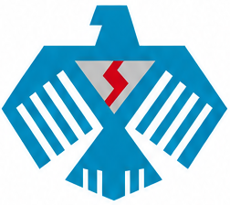

Example: Nation-led solutions
Chippewas of the Thames First Nation is developing an Indigenous-led Trade School:
  “a lifelong learning and workforce development ecosystem that connects education, training, apprenticeship, employment, entrepreneurship, and continued learning”
  Three foundational models:
      Lifelong learning
      Workforce development
      Child-centric approach
      “Cultural learning, mentorship, holistic supports, and Indigenous ways of knowing will be woven throughout all programming”
42
Building Bridges | Catalyzing Change

Slide 43
Five Actions to Take Now
1
Meet with the economic-development team
2
Identify the likely projects and growth sectors in your territory
3
Work backward from hiring dates and qualification requirements
4
Bring workforce commitments into procurement and project negotiations
5
Build a repeatable model instead of starting over for every project
43
Building Bridges | Catalyzing Change
Notes:
Speaker: Jesse.

Slide 44
Key Takeaways
01
Start Before the Project Arrives
By the time an EPC contractor is on site, it is too late to start training. Standing capacity has to be built years ahead of the shovel going in the ground.
02
Tie Procurement to Training
Joint ventures and impact-benefit agreements are the leverage point. Build workforce commitments into the partnership terms, not as an afterthought.
03
Build Once, Reuse Often
A repeatable, forecasting-based model beats a one-off response to every new project — and it compounds capacity and benefit over time.
44
Building Bridges | Catalyzing Change

Slide 45
What opportunity is coming to your region that you need to start preparing for today?
DISCUSSION
Notes:
Follow-up prompts:
What skills will be needed?
Who controls the entry points?
What commitments should be negotiated now?

Slide 46
Discussion – Session Wrap Up
Which major projects or industries are emerging in your region?
What occupations will those projects need?
How long do the credentials or apprenticeships take?
Which barriers will stop people from starting or staying?
Who needs to be at the table before demand arrives?
What is being negotiated through IBAs, JVs or procurement?
Where is the greatest gap between training and actual employment?
What prevents earlier workforce planning?
Which partners need to be brought into the conversation?
What would a repeatable model look like in your community?
46
Building Bridges | Catalyzing Change

Slide 47
MOKWATEH
The goal is not simply to fill today's vacancies. It is to create the skills, partnerships, businesses, and systems that allow Indigenous communities to capture opportunity over the long term.
Finding common ground and creating common good in the Indigenous Economy
Max Skudra // Jesse McCormick // mokwateh.com
We welcome the chance to continue this conversation.
Notes:
Speaker: Jesse and Max. Include contact details and an invitation to continue the conversation.

Slide 48

Connect With Us
To ask any questions, big or small
jmccormick@mokwateh.com
mskudra@mokwateh.com
MAILING ADDRESS
41 Copper Thunderbird Road,
Sand Point First Nation, ON P0T 2B0
Land Acknowledgement
The Mokwateh team lives and works across Turtle Island which is representative of a diverse and beautiful mosaic of Indigenous Nations.
FOLLOW MOKWATEH
SPEAKING ENGAGEMENTS
JP Gladu and the team are accomplished public speakers, bringing current issues and insights to your organization’s stage.
Our head office is located on Sand Point First Nation on the eastern shores of lake Nipigon within the Robinson Superior Treaty which was signed in 1850 and is represented by the Anishinaabe Nation.
JOIN THE TEAM
Do you share our vision for the future of Canada’s Indigenous Economy? Let’s talk. Please send your resume to info@mokwateh.com so that we may reach out for relevant roles.
mokwateh.com/contact
48
Building Bridges | Catalyzing Change

Slide 49
Hidden slides

Slide 50

Max Skudra
TEAM
Partner
+647 970-3160 | mskudra@mokwateh.com
Max Skudra is a Partner at Mokwateh and brings a wealth of experience and dedication to Indigenous reconciliation and community empowerment.
Max brings extensive experience working with Indigenous people, communities, and businesses to Mokwateh. He formerly led the research department for the Canadian Council for Indigenous Business (CCIB), his work has been used to create the Federal government’s 5% procurement target for Indigenous businesses, to justify the province of Ontario’s $100 million Indigenous Economic Development Fund (IEDF), and to set corporate strategy for companies like VIA Rail, Canada Post, Enbridge, and OPG. Max has worked with hundreds of First Nations, Métis, and Inuit communities, spending his time building relationships with a hands-on understanding of what it takes to create economic reconciliation.
Max served on the Working Committee developing the Indigenous chapter for the United States-Mexico-Canada Agreement (USMCA) alongside Global Affairs Canada and a small team of key stakeholders including the Assembly of First Nations, Inuit Tapiriit Kanatami, and the Métis National Council. He was also a member of the Canadian Project Consultative Committee for The Organization for Economic Co-operation and Development (OECD), an international initiative for Indigenous economic development. Max currently sits on the diversity and inclusion committee for the Canadian Research Insights Council (CRIC). With his professional experience and aptitude, Max is well qualified to successfully plan, conduct and present practical knowledge and research for the proposed project.
Expertise
Quantitative & qualitative research
Community engagement
Project management
Building networks
Event organization
Advocacy & government relations
Incorporating Indigenous perspectives
Strategy & planning
Indigenous procurement
Reconciliation
Building Bridges | Catalyzing Change

Slide 51

Jesse McCormick
TEAM
Senior Advisor
jmccormick@mokwateh.com
Jesse McCormick works at the intersection of First Nations rights, environmental protection and major project development.
Jesse previously served as Senior VP, Research, Innovation and Legal Affairs for the First Nations Major Projects Coalition, Director of Policy and Indigenous Relations for the Minister of Environment and Climate Change and Director of Rights Implementation for the Minister of Justice and Attorney General of Canada. In those roles, he helped to support First Nations participation in major project development and contributed to the establishment of Indigenous Protected and Conserved Areas, the reform of Canada’s environmental assessment processes and the passage of federal legislation to implement the Declaration on the Rights of Indigenous Peoples.
Jesse has also advanced First Nations rights and interests internationally as a Senior Indigenous Fellow at the Office of the United Nations High Commissioner for Human Rights and he has served as a law clerk at the Federal Court of Canada. He holds degrees from the University of Guelph, the University of Ottawa and the Harvard Law School. Jesse is a member of the National Board of the Liberal Party of Canada and previously served as Chair of the Indigenous Relations Council of the Canadian Nuclear Association. Outside of his work with Mokwateh, Jesse practices law with a leading Canadian law firm focused on supporting First Nations in relation to major project development.
As a proud citizen of Canada, the Anishinabek Nation and the Oneida Nation (Wolf Clan), Jesse is committed to the achievement of reconciliation through the implementation of rights, treaties and responsibilities.
Expertise
First Nations Rights Implementation & Reconciliation
Major Project Development & Indigenous Participation
Environmental & Impact Assessment Reform
Indigenous–Crown Relations & Public Policy
International Indigenous Human Rights Advocacy
Building Bridges | Catalyzing Change

Slide 52
Supports Determine Whether Training Converts Into Participation
Ask what people need to start, stay and advance.
Transportation
Childcare
Tools / PPE
Mentorship
Work Rotations
Accommodation
Cultural Obligations
Retention Supports
Some supports may sit outside the formal training mandate, but they still shape whether people can participate.
52
Building Bridges | Catalyzing Change
Notes:
This slide validates barriers without overloading the audience.

Slide 53
A Repeatable Workforce Development Framework
A practical cycle ISET holders can adapt across sectors.
1
2
3
4
5
1. Scan
Project Pipeline
›
2. Forecast
Skill Demand
›
3. Identify
Gaps & Barriers
›
4. Build
Partners + Supports
›
5. Deploy, Measure
and Refine
The framework turns “capacity building” into a repeatable operating rhythm.
53
Building Bridges | Catalyzing Change
Notes:
This is the central strategy slide. Return to it during Q&A.

Slide 54
Lessons From Mokwateh's Work
Forecasting improves the reuse of training and equipment
Workforce and procurement plans should be developed together
Short-term investments can support multiple future projects
Indigenous businesses benefit when demand is predictable
Community-specific plans work better than generic targets
54
Building Bridges | Catalyzing Change
Notes:
Speaker: Jesse.

