Slide 1
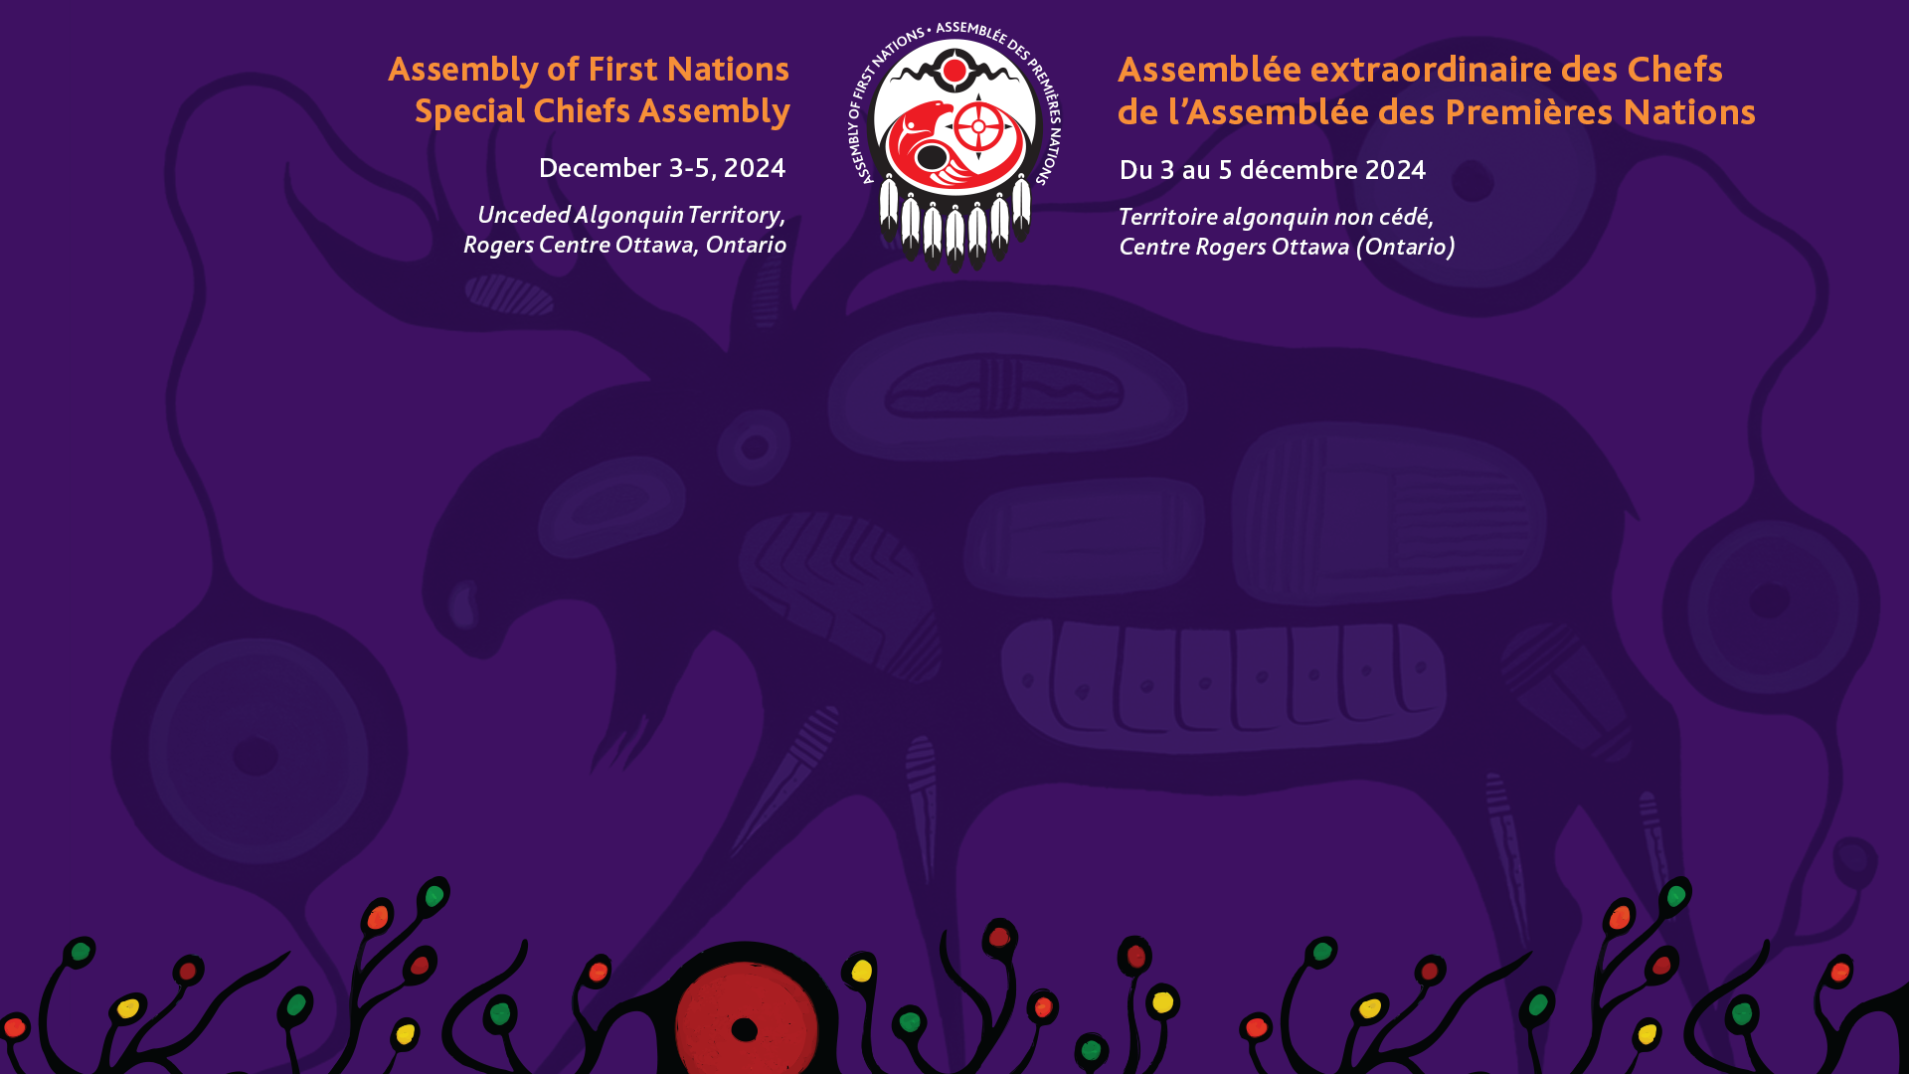
Exercising Jurisdiction over Child and Family Services, Update on An Act respecting First Nations, Inuit and Métis children, youth and families
Monday December 2, 2024

Slide 2

Overview
Background
Overview of the AFN’s Mandate
Joint Protocol
Recent Supreme Court Ruling
Firelight Group’s Research and Engagement
Current Advocacy
Looking Ahead
Questions
Facilitated Discussion

Slide 3
Background
In 2019, Canada passed Bill C-92, An Act respecting First Nations, Inuit and Métis Children, Youth and Families (the Act), which came into force on January 1st, 2020.
The Act was developed with input by the Assembly of First Nations (AFN) through a legislative working group, comprised of First Nations leaders, technicians and experts from across the country, drawing on years of advocacy and direction.
The Act affirms the inherent right of First Nations to self-government, which includes jurisdiction over child and family services, and provides a pathway for First Nations to exercise their legislative authority in relation to child and family services.
Indigenous Services Canada reports that as of September 13, 2024, 238 Indigenous Governing Bodies have been approved for capacity-building funding under the Act.
Additionally, 11 Coordination Agreements have been signed, with 18 more currently at Coordination Agreement Discussion tables.

Slide 4
AFN Mandate
AFN Resolution 16/2019, An Act respecting First Nations, Inuit and Métis Children, Youth and Families— Transition and Implementation Planning, directs the AFN to establish a Chiefs Committee on Child and Family Services and Self-Determination and a technical sub-committee of the Chiefs Committee called the First Nations National Transition Planning Committee.
The AFN and both Committees are further directed to:
  Support First Nations self-determination in all matters related to the Act, including the choice not to work within the Act.
  Conduct their work in a manner that affirms the inherent and Treaty rights of First Nations.
  Not restrict or limit the pace of implementation of the Act where First Nations are prepared to exercise their own jurisdiction.
  Acknowledge and defer to regional or local committees created to implement the Act and respect the rights and title holders of First Nations as the rightful decision-makers in relation to their children and families.

Slide 5
AFN Mandate (cont’d)
AFN Resolutions 30/2019, 31/2019 and 88/2019 provide regional specific direction with respect to implementation of the Act by directing:
  Canada to support and fund a First Nations-led, distinctions-based transition and implementation planning process for the Act.
  Canada and the AFN ensure established Nation-to-Nation and First Nation regional tables are prioritized over AFN national table processes pertaining to negotiations and discussions to work outside and inside the Act.
  That any national table process affirm and assert in a manner that guarantees transparency and accountability with the rights holders as it relates to the Act.
  Canada to engage in region specific processes with British Columbia (30/2019), Ontario (31/2019) and Saskatchewan (88/2019).

Slide 6
Joint Protocol
In 2020, a Joint Protocol was signed between the AFN and Indigenous Services Canada (ISC) on behalf of Canada that serves to guide collaborative work undertaken in support of the ongoing implementation of the Act.
The primary elements of the mandate and direction provided through AFN Resolutions are critical to this work and as such are reflected throughout the Joint Protocol.
The Joint Protocol also sets out a bilateral process to support ongoing discussions on the implementation of the Act that includes the establishment of a Joint National Working Group to support the AFN and ISC as it undertakes these discussions.
Important to note, the work of the Joint National Working Group shall not act as a barrier to the activities of First Nations seeking to implement the Act nor are First Nations compelled to work within the process within the Protocol.
Notes:
An important element to supporting the ongoing progress in implementing the mandate provided to the AFN, is the guidance and structure provided through the Joint Protocol signed in 2020 between the AFN and ISC on behalf of Canada. This document represents a formal commitment and understanding of the respective mandates each party has with respect to the work supporting the ongoing implementation of the Act. As such, the Joint Protocol represents an important vehicle in capturing and actioning the mandate provided to the AFN through the Resolutions just discussed.
Besides also capturing the bilateral mechanism for this work, it also establishes a Joint National Working Group comprised of regional appointed representatives along with technical staff from the AFN and ISC.
Finally, the Joint Protocol explicitly provides that the work undertaken within shall not act as a barrier to First Nations seeking to implement the Act or compel any First Nations to work within the process in the Protocol. This reenforces the nature of the work undertaken as purely supportive and again respecting the decision-making authority of each First Nation as per the Resolutions discussed.

Slide 7
Supreme Court of Canada Ruling
The Government of Quebec challenged the constitutionality of the Act by launching a constitutional reference at the Quebec Court of Appeal that was heard in September 2021.
Quebec’s challenge was primarily focused on whether the federal government can assert that First Nations, Inuit, and Metis Peoples have jurisdiction over child and family services without a Treaty or an amendment to the Constitution and that the Act inappropriately impacted Quebec’s authority to regulate public services.
The AFN, as a co-drafter of the Act, intervened in the reference and argued that First Nations have always maintained their inherent right of self-government, never abrogating their jurisdiction over their children and families.
On February 9, 2024, the Supreme Court of Canada held that the Act in whole is constitutional, and in doing so endorsed the creativity of the co-drafted legislation as a viable alternative to affirm the Inherent Right of First Nations and other distinctions-based rights-holders.
Notes:
A key part of the AFN’s recent advocacy work on the Act was our involvement as an intervenor in response to Quebec’s constitutional challenge of the Act. The arguments put forward in response to Quebec’s challenge were ultimately successful with the Supreme Court of Canada finding the Act in whole is constitutional. The Supreme Court went as far as to endorse the creativity of the co-drafted legislation as a viable option to affirming the inherent rights of First Nations.
With this ruling, attention is now turned to ensuring the provincial and territorial governments respect this finding and consistently and meaningfully engage in future and ongoing Coordination Agreement Discussion tables.

Slide 8
Firelight Group Project
Strategic communications planning to support the AFN in determining its most effective role in information sharing around Bill C-92
Development of principles for safe and meaningful data collection related to Nations advancing jurisdiction through the Bill C-92 process.
Development of considerations for a long-term approach for jurisdictional capacity funding.
Research on First Nations models of dispute resolution.
Analysis and understanding of potential statutory funding frameworks to ensure adequate and sustainable funding for Nations working with their own legal frameworks.
Notes:
To assist with the ongoing work in implementing the mandate provided to the AFN through Resolution 16/2019, the Firelight Group has been contracted to conduct supportive research and engagement on key elements regarding the Act. The project phases include:
Strategic communications planning to support the AFN in determining its most effective role in information sharing around Bill C-92.
Development of principles for safe and meaningful data collection related to Nations advancing jurisdiction through the Bill C-92 process.
Development of considerations for a long-term approach for jurisdictional capacity funding.
Research on First Nations models of dispute resolution.
Analysis and understanding of potential statutory funding frameworks to ensure adequate and sustainable funding for Nations that developed child welfare legislation.

Slide 9
Firelight Group Project
Work completed to date:
  A communications plan to support the AFN in determining its most effective role in information sharing around Bill C-92
  Background paper detailing the national data landscape on First Nations child welfare.
  A background literature review discussing concepts around capacity funding with insights on decolonizing capacity funding.
  A literature review related to understanding wise practices in First Nations dispute resolution processes including reinvigorating Indigenous legal traditions around dispute resolution.
  A report detailing some key facts and considerations around how statutory funding for C-92 may look.
Notes:
Each of the phases of work are meant to serve as a foundation on which to build various tools to support Nations in contemplating or moving through this process. Beyond just desktop research, for most of this work, Firelight anticipates doing some targeted engagement to learn from those doing this work on the ground, and in doing so, magnifying wise practices and lessons learned across Canada.

Slide 10
Firelight Group Project
Anticipated next steps for this work include:
  Engaging with Nations in various stages of the C-92 process to understand lessons learned around jurisdictional development with the intent of highlighting wise practices that emerge to support First Nations across the country.
  Undertake the development of a public-facing document meant to support First Nations in the considerations related to data within the C-92 context.
Notes:
One of the next steps to be undertaken is some targeted engagement on capacity building, specifically with Nations in various stages of the C-92 process to understand lessons learned around jurisdictional development with the intent of highlighting wise practices that emerge to support First Nations across the country. This could include information related to capacity building, community engagement, law and policy development, and program and service design, among others.
The capacity building will likely be of particular interest with the anticipate work given the interesting findings emerging so far. Specifically, the current paradigm being inherently deficit based in starting with what Nation’s do not have. Firelight would like to explore through its engagements ways to shift the foundation of these sorts of funding supports to one grounded in Indigenous rights and Canada’s moral and ethical obligations to make up for what was taken from First Nations.
In addition, we will be working with Firelight on a public-facing document meant to support First Nations in the considerations related to data within the C-92 context. These are important points to consider when contemplating or advancing within negotiations and in seeking capacity support.

Slide 11
Current Advocacy
Focus of current advocacy at the bilateral table with ISC includes:
  Data Strategy
  Long Term Funding Framework
  Meaningful Engagement on funding authority renewal
  Seeking clarity on ISC’s planned approach to the 5-Year Review of the Act
  Finalizing the inclusion of the ongoing implementation work of the Act into the Permanent Bilateral Mechanism draft priorities

Slide 12
Looking Ahead
Work to be explored and possibly undertaken could include:
  Renewal of the Joint Protocol with ISC
  Identifying linkages to the ongoing long-term reform work for Child and Family Services programming
  Seeking an updated mandate from the First Nations-in-Assembly
  Communicating the final support products from the Firelight Group’s work
  Ensuring ISC is undertaking its responsibility to meaningfully engage First Nations as the rightful decision makers

Slide 13
Discussion
Opportunities
  What do you see as the biggest opportunity presented by the Act?
  In what way(s) can the AFN focus its work to support First Nations in helping to realize these opportunities presented by the Act?

Slide 14
Discussion
Challenges and Barriers
  What types of challenges or barriers has your First Nation experienced with respect to pursuing the pathway to exercising jurisdiction under the Act?
  Do you have any suggestion as to how these challenges and/or barriers could be addressed or removed?

Slide 15
Discussion
Priority Areas of Focus
  Having heard an update on the ongoing and anticipated work of the AFN, does it align with what you would consider priority issues with respect to the ongoing implementation of the Act?
  If not, what other areas of focus do you feel are not reflected in the work presented today?

Slide 16
Discussion
Are there any final thoughts or questions anyone would like to share regarding the discussion this afternoon that we have not touched on?

Slide 17
Conclusion
Thank you everyone for you participation!

