Slide 1

First Nations National Action Plan for the United Nations International Decade of Indigenous Languages
(2022-32)

Slide 2

Introduction
The Action Plan was developed by the Assembly of First Nations (AFN) to ensure First Nations are involved in setting the agenda for the Decade
The Action Plan was ratified by First Nations-in-Assembly in April 2023, through AFN Resolution 10/2023, Support for the First Nations National Action Plan for the United Nations International Decade of Indigenous Languages (2022-32)
Notes:
The Decade provides unique language revitalization opportunities for our generation and for generations to come
The Action Plan was developed with feedback from engagements, reports and input from the Technical Committee on Languages (TCOL)
Government policies and actions aimed to destroy First Nations languages
First Nations have advocated for urgent action to support their languages for decades however, insufficient funding and support have impeded progress
Other relevant Resolutions that guide our work:
AFN Resolution 17/2022, Support for the First Nations Languages Funding Model
AFN Resolution 47/2022, First Nations Languages – A Defined and Enforceable Right
AFN Resolution 2021/16, United Nations International Decade of Indigenous Languages, calls on the AFN, the TCOL and the Chiefs Committee on Languages (CCOL) to support activities of the Decade, including planning, participation and funding

Slide 3
The Vision
Growth in First Nations language reclamation, revitalization, maintenance and normalization, including access to instruction and language fluency
Greater visibility of First Nations languages
More coordination across First Nations and language organizations
Increased support from all levels of government and sectors
Adequate, sustainable, and long-term funding for languages
Notes:
First Nations control of First Nations languages
Provides examples for action at all stages of revitalization
Enhances awareness of the value and importance of First Nations languages
Increase support from all levels of government, opposition parties, advocacy organizations, all sectors of civil society
The Decade is an opportunity for action and to build enthusiasm and engagement among First Nations of all ages
Renewing engagement in revitalizing our languages can greatly benefit our people and communities
Recognizes that language revitalization requires support from all segments of society, and each has a role:
First Nations and First Nations organizations
Canadians across the political, cultural, and socio-economic spectrum
The AFN to help establish support mechanisms and to continue funding advocacy (including Decade-specific funding) and improved government processes
All levels of government, opposition parties, civic leaders from all sectors
Enhancing awareness:
Increase awareness of the relationship between languages and traditional territories
Increase the visibility of First Nations languages
Increasing Engagement:
The Action Plan considers priorities for every stage of language revitalization
Languages states provide the basis for increasing engagement, determining appropriate action, and accessing support

Slide 4
The Objectives
To support First Nations languages so they thrive as living languages over the course of the Decade and beyond by:
  Enhancing Awareness
  Increasing Engagement of First Nations
  Building Community Strategies
  Enhancing Support
  Improving Measurement

Slide 5
Timeline
The Launch: 2022 – 2023
  Developing awareness, engagement, communications strategies, enhancing regional and national supports
Phase Two: 2024 – 2027
  Planning, creating partnerships and opportunities, awareness
Phase Three: 2028 – 2031
  Implementing language plans and programs; First Nations languages becoming better integrated in communities and beyond
Phase Four: 2031 – 2032
  Measuring and sharing success; building data; advocating for more funding, resources, and support

Slide 6
Implementation Plan

Slide 7

1. Increasing Awareness
Developing Communications Plan and Decade fact sheet
Social Media Campaign - #ShareYourLangauge, #LearnAWord, #LearnAPhrase
Video Campaigns to showcase the importance of language revitalization
Logo developed for the Decade, by First Nations youth
Notes:
The Action Plan strives to build awareness among First Nations, all governments and the public at large of the value, beauty and distinctiveness of First Nations languages; of the importance of keeping them alive and thriving; and of First Nations inherent rights to their languages. The aim is for concrete commitment and action to flow from this awareness.
The Decade is an opportunity to enhance awareness and build communication among all Canadians of the value and importance of revitalizing First Nations languages of the impact colonialism has had on First Nations languages and First Nations enjoyment and exercise of their rights related to languages; and, of the relationship between languages and traditional territories.
Brent Beauchamp:
Is Anishinaabe and Onondaga from the Six Nations Reserve of the Grand River currently living in Toronto. They are an animator, and graphic designer. Their passions are rooted in creating art that represents indigenous people, culture, and uplifting other young indigenous artists.

Slide 8
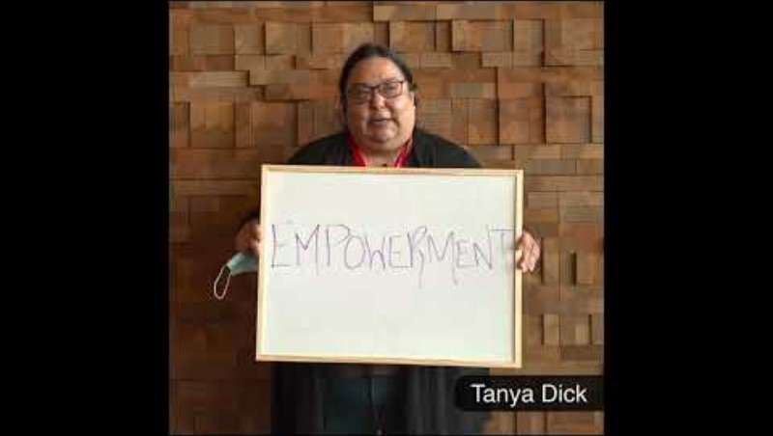
Implementation Plan
  Video Campaigns to showcase the importance of language revitalization

Slide 9
2. Increasing Engagement
Languages and Learning forums
AFN National Youth Gathering
Participating in national and international events, forums and conferences
Notes:
The Action Plan aims to increase engagement on the part of First Nations Peoples of all ages in the work of revitalizing their languages through the mobilization opportunities that are part of the Decade.
Within the first two years of the Decade, the aim is for each First Nation as well as First Nations individuals, to consider where they are at in their language revitalization journey and to begin to determine what steps they would like to take.
As an international platform, the Decade aims to mobilize Indigenous Peoples, with the support of others, to work toward greater revitalization of their languages.
Understanding each community's state of language is essential
Knowing the number and nature of a community’s speakers and the organizational capacity, and available resources is necessary for choosing appropriate strategies
Some First Nations, language families and isolates have regional or other support, and some are doing the work on their own
BC, ON, QC and NS have Regionally Designated Organizations that manage the Indigenous Languages Component funding in their regions
Building Community Strategies
The Action Plan pairs speaker categories with examples of relevant actions based on First Nations and international expertise
The Action Plan underscores the need for lifelong learning approaches in formal and informal settings acknowledges the time, cost and effort it takes to create new speakers at every stage
Speaker categories include:
Very few elders
Only Elders
Adults past child bearing age
Some intergenerational use
Language is used in community
Language is used in elementary schools
Language is widely used
The List in the Action Plan links First Nations speaker realities and situations with possible approaches that fit their situation
Enhancing Support:
All First Nations should have access to support where needed and desired
A First Nations-led national network comprised of regional representatives can help coordinate partnerships, identify resources or provide support where lacking

Slide 10
3. Building Community Strategies
Sharing the Action Plan
Development of the interim First Nations Languages Funding Model to support First Nations-led community initiatives and transition to long-term language plans
Languages and Learning Forums promoting information and materials on how to build language plans and funding agreements
Supporting community strategies
Notes:
The Action Plan provides strategies and approaches for First Nations and their organizations based on the number and type of community speakers. The Plan emphasizes the need to choose actions in appropriate sequence to ensure strong foundations for programming. The Plan also acknowledges the need to integrate First Nations languages in all sectors of society, including the arts, TV, radio, and all other types of media. One early goal is for each First Nation to have an active language plan, and, over time, to experience success according to their self-determined objectives.

Slide 11
4. Enhancing Support
Ensuring First Nations youth are involved in AFN advocacy work
Nominating First Nations representatives to UNESCO’s Global Task Force for the Decade
Budget advocacy in line with AFN Costing Analysis
2024 Pre-Budget Submission: $3.8B over the next five years to support First Nations languages and Decade-specific funding ask
Notes:
The Action Plan promotes the development of mechanisms to support First Nations, particularly where supports are not available, in areas of language planning, capacity building, accessibility to resources, and sharing innovative and promising practices. The Plan supports and encourages First Nations advocacy for adequate, sustainable, and long-term funding from all levels of government. The aim is for First Nations language activities to be funded to a level that reflects actual needs and for these activities to be well-supported by regional and national networks as determined by First Nations by the end of the Decade.
(Young World Summit, Global Task Force, United Nations Permanent Forum on Indigenous Issues, among others)
In the next five years, First Nations will require over $3.8 billion in incremental funding to support Section 8 and 9 agreements, the shift to ongoing programmatic funding, and all proposals submitted to the Indigenous Languages Component.
In the next five years, First Nations will require at least $106.6 million in funding from the Department of Canadian Heritage, and Global Affairs Canada to support language revitalization activities related to the United Nations (UN) International Decade of Indigenous Languages (IDIL).
The IDIL funding ask considers similar programming such as the Department of Canadian Heritage’s Building Communities through Arts and Heritage Program ($14M over two years) and Destination Canada ($50M over 3 years). These funds assist in celebrating communities through festivals, events, conferences and projects, similar to the funding needed for First Nations communities to celebrate the IDIL.

Slide 12
5. Improving Measurement
AFN Language Revitalization Survey
Working with DCH to acquire more data on how the ILC funding is spent
Identifying research to be done throughout the Decade to establish tools for evaluation and measurement
Notes:
The Action Plan promotes enhanced tools for measuring progress and provides a list of indicators for success that can be measured within the timeframe of the Decade. It also includes suggestions regarding who could facilitate the various measurement functions. The aim is for the implementation of a robust, accurate, and useful measurement framework that upholds First Nations data governance.
A lack of data has been a barrier to enhancing awareness, engagement, support, and to getting more funding
Enhancing data and measurement requires collaboration across communities, organizations, the government, and other parties
The Action Plan provides a list of key indicators as an example of needed data
It explores the potential roles of the AFN, the Department of Canadian Heritage, and the OCIL in collecting and distributing data

Slide 13
Conclusion
Support is essential among all Canadians – all levels of government, all political affiliations, and all sectors of civil society
With the aim to increase fluency and have First Nations languages normalized across the country
The aim is to have First Nations acquire control over First Nations language revitalization with adequate, sustainable, and long-term funding during the Decade and for years to come
What is the primary meaningful difference you hope to achieve over the course of the Decade?

Slide 14
THANK YOU / EKOSANI / NITSINIIYI’TAKI / MASI CHO

