Slide 1


Examining Language and Culture Planning
Davin Dumas
Director of Languages and Cultures, MFNERC
February 2024
Notes:
Introduction, Land Acknowledgement, Brief personal description.

Slide 2
Introductions
Who are we?
Notes:
By poll, who do we have here today. Elders, Leadership, Language teachers, Education Directors, cultural centre staff, and other.
How many language speakers?

Slide 3
Language Planning
Who here has language plans?
Who is responsible for those language plans?
What is the difference between language plans and language and culture plans?
Notes:
Ask participants for their input. What shapes our understanding of language and culture plans.

Slide 4
Purpose of Language and Culture Planning
Purpose varies
Factors that influence.
What has been done?
Notes:
Ask about some things that they have done. Reflect on the work done in the past.

Slide 5
Purpose of Language and Culture Planning
Article 11
1. Indigenous peoples have the right to practise and revitalize their cultural traditions and customs. This includes the right to maintain, protect and develop the past, present and future manifestations of their cultures, such as archaeological and historical sites, artefacts, designs, ceremonies, technologies and visual and performing arts and literature.
Article 13 1. Indigenous peoples have the right to revitalize, use, develop and transmit to future generations their histories, languages, oral traditions, philosophies, writing systems and literatures, and to designate and retain their own names for communities, places and persons. (UNDRIP)
Notes:
Essentially this Language and Culture are a right. UNDRIP lays out a few articles that reinforce this.

Slide 6
Where do we start?
Write down what you think a goal for language and culture revitalization should be for your First Nation.
  Focus on what the desired result should be for all members.
  Planning to get there involves the development of a language and culture plan.
Notes:
Take a couple of minutes to think of what the end goal should be. Keep this in mind as we go through presentation. It is possible.

Slide 7
Language and Culture Planning Steps
Find your champion or core members

Slide 8
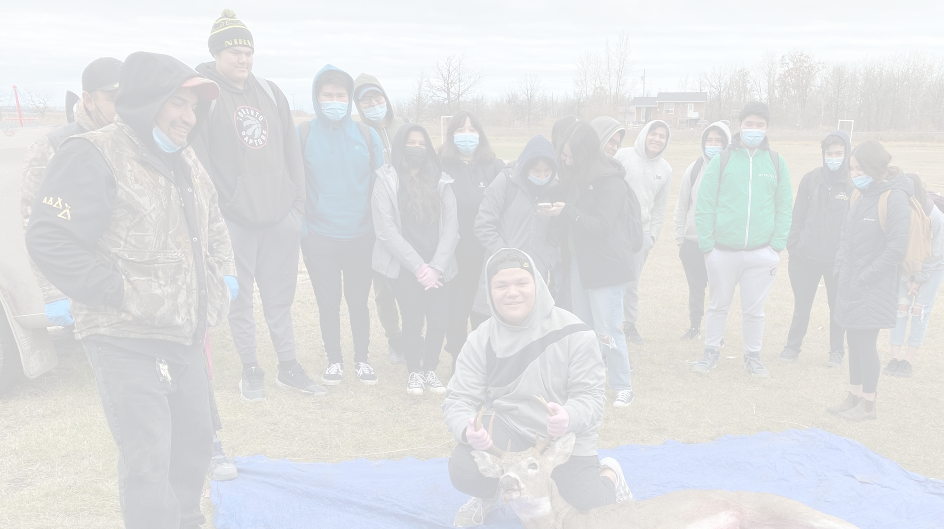
Champion or Core Members
Language and Culture Coordinators
Dedicated individuals to support all language and culture processes
Ensure that activities are taking place
Promote
Programs not affiliated with the school
Carry and implement the plan
Notes:
A position like this should be considered or part of the acquisition and revitalization process.
They are the champion who promotes, supports, and drives language and culture processes.

Slide 9
Language and Culture Planning Steps
Find your champion or core members
Determine why language is important

Slide 10
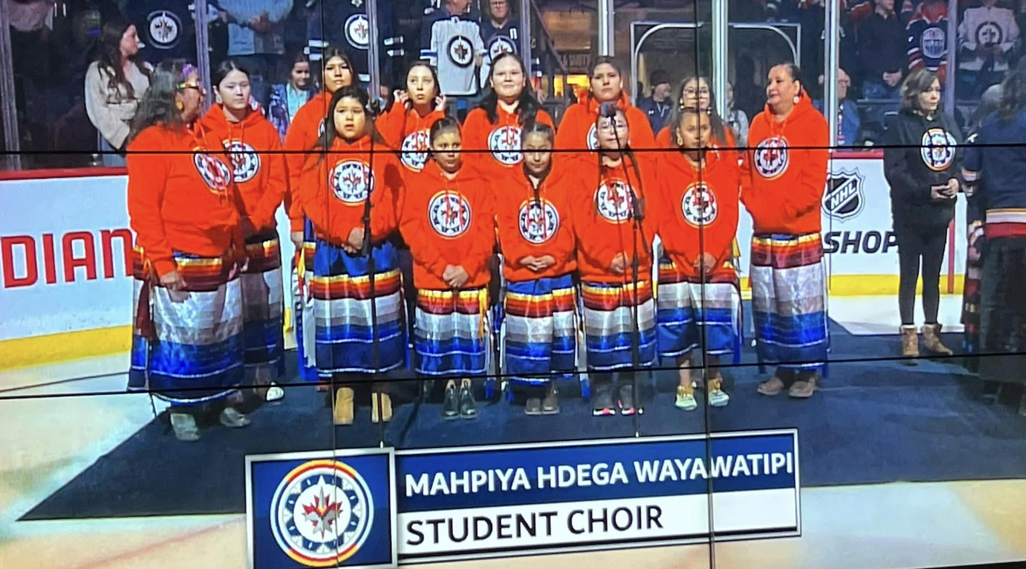
Importance of Language and Culture
First Nation Languages are in a dangerous state
Fewer new speakers are emerging
Language speakers not teaching language
A disconnect between language and culture
Cultural Knowledge is decreasing
Language and Culture define who we are
Notes:
DeCaire2% Part of social and political identity
Connect to knowledge systems, music, art, environmental, medicinal, and culture
International right, political autonomy
Health, wellness, spirituality
What do we lose when we lose our language and culture?
We lose all the ways we communicate, curse, joke, pray, etc.
We lose what makes us a distinct nation.

Slide 11
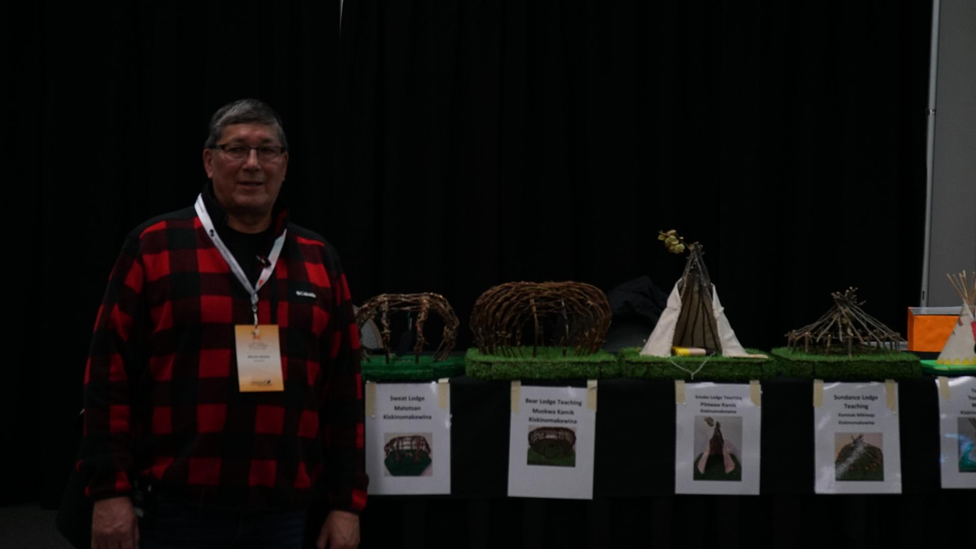
Language is Culture and Culture is Language
Have to remember this statement.
These are intertwined
Key to identity
Notes:
Dr. Verna Kirkness stresses the importance of this connection.

Slide 12
Language and Culture Planning Steps
Find your champion or core members
Determine why language is important
Assess the state of language for your First Nation

Slide 13
Assessing State of Language
Respecting Realities of Language
Each instance of language in each First Nation faces a different reality.
This determines the path for planning.
Notes:
Is key to determining what First Nations will need to do to revitalize language. There are many different ways to determine the state of language.
It is recommended that more than one approach or a combination of approaches is used.

Slide 14
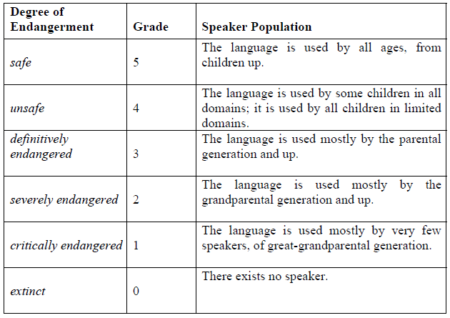
Status of Language
Notes:
UNESCO uses charts like this as a way to determine the status of indigenous languages.

Slide 15
Language and Culture Planning Steps
Find your champion or core members
Determine why language is important
Assess the state of language for your First Nation
Establish what resources are available (human, funding, space, etc.)

Slide 16
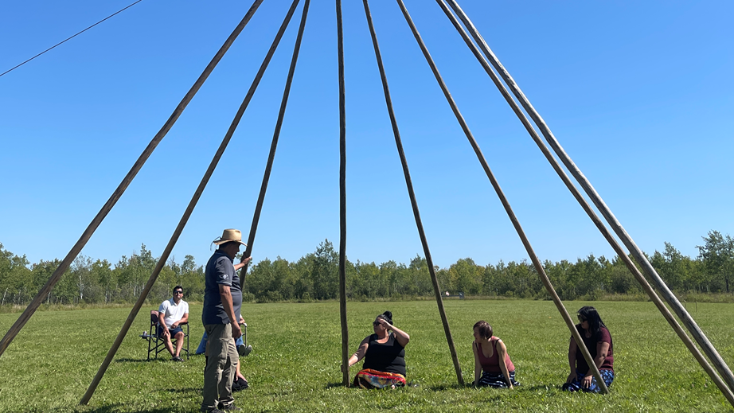
Establishing Resources
Elders to help with language and culture acquisition.
Chief and Council
Board of Education
Knowledge Keepers to assist with the cultural language.
Language Policy
Community Language Coordinator (dedicated position)
Funding sources
Resources
Building Supports
Notes:
One of the difficulties of having programs is the resources to do so.

Slide 17
Language and Culture Planning Steps
Find your champion or core members
Determine why language is important
Assess the state of language for your First Nation
Establish what resources are available (human, funding, space, etc.)
Develop a plan
Notes:
These are general statements for planning or steps up to and after the creation of a plan.
There are many examples of similar steps that exist. FPCC, FNESC, AFN, UNESCO, and others

Slide 18
Developing a Plan
Vision for all
First Nation specific starting point
Long and short-term goals
Implementation
Resources
Notes:
Your plan is what you make it. There are examples out there that you can utilized to develop your own. This step will need to include key stake holders that will support, promote and ensure efforts are carried out. Should include Elders, leadership, educators, parents, and youth.

Slide 19
Language and Culture Planning Steps
Find your champion or core members
Determine why language is important
Assess the state of language for your First Nation
Establish what resources are available (human, funding, space, etc.)
Develop a plan
Evaluate your work

Slide 20
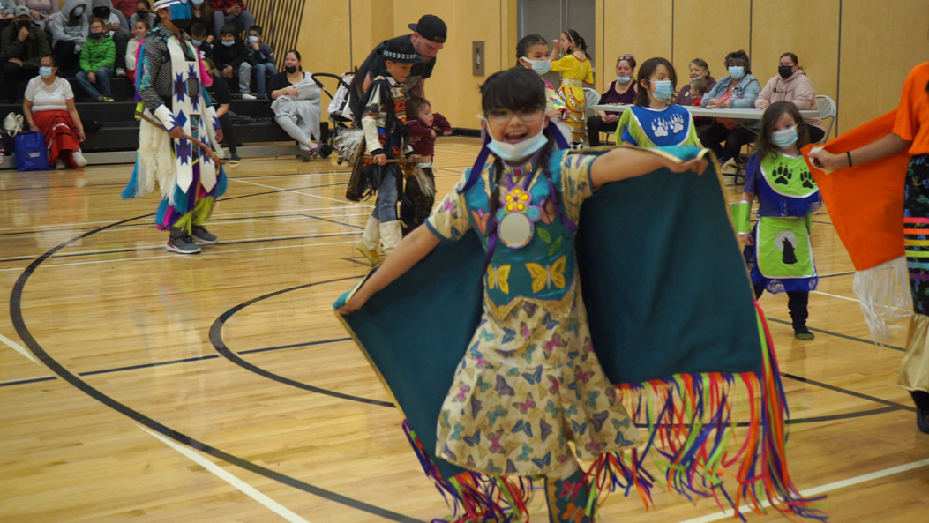
Evaluate Your Work
How will you know your activities were successful?
It is important to monitor and share your success.
Be proud of the progress. Make language and culture learners proud of what they have accomplished.
Notes:
Seeing the progress of your efforts is the reward. Having everyone speak their language needs to be celebrated. Share your success

Slide 21
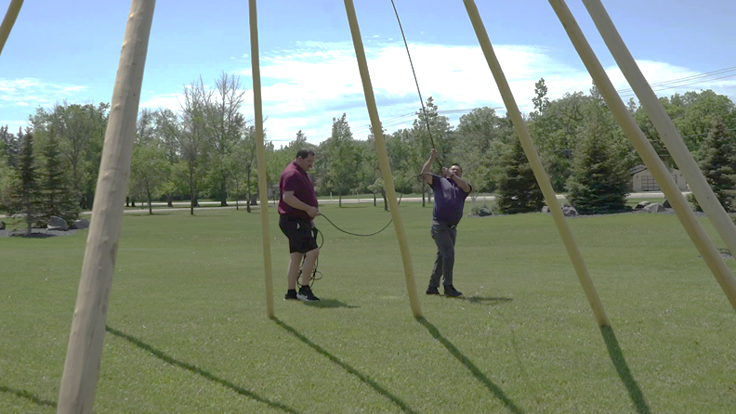
First Nation Perspective
Grounding Practices In Languages and Cultures
What are ways we can ground our practices in Language and Culture?
Notes:
First Nation Pedagogies, our ways of thinking knowing and doing.
Use what works for First Nations, for your community. Again many examles exist but take what works for you.

Slide 22
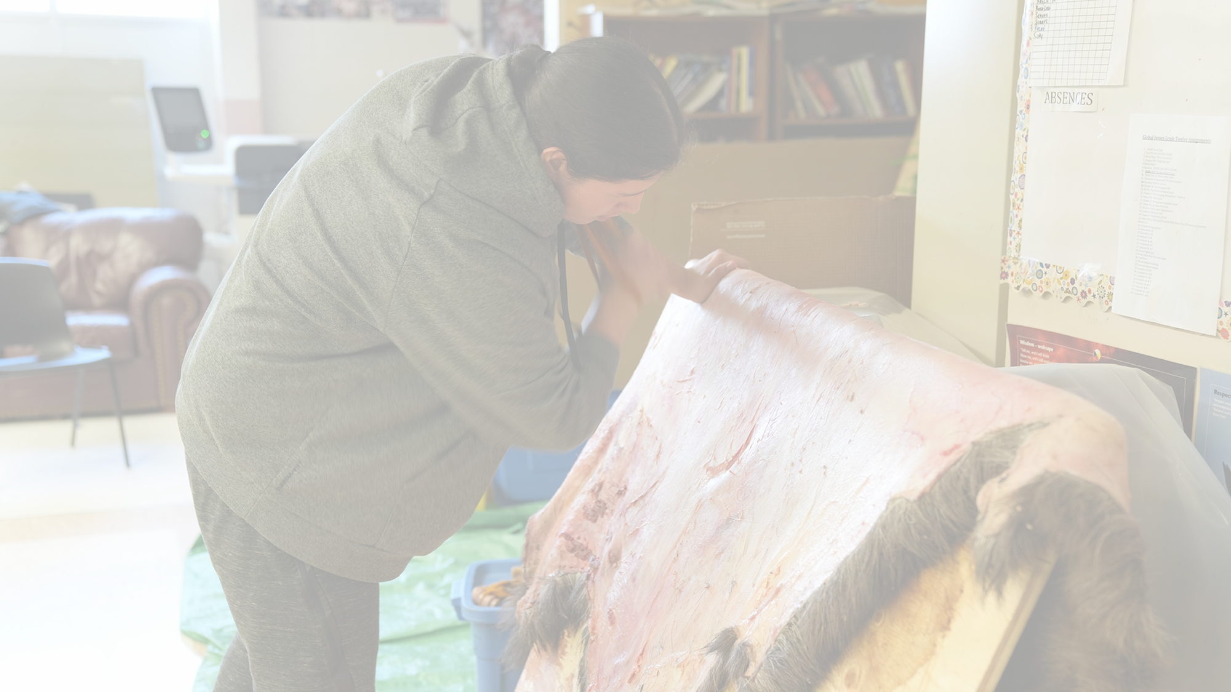
Options for Language Acquisition
Early Learning
School Programs
Youth Programs
Adult Programs
Notes:
Language nest programs, subject, bi-lingual, immersion, master-apprentice, tea and bannock sessions

Slide 23

Land-Based Education
Types of Programs makes a difference.
Language usage must be considered.

Slide 24
Barriers of Language and Culture
What has blocked the success of language and culture acquisition and revitalization?
Notes:
What are 5 things you think have blocked the success of language and culture acquisition and revitalization.
Barriers, residential schools, teaching language isolation of culture, not teaching conversationally.
We are going to park these items for now. This is what has been holding us back. We can focus on starting anew.

Slide 25
Considerations
Think about the positives of language and culture revitalization.
Do it now.
Do it with care.
Support the process
Culture is key
Include land-based education
Don’t indigenize, create a First Nation one

Slide 26


Contact information:
Davin Dumas
davind@mfnerc.com
Questions? Comments?

