Slide 1
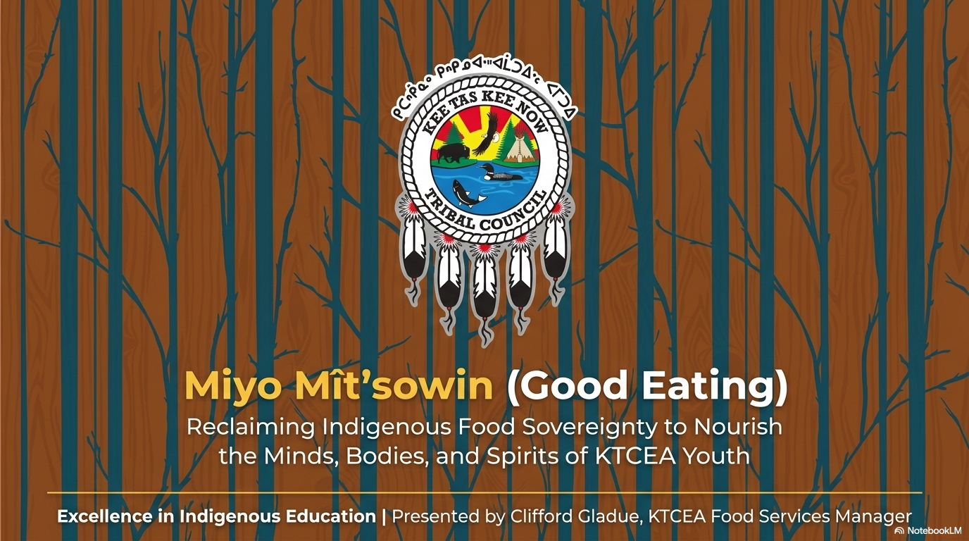
Notes:
Our traditional foods program includes two traditional meals each month for approximately 1100 students in six schools.
This is a pilot program that started in 2019, which provided our schools with a certificate to store, cook, and serve wild game on the school menu.
This fall, we have increased the program to offer four traditional meals each month.
The current traditional meals include, but are not limited to, moose, buffalo, elk, deer, whitefish, trout, salmon, duck, beaver, and oxtail.
Wildlife is harvested by local community hunters from KTC Nations and is prepared, cooked, and served in accordance with food safety guidelines.
Parental permission is required for students to participate, and it is voluntary.
The goal of the program is not only to provide healthy foods but to ensure Cree ways thrive and to leave a legacy for present and future generations.

Slide 2
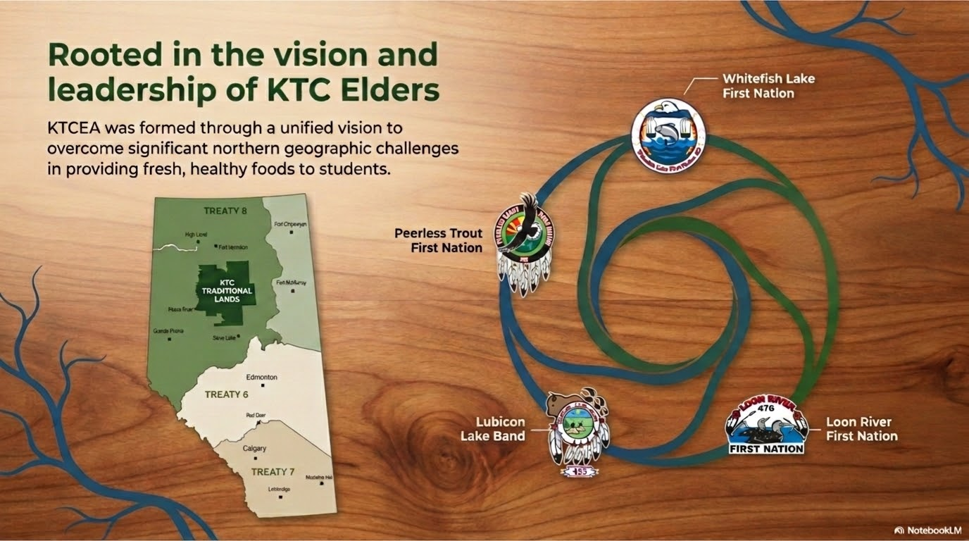

Notes:
This map shows the KTC Nations and the region our schools are located
- this area covers a geographic area of 8200 square kilometers in north central Alberta.
KTCEA was officially formed as an education authority in July 2019.
Kee Tas Kee Now Tribal Council Education Authority (KTCEA) administers education for 1100 students in six schools in five First Nation communities.
Loon River First Nation
Lubicon Lake Band,
Whitefish Lake First Nation #459, and
Peerless Trout First Nation.

Slide 3
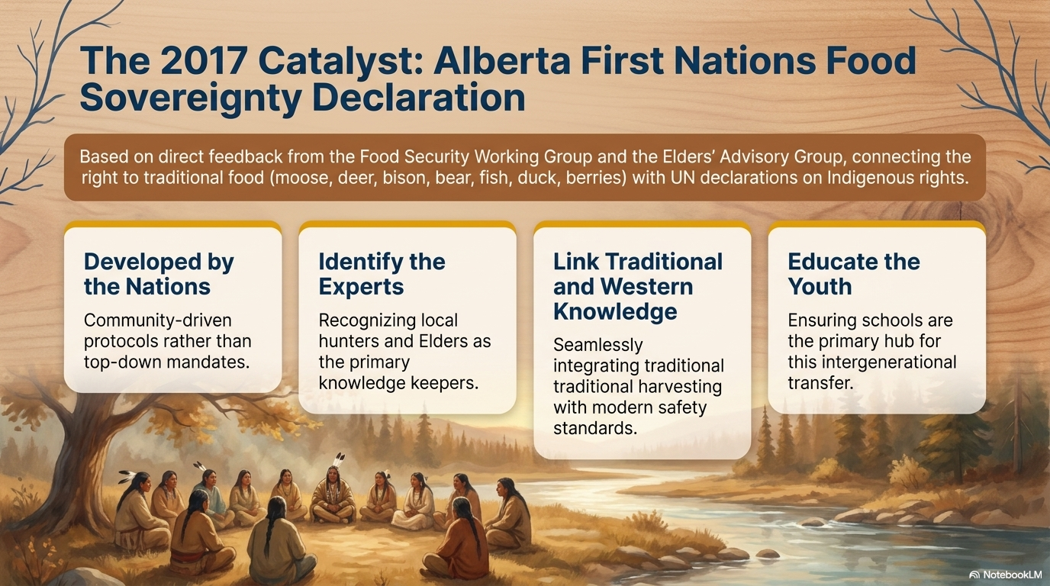

Slide 4
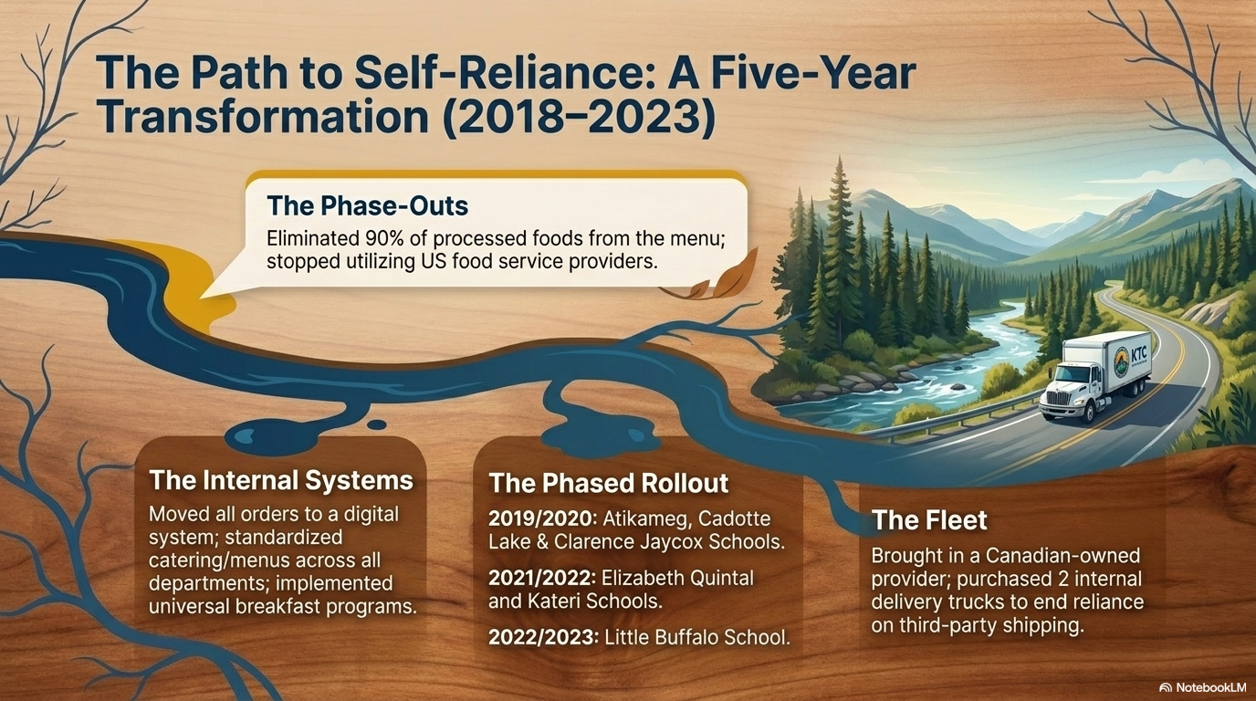


Slide 5
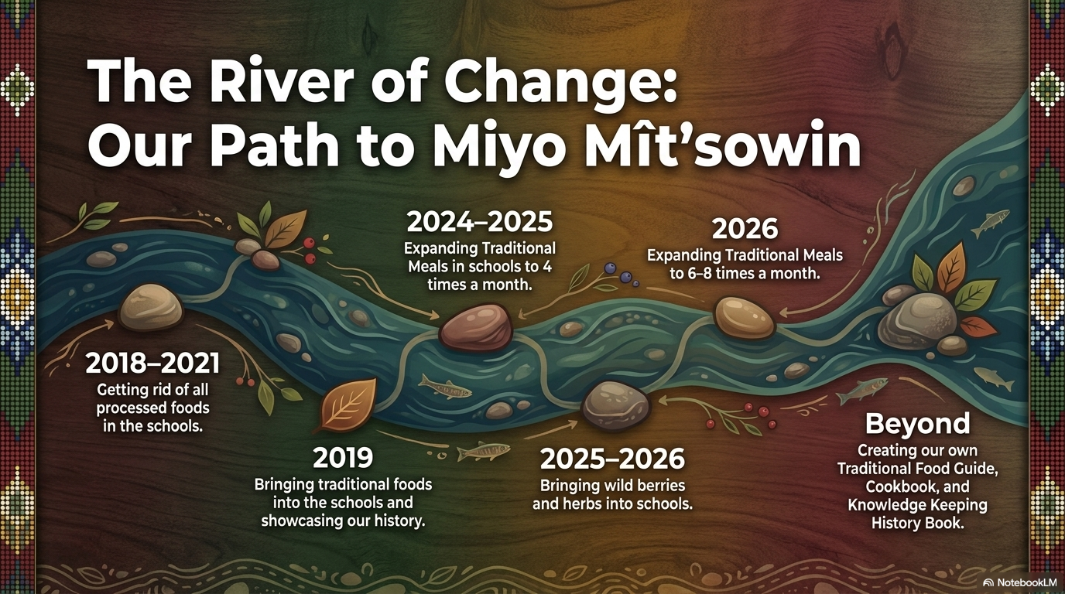
Notes:
Our traditional foods program includes two traditional meals each month for approximately 1100 students in six schools.
This is a pilot program that started in 2019, which provided our schools with a certificate to store, cook, and serve wild game on the school menu.
This fall, we have increased the program to offer four traditional meals each month.
The current traditional meals include, but are not limited to, moose, buffalo, elk, deer, whitefish, trout, salmon, duck, beaver, and oxtail.
Wildlife is harvested by local community hunters from KTC Nations and is prepared, cooked, and served in accordance with food safety guidelines.
Parental permission is required for students to participate, and it is voluntary.
The goal of the program is not only to provide healthy foods but to ensure Cree ways thrive and to leave a legacy for present and future generations.

Slide 6
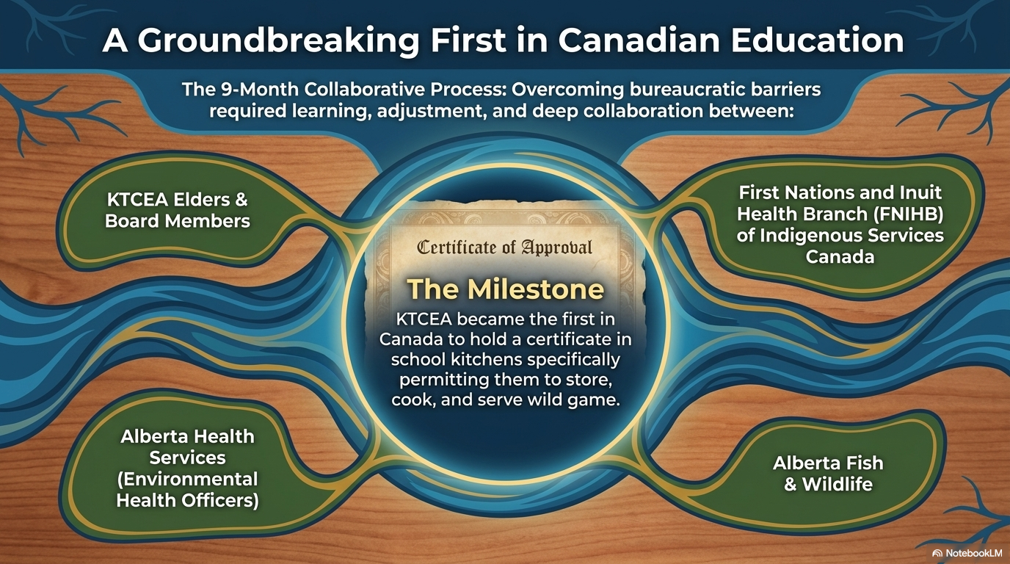

Slide 7
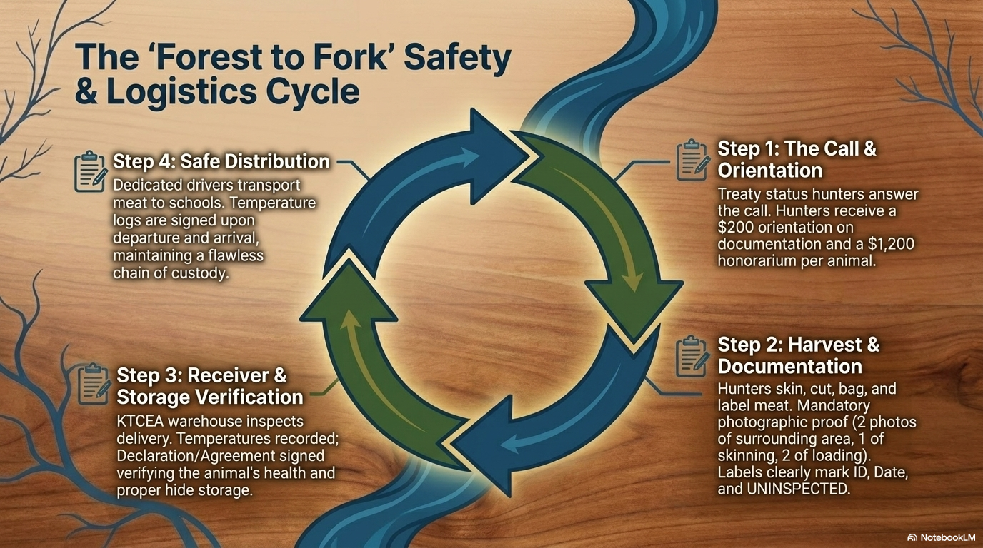

Slide 8

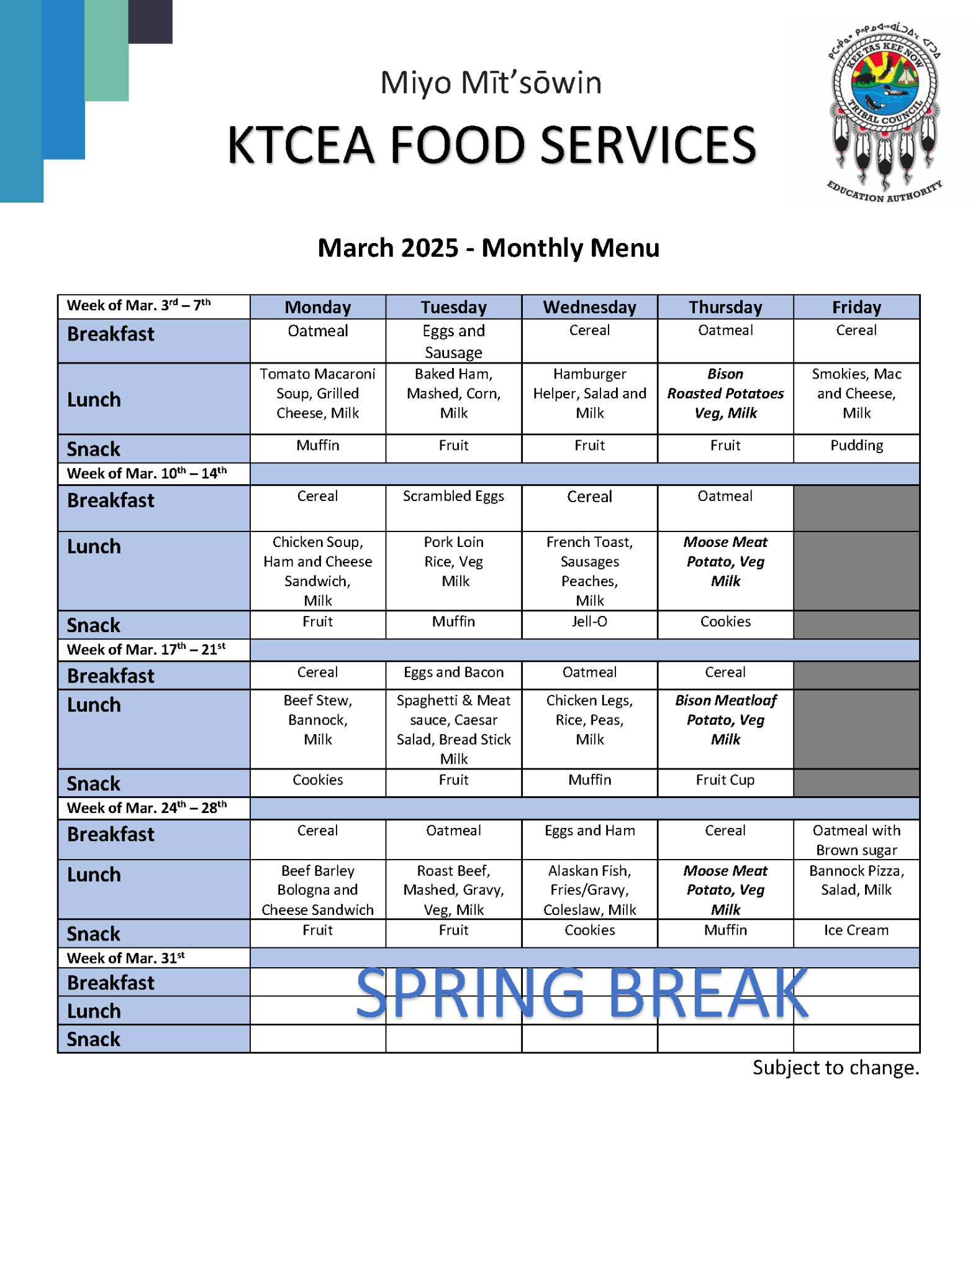
March 2025 Menu Highlights
Nutritious & Traditional Meals
The March Menu 2025 from KTCEA Food Services offers a variety of nutritious and delicious meals each week, ensuring a balanced diet for all.
Featured Dishes:
Traditional: Moose Meat, Bannock Pizza, Alaskan Fish.
Hearty Favorites: Roast Beef, Beef Stew, Spaghetti & Meat Sauce.
Weekly Comfort: Oatmeal, Eggs & Sausage, Chicken Soup.
Notes:
This is our Menu for March 2025 from KTCEA Food Services offers a variety of nutritious and delicious meals each week.
It includes traditional and contemporary dishes such as oatmeal, eggs and sausage, tomato macaroni soup, baked ham, chicken soup, pork loin, beef stew, spaghetti & meat sauce, roast beef, Alaskan fish, moose meat, and bannock pizza.
This ensures a balanced diet for all.

Slide 9
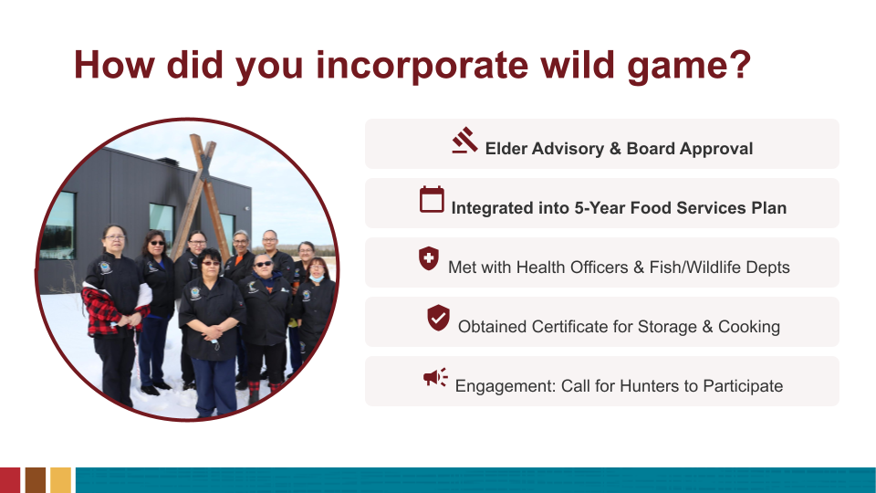
Notes:
This idea began when I was talking to an Elder, who told me about the Alberta First Nations Food Sovereignty Declaration (2017) and how a lot of young people were losing knowledge of our traditional foods. I wanted to do my part and introduce this into the schools, to serve traditional foods and school meals and support land-based learning.
I brought the proposal to a board meeting and explained what I wanted to do with this program. The Board agreed. The land-based learning camps offered at KTCEA schools have also helped to support students and staff to learn about preparing traditional foods.
This slide shows some of the steps we took:
Elder and Board approval
We made sure that serving Traditional meals and wild game in our schools was part of our food services five year plan.
Other aspects of this plan helped us to be consistent with traditional meals:
- developing a standardized menu
- Kitchen policies, procedures and training for all cooks
- Reducing most processed foods
We met with Environmental Health Officers for Alberta and Canada over 18 months
Obtained a certificate for our school kitchens to store, cook and serve wild game on the school menu.
Wild game is harvested by community hunters from KTC Nations and is prepared, cooked and served in accordance with food safety guidelines.
At first, we put a call out to hunters in each community to participate and provide moose and other meat for use in the schools. All the communities participated, but we had to adjust once we tested it, to determine how much food was needed for the schools.

Slide 10

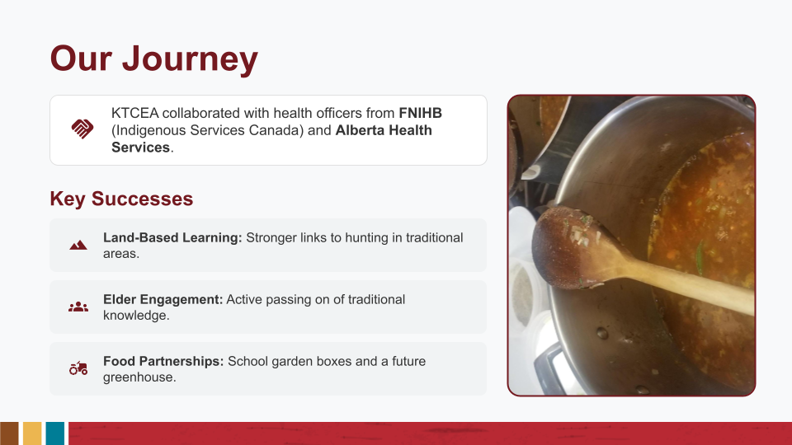
Notes:
We spent 18 months working with environmental health officers to obtain certificates for our schools. We also had Fish and Wildlife, and dieticians from federal and provincial governments involved as well.
This requires that all hunters receive an orientation. There are certain forms that must be completed. Then wild game is then inspected by the food services manager, stored and cooked so it meets health and safety requirements.
As food services manager, I was trained in receiving and inspecting the harvested wild game.
School kitchen staff and cooks have also received training for cooking wild game.
Some successes we’ve seen: The biggest is the link to traditional Cree way of life and the land-based learning that is part of our curriculum.
Students are enjoying the traditional meals and I have heard of more students are hunting in traditional areas
The schools also Elders to share stories about plants and herbs on the land and how they are being used.
KTCEA is also exploring partnerships for growing food – garden boxes at some schools and a future greenhouse project in development.

Slide 11
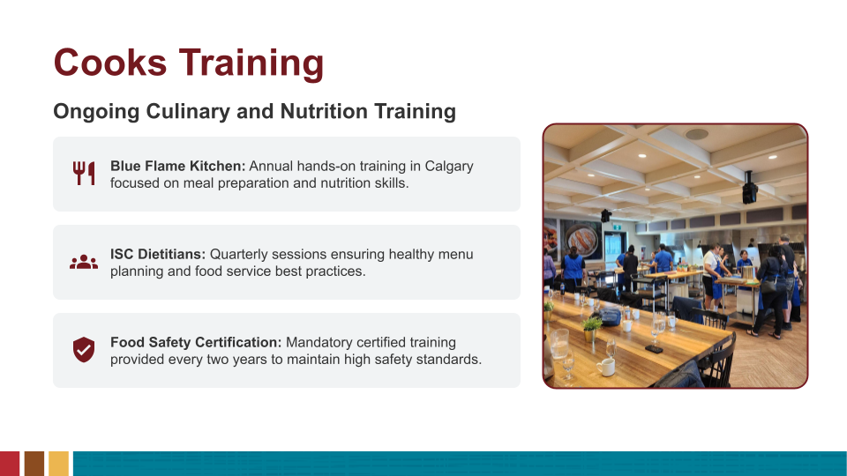
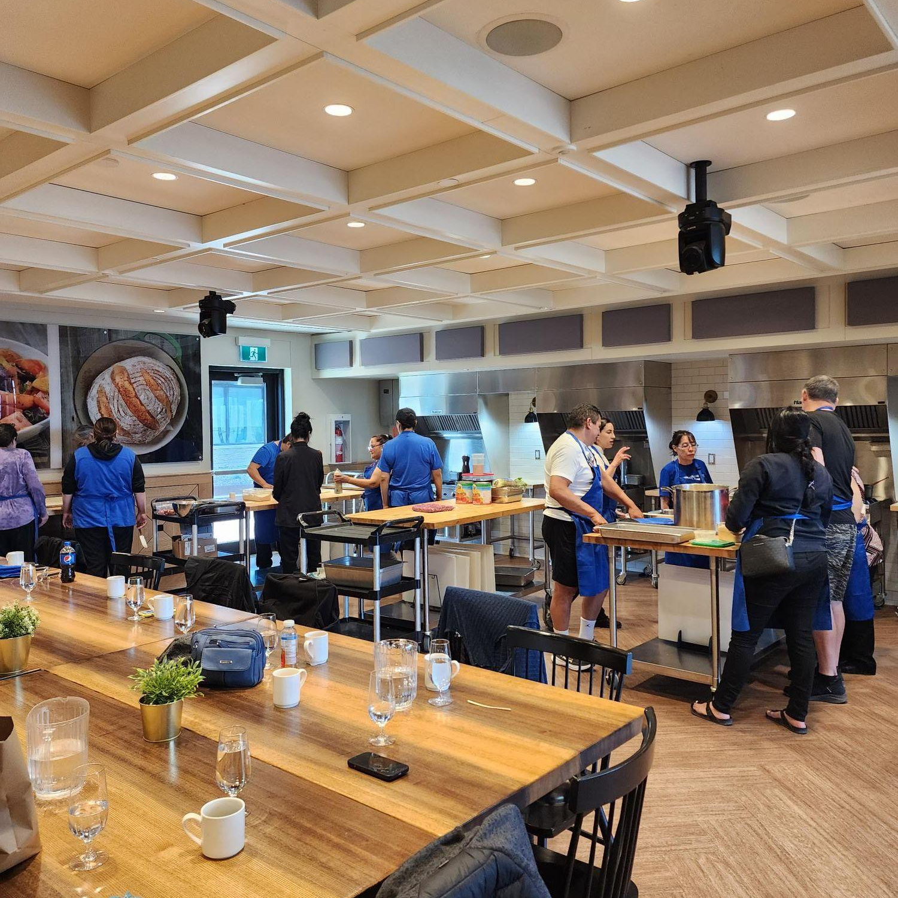

Slide 12
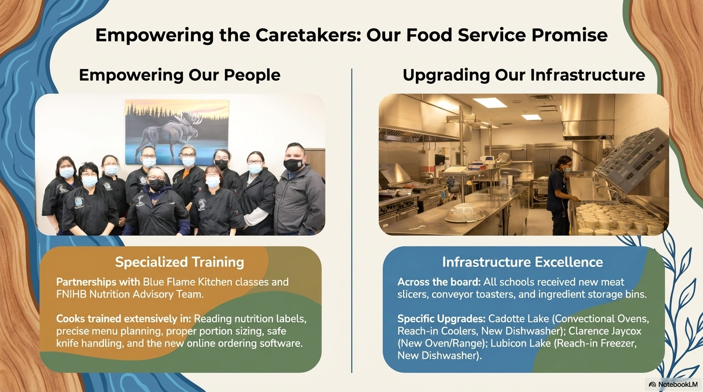

Slide 13
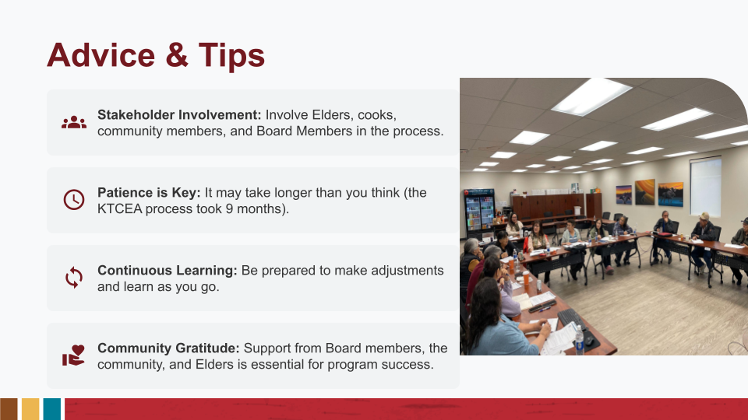
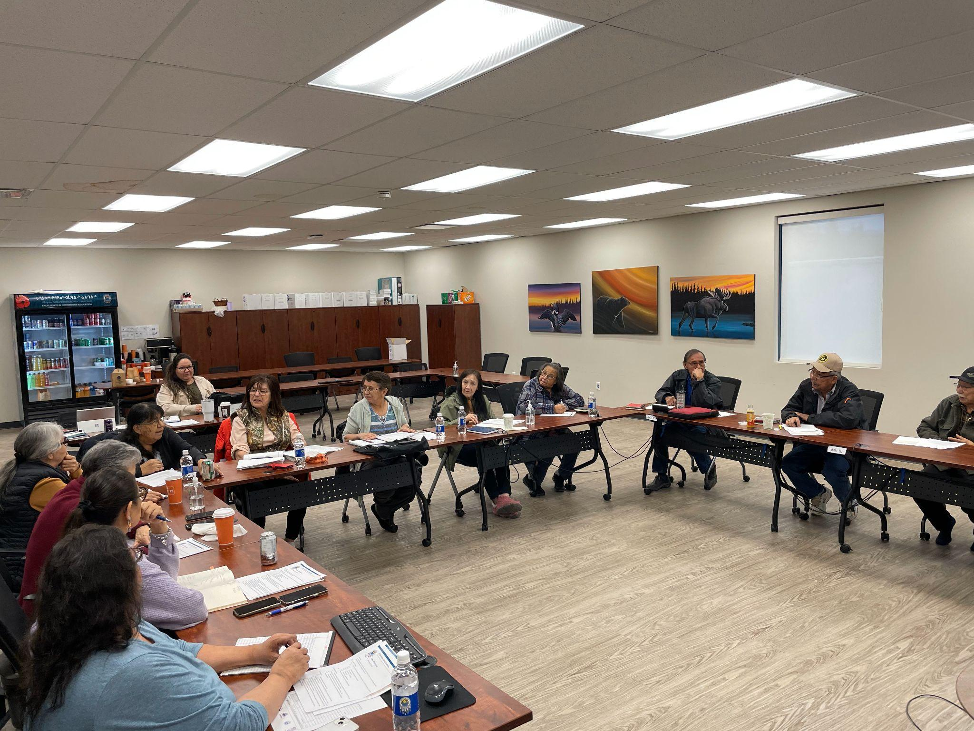
Notes:
Involve Elders, cooks, community members and Board Members in the process from the start.
Our cooks have been a big part of our success. Most of our cooks already knew how to prepare and cook traditional foods.
It may take longer than you think (ours took 18 months) or working to ensure the health and safety certificate and processes were approved by both provincial and federal governments.
Its worth it in the end: you will develop good partnerships with hunters from the communities, teachers and Elders sharing local, traditional knowledge with students.
Some things we needed to adjust:
When we first started – we had to figure out how to organize the hunting and get the supply of meat. We started a hunting pool but that didn’t work well. So, then we gave everyone a chance to hunt if they were interested. We keep track so we don’t always have the same people. We try to give different hunters from each community a chance to be involved.

Slide 14
Our Journey & Future Milestones
ACHIEVED GOALS
NEXT STEPS (2026-2027)
Bringing traditional foods into the schools (2019)
Showing our history (2019)
Getting rid most of processed foods (2018-2021)
Expanded Traditional Meals to 4x a month (2025-2026)
Bringing wild berries and herbs into schools (2026/2027)
Expand Traditional Meals to 6-8x a month (2026)
Creating our own Traditional Food Guide (2026)
Cookbook & Knowledge keeping History Book (2027)

Slide 15
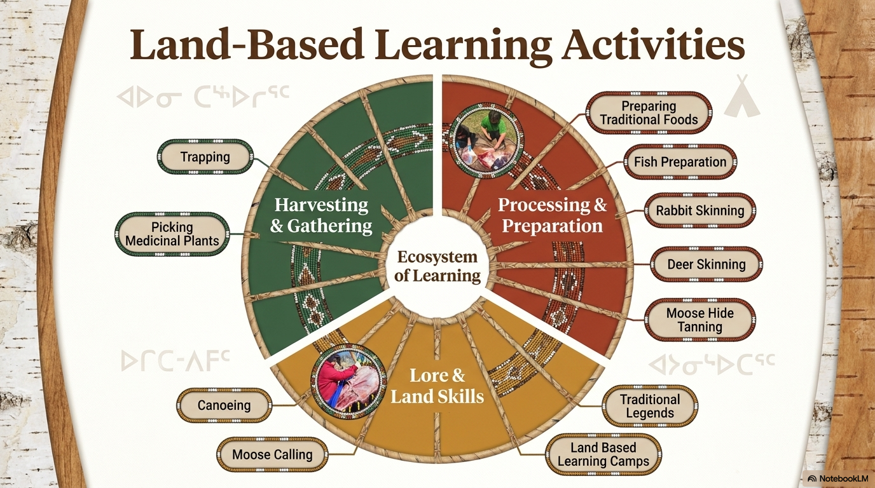

Slide 16
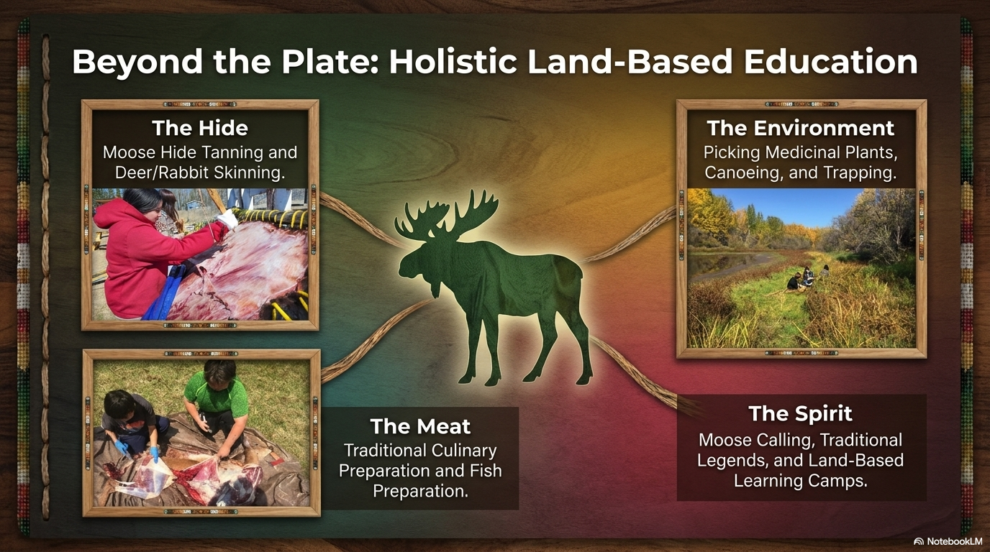

Slide 17
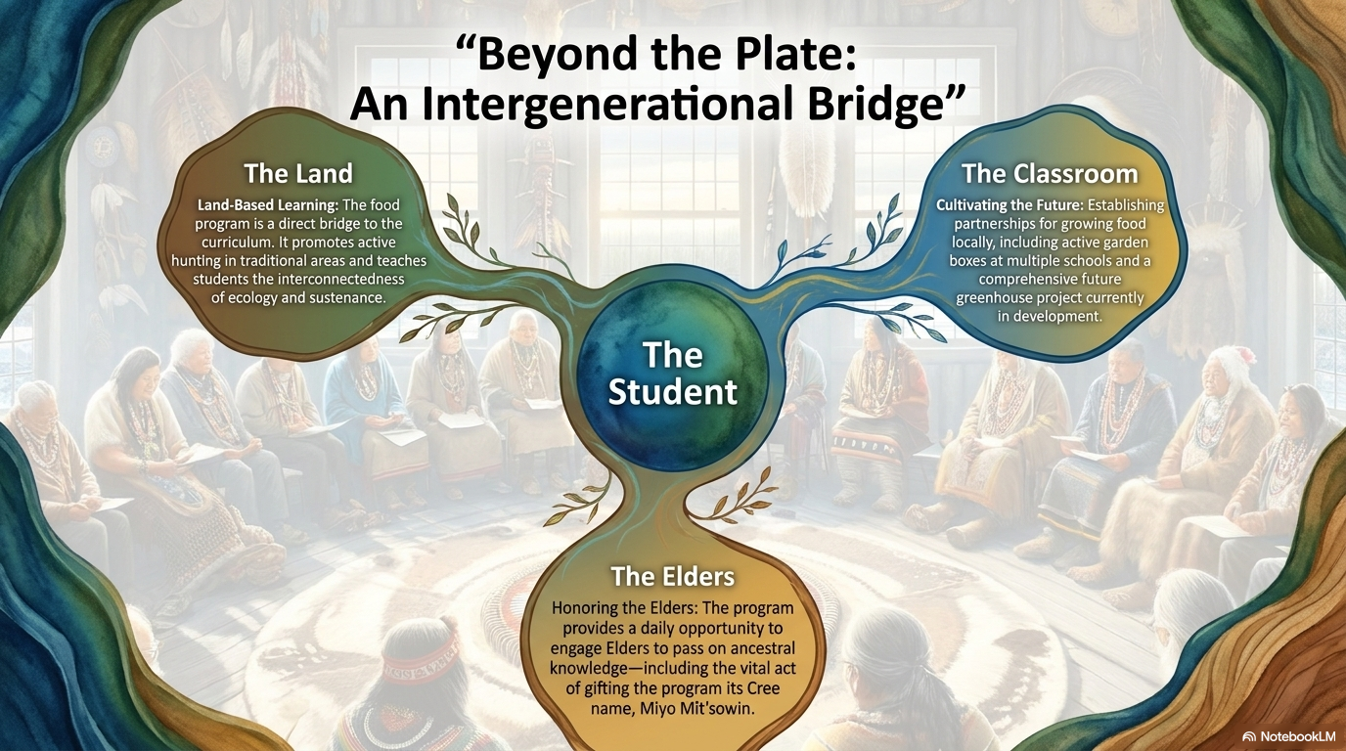

Slide 18
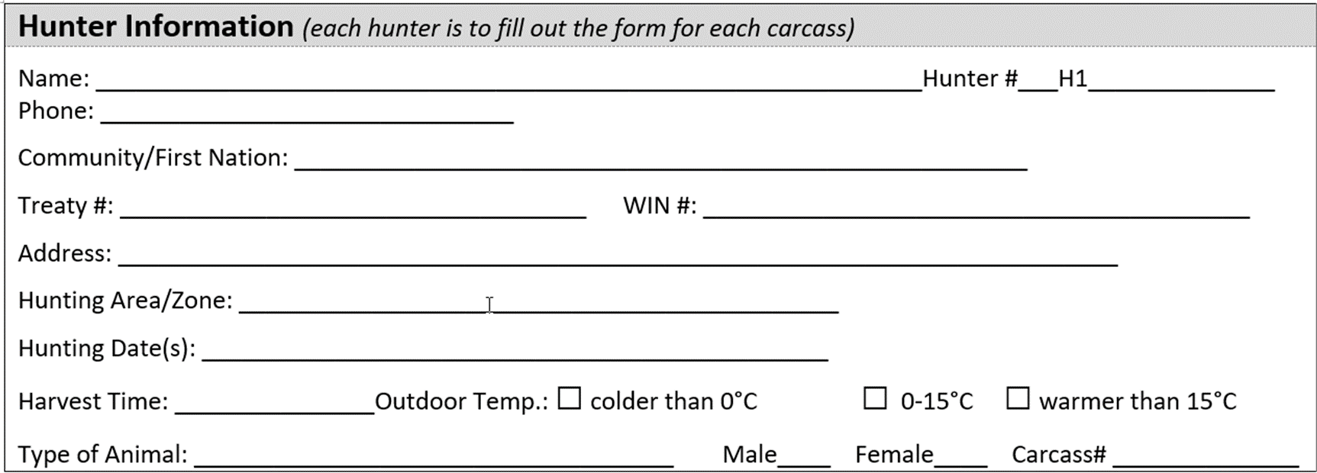
Hunter Information Form (KTCEA File – ONLY)
Hunter # and Animal # (M(1),B(2),D(3))
“UNINSPECTED” ,
TYPE OF ANIMAL
DATE OF HARVEST
Example: KTCEA- H1- 01, UNINSPECTED MOOSE MEAT , Sept 13 2023
LABELLING INFORMATION

Slide 19
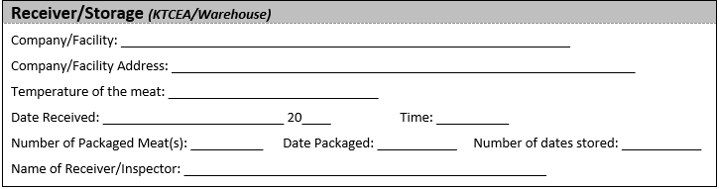
Receiver/Storage

Slide 20
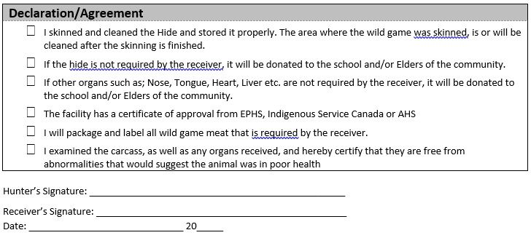
Declaration/Agreement

Slide 21
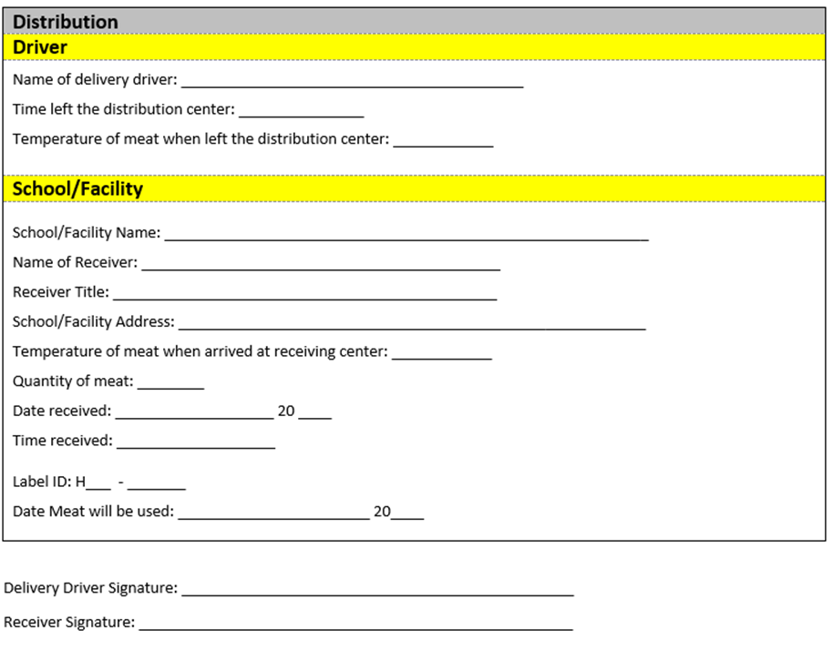
Distribution

Slide 22
Hunters at KTCEA
Honorarium: $1,200.00
Includes: Skinning, cutting, bagging, and labeling of the animal.
What Hunters Must Provide
What KTCEA Provides
• 2 pictures of your surrounding area
• 1 picture of you skinning the animal
• 2 pictures of you loading the animal on to the vehicle
• Labels and Bags
• Orientation & Forms ($200.00 Stipend) Environmental Public Health Officer (FNIH Branch)
• Required hunter documentation forms

Slide 23
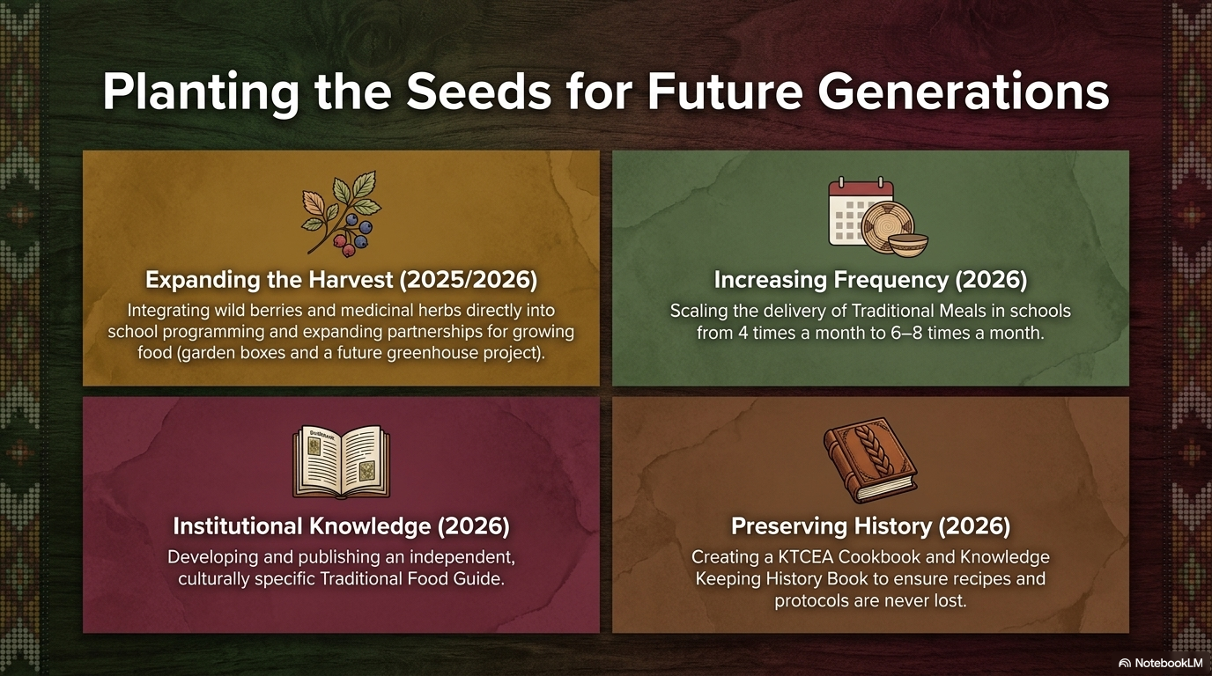

Slide 24
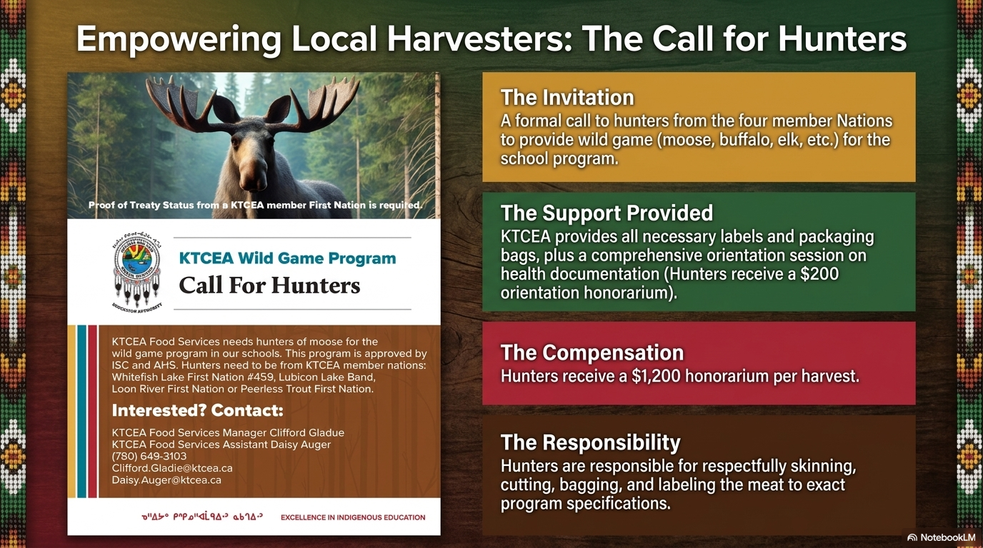

Slide 25



Questions/Comments
Thank you!

