Slide 1
Post-Secondary Education
Virtual Town Hall on
First Nations-First Ministers’ Meeting
April 2026

Slide 2
Assembly of First Nations Education Mandates
AFN Resolution 28/2025: Advancing Federal Recognition and Investment in First Nations Post-Secondary Institutions
AFN Resolution 26/2025: Support for the Renewal and Expansion for First Nations Adult Education Funding
AFN Resolution 102/2023: Support for First Nations Post-Secondary Institutions
AFN Resolution 19/2021: Funding for Post-Secondary Indigenous Institutions and Students
AFN Resolution 21/2021: Post-Secondary Education Policy Proposal on First Nations Models
AFN Resolution 21/2020: First Nations-Led Local, Regional and Treaty-based Post-Secondary Education Models

Slide 3
Post-Secondary Education (PSE) - Background
Indigenous Services Canada (ISC) provides funding to FNIs through the Post-Secondary Partnership Program (PSPP) and for students through the Post-Secondary Student Support Program (PSSSP)
Chronic underfunding remains a significant barrier to First Nations PSE attainment and to the full realization of Treaty and Inherent rights.
While governments invest approximately $29.4 billion annually in mainstream post-secondary institutions, less than $50 million is invested for the ~80 First Nations Institutions (FNIs) serving 10,000+ students across Canada
ISC also provides funding for adult education, which is set to conclude in 2026-2027 without any indication of new investments

Slide 4
PSE to Support Canada’s Infrastructure Agenda
Canada is entering a period of large-scale infrastructure investment
Through Budget 2025, $280 billion will be invested to accelerate major projects – several of which are located near and directly impacting First Nations. These projects will require a sustained supply of workers in a variety of professions and skilled trades.
There is an opportunity to expand Canada’s workforce by funding the over 32,000 First Nations students eligible for PSE but are unable to access funding supports.
Targeted investments in PSE advance both education outcomes for First Nations while also generating strong returns for Canada’s economy by strengthening workforce participation, productivity, and long-term growth.

Slide 5
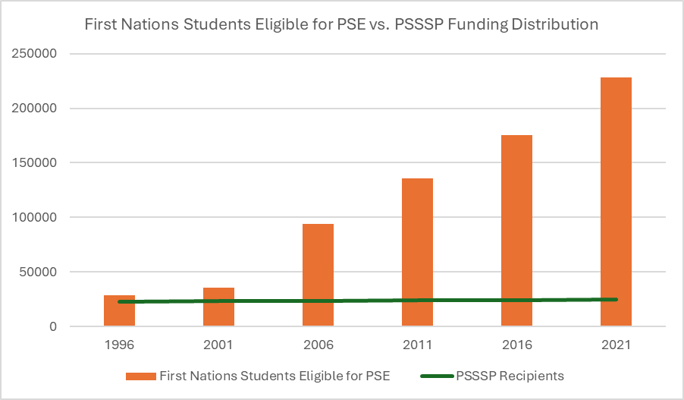
Despite inflation, population growth, and increased secondary school graduation rates, funding for First Nations post-secondary students has not kept up to the growing needs. Since 1996, federal support has reached only 25,000 students annually, leaving many qualified learners without access.

Slide 6
Proposed Funding
An additional $292.5M per year is required to further support First Nations students,
institutions, and adult learners in attaining the PSE required for jobs related to Canada’s infrastructure projects
PSPP | PSSSP | Adult Education
An additional $67.5 million per year would support FNIs and community-based programming by increasing capacity for 2250 new students | An additional $155 million per year is needed to support up to 4500 more students who are currently unfunded by the PSSSP | An additional $70 million per year of renewed funding is needed to continue supporting adult education

Slide 7
Strategic Policy Recommendations
Fund community-based PSE programs that align with needs in high-demand sectors, particularly in regions where major projects are planned.
Increase funding for First Nations student support programs to allow for higher rates of PSE completion and contribution to Canada’s workforce.
Provide stable, core funding for First Nations Institutions to support sustainable operations and community‑responsive growth, comparable to mainstream PSE models.
Re-invest in adult education programming to increase the attainment of PSE credentials for individuals entering the labour force.

Slide 8
Engagement Questions on Post-Secondary Education
What barriers do you see in your communities that limit access to post‑secondary education or skilled trades training, and what supports would make the biggest difference?
How do you engage with First Nations Institutions in your region, and what resource gaps or needs have been identified?
From your perspective, are there other investment needs related to post-secondary education or infrastructure that we should be highlighting?

