Slide 1

Clean Water, Water Services and Wastewater Legislation
Bill C-61, First Nations Clean Water Act

Slide 2
Opening Remarks
Brendan Mitchell
Newfoundland Regional Chief
Infrastructure Portfolio

Slide 3
Overview and Background
Julie Pellerin, Senior Director
Economic Development and Infrastructure Branch (AFN)

Slide 4
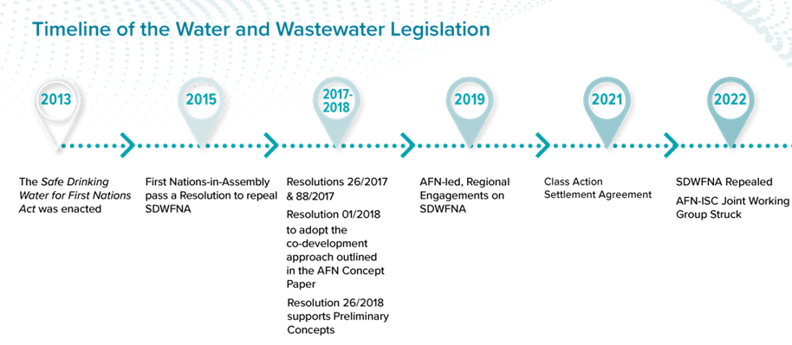

Slide 5
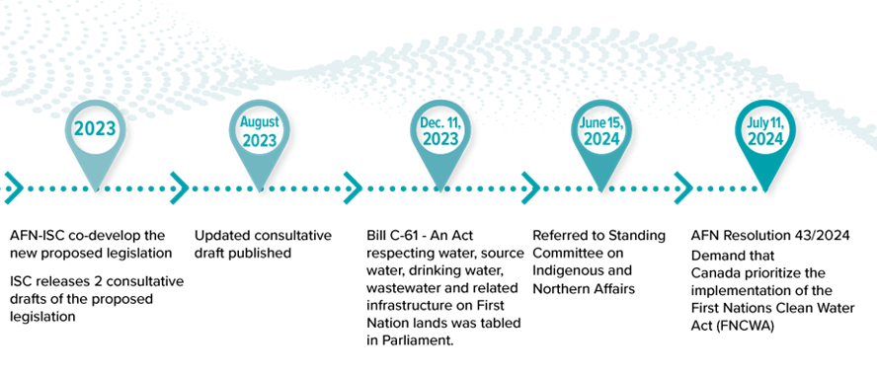

Slide 6
Legislative Process and Amendments Update
Chris Rapson
AFN In-House Legal Counsel

Slide 7
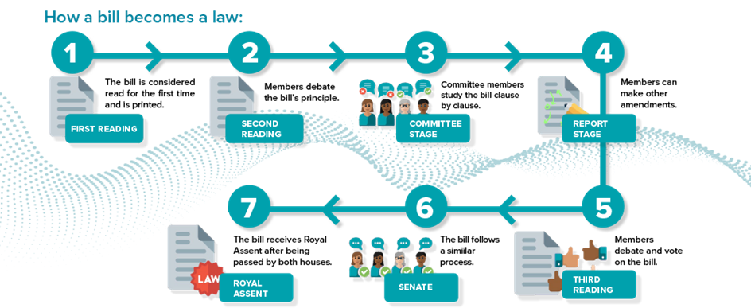

Slide 8
Key Areas of Bill C-61
Preamble
Purpose
Jurisdiction
Conflicts
Standards
Rights
Regulations
Principles
Agreements
Environmental Protection
Funding Framework & Grants
Immunity & Liability
First Nations Water Commission

Slide 9
Amendments to Bill C-61
AFN's INAN Committee Submission and Appearance – Key Points
  First Nations Jurisdiction on- and off-reserve
  Defining "Protection Zones" and coordinating laws in them
  Firm commitments vs. Canada's "best efforts"
  Protecting water quantity for various uses
  Protecting First Nations from liability
INAN Committee's Amendments to Bill C-61
  Update based on current status

Slide 10
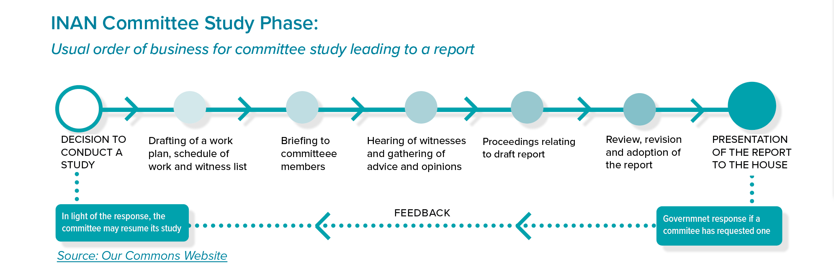
Next Steps

Slide 11
Questions?

Slide 12
Thank You
Merci

