Slide 1
Construction Workforce Outlook:
Labour Demand, Major Projects, and Indigenous Participation
2026 AFN ISET First Nations Agreement Holders National Annual Meeting
Notes:
Today we’d like to share some of BuildForce Canada's latest labour market intelligence and construction forecasts, highlight where workforce demand is expected to emerge across the country, and discuss why Indigenous participation will play an increasingly important role in helping the industry meet future workforce needs.

Slide 2
About BuildForce Canada
Our Mandate
  BuildForce is an industry not-for-profit that was originally created in 2001 as the Construction Sector Council.
  As a national industry-led organization,
  it is committed to working with the construction industry to provide information and resources to assist with its management of workforce requirements.
Our Strategic Partners
Our Forecasting Product
  BuildForce scenario forecasts are based on:
  macroeconomic and demographic data
  construction and maintenance investment in residential and
  non-residential sectors
  inventory of major construction
  projects
  input of provincial LMI committees
  The BuildForce labour market model covers 34 on-site trades and occupations and an “other” category that includes all remaining occupations (mostly office/administrative staff).
  Construction industry totals align with Statistics Canada’s Labour Force Survey.
Owners
Alberta Council of Turnaround Industry Maintenance Stakeholders
BC Hydro
Irving Oil
LNG Canada
Newfoundland and Labrador Hydro
Ontario Power Generation
Shell Canada
Suncor
Construction Associations
Canadian Construction Association
Canadian Home Builders’ Association
Merit Canada
National Construction Labour Relations Alliance
Progressive Contractors Association of Canada
Labour Unions
Canada’s Building Trades Unions
CLAC
Notes:
Before we get into the data, a quick introduction to BuildForce Canada.
We are a national industry-led organization that provides labour market information, forecasts, and workforce development resources for the construction industry. Our forecasts combine economic and demographic data, construction investment forecasts, major project information, and input from industry stakeholders across Canada.
The goal is to help industry, governments, workforce organizations, and communities better understand where workforce demand is heading and how to prepare for it.

Slide 3
Agenda
Investment growth to 2030
  National trends and major projects
Where the labour market stands today
  Trades under pressure – and opportunities
Opportunities for engagement and participation for Indigenous communities and youth
Notes:
Our discussion today starts with a national overview of the construction investment market to 2030. We will look at the workforce pressures shaping demand over the next decade, discuss where opportunities are emerging, and then spend some time looking at Indigenous participation in the industry and the tools available to support workforce planning.
Our goal today is not just to tell you a bit about BuildForce and our work, but also to hear from you about what you’re seeing on the ground, in your communities.
You’ll see from our presentation that the next five to ten years are very much a moment – for construction and for greater Indigenous participation in the industry.
And we want to hear from you about what will have to happen for your communities to help make all these projects a success.

Slide 4

Construction and Maintenance Looking Forward
Track the state of construction labour markets
Promote awareness and discussion on workforce planning and project implications for the industry.
An analytical tool to help decision-makers better identify and understand labour market trends and imbalances
Scenario forecast is based on:
  macroeconomic and demographic assumptions (national / regional)
  inventory of major construction projects, by province
  input of provincial LMI committees - feedback on current and anticipated market conditions and pinch points
Notes:
The Construction and Maintenance Looking Forward program is BuildForce Canada's long-term forecasting system.
What makes it unique is that it doesn't just look at historical trends. It combines economic forecasts, demographic information, construction investment outlooks, and a national inventory of major projects to estimate future workforce requirements.
This helps us identify where labour shortages are likely to occur and which occupations may face recruitment pressures.
If you take nothing else away from this today, remember this one point. Our data is validated by committees of experts from all provinces. They tell us what we’ve got right, what we’ve got wrong, and what they’re seeing that we’re not.
In other words, we’re not just imagining economic forecasts. We’re asking local experts to validate those forecasts for us, based on what they’re living in their provinces and regions.

Slide 5


Where We Are Today – Canada
1,633,600¹
people employed in a variety of construction trades and professions
1 in 13¹
Workers employed in the construction industry
$170.3bn
7.3%²
of Canada’s GDP was contributed by the construction industry
415,410³
construction firms were in operation
62.0%³
of construction employers employed less than 5 people
Source: Statistics Canada. Table 14-10-0023-01 Labour force characteristics by industry, annual
Source: Statistics Canada. Table 36-10-0711-01 Gross domestic product (GDP) at basic prices, by industry, provinces and territories (x 1,000,000).
Source: Statistics Canada, special tabulation, unpublished data, unclassified excluded, 2025.
Notes:
Canada’s construction industry plays a critical role in supporting the national economy.
In 2025, the sector contributed approximately $170 billion to Canada’s GDP. That figure represented about 7.3% of total economic output. Its influence on employment is just as significant, with more than 1.6 million individuals working in construction-related occupations - equivalent to roughly one in every 13 workers across the country.
The industry is also characterized by a large number of active firms, with more than 415,000 construction businesses operating nationwide.
Notably, the sector is dominated by micro-enterprises. According to Statistics Canada, approximately 62% of construction employers have fewer than five employees.
This structure underscores both the entrepreneurial nature of the sector and the reliance on small, specialized service providers.

Slide 6
Residential Construction Investment, Canada
Residential realignment
Medium-term growth anticipated after initial contraction
  Combined growth projected at 1.4% to 2030
  New housing activity
Affordability, reduced immigration constrain demands
  Contraction of 4.8% projected to 2030 – but compared to elevated levels
  Renovation activity
Demand is strong through the outlook period
  Increase of 11.3% projected to 2030
* $2017 millions indicates that the investment values are in year 2017 dollars (base year), that is, adjusted for inflation. This is used to calculate the real physical year-to-year change of the value of construction, factoring out growth (increase in value) due to increases in prices
Notes:
Turning to the data.
This slide shows the outlook for investment in residential construction for the period of 2026 to 2030. Our most recent forecasts actually look further into the future – to 2035. But we wanted to show you the cycles at play in the nearer term.
And what you can see probably doesn’t surprise you. You can see by the red line that investment in new housing has been trending downward trend since 2021. That’s due to a number of factors, including housing affordability and changes to the federal Immigration Levels Plan that have reduced the number of temporary foreign residents coming into Canada.
We project levels to continue to trend lower into the end of 2027. Again that’s in line with the federal immigration plan. As that resets to what we expect will be more normal levels of immigration, we expect the new housing component to return to growth into the early 2030s.
It’s worth noting that even though we are forecasting a contraction in new housing investment to 2030, that figure is compared to a high level of activity that we saw at the starts of the forecast period – at the end of 2025. Historically, activity is still higher that it was during the pre-pandemic years.
Residential renovation activity meanwhile, comes into the forecast period on an upward swing. Levels slowed after a peak in 2021 – due to elevated interest rates. We project they will increase through 2030 – and through to 2035 – as the housing stock ages and as people choose to upgrade their homes rather than purchase new ones.
Overall, and this is the first of the three bullets on our list, we’re calling this period a moment of realignment. The combination of the increase in renovation activity and the drop off in new housing should create modest overall residential growth to 2030.

Slide 7
Non-Residential Construction Investment, Canada
Non-residential expansion
Broad-based major infrastructure and ICI projects yield strong base demand
  Growth projected at 6.2% to 2030
  Engineering construction activity
Essential infrastructure projects underway everywhere; activity on known projects rising to a peak in 2029
  Growth projected at 4.6% to 2030
  ICI buildings activity
Strong activity across healthcare, education, and commercial sectors in response to the needs of a growing population
  Growth projected at 9.1% to 2030
BuildForce is currently tracking $500+ billion worth of major projects
* $2017 millions indicates that the investment values are in year 2017 dollars (base year), that is, adjusted for inflation. This is used to calculate the real physical year-to-year change of the value of construction, factoring out growth (increase in value) due to increases in prices.
** Industrial, commercial, institutional
Notes:
On the non-residential side, we track two streams of construction. One we call engineering construction. That’s your roads, highways, bridges, transit projects, utilities, pipelines mines and so on. For any engineers in the room, it’s not design and schematics work. Sorry. The other stream we refer to is ICI buildings, which are industrial, commercial and institutional buildings.
You can see by the green line that investment in engineering construction has been on a strong upward curve since 2021. And that makes sense. No matter where you go in the country, you see the expansion of roads, utilities, new transit work, mines, energy projects. If you’re from Calgary, you’ve been living alongside work on the Deerfoot Trail and you’re seeing the work on the Green Line LRT. And what you probably don’t see is the ongoing work on the Bonnybook and Fish Creek waste water plants. These kinds of projects are happening everywhere in the country right now. And we expect that they will rise to a peak in 2029.
If you’re wondering, by the way, the inventory of federal Major Projects falls into our engineering category. More on those in a moment.
There’s a similar story on the ICI buildings side. The need to up with population growth has driven demand for hospitals, schools, factories, commercia buildings, community centres into full expansion mode. Again, you don’t have to look far in Calgary to see proof of that: the Calgary Events Centre, the Calgary Arts Commons are two major commercial projects underway in town. And you can tell the same story in every province. Given this, we’re expecting investment in ICI buildings to rise by about 9% to 2030.
If all this excites you, I’ve got good news for you. There’s more. As part of our forecasting process, we map the likely effects of those projects that we know are going ahead, with certain scopes and timelines. There are hundreds more on our watch list that have been announced, but don’t yet have confirmed schedules or scopes or final investment decisions.
Our major projects inventory stands at more than $500 billion worth of activity – including transit, water treatment, power and critical minerals, health care, educational institutions. And several of the federal government’s planned major projects.
We create this inventory in partnership with provincial LMI committees – networks of industry stakeholders that include labour groups, construction associations, owners, and federal/provincial government departments. The goal is to report on projects that individually or collectively are expected to distort local labour markets during their construction phase (starting up or winding down).
Specific types of projects on our watch list include
Aging infrastructure (healthcare, education, water treatment, urban transit expansion, replacement and restoration)
Clean energy projects
Critical mineral developments
Department of National Defence
Data centres
Affordable housing programs
Industrial turnaround cycles and scheduled utility outages competing directly for specialized trade supply

Slide 8
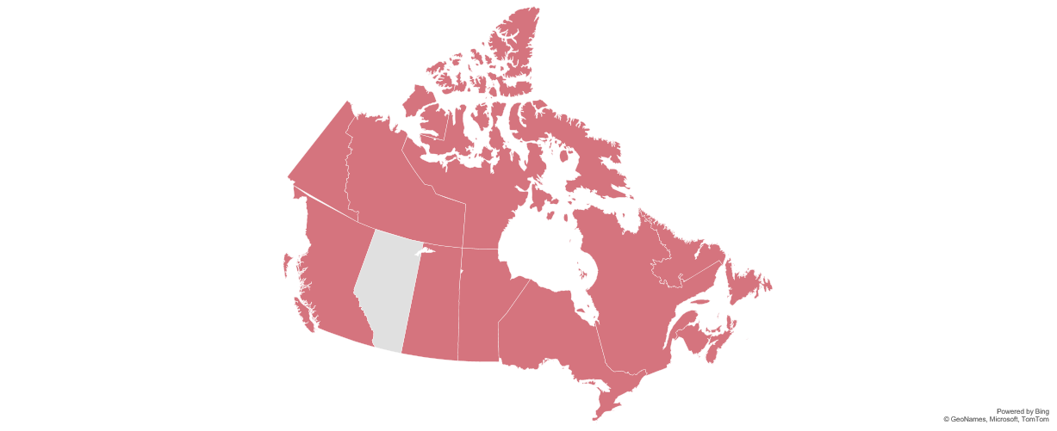
Change in Construction Investment (2026–2030)
QC
Res: -9.4%
Non-res: -2.2%
NL
Res: 0.0%
Non-res: +83.8%
BC
Res: -3.8%
Non-res: +3.3%
ON
Res: +14.6%
Non-res: +5.3%
PEI
Res: -11.9%
Non-res: -37.5%
AB
Res: -8.4%
Non-res: +7.7%
NS
Res: -10.0%
Non-res: +26.4%
SK
Res: +22.1%
Non-res: +1.4%
MB
Res: +1.1%
Non-res: +23.3%
NB
Res: -22.5%
Non-res: +45.3%
Source: Statistics Canada, BuildForce Canada (2026-2030)
Notes:
We’ve talked about construction investment on a national scale in the past two slides. Here is what it looks like, province by province.
You’ll see what we’re missing data from the territories. We’ll get into that in a moment, but the challenge is that data is hard to come by. Closing that gap is a goal for us in the next couple of years.
We’d like to work with AFN and ISET holders to hear what we can do, who we can talk to, to deepen our data in the North and make it even more valuable to you.

Slide 9
National Trends
Labour & Capacity Challenges
  Demographic Headwinds: A shrinking pool of younger candidates creates intense competition across all industries.
  The Experience Gap: A "one in does not equal one out" imbalance means retiring veteran tradespeople leave with institutional knowledge that entry-level workers cannot immediately replicate. This slows project execution times, increases mentorship burdens on remaining staff.
  Supervision & Project Manager Shortages: Departing seniors leave an immediate void in site supervision, project management, and quality assurance expertise.
  Execution Risk: Project timing overlapping across regions threatens to strain local capacity, turning project scheduling into the primary risk factor.
  Major projects are disruptive: Individually or collectively, these projects are expected to distort local labour markets during their construction phase – whether starting up or winding down.
The Bottom Line: We have more projects to build than we have people available to build them
Notes:
Growth is good. But it’s not without challenges.
And probably the simplest way to summarize Canada's construction labour market today is this:
We have more projects underway than there are people available to build them.
In other words, all this growth we’re seeing in the non-residential sector, and the growth to come in the residential sector is creating its own new labour and capacity challenges, or creating new ones.
What do we mean by that?
Retirements remain a major issue, experienced workers are leaving the workforce, and fewer young workers are available to replace them. The challenge isn't only replacing workers, it's replacing experience, supervision, and leadership capacity.

Slide 10
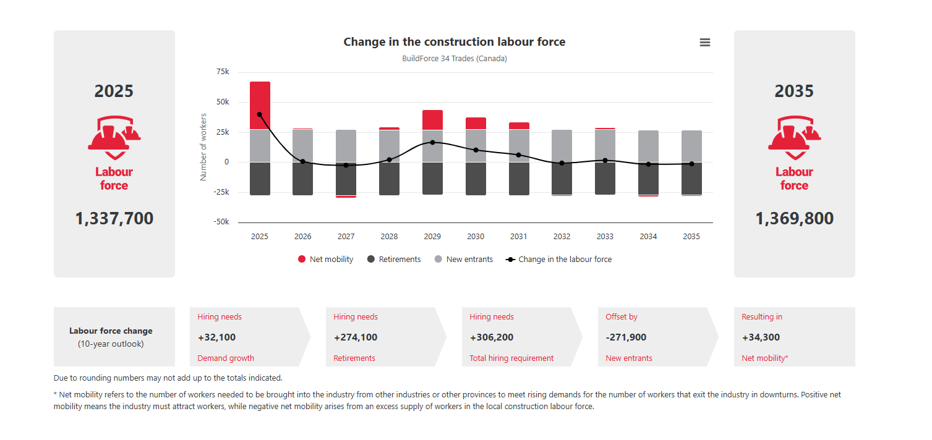
Change in the Construction Labour Force, Canada
** Total direct trades and occupations excludes individuals employed within the construction sector in office administration and management positions.
Notes:
This is one of the most important slides in today's presentation.
Between now and 2035, the industry will need to recruit more than 306,000 workers. Nearly nine out of every ten hires will simply be replacing retirees rather than accommodating growth.
Closing that gap will require the industry to broaden recruitment efforts, including increasing participation among underrepresented groups such as Indigenous Peoples, women, youth, and newcomers.
For First Nations communities, this represents a significant opportunity. I may even go a step further to suggest that without participation from Indigenous communities, there’s a risk these gaps aren’t closed.

Slide 11
Indigenous Participation in Canada's Construction Workforce
Where participation stands
Why the opportunity is growing
Partnership models
Notes:
We've talked about workforce demand. Now let's look at one of the most important solutions.
Indigenous participation in construction continues to grow, and Indigenous workers are already making a significant contribution to the industry. Given demographic trends, Indigenous communities will remain an important source of future construction talent across Canada.

Slide 12
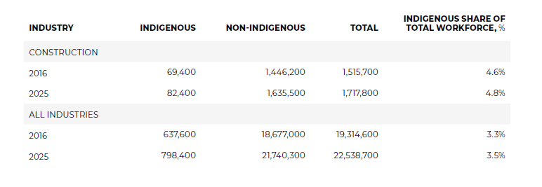
The Indigenous Workforce Today
An Opportunity for Impact
Indigenous demographics
The average age of the Indigenous population is 33.6 years
  Compared to 41.8 years for the non-Indigenous population
  A gap of 8.2 years
More than 33% of the Indigenous population is under the age of 25.
  Compared to 23% of the non-Indigenous population.
Young Indigenous people represent the fastest growing segment of the workforce
There is an urgent need to invest heavily in culturally relevant, accessible post-secondary education, trades training, and economic development.
Source: BuildForce Canada (2023) Statistics Canada, Labour Force Survey, custom data request (2025)
Notes:
Indigenous participation in the construction workforce has been growing over the past 10 years.
It increased from 69,400 workers to 82,400 workers, or from 4.6% of the total construction labour force to 4.8%. There is a notably higher representation among Indigenous people in construction than in the labour force as a whole.
While Indigenous participation is strong in many trades, representation remains lower in management, supervision, estimating, and some specialized trades, highlighting opportunities for targeted training and career progression initiatives.
The information that we have is based on the data available to us which includes data from Statistics Canada, however, we are working to source data from additional resources, to improve accuracy of data available to us, and to improve our products.

Slide 13
Representation by Province
NATIONAL BENCHMARK
4.8%
Indigenous share of construction, Canada, 2025
3.5%
Indigenous share across all industries — construction leads
82,400
Indigenous construction workers, up from 69,400 in 2016
Representation varies widely by province — Manitoba and Saskatchewan are well above the national average.
Source: Statistics Canada, Labour Force Survey, custom data request (2025)
Notes:
Indigenous participation varies considerably across the country.
Provinces like Manitoba and Saskatchewan are well above the national average, demonstrating the important role Indigenous workers are already playing in construction labour markets.
The opportunities and workforce needs look different in every region, which is why local labour market information is so important.

Slide 14
What WE Know – And what WE’re Working to Learn
BuildForce is committed to transparency about data gaps —
and to working with ISET holders to close them.
What the data tells us
Where the gaps are
What we’re doing about it
An Opportunity for Impact
Indigenous workers make up 4.8% of Canada's construction workforce — and that share is growing
Representation varies widely by province, with Manitoba and Saskatchewan well above the national average
Indigenous workers are underrepresented in management, supervision, and some specialized trades
Reserve-based and community-led construction activity is difficult to capture in national datasets
Work performed under Impact Benefit Agreements is largely untracked in our current model
Territorial data remains limited — workforce numbers in Yukon, NWT, and Nunavut are incomplete
Trade-level data disaggregated by Indigenous identity is not yet available at the provincial level
Expanding engagement with provincial and territorial LMI committees to improve Northern coverage
Working with Statistics Canada to refine custom data requests
Seeking partnerships — including with AFN and ISET holders — to validate and supplement our data

Slide 15
British Columbia
48,400
workers to recruit by 2035
Workforce math, 2026–2035 | Workers
Growth in the workforce | 1,600
Retirements to replace | 46,800
Total hiring requirement | 48,400
Expected new entrants | 40,900
Shortfall to close | +7,500
TOP TRADES IN DEMAND
Construction managers · Gas fitters · Industrial instrument technicians
MAJOR PROJECTS
LNG Canada · Richmond Hospital Expansion · Highland Valley and Red Chris Mines
WATCH LIST PROJECTS
Critical mineral development · Power generation · Green transformation
Indigenous workers are 4.6% of the province’s construction workforce.
Source: BuildForce Canada, Looking Forward 2026–2035; Statistics Canada

Slide 16
Alberta
48,900
workers to recruit by 2035
Workforce math, 2026–2035 | Workers
Growth in the workforce | 5,200
Retirements to replace | 43,700
Total hiring requirement | 48,900
Expected new entrants | 43,600
Shortfall to close | +5,300
TOP TRADES IN DEMAND
Elevator constructors · Floor covering installers · Glaziers
MAJOR PROJECTS
Scotia Place, Calgary · Calgary Arts Commons · Red Deer Regional Hospital
WATCH LIST PROJECTS
Pathways Alliance (+$16B) · Data centres · Moraine Power Generation
Indigenous workers are 6.5% of the province’s construction workforce.
Source: BuildForce Canada, Looking Forward 2026–2035; Statistics Canada

Slide 17
Saskatchewan
13,400
workers to recruit by 2035
Workforce math, 2026–2035 | Workers
Growth in the workforce | 4,100
Retirements to replace | 9,300
Total hiring requirement | 13,400
Expected new entrants | 9,900
Shortfall to close | +3,500
TOP TRADES IN DEMAND
Steamfitters and pipefitters · Construction managers · Concrete finishers
MAJOR PROJECTS
BHP Jansen Potash Mine · Foran McIlvenna Bay Mine · Aspen Power Station
WATCH LIST PROJECTS
K+S Potash Canada Expansion · Bell Canada AI Data Centre
Mining · SMRs
Indigenous workers are 13.1% of the province’s construction workforce.
Source: BuildForce Canada, Looking Forward 2026–2035; Statistics Canada

Slide 18
Manitoba
13,500
workers to recruit by 2035
Workforce math, 2026–2035 | Workers
Growth in the workforce | 3,400
Retirements to replace | 10,100
Total hiring requirement | 13,500
Expected new entrants | 11,700
Shortfall to close | +1,800
TOP TRADES IN DEMAND
Power line and cable workers · Industrial mechanics · Construction managers
MAJOR PROJECTS
Winnipeg North End Sewage Plant · Lynn Lake Mine Expansion · Health Sciences Centre Bannatyne
WATCH LIST PROJECTS
Port of Churchill Development (Major Project) · Brandon Generation Station · Critical Minerals
Indigenous workers are 16.5% of the province’s construction workforce.
Source: BuildForce Canada, Looking Forward 2026–2035; Statistics Canada

Slide 19
The Territories
Building Canda’s North: Billions in tracked infrastructure investments
The challenge: Limited local workforces
Workers will need to be pulled from outside local markets – from neighbouring provinces in the South
This will put these projects in competition with the same pools of workers that are in high demand elsewhere
Yukon – critical mineral development, energy and grid modernization, Arctic sovereignty and defence infrastructure
Northwest Territories – critical mineral development, bridges and highways, hydroelectricity, Arctic sovereignty and defence infrastructure
Nunavut – critical mineral development, road and port projects, energy transmission, port and community infrastructure activities, Arctic sovereignty and defence infrastructure, northern housing investments
Source: BuildForce Canada, Looking Forward 2026–2035; Statistics Canada
Notes:
Because of their comparatively smaller labour forces, the territories are a gap for us. It’s something we’re taking steps to close. That’s in part because it’s under-served, and in part because there are so many major projects planned an underway for the region.
The federal government has planned five of its major projects for the territories: the Taltson Hydro Expansion, Mackenzie Valley Highway, the Arctic Economic and Security Corridor, Grays Bay Road and Port, and the Iqaluit Hydro Project. That does not include a series also planned in north of British Columbia and Ontario.
And that list doesn’t include a series of other major projects in defence, critical minerals, Arctic sovereignty, and even basic infrastructure like houses, utilities and roads.
Understanding what those pressures are, how the local labour forces can participate, how Indigenous communities can participate, and how these projects can complement – rather than compete against – projects underway in adjacent provinces will be critical.

Slide 20
Ontario
125,900
workers to recruit by 2035
Workforce math, 2026–2035 | Workers
Growth in the workforce | 34,000
Retirements to replace | 91,900
Total hiring requirement | 125,900
Expected new entrants | 98,800
Shortfall to close | +27,100
TOP TRADES IN DEMAND
Refrigeration and A/C mechanics · Carpenters · Ironworkers
MAJOR PROJECTS
SMR Expansion (3 additional) · Bruce C New Nuclear · Meaford Pump Storage
WATCH LIST PROJECTS
Mining· Toronto Pearson LIFT · ALTO High Speed Rail · Battery Energy Storage · Data Centres
Indigenous workers are 3.5% of the province’s construction workforce.
Source: BuildForce Canada, Looking Forward 2026–2035; Statistics Canada

Slide 21
Quebec
35,400
workers to recruit by 2035
Workforce math, 2026–2035 | Workers
Growth in the workforce | -14,500
Retirements to replace | 49,900
Total hiring requirement | 35,400
Expected new entrants | 47,700
Shortfall to close | -12,300
TOP TRADES IN DEMAND
Boilermakers · Bricklayers · Carpenters
MAJOR PROJECTS
Canadian Malartic Odyssey Mine · Pont de l'Ile-aux-Tourtes · CHU de Quebec · Hydro Quebec· Transit
Indigenous workers are 2.7% of the province’s construction workforce.
Source: BuildForce Canada, Looking Forward 2026–2035; Statistics Canada

Slide 22
New Brunswick
5,000
workers to recruit by 2035
Workforce math, 2026–2035 | Workers
Growth in the workforce | -1,500
Retirements to replace | 6,500
Total hiring requirement | 5,000
Expected new entrants | 6,500
Shortfall to close | -1,500
TOP TRADES IN DEMAND
Construction managers · Crane operators · Construction estimators
MAJOR PROJECTS
Mactaquac Hydro Refurbishment · Irving Pulp & Paper NextGen · Fredericton Performing Arts Centre
WATCH LIST PROJECTS
NB Power Renewable Program · Belledune Station Conversion · Sisson tungsten mine · CFB Gagetown projects · SMR · Green Hydrogen
Indigenous workers are 3.2% of the province’s construction workforce.
Source: BuildForce Canada, Looking Forward 2026–2035; Statistics Canada

Slide 23
Nova Scotia
8,500
workers to recruit by 2035
Workforce math, 2026–2035 | Workers
Growth in the workforce | 400
Retirements to replace | 8,100
Total hiring requirement | 8,500
Expected new entrants | 7,200
Shortfall to close | +1,300
TOP TRADES IN DEMAND
Construction managers · Contractors and supervisors · Bricklayers
MAJOR PROJECTS
QEII Halifax Infirmary · Cape Breton Regional Hospital · Wasoqonatl Transmission Line
WATCH LIST PROJECTS
Wind West Atlantic Energy · Hydrogen Projects (EverWind, Bear Head Energy, Nova Sustainable Fuels) · Wind · Solar
Indigenous workers are 4.2% of the province’s construction workforce.
Source: BuildForce Canada, Looking Forward 2026–2035; Statistics Canada

Slide 24
Prince Edward Island
1,170
workers to recruit by 2035
Workforce math, 2026–2035 | Workers
Growth in the workforce | -480
Retirements to replace | 1,650
Total hiring requirement | 1,170
Expected new entrants | 1,730
Shortfall to close | -560
TOP TRADES IN DEMAND
Carpenters · Construction managers · Contractors and supervisors
MAJOR PROJECTS
Energy from Waste Modernization · Hillsborough Mental Health Facility · Kings County Memorial Hospital
WATCH LIST PROJECTS
Stratford mixed-use development · Queen Elizabeth Hospital redevelopment
Indigenous workers are 2.6% of the province’s construction workforce.
Source: BuildForce Canada, Looking Forward 2026–2035; Statistics Canada

Slide 25
Newfoundland and Labrador
5,600
workers to recruit by 2035
Workforce math, 2026–2035 | Workers
Growth in the workforce | -300
Retirements to replace | 5,900
Total hiring requirement | 5,600
Expected new entrants | 4,100
Shortfall to close | +1,500
TOP TRADES IN DEMAND
Construction managers · Industrial mechanics · Contractors and supervisors
MAJOR PROJECTS
West White Rose · Voisey's Bay Underground Mine · Bay du Nord
WATCH LIST PROJECTS
Churchill Falls Hydro Expansion · Kami Project Iron One · Mining · Hydrogen + Supporting Infrastructure
Indigenous workers are 8.4% of the province’s construction workforce.
Source: BuildForce Canada, Looking Forward 2026–2035; Statistics Canada

Slide 26
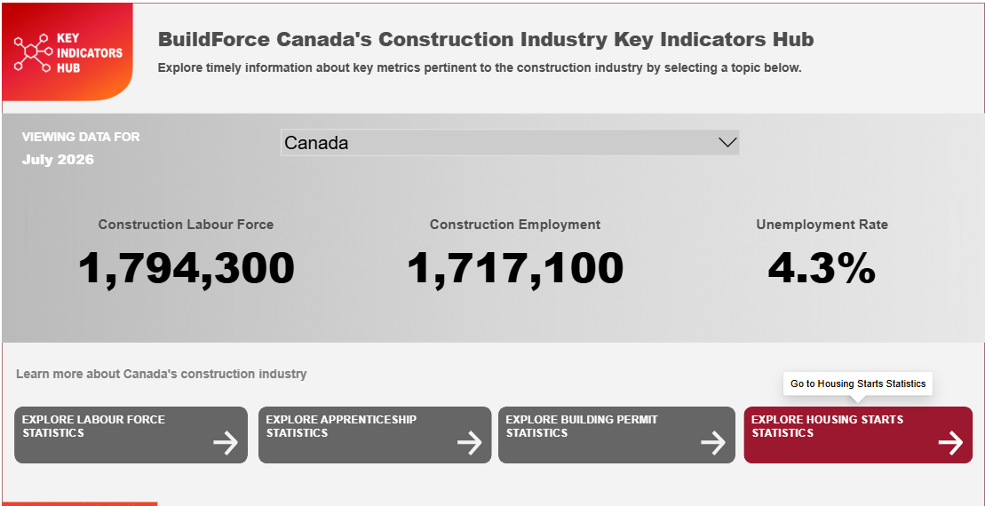

Our Tools and Dashboards
Construction Key Indicators
Labour force, apprenticeship, permit & housing data
Provincial and regional trends
Monitor workforce and construction activity
Labour Market Corner
Monthly labour force snapshot
Analysis of emerging workforce trends
Updated every month
Career Finder
Explore careers by skills and interests
Discover occupations and career pathways
Notes:
Everything we’ve shown today is supported by resources that are publicly available through BuildForce Canada.
Our Construction Key Indicators Dashboard provides labour force, apprenticeship, permit, and housing data.
Labour Market Corner provides a monthly snapshot of construction labour market conditions.
Our Career Finder tool helps individuals explore careers based on their skills, interests, and experience while also identifying where occupations are likely to be in demand.
What would you like to see from the Career Finder that speaks to Indigenous participation?

Slide 27

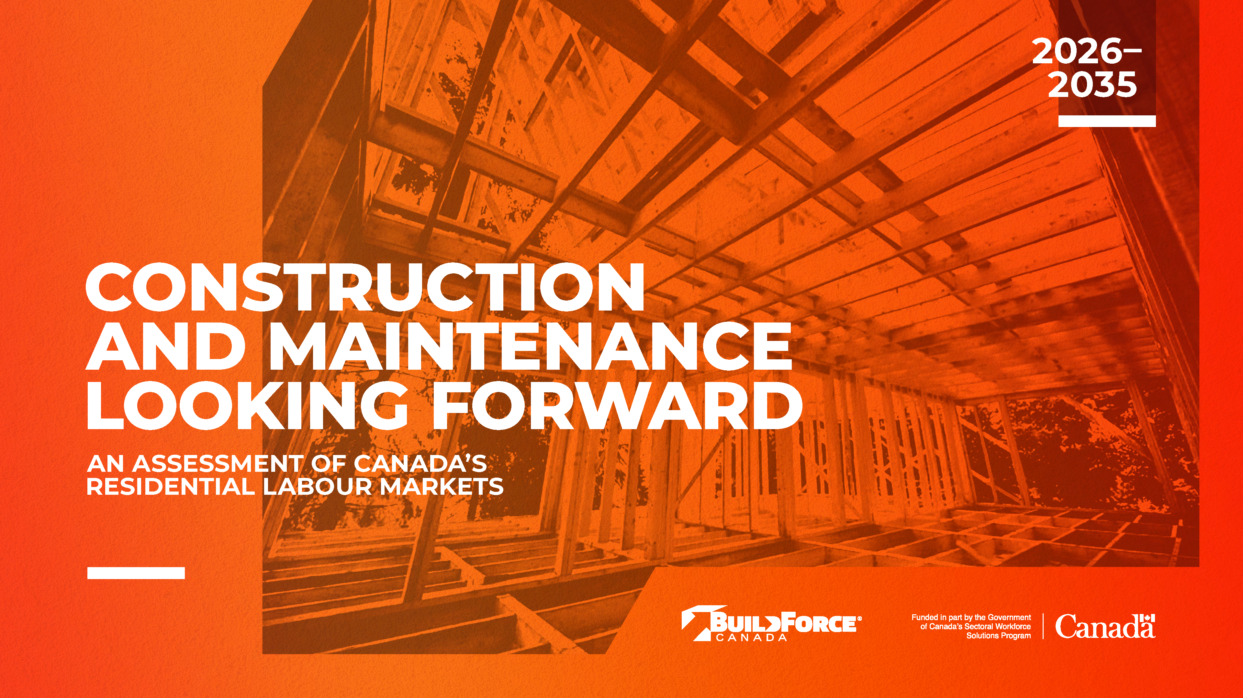
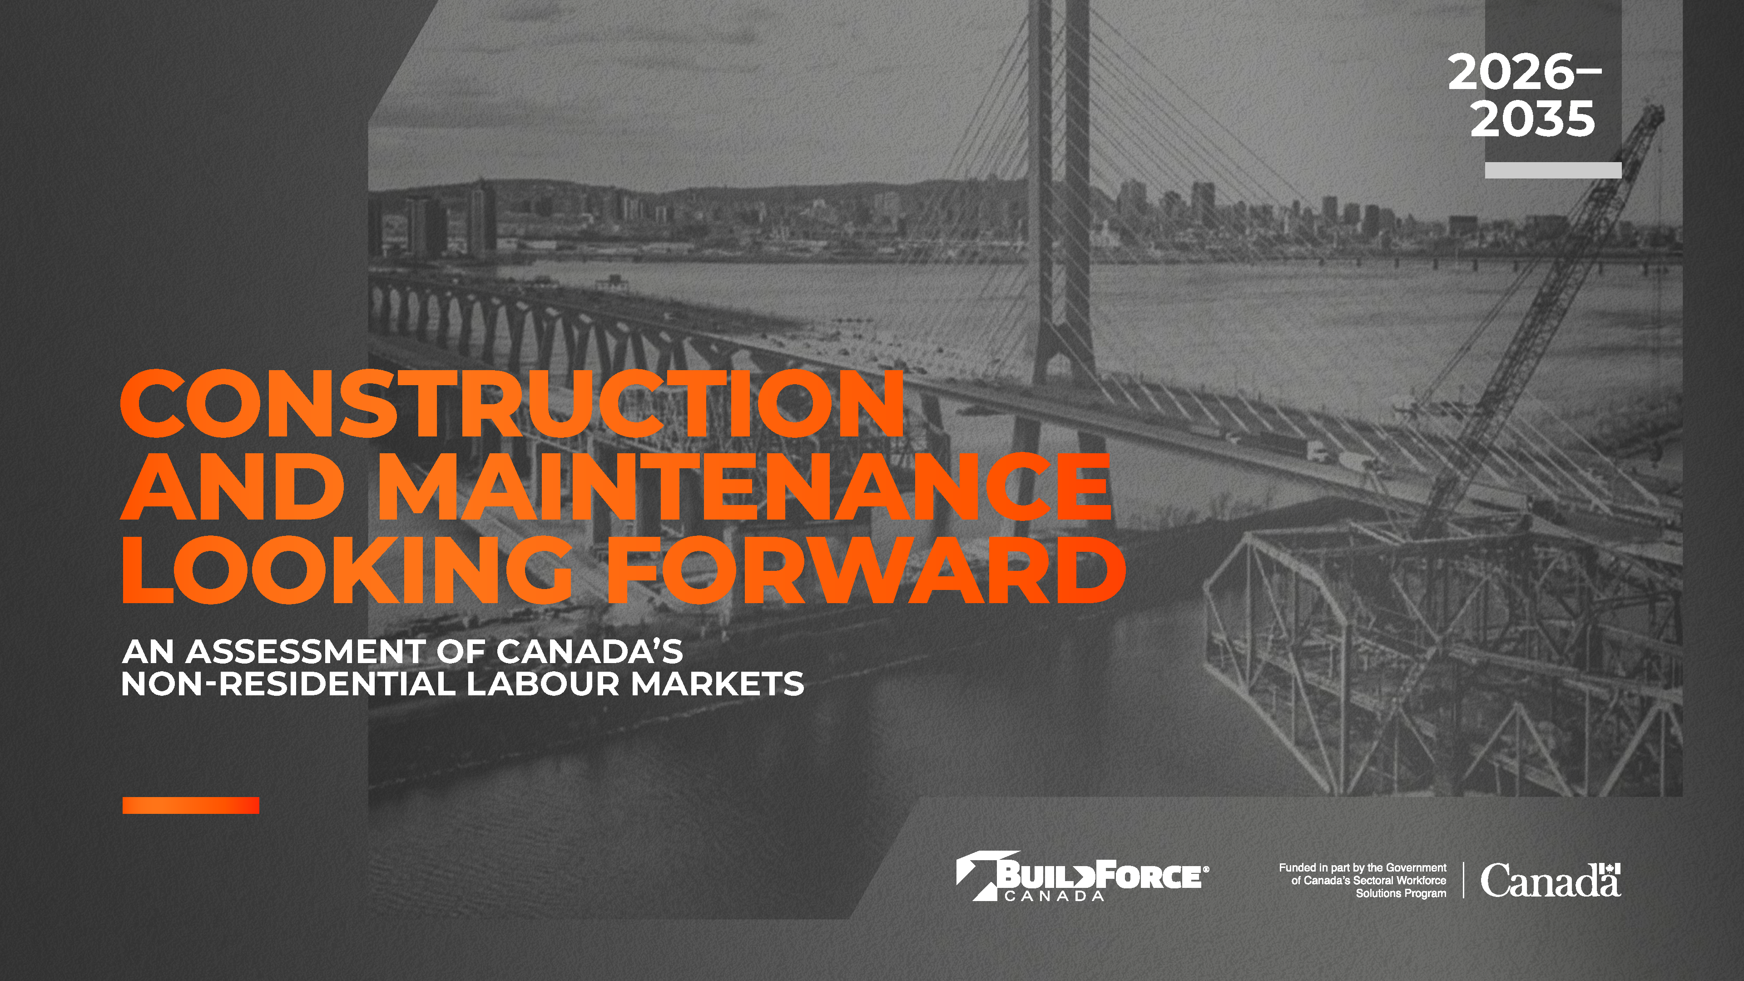
2026–2035 Looking Forward Reports
What the tools provide
Employment and investment trends
Hiring and retirement outlooks
Regional and trade-specific forecasts
How the information can be used
Support workforce and training planning
Strengthen proposals and funding applications
Inform employer and community partnerships
Download our 2026-2035 reports at buildforce.ca/LMI-2026

Slide 28

Discussion – working together
We want to hear from you. Scan the QR code to complete a brief survey.
An Opportunity for Impact
1
What additional labour market information would help you most?
How can we improve our products to make them more helpful?
An Opportunity for Impact
What are the labour market challenges and opportunities unique to Indigenous participation in the trades that should inform future forecasts?
2
An Opportunity for Impact
3
What are the opportunities to continue engagement and discussion around these themes?
Notes:
We're interested in hearing what labour market information would be most helpful to your organizations, what challenges you're seeing in your regions, and where we might work together to improve data, tools, and workforce development resources that support Indigenous participation in construction.
For example, one of our priorities for this year is to engage with stakeholders such as ISET to build greater granularity in our labour market information and to increase the accuracy of our forecasts. That includes gathering more information on Indigenous participation in the construction sector and better project monitoring in the North.

Slide 29



Connect With Us
Shaily Allison: allison@buildforce.ca
James Raiswell: raiswell@buildforce.ca
Notes:
Thank you again for the opportunity to speak with you today.
Please feel free to connect with us after the session. We'd welcome the opportunity to discuss your workforce priorities, demonstrate our tools, and explore ways we can continue sharing information and supporting workforce planning efforts in your communities

