Slide 1
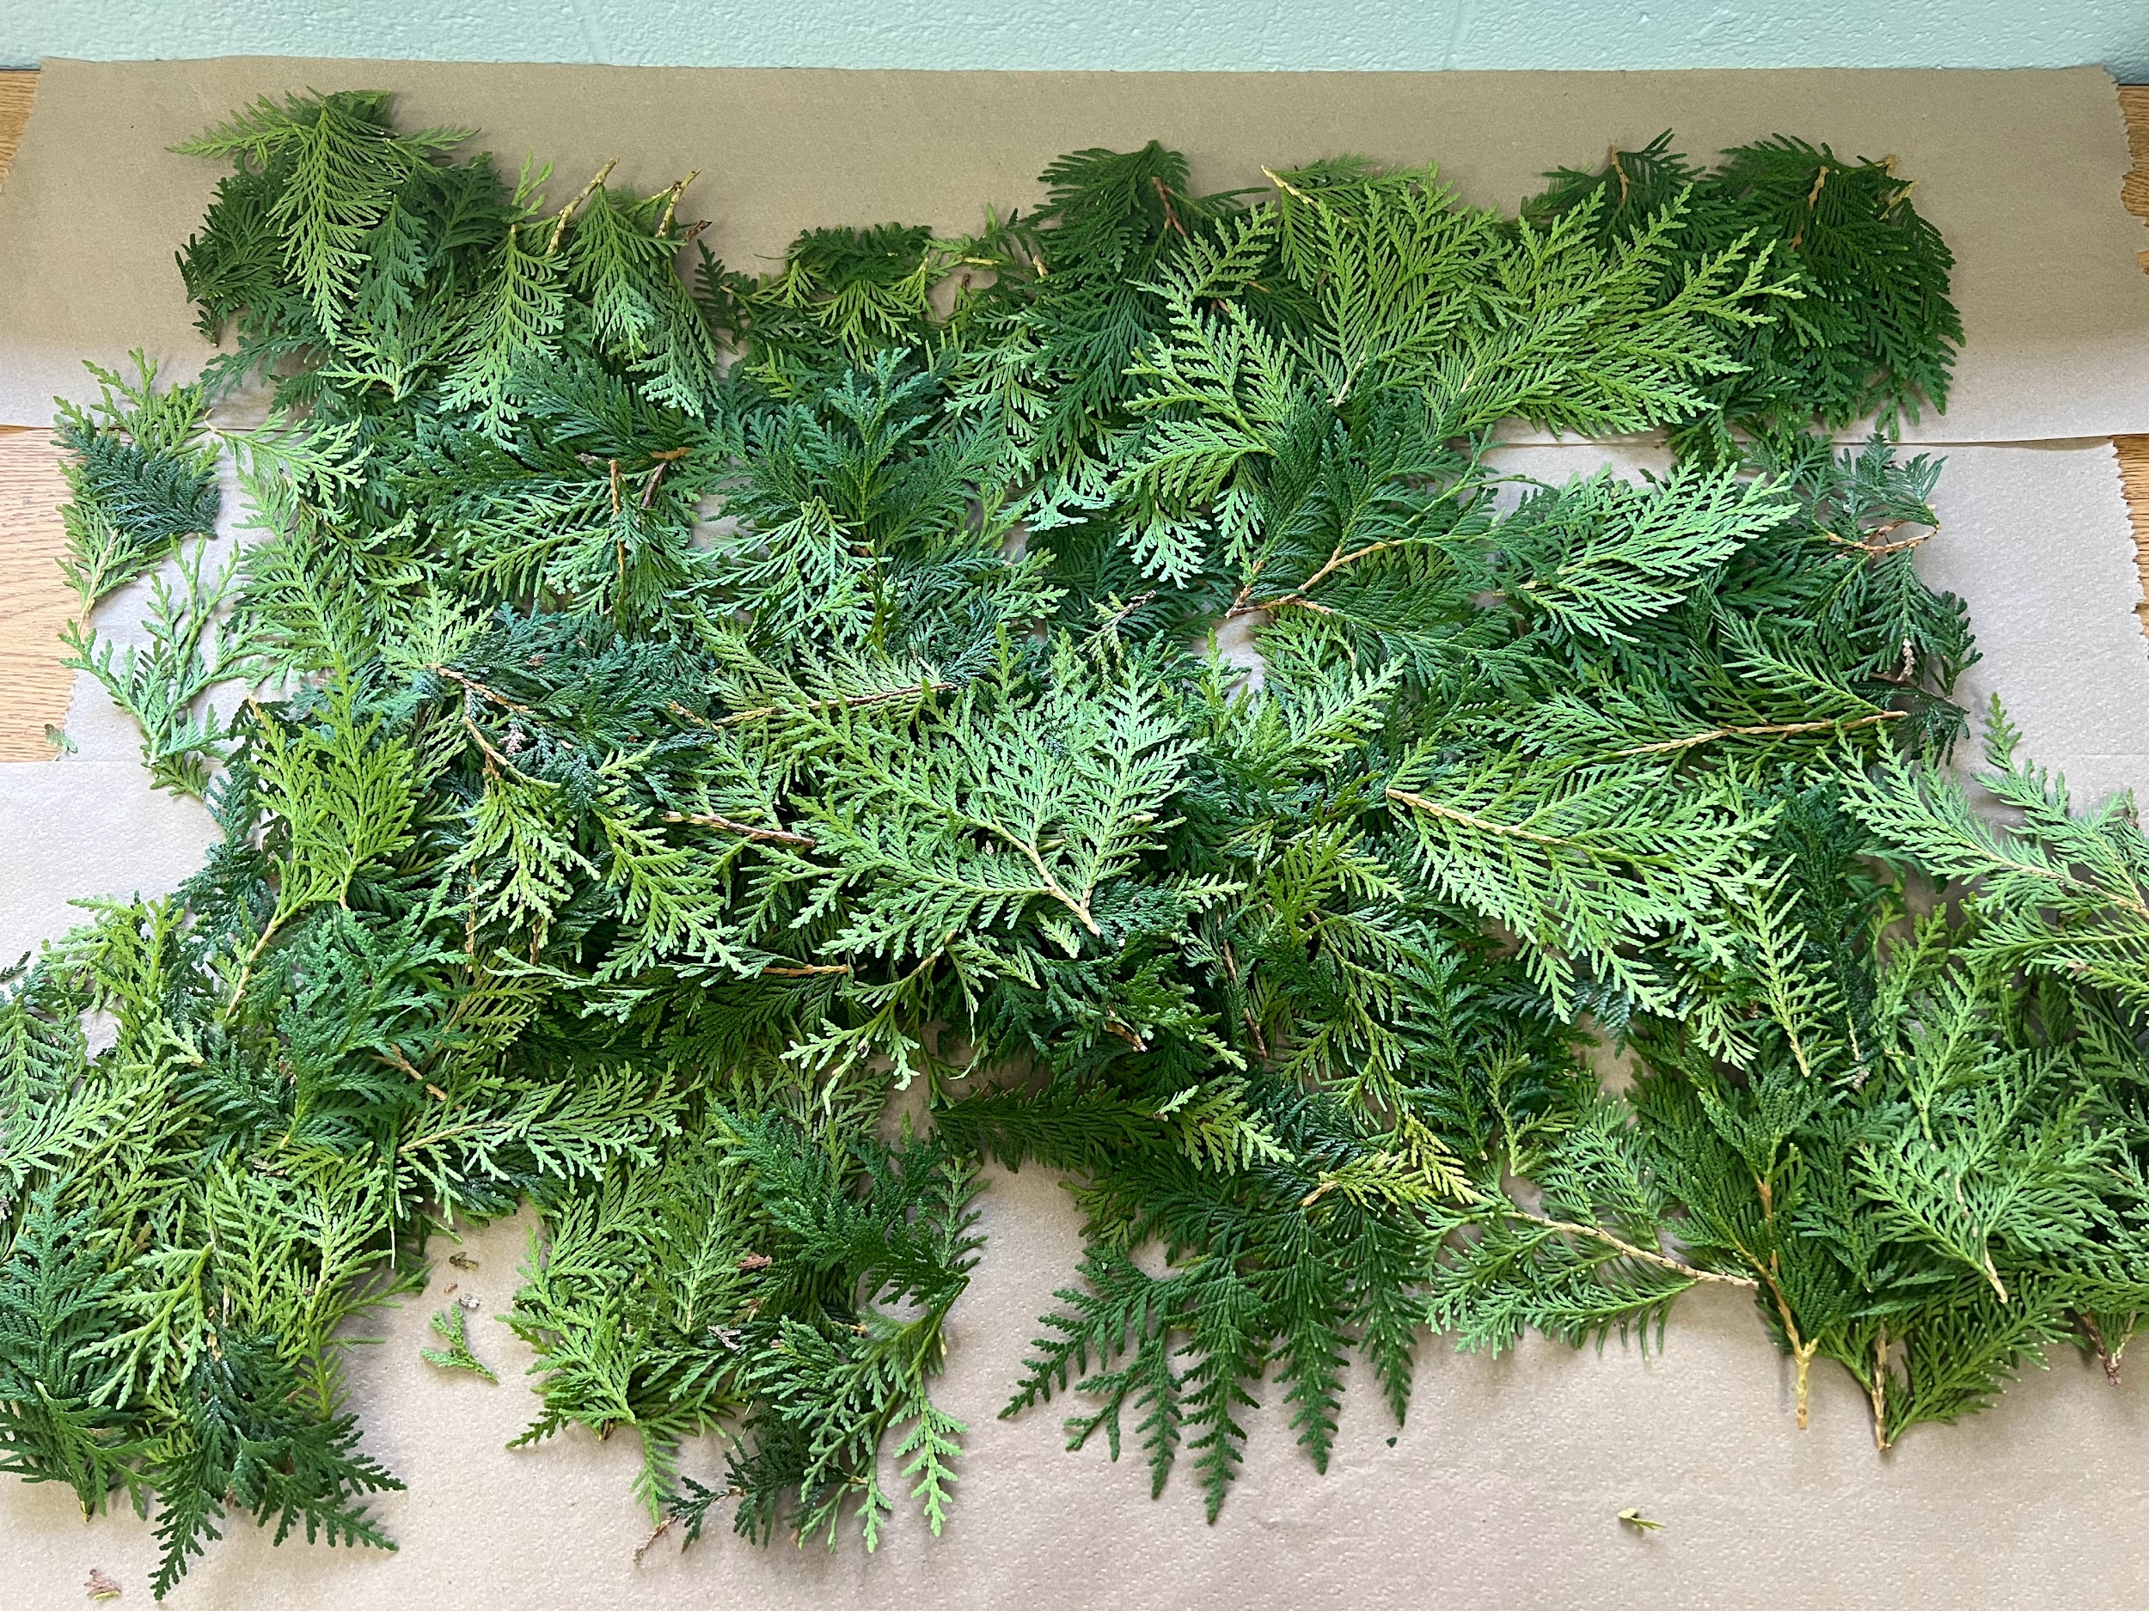
Revitalizing Language and Culture on the Land, Instilling Identity, Promoting Learning and Wellness Through Traditional Foods
Paulette Wrightman

Slide 2
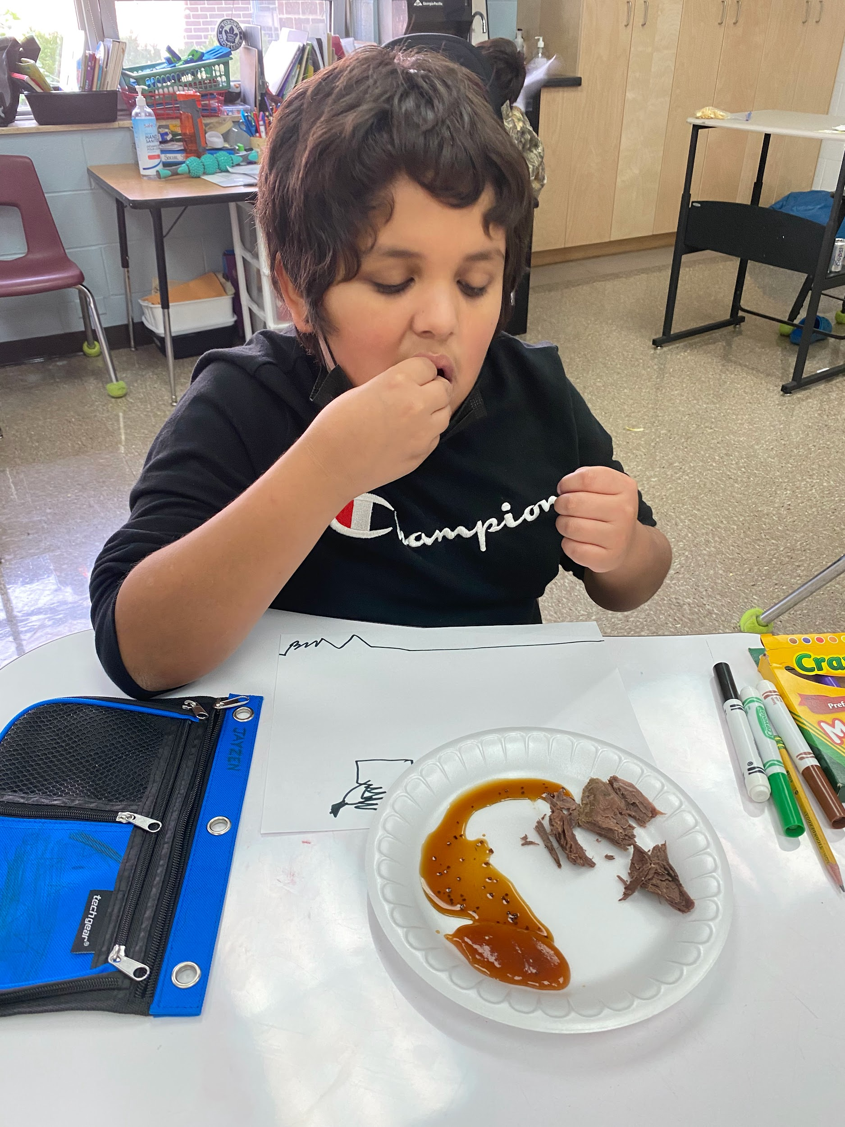
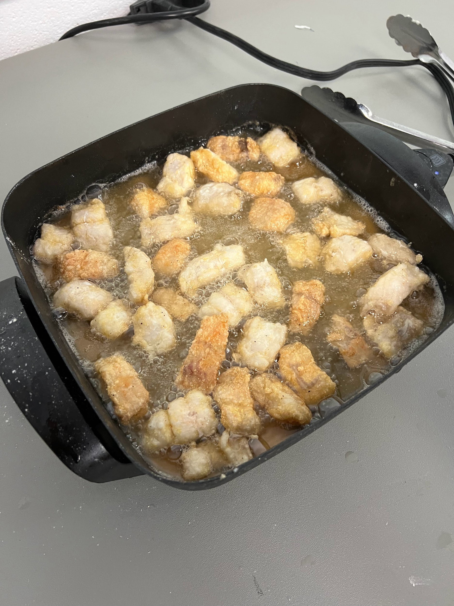
Traditional food was introduced sometimes for the first time while in my classroom.
Notes:
Tell the ocean fish story

Slide 3
Harvest
Prepare
Cook
Notes:
Showed students what I saw growing up. Told my stories of ppl who I learned culture and traditions from. Then took them to live and learn the traditions.

Slide 4
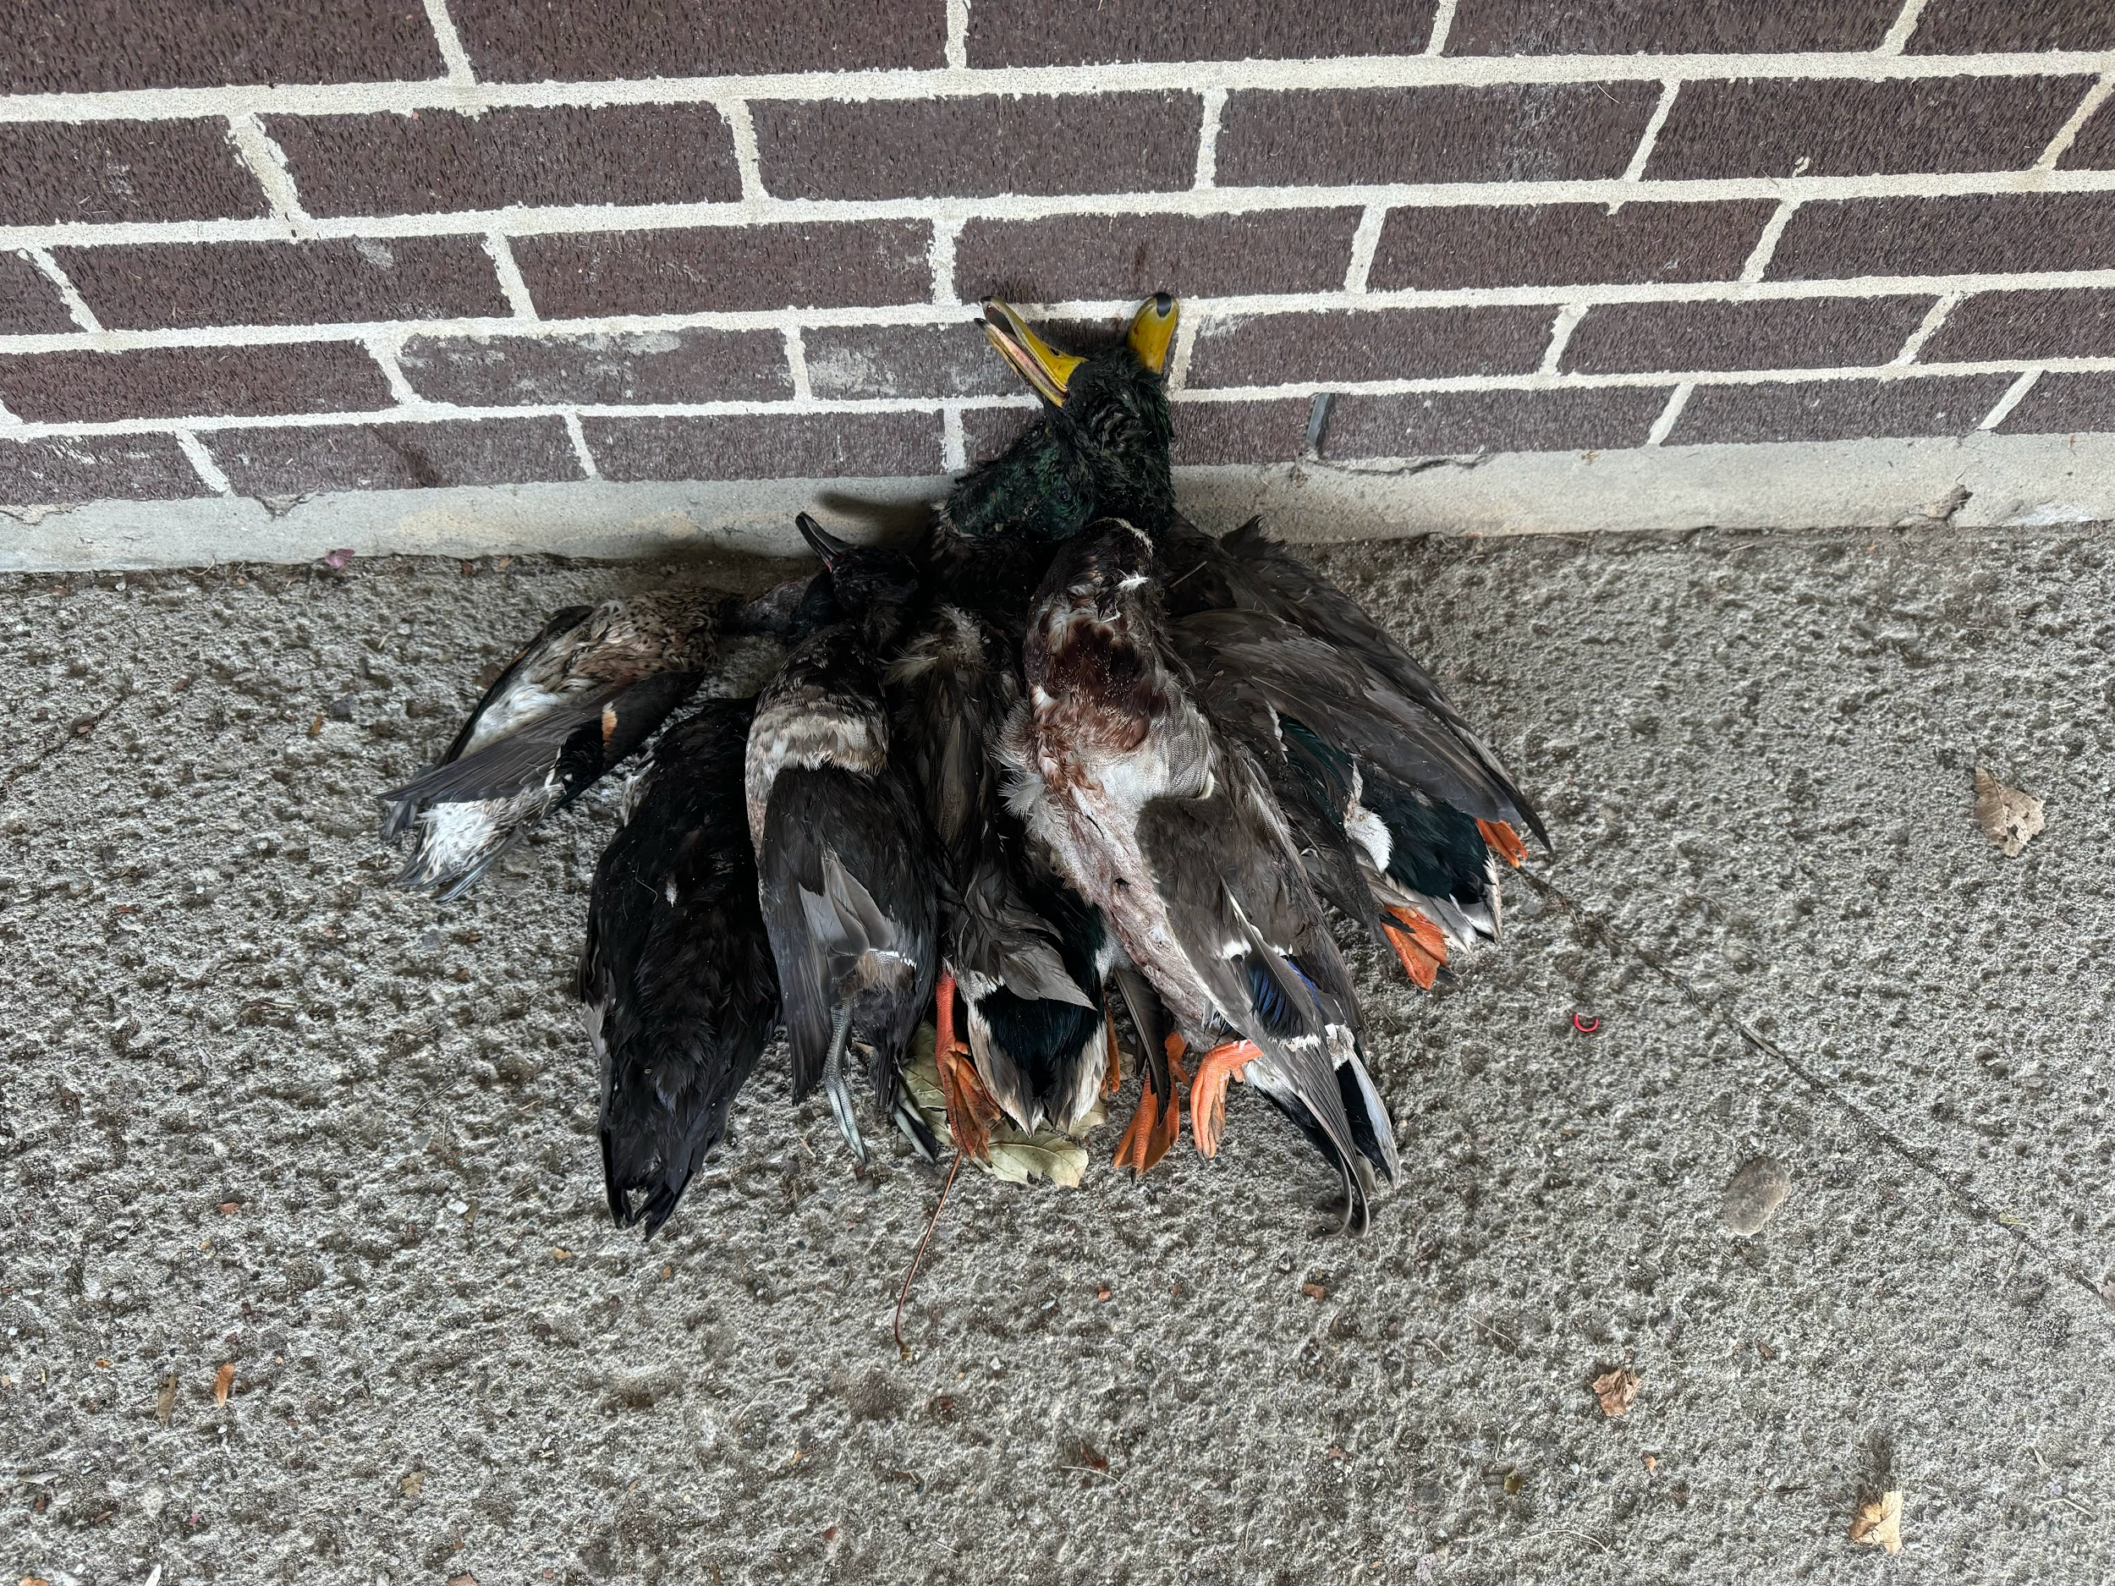
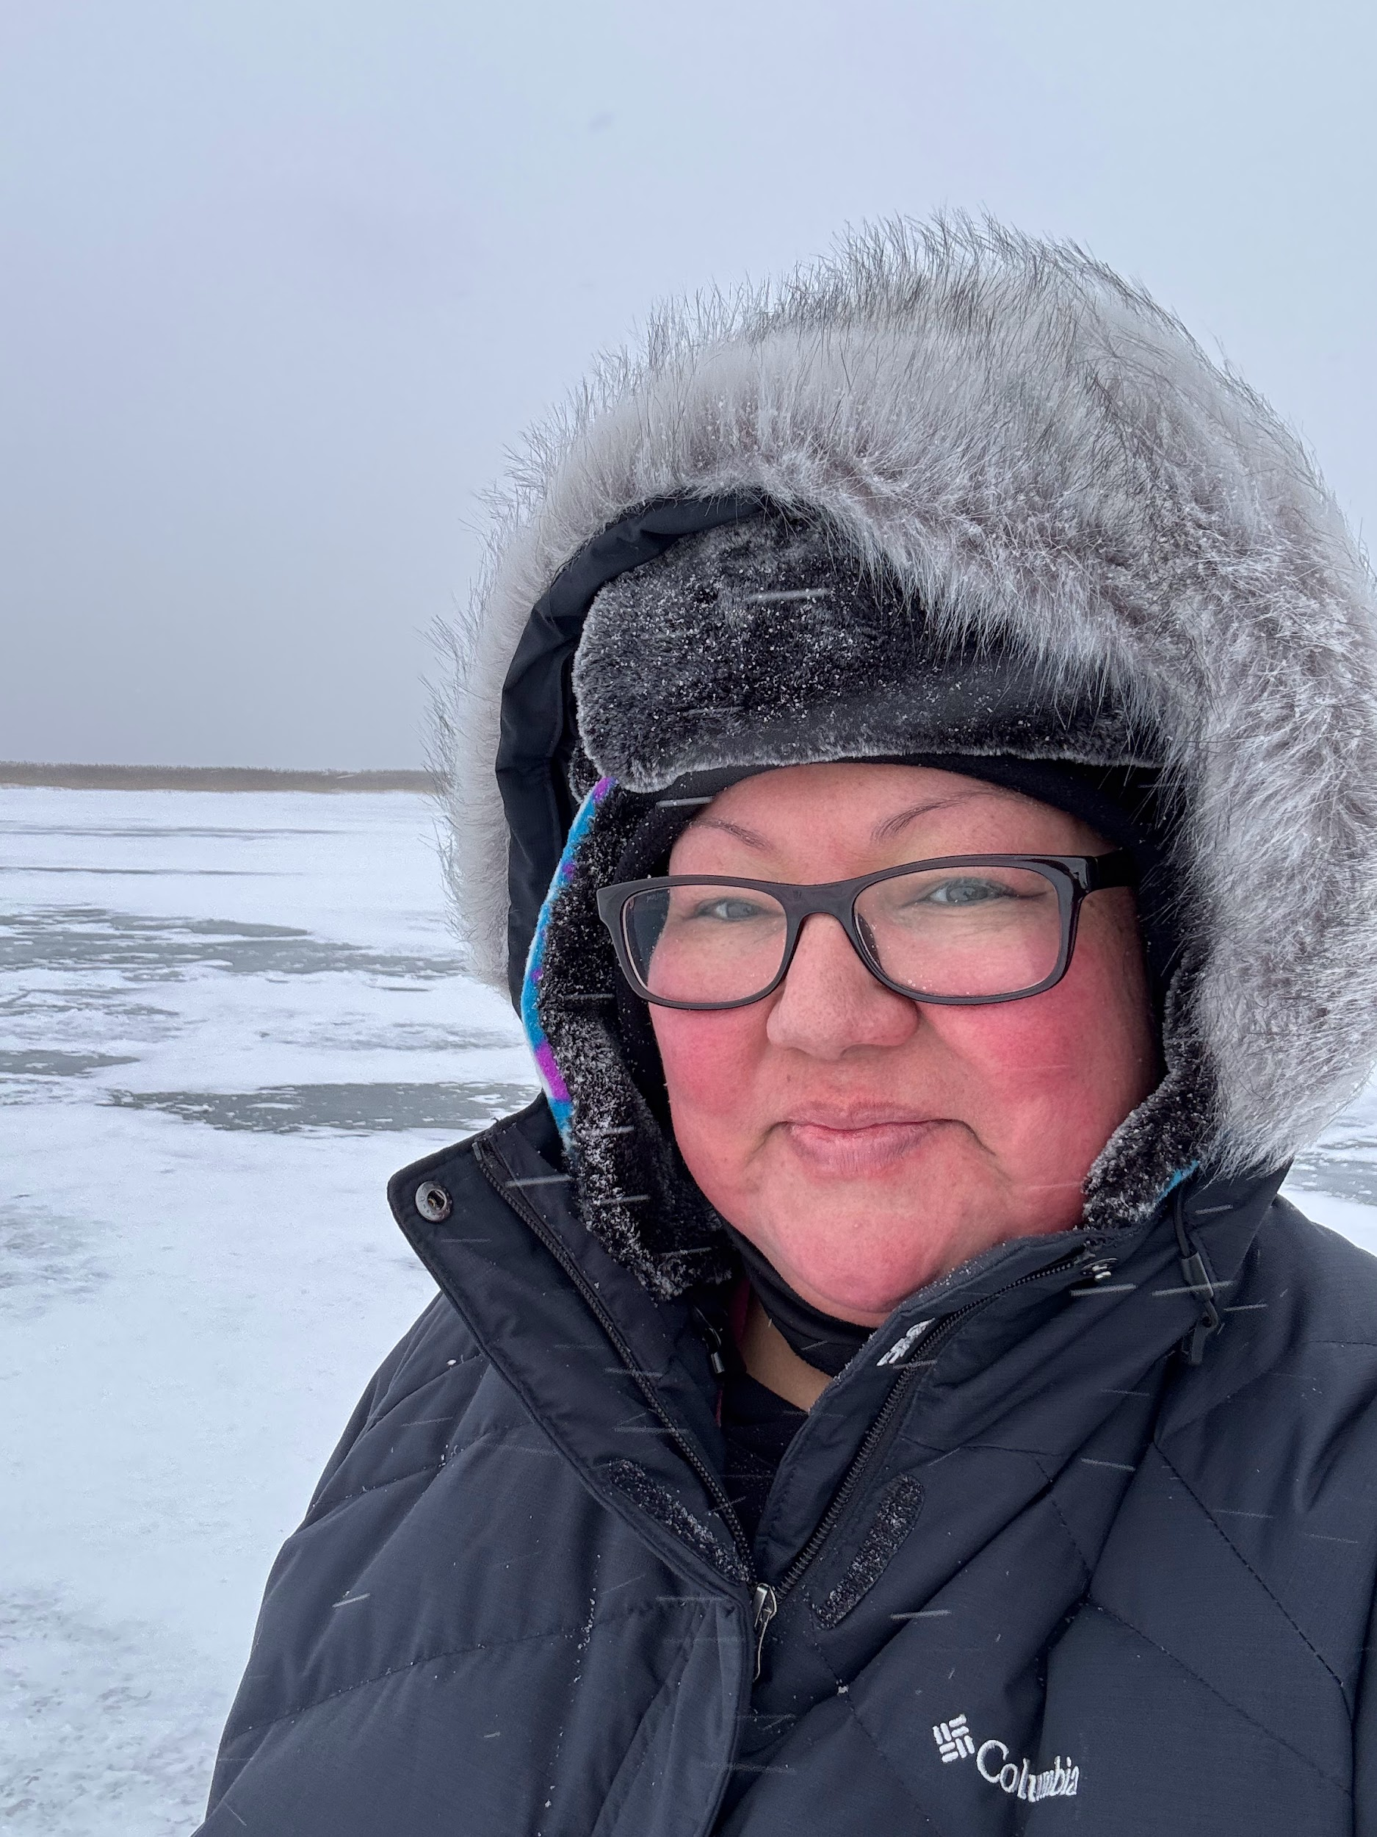
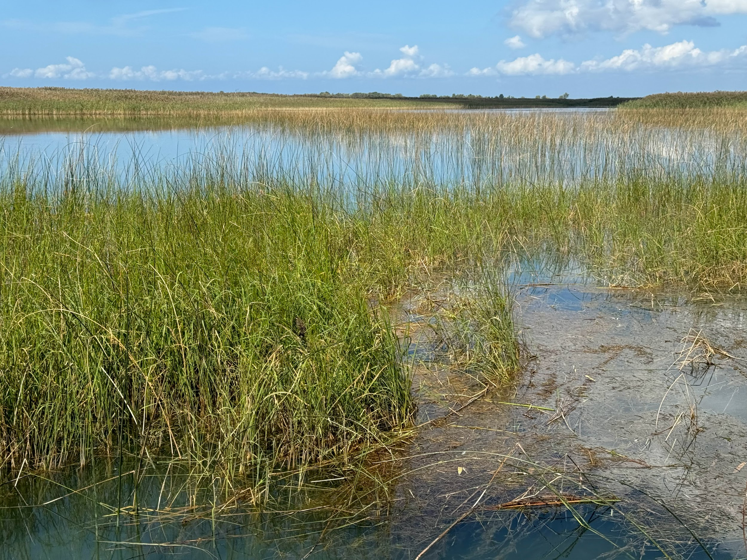
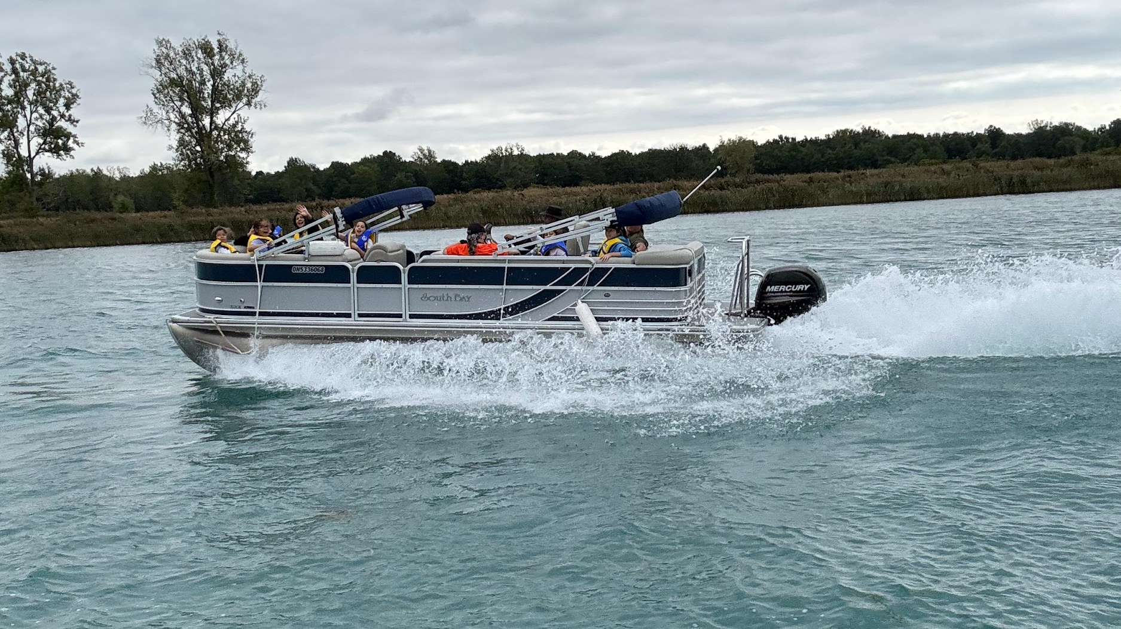
Learning is based on the seasons and the moons.
Notes:
I mapped out my long range lesson plans based on seasons and the moons. I listed all the teachable moments for each of the 10 school months. Wild Rice - coming back. Sept - corn, apples, opening day - ducks, wild rice. Oct - pumpkins, more ducks, drying corn, Nov - cooking in the lodge over the fire, Jan - ice fishing, storytelling - cedar tea, March - sugar bush, maple syrup, Spring - netting fish, cleaning fish, cooking fish, fishing from land, June - strawberries, strawberry drink with maple syrup

Slide 5
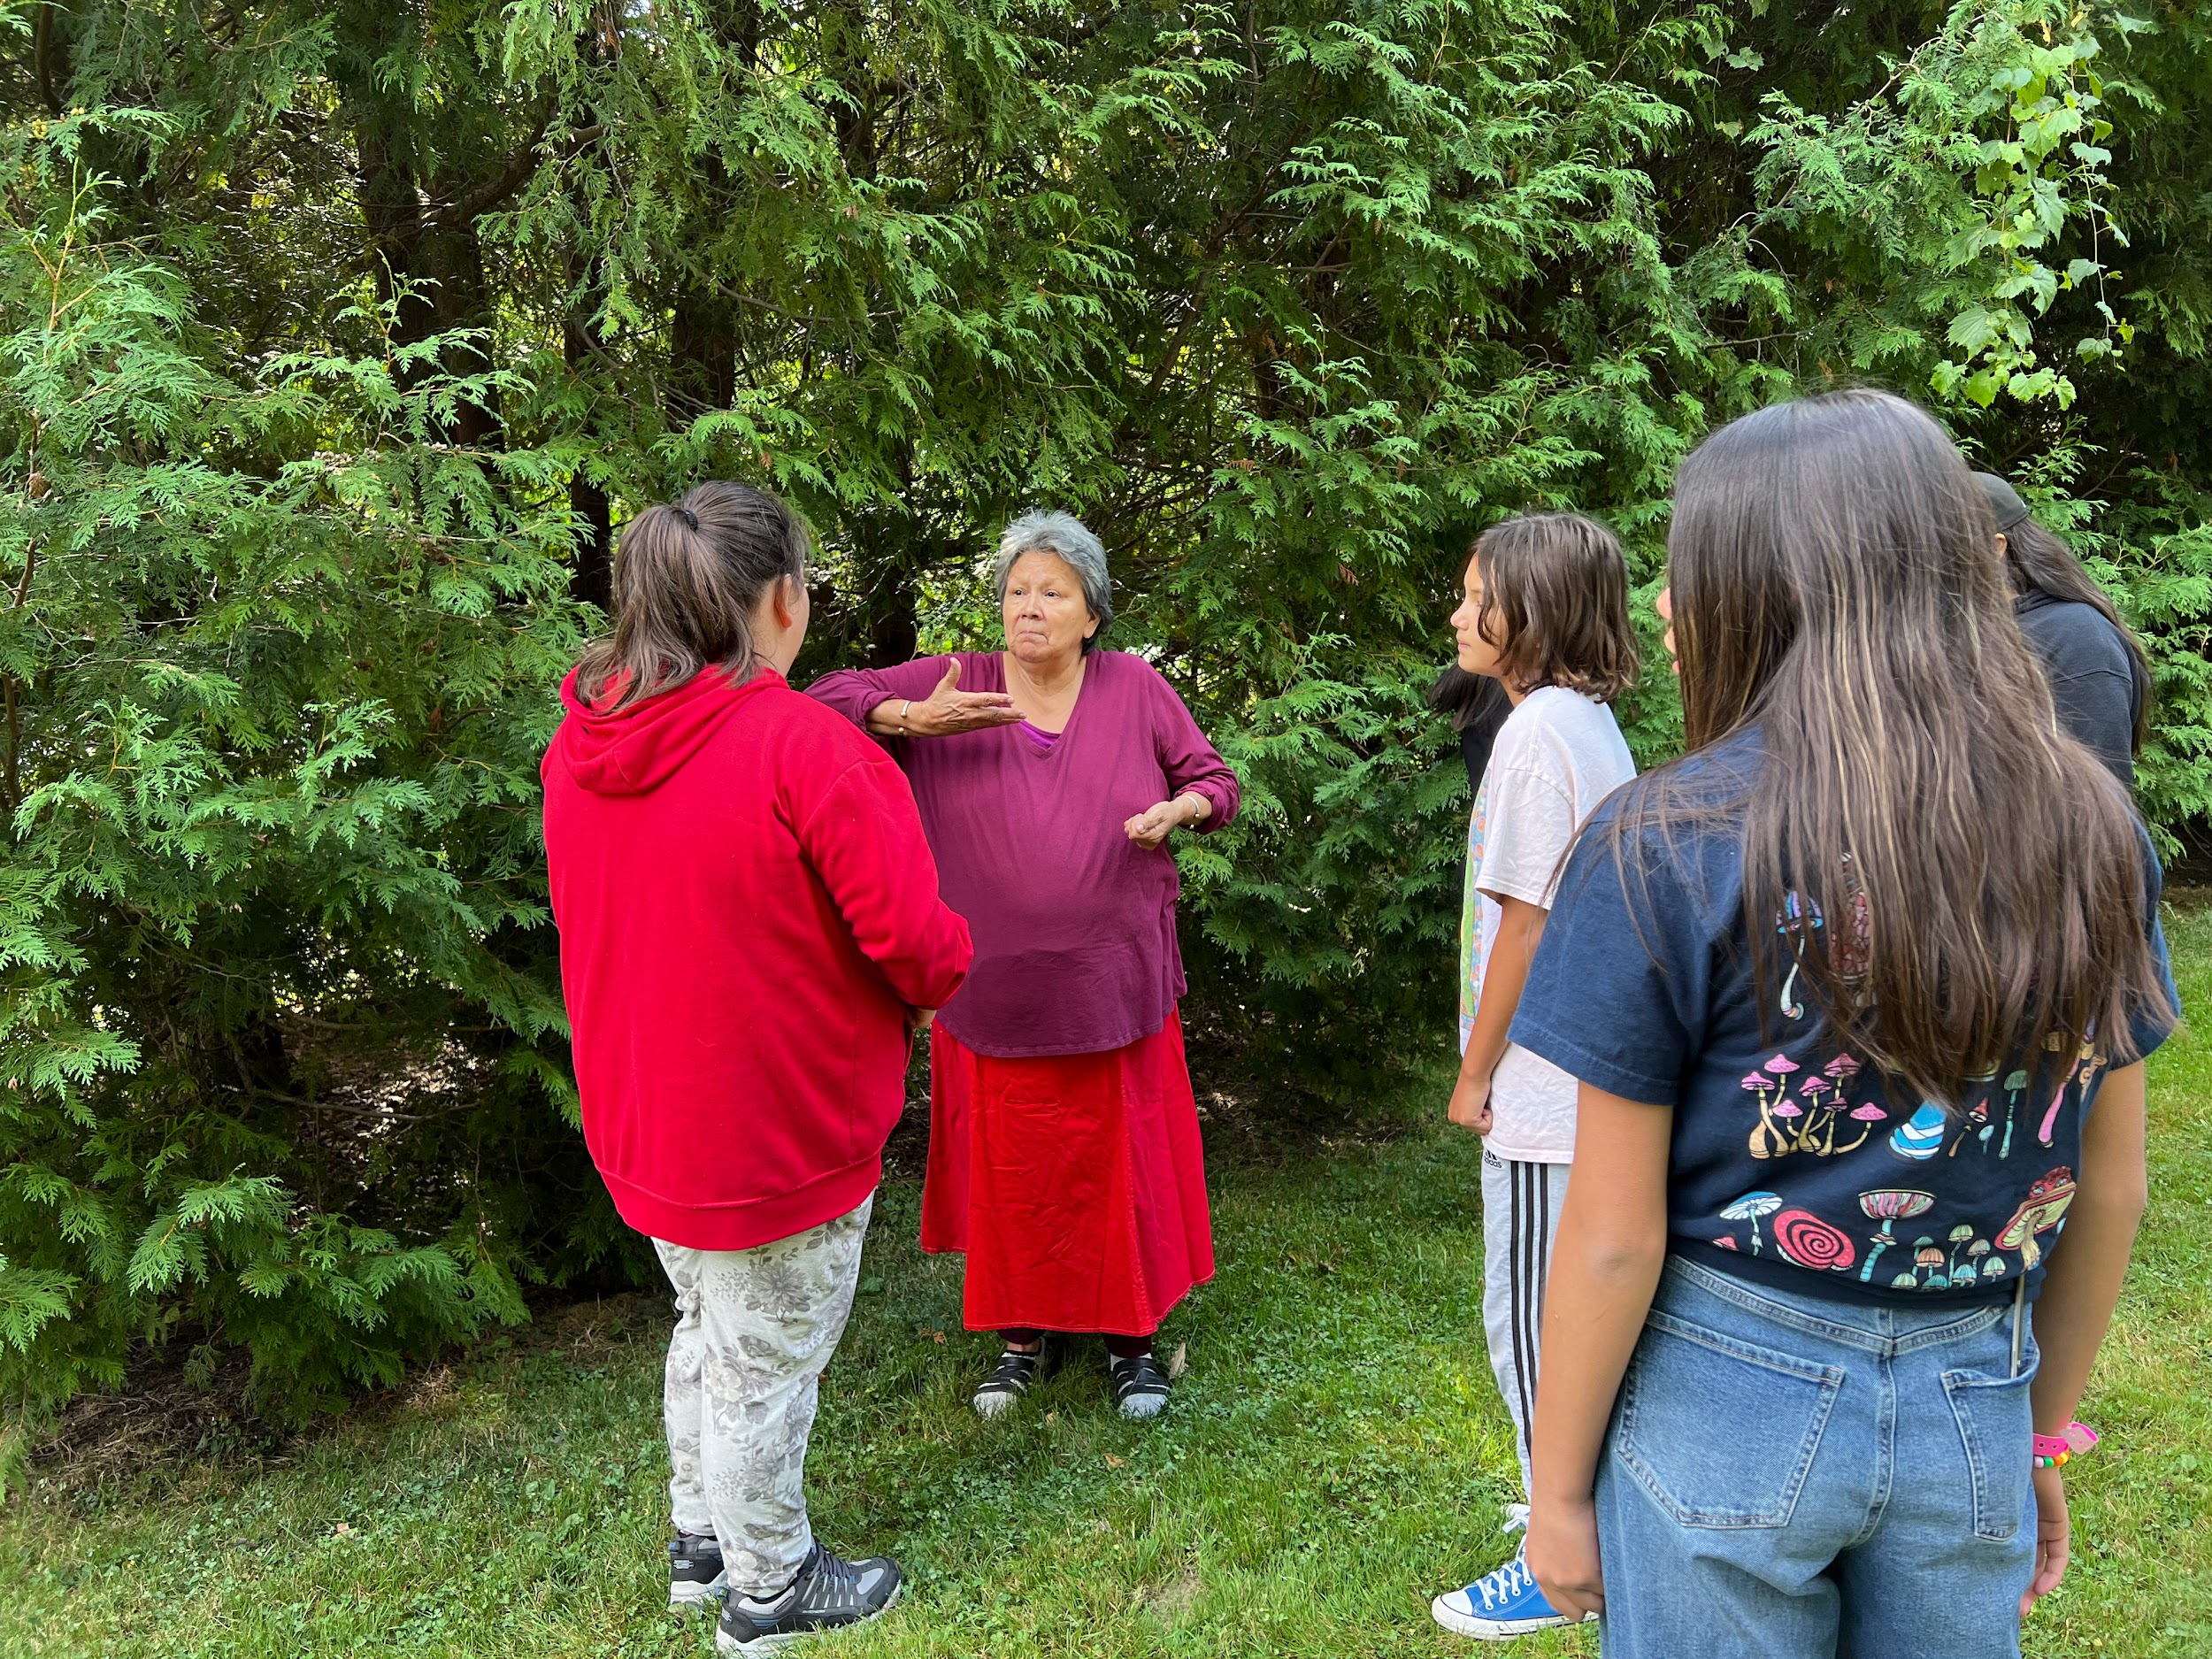
It takes a community to raise a child.
Elders, Knowledge Keepers and Community Members are used to support learning.
Notes:
I reached out to community members, knowledge keepers and Elders to support my teaching. They were brought into the school - my classroom, school yard (to hand deer, stretch and clean fur/hides) or the lodge. We also took many field trips and visited Elder’s homes.

Slide 6
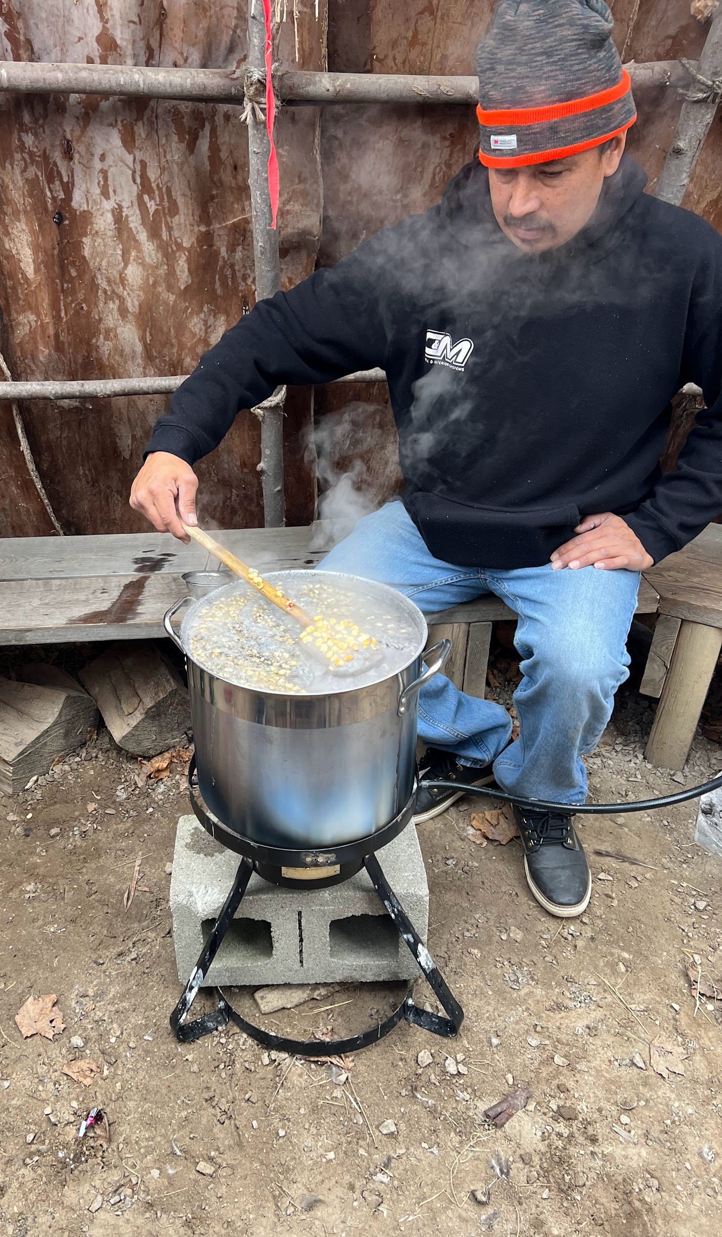
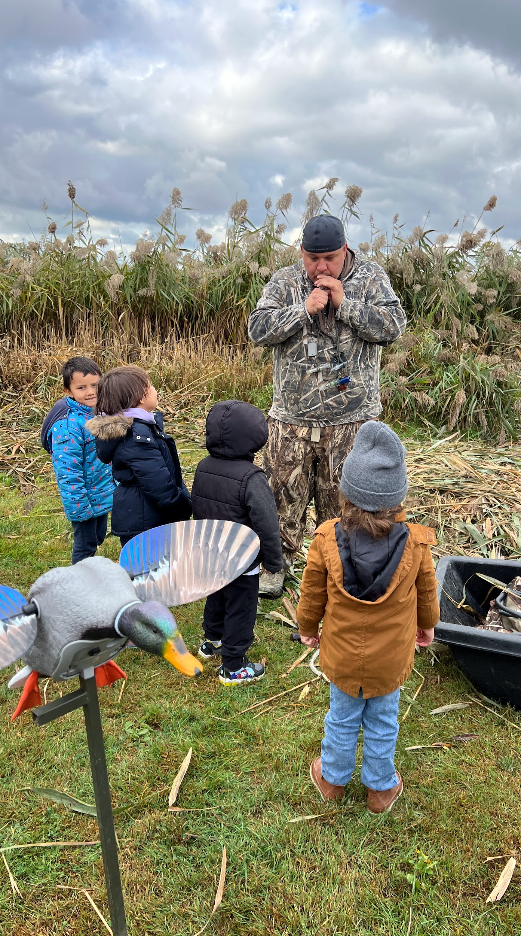
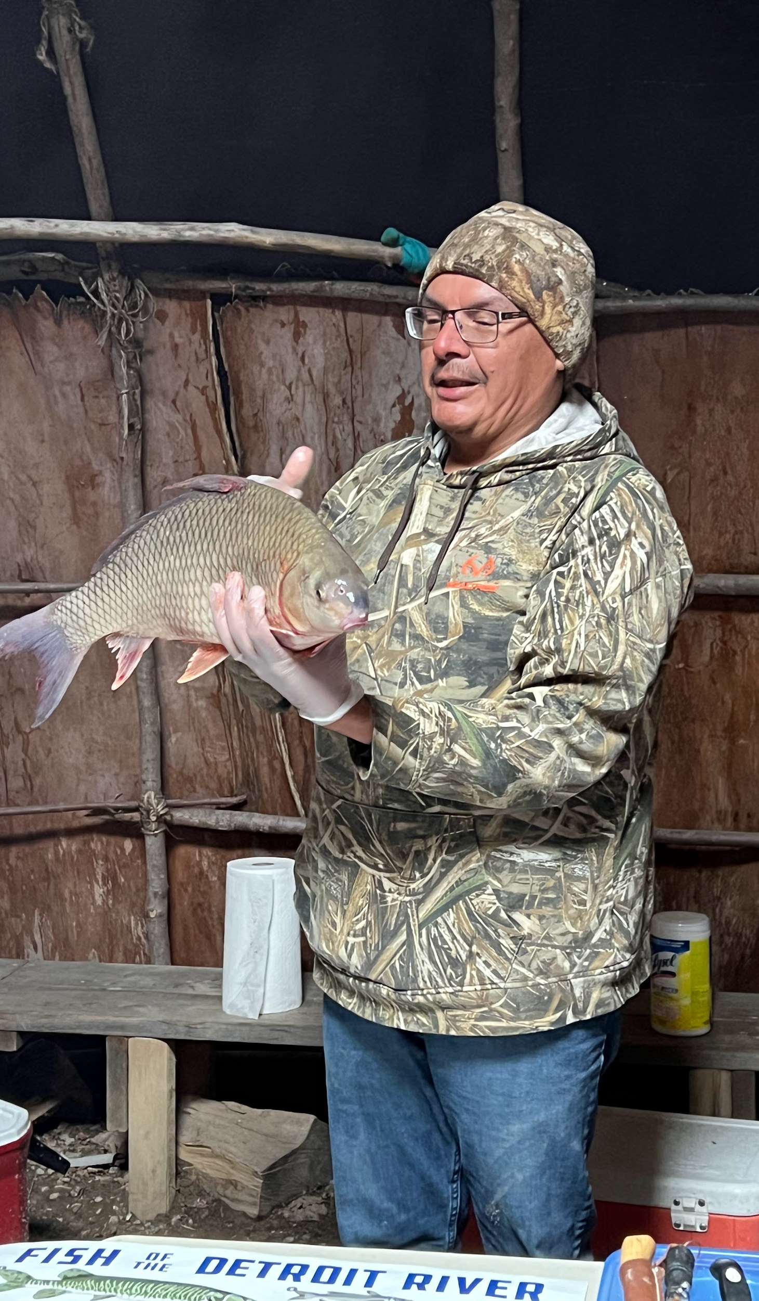
Notes:
All learning took place on our traditional territory of Bkejwanong with our own member. Our First Nation is rich in natural resources.

Slide 7
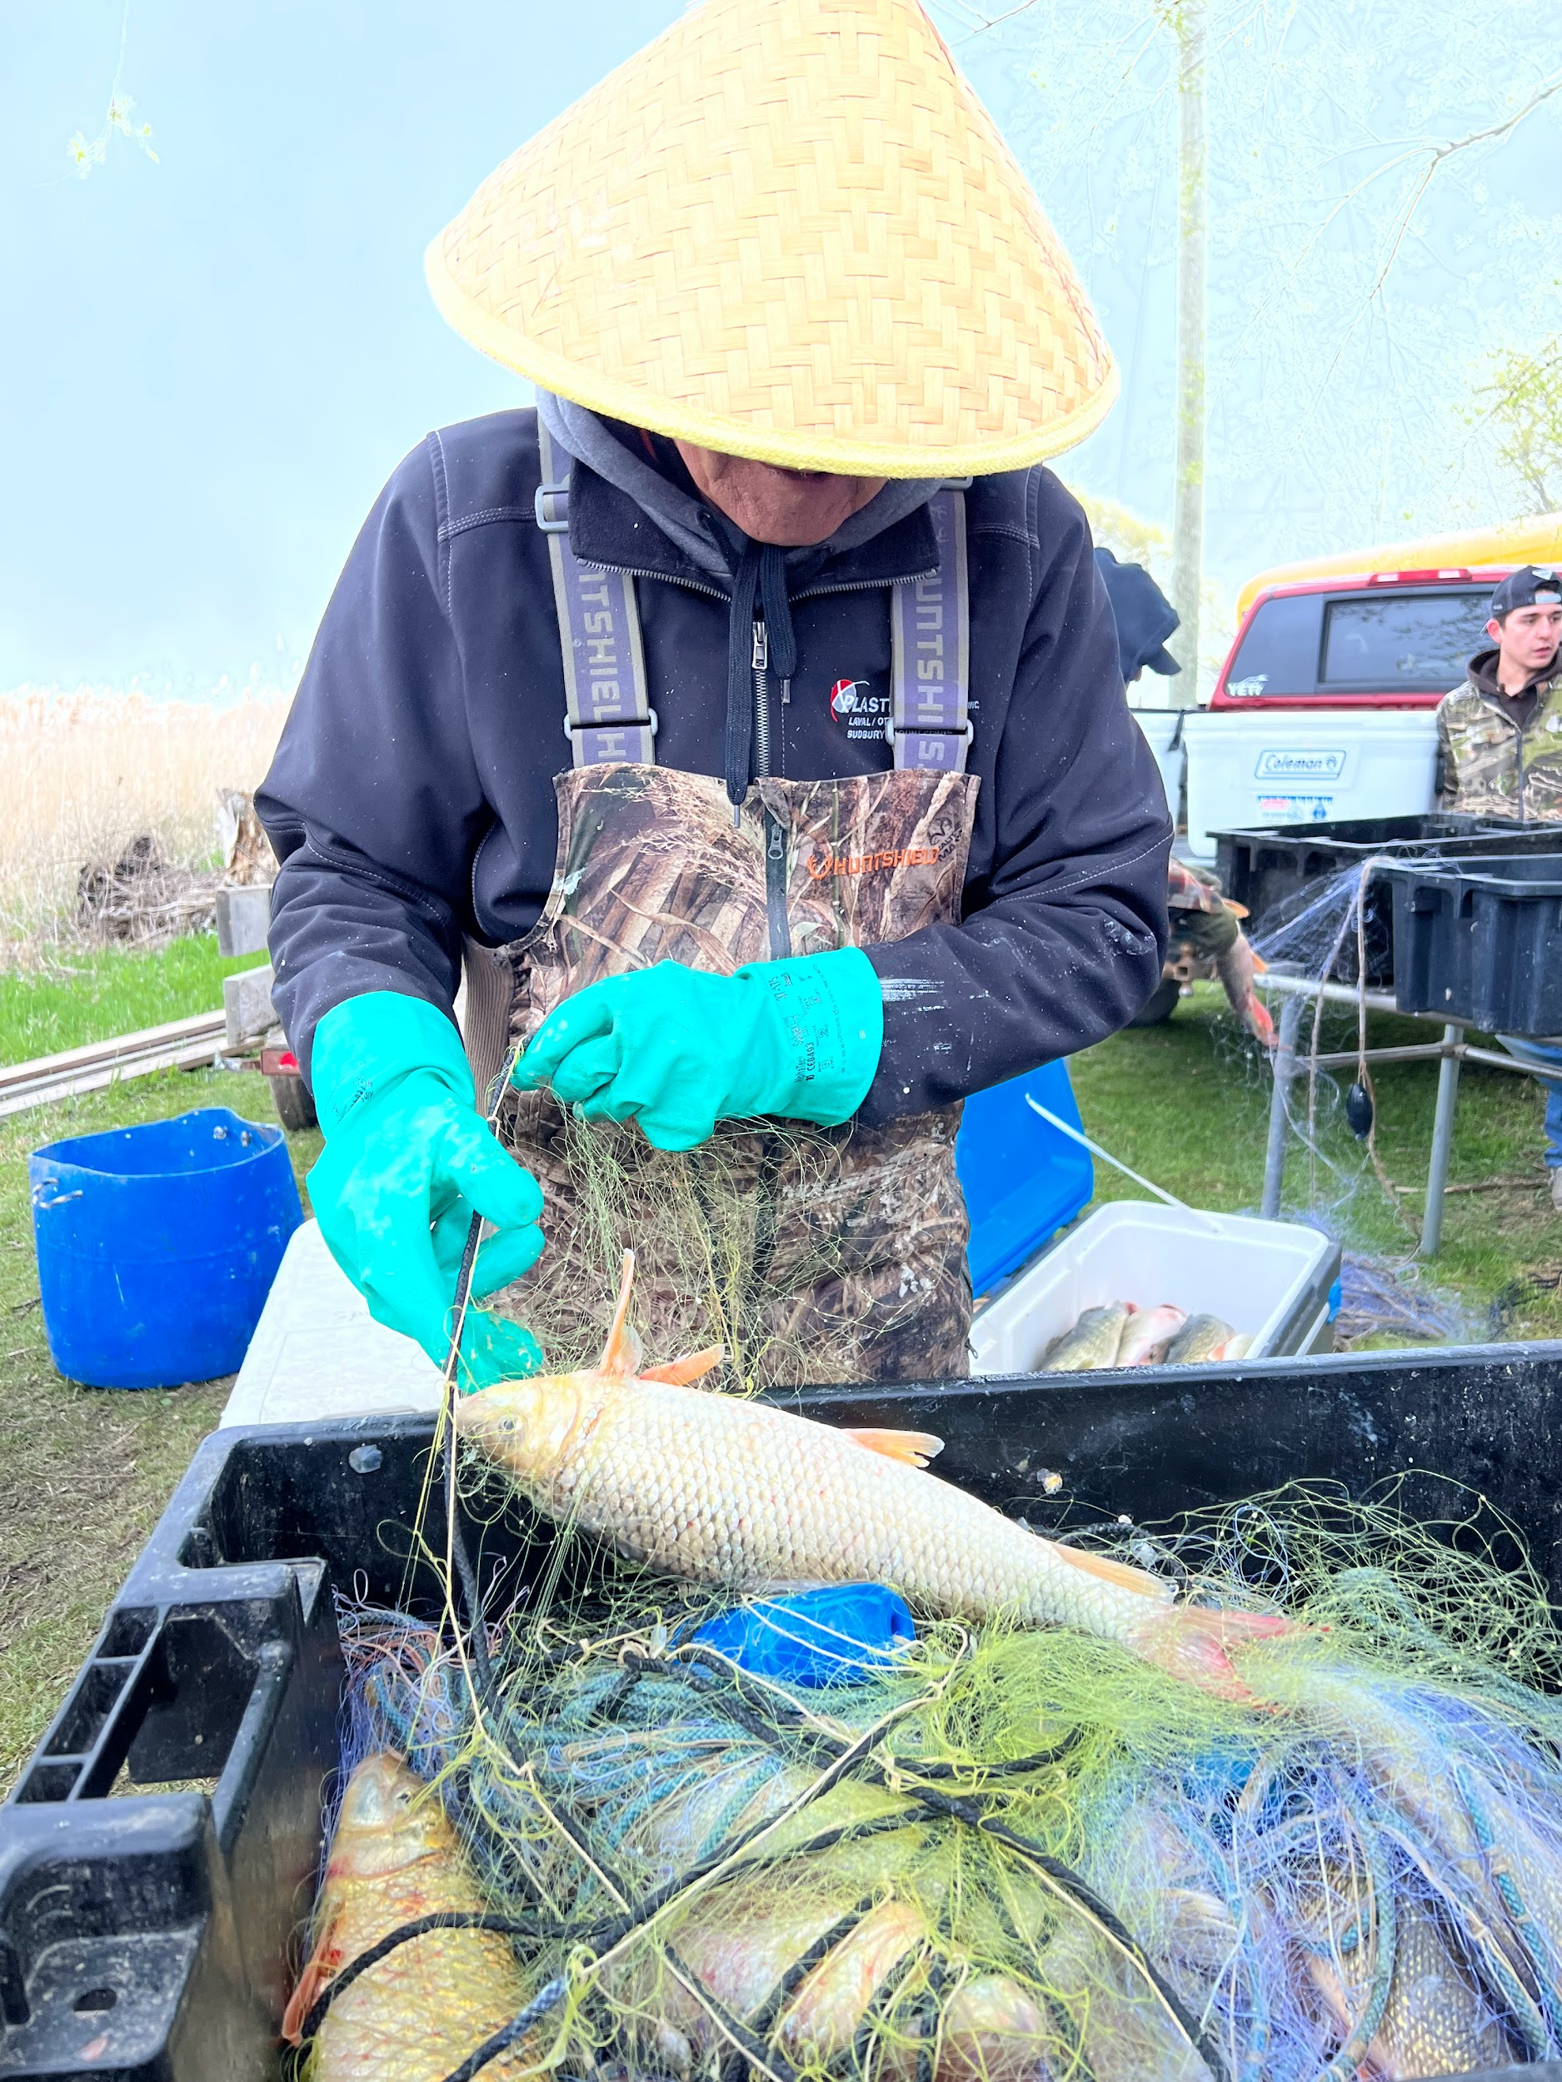
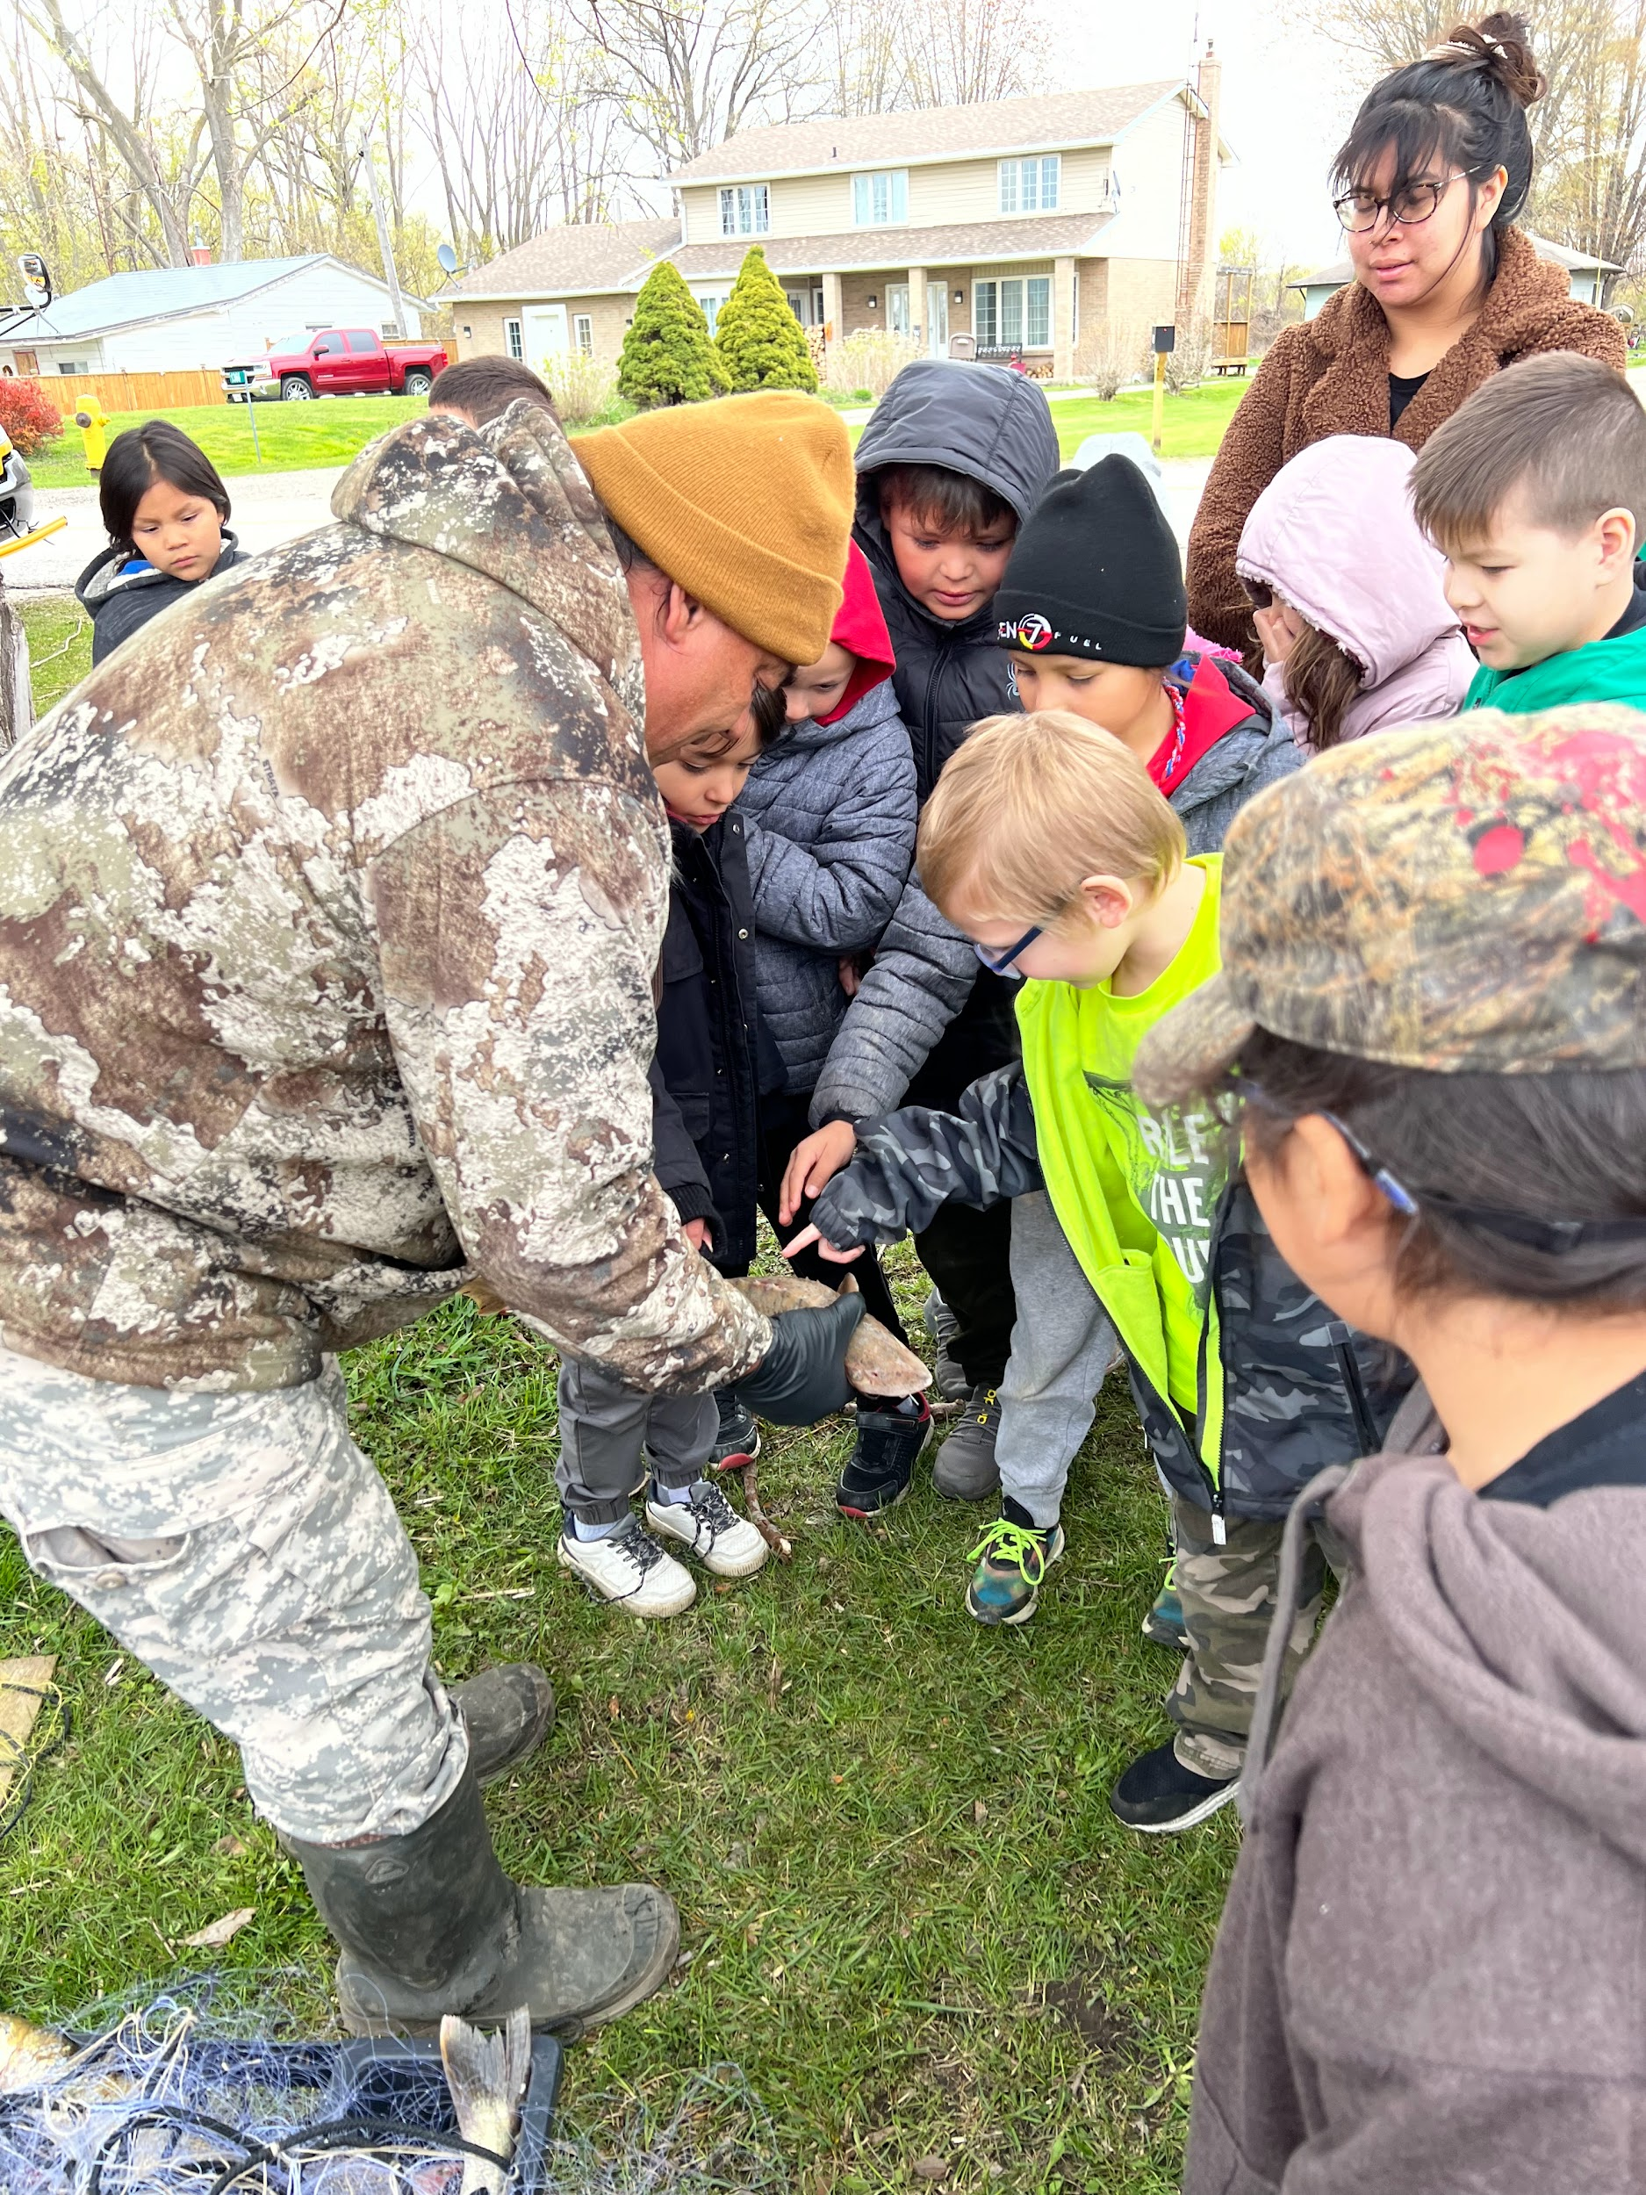

Slide 8
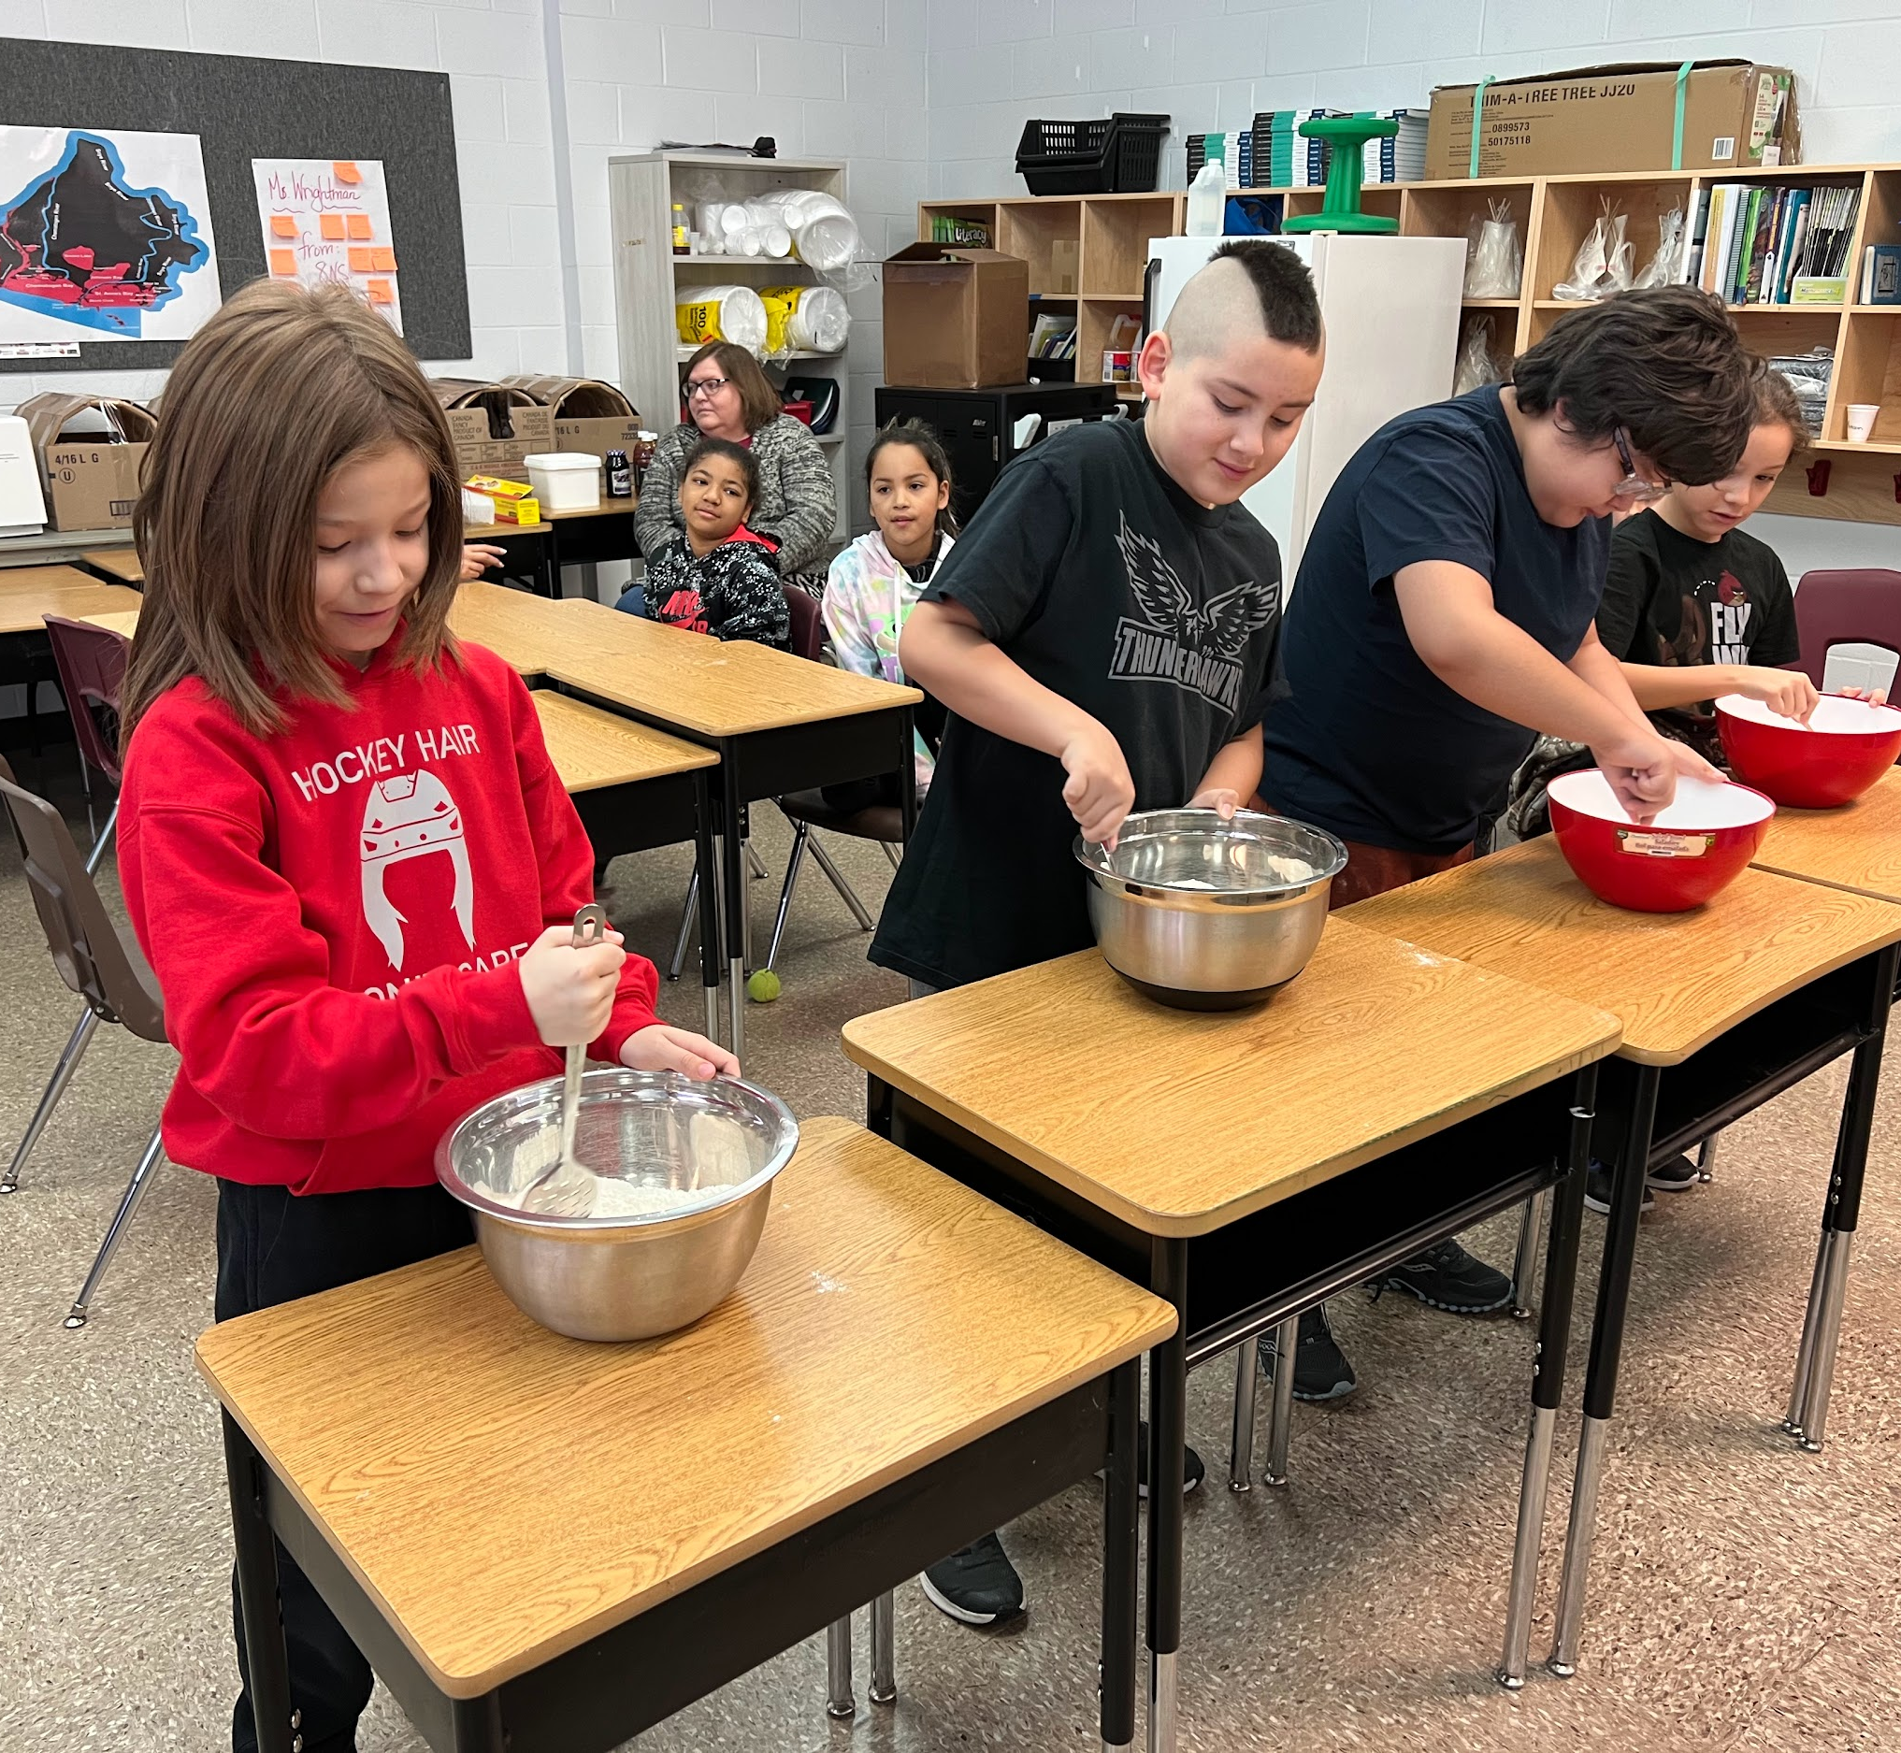
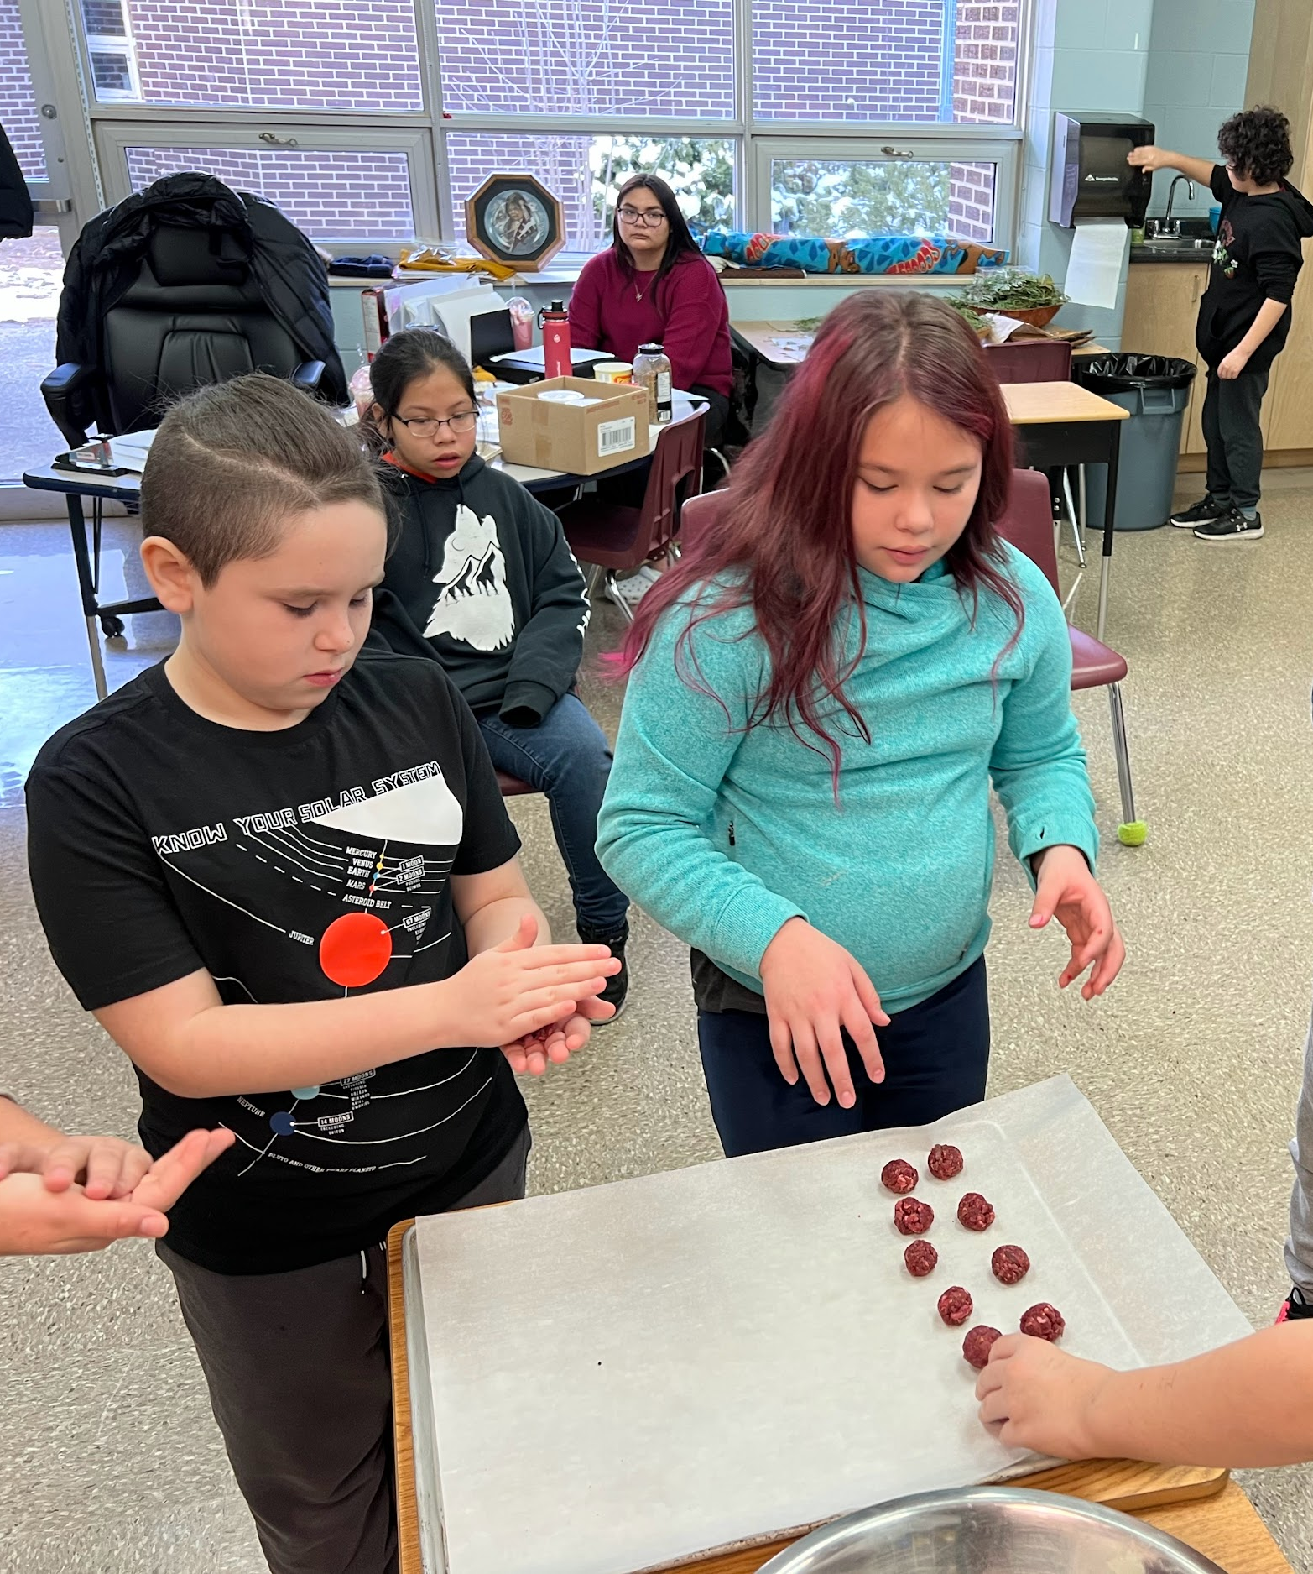
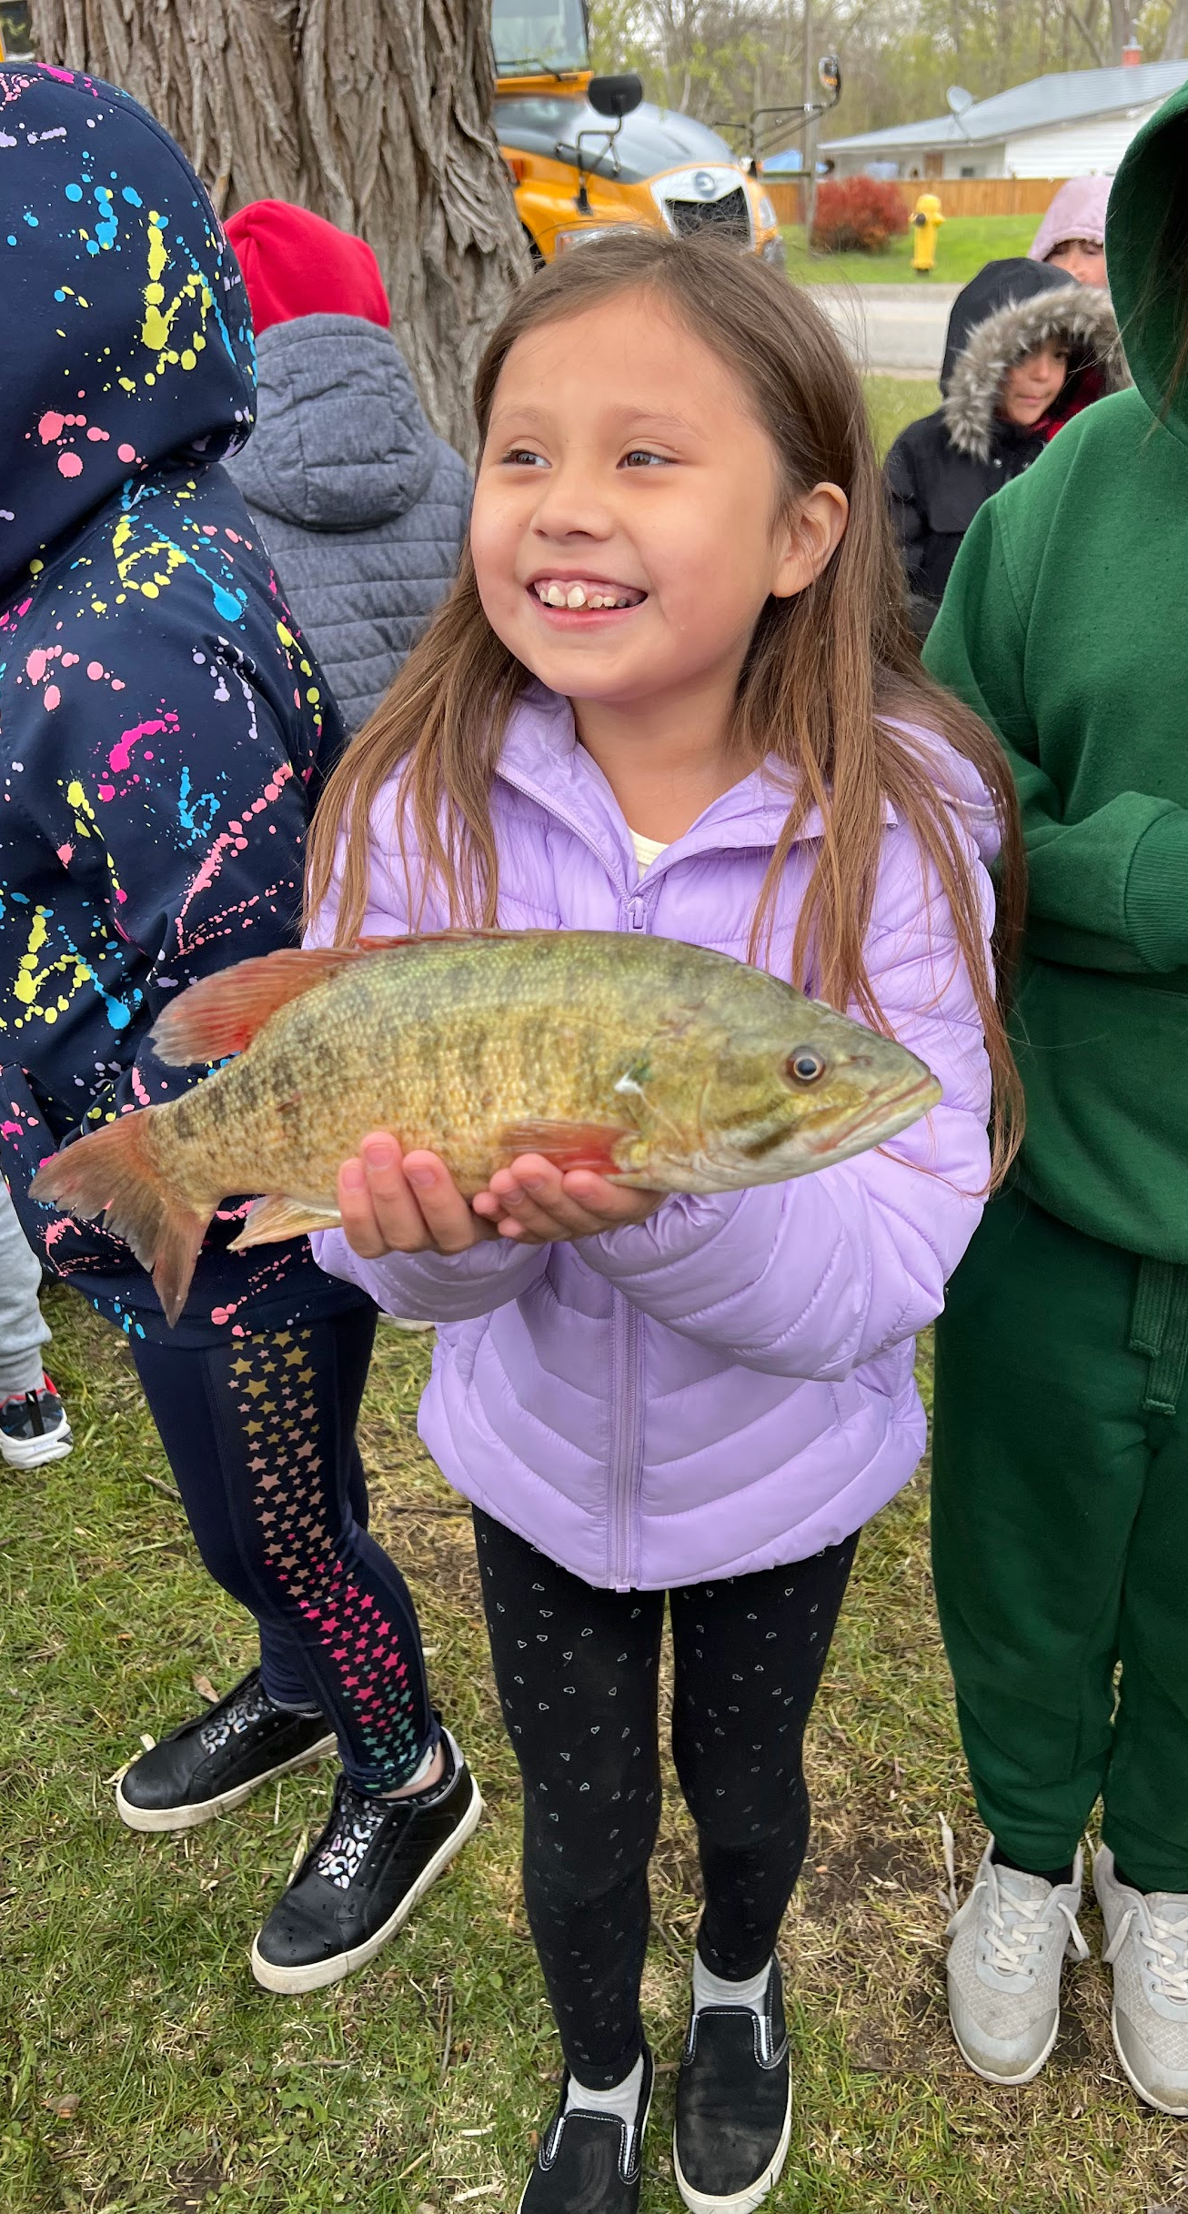
Students were “hands on” in my classroom. I would model and they would take over.

Slide 9
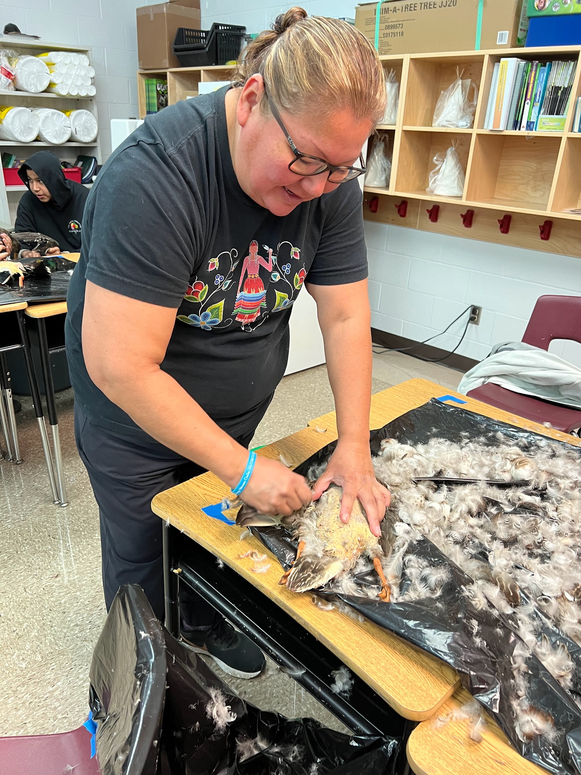
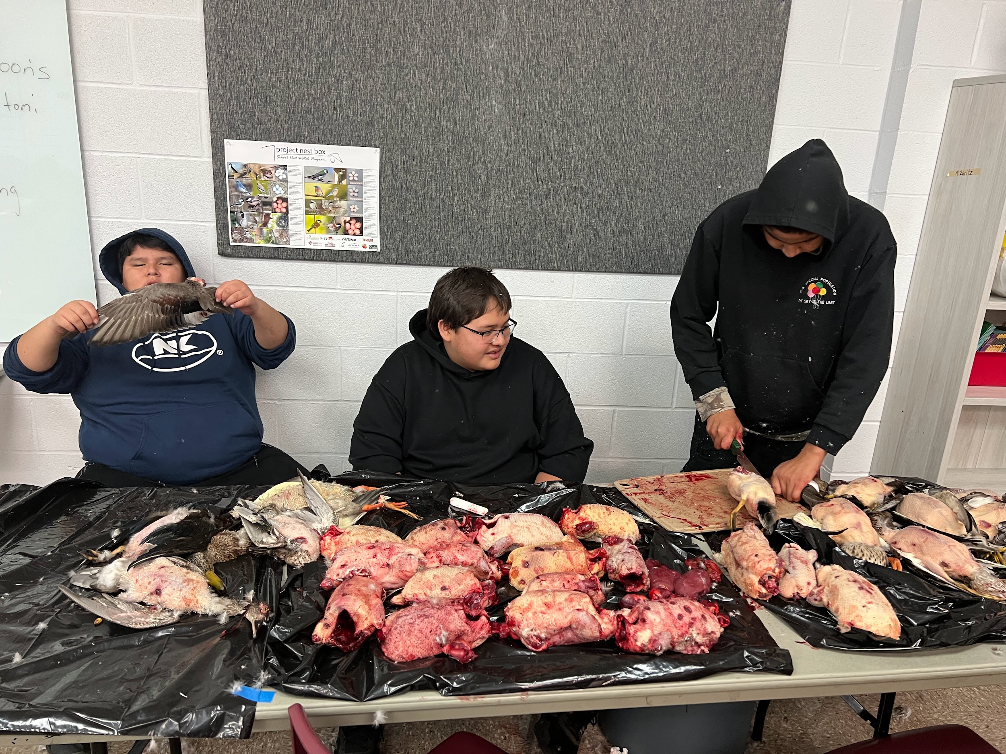
Notes:
My classroom had a chest freezer. We harvested, cleaned the meat and froze it to cook throughout the school year. Rainy days - cooking days. Cooking days were also spontaneous as students requested certain meals. We also used our wild game for feast days.

Slide 10
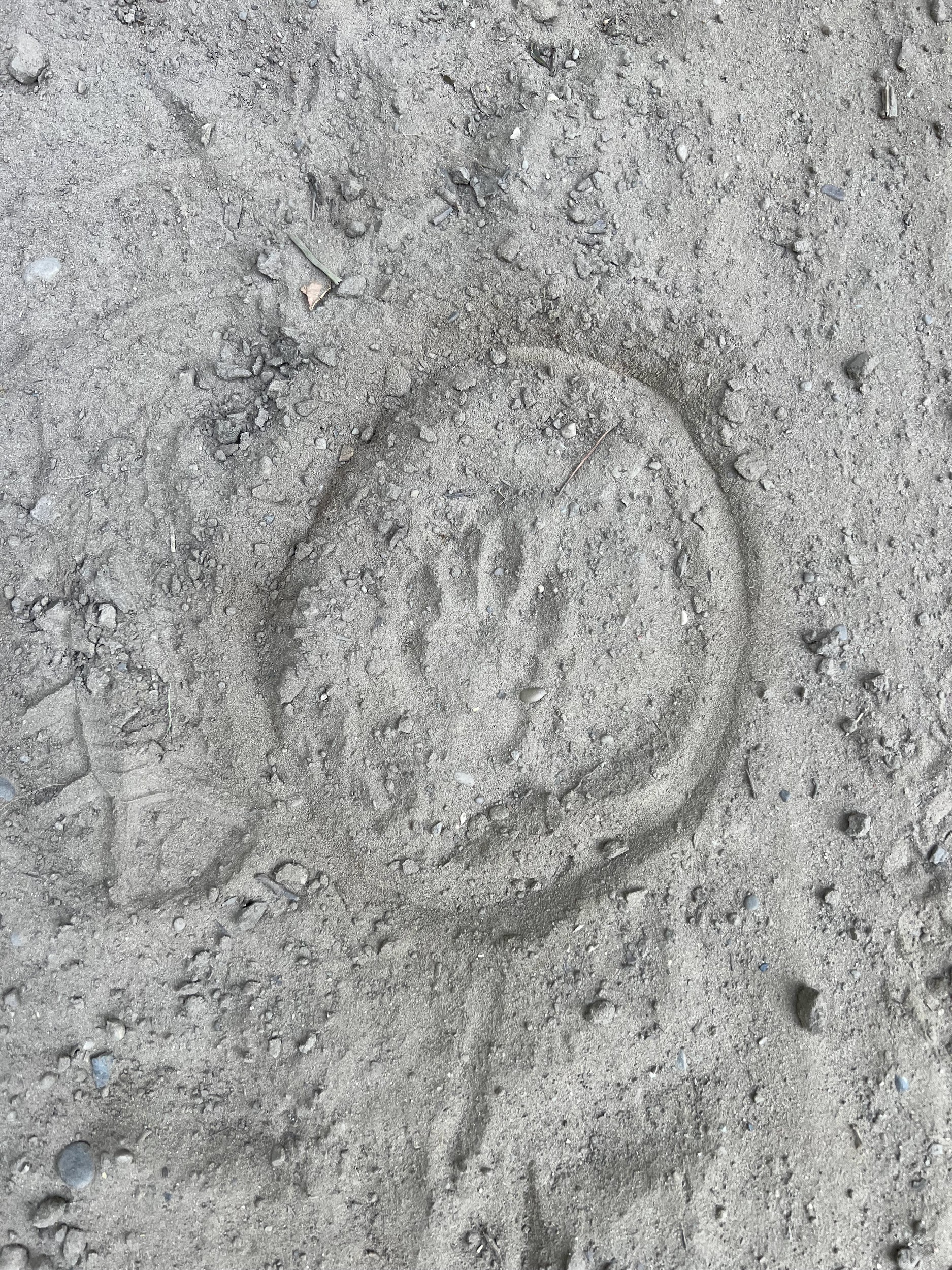
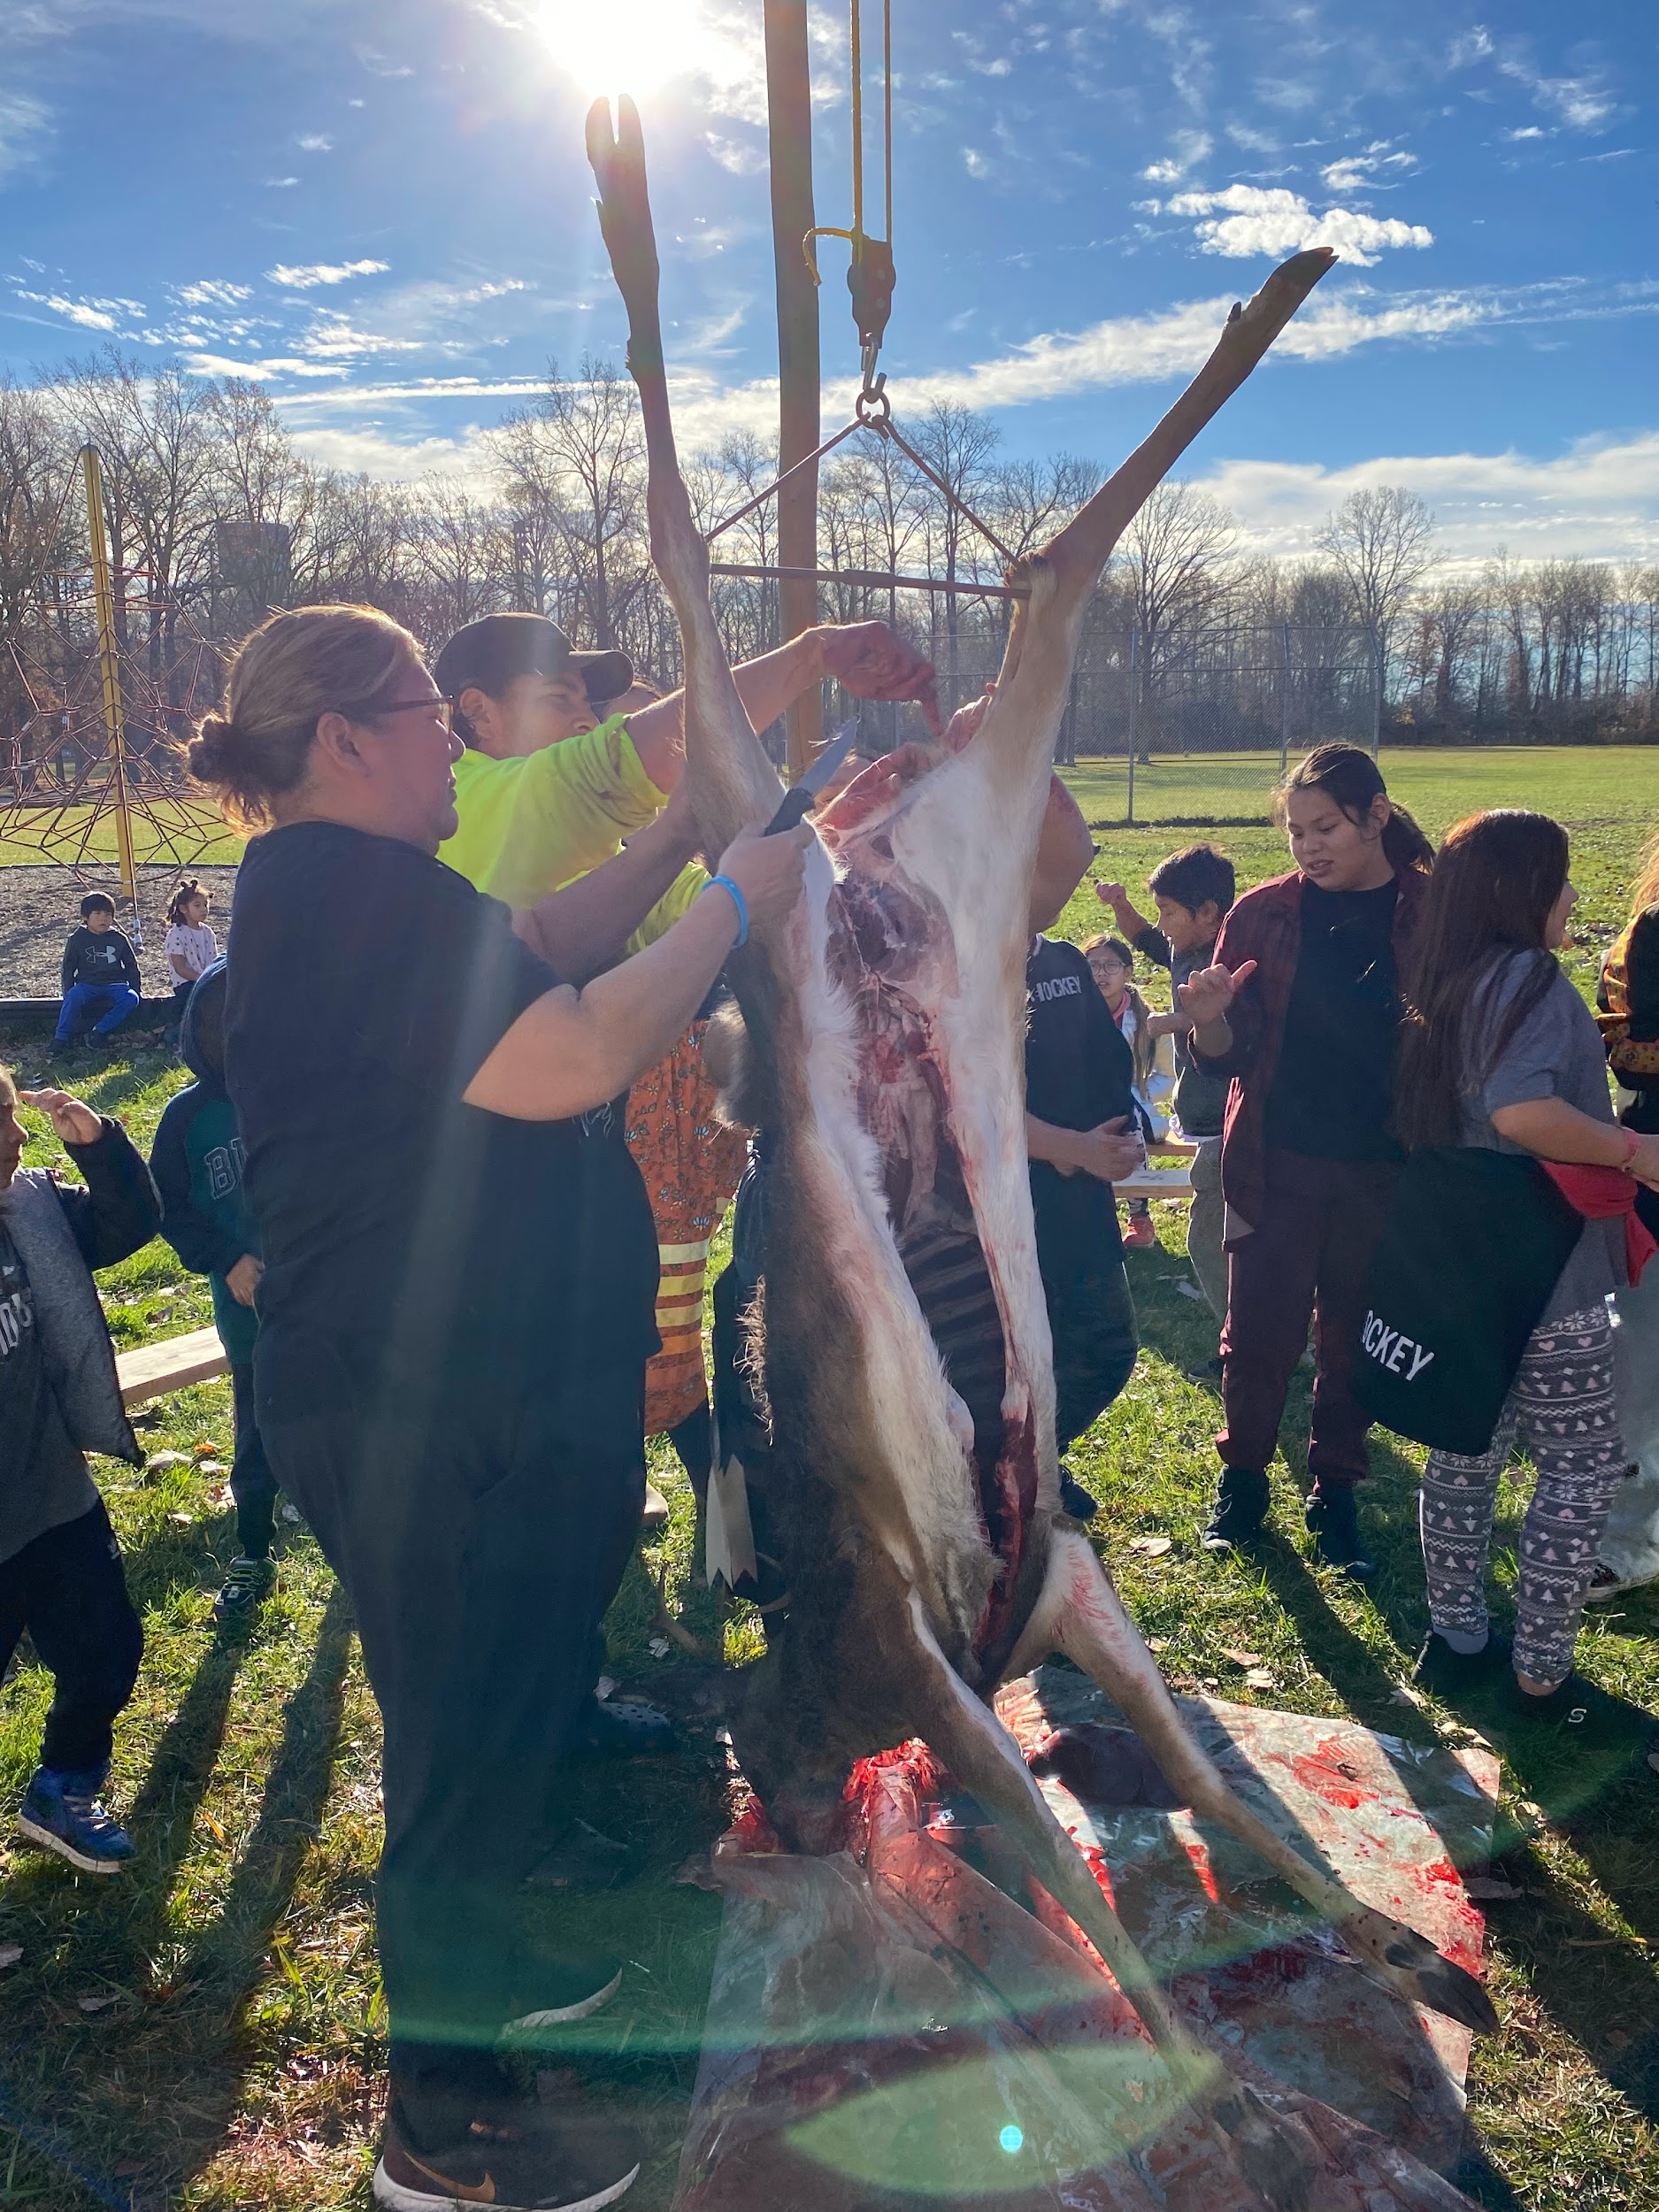
My classroom door was always open. Students would smell, hear, taste, touch and see in my classroom. They learned that my classroom was often outdoors.

Slide 11
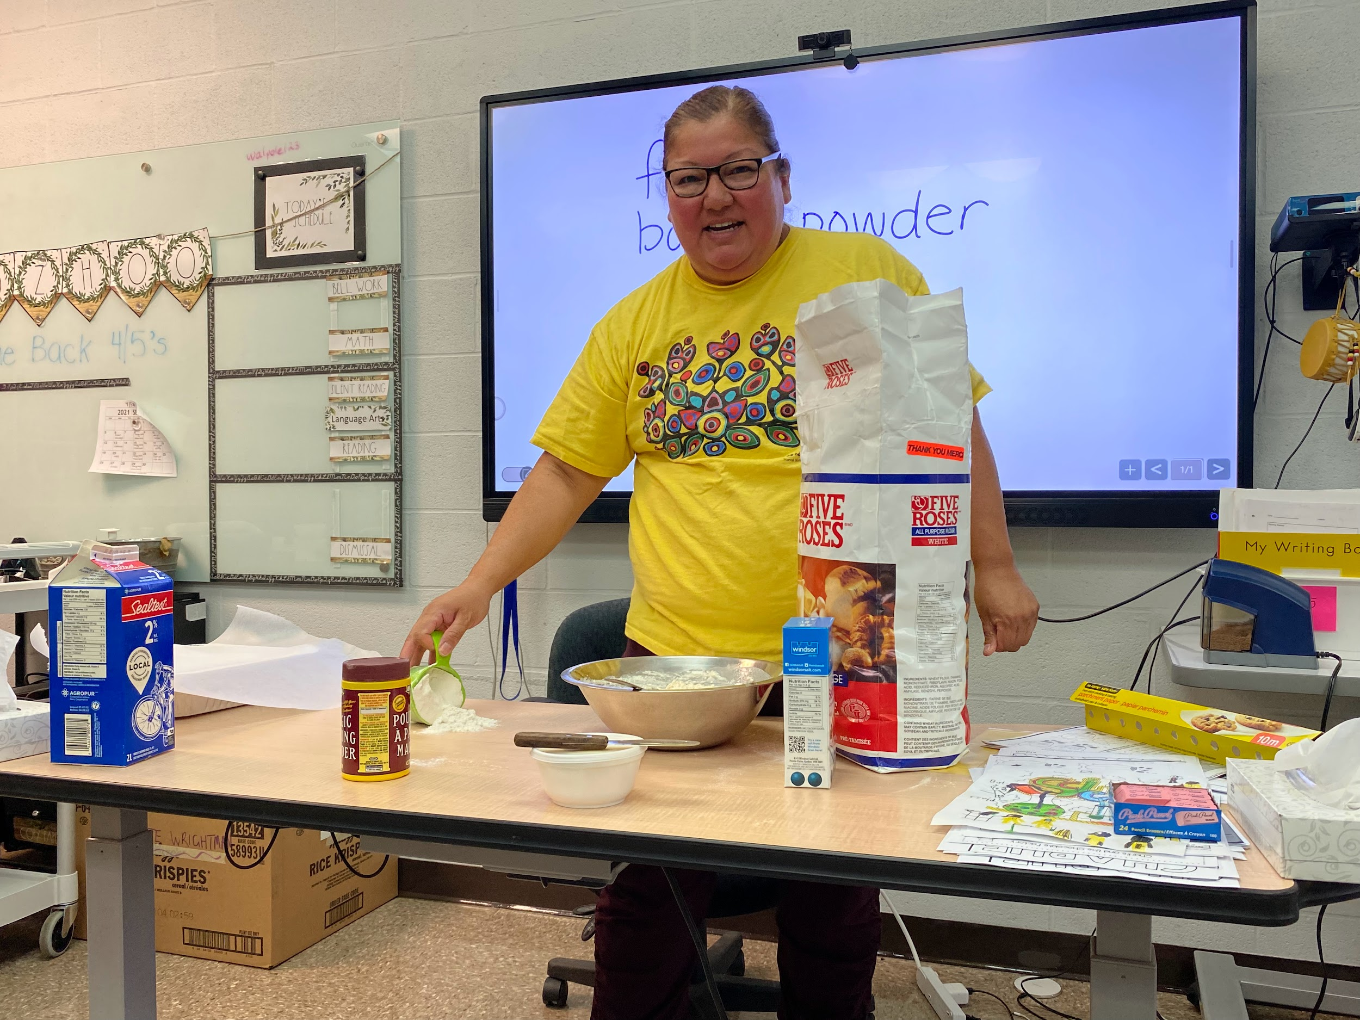
My last homeroom classroom:
Students were never late on Mondays.
Respect. Courage. Love. Wisdom. Truth. Humility. Honesty. (& Patience)
Notes:
New student mixed the bread each week. We ate the bread when it was finished. Students did their math and finished to make sure the bread didn’t get cold. Any left overs went home with the cook. My students were bread critics. Every single student’s bread was perfect. They would go home and make the bread at home for their families.

Slide 12
Students:
Can we cook…
Check your schedule…
Can you talk to my teacher…
Notes:
This was the proof that the opportunities and experiences from the increase of language and culture in the classroom was needed. Students would come to school. There were no behaviours. Accessible to all. Learning happened equally, respectfully and constantly.

Slide 13
Miigwech!

