Slide 1

AFN & ISET FIRST NATION AGREEMENT HOLDERS
NATIONAL MEETING 2026
Inspector in a Box
Building Indigenous Workforce, Business Development,
and Community Wealth Through Skills Training
A SKILLS, EMPLOYMENT & TRAINING MODEL FOR ISET AGREEMENT HOLDERS
Stan Knight
Founder & Principal Consultant, Zachary Knight Enterprises
Founder, Knight Myers Memorial Foundation
September 1–3, 2026 | Fairmont Palliser, Calgary, AB

Slide 2
LAND ACKNOWLEDGEMENT
I would like to acknowledge that I reside on the traditional, ancestral, unceded territory of the syilx/Okanagan people, who have been here since time immemorial. I am deeply grateful for the privilege to live and work on these lands.
I also wish to extend my respect and gratitude to all First Nations, Métis, and Inuit across Canada. Their enduring connection to the land, culture, and community serves as a foundation for reconciliation and a path toward meaningful partnerships and understanding.
May we continue to honor their contributions, protect their rights, and work collaboratively to build a more inclusive and respectful future.
02

Slide 3
MEET THE SPEAKER
Stan Knight
SK
Stan Knight is the Founder and Principal Consultant of Zachary Knight Enterprises and the creator of Inspector in a Box (IIAB), an Indigenous-developed workforce and capacity-building program. He has more than 25 years of experience in housing inspections, insurance claims, construction estimating, and Indigenous housing and infrastructure consulting. Stan is also the Founder of the Knight Myers Memorial Foundation, which supports Indigenous scholarships, business incubation, and access to capital for Indigenous entrepreneurs. His work focuses on creating Indigenous-owned solutions that strengthen local economies through employment, entrepreneurship, capacity building, and community wealth creation.
Member of Opaskwayak Cree Nation
The Pas, Manitoba
•
Professional Credentials
Certified Master Inspector · Level 3 Insurance Adjuster · Level 2 Xactimate Estimator · HAGG Certified Roof Inspector
•
Strategic Roles
Advisory Council Member for ICE and PIEER · Consultant for FNMHF
03

Slide 4
INTRODUCTION · 10 MIN
Closing the Indigenous Skills & Employment Gap
1
Training opportunities exist across Canada — but too few connect graduates to sustained, local careers.
2
Local capacity matters: Nations that train, certify, and employ their own members keep skills, wages, and decisions at home.
3
This session shows how one hands-on skills-training model turns ISET investment into certified inspectors, career pathways, and Indigenous-owned businesses.
TODAY'S 60-MINUTE SESSION
10m
15m
10m
15m
10m
Introduction
IIAB Skills Training
Careers & Businesses
Knight Myers Foundation
Discussion & Next Steps
04

Slide 5
THE HOUSING CRISIS
Two Numbers That Changed Our Approach
85,000
Losing Ground
Homes Short
Decommissioning Faster Than Building
First Nations communities remain an estimated 85,000 homes short of what's needed to adequately house their people.
The lesser-known number: communities are losing existing homes to decommissioning faster than new ones are being built.
The result: new construction is only replacing the housing stock we're losing — not growing it. Every new home built has no measurable impact unless we first stabilize the housing that already exists.
05

Slide 6
CORE PHILOSOPHY
"Own The Process" Starts With Owning the Paperwork
Right now, an outside inspector hands a Nation a scope of work, a cost estimate, or an inspection report — and the Nation is beholden to accept it, because building that expertise locally has always seemed out of reach.
Own the Inspection
Local, certified inspectors produce the Nation's own condition reports and asset data — no longer dependent on whoever happens to be available.
Own the Scope & Cost Estimate
Community-generated scopes of work and cost estimates that the Nation controls — and can put in front of multiple bidders.
Own the Funding Pathway
In-house capacity to identify energy rebates and funding grants, and to prepare the Nation's own renovation and repair funding applications.
06

Slide 7
SKILLS TRAINING IN ACTION · 15 MIN
The Inspector in a Box Training Curriculum
A hands-on training pathway that turns community members into certified inspectors, estimators, and future entrepreneurs.
07

Slide 8
FLAGSHIP PROGRAM
The IIAB Training Pathway
The Concept: A turnkey, hands-on curriculum that trains local members to become professional-grade housing inspectors.
Mission: Building certified local capacity so employment, wages, and expertise stay in the community — and stabilizing existing housing stock by catching problems before they become crises.
TRAINING PIPELINE
1
→
2
→
3
→
4
Candidate
Recruitment
Hands-On
Training
Supervised
Practicum
Certification &
Employment
Outcome: A certified local workforce supporting planned maintenance and asset management — because getting homes fixed is how we build a safe, healthy environment.
08

Slide 9
SKILLS DEVELOPMENT
Technical Skills Participants Gain
✦
✦
✦
Drone Operation
Thermal & Moisture Diagnostics
AI-Assisted Reporting
Aerial mapping and roof/site inspection — an in-demand technical skill
FLIR thermal cameras and moisture meters for defect detection
Smartphone-based inspection and data collection software
✦
✦
✦
3D Modeling (Hover)
Digital Floor Plans (Cubicasa)
Construction Estimating (Xactimate)
Exterior measurements and accurate 3D building models
Rapid, accurate floor plans learned with minimal training time
Standardized, industry-recognized pricing and scoping skills
09

Slide 10
THE RESULT
What Ownership Actually Saves
Competitive Bidding
Removing the General Contractor
Landed, Tax-Exempt Delivery
Owning the scope and estimate means a Nation can send it out to multiple contractors and suppliers instead of accepting a single bid.
Splitting supply from install and cutting the GC out of its traditional role saves roughly 15% on its own.
Materials shipped directly to the Nation as a landed delivery qualify for on-reserve tax exemption.
20–50%
lower project costs — which means more annual savings and more projects completed with the same housing budget.
10

Slide 11
BUILDING CAREERS & BUSINESSES · 10 MIN
From Skills Training to Stable Employment
How training becomes stable local employment — and stable employment becomes Indigenous-owned business.
11

Slide 12
CAREER MOBILITY
Beyond Housing: Transferable Career Pathways
One training pathway opens four career directions — all rooted in the community, not contracted out.
Housing & Property Inspection
Infrastructure & Facilities Management
Certified residential inspections and condition assessments for the Nation's own housing stock.
Asset management, preventative maintenance, and capital planning roles within Nation departments.
Insurance & Claims Adjusting
Construction Estimating & Capital Planning
Xactimate-based estimating skills open pathways into insurance and claims work.
Community-developed scopes and estimates strengthen bidding, budgeting, and project planning — often reducing project costs 25–50%.
12

Slide 13
PATHWAY
Career Progression & Deliverables
0–3 Months
4–12 Months
Year 1–3
Training via the Carson Dunlop program and initial Safer Home inspections.
Full-time community employment and progress toward professional licensing.
Graduates become certified home inspectors and franchisees.
Professional Ties: Alignment with CAHPI (Canadian Association of Home & Property Inspectors) and FNNBOA (First Nations National Building Officers Association).
13

Slide 14
KNIGHT MYERS MEMORIAL FOUNDATION · 15 MIN
From Employee to Employer
Every year, $2B flows into the Indigenous construction economy — and 80–90% of it leaves in the pockets of contractors and consultants with no stake in these Nations' future.
We asked: how do we change that?
That question is why the Knight Myers Memorial Foundation exists — turning a training pathway into an ownership pathway through scholarships, business incubation, and capital for Indigenous entrepreneurs.
14

Slide 15
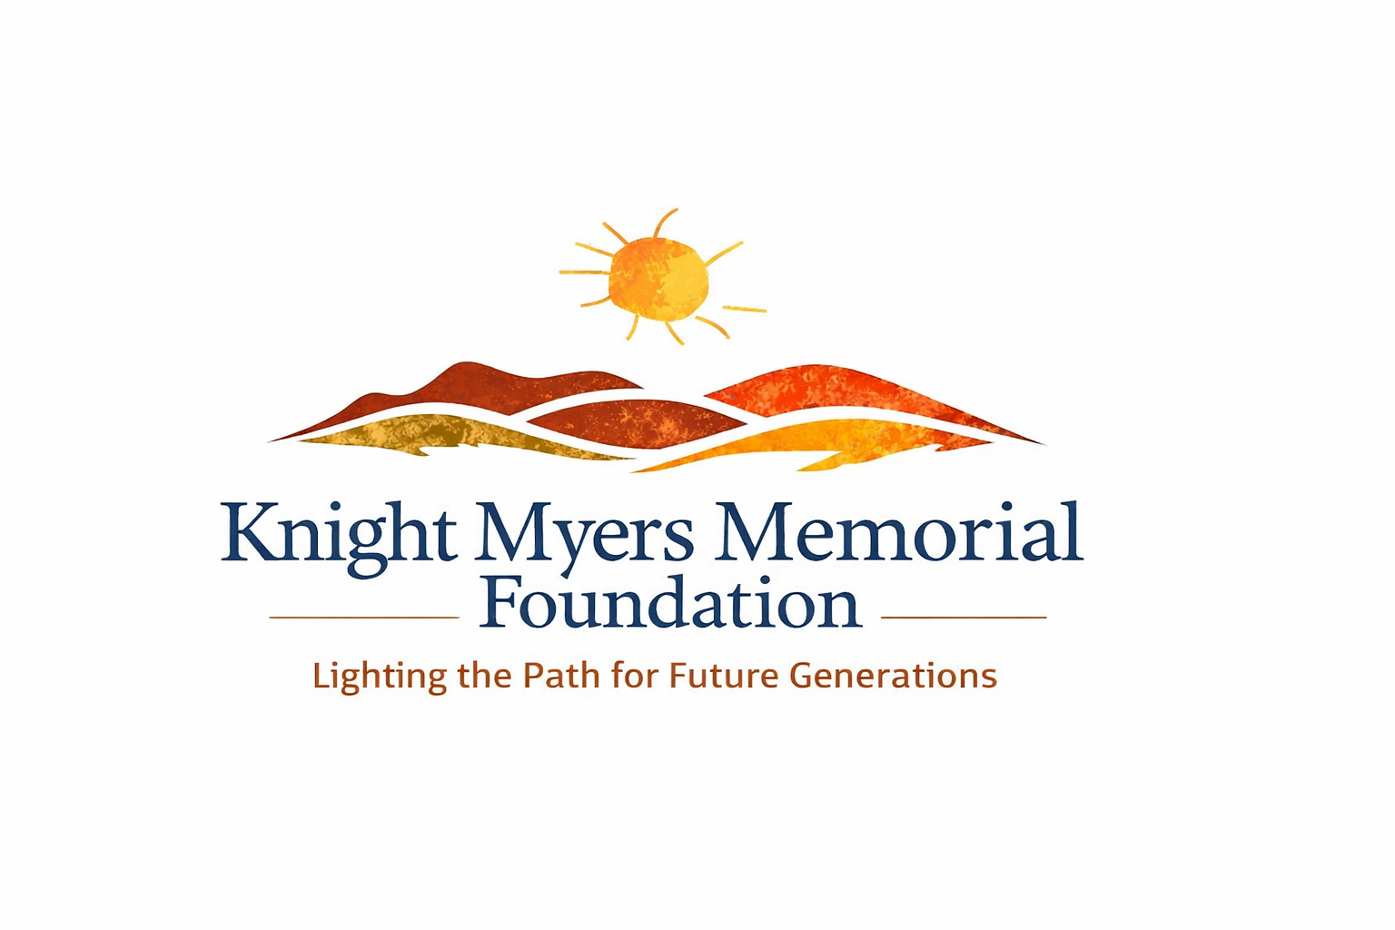
BUILDING THE NEXT GENERATION
Turning Training Into Ownership
2026
2027
2028
Scholarships
Business Incubator
Capital Investment Fund
$10,000/year per student for four-year degrees or two-year trades programs — educating our future leaders.
Teaching Indigenous entrepreneurs everything it takes to stand up and run a business. Details next.
$100,000 0% interest loans that build credit history, not dependency. Details next.
15

Slide 16
PILLAR TWO · BUSINESS INCUBATOR
What Business Owners Actually Learn
Most people don't fail in business because of a bad idea — they fail because no one taught them the mechanics of running one. That's what the incubator covers.
Corporate Registration
Banking
Taxation (On- & Off-Reserve)
Choosing and setting up the right business structure, on- or off-reserve.
Opening accounts, managing cash flow, and building a relationship with a lender.
Understanding tax obligations and exemptions that differ by where the business operates.
Legal Liability
Websites & Digital Presence
Everything Else
Contracts, insurance, and protecting the owner and the business from risk.
Getting found, taken seriously, and ready to bid on work.
Bookkeeping, quoting, hiring, and the day-to-day of actually running the business.
16

Slide 17
PILLAR THREE · CAPITAL INVESTMENT PROGRAM
A Loan Built to Be Paid Off — By Design
$100,000
at 0% interest, given directly to the business owner so they can focus on building the business — not on making a payment this month.
HOW IT WORKS
1
→
2
→
3
Borrow $100K
at 0% interest
Repay the first
$50,000
The remaining
$50,000 is forgiven
Why a loan, not a grant? A loan builds a credit history — a grant doesn't. That history lets the owner go back to the bank and secure more credit on their own.
17

Slide 18
IMPLEMENTATION ROADMAP
A Model Built to Plug Into ISET Programming
1
Align
Map IIAB training modules onto ISET-funded programming and each agreement holder's existing priorities.
2
Layer In
Add hands-on certification and paid practicum hours onto training streams already running today.
3
Track
Use ISET's existing data collection and case management systems to report participant outcomes.
4
Advocate
Feed results back into Indigenous Labour Market Initiative priorities and future ISET planning.
18

Slide 19
ALIGNMENT
Conference Themes This Session Addresses
This presentation directly supports the following AFN ISET priorities:
First Nations Employment & Skills Training
AI and the Labour Market
Emerging Technologies for Capacity Building
Practical Tools for Success
Hands-on Learning
Meaningful Industry Partnerships
Mentorship Opportunities & Successes
Succession Strategies
Youth & Community Engagement
Data Collection & Case Management
Building Efficient Administration Systems
Indigenous Labour Market Initiative Advocacy
19

Slide 20
KEY TAKEAWAYS
What Participants Leave With
✓
A proven skills-training and certification model
✓
A roadmap for integrating IIAB into ISET-funded programming
✓
Practical examples of AI/tech-enabled workforce training
✓
Career pathways spanning housing, infrastructure, insurance, and capital planning
✓
Tools to build local employment instead of relying on outside contractors
✓
A framework connecting training, employment, and entrepreneurship under Indigenous ownership
20

Slide 21
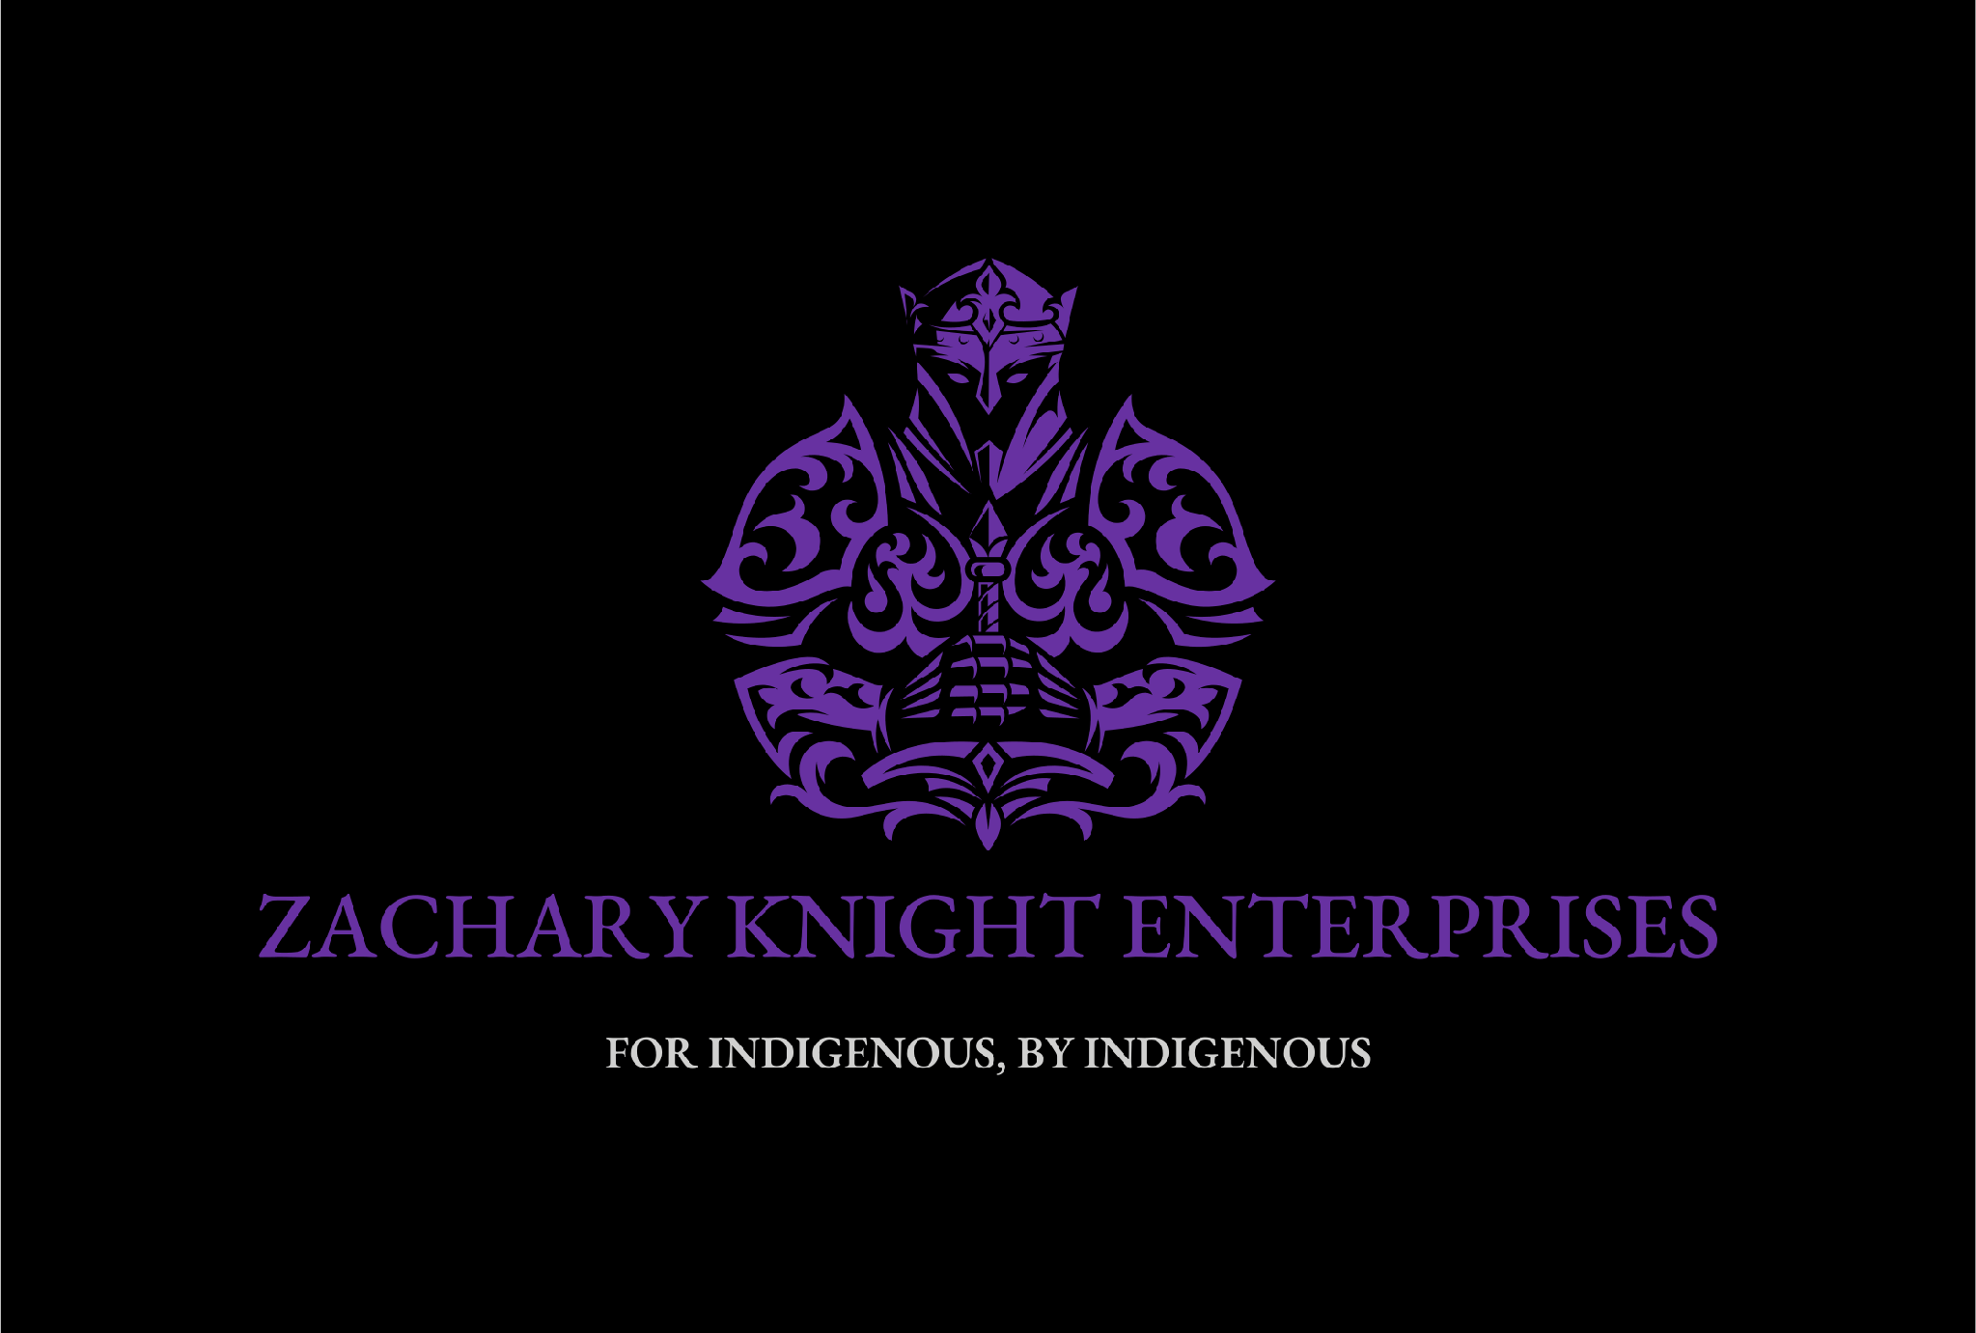
QUESTIONS, DISCUSSION & NEXT STEPS
From Skills Training to Full Economic Ownership
→
Bring an IIAB demonstration or pilot cohort to your Nation
→
Explore how IIAB fits within your existing ISET-funded programming
→
Connect graduates to Knight Myers Foundation scholarships and business incubation
Stan Knight
Founder & Owner, Zachary Knight Enterprises
Phone: 204-441-1025
Email: stan@zke.ca
Website: zacharyknightenterprises.com
21

