Slide 1
Transforming Public Education:
Delivering on the BC Tripartite Education Agreement (BCTEA) and the BC Declaration Act Action Plan (DAAP) Commitments
February 27, 2024
Jan Haugen, Director of Executive Services and Community Support, First Nations Education Steering Committee
Thane Bonar, Director of Communications and Policy, First Nations Education Steering Committee

Slide 2
Recognition of Traditional Territory

Slide 3
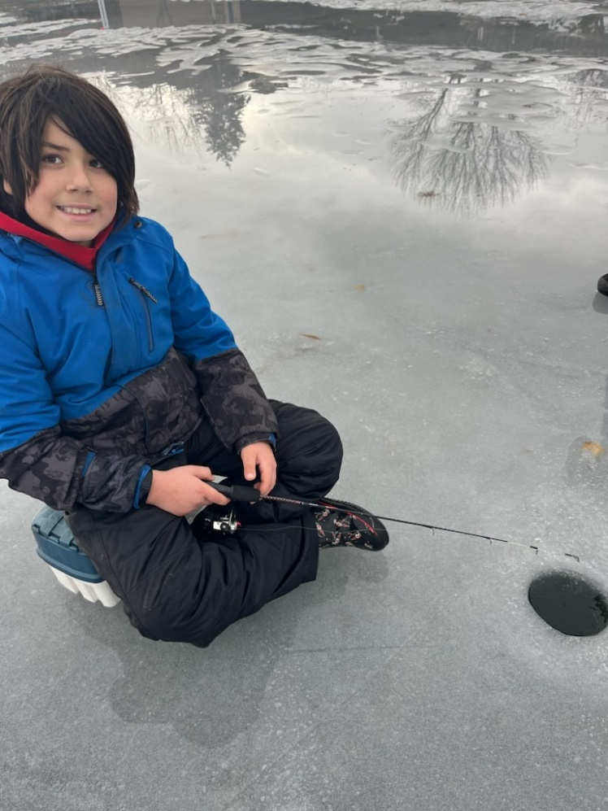
Presentation Overview
Context
First Nations School of Choice (FN SoC)
Local Education Agreements (LEAs)
Indigenous Education Councils (IECs)
Questions
Senpaq’cin School

Slide 4
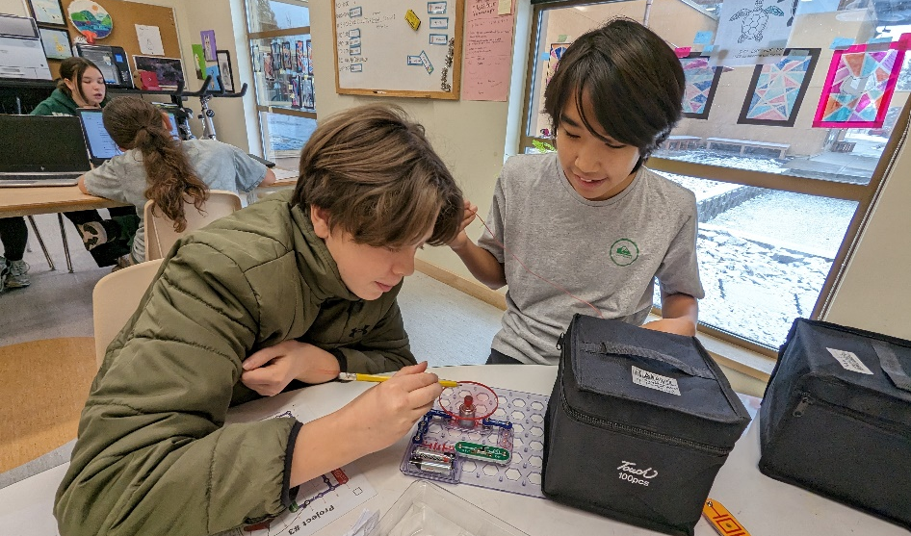
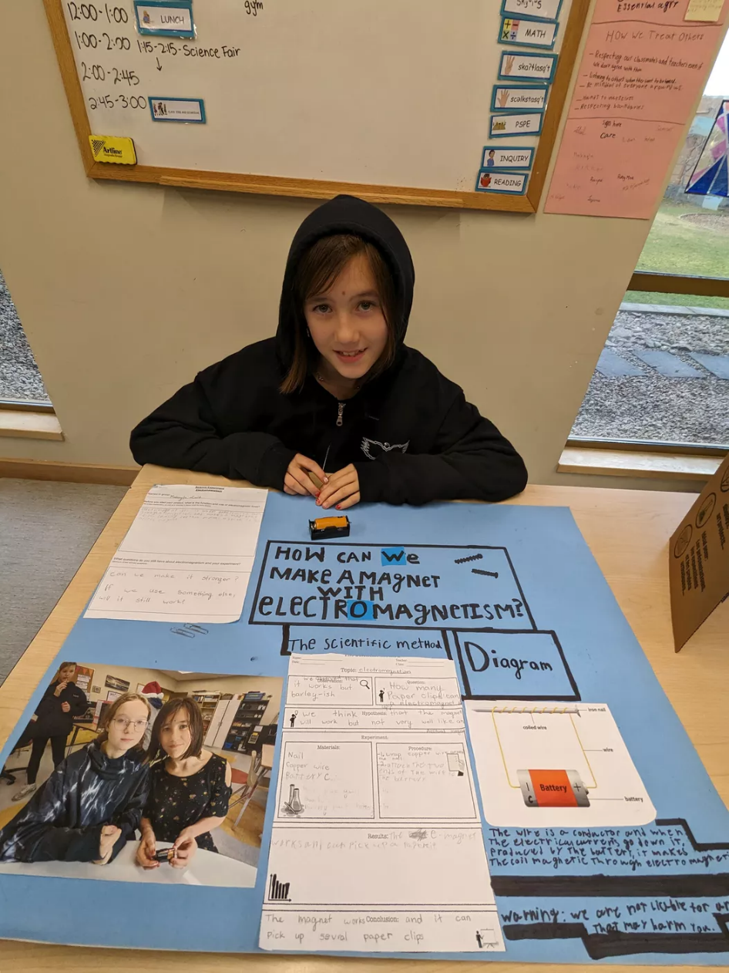
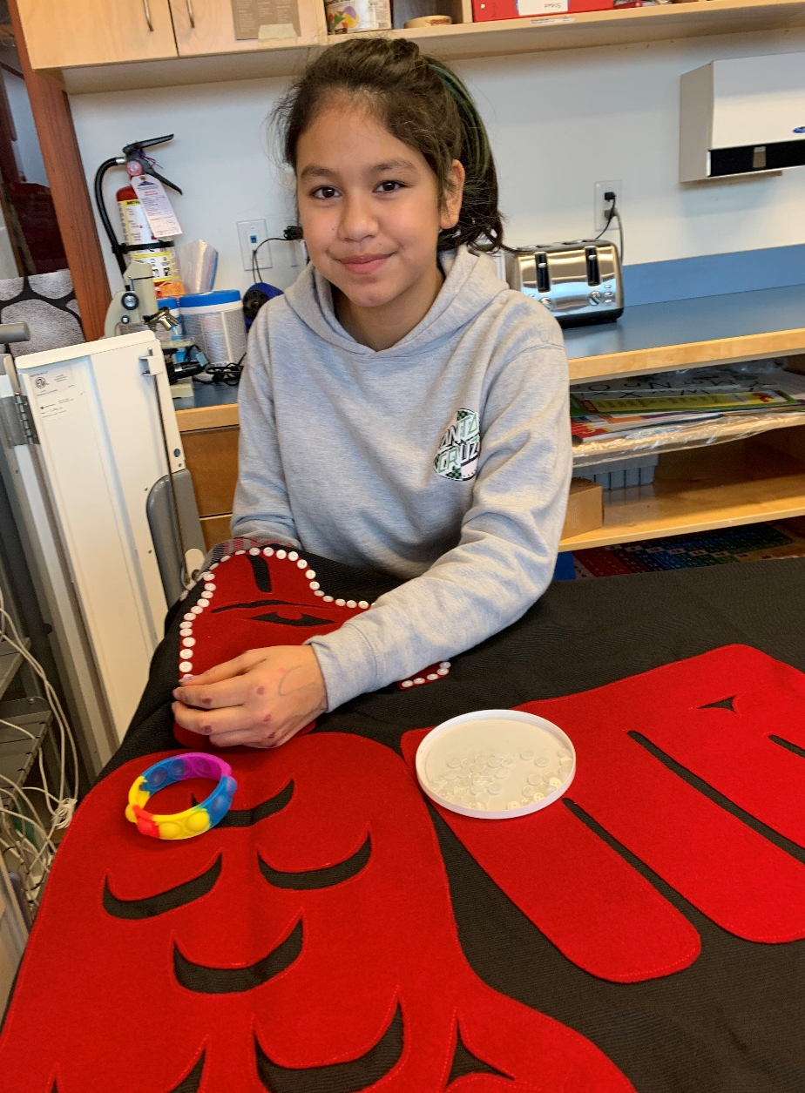

Building Pride
Senpaq’cin School
Tʼlisalagiʼlakw School
Wagalus School
Senpaq’cin School

Slide 5
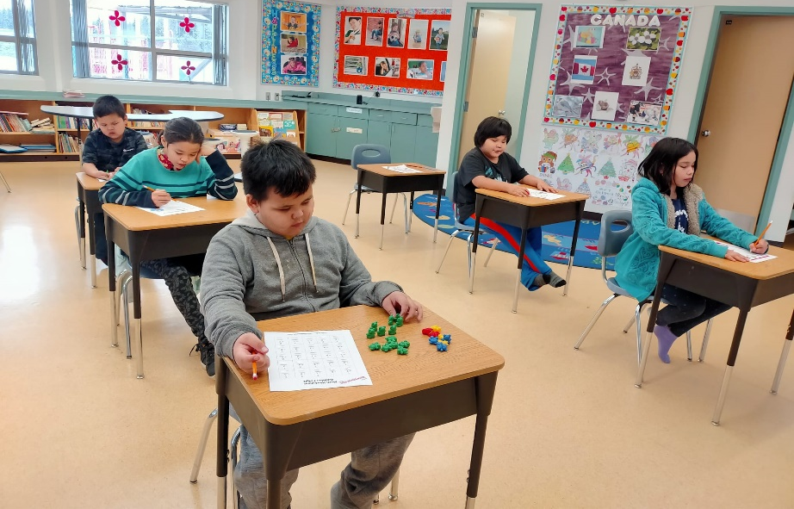
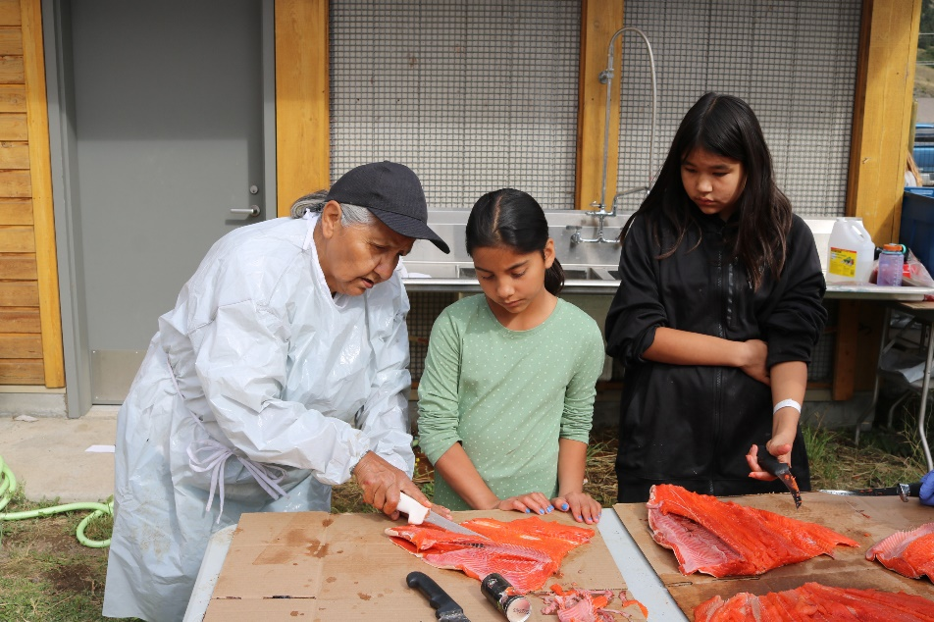
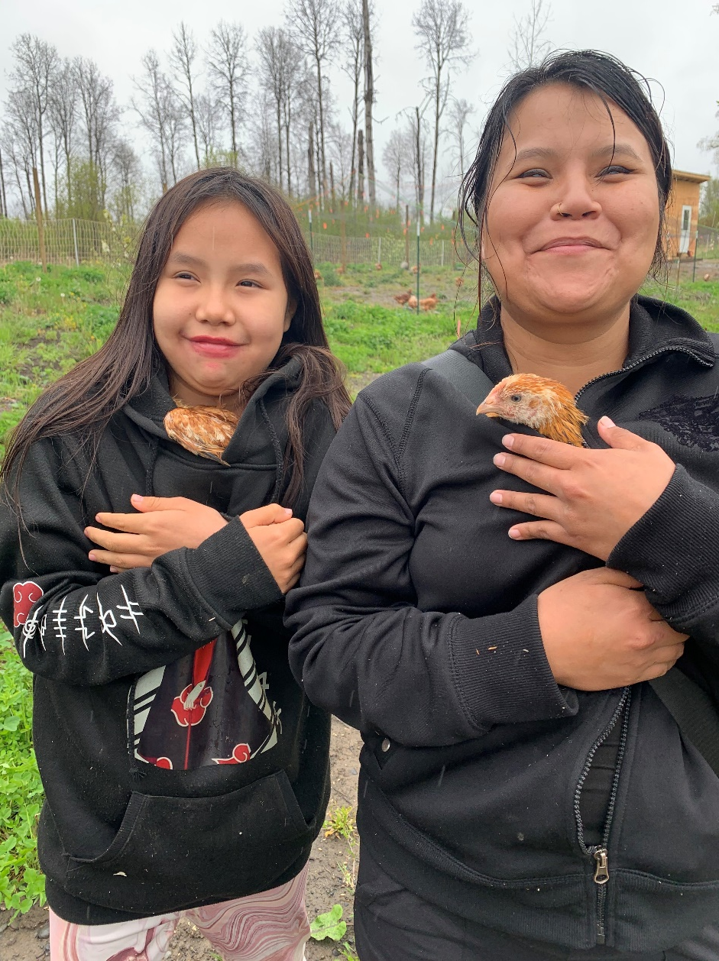

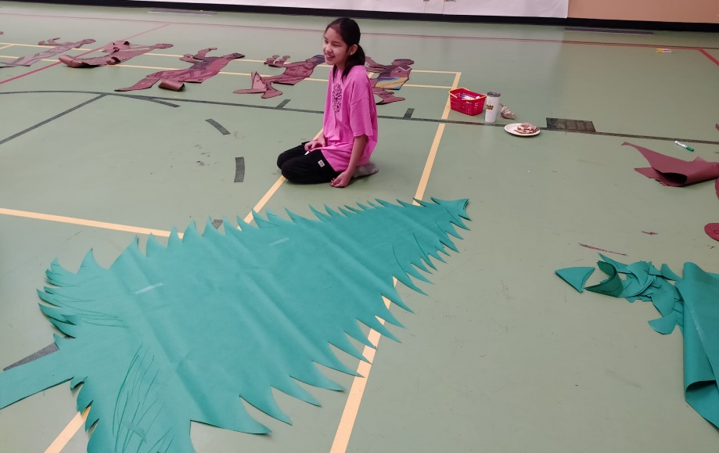
Strengthening Identity
Yekooche School
Sxoxomic School
Yekooche School
Chilliwack Landing Preschool and Kindergaten
Sik-E-Dakh School

Slide 6
About FNESC
FNESC was established in 1992 to advance quality education for First Nations learners.
FNESC has a formal protocol with the First Nations Leadership Council that recognizes FNESC as the lead policy and advocacy body, working under the direction of First Nations, to advance quality education, relevant accountability mechanisms, and improved education outcomes for all First Nation students in BC.
FNESC also reports to and seeks direction from the First Nations Summit, Union of BC Indian Chiefs, and BC Assembly of First Nations. Direction and guidance is often represented in formal resolutions from the three organizations.
FNESC has subcommittees that focus on Post-Secondary Education, Local Education Agreements, and First Nations Languages, as well as Personnel and Finance Committees.
Notes:
FNESC meets regularly with the First Nations Leadership Council to seek support and direction.

Slide 7

Number of Learners in Public School
Total number of students in BC public schools is 570,000.
Indigenous students make up 12% of the student population.
Year | Indigenous | On-Reserve | Off-Reserve
2018/19 | 73,444 | 7,993 | 65,451
2019/20 | 73,322 | 8,209 | 65,113
2020/21 | 71,082 | 7,751 | 63,331
2021/22 | 71,470 | 7,991 | 63,479
2022/23 | 70,153 | 8,073 | 62,080

Slide 8
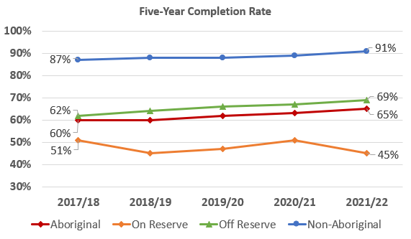
Five-Year Completion Rate
Notes:
Five-year completion rate for Indigenous learners has increased to 65% in 2021/22, having gradually risen from 60% in 2017/18. Five-year completion rate for Non-Indigenous learners has been trending upward since 2017/18, currently at 91%.

Slide 9
Foundation Skills Assessment, 2022/23
The Foundation Skills Assessment is a provincial assessment conducted annually for grades 4 and 7.
“On Track” and “Extending” Expectations, 2022/23
Skill | Aboriginal | On-Reserve | Off-Reserve | Non-Aboriginal
Grade 4 Literacy | 59% | 42% | 61% | 75%
Grade 4 Numeracy | 44% | 24% | 46% | 65%
Grade 7 Literacy | 50% | 28% | 54% | 72%
Grade 7 Numeracy | 36% | 17% | 39% | 60%

Slide 10
Student Absence Rates
39%
29%
29%
26%
28%
21%
20%
18%
10%
16%
10%
8%
Notes:
Barb’s notes Joint exec ppt

Slide 11
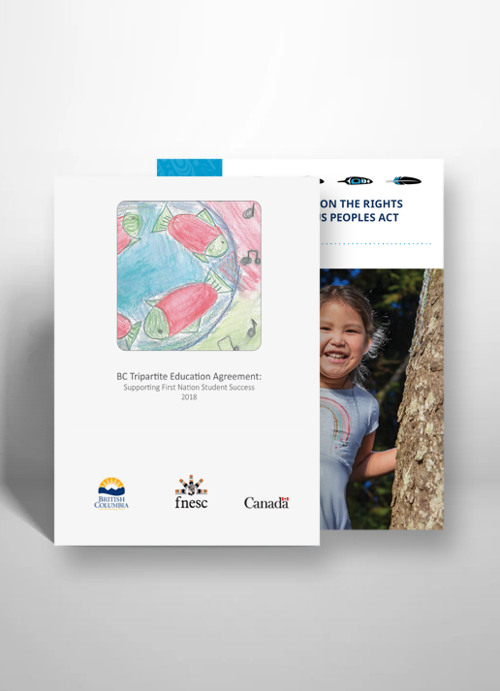
BC Tripartite Education Agreement (BCTEA)
An agreement between the Province, Canada and First Nations Education Steering Committee (FNESC) to achieve systemic shifts in law and policy to support successful educational outcomes for First Nations students on and off reserve.
BCTEA was signed in 2018 and includes commitments within the provincial public system including LEAs and parental choice. A number of these commitments are also reflected in the Declaration Act Action Plan.

Slide 12
Declaration Action Plan Commitments
Declaration Act Action Plan Action 1.6
  Co-develop an approach to deliver on the BC Tripartite Education Agreement commitment, in which the Ministry of Education and Child Care and the First Nations Education Steering Committee will co-develop legislation that requires local education agreements (LEAs) with First Nations where a First Nation wants one, and that requires the application of the provincial LEA at the request of a First Nation.
Declaration Act Action Plan Action 4.3
  Co-develop and implement a framework for the involvement of Indigenous Education Councils in school district financial planning and reporting.

Slide 13
Declaration Action Plan Commitments, cont’d
Declaration Act Action Plan Action 4.4
  Identify, develop and implement mechanisms and approaches to enable boards of education to better support Indigenous students, including increasing and ensuring equitable access to education and safe environments.
  3.4 Implement..
Notes:
The Parties recognize and respect the rights of parents
to decide where their children will be enrolled to receive the benefit of an education program (BCTEA sec 1.1 (J))
FNESC LEA Template Language – Parents have the right
to decide where their children will be enrolled to receive the benefit of an education program. (FNESC LEA template sec. 3.1 (n))
Prioritization of First Nations students is already happening in some districts

Slide 14
Indigenous-Focused Graduation Requirement
Starting in the 2023-24 school year, all secondary students pursuing the Dogwood Diploma will be required to complete 4 credits of Indigenous-focused coursework in order to graduate.
The change to the graduation program represents a systemic shift in K-12 education and a meaningful step toward reconciliation. The requirement is also an important component of a wider strategy to address racism in public institutions.
Notes:
First Nations and FNESC have been advocating for this important change for a number of years, with formal support from the BC School Trustees Association, the BC Teachers’ Federation, the BC Association of Institutes and Universities, and the First Nations Leadership Council.

Slide 15
Indigenous-focused Course Completions
The requirement will have a significant impact on the number of students completing an Indigenous-focused course at the secondary level, a key mechanism to addressing racism in BC.
Includes:
  English First Peoples 10-12 courses
  BC First Peoples 12
  Contemporary Indigenous Studies 12
49,800
400
2023/24
(estimated)
2020/21

Slide 16
Distinctions-Based Approach
“The Province is committed to a distinctions-based approach. This requires that the Province’s dealings with First Nations, Métis and Inuit Peoples be conducted in a manner that acknowledges the specific rights, interests, priorities and concerns of each, while respecting and acknowledging these distinct Peoples with unique cultures, histories, rights, laws, and governments. Section 35 of the Constitution Act, 1982, recognizes and affirms the rights of Aboriginal Peoples of Canada, while all Indigenous Peoples have human rights that are expressed in the UN Declaration. However, not all rights are uniform or the same among or between all Indigenous Peoples. In many cases, a distinctions-based approach may require that the Province’s relationship and engagement with First Nations, Métis and Inuit Peoples include different approaches or actions and result in different outcomes.”
DRIPA Action Plan, p. 3, emphasis added.

Slide 17
Distinctions-Based Approach: First Nations Leadership Resolutions
The First Nations Summit, UBCIC and BC AFN passed similar resolutions on the distinctions-based approach (Fall 2022)
THEREFORE, BE IT RESOLVED:
That the First Nations Summit (FNS) Chiefs in Assembly call upon all governments to adopt a distinctions-based approach to ensure the distinct rights, interests, histories, and contexts of original First Nations as the first occupants and owners of their respective territories are recognized, while also ensuring that there is a recognition that First Nations, as territorial rights holders in BC, are distinct from Métis and/or other Indigenous peoples who are visitors to our territories.

Slide 18
Distinctions-Based Approach: First Nations Leadership Resolutions, cont’d
That the FNS Chiefs in Assembly call upon all governments to work with the FNS, working alongside the BC Assembly of First Nations and Union of BC Indian Chiefs, as the First Nations Leadership Council, to co-develop and affirm a distinctions-based approach in all of its work to recognize, affirm, implement and respect the rights of First Nations in BC.
That the FNS Chiefs in Assembly direct the FNS Executive and staff to seek funding and/or necessary resources to advocate for and assist in the development of a distinctions-based policy to all aspects of action planning on the implementation of the United Nations Declaration on the Rights of Indigenous Peoples at the federal, provincial and municipal levels of government, that is reflective of the distinctions among Indigenous peoples in order to strengthen future state-led policy and law making.

Slide 19
Distinctions Based Approach Primer - BC Government
The Primer, released December 2023, is intended to assist BC in building and understanding of the legal basis for, and core elements, of a distinctions-based approach with all the of the provinces relations with First Nations, Metis and Inuit.
First Nations leadership applauds BC for clarifying its position on Metis rights in BC. The Primer includes helpful direction to provincial ministries and agencies, which emphasize the importance of engaging with appropriate rights holders.
Leadership assert First Nations are the only Indigenous Peoples that hold and exercise inherent, constitutional, and human rights in respect of land, water, and air, and associated jurisdiction, and it is incumbent on the provincial government to formally and unequivocally respect this.

Slide 20
School Act Amendments Bill 40
FNESC and the Ministry of Education established a policy and legislation table for the purposes of developing policy and legislation to implement the actions in the Declaration of Indigenous Peoples Action Plan.
Three action plan items in the Action Plan translated to amendments to the School Act:
  First Nations School of Choice
  Local Education Agreements
  Indigenous Education Councils
  These amendments received formal royal assent in November 2023.

Slide 21
First Nations Schools of Choice – Current Context
Boards of Education set catchment areas for all schools in their school district
First Nations were not considered when school districts were created nor when catchment areas were designated

Slide 22
First Nations Schools of Choice – Legislative Change
First Nations Schools of Choice provisions set out a process for First Nations to designate a school as their school of choice for those First Nation students who live on-reserve, self-governing First Nation lands or Treaty lands
Ensure that a First Nation can designate an elementary, middle school (where applicable), and secondary school for their students
First Nations will determine which schools through their own internal processes with parents
The First Nation will not have to negotiate this with the board of education, the board will accommodate the First Nation students

Slide 23
First Nations Schools of Choice – Next Steps and Consideration
In some areas of the province, there may not be reasonable choices of different schools (i.e. only one middle school or high school)
This is an optional choice for First Nations. Other agreements between schools, First Nations, or parents/guardians of First Nations students respecting school choice are not affected by this amendment

Slide 24
Local Education Agreement – Current Context
Local Education Agreements (LEAs) between a First Nation and a Board of Education are important for a number of reasons:
  Support improved student attendance and outcomes
  Engagement on broader issues
  Support for the First Nation’s students
These LEAs are formal contracts related to the purchase of services for on-reserve students attending public schools.
LEAs are a key mechanisms for accountability and effective working relationships between a First Nation and a Board of Education.

Slide 25
Local Education Agreements (LEA) – Legislative Change
First Nations may:
  Choose not to have an LEA
  Choose to remain in their existing LEA
  Choose to negotiate a custom LEA
  Apply the Model Local Education Agreement (Model LEA) at their request
A First Nation may choose to apply the Model LEA where:
  The First Nation has Nominal Roll students enrolled in the current or upcoming school year with a Board of Education, and
  There is no existing LEA between the First Nation and Board

Slide 26
Local Education Agreements (LEA) – Model Local Education Agreement
The First Nations Education Steering Committee (FNESC) and the Ministry of Education and Child Care are co-developing the Model LEA
Model LEA aims to establish minimum standards for an effective LEA and includes the LEA Guiding Principles established by the BCTEA parties:
  Increase accountability to support improved First Nation student achievement
  Govern the purchase of educational services from a board of education
  Include processes for information sharing, collaboration and decision-making
  Support improved relationships between First Nations and boards of education
Will be available by Spring 2024 with implementation for the 2024/25 school year

Slide 27
Indigenous Education Councils – Current Context
Indigenous Education Councils (IECs) currently exist in most but not all of the school districts
IECs vary in their mandate and composition, often including district staff and Indigenous service delivery organizations
IECs vary in effectiveness with limited decision-making authority and exist at the discretion of the board
Notes:
They haven’t been effective in transforming education at the local school level.

Slide 28
Indigenous Education Councils – Legislative Change
Mandatory for School Districts to have an Indigenous Education Council
New Indigenous Education Council policy will set a provincial standard for Indigenous Education Councils
Will prioritize First Nations on whose territory the school district operates, consistent with a distinctions-based approach
The IEC will be an independent body, not a committee of the board
An IEC terms of reference will be created and set minimum requirements for the IEC
Trustees and district staff can attend Indigenous Education Council meetings, if invited, but not as voting members

Slide 29
Indigenous Education Councils – Legislative Change
Indigenous Education Councils purpose will include:
  integrating into learning environments Indigenous world views and perspectives, in particular those of the First Nations, in whose traditional territory the board operates
  advising the board in relation to the distinct languages, cultures, customs, traditions, practices or history of the First Nations, in whose traditional territory the board operates, through advice from the Indigenous Education Council members representing those First Nations.

Slide 30
Indigenous Education Councils – Role and Responsibilities
Will review and approve plans and reports related to Indigenous Education Targeted Funds ($110M), and other targeted grants related to Indigenous students
Will advise on:
  Providing comprehensive and equitable educational programs and services to Indigenous students;
  Improving Indigenous student achievement;
  Integrating Indigenous world views and perspectives into learning environments, in particular those of the First Nations in whose traditional territory the board operates; and
  Other grants provided in relation to Indigenous students.

Slide 31
Indigenous Education Councils – Terms and Reference
An IEC Terms of Reference will be set out in a Ministerial Order. This is being co-developed by FNESC and the Ministry of Education.
This Terms of Reference will give direction and guidance to boards of education respecting such matters as the establishment and composition of the Indigenous Education Council, voting rights, and conduct of business
Indigenous Education Councils will be able to develop additional procedures, based on their local context, on how their meetings will be conducted (i.e. meeting schedules and location, decision-making processes, dispute resolution). These cannot be inconsistent with legislation.
Notes:
School Districts will support the effective implementation and function of Indigenous Education Councils. Working with the province in details..

Slide 32
DRIPA Action Plan Next Steps
3.3 Conduct an external review of Indigenous- specific external racism and discrimination in the provincial public education system and create a strategy, including resources and supports, to address findings.
4.2 Develop and implement an effective recruitment and retention strategy to increase the number of Indigenous teachers in the K-12 public education system.
4.18 Co-develop and implement measures to support improved education outcomes of current and former First Nations Children and Youth in Care.
Notes:
We doing work on all of these items with formal tables established.

Slide 33
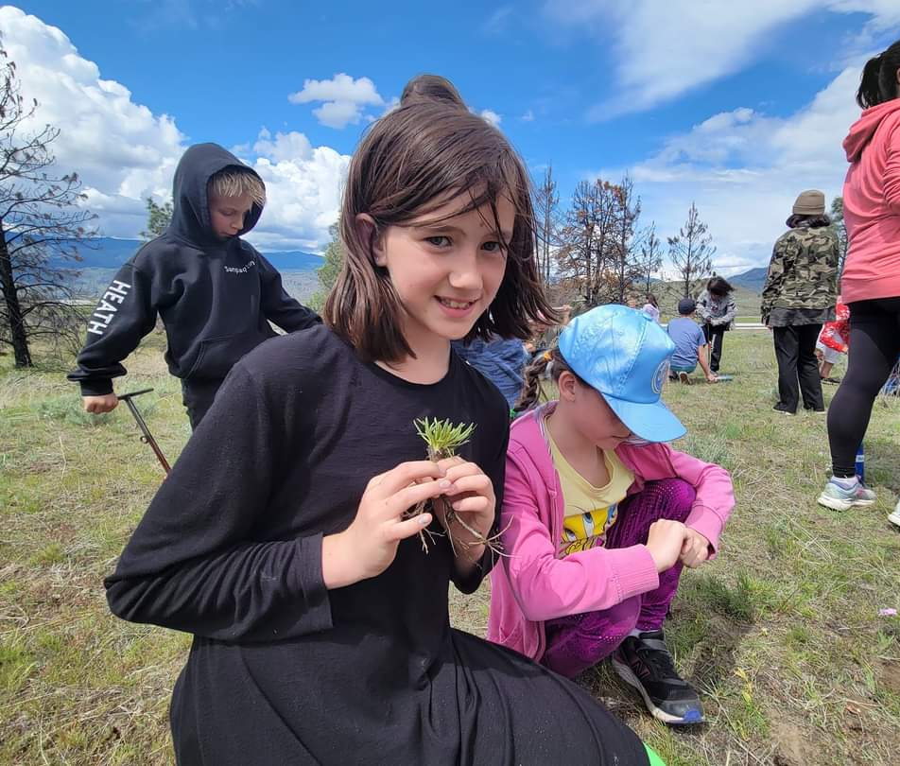
Next Steps and Considerations
Co-develop policy and legislation to effectively implement new School Act amendments.
Support increased capacity for the public school system and First Nations to implement these changes.
Planning and preparation for other DRIPA Action Plan action items – 17 action items related to language and education.
Senpaq’cin School

Slide 34
Questions

Slide 35

Thank you for your commitment to
First Nations education.

