Slide 1

Building the Case for Equitable Funding for First Nations Institutes
Research Update and Discussion
Jon Medow, President (Medow Consulting)
AFN Education Forum – February 20, 2025

Slide 2
Agenda
About Medow Consulting
About First Nations Institutes (FNIs)
2018: Institutions Costing Study
2025: Assessing Structural Funding Availability Study
AFN: PSE Policy Context
Discussion: Role of Adequately Funded FNIs

Slide 3


About Medow Consulting
Mission:
Vision:
We support organizations of all forms to shape public policy and program delivery through solutions-focused analysis, engagement, and strategy.
To advance solutions that improve the lives of individuals, our communities, and societies.

Slide 4
About First Nations Institutes (FNIs)
About First Nations Institutes (FNIs)

Slide 5
FNIs at a Glance
Founded beginning in 1970s (First Nations Control of First Nations Education)
Credentials: high school to PhD (lifelong learning)
Focus: Education, health, trades, business, First Nations languages & more
Flexible delivery: In-person, online, blended, in-community
Demand-driven: Respond to labour market and community needs
Culture and language-based learning and wrap-around support
Focus on supporting transitions into PSE for First Nations learners (pathways and bridging)
First Nations mandated and governed post-secondary institutions
Wide variety of programs:
Community responsive:

Slide 6
By the Numbers
According to Conference Board of Canada (2020):
About 80 “Indigenous Institutes” serving around 10,000 students a year
More than 25 have a two-decade track record or longer
Some Institutes serve one community, other serve wide regions with multiple campuses

Slide 7
Relationships to non-First Nations governments and PSE systems
Majority of FNIs are independently mandated and operated (may receive federal or provincial funding)
Six Nations Polytechnic (ON)
Red Crow Community College (AB)
A few FNIs are part of provincial PSE systems, funded as public institutions
Nicola Valley Institute of Technology (BC)
Saskatchewan Indian Institute of Technologies (SK)
One FNI receives annual federal operating funding
First Nations University of Canada (SK)

Slide 8
Primary Federal Funding
Post-Secondary Partnerships Program
Proposal-based with $500,000 maximum
Funds PSE programs “…tailored to First Nations cultural and educational needs”
FNIs are among several eligible First Nations recipients
“Not intended as a source of core operational funding”
Post-Secondary Student Support Program
Funding to First Nations PSE students (including to pay tuition, which supports FNIs)
First Nations University of Canada
Annual operating grant (Since 19XX)
Annual operating funding

Slide 9
Legislated funding in two provinces
Ontario: Indigenous Institutes Act, 2017
British Columbia: First Nations Mandated Post-Secondary Institutes Act, 2024
Nine Indigenous Institutes receive “regular and on-going operating funding”
Establishes a framework for Indigenous Institutes to independently deliver provincially-recognized PSE credentials
Establishes on ongoing operational funding and interim capacity funding
Both result from FNI advocacy and co-creation with provincial governments
Other provinces may provide funding through programs (not legislated)

Slide 10




Bottom line on FNI funding
Communities and Nations have founded FNIs to advance First Nations Control of First Nations Education without committed financial support; have sought funding overtime
Large majority of FNIs are outside a stable, equitable funding framework and this hinders growth and development
FNIs have not benefited from the same current and historic government investment as non-Indigenous post-secondary institutions: start-up, capital, operating funding
Work continues for FNI funding consistent with “Constitutional, Treaty and international obligations” to support First Nations Control of First Nations Education

Slide 11
About First Nations Institutes (FNIs)
Our Research on FNI Funding

Slide 12
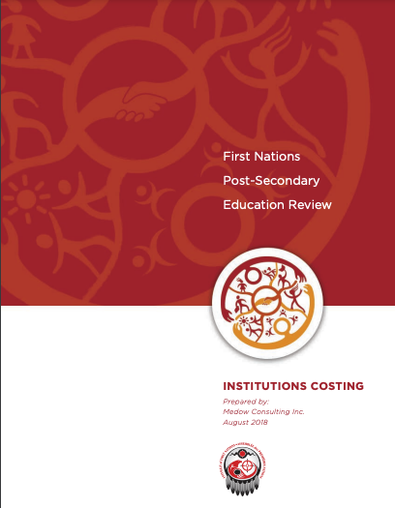
Institutions Costing (2018)
Approach: outline a high level “costing model” for FNIs based on:
Analysis of three First Nations Institutes (First Nations University of Canada, Six Nations Polytechnic, Red Crow Community College)
Analysis of international Indigenous post-secondary systems in the United States and New Zealand/Aotearoa
Broad consideration of the cost-drivers of PSE across Canadian jurisdictions and in international context

Slide 13
Institutions Costing (2018) Continued
Costing model: Based on four weighted variables: 1) research mission, 2) program offerings, 3) institutional size, 4) rural/remote status + unique cost elements for FNIs
Results: Projected annual operating cost of roughly $22,000 - $67,600 ($2018) per FTE for FNIs with differing missions, programs, size, and location
However: “With limited exceptions, existing funding sources for FNIs are not intended to support on-going institutional sustainability, but rather to support specific and time-limited program delivery.”
Findings remains broadly applicable seven years later

Slide 14
Assessing Structural Funding Availability (2025)
Identify gaps in funding sources and delivery mechanisms
Our 2018 research focused on cost of operating FNIs
The current 2025 research focuses on understanding structural funding gaps between FNIs and non-Indigenous post-secondary institutions (PSIs).
Uncover key distinctions in funding mechanisms between FNIs and non-Indigenous post-secondary institutions (PSIs)
Evaluate the impacts of these gaps on FNIs
Indigenous Institutes Consortium is serving as project special advisor

Slide 15
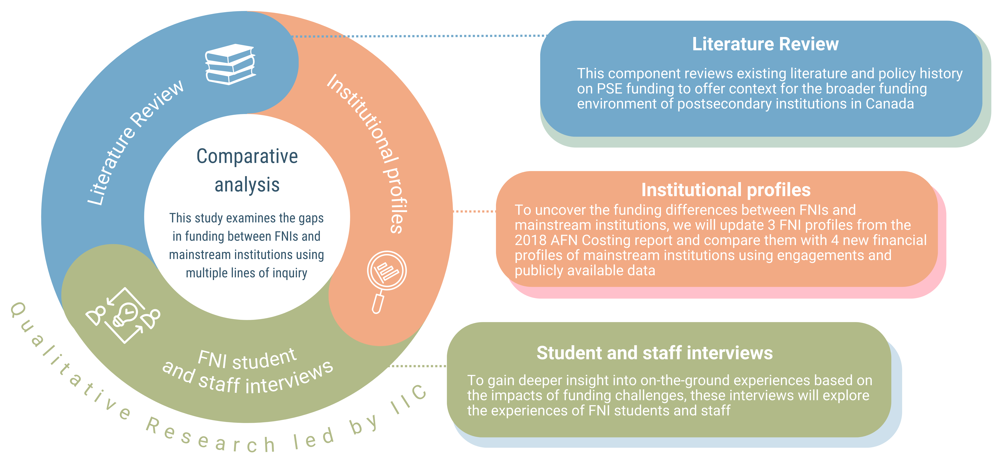
Assessing Structural Funding Availability (2025) Continued

Slide 16
About First Nations Institutes (FNIs)
IIC Special Advisor Role

Slide 17
About First Nations Institutes (FNIs)
PSE Policy Context in Brief (AFN)

Slide 18
About First Nations Institutes (FNIs)
Discussion: Role of Adequately Funded FNIs

Slide 19
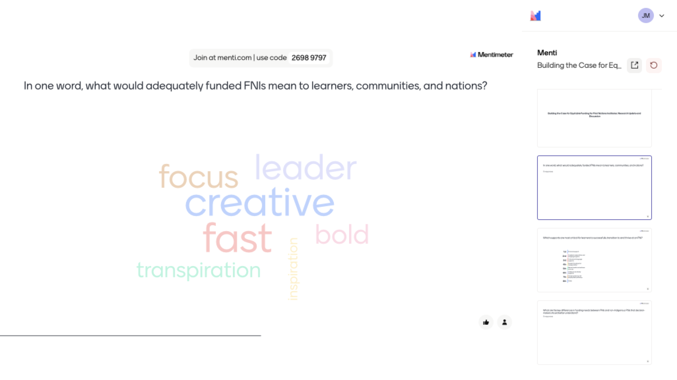

Slide 20
About First Nations Institutes (FNIs)
Thank you! Miigwech! Niá:wen!

