Slide 1


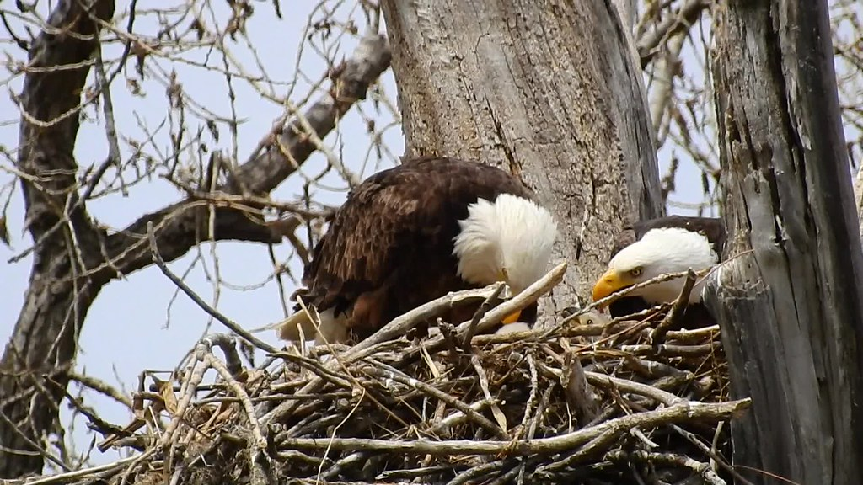
Director of Education Randy Constant Superintendent of Education Pauline McKay
Miyo-Pimatisiwin – Living the Good Life
Becoming a Trauma Informed School and System

Slide 2
The September 4th Critical Incident and follow up.
The James Smith Cree Nation critical incident left 11 fatalities and 17 injured.
RCMP investigators documented, examined, and processed 42 different crime scenes, buildings, and vehicles.
Over 1250 investigated tasks were identified.
697 exhibits were seized during the course of crime scenes processing
257 witness interviews completed by investigators and RCMP Behavioural Sciences branch experts.
Inquests completed in January 2023.

Slide 3
Our Community
James Smith Cree Nation comprises the following 3-2-1 political scenario:
3 Bands: James Smith, Peter Chapman, and Chakastaypaysin Bands
2 Reserves: James Smith #100 and Cumberland #100A
1 community: James Smith
Four agencies support leadership in conducting the day- to-day business of the community:
Band Administration, Health Clinic, ICFS, and Education
Bernard Constant Community School is the primary school comprising 419 students from Grades N-12
102 staff members comprising teachers, support staff, bus drivers, consultants, school & Sr. Administrators
278 homes house the families on the First Nation
We work with 158 families in our school.

Slide 4
Answering the call - Our Partners
Reaching out to our partners included the following:
Ministry of Education – Invitational Shared Services Initiative. (ISSI)
Saskatchewan Health Authority
Victim Services
Ministry of Social Services
North East, SaskRiver Public, and Northern Lights School Divisions
Saskatchewan Teachers Federation (STF)
SK Polytech
Violence Threat Assessment (VTRA) training – David Cameron
ISC
Kindness and Caring from Everywhere.

Slide 5

What Now ????
Debriefing with Education Staff
Debriefing with Students
Debriefing with Community Members
Debriefing with Interagency groups
Debriefing with Leadership

Slide 6
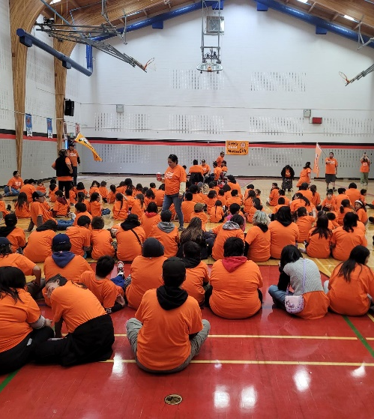
The Plan: Become trauma-informed with the goal of being a trauma-sensitive school & organization
2022 – 2025 Focus on creating a Trauma-Informed School which will be heavily supported by the Mental Health of our Staff, students, Parents and Community Members and Leadership.

Slide 7
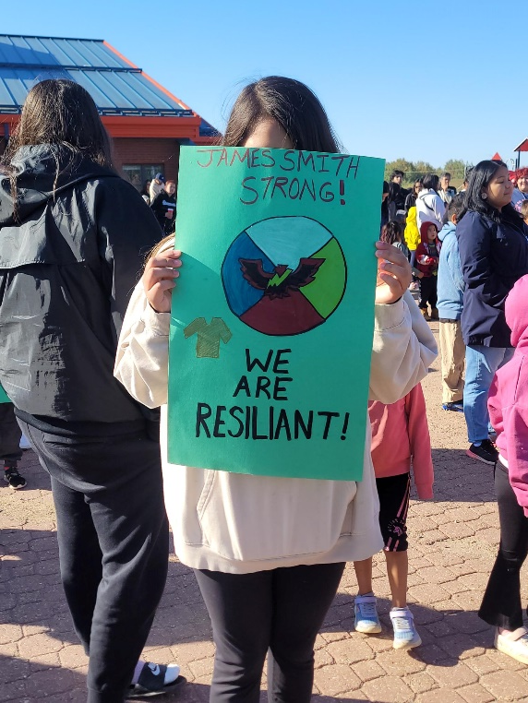
DEFINITION OF TRAUMA The Three Es
Trauma refers to an Event, series of events, or set of circumstances that is Experienced by an individual as physically or emotionally harmful or life threatening and that has lasting adverse Effects.

Slide 8

What does it mean to be a trauma informed school?
A trauma-informed school system (K-12) is one in which all teachers, school administrators, staff, students, families, and community members recognize and respond to the behavioral, emotional, relational, and academic impact of traumatic stress on those within the school system.

Slide 9
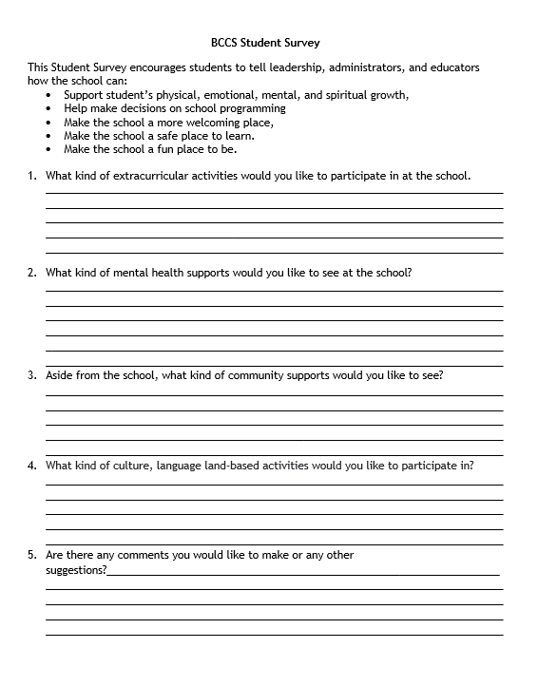
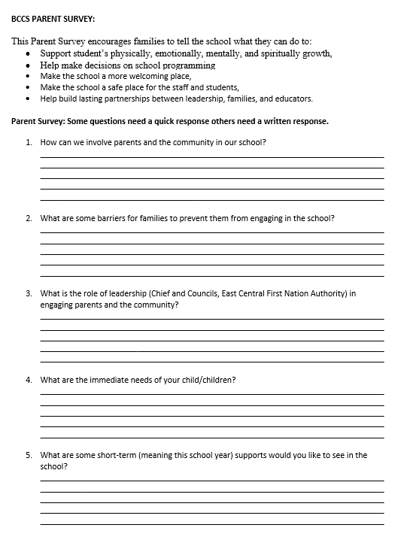

Surveys Gathering Voices
Students
Teachers
Support Staff
Parents

Slide 10
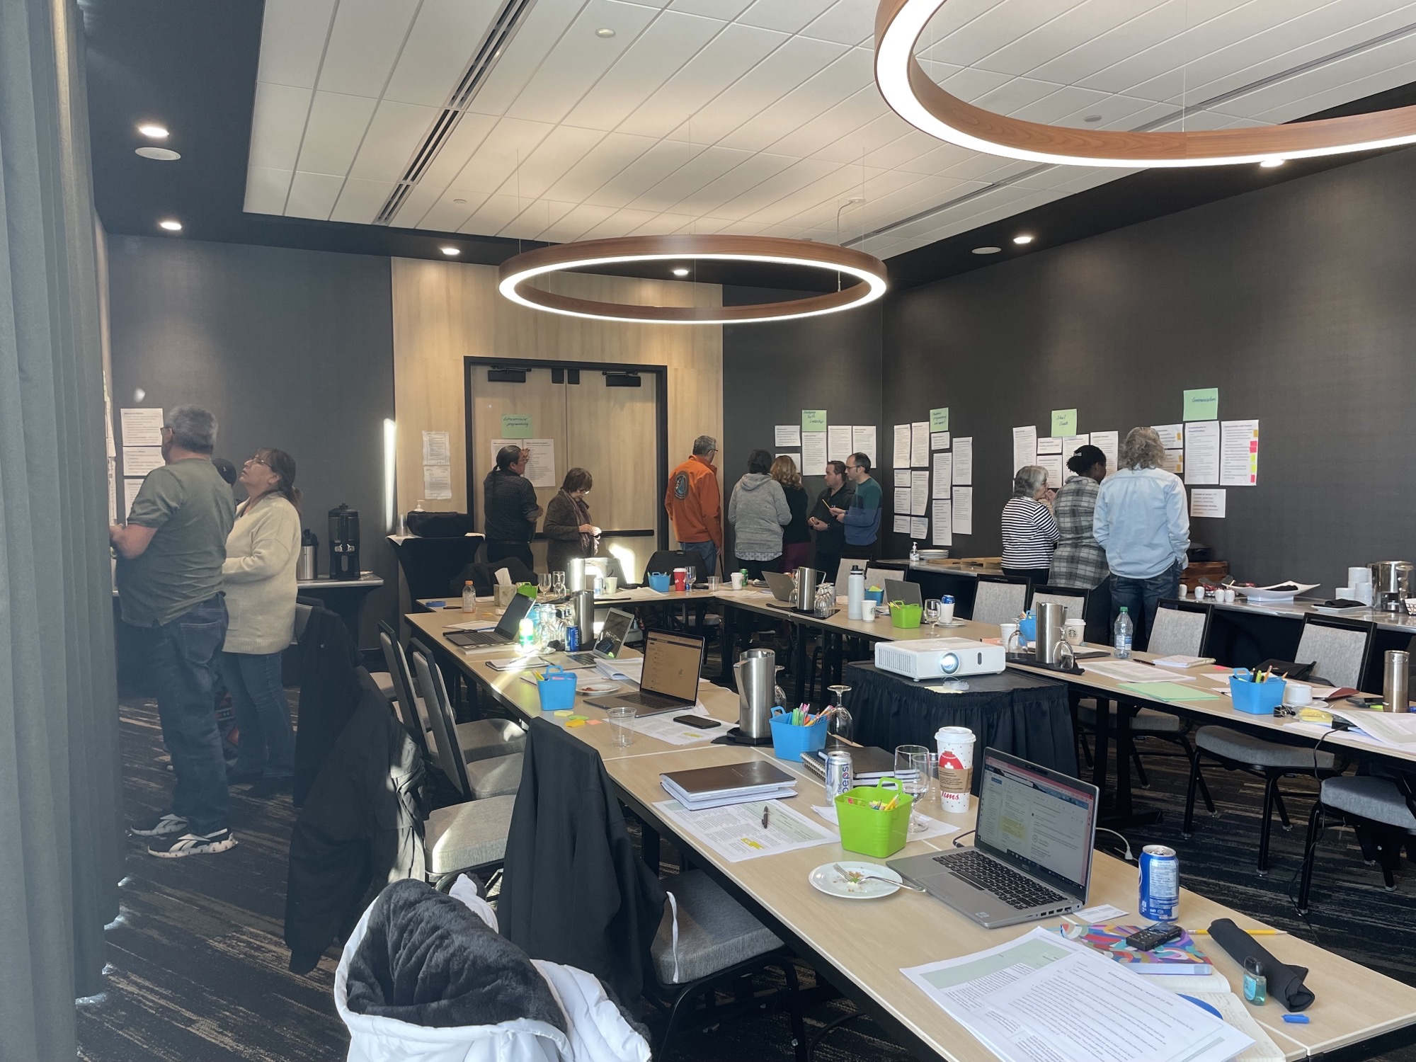
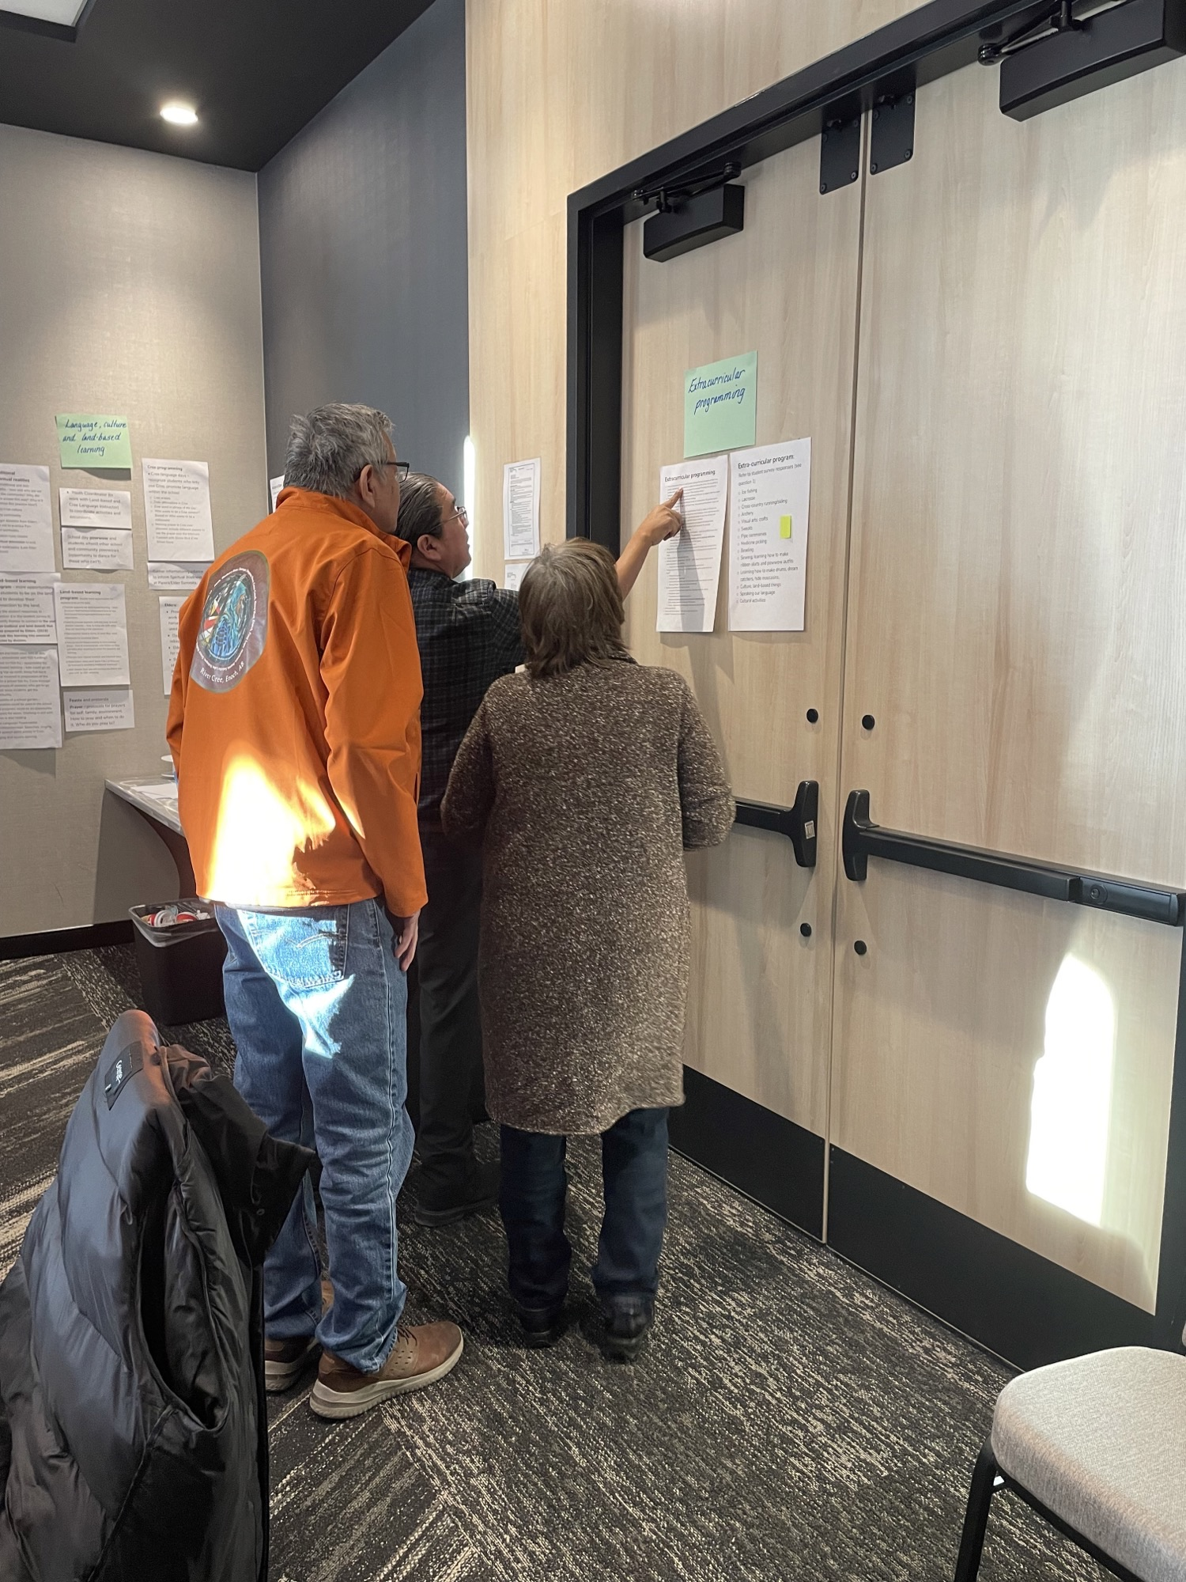
Miyo-pimahtisiwin (Living the Good Life) (Well-Being) Four Pillars Created from Voices
Miyawyawin – Physical and Mental Health
Kākīsimowin - Spiritual Health
Wahkowtowin - Identity, Belonging, and Kinship
Nehiyaw-pimahtisowin – Land-based Learning, Cultural Learning and Language

Slide 11
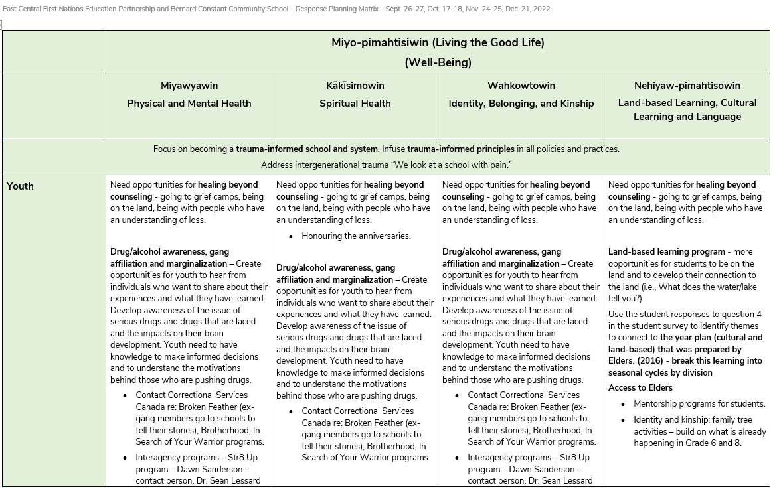

Slide 12
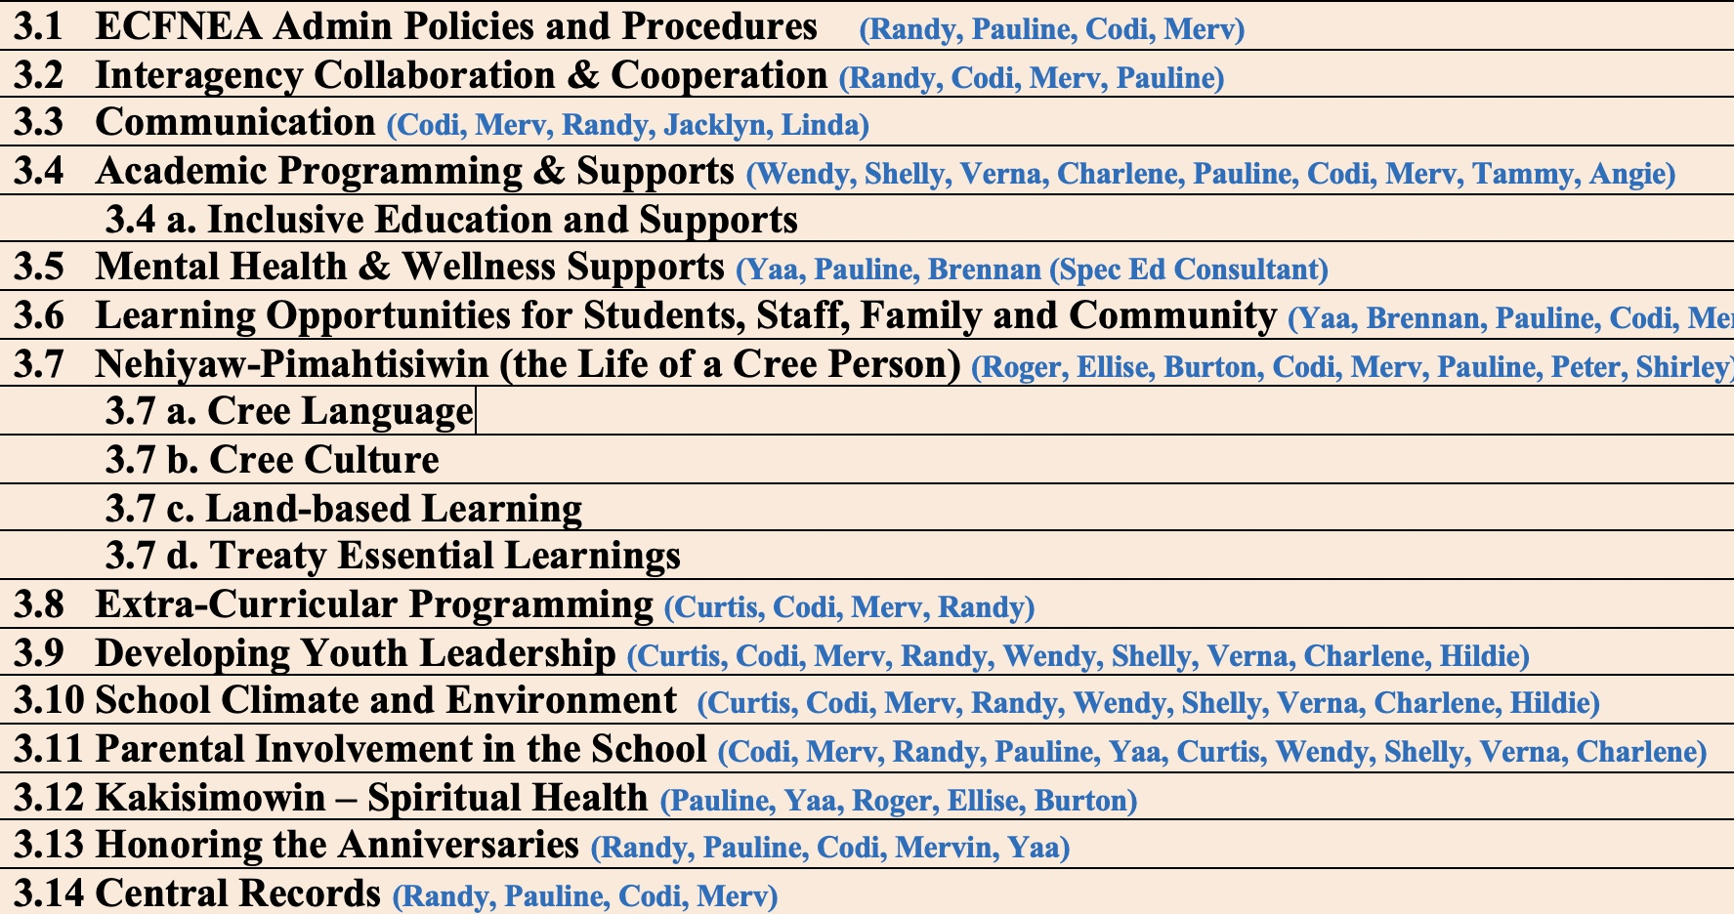

Slide 13
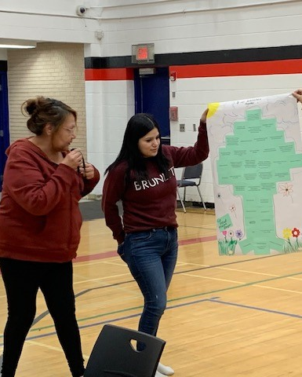
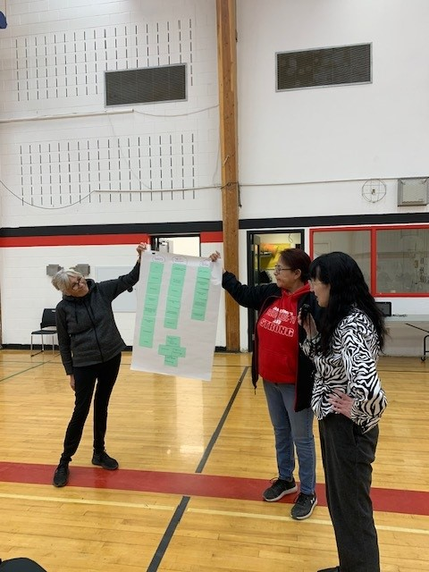
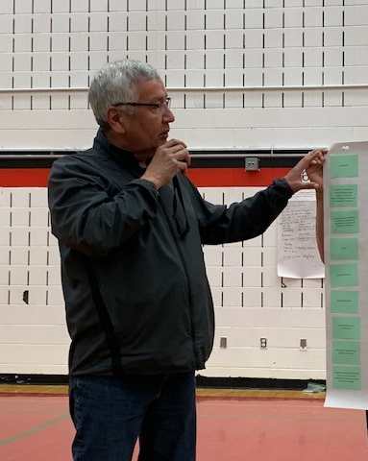
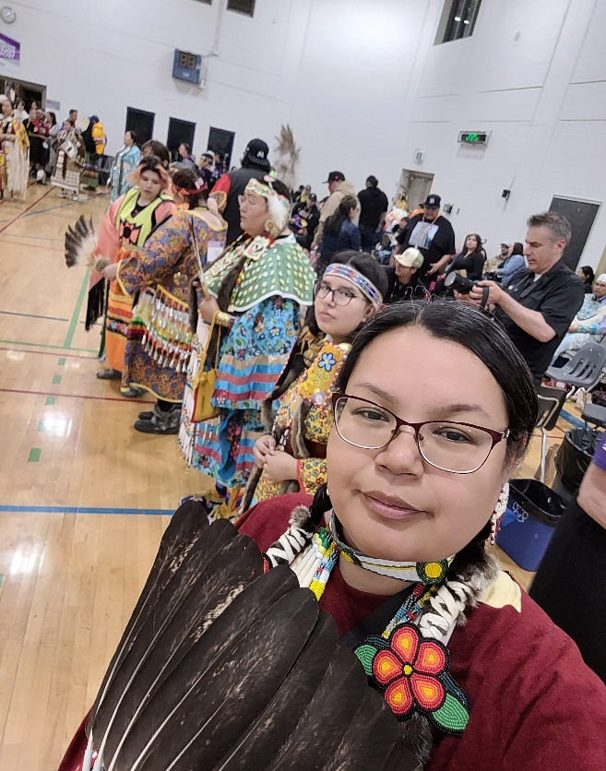
Three Ongoing and Onboarding Training for all staff including Interagency partners.
ARC – Attachment, Regulation and Competency Training: The ARC Model, also known as the ARC framework, is an approach to trauma-informed therapy, offering a flexible framework designed specifically for children and adolescents who have experienced complex trauma, such as abuse, neglect, or exposure to violence.
ACES - Adverse Childhood Experiences are potentially traumatic events that occur in childhood. ACEs can include violence, abuse, and growing up in a family with mental health or substance use problems. Toxic stress from ACEs can change brain development and affect how the body responds to stress.
VTRA & TES A standard in Violence Threat Risk Assessment (VTRA™) and the Traumatic Event Systems (TES™)V the trauma-informed threat assessment framework that aims to identify and intervene within potential pathways to violence. The training is from an Indigenous Perspective.

Slide 14
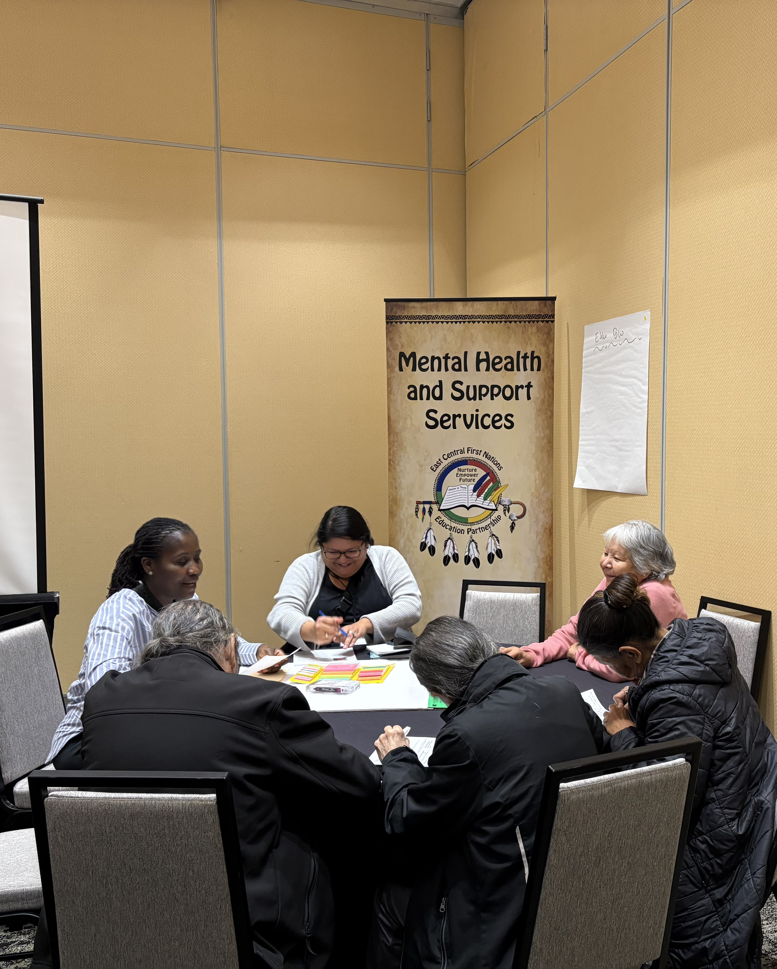
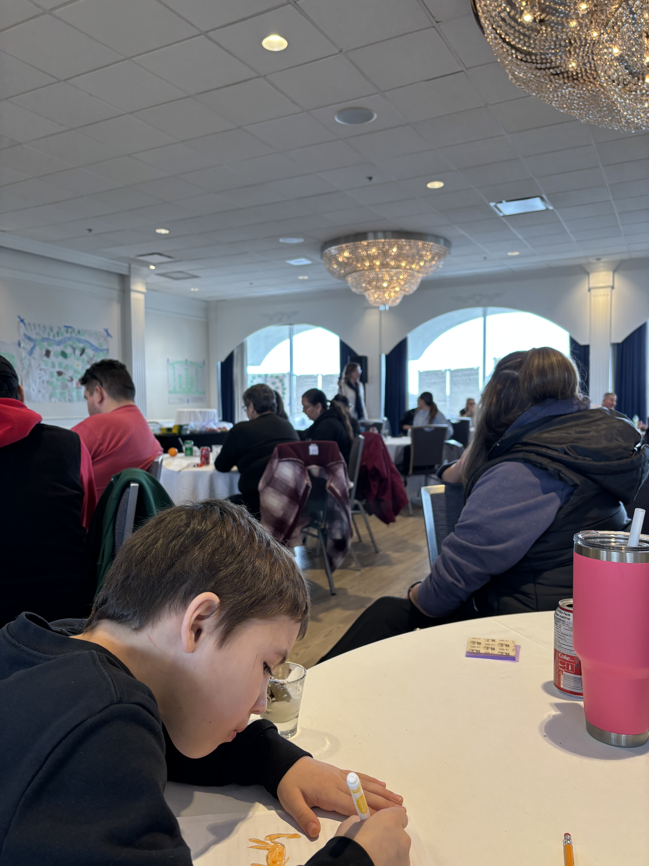
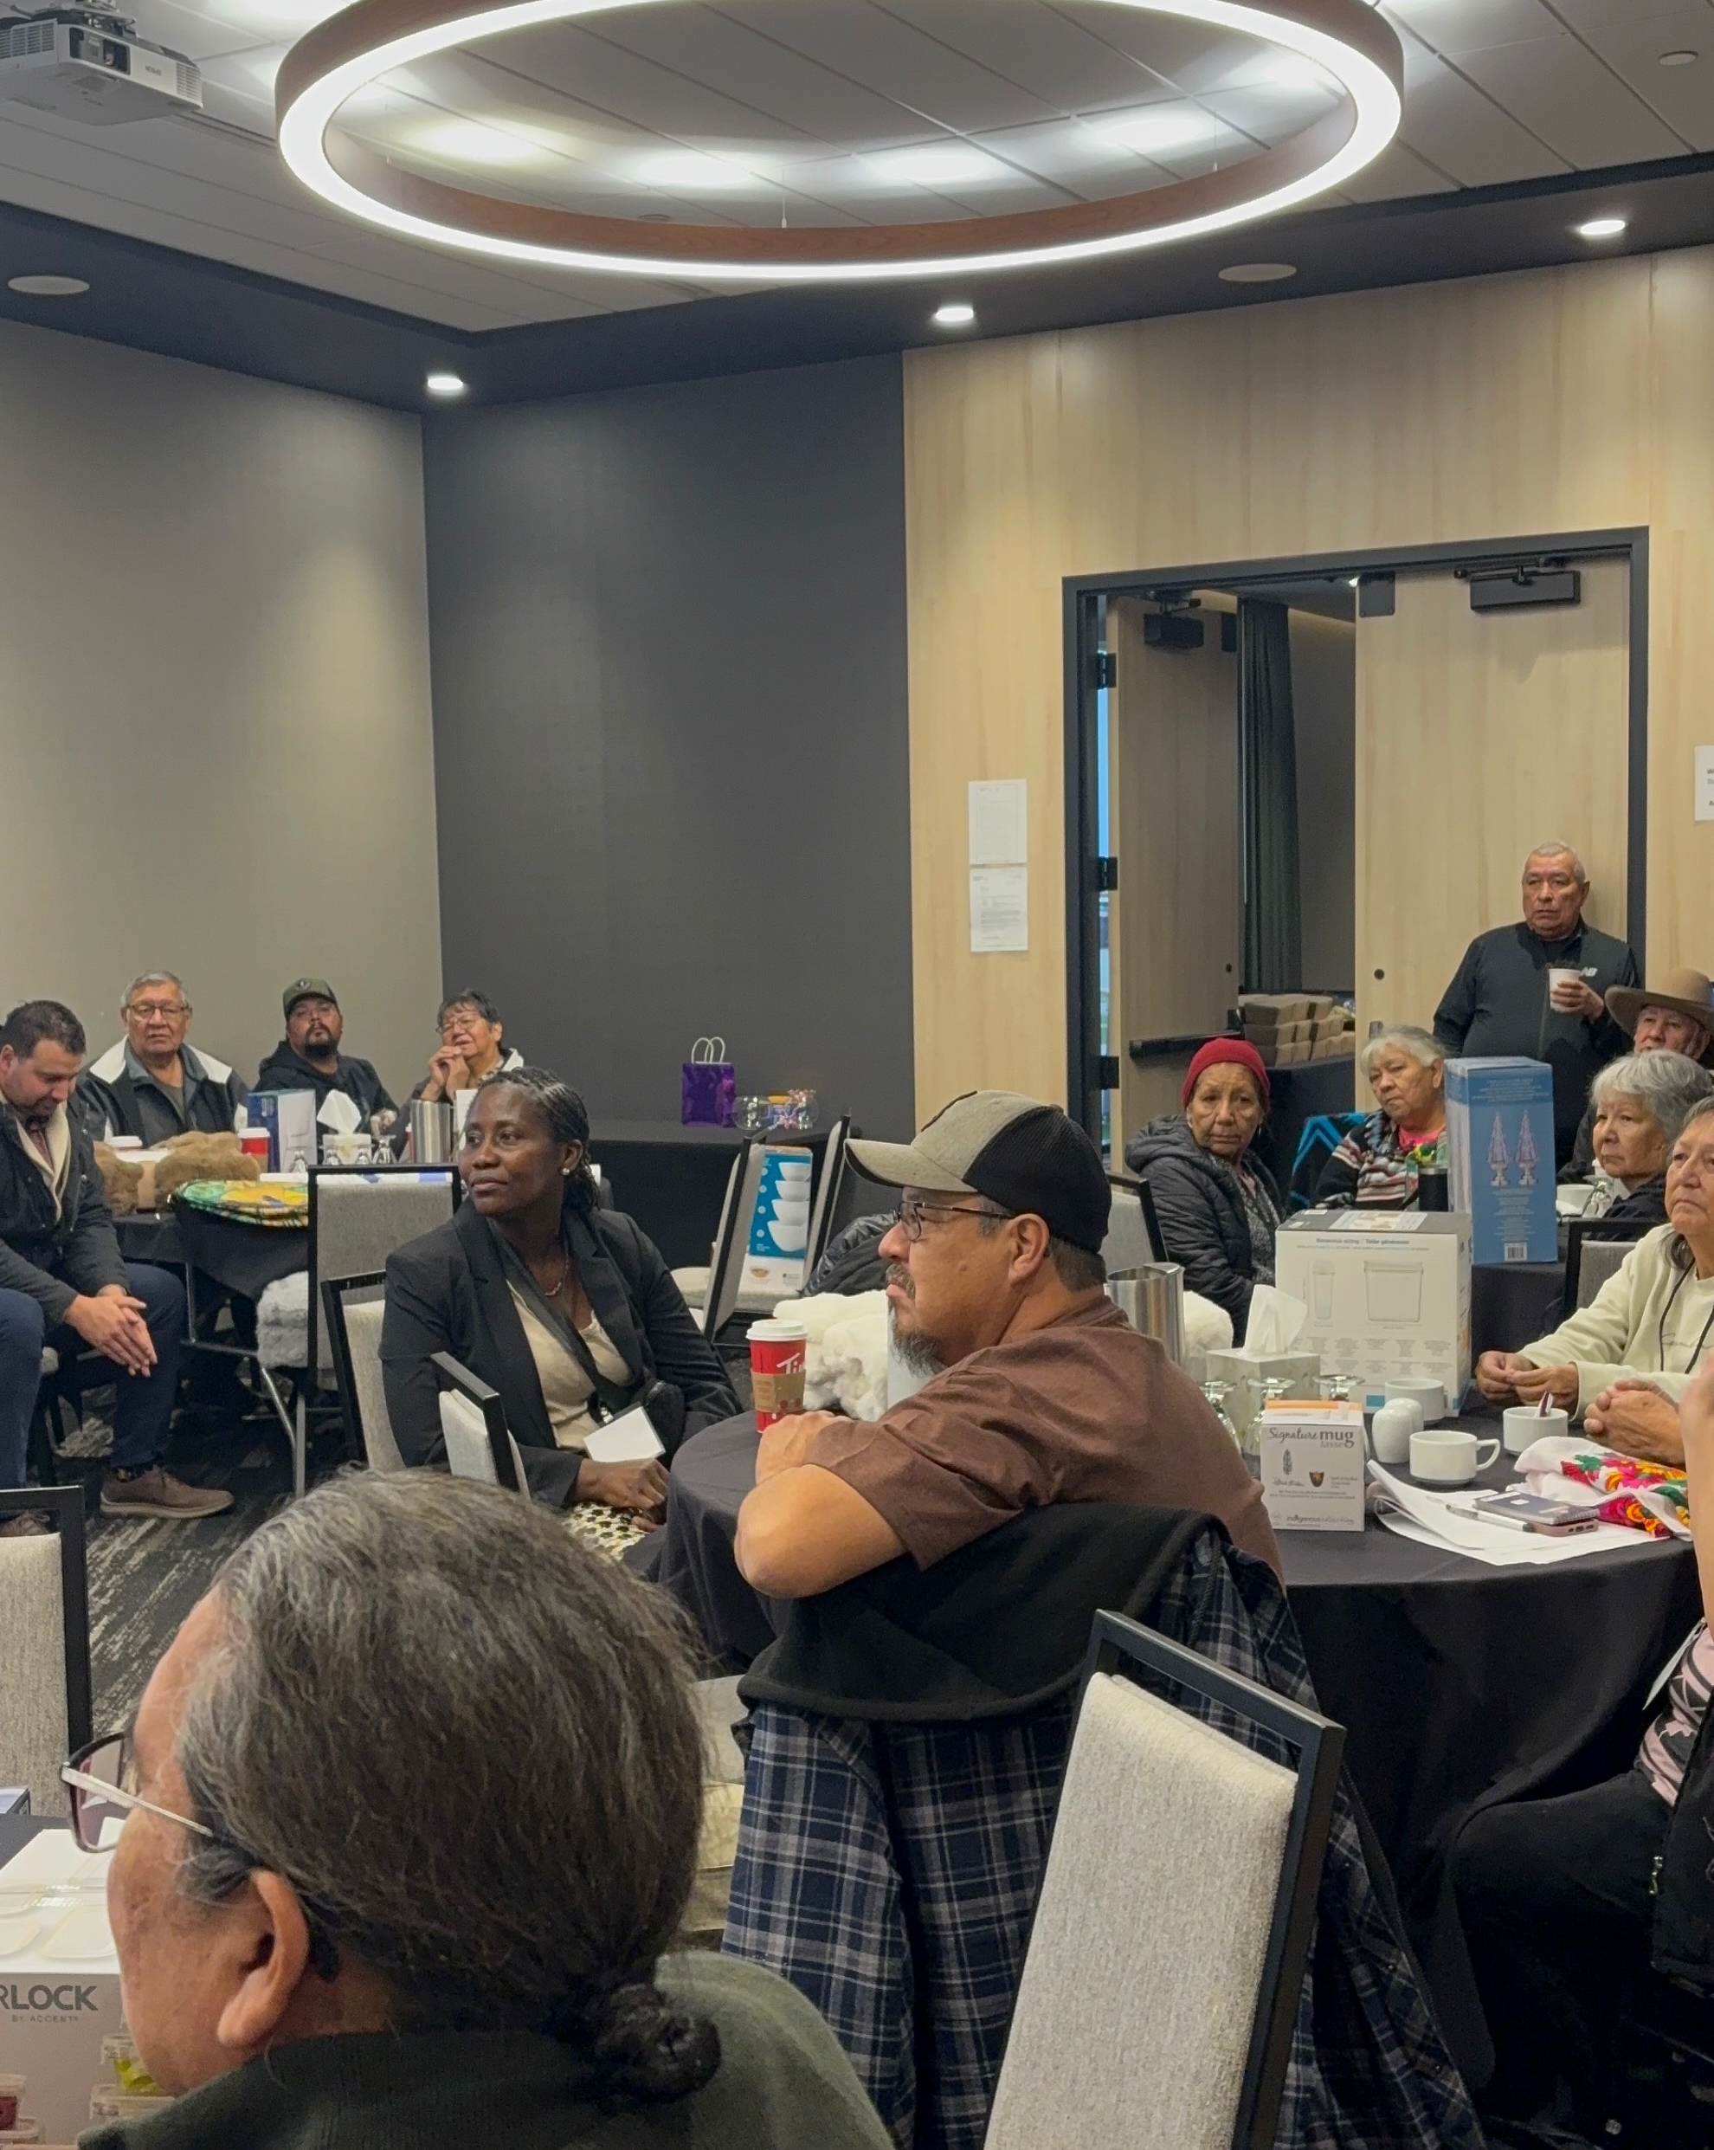
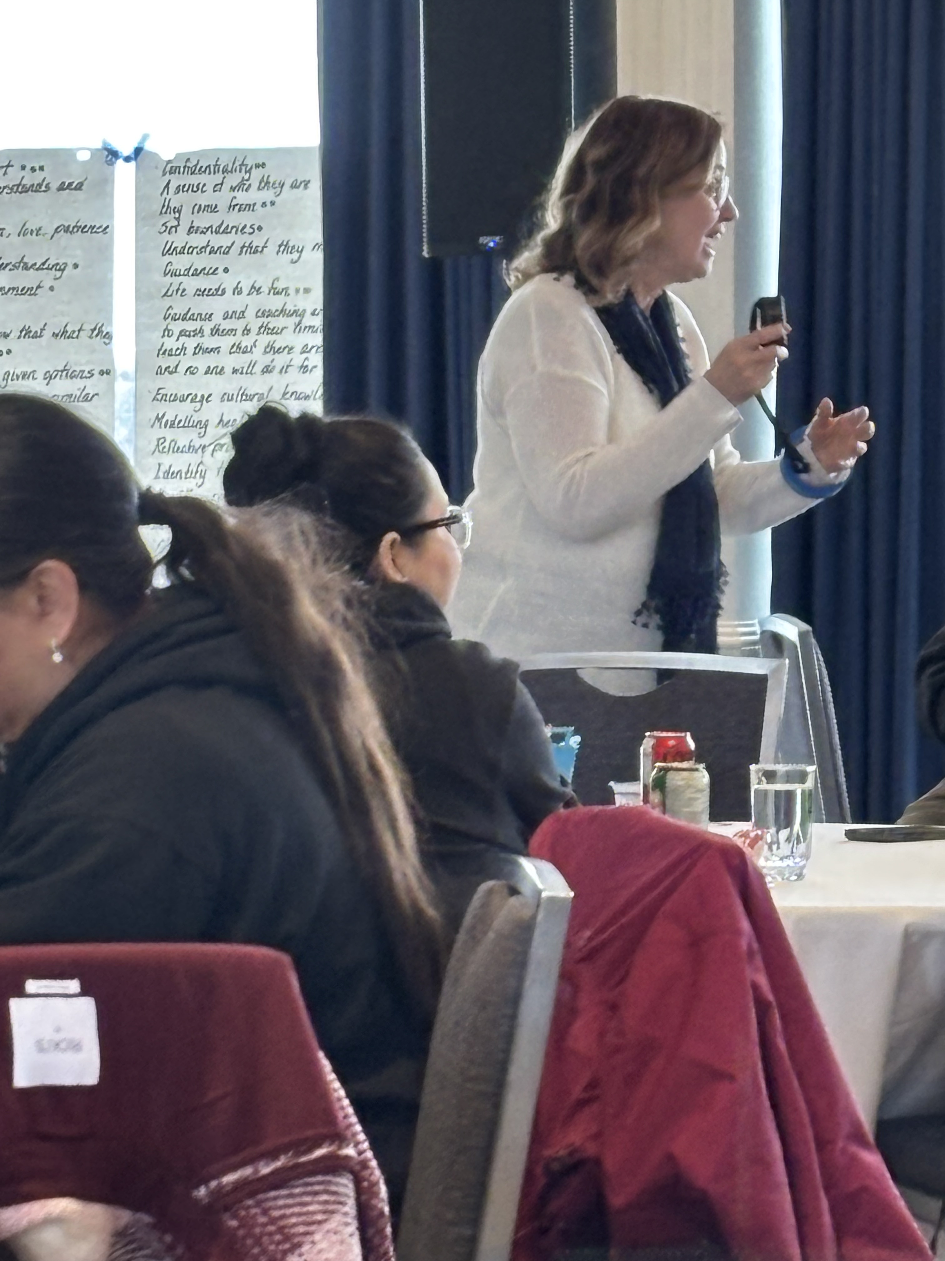
Annual Summits and Retreat
Elder’s Summits
Parent Summits
Student Summits
Teacher Summits
Interagency Retreat

Slide 15

ECFNEA Continuing and Ongoing Supports for BCCS, Every Action is from a Trauma Informed Lens.
Literacy
Numeracy – PAA and supports
Mental Health and Counselling
Learning Supports
Cree Language & Land based
Treaty Essentials
Sports Academy
Performance Measurements

Slide 16
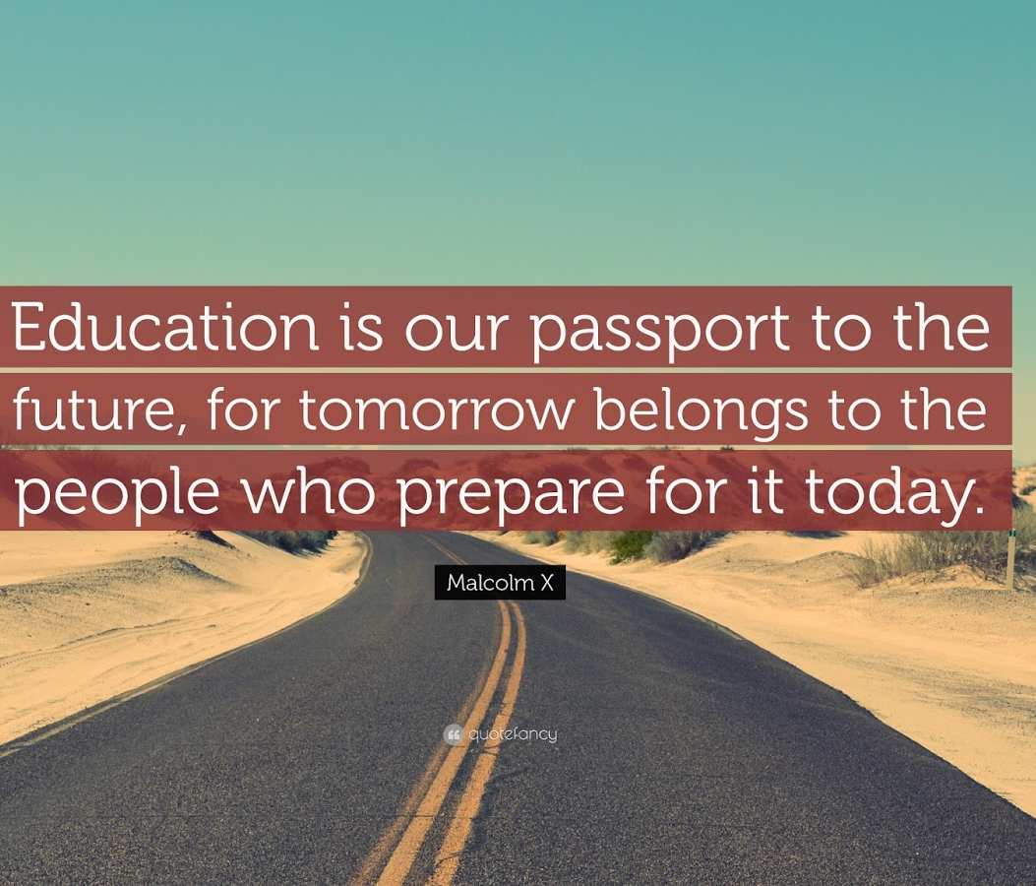
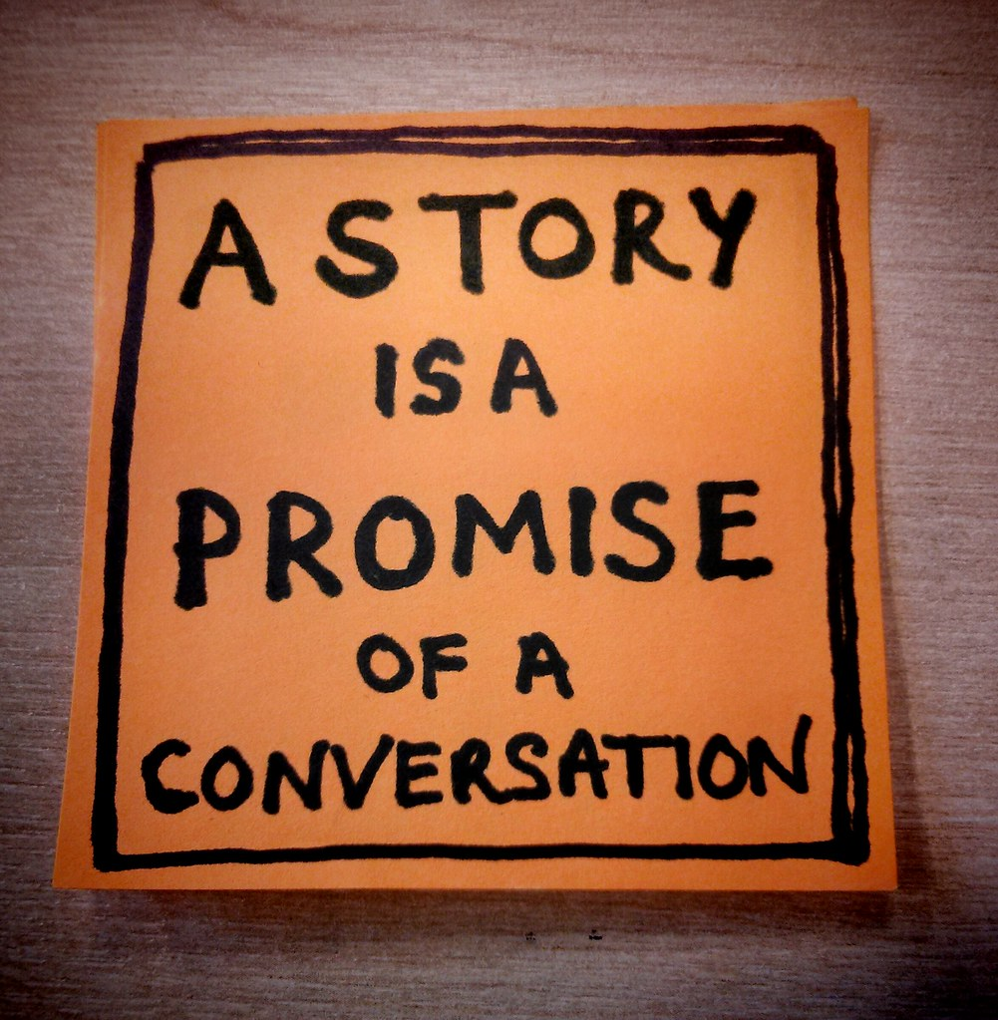
“ECFNEA A New Story”
Complete the Five-year Transformational Planning in creating a Trauma Informed School
Soft Landing activities all week starting on September 4th. Powwow, Round dance, cultural events and ceremonies, Fun activities for children. Memorial services.
Interagency monthly meetings with Mental Health and band support staff.
Wellness Center established at BCCS complete with Mental Health worker, Social Worker, and guidance counselors. Resident Elders.
Collecting Data, Making Data Driven Decisions

