Slide 1


Slide 2
Acknowledgement
We would like to begin by acknowledging that we are visitors to the territory of the Cree, Dene, Lakota, Dakota, Nakota, and home of the Metis. We arrive in Saskatoon, on the lands now known as Saskatchewan with simple commitment to leave your territory as we found it, an act of both respect and humility. We pay our respects to your people, Elders, ancestors, and recognize your continued presence and connection to this land, as we are connected to our home territories in what is now known as Ontario. Miigwech!

Slide 3
Who we are
Indigenous Financial Institution (IFI)
Not for Profit Organization Formed
in 1984
Offices Located in Tyendinaga
Mohawk Territory, Stirling, and London, ON
We Offer Farm Financing, Agricultural Extension and Business Advisory Services
Financing for First Nations Membership Across Ontario

Slide 4
Food Security Initiative
Seven Generations Program

Slide 5

Annette Peltier-Flamand
Food Security Specialist

Slide 6
Annette Peltier-Flamand Background
Was self-employed as a graphic designer/short run printer before deciding to change careers in 2019.
Obtained Horticulture Diploma from the University of Guelph
Former Master Gardener and 4 H Leader
Graduate of Graham School for Livestock Men and Women
Trained in Bovine Artificial Insemination
Workshops include soapmaking from scratch, pressure canning and boiling water bath canning
Small beef cattle herd, knits/crochets

Slide 7
Before I came to work for FNAFO, I administered the agriculture program in my home community of Wikwemikong in Ontario from 2020 to 2024. During this time, I also assisted the high school with implementing the Green Industries course and the utilization of their greenhouse. Through my experience working with my home community I found out that the majority of youth are extremely disconnected with their food supply.
When I heard a youth say, “This is the only reason I came to school today”, as she held a chick, I knew there was great potential for agricultural and land based programming in the schools because they create motivation.
Through my work at FNAFO, I am looking to create opportunities in First Nations agriculture in Ontario. Revitalizing community agriculture starts with our YOUTH through Education and hands-on opportunities.

Slide 8
FNAFO First Nations Food Security Program (FNFS)
What is Food Security?
Food security means that all people, at all times, have physical, social, and economic access to enough safe, nutritious, and culturally appropriate food to meet their dietary needs and food preferences for an active and healthy life.
It’s often described as having four main pillars:
🥦 Availability – There’s enough food being produced and supplied
💰 Access – People can afford and physically reach that food
🍲 Utilization – The food is nutritious, safe, and properly used
🔄 Stability – These conditions are steady over time, not easily disrupted by things like climate change, conflict, or economic instability.
In a First Nations context, food security often goes beyond just having enough to eat — it’s about food sovereignty too: the right to define and control local food systems, protect traditional food sources (like hunting, fishing, and harvesting), and preserve cultural and spiritual relationships with the land.

Slide 9
FNAFO First Nations Food Security Program (FNFS)
Many First Nations Communities are “Food Insecure”
🥦 Availability – There’s enough food being produced and supplied
There is currently enough food being produced and supplied, but is not locally produced.
💰 Access – People can afford and physically reach that food
We are reliant on external food suppliers from all over the world to ship food to local grocery stores for distribution. Shipping is an expense that is passed on to the consumer. Staple grocery items such as meat and fresh produce are no longer affordable for many families. If an event happened that affects shipping we would no longer have access to that food. Mostly processed foods are affordable in many communities.
🍲 Utilization – The food is nutritious, safe, and properly used
Fruit and vegetables are harvested before ripe. They lose some nutritional content during shipping and are sometimes overripe or spoiled when they reach their final destination. Food that is mass produced is usually treated with fungicides, pesticides, herbicides, insecticides, antibiotics, growth hormones which makes safety questionable. Mostly processed foods are readily available which are high in calories, sugars, fats and carbohydrates. It is also becoming apparent that cooking is becoming a lost skill.
🔄 Stability – These conditions are steady over time, not easily disrupted by things like climate change, conflict, or economic instability
Rural areas will be the first to feel the effects due to increased production costs and shipping fees during times of economic and climate instability.

Slide 10
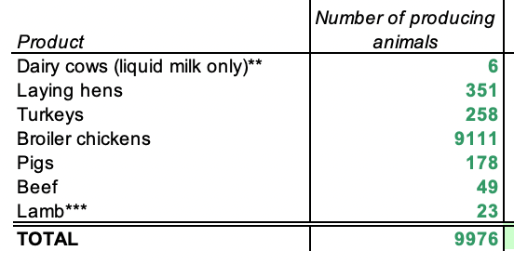
How Much Food is Required to Sustain Your Community?
FNAFO First Nations Food Security Program (FNFS)
Annual Meat and Milk Needs, Based on a population of 500
Local Food Production Tool Excel spreadsheet courtesy of the Ontario Ministry of Agriculture, Food and Rural Affairs

Slide 11
FNAFO First Nations Food Security Program (FNFS)
Current State
Children are unaware that they are capable of growing and raising their own food.
Youth don’t see agriculture as an exciting and viable career option for various reasons.
People are eating less meat and produce due to prohibitive costs.
People are eating more prepared processed foods - basic skills like cooking are being lost.
Food transported from other countries requires cooling systems, fuel (truck and airplane), which has a heavy environmental impact.
Food transported from other countries is not fresh and not as nutritious as locally produced.
Food produced on large farms is subject to food poisoning outbreaks that can affect all of the people in their distribution networks (E. coli, salmonella, listeria)

Slide 12
FNAFO First Nations Food Security Program (FNFS)
Why Schools Should Be More Involved in Food Security
Self-sufficiency in food production means a community, region, or country is able to produce enough of its own food to meet the nutritional needs of its people without having to rely heavily on imports or outside sources.
First Nation leadership conducts strategic planning sessions where priorities are decided. FOOD SECURITY is usually one of them. First Nations communities have reached populations that cannot be sustained by traditional food sources but have no agricultural knowledge keepers, or they are aging out of the agricultural lifestyle.
We need more farmers, and schools are an important place to introduce youth to food security and food security career options. The students of today are the farmers of tomorrow!

Slide 13
Benefits
FNAFO First Nations Food Security Program (FNFS)
Youth gain confidence and are empowered in times of uncertainty
Food production/harvesting/preservation activities unite all age groups and creates a sense of community
Agricultural and harvesting activities are great forms of exercise
Food production is a practical application basic scientific principals including physics, chemistry that can reinforce lessons learned in other classes
Food production/harvesting is season specific. Doing something different every day in an outdoor environment is stimulating for the 5 senses and resulting in motivation to attend school
Fresh healthy meat and vegetables can be introduced into children’s diets through school nutrition programs that get them accustomed to vegetables and healthier meals.
School agricultural programming allows for experiential learning.
Agriculture is a gateway to introducing a variety of career paths

Slide 14
Agriculture Creates Communities
Agricultural Careers and Supporting Careers Generate Opportunities for Students
FNAFO First Nations Food Security Program (FNFS)
Food Scientist
Drone Operator
Beef Cattle Farmer
Heavy Equipment Operator
Feedlot Operator
Cash Crop Farmer
Agronomist
Livestock Nutrition
Welder
Heavy Equipment Mechanic
Food Processing
Greenhouse Technician
Precision Agriculture Technician
Poultry Farmer
Veterinarian
Biologist
Sawmill Operator
Logging
Chainsaw Safety and Tree Felling
Small Engine Repair
Abattoir
Butcher
Farm Hand
Farrier
Fruit Packer
Sales and Marketing
Contractors
Commercial Seed Suppliers
Engineers
Research Scientists, and more!

Slide 15
FNAFO First Nations Food Security Program (FNFS)
Community Benefits
Self-Employment and Employment Opportunities
Personal Food Security
Processing/Packaging/Infrastructure Opportunities
Providing First Nations with Food for Personal Use,
Distribution, Commercial Production and Sales
Local Food Production Means Food Security!

Slide 16
FNAFO First Nations Food Security Program (FNFS)
MIIGWECH!
Want to know more?
Reach out to get our Food Security Specialist to meet with your community
annette@firstnationsag.ca

Slide 17

Seven Generations Program
JENNIFER O’BRIEN RVT
SEVEN GENERATIONS LEAD

Slide 18
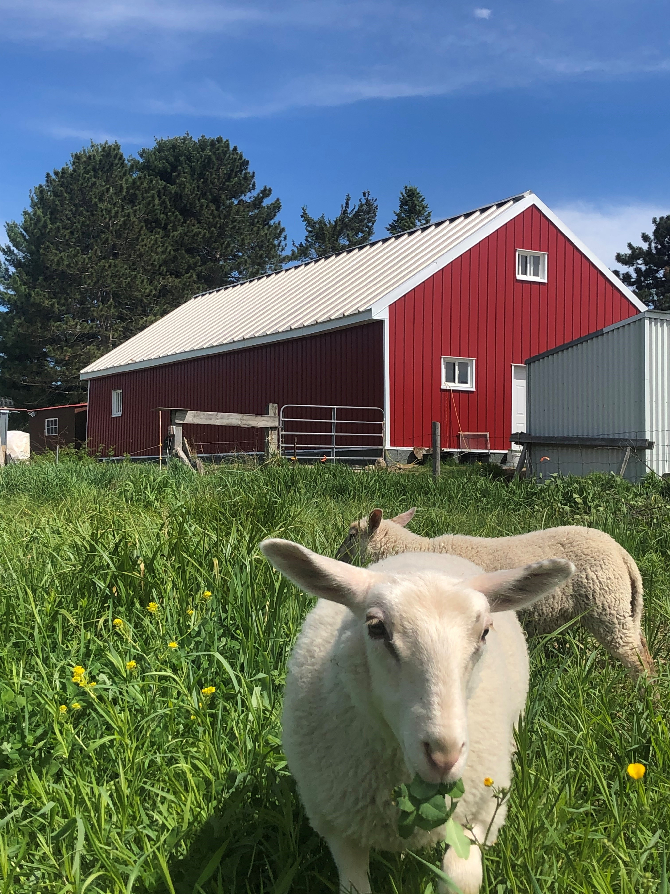

First Nations Agriculture & Finance Ontario, often referred to as FNAFO, is a First Nations not-for-profit with our roots stretching back to 1984 as IAPO. First Nations Ag and Finance is dedicated to empowering First Nations people of Ontario through farm and agribusiness financing, learning and training opportunities, and agricultural extension services

Slide 19

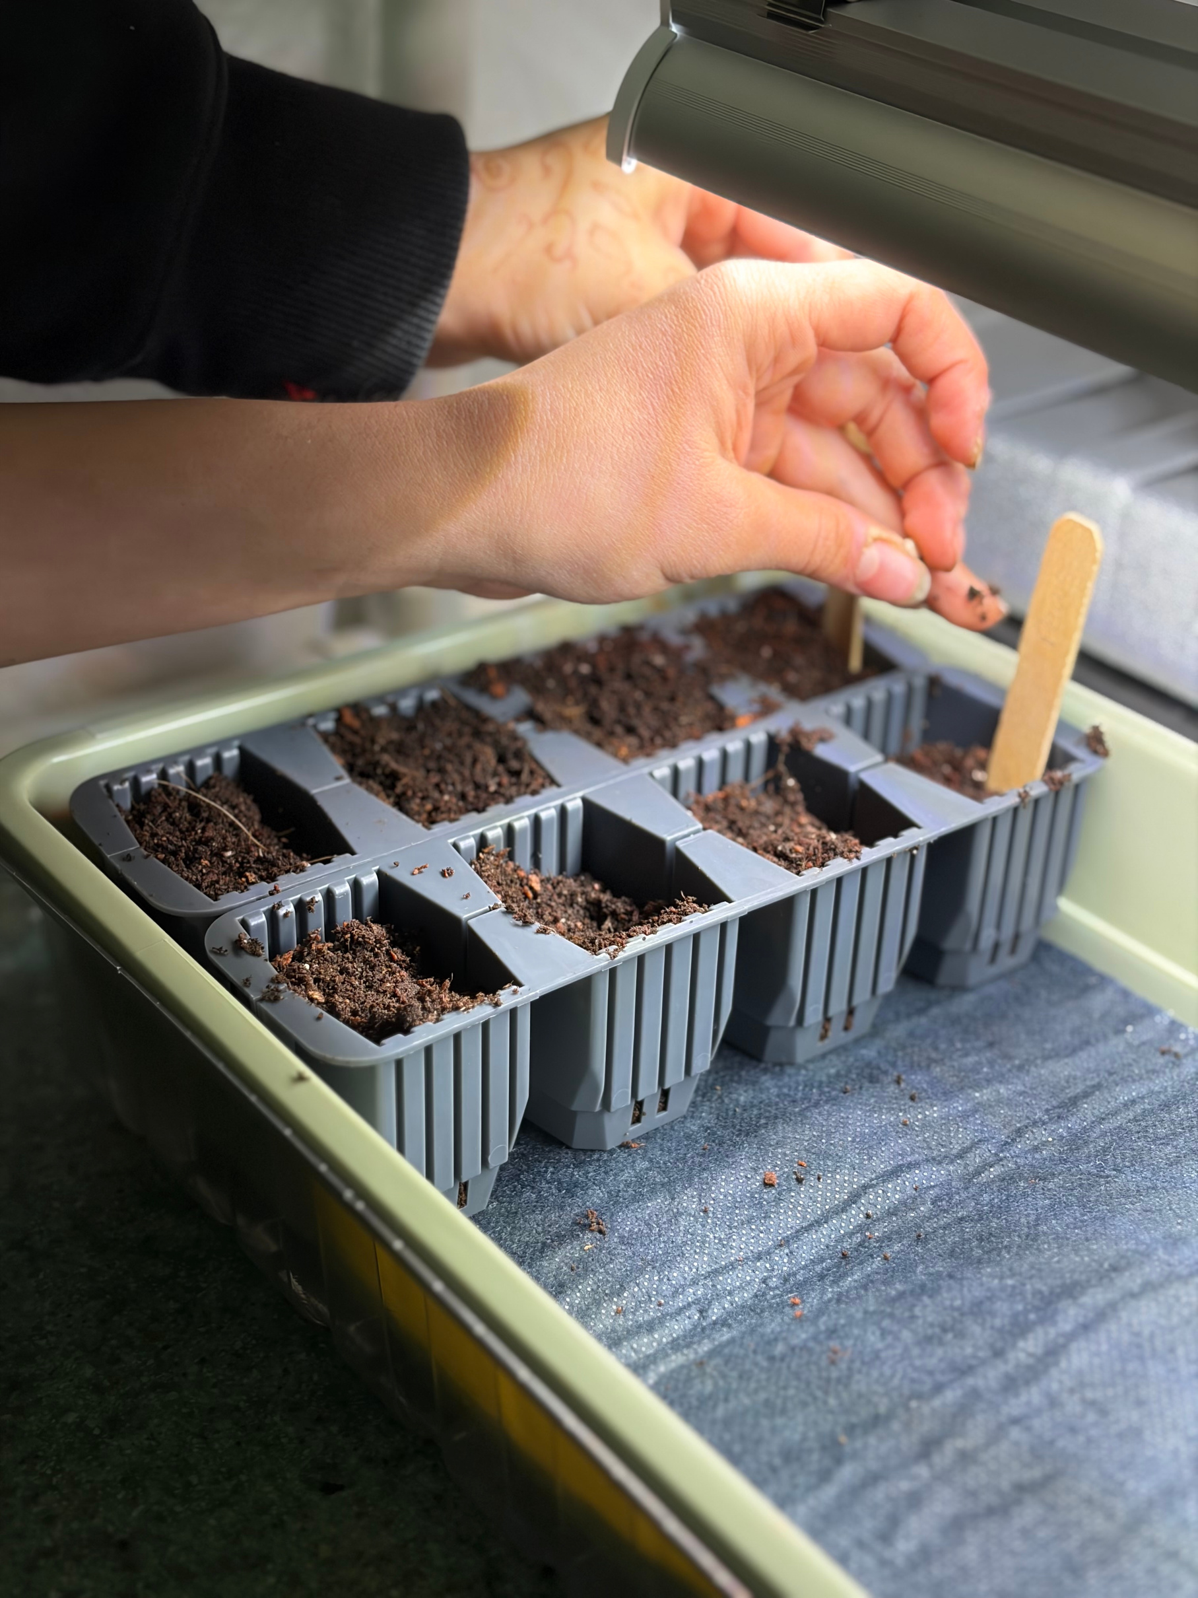
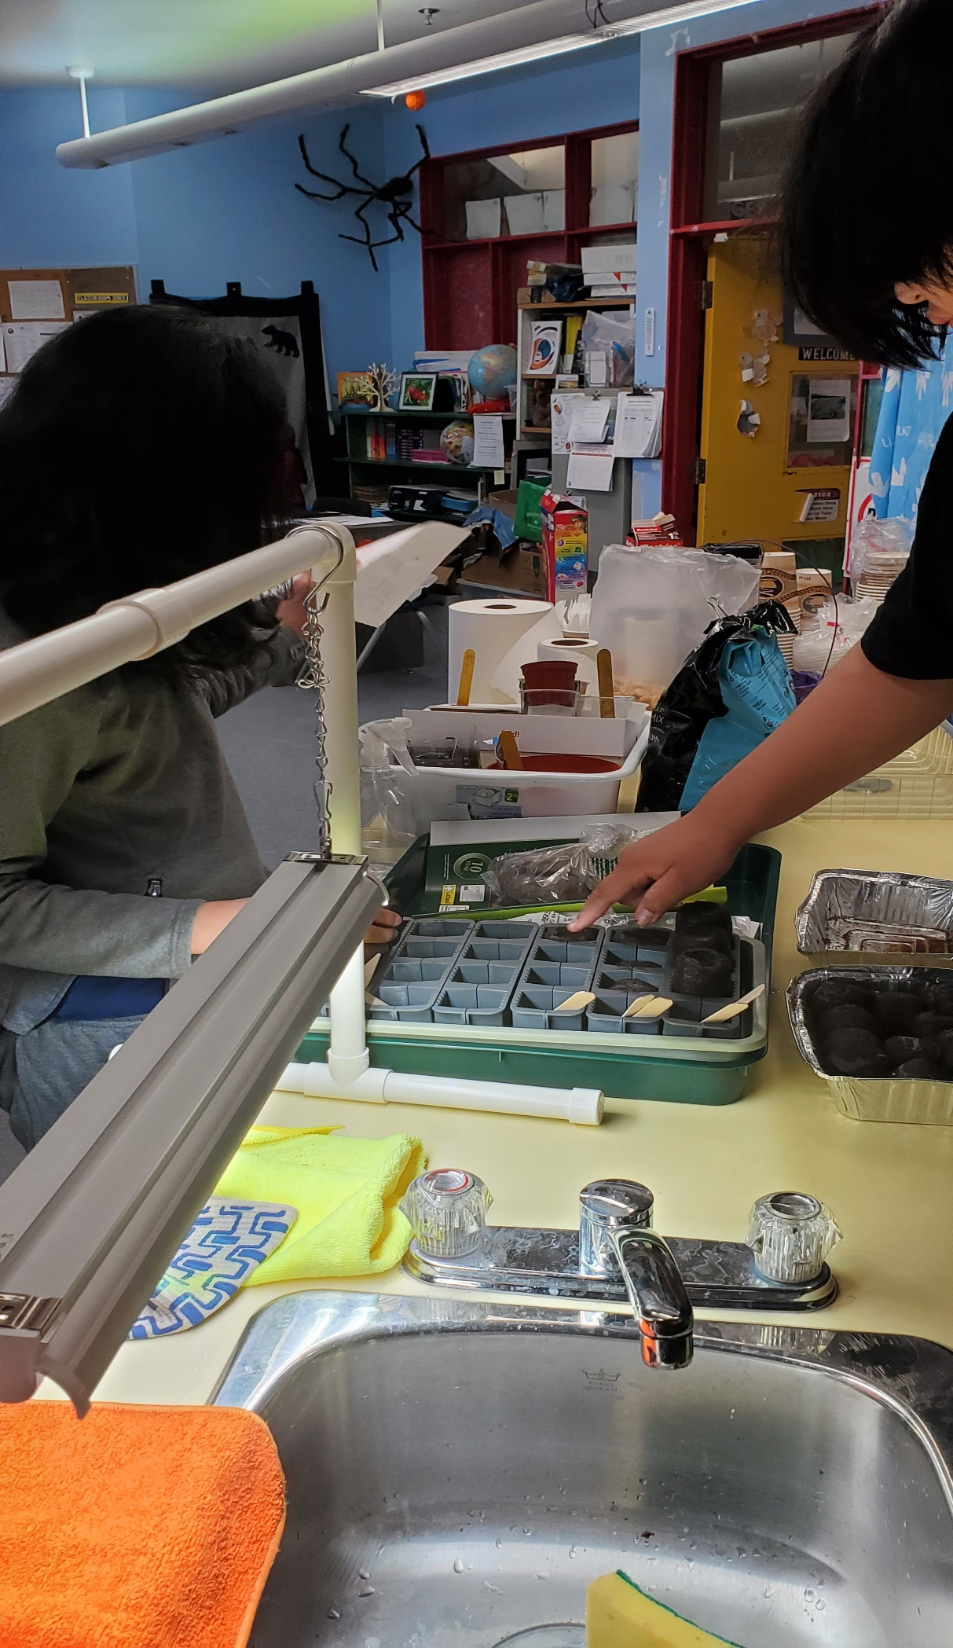
FIRST NATIONS AGRICULTURE
Our
Goal
The goal of First Nations Agriculture is to engage First Nation Youth’s interest in farming and agribusiness possibilities and opportunities

Slide 20
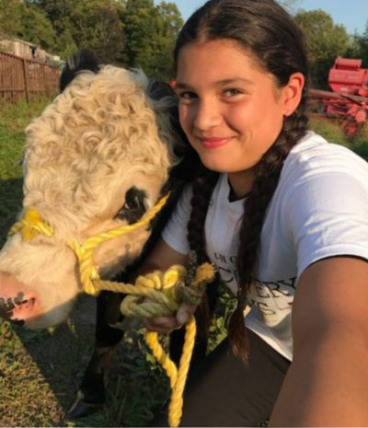
FIRST NATIONS AGRICULTURE
Who we Teach
First Nation students in Grades 7 ~ 12
Virtually or In Person Lessons
Ontario wide currently
(open to other provinces)

Slide 21
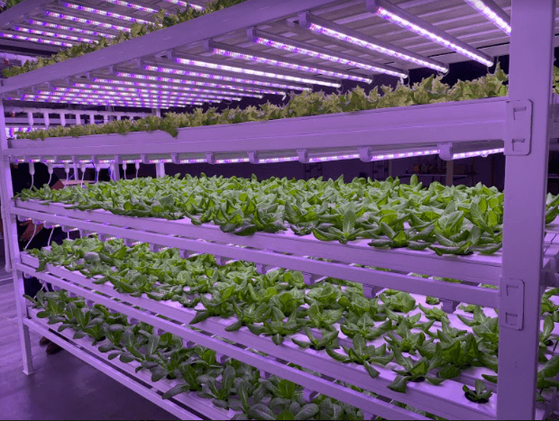
FIRST NATIONS AGRICULTURE
Program Lessons
Program is created with AgScape
AgScape provides factual, balanced, curriculum-linked food literacy programs and resources to Ontario’s educators and students.
Curriculum based lessons
Designed with the Ontario school curriculum in mind
Lessons are approximately 75 minutes
4 Different Lessons to choose from
Some lessons are geared towards a specific grade however they can be adjusted with the grade level bein taught

Slide 22

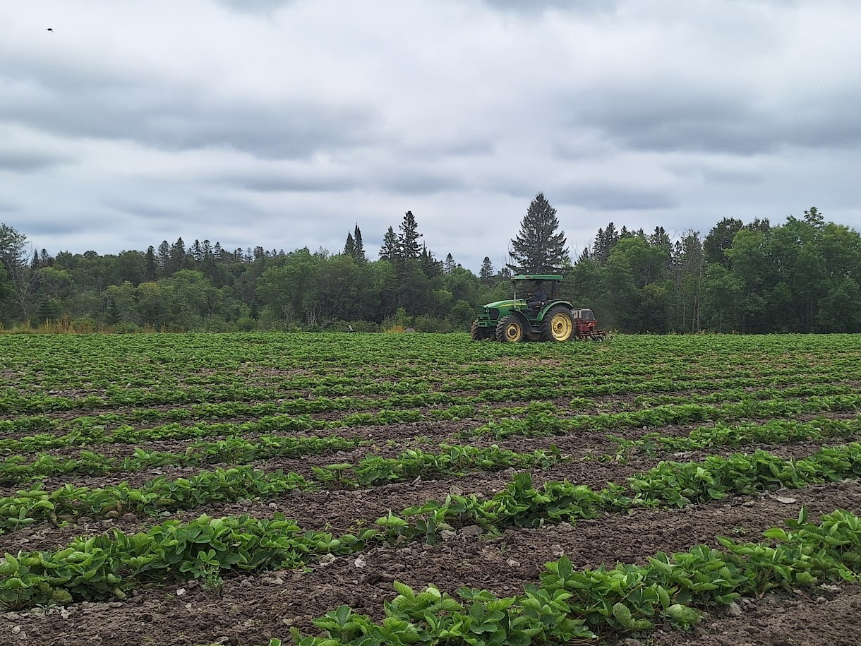
LESSONS
Local and Global Food Impacts
Past, Present and Future of First Nations Agriculture
Honoring Our Relationship with Mother Earth
Food Sovereignty
FIRST NATIONS AGRICULTURE

Slide 23

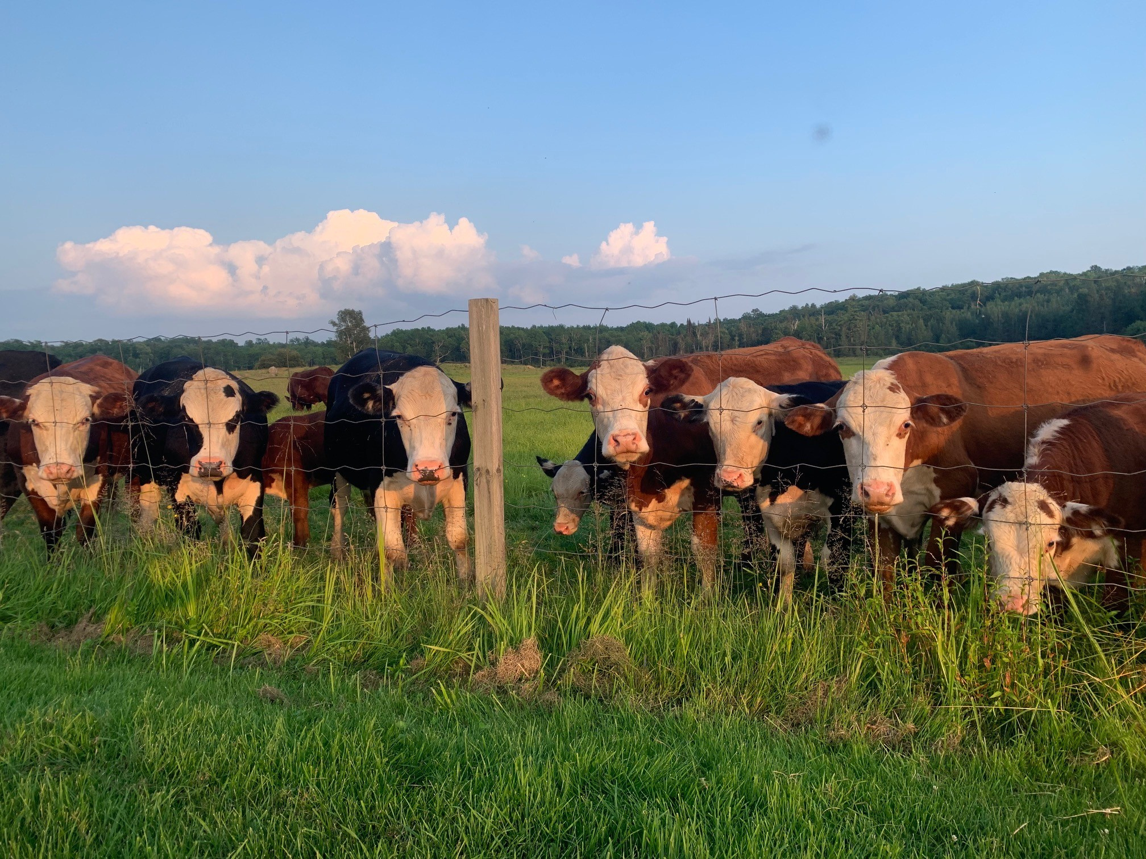
FIRST NATIONS AGRICULTURE
Future of Indigenous Agriculture
Indigenous agriculture teaches us that caring for the land means caring for each other, future generations, and the environment. By learning from Indigenous knowledge and sustainable practices, we can build healthier communities and a more respectful relationship with the Earth

Slide 24
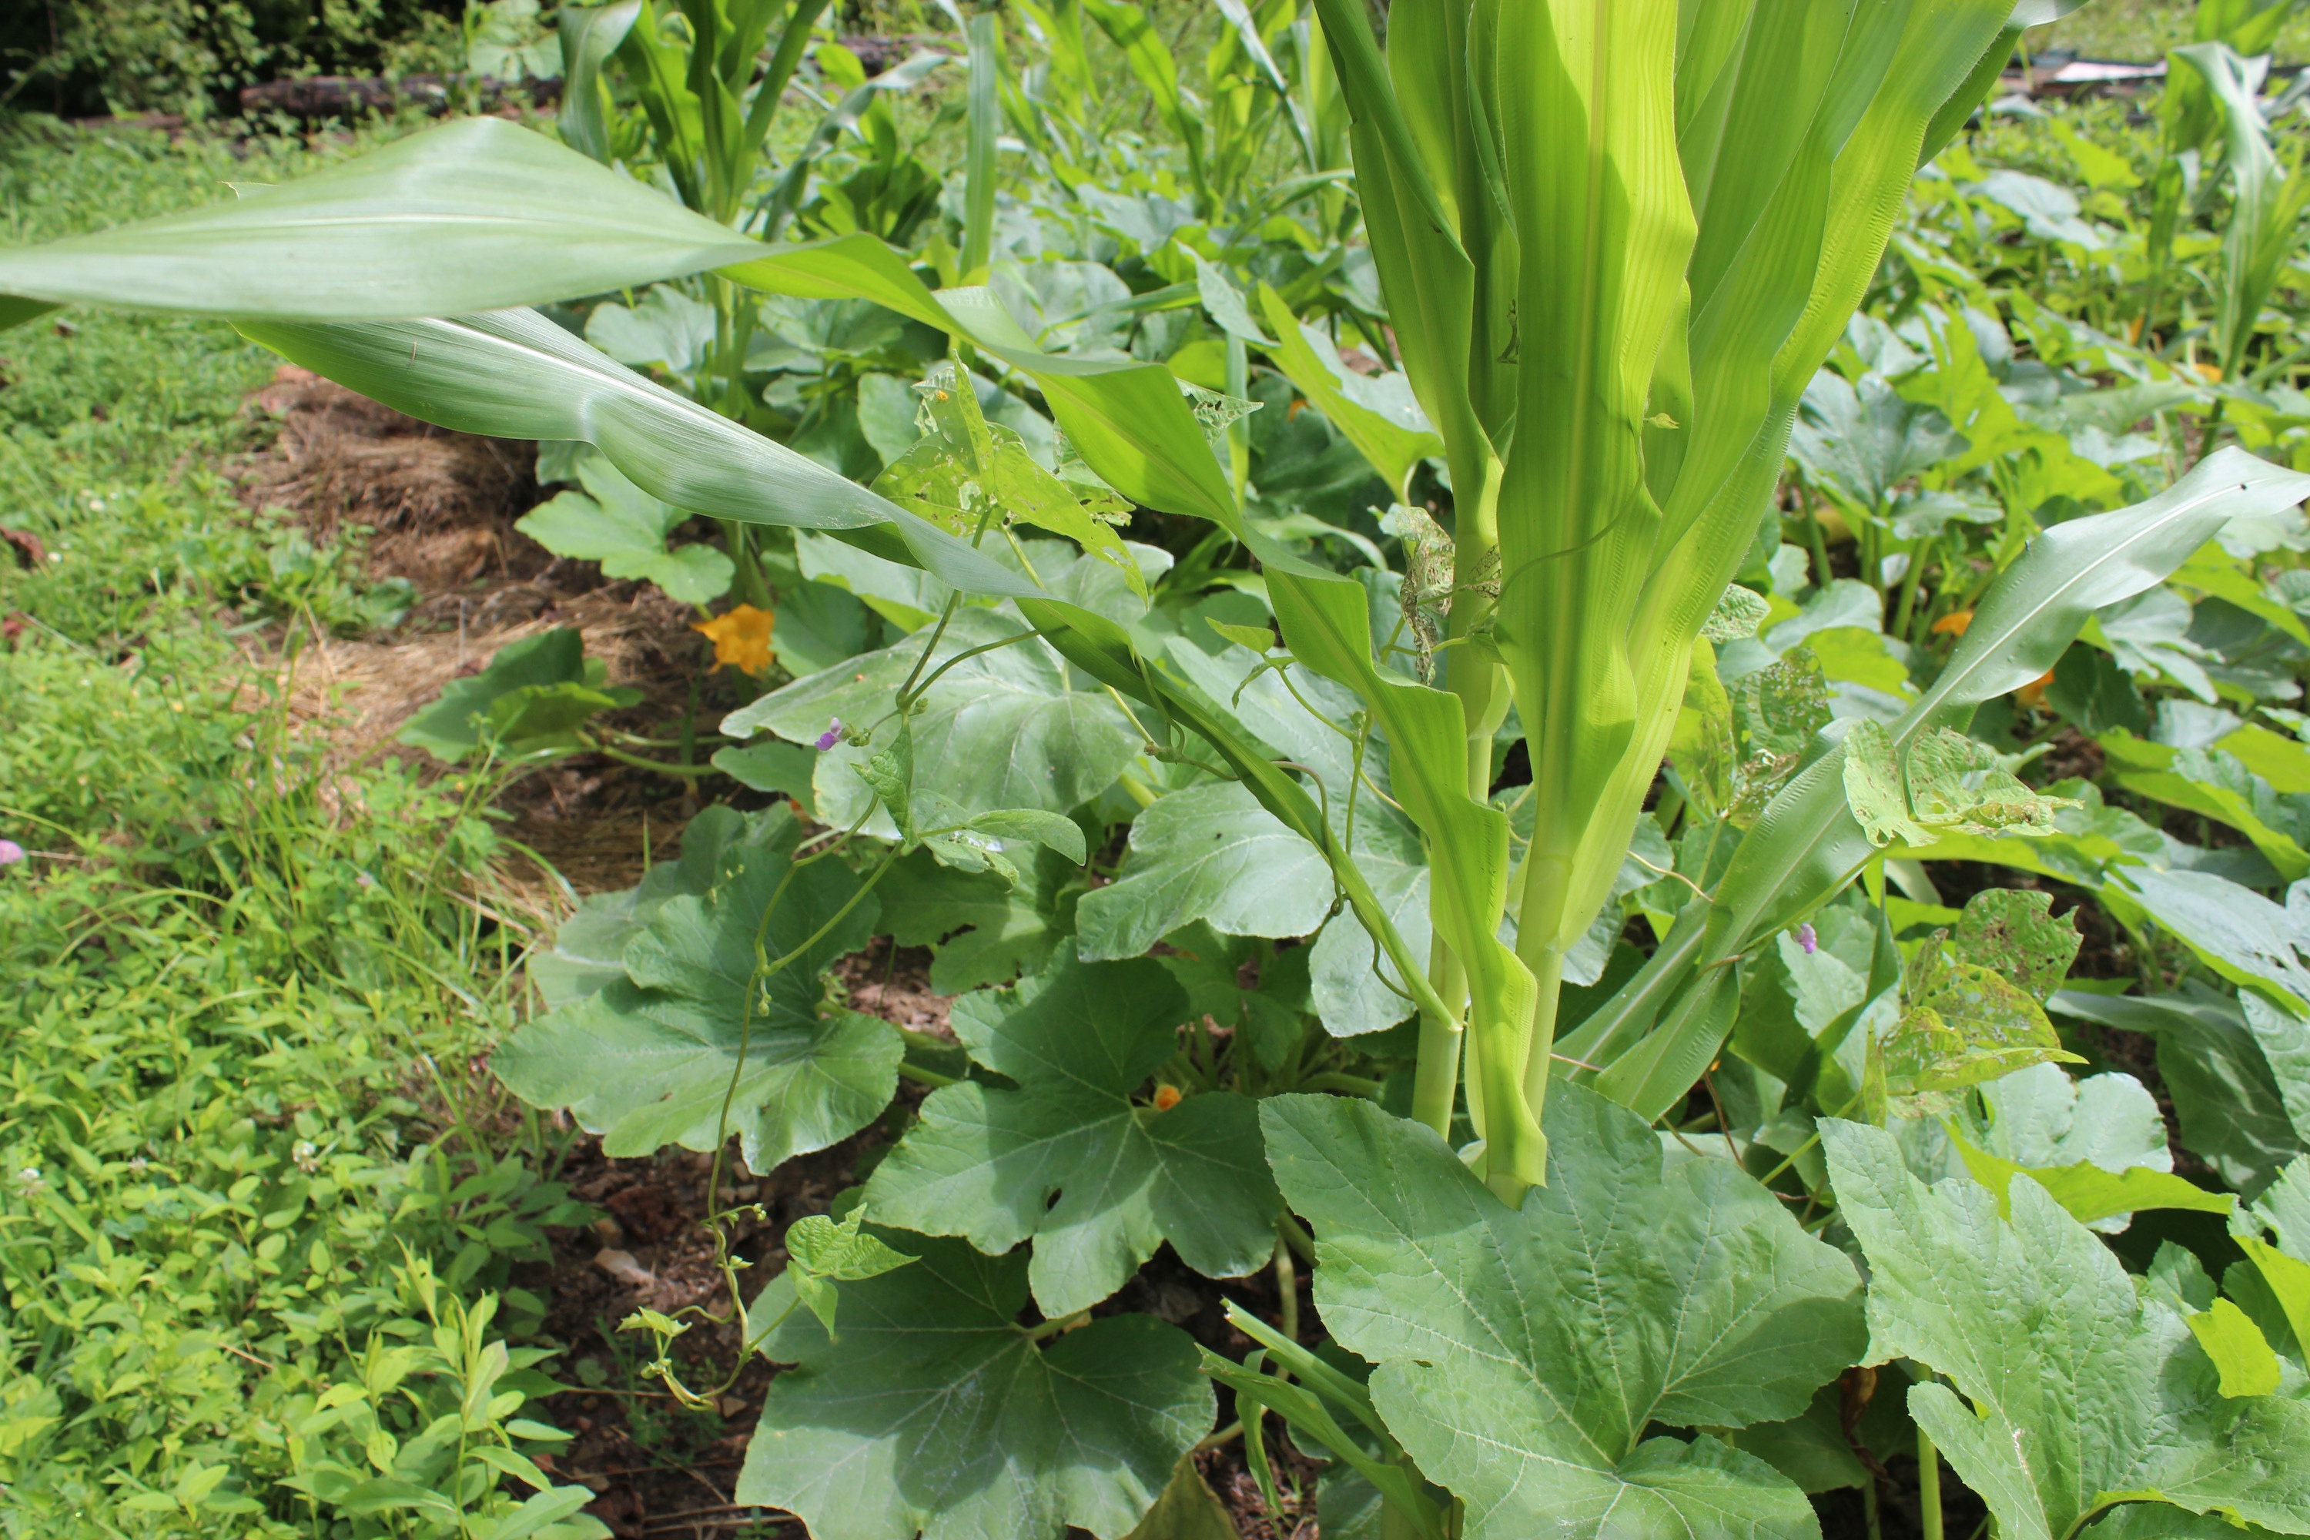

Thank You
JOBRIEN@FIRSTNATIONSAG.CA
WWW.FIRSTNATIONSAG.CA

Slide 25





Partnering…

Slide 26
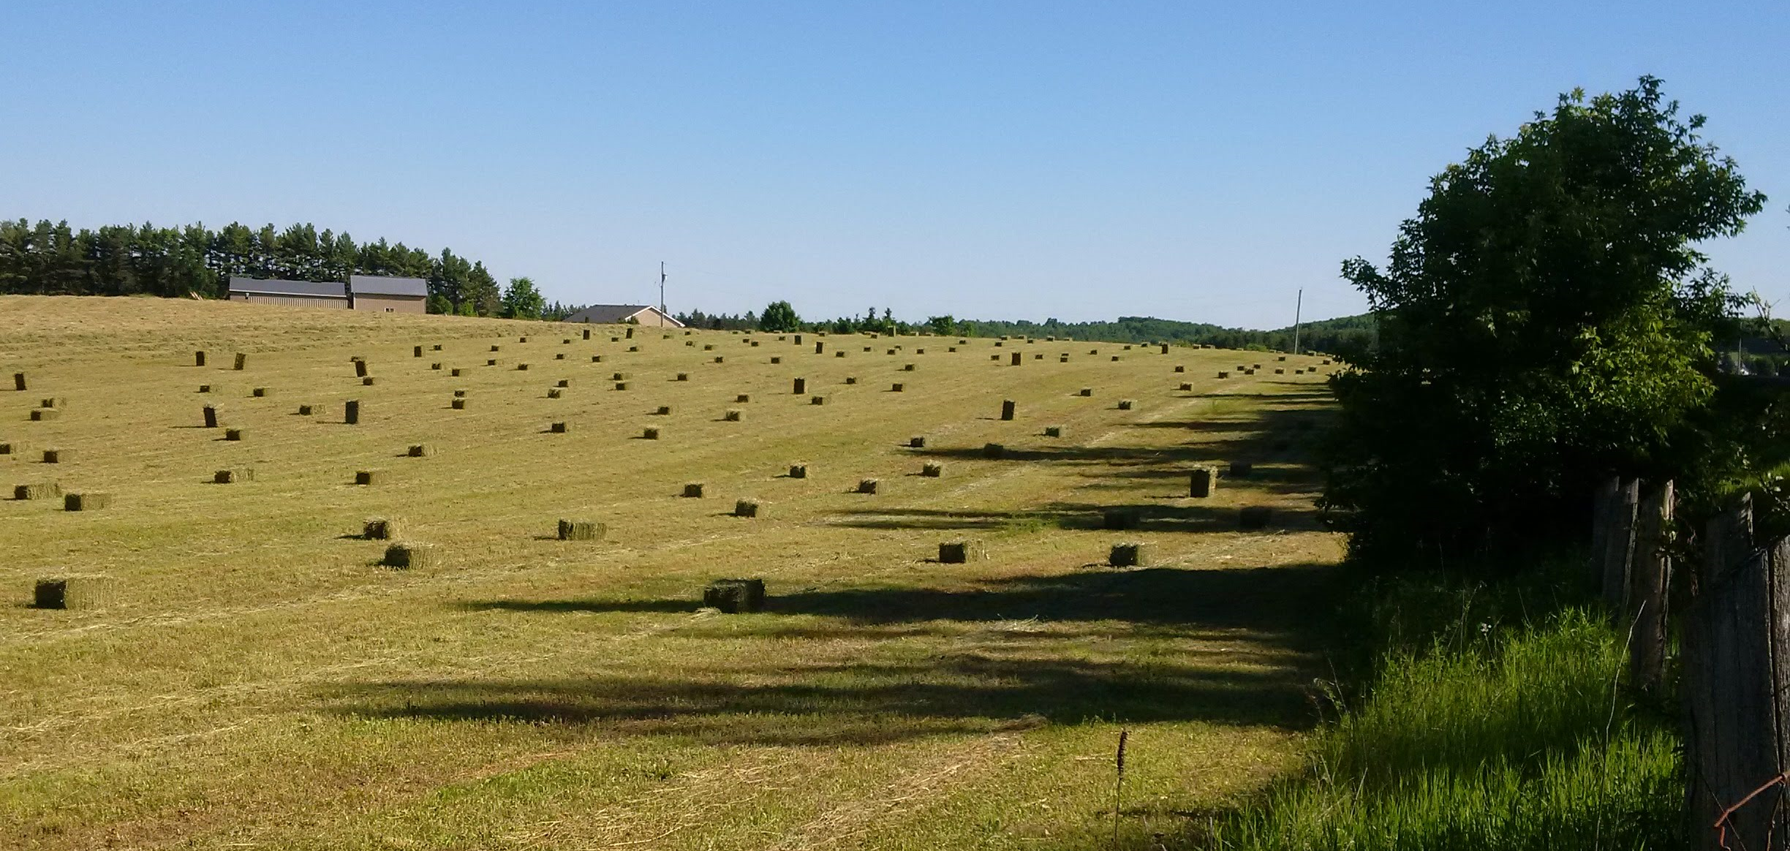
Questions ?

