Slide 1
Evolution of First Nations Emergency Management
AFN Management Forum – Chief’s Committee on Emergency Management
March 6th, 2024

Slide 2
Purpose
Provide an overview of Indigenous Services Canada’s role in Emergency Management: Emergency Management Assistance Program
Provide an overview of Select Evolving Emergency Management Initiatives:
AG Management Response Action Plan
Multilateral Agreements

Slide 3
ISC’s Emergency Management Assistance Program (EMAP)
EMAP
Response
Capacity Enhancement
Mitigation & Preparedness
Recovery
Engagement / Governance
FireSmart & Fire Suppression
The department provides direct funding to First Nation communities to strengthen resiliency, prepare for hazards and respond to them using the four pillars of emergency management

Slide 4
Emerging Trends & Pressures
Key drivers are working in tandem with the changing nature of emergencies in Canada that are driving the evolution of the program.
Past and Present Wildfire Seasons
Climate Change
First Nation Priorities
Canada’s emergency management system is being challenged by the evolving nature of emergencies due to climate change.
First Nation leaders have expressed a desire to have more autonomy over emergency management services.
Succession and anticipated continuance of record-breaking wildfire seasons
Health/Social Emergency Management
Service Transfer Mandate
EMAP Eligibility
Indigenous Services Canada is mandated to transfer the care and control of services to self-determining First Nation communities.
Expansion of EMAP eligible communities especially in the North to address existing gaps
The addition of health and social emergency management to EMAP’s terms and conditions has evolved the programs scope.
Other Government Department Priorities
Public Safety’s Emergency Management transformation and other key priorities.

Slide 5
2024 Wildfire Season & Preparedness
Preliminary forecasts indicate that the upcoming wildfire season has the potential to be once again significant and challenging.
Ensuring that First Nations are supported in their efforts remains our top priority.
EMAP has developed a First Nation
community highest risk list for
each region to ensure those with the
greatest need are supported.
ISC continues to collaborate with First Nations, First Nation organizations, and key
government stakeholders to ensure a solid
preparedness strategy, and that lessons
learned from past season are incorporated
into present efforts.
Preparedness and Planning in the NWT
With Indigenous and Northern partners driving the conversation, ISC, PSC and CIRNA will continue to support emergency management efforts and preparedness initiatives in the North:
Continued focus on building relationships with Indigenous partners based in Self-determination.
Continued support for community efforts in Prevention, Mitigation and Preparedness as a key element of Climate change leadership.
Working collaboratively with Indigenous, Territorial and Federal partners, develop a long-term strategy to address culturally appropriate emergency management service gaps in the North.

Slide 6
Emergency Management Transformation
To respond to growing pressures, EMAP must further evolve. EMAP continues to seek innovative methods to transform the program in ways that benefit First Nations directly.
Management Response Action Plan
The Office of the Auditor General (OAG) issued seven recommendations.
ISC has fully embraced these and begun implementing a comprehensive Management Response Action Plan.
Short-term
Medium-term
Multilateral Agreements
Replace current bilateral agreements with multilateral agreements and build long-term capacity in EM.
EM Transformation
Program adjustments that are within current funding and authorities.
Internal Evaluation
Indigenous Services Canada is in the process of conducting an internal evaluation of both EMAP and Indigenous Community Support Fund to inform the future of Indigenous Services Canada programs and policies.
Long-term
Deeper EM Transformation
Consider deeper transformative changes to Indigenous Services Canada’s EM approach based on engagement with First Nations partners and analysis of EMAP’s strengths and gaps.

Slide 7
OAG & Management Response Action Plan
In response to the Office of the Auditor General report, Indigenous Services Canada has created a Management Response Action Plan, which lays out the department’s intended approach to address each recommendation:
Office of the Auditor General Report Recommendations
Risk-Based Approach
Unfunded Structural Mitigation Projects
Emergency Management Plans
Emergency Management Coordinators
Service Agreements
Performance Indicators
Comparable and Culturally Appropriate Emergency Management Services

Slide 8
First Nations Steering Committee- First Nations Engagement
Co-chaired with the Assembly of First Nations.
Intended to inform, oversee, and provide guidance on Indigenous Services Canada’s actions to respond to the Auditor General’s report and recommendations.
Committee Members are predominantly current Emergency Management Coordinators (or similar) in First Nation Communities and Tribal Councils.
At least one representative from each of the 9 Indigenous Services Canada regions.
Made up of First Nations representatives across Canada with emergency management experience identified by the Assembly of First Nations and Indigenous Services Canada staff.
Committee is supported by advisors from ISC-Regional Offices, ISC-Community Infrastructure Branch, and Public Safety.
Meetings occur bi-weekly and started October 12.
Structural and Wildland Firefighting
Health Emergency Services
Canadian Armed Forces & Royal Canadian Mounted Police
Members have experience in:
Housing
Human Resources
Pandemic Response

Slide 9
Auditor General Report: Indigenous Services Canada Response Updates
Indigenous Services Canada accepted the AG’s findings and agreed with the seven recommendations laid out in the report.
Updates on the status of Indigenous Services Canada’s response are as follows:
Recommendation | Key Milestones | Due Date
Risk-Based Approach | Existing risk-based formula reviewed and developed responses AG Steering Committee engaged on numerous occasions Reponses being finalized for April 1 implementation | April 2024
Unfunded Structural Mitigation Projects | Number of unfunded structural mitigation projects reduced to 51 working towards funding all projects. Engaged First Nations to determine priority projects | April 2028
Service Agreements | Developed regional plans or timelines to advance conversations with FNs and PTs | April 2025
Emergency Management Coordinators (EMC) | Identified high risk communities using forthcoming risk-based approach Engaged the Steering Committee | April 2024

Slide 10
Auditor General Report: Indigenous Services Canada Response Update (continued)
Recommendation | Key Milestones | Due Date
EM Plans | Developed a national and reginal template Shared with First Nation partners from feedback National and regional plans updated and in final approvals process | April 2024
Performance Indicators | Reviewed current performance indicators to identify gaps. Developed new indicators, aligned to UN Sustainable Development Goals. Engaged First Nation partners | March 2025
Comparable and Culturally Appropriate EM Services | Assessing if, and how, the department defines and assesses comparability, culturally appropriate services. Engaged First Nations Steering Committee Developed draft service standards and After-Action Report template – reviewed by the Steering Committee and the ISC regions and in final review process | April 2024

Slide 11
Multilateral Emergency Management Service Agreements
Multilateral Emergency Management Service Agreements are a mechanism to formalize First Nations-led EM and clarify roles and responsibilities of all partners. Through a more holistic approach, all partners can better manage risks at the local level and strengthen collective resilience through collaboration.
Formalize partnership in decision-making and implementation mechanisms.
Means to ensure the implementation of local knowledge, solutions, and culturally appropriate emergency management services and;
Build enhanced capacity within all pillars of emergency management.
Co–developed agreements that are inclusive of First Nations as full and equal partners from design to
delivery.

Slide 12
Supporting First Nations-led Emergency Management through Multilateral Emergency Management Service Agreements
First Nations partners identify the emergency management supports needed to formalize and enhance capacity within all pillars of emergency management. Multilateral Emergency Management Service Agreements May:
Enhance collaboration through a multi-partite process
Provide funding to bolster work in all four pillars of emergency management
Identify and seek resources for the capacity needs of communities for effective emergency management service delivery
Improve risk assessment and emergency preparedness, response, recovery, and mitigation

Slide 13
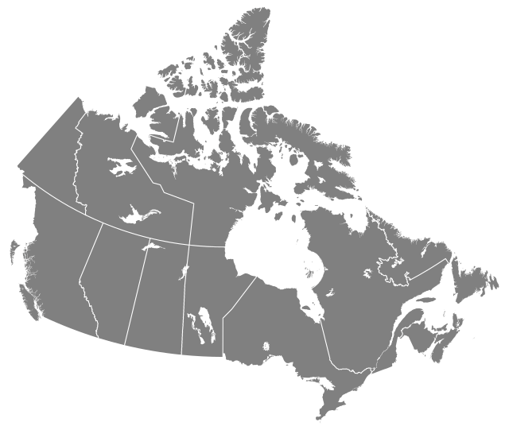
National Overview of the Status of Multilateral Agreement Discussions
YUKON
Emergency Management Forum February 2024 – Kick-off for introduction to multilateral discussions
NORTHWEST TERRITORIES
Identifying avenues to engage with First Nations on Multilateral Agreements
QUEBEC
Identifying avenues to engage with First Nations on Multilateral Agreements.
BRITISH COLUMBIA
First Nations Leadership Council, Canada, BC actively engaged in advancing work to support the development of a new multilateral agreement.
First Nations Leadership Council developing negotiation models.
ATLANTIC
Engagement with FNs and Provincial Governments ongoing in all provinces with growing interest and commitments to engage further.
MANITOBA
Establishing shared governance model to advance a multilateral agreement.
ONTARIO
Assembling a multilateral roundtable to develop the governance structure of a future multilateral agreement.
ALBERTA
Organizing pre-engagement sessions to assess First Nations interest and capacity to discuss multilateral partnerships.
SASKATCHEWAN
5 Tribal Councils currently engaging First Nations on emergency management models and costing. Interest in expanding discussions further

Slide 14
Next Steps
Ensuring that First Nations are supported in their efforts remains our top priority and we will continue to collaborate with all partners to ensure solid preparedness strategies are in place
Continue work to address the Auditor General’s Recommendations focusing on engaging with First Nation partners
Continue work towards multilateral partnership agreements

