Slide 1
Update on Panel 13 Report Recommendations
AFN SCA December 2024

Slide 2
Background: Resolution & Objectives
Resolution
Objectives
AFN Resolution 13/2020 passed in December 2020.
Independent review to address gender & sexual orientation-based discrimination.
Title: "Becoming A Role Model in Ending Sexual Orientation and Gender-Based Discrimination Within the Assembly of First Nations."
Goal: Eradicate violence, sexualized violence, and bullying within the AFN.
Panel 13 final report presented at July 2023 AGA.

Slide 3
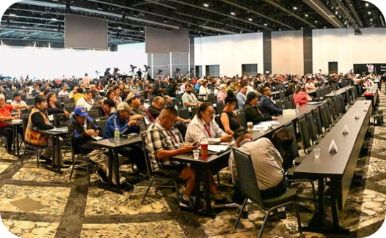
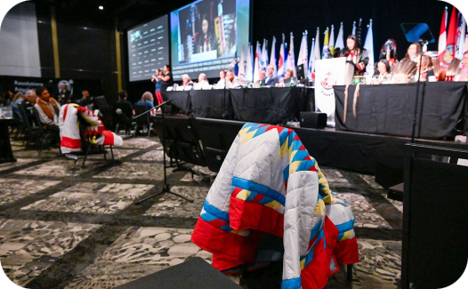
Panel 13: Zero-Tolerance Policy
Event Registration
Code of Conduct
First Implementation
One recommendation of the Panel 13 Report is to adopt a Zero-Tolerance policy at AFN events, requiring attendees to sign an acknowledgment at registration.
A Code of Conduct for Event Participants has been implemented and included in the registration package for all AFN events.
This new policy was first introduced at the December 2023 Special Chiefs Assembly, ensuring clear guidelines for all participants.
Notes:
7

Slide 4
Training Efforts: HR Programs
1
Management
2
HR Staff
AFN Managers completed a comprehensive training program covering key topics like gender discrimination, harassment prevention, and leadership integrity.
AFN HR staff attended a training session called, "Human Resources in an Era of Reconciliation & Decolonization."

Slide 5
Mental Wellness Initiatives
Access to Services
Training
More staff are participating in both one-time consultations and formal counseling sessions offered by the Mental Health Support Counsellor (MHSC).
MHSC completed training in Body-Oriented Trauma Counselling, focusing on trauma storage, stabilization, and healing strategies.
Data Collection
Data is being gathered confidentially to identify staff wellness patterns and proactively address key issues affecting the workforce.

Slide 6
Health Benefits: Proposed DEI Changes
Education
The AFN HR team participated in the National Benefit Administrator Education Session, focusing on mental health and women’s health issues in the workplace.
Proposed Benefit Enhancements
Proposed changes include increasing mental health coverage, expanding women’s health services, and introducing Gender Affirmation Coverage.
Plan Review
A meeting is scheduled with AFN's insurance broker in December 2024 to discuss the proposed benefit plan enhancements.

Slide 7
Accessibility Initiatives: ACA Compliance
Compliance Review
AFN is committed to preparing and publishing accessibility plans, progress reports, and feedback processes to ensure compliance with the Accessible Canada Act (ACA).
Barrier Identification and Removal
Efforts are underway to identify, remove, and prevent accessibility barriers in line with the seven priority areas of the ACA, including employment.
Documents
AFN is revising HR documents to ensure they are accessible and easy to understand, minimizing the need for unique accessibility requests.

Slide 8
JHSC: Training Updates
Basic Training
Specialized Training
The JHSC meets regularly to discuss workplace health and safety matters, with all members completing basic training.
Some members have received additional training in violence and harassment prevention, with others scheduled to complete it soon.
Data Collection
Data is being gathered confidentially to identify staff wellness patterns and proactively address key issues affecting the workforce.

Slide 9
Policy Revisions
AFN has reviewed and revised its HR policy manual to align with recommendations from the Panel 13 Report.
Updates include enhancing the Workplace Harassment and Violence Prevention Policy, improving the Return-to-Work Policy, and revising the IDEA Policy.
The draft policies have been shared with the the First Nations Financial Management Board (FMB), and feedback is expected by early 2025.

Slide 10
Workplan & Steering Committee
1
Formation
A dedicated steering committee was formed to oversee the implementation of the initiatives.
2
Develop
A detailed workplan was developed with timelines, responsibilities, and metrics.
3
Meetings
Several meetings have taken place in 2024, with one scheduled following the Special Chief’s Assembly.

Slide 11
Funding Restraints
Some initiatives delayed due to funding constraints.
Significant costs for Indigenous-specific training programs.
Exploring alternative approaches to fulfill Panel 13 Report recommendations sustainably.

Slide 12
Conclusion
Ongoing Efforts
Commitment
Growth
AFN is actively addressing gender- and sexual orientation-based discrimination through training, wellness support, and policy revisions.
The AFN continues to focus on fostering a respectful, inclusive, and equitable workplace for all members.
AFN remains committed to implementing essential changes and ensuring that all members feel valued and supported in their roles.

