Slide 1
Accessibility and Disability First Nations Persons with Disabilities Survey
November 2, 2023

Slide 2
Disability and Accessibility: First Nations Persons with Disabilities Survey
Introduction
The Accessible Canada Act (ACA) https://www.canada.ca/en/employment-social-development/programs/accessible-canada.html was introduced in 2019 and provides an opportunity to further the rights of persons with disabilities and to remove barriers.
The Assembly of First Nations (AFN) Resolution 10/2018 Resources for Engagement on Distinct First Nations Accessibility Legislation provides a mandate to work with Employment and Social Development Canada (ESDC) to secure resources to support First Nations persons with disabilities (FNPWD) and to help build regional capacity.
With the Guidance of First Nations Persons with Disabilities and Knowledge Keepers the AFN developed a a culturally sensitive distinct First Nations accessibility framework that will help to build fully accessible First Nations governments.

Slide 3
Elements to Inform A Distinct First Nations Accessibility Framework
The Advancing Accessibility in First Nations on Reserve project, served to inform draft elements of A Distinct First Nations Accessibility Framework.
A National Knowledge Keepers Circle guided a responsive engagement process and included First Nations persons with disabilities (FNPWD) and regional and First Nations voices.
To understand what is needed to build accessible First Nations, we recently took a poll to get a pulse on the status of accessibility/ disability in First Nations with guidance from the Knowledge Keepers Circle.
The Draft Framework is held up as a living document guided by First Nations traditional laws that work to unite collaboration and understanding with all levels of governments in alignment with Natural Law.
Notes:
In partnership with ESDC’s Accessible Canada Directorate and the Advancing Accessibility in First Nations on Reserve project, the AFN also undertook the development of elements to inform A Distinct First Nations Accessibility Framework. The framework is inclusive of the voices of First Nations citizens residing away from their respective First Nations to access services and programs that currently do not exist in First Nations.
The AFN continues to advocate that the momentum established in the Advancing Accessibility in First Nations on Reserve project and the data gathered to date helped to inform elements of Distinct First Nations Accessibility Framework and serves as strong foundation and rationale for securing sustained funding to build fully accessible First Nations governments. The Knowledge Keepers Circle and many other voices nationally and across the regions contributed to form the draft elements of a Distinct First Nations Accessibility Framework and it is to be understood as a living document guided by First Nations traditional laws that work to unite collaboration and understanding with all levels of government for the benefit of everyone. The framework is based on the premise that all policy is disability policy, and that every budget, policy, and service decision is informed by an accessibility and disability inclusion lens.
The First Nations ancestors foretold of a time when the traditional and spiritual teachings would be revived to heal and rebuild the Nations, transform society, and all members of the human family. In the 21st Century, these traditional and spiritual teachings are relevant to building fully accessible First Nations and First Nations governments. It is timely that these teachings are used as the foundation for achieving our vision.

Slide 4
Disability and Accessibility: First Nations Persons with Disabilities Survey
AFN Disability and Accessibility Poll
We have finalized a short poll geared toward First Nations Persons with Disabilities (whether or not they have a formal diagnosis) to get a pulse on some of the realities of disability and accessibility in First Nations across Canada.
This poll was developed with the guidance and approval of our AFN Accessibility Knowledge Keepers Circle. The insights gained from these surveys will be instrumental in informing the development of better accessibility policy and legislation.

Slide 5
Disability and Accessibility: First Nations Persons with Disabilities Survey
Access is everyone’s right:
All people deserve fair and equitable access to opportunities, environments, and resources and some people face more barriers than others to access these birthrights.
To help remove barriers faced by individuals, it is necessary to understand who is facing difficulties, and why are they facing these challenges.
Therefore, we would like to invite your important participation in completing all or portions of this survey that are most relevant to you and to your experience.
The goal of the survey is to gather basic information on the different disability conditions and the types of barriers First Nations individuals may be experiencing, as well as the programs and services that are working well and providing accessible inclusive environments.

Slide 6
Disability and Accessibility: First Nations Persons with Disabilities Survey
20-minute survey
Your voice and your experience will shape and guide the development of a that will help to build fully accessible First Nations governments. culturally sensitive distinct First Nations accessibility framework
Who can fill in this survey?
We are very open and interested in any knowledge or experiences you would like to share about disability and accessibility in First Nations, please feel welcome to share as much as you wish.
Protecting your privacy
In accordance with traditional sharing practices and respect for First Nations personal privacy, we remain committed to protecting your privacy and we understand that your participation in this engagement is completely voluntary.

Slide 7
Disability and Accessibility: First Nations Persons with Disabilities Survey
The Links to the Poll:
English: https://www.surveymonkey.com/r/6V3WBRZ
French: https://www.surveymonkey.com/r/2T35JQB

Slide 8
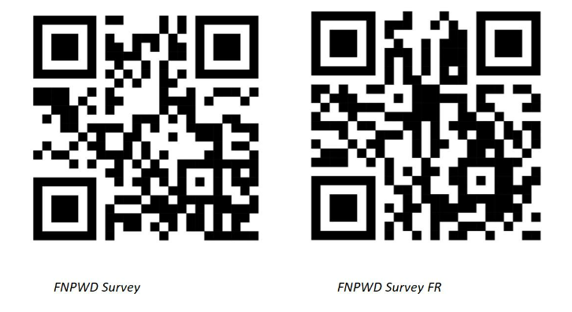
Disability and Accessibility: First Nations Persons with Disabilities Survey

Slide 9
Disability and Accessibility: First Nations Persons with Disabilities Survey
Please feel welcome to visit the
AFN Accessibility Hub Excellence
Link for our Surveys
https://afn.ca/a-first-nations-accessibility-hub-of-excellence/
Watch for new posting of resources and tools and information to
help build fully accessible First Nations.
MIIGWETCH!

