Slide 1
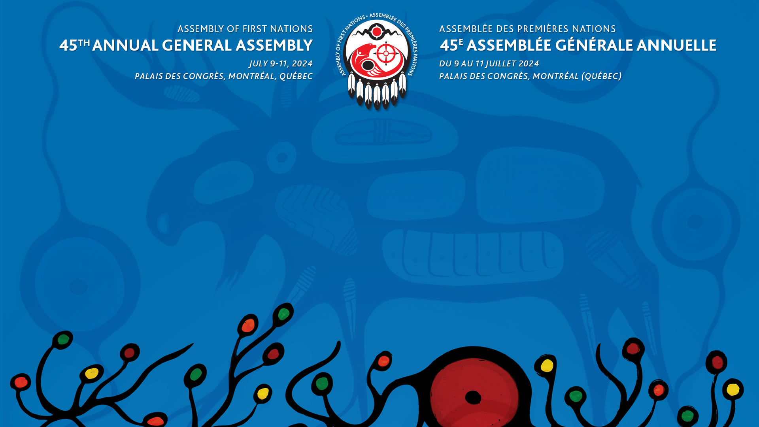
First Nations Identity Rights and Citizenship
– Dialogue Session
Assembly of First Nations
Annual General Assembly
Montréal, QC
July 9 – 11, 2024

Slide 2
Overview
First Nations Citizenship
Background
AFN Mandates
Bill C-53
Background
AFN Mandates
Advocacy
Next Steps

Slide 3
Background
Since the Royal Commission on Aboriginal Peoples released its report in 1996, First Nations have consistently taken the position that they have an inherent right to control their citizenship. The right is said to be “inherent” because “it is derived not from the Canadian Constitution or Canadian law, but from the existence of First Nations as independent cultural, social, and political entities with their own laws and systems of government prior to European colonization of North America.”
This right is also now recognized in international law, at articles 9 and 33 of the United Nations Declaration on the Rights of Indigenous Peoples.

Slide 4
Background
Canada has incrementally removed certain discriminatory elements of the Indian Act through policy, regulatory, and legislative measures.
In 2017, the Government of Canada initiated Bill S-3, An Act to Amend the Indian Act in response to the Superior Court of Quebec decision in Descheneaux c. Canada (Procurer general).
Bill S-3, which was designed to remove all gender-based discrimination in the Indian Act, came into force in 2019. This Bill failed to address the broader denial of self-determination in the registration provisions of the Indian Act.

Slide 5
Background
In 2019 and 2020 the AFN published a series of discussion papers on transitioning to First Nations control of citizenship along with a guide to establishing membership codes.
In 2021, a group of plaintiffs launched a constitutional challenge (Nicholas v. AGC) to address ongoing inequities faced by individuals with a family history of enfranchisement under the Indian Act.
After a brief period of engagement, the Minister of Indigenous Services Canada introduced Bill C-38, An Act to amend the Indian Act (new registration entitlements), in Parliament to remedy the impacts of historical enfranchisement.

Slide 6
AFN Mandates
AFN Resolution 42/2022, Demand for Consultation on Amendments to the Indian Act (1985), calls on the Government of Canada to not table any legislative amendments until it has adequately consulted with First Nations and provided the necessary resources for community engagement.
Former AFN National Chief Archibald sent a letter to Minister Hajdu in March 2023 calling for the immediate withdrawal of Bill C-38.

Slide 7
Bill C-38
The amendments in the bill mean that individuals whose status under the Act was reinstated after enfranchisement can transmit status to their direct descendants to the same extent as individuals who were never enfranchised.
Currently, only women who were reinstated after being enfranchised for marrying non-status men can transmit status to their direct descendants to the same extent as individuals who were never enfranchised

Slide 8
Bill C-38
The bill also:
  repeals the term “mentally incompetent Indian” from the interpretation section of the Indian Act, replacing it with “dependent person”;
  permits persons to apply to have their names removed from the Indian Register; and
  entitles persons to have their names entered on the band list maintained by (SC for the band they were born into if they had ceased to be a band member as a result of marrying someone who was not a member of that band.

Slide 9
Implications for First Nations
Statistics Canada estimated that the removal of known sex-based inequities from the registration provisions of the Indian Act since legislative amendments in 2017 and 2019 could result in almost 256,000 newly registered persons by 2041.
Currently, First Nations can explore paths to assuming control of their membership under section 10 of the Indian Act or by negotiating self-governing agreements and modern treaties through Crown-Indigenous Relations and Northern Affairs Canada.

Slide 10
Indigenous Advisory Process
The IAP, which formally launched on November 20, 2023, brings together First Nations regional and national organizations to provide guidance to ISC on how to consult and cooperate with First Nations to address the second-generation cut-off.
The AFN is pursuing opportunities with ISC to support First Nations to engage in reforming elements of the Indian Act surrounding enfranchisement, deregistration, the second-generation cut-off, and to promote First Nations’ rights to self-determination over citizenship.

Slide 11
Next Steps
The AFN continues to monitor Bill C-38 and has called on the Government of Canada to provide adequate resources to all First Nations to engage with their community members.
The AFN is also participating in the IAP, the multi-partner engagement process on the second-generation cut-off in the Indian Act.

Slide 12
Background – Identity Claims
Individuals and communities making false claims of Indigeneity, resulting in rights assertions and obtaining resources/benefits, is an increasingly prevalent problem.
First Nations Inherent and Treaty rights are being impacted by groups, organizations, and individuals who are making illegitimate or unfounded rights assertions on the traditional and Treaty territories of First Nations.
These rights assertions, which in many cases are being legitimized by the Government of Canada, undermine First Nations Inherent and Treaty rights and are antithetical to reconciliation.

Slide 13
Rise in Unfounded Rights Assertions
Section 35 of the Constitution Act, 1982 recognizes and affirms the existing Aboriginal and treaty rights of the Aboriginal peoples of Canada, which includes the “Indian, Inuit and Métis peoples of Canada”.
In 2003, the Supreme Court of Canada (SCC) defined the test for establishing Métis section 35 rights in R v Powley, 2003 SCC 43.
First Nations have repeatedly rejected fraudulent assertions and condemned the rise of settler self-Indigenization.

Slide 14
The Duty to Consult
The duty to consult is a fundamental aspect of the relationship between the Crown and First Nations, reflecting the importance of respecting and protecting Aboriginal and treaty rights within the Canadian legal and constitutional framework.
First Nations have repeatedly asserted the lack of adequate consultation in Canada-driven processes.

Slide 15
Bill C-53, Overview
Bill C-53 provides for the recognition of MNA, MNS, and MNO as Indigenous governing bodies with a right to self-government under section 35 of the Constitution Act, 1982.
Bill C-53 also provides a framework for the implementation of treaties entered into by those Métis governments and Canada.

Slide 16
Recent Developments
Several recent developments have created uncertainty about the future of Bill C-53.
  On March 28th, the Federal Court ruled that the agreement with the MNA is too broad and must be revised.
  On April 17th, the MNS withdrew its support for Bill C-53.
While these are welcome developments, the broader issue of unfounded rights assertions remains outstanding, and is likely to come forward in different forms.

Slide 17
Bill S-14, Overview
Bill S-14, An Act to amend the Canada National Parks Act, would recognize members of the NunatuKavut Community Council (NCC) as “traditional land users” with statutory rights to engage in traditional activities within Akami-Uapishkᵁ, a National Park Reserve created pursuant to a Treaty between Canada and the Innu Nation.
Bill S-14 was introduced in the Senate in October 2023 and completed third reading in December 2023.
Bill S-14 is a prominent example of legislation being advanced by the Government of Canada without adequate consultation that facilitates illegitimate rights assertions.

Slide 18
AFN Mandates
Resolution #44/2023 - nationally amplify First Nations opposition to unfounded Métis rights assertions and the role of governments in recognizing these unfounded assertions.
Resolution #81/2023 - engage with First Nations to determine how Bill C-53 could be amended to ensure that First Nations inherent and Treaty rights are adequately protected.

Slide 19
AFN Advocacy
AFN advocacy throughout fall 2023 focused on Bill C-53, including supporting a demonstration day at Parliament Hill led by Chiefs of Ontario, providing testimony in Parliament, and raising awareness on social media.
The AFN convened virtual regional engagement sessions in Spring 2024 to discuss these emerging issues with First Nations Leadership.

Slide 20
AFN Advocacy
First Nations and the AFN continue to advocate for protections for First Nations rights from potential infringement.
This includes the lack of adequate consultation, the failure to obtain First Nations’ free, prior, and informed consent, and the consistent burden to prove inherent and Treaty rights and title.

Slide 21
Next Steps
The AFN will continue political advocacy to seek the withdrawal of Bill C-53 and the creation of a national consultation process. The AFN will continue to coordinate with regions to develop a national strategy to oppose unfounded rights assertions.
CIRNAC is engaging with First Nations throughout 2024-2025 to update Canada’s Federal Consultation and Accommodation Guidelines.
The AFN is looking to support First Nations in ensuring the federal approach to consultation and accommodation fulfills Canada’s duty to consult, aligns with First Nations inherent and Treaty rights and s. 35 rights, and fulfills UNDRIP.

Slide 22
Questions and Discussion

Slide 23
Contact Information
For additional information, please contact:
Natasha Beedie, nbeedie@afn.ca (Director of Rights and Governance)
Jordan Ames-Sinclair, jasinclair@afn.ca (Associate Director of Rights and Governance)

