Slide 1
Floods, Wildfires, Severe Storms, and Pandemics: Are First Nations Ready?
Community-driven disaster risk reduction
Etsuko Yasui, Ph.D.
Applied Disaster and Emergency Studies (ADES)
Brandon University, Brandon, Manitoba
Prepared for The 2nd National Emergency Management Forum
March 6, 2024, Gatineau, QC

Slide 2
Land Acknowledgement
Kintsugi—Art of repair
Notes:
https://traditionalkyoto.com/culture/kintsugi/

Slide 3
Who I am and why I am here
Born in Kyoto, Japan
Lived in Canada for over 25 years
Teaching Disaster and Emergency Studies at Brandon University for over 16 years
Two adult children + one dog
I am interested in community disaster planning
How communities manage vulnerability
How communities build capacity/resilience
How communities build relationships to achieve safe communities
How communities recover from disasters

Slide 4
How communities are doing in disaster recovery: Community-based organizations
A group of people initiating activities (Kobe earthquake, east Japan earthquake and tsunami, Brandon flood, Rapid City flood, etc...)
Communities of practice: a group of like-minded people working together to achieve community’s interests (Wenger, 2000: 5).
Emergent Norm Theory: To respond to unmet, unanticipated, or newly appearing needs, newly appearing groups and organizations will emerge (Dynes and Quarantelli 1968; Neal and Phillips 1995).
Notes:
Phillips, Brenda D.. Disaster Recovery (p. 47). CRC Press. Kindle Edition.

Slide 5
Gaps in the existing knowledge and practice
Four phases of disaster and emergency management
Risk (risk assessment and disaster & emergency management)
Hazards (physical events = scientific/engineering/technological solutions)
Vulnerability (Vulnerability analysis is not sufficient by itself)
Exposure (physical proximity vs social/historical conditions)
Capacity (Adaptive capacity? Resilience?)
Communities (excluded?, collective vulnerability, community cohesion)

Slide 6
Gap 4: Community experiences of disasters through Indigenous lenses: What does a disaster mean to you?
There was no “natural” disaster (Indigenous knowledge of coping)
Human-made disasters (loss of lives and land)
Ceremonial activities for the loss and impact (not part of DEM)
Forced relocation, displacement, misplaced, (…from their land)
Missing (residential school) (search and rescue)
No planned recovery but expect to recover
Health consequences: mental health, emotional injuries, trauma
Risk reduction: risk is a cultural product (social breakdown)

Slide 7
Can we fill in these gaps?: We need to plan for coping, managing, living with disasters
Disasters as part of everyday life (Hewitt, 1997).
Recovery needs more attention (who plans? what does recovery mean?)

Slide 8
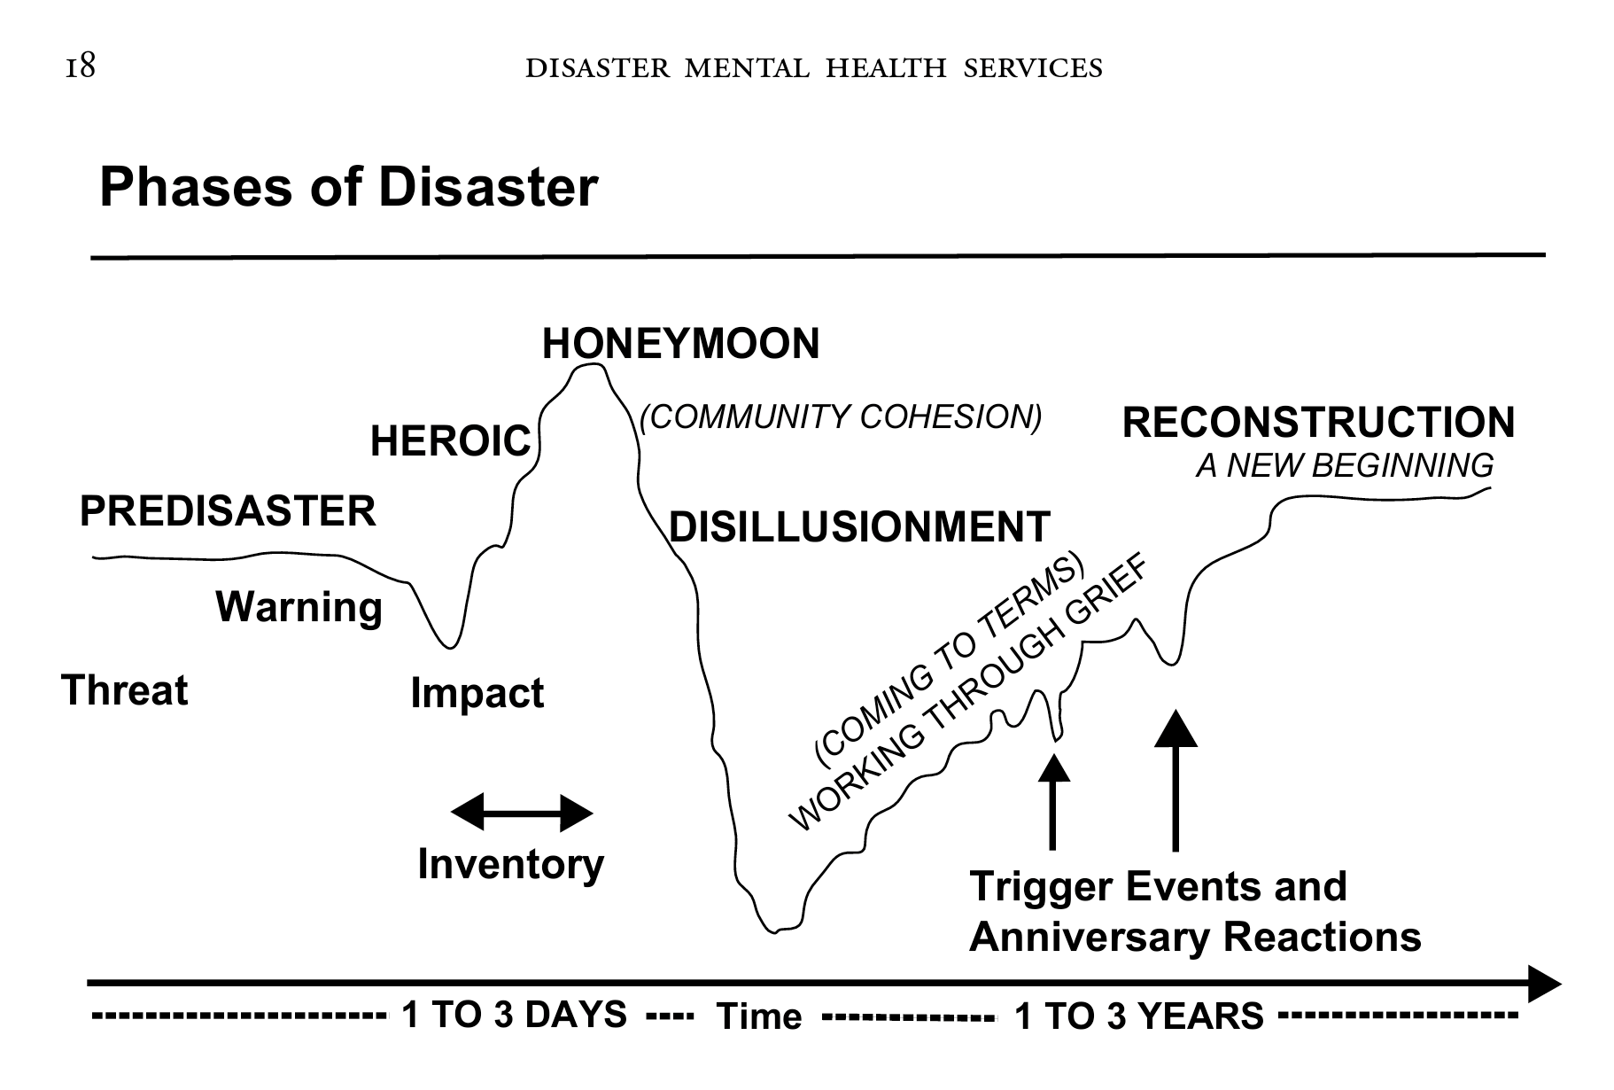
Recovery is the beginning of hardship
Emotional life cycle
The disaster impact vs mental health impact
Myers, D., & Wee, D. (2004). Disaster Mental Health Services: A Primer for Practitioners (1st ed., Vol. 27). London: Taylor and Francis. https://doi.org/10.4324/9780203646908 in page 18

Slide 9
The current state of communities: Are we recovering from disasters?
Flooding, wildfires, hurricanes, heat waves, droughts, COVID-19, etc. (what about the residential schools? Colonization? Have we recovered?)
People need to recover from a disaster first in order to be able to prepare for future disasters
Pre-event disaster recovery (plan for recovery before an event)
Build back better recovery: Leave no one behind
Disaster as collective experience: Community is the key
Co-existence of vulnerability, resilience, and DEM cycle: ”Everything, Everywhere, All at Once”

Slide 10
How do Indigenous communities manage disasters?
What do Indigenous community-based organizations do to help their communities?

Slide 11
Survey: Understanding EM. Org. activities
Indigenous people and EM organizations (community-based orgs.)
Learn from Indigenous organizations of how they care for the communities
Survey emailed to about 20 organizations across Canada (last fall, 2023)
What do you do to help communities in disasters and emergencies?
What resources are needed?

Slide 12
Survey sample questions
What specific focus/expert services does your organization offer to communities (ex., emergency response, fire emergencies, disaster drills, community disaster planning, etc.)?
Are there any services your organization does not offer? (ex. Financial aid, housing recovery, case management, etc.)
What type of resources (money, people, equipment, etc.) does your organization wish to have?
During the COVID-19 pandemic, what activities did your organization mainly involved in? (ex. Safety control for vaccine centers, border traffic control, assisting senior homes, etc.)
What areas does your organization want to grow more? What is needed to achieve such growth?

Slide 13
Can I send (email) you the survey (again)?
yasui@brandonu.ca

Slide 14
Community’s recovery approach: Desire to connect and bond
The 2011 Great East Japan earthquake (dead: 15,900, missing: 2,523, total: 18,423)
Beach cleaning (looking for any items for the missing family members).
The wind phone (connect with the loved ones)

Slide 15
Kaze no Denwa （風の電話） (the Wind Phone) (not connected)
https://www.kenzai-navi.com/makers/syousei/news/11138
Notes:
Covid, Asian Tsunami,

Slide 16
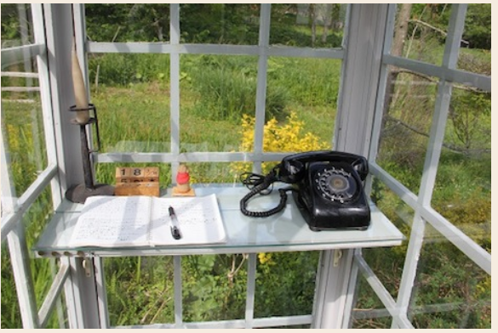
Kaze no Denwa（風の電話）(the Wind Phone): in Otsuchi town, Japan（大槌町）
https://plaza.rakuten.co.jp/nyankoroom/diary/201603120000/

Slide 17
Kaze no Denwa（風の電話）(the Wind Phone): A ripple effect
https://www.youtube.com/watch?v=mquUyAG4T7k

Slide 18
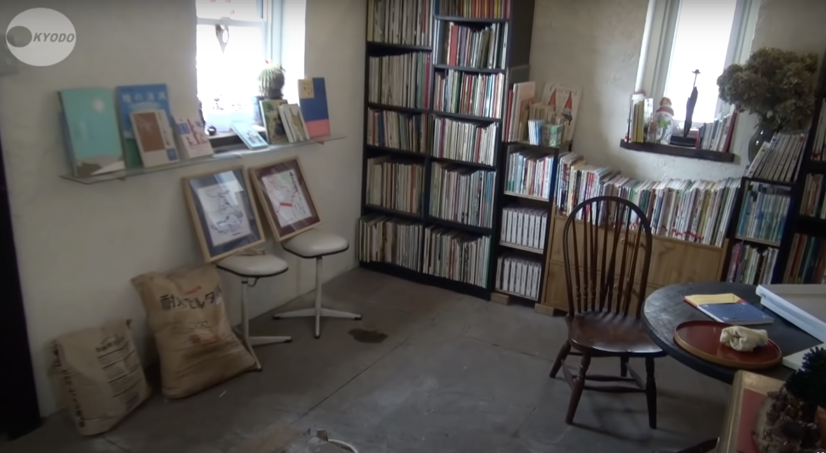
- Mourning procee - The Wind Phone - The Forest Library - Counseling room - Music concert - Gathering space

Slide 19
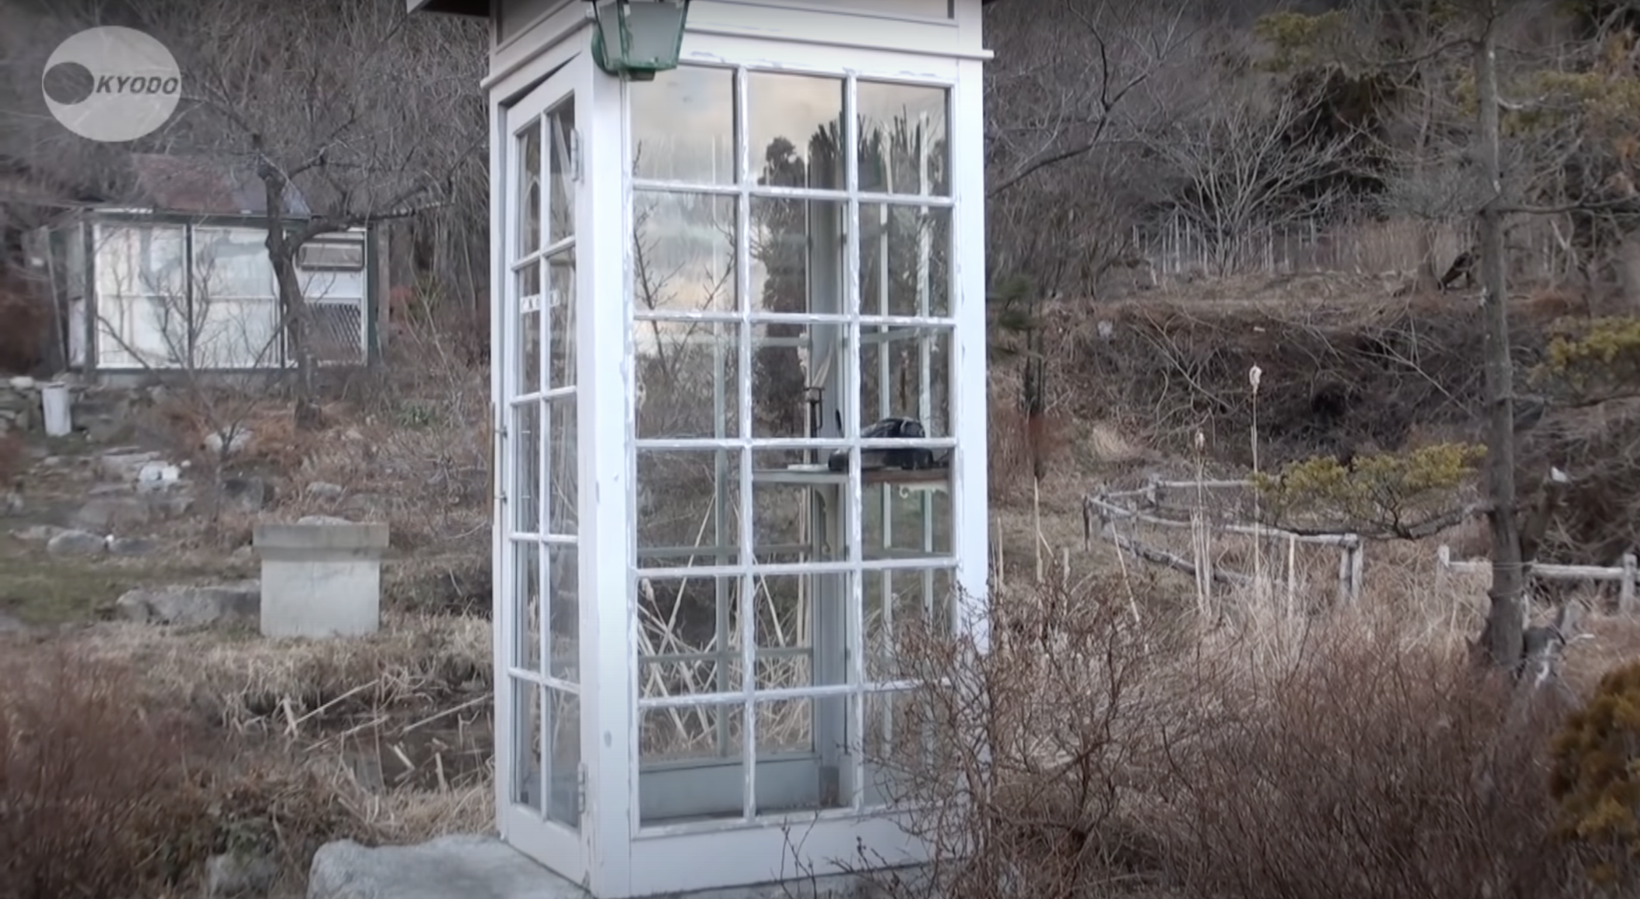
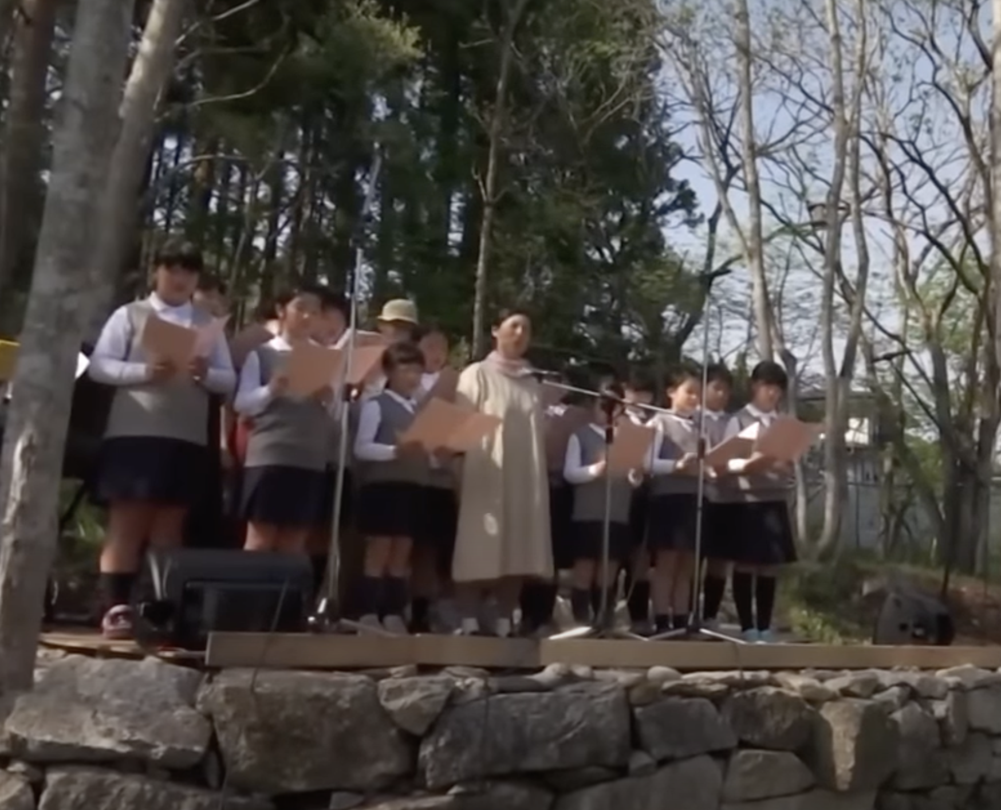
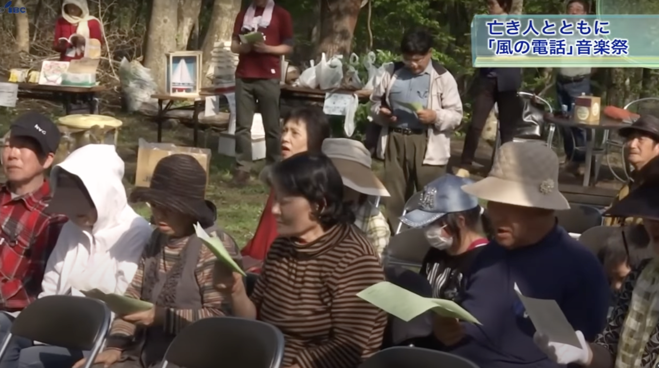

Slide 20
The wind phone
BBC video (Otsuchi, Japan)
https://www.bbc.com/reel/video/p07cj0h3/japan-s-telephone-to-the-dead (3:40)
The 2011 Great East Japan earthquake (dead: 15,900, missing: 2,523, total: 18,423)
in Japanese
https://www.youtube.com/watch?v=mquUyAG4T7k
Canada (The ‘wind phone’ is situated at the edge of Gatineau park in Old Chelsea, Que., close to hiking trails and accessible by wheelchair. (Jessa Runciman/CBC))
https://www.cbc.ca/news/canada/ottawa/chelsea-wind-phone-1.6621595

Slide 21
Communities in disasters: Building back better
Community disaster planning should be flexible, make-sense, and forgiven (Allow time for reflection, changing plans, new options, no rush, etc.)
Knowledge sharing (elders, knowledge-keepers, etc.)
Ceremonies (space for building relationships, preserving culture and tradition, etc.)
Communities are fragile: Working together with community-based organizations for problem-solving, common ground, relationships, etc.

Slide 22
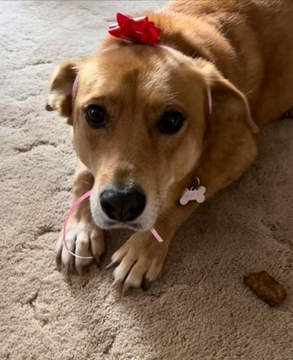
Thank you for having me!
Any questions?
Contact:
Etsuko Yasui, Ph.D.
Applied Disaster and Emergency Studies
Brandon University
Email: Yasui@brandonu.ca
Office: 204-571-8575

Slide 23
List of references
Bernard Manyena, Fortunate Machingura, Phil O'Keefe, Disaster Resilience Integrated Framework for Transformation (DRIFT): A new approach to theorising and operationalising resilience, World Development, Volume 123, 2019, https://doi.org/10.1016/j.worlddev.2019.06.011.
Dianne M. Longboat Traditional Teacher and Healer Mohawk Nation (2002). Ian Anderson Program in End-of-Life Care Module 10 Indigenous Perspectives on Death and Dying. University of Toronto. https://www.cpd.utoronto.ca/endoflife/Modules/Indigenous%20Perspectives%20on%20Death%20and%20Dying.pdf
Douglas, M. (1992). Risk and blame: Essays in cultural theory. London ; [Toronto]: Routledge.
Hewitt, K. (1997). Regions of risk: a geographical introduction to disasters. Addison Wesley Longman Limited. Essex. UK.
Lupton, D. (1999). Risk. London ; New York: Routledge.
Muhibuddin Usamah, John Handmer, David Mitchell, Iftekhar Ahmed, 2014.Can the vulnerable be resilient? Co-existence of vulnerability and disaster resilience: Informal settlements in the Philippines,International Journal of Disaster Risk Reduction,Volume 10, Part A,2014,Pages 178-189,ISSN 2212-4209, https://doi.org/10.1016/j.ijdrr.2014.08.007
Myers, D. G., & Wee, D. F. (2005). Disaster mental health services : a primer for practitioners. New York: Brunner-Routledge.
Neal and Phillips. 1995. Effective emergency management: Reconsidering the bureaucratic approach. Disasters. 19(4), 327-337
Phillips, B. D. (2009). Disaster recovery. Boca Raton, FL: CRC Press, Auerback Publications.
Quarantelli, E. L., & Dynes, R. R. (1968). Looting in Civil Disorders: an Index of Social Change. The American Behavioral Scientist (Beverly Hills), 11(4), 7–10. https://doi.org/10.1177/000276426801100403
Wenger, E. (2000). Communities of Practice and Social Learning Systems. Organization (London, England), 7(2), 225–246. https://doi.org/10.1177/135050840072002

Slide 24
Session Abstract: Workshop #11: Community-driven disaster risk reduction:
Wednesday, March 6th at 2:15: Workshop #11: Community-driven disaster risk reduction:
By Etsuko Yasui, Brandon University
How can communities prepare, respond, recover, and mitigate disasters? This presentation discusses the vital roles of existing and emerging community-based organizations that assist communities in disaster risk reduction and in times of disaster. The conventional disaster and emergency management approach is limited in its resource allocation to an inclusive and community-driven approach to plan for disasters, even though disasters are fundamentally local events. By utilizing existing social resources, there are potential opportunities for communities to organize and engage with key emergency management partners to promote community-based disaster planning.

Slide 25
List of EM organizations
Alberta First Nations – Technical Services Corporation (TSAG) (AB)
Tsuut’ina Nation – Treaty 7 (AB)
North Shore Micmac District Council (NSMDC) (NB)
3 Nations Partnership (BC)
Holistic Emergency Preparedness and Response (HEPR) (BC)
First Nations Emergency Services Society (FNESS) (BC)
Kwilmu’kw Maw-klusuaqn (KMK) (NS)
Confederacy of Mainland Mi’kmaq (CMM) (NS)
Mi’kmaq Confederacy of PEI (MCPEI) (PE)
Qalipu Mi'kmaq First Nation (QMFN) (NL)
Interlake Reserves Tribal Council (IRTC) (MB)
Southern Chiefs' Organization Inc. (SCO) (MB)
Manitoba Keewatinowi Okimakanak Inc. (MKO) (MB)
Assembly of Manitoba Chiefs (AMC) (MB)
Métis National Council (MNC) (ON)
Nishnawbe Aski Nation (NAN) (ON)
Independent First Nations Alliance (IFNA) (ON)
Mushkegowuk Tribal Council (MTC) (ON)
Federation of Sovereign Indigenous Nations (FSIN) (SK)
Saskatchewan First Nations Emergency Management (SFNEM) (SK)

