Slide 1
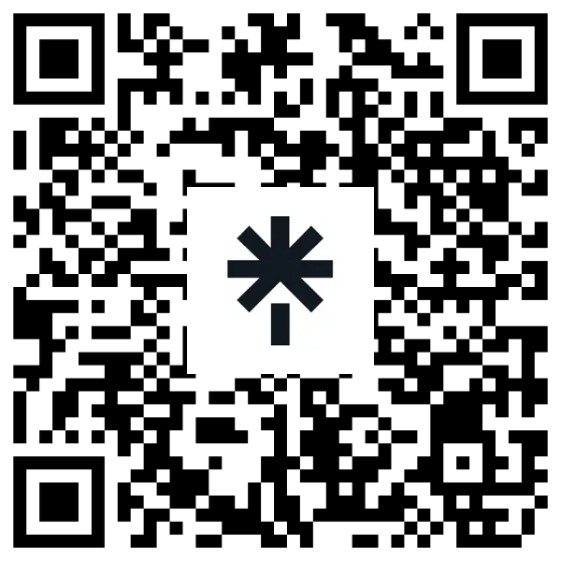
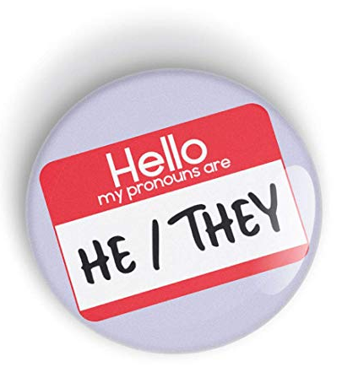
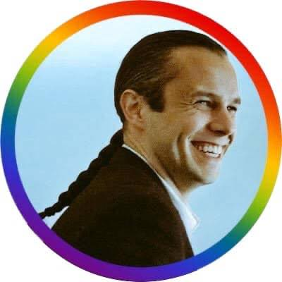
Supporting 2SLGBTQQIA+ Youth: Jordan’s Principle Service Coordinator Gathering
Dr. Jaris Swidrovich, BSP, PharmD, PhD, AAHIVP, RPh
Assistant Professor, Teaching Stream
Indigenous Engagement Lead
Leslie Dan Faculty of Pharmacy
University of Toronto
March 5, 2024
@JarisOfThePrairies
@JarisSwidrovich
Jaris Swidrovich
Notes:
For the presentation, we envision that each panelist will take 10 or so minutes to introduce themselves and their work and speak to the topic at hand, in your case a clinical/professional perspective of supporting gender diverse individuals and youth. Joining you on this panel are Dr. Albert McLeod who will be joining us virtually to speak to his work and advocacy as an expert and Elder in this space, as well as a youth member of the Ontario Young People’s Council, Kieran Davis, who is a strong advocate and will speak to their experience as a Two Spirit youth to share a key perspective and advice on supporting gender diverse youth. We hope that this session will leave participants with a strong sense of how their work impacts 2SLGBTQQIA+ youth and how to best support youth and their families through Jordan’s Principle, including perhaps tools or recommendations on best practices. If you find it helpful to present using slides, you are most welcome to do so, or if you prefer to speak without slides that is also ok! If you have any materials or handouts you would like to provide, please let me know and we can add these to our conference website.
Two-Spirit and gender diverse individuals have special gifts from the Creator which must be celebrated and nurtured. The CHRT orders affirm that all First Nations children are eligible under Jordan’s Principle, including those who are 2SLGBTQQIA+. Gender diverse youth have unique experiences and needs for gender-affirming care that are eligible for support under Jordan’s Principle, which could include culturally-safe exploration of pronouns and gender, individual or family mental wellness supports, gender-affirming garments or travel to appointments for gender-affirming care. In this session, participants will hear from youth, advocates and professionals with lived experience on how to best support First Nations youth to access gender-affirming care, as well as the systemic barriers to accessing such services. This session includes a question and answer period with panelists.

Slide 3
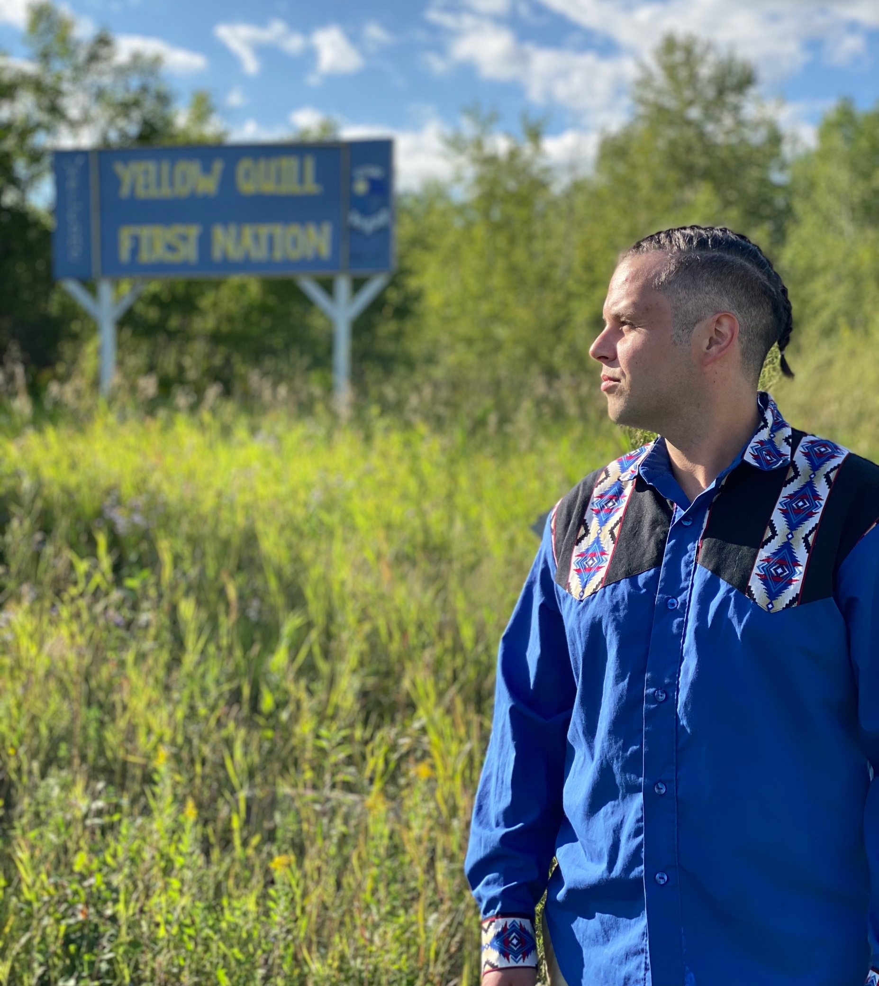
Introduction and Self-situating Disclosure
I am a white-presenting Saulteaux & Ukrainian urban First Nations, Two Spirit, queer, disabled person from Yellow Quill First Nation (Treaty 4 territory, SK)
Spirit name = wapiska kiniw (White Eagle)
Otter Clan and Bear Clan
I have spent most of my life in suburban and urban Saskatoon (Treaty 6 territory and the homeland of the Métis)

Slide 4
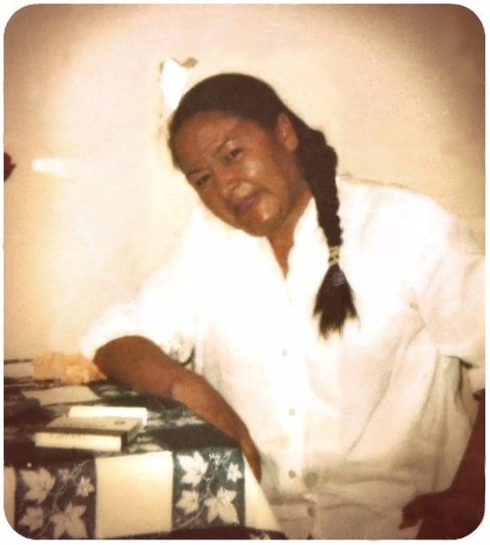
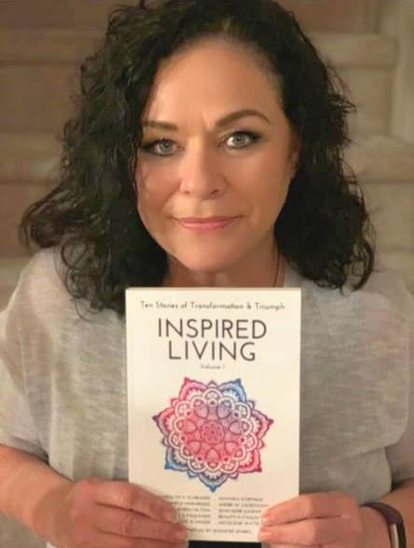
My relatives:
Marina Elder (Grandma)
Cheryl (Sherri) Swidrovich (Mom)
Peter Gilbert (Great Grandpa)

Slide 5
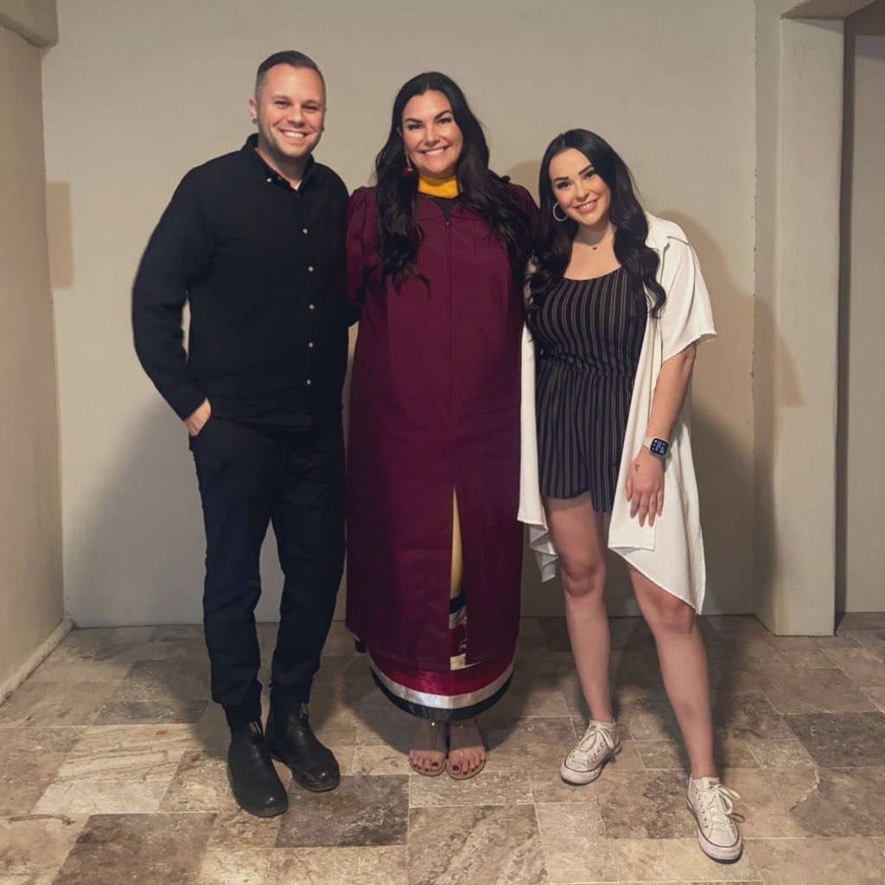
Siblings: Shaina and Jenna

Slide 6
Introduction: Jaris Swidrovich
Pharmacy Work Experience:
Community Pharmacy
Costco – Saskatoon (2008-2011)
Hospital Pharmacy
Royal University Hospital – Saskatoon (2011)
St. Paul’s Hospital – Saskatoon (2013 – 2015); HIV Pharmacist
Academia
College of Pharmacy and Nutrition – University of Saskatchewan (2015-2021)
Assistant Professor
Leslie Dan Faculty of Pharmacy – University of Toronto (2021-Present)
Assistant Professor, Teaching Stream, and Indigenous Engagement Lead

Slide 7
Introduction: Jaris Swidrovich
Formal Education:
Bachelor of Science in Pharmacy (BSP) (2010)
University of Saskatchewan
Doctor of Pharmacy (PharmD) (2013)
University of Toronto
Doctor of Philosophy (PhD) in Education (2024)
University of Saskatchewan
Dissertation: Indigenous Peoples’ experiences with pharmacy education in Canada

Slide 8
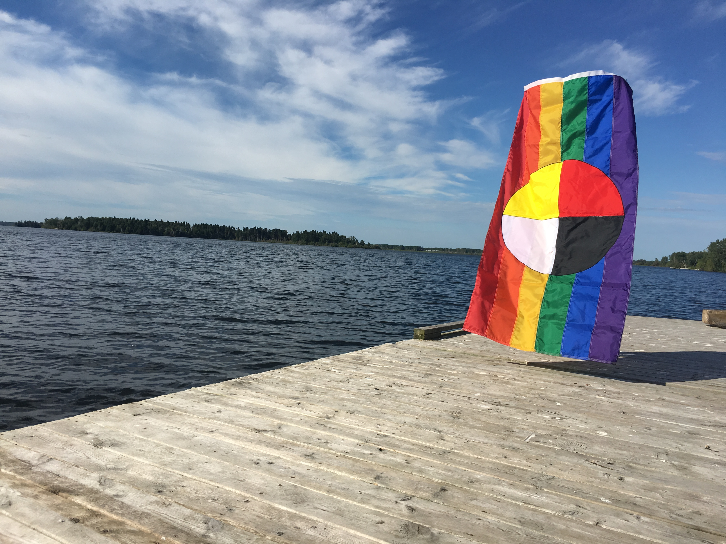
I will share:
A summary of Two Spirit Peoples’ history and current landscape
5 ways to support gender-affirming care for Two Spirit youth

Slide 9
Colonization and Queerness
The introduction of Residential Schools by the Government of Canada and the Catholic Church, beginning in the 1870s, introduced rigid gender roles and heteronormative thinking to Indigenous communities.
This Homo/bi/transphobia was able to flourish for more than a hundred years as Residential Schools expanded to nearly every Indigenous community in Canada and over 150,000 First Nations, Inuit, and Métis children were torn away from their parents, family, and culture.

Slide 10
Colonization and Queerness
The contemporary term Two Spirit was first coined in 1990 at the 3rd annual Native American and Canadian Aboriginal LGBT people gathering in Winnipeg.
In creating the term, the founding group wanted to reflect the historical acceptance of gender-variant peoples and diverse sexual identities within Indigenous communities in pre-contact times.

Slide 11
Colonization and Queerness
Two Spirit is meant to be an umbrella term that points to the important roles that Two Spirit people held prior to colonization; however, as an umbrella term, specific teachings, roles, meanings, and language must come from the community.
The identity itself was introduced by the Elder Myra Laramee through a vision she had prior to the 1990 gathering in Winnipeg.
Within this vision, Myra shared the vision she had of her Anishinaabemowin name of niizh manidoowag; which roughly translates to having the ability to be neutral through the lens of having both a feminine spirit and masculine spirit within one's body.

Slide 12
Colonization and Queerness
Being Two Spirit is a very fluid identity and each tribe and Indigenous person has their own understanding of what it means to live and be Two Spirit.
One important element to note however is that the identity is specific to being Indigenous, in that the identity is a direct acknowledgement of the disruption of Two Spirit teachings that took place when first-contact between Indigenous peoples and settlers was made and the ongoing impact of colonization.

Slide 13
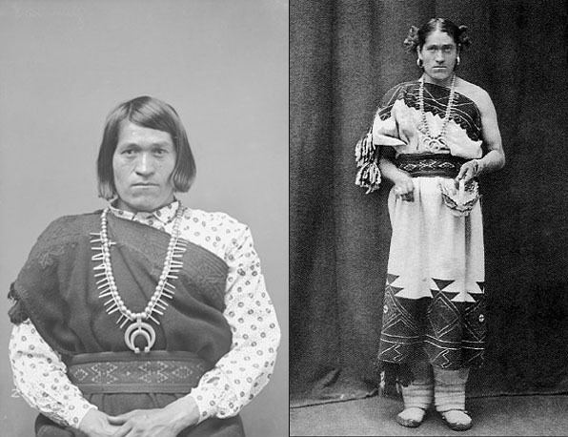
Colonization and Queerness
In most Indigenous communities, Two Spirit people were seen, loved, and respected as unique individuals.
They were gifted with keen insight and the ability to see things through both feminine and masculine eyes (double vision).
Many held important roles within their tribes, such as Chiefs, medicine people, caregivers, protectors, and knowledge keepers, as well because they possessed a “double vision” they were often marriage counselors.
Two Spirit people also took on the role of being caregivers for orphaned children.

Slide 14
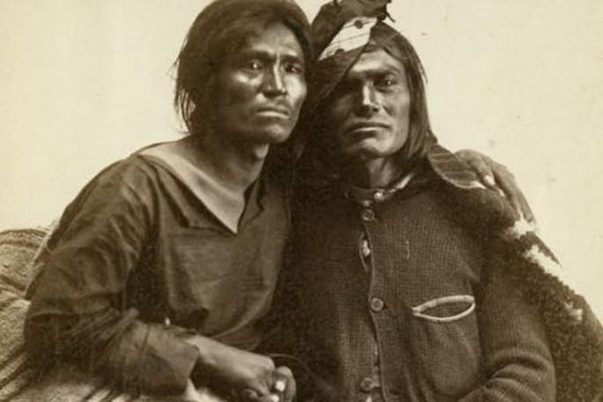
Colonization and Queerness
Traditionally in a time before colonial contact being Two Spirit was not specifically tied to one's own sexual and/or romantic orientation, instead it was tied to one's own gender and/or the roles the person chose to do in their community.
Some Two Spirit people chose to marry a person of the same sex, while other Two Spirit people chose to marry a person of opposite sex.
Most Indigenous tribes recognized up to 6 different genders
For example, a Two Spirit person whose sex is male and has a male partner could be considered a different gender from a Two Spirit person whose sex is male and has a female partner.

Slide 15
Colonization and Queerness
Two Spirit people have existed since the beginning of Indigenous oral history and many Two Spirit activists are working together to teach the traditional values of respect, love, and kindness for all human beings.
Tribes across North America, and beyond, are reclaiming traditional names for gender diverse community members and diverse sexual orientations. Indigenous communities are now holding their own Two Spirit Pride Festivals to highlight the love and acceptance the community holds for all members.
June is a great month to celebrate! It is both PRIDE and Indigenous History Month

Slide 16
Supporting Gender-affirming care for Two Spirit Youth
Education and awareness
Health care providers
Community support
Government and policy
Resources

Slide 17
1. Education and awareness
Learn about Two-Spirit identities: Understand the unique experiences and cultural significance of Two-Spirit individuals within Indigenous communities.
Promote awareness: Educate others about Two-Spirit identities, challenges, and the importance of gender-affirming care.

Slide 19
2SLGBTQ+ or 2S/LGBTQ+
“2S then the rest.”

Slide 20
2. Health care providers
Training and education: Ensure health care providers receive training on gender-affirming care, including Two-Spirit-specific considerations.
Inclusive practices: Create safe spaces where Two-Spirit youth feel respected and understood.
Access to knowledgeable providers: Connect youth with health care professionals who are knowledgeable about gender-affirming care.

Slide 21
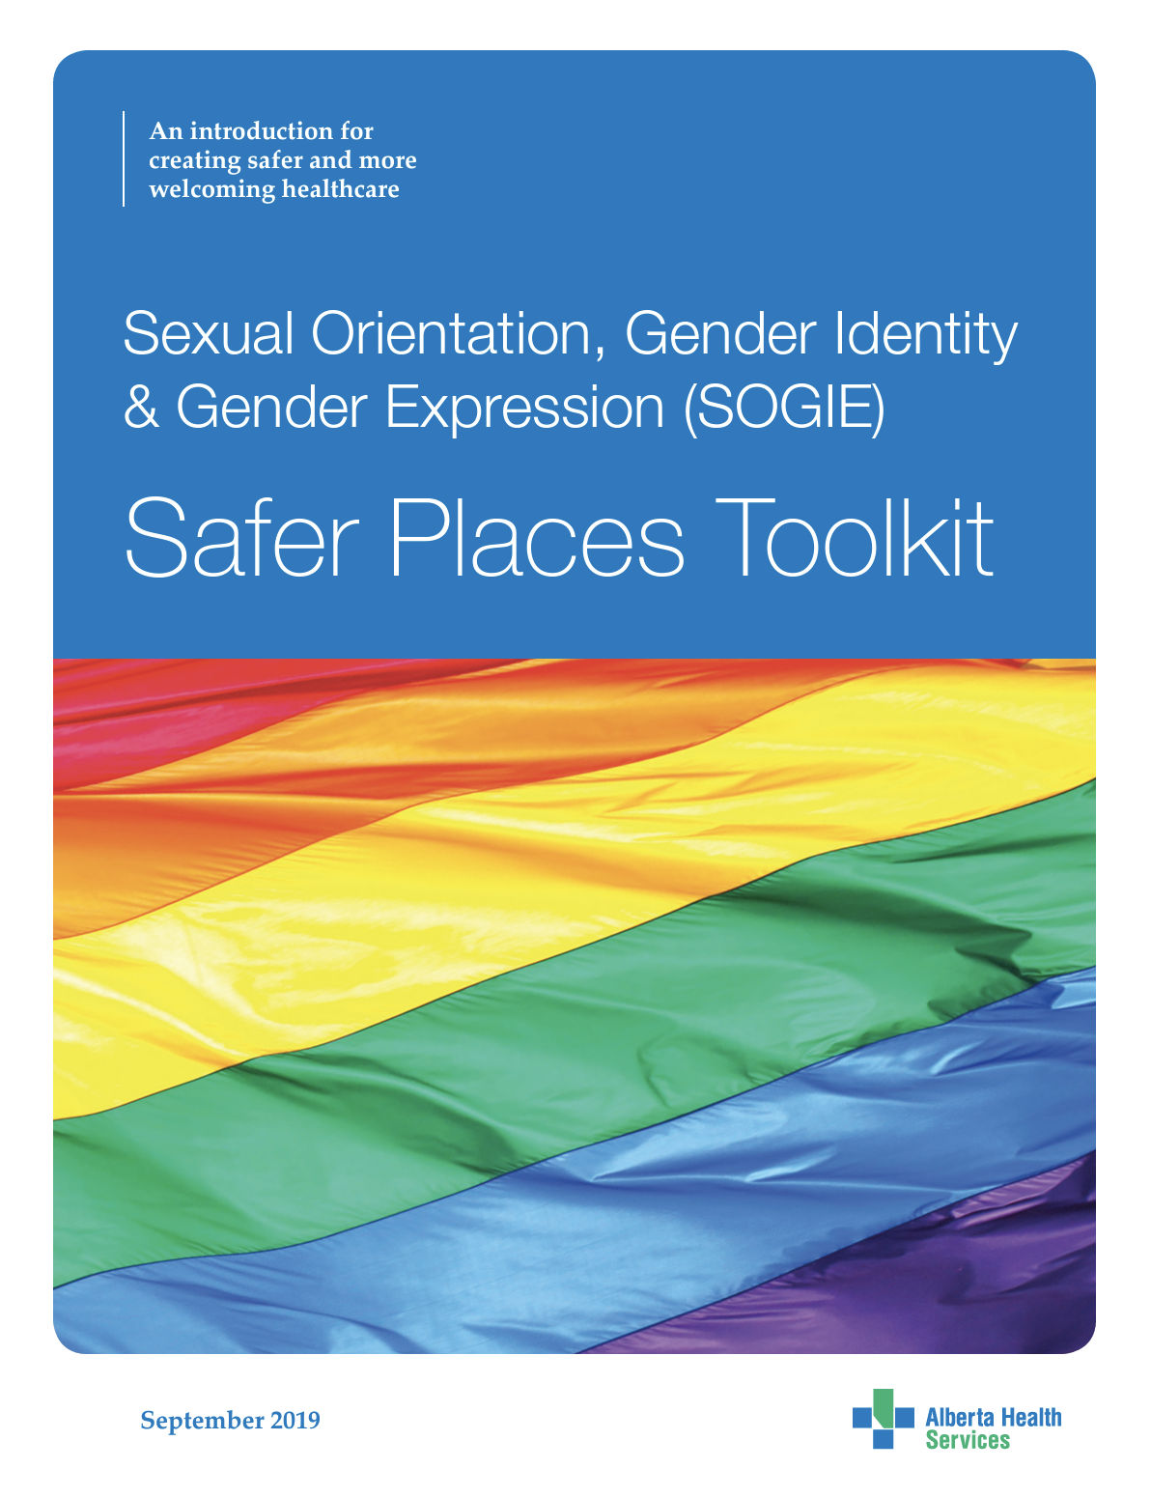
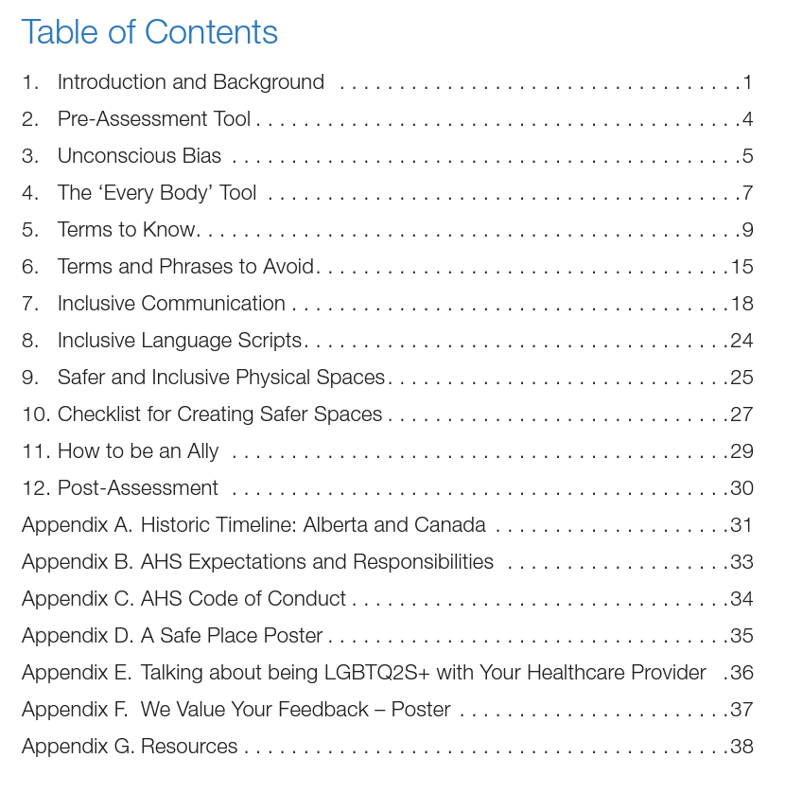
https://www.albertahealthservices.ca/assets/info/pf/div/if-pf-div-sogie-safer-places-toolkit.pdf

Slide 22
Two Spirit Experiences in Health Care
Two Spirit Peoples experience health inequities due to homophobia, transphobia, heteronormativity, and racism embedded in the Canadian healthcare system due to colonization.
More likely to experience mental health disorders such as anxiety, depression, substance use disorders, and are at a higher risk of suicide.
Two Spirit health is impacted by the societal and healthcare exclusion of gender and sexually diverse peoples, as well as homophobia and heterosexism amongst front-line healthcare practitioners.
Due to the gender-based nature of some programs for Indigenous Peoples, Two Spirit individuals may be left out of these programs.

Slide 23
Two Spirit Experiences in Health Care
Two Spirit Peoples are at an intersection of multiple minority groups, which results in various forms of discrimination such as misogyny, racism, and transphobia, which contributes to increased health inequities
Two Spirit individuals cannot be lumped together with Indigenous Peoples or with the 2SLGBTQIA+ community when looking at health disparities
It is important to note that when discussing Two Spirit Peoples and their health, we should not talk about this group of people being vulnerable.
They are at an increased risk of certain medical conditions and inequities because Western society has created a system that harms and causes disparities for Two Spirit Peoples.

Slide 24
Transitioning
Transitioning is the process a person may go through in order to feel more comfortable socially, physically, and legally.
It’s important to note that:
Transitioning does not validate or invalidate a trans person’s identity
A person who is transgender does not need to transition
Some trans folks may undergo some, all, or no types of transitions.
Trans people do not have to transition in a hyper-feminine way nor hyper-feminine way to fulfill stereotypical feminine or masculine roles (e.g., trans women can be tomboys).

Slide 25
Transitioning
Transitioning can be broken into two types: social transitions and medical transitions
SOCIAL
MEDICAL
Name
Puberty blockers
Pronouns
Hormones (estrogen or testosterone)
Clothing
Gender affirming surgeries
Hair
Top surgeries
Space (e.g., Washrooms and change rooms)
Bottom surgeries
Electrolysis or hair implants
Legal changes
Other surgeries
Speech Therapy

Slide 26
3. Community support
Peer support: Facilitate connections between Two-Spirit youth to share experiences and provide emotional support.
Cultural competency: Encourage cultural competency training for community members and service providers.

Slide 27
Example of health care interactions using pronouns and gender inclusive language:
”Hi. My name is Jaris and my pronouns are he/him/they/them. How may I refer to you?”
“Hi, _______. Nice to meet you. My name is Jaris. My pronouns are he/him/they/them – what are yours?
“I see your doctor prescribed ramipril for you. What did they tell you this medication was for?”
”Is there anyone who assists you with your medications, such as a partner, family member, friend, or someone else?”
“I have Ravi on the phone, and they have a question for you. Can you help them?”
“I am sorry, Lin. Thank you for correcting me. I have taken note of your pronouns and will make sure I use refer to you correctly moving forward. If or when I make the same mistake again, please let me know.”
“Everyone has pronouns and I just want to be sure I refer to all patients and people correctly. I have a great resource I can share with you if you would like to learn more about different pronouns.”

Slide 28
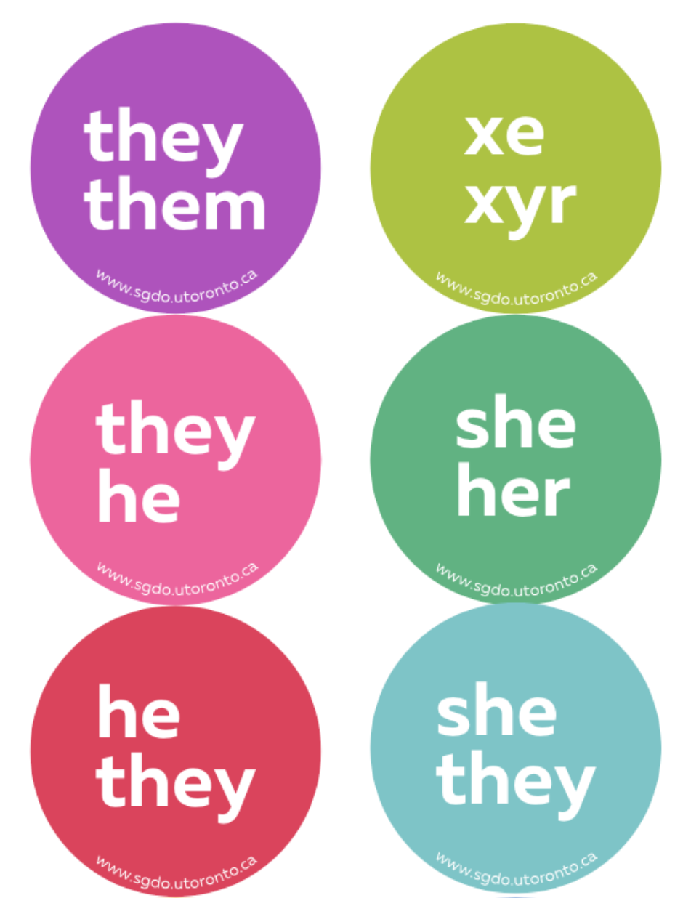
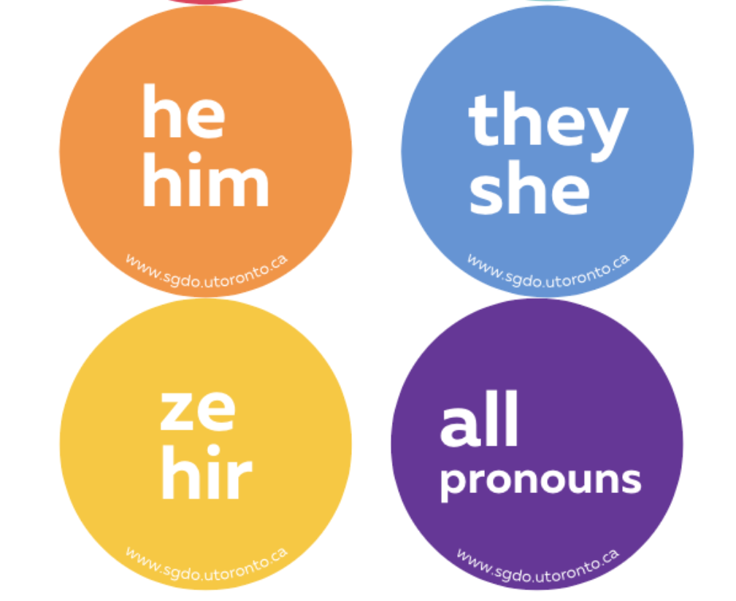
Wear a pronoun button!

Slide 29
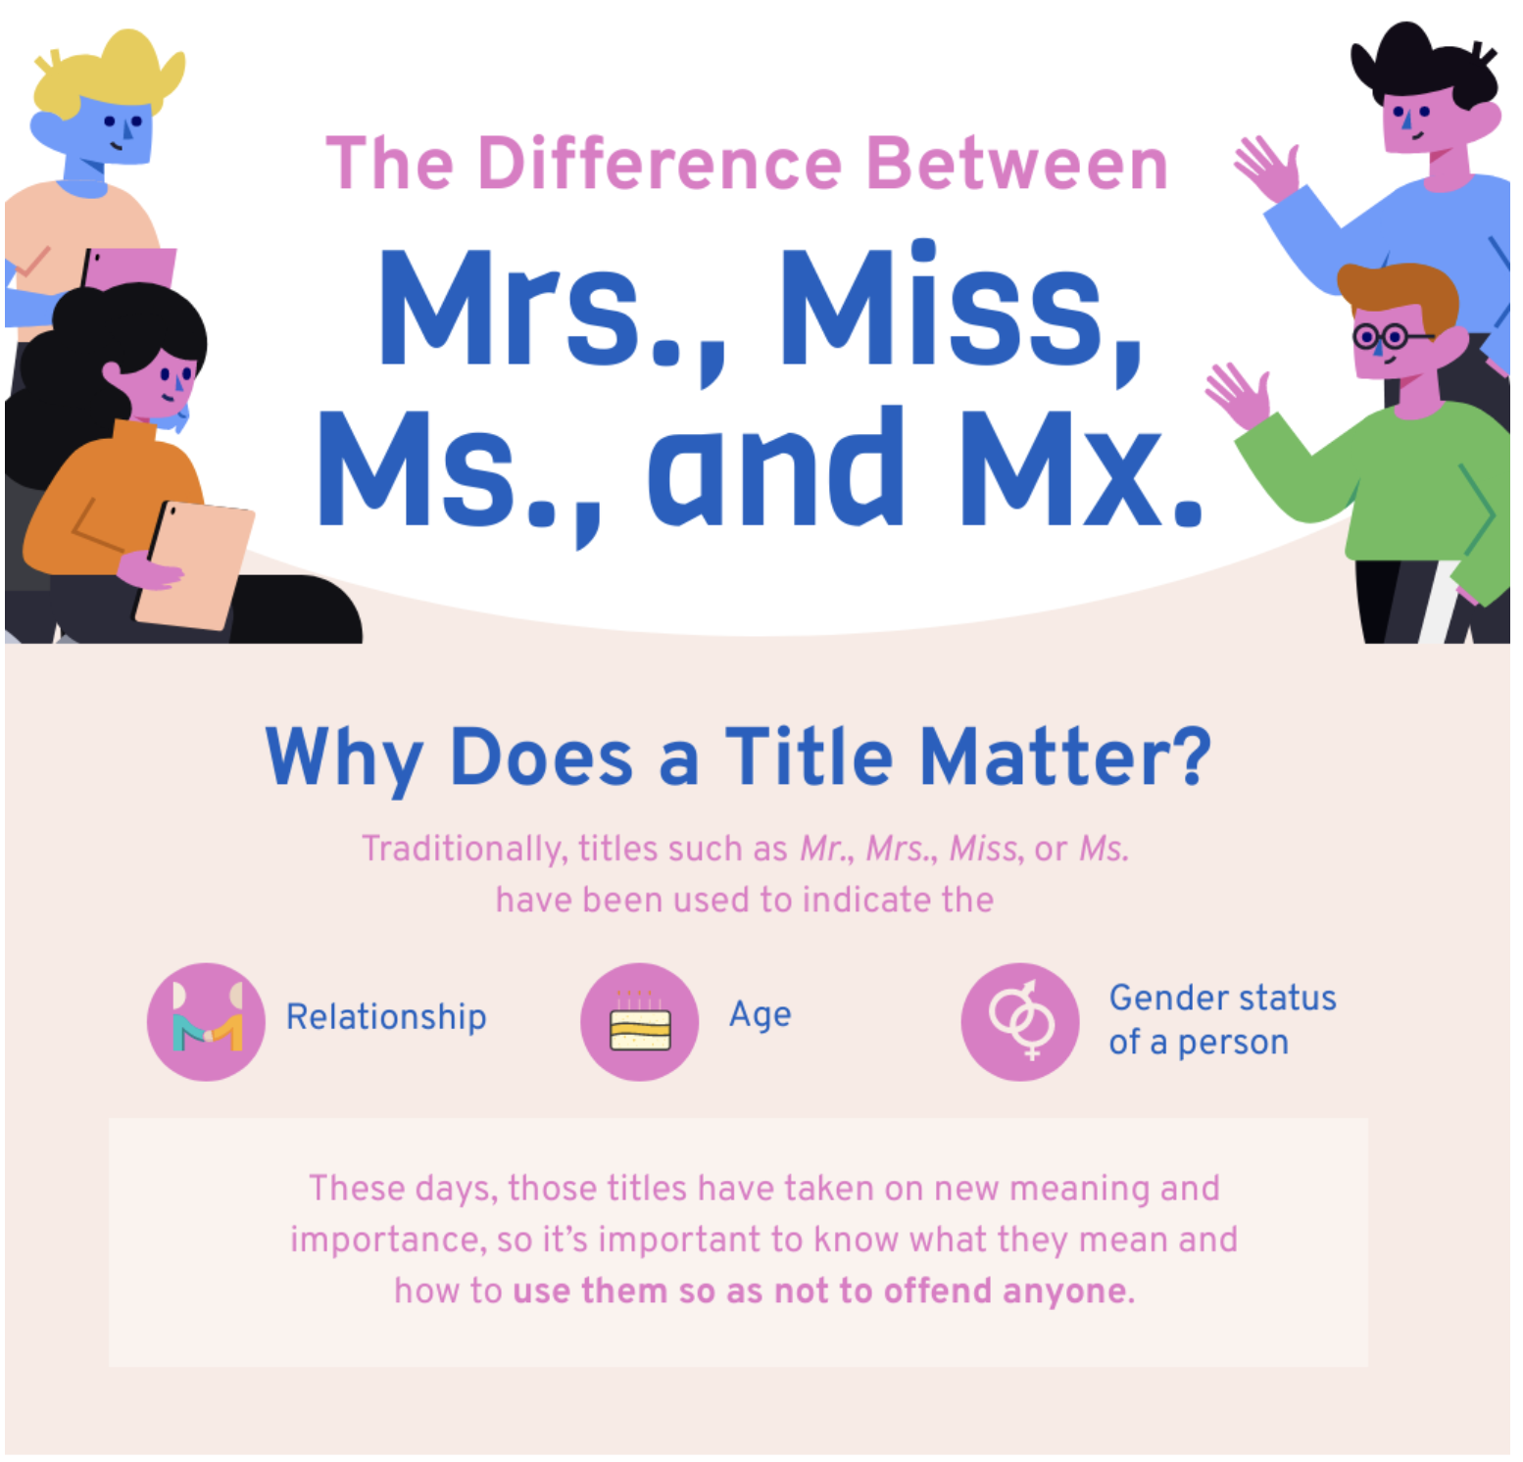
My advice:
Don’t use any of these and just address people by their name
or use non-gendered titles, if applicable (e.g., Dr., Rev., etc.)

Slide 30
2spirits.org

Slide 31
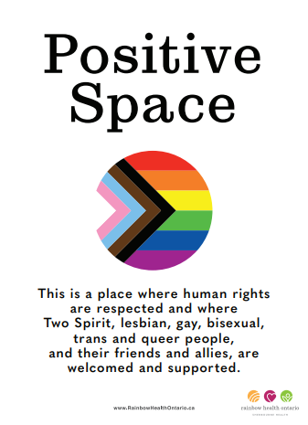
Put up signage like this!

Slide 32
pflagcanada.ca

Slide 33
4. Government and policy
Advocate for policy changes: Push for legislation protecting Two-Spirit youth from misinformation and discrimination.
Equitable access: Ensure equitable access to gender-affirming care, regardless of geographic location or socioeconomic status.

Slide 34
5. Resources
Queer Ontario, LGBT Youthline, Rainbow Health Ontario, The Get Real Movement, Pride Toronto, Trans PULSE, CAMH Gender Identity Clinic, U of T Sexual and Gender Diversity Office (SGDO.utoronto.ca)
Reach out to queer and trans knowledgeable colleagues
Request to attend conferences or workshops
CPATH, WPATH, and more
Make contacts with Queer community organizations inside or outside your community
Safer Spaces Toolkit (AHS): https://www.albertahealthservices.ca/assets/info/pf/div/if-pf-div-sogie-safer-places-toolkit.pdf
Remember:
When you publicly identify as an ally or as a safe space you have an accountability to have the knowledge and resources needed to support gender and sexually diverse communities. If you don’t have the knowledge and resources, it’s up to you to find out who does. If you or your co-workers mess up, recognize it, apologize, and work with the patient to make the situation right.

Slide 35
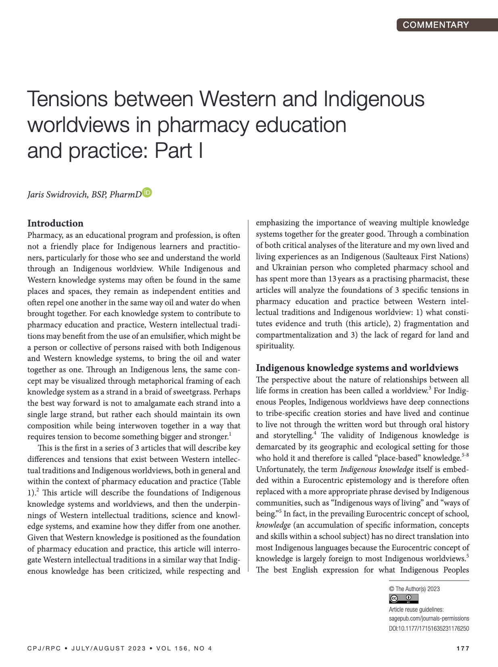
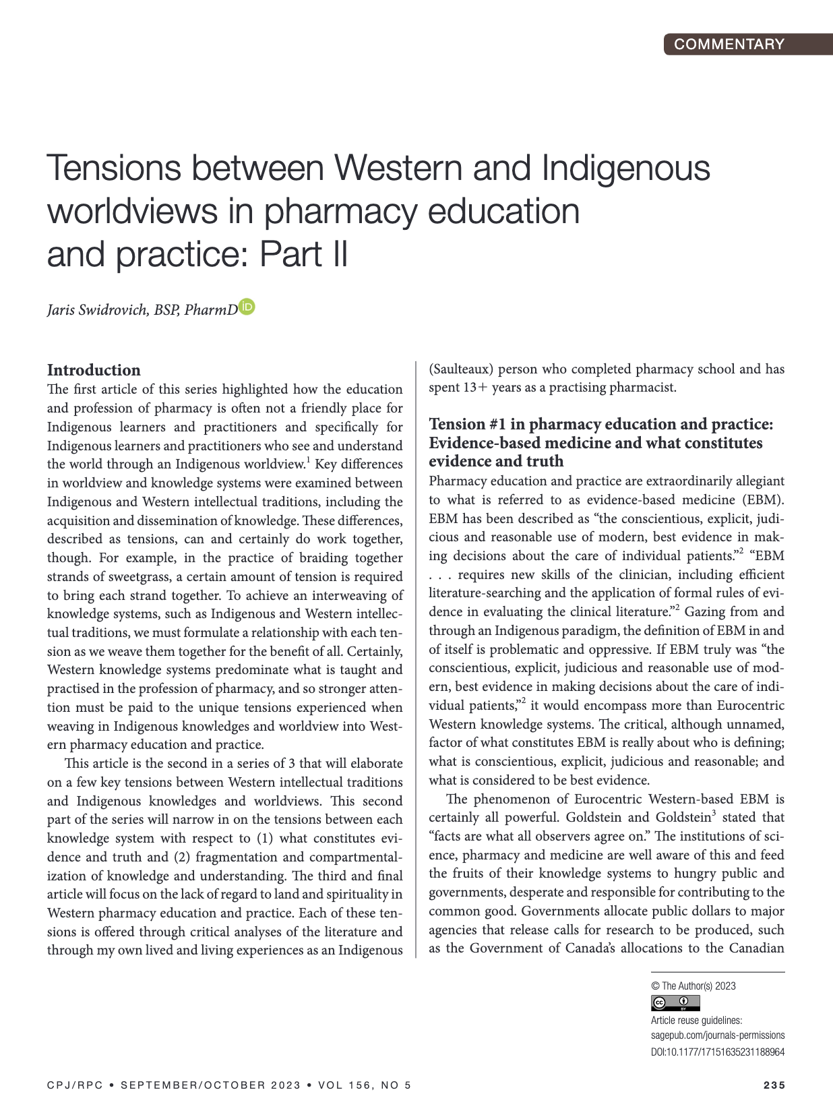
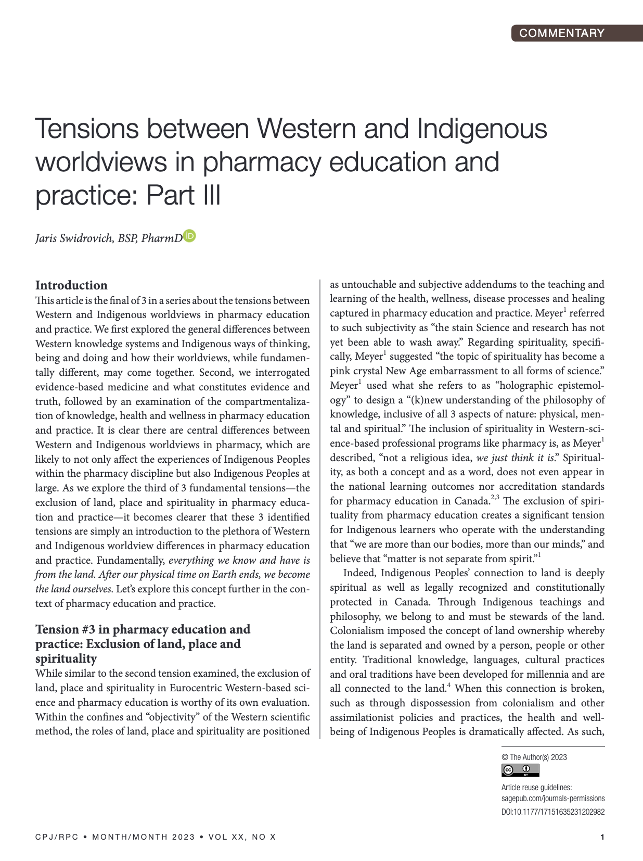
Tensions between Western and Indigenous worldviews in pharmacy education and practice
3-part series in Canadian Pharmacists Journal (Open Access)
https://linktr.ee/jaris.s

Slide 36
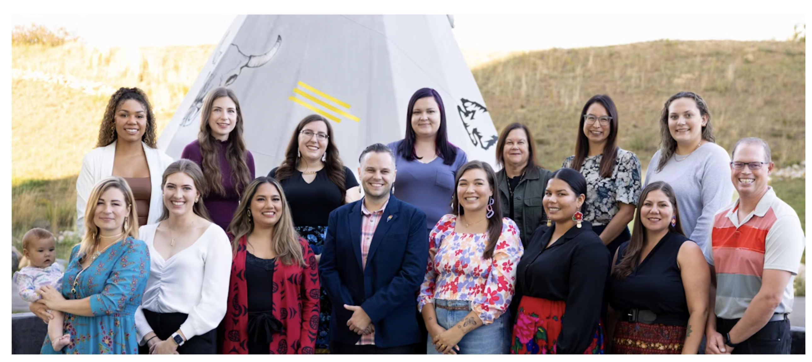
www.indigenouspharmacy.ca

Slide 37
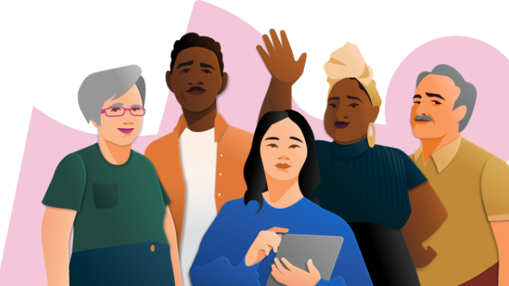
Thank you for being 2SLGBTQ+ inclusive!

Slide 38
Questions & Discussion
Remember, supporting gender-affirming care is a collective effort.
By advocating, educating, and creating inclusive spaces, we can improve the health and well-being of Two-Spirit youth. 🌈🌟

