Slide 1
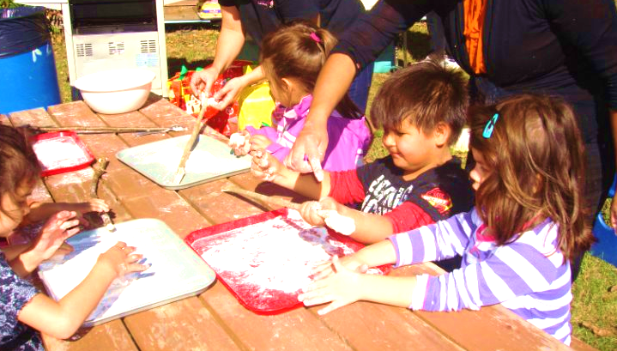
The Roots of Preschool Education in First Nations Communities

Slide 2
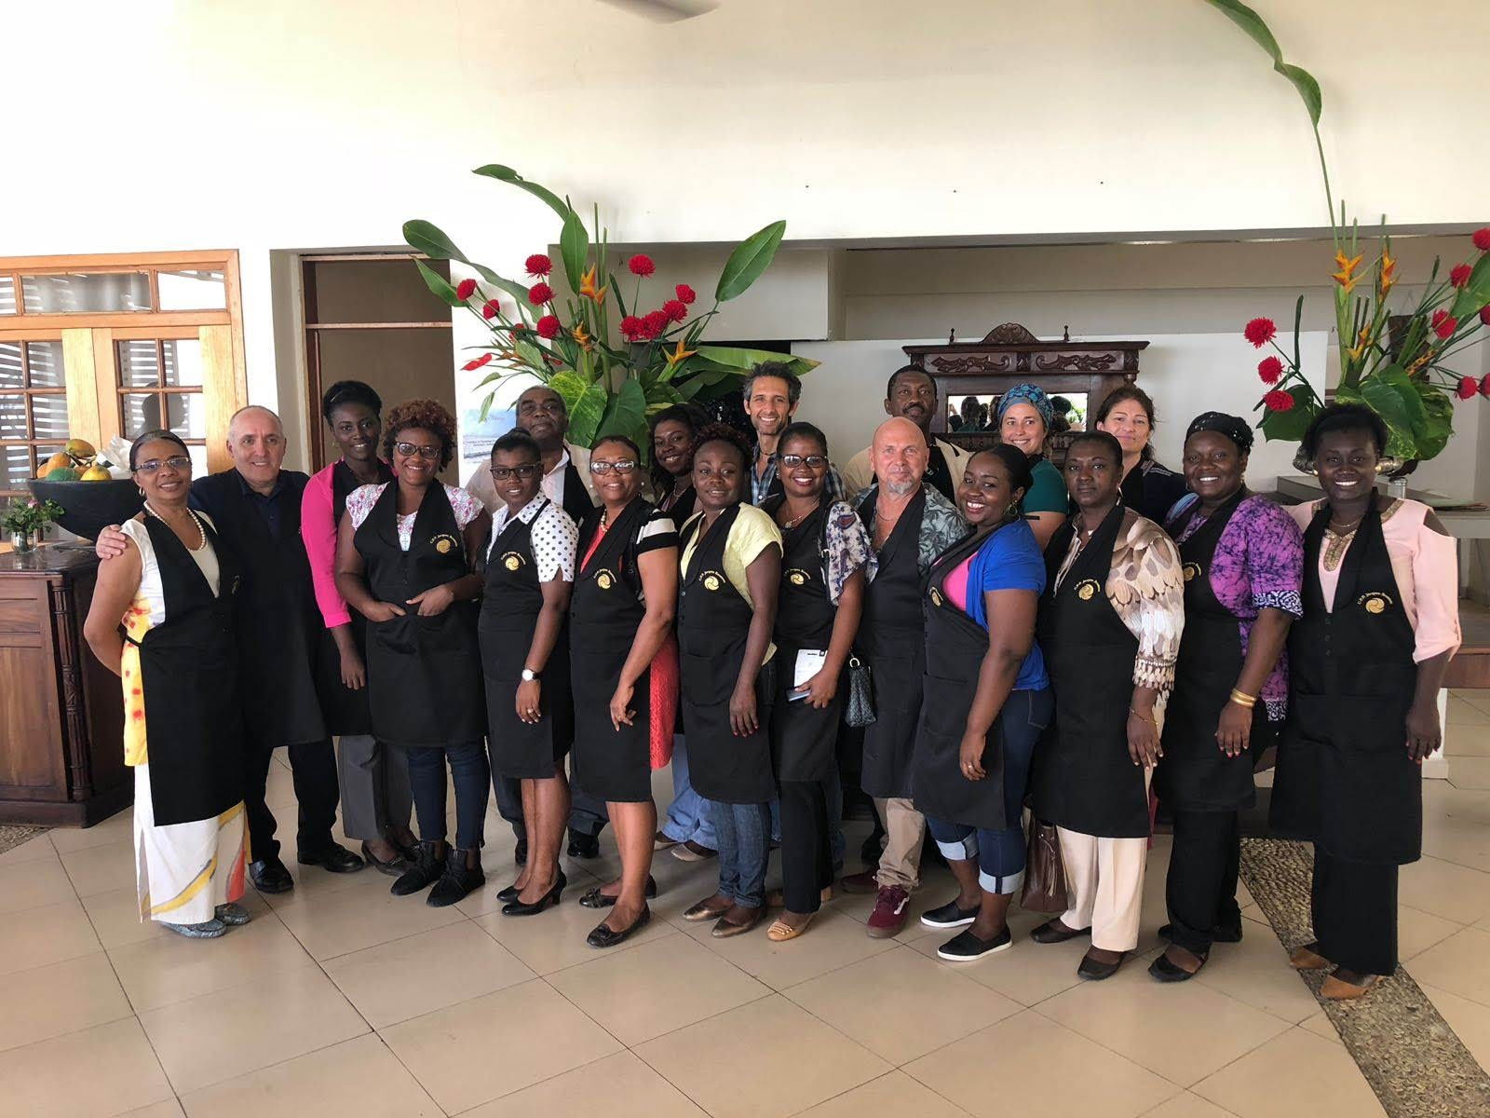
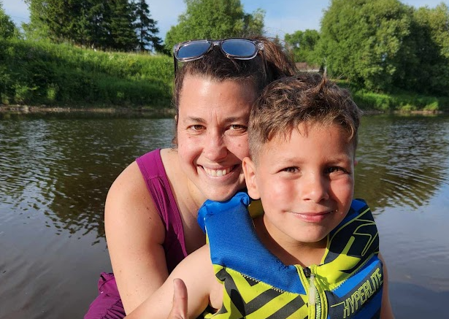
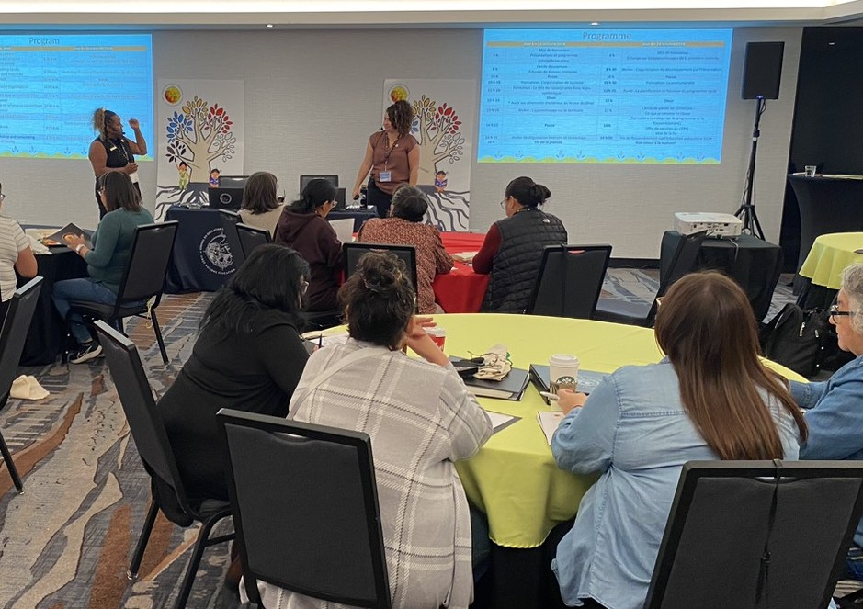
Anne-Marie Angers
Student Success Advisor, English Language Arts and Preschool Education
Language acquisition, intercultural education, pedagogical design
Based in Lévis, working in Wendake
Outdoors, literature, mindfulness

Slide 3
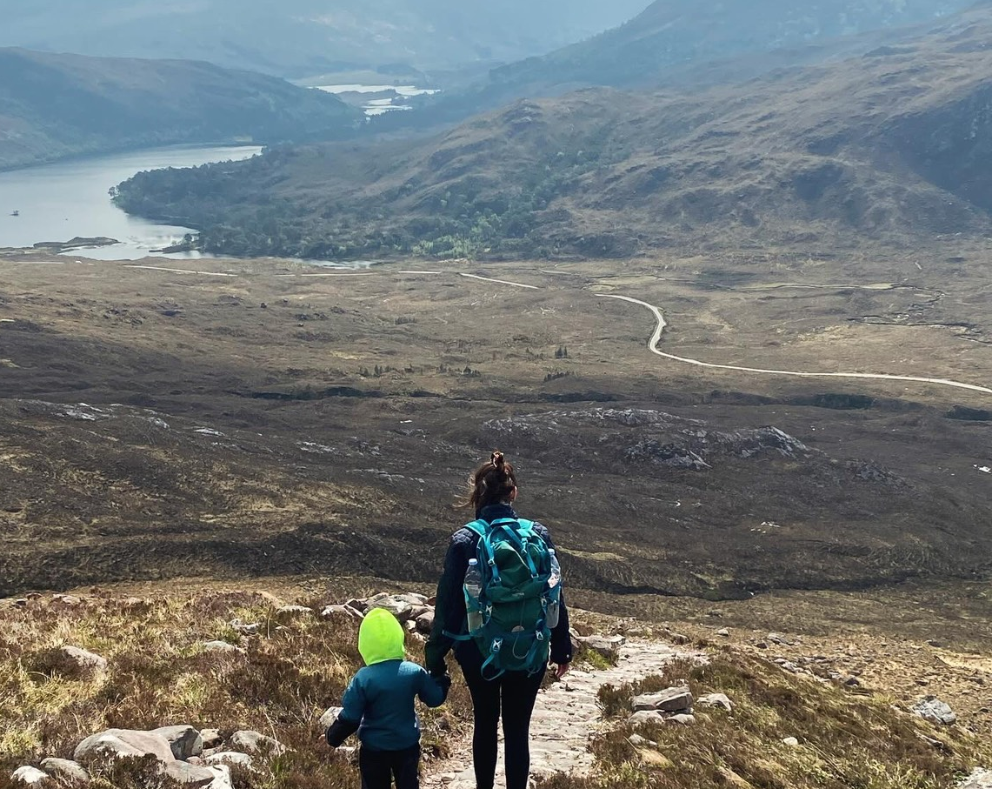
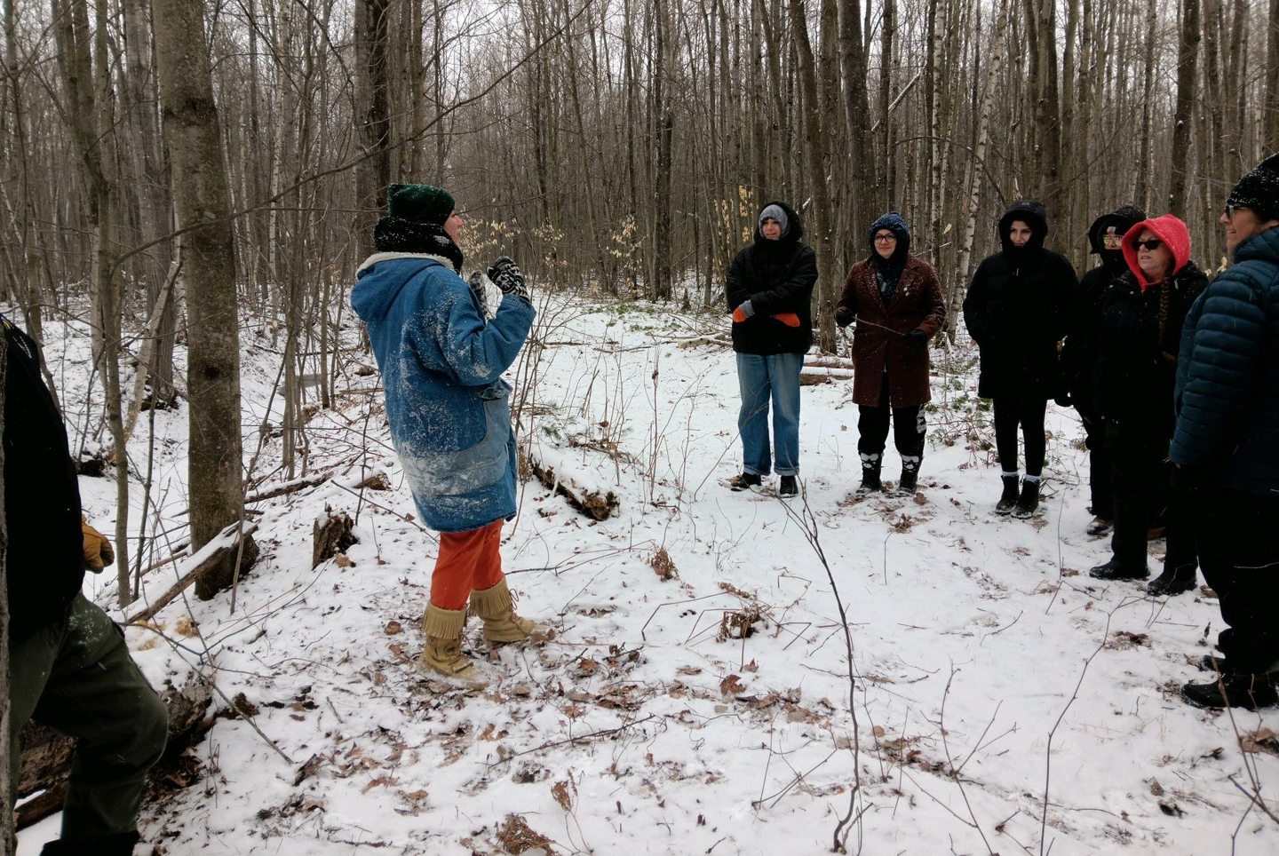
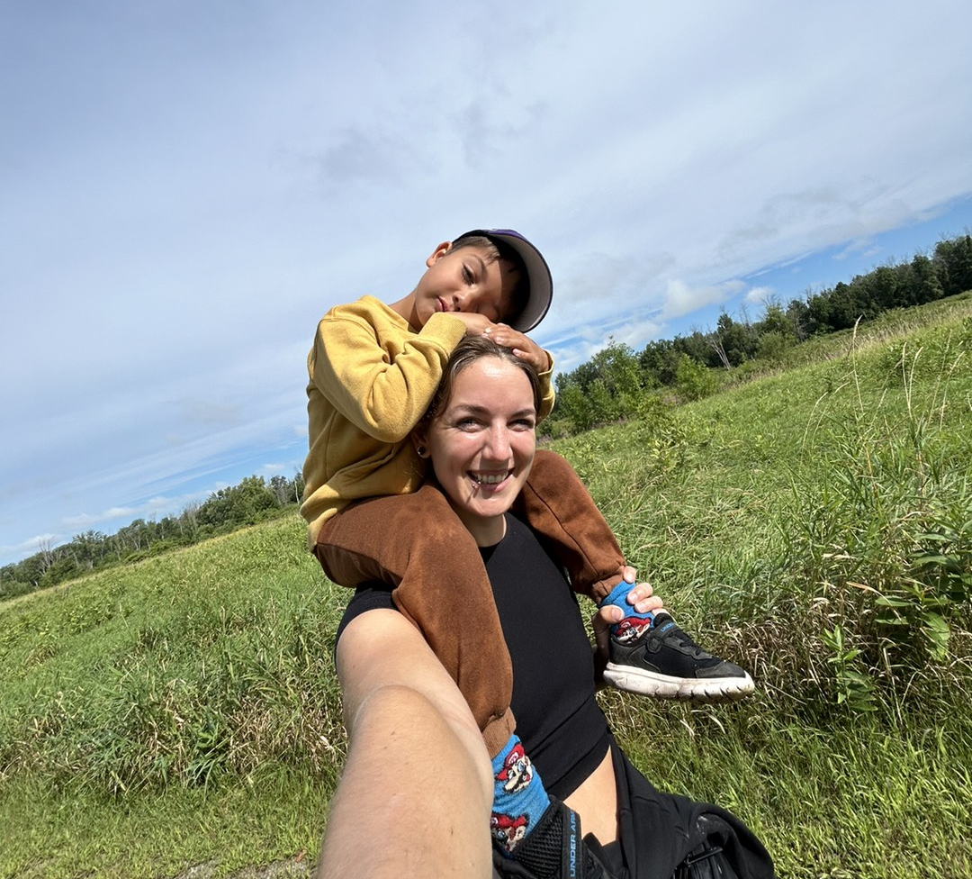
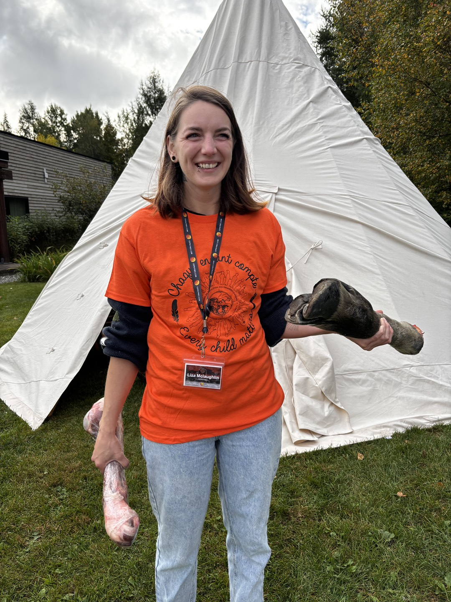
Introductions
Liza Mclaughlin
Student Success Advisor, Land-Based Education
Special Education, Mental Health and substance abuse and addiction, First People Studies, daycare worker for 3 years.
Based in Kanesatake for the last 10 years with my partner and son
Outdoors, reading, running, climbing, hiking.

Slide 4
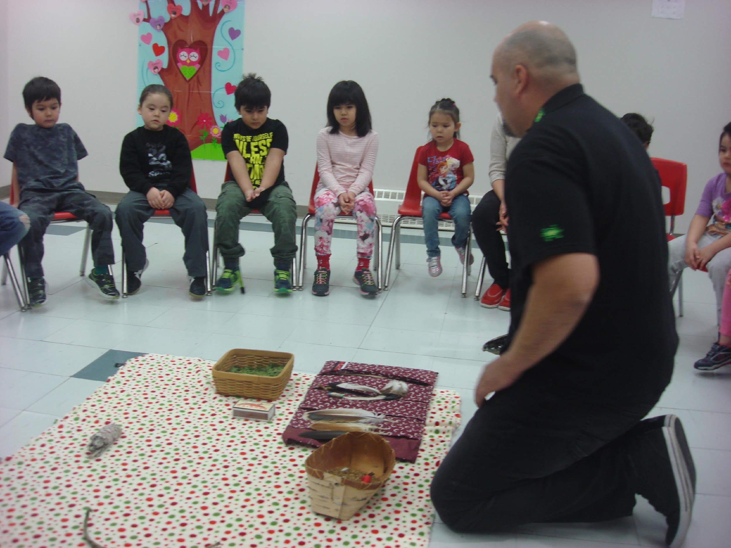
Presentation
Introductions
First Nation Education Council
The Process
The Program
Tools and Add-ons
Connecting communities to the program

Slide 5
The FNEC
Summary of the organization and offered services, and First Nation preschool cycle-program
Notes:
Anne-Ma

Slide 6
The First nation Education council (FNEC)
Who are we?
Which communities are we supporting?
What is our mission, values and responsabilities?
In what sectors do we work?
Notes:
Anne-Marie
Creation of the CEPN in 1985, after three years of meetings between educators from the first nations who wanted to take over the governance of their education system, to discuss good practices specific to their realities and to make themselves heard.​ It is 8 member nations, more than 22 communities, more than 25 schools and more than 5900 students that the CEPN supports in one way or another.​ Values ​​such as pride of identity, self-determination, excellence and the development of expertise specific to each community act as a framework for all our actions.​ Intervention at the political and administrative level to ensure self-governance of their education, increase the quality of services provided in educational services by offering qualifying training, professional development, networking, symposiums, gatherings affecting several sectors and subjects, manage programs transferred by various ministries to benefit communities, publish tools, educational programs and others, offer human resources when there is a need for consultation, maintain links with other First Nations organizations working in the area of education.​

Slide 7
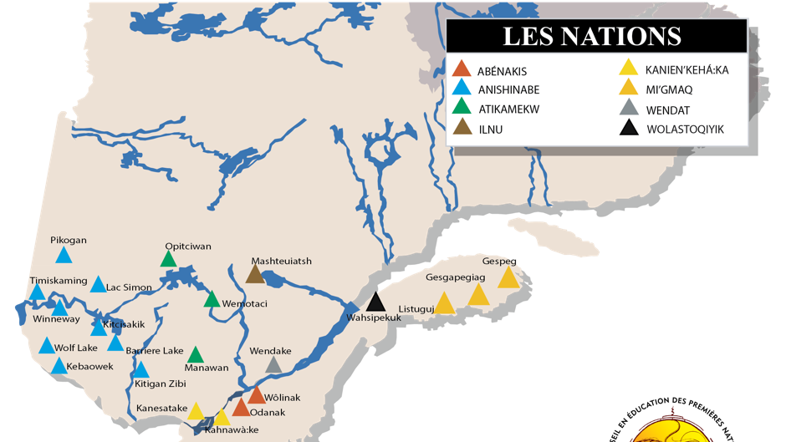
Member Communities
Notes:
Anne-Marie

Slide 8
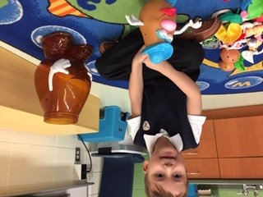
Cycle-Program Chronology
Selection of competences with all member community preschool teachers
Launching
Bulding of the activity book, literary box, observation grids, Learning Journey
Trial run in community preschool classes
Pre-K program
Tools and add-ons
Cycle program
Training and support
Same selection process
Holistic framework
Strong expertise
In community visits to train staff
On-going support
Notes:
Liza

Slide 9
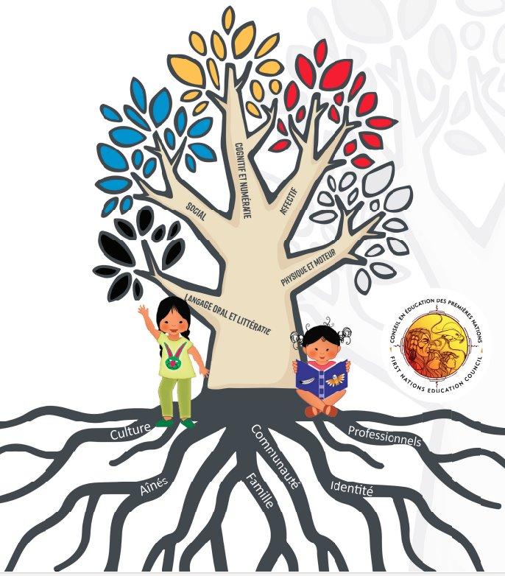
The Cycle-Program
Holistic Approach
Field, community and professional expertise
Dynamic program in constant evolution
Active participation
Concrete tools
Emphasis on culture, language, territory
Literary kit with works by First Nations, Métis and Inuit authors only.

Slide 10
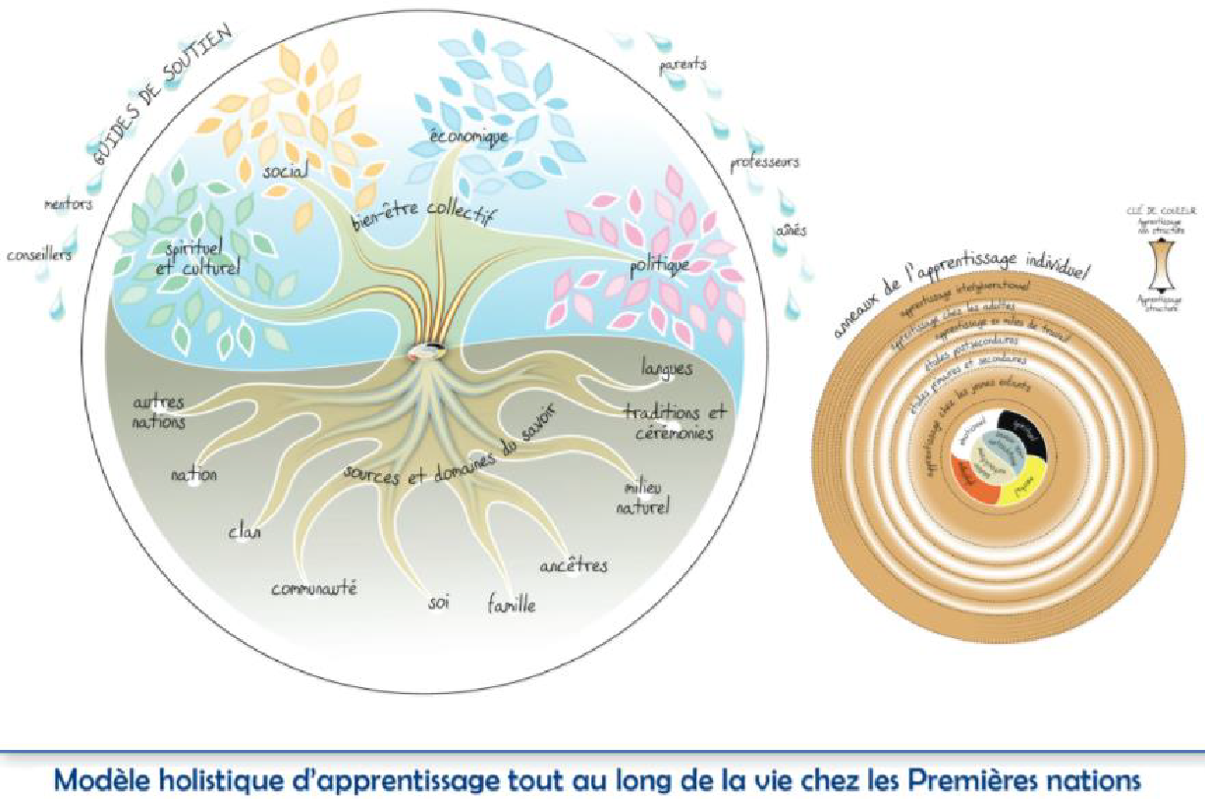

Slide 11
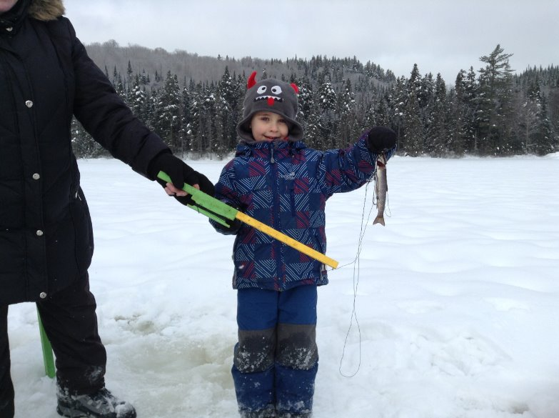
Holistic approach
The child as a global, complex and complete being
Cognitive sphere: Promote academic potential and critical thinking
Affective sphere: Regulation and acceptance of one's emotional world and self-expression
Spiritual sphere: Rooted in the strengthening of identity, traditional practices and language
Physical sphere: The land as the first teacher
Growing and developing in a family, a community and a society
Throughout life: Transfer of knowledge from one generation to the next
Varied sources and knowledge: Rooted in experience
Focus on community well-being

Slide 12
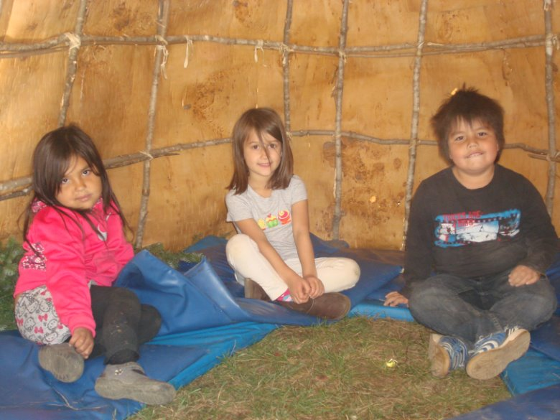
Co-construction of the program
Field expertise: Choosing essential skills
Cycle Committee: Review and follow-up throughout construction
Language and Culture: A program rooted in culture and promoting the integration of Indigenous languages
Special Education: Differentiation
Parental Involvement: Information and involvement of parents in the program
Literacy: Focus on First Peoples authors
Land-Based Learning: Practice promoted by the program

Slide 13
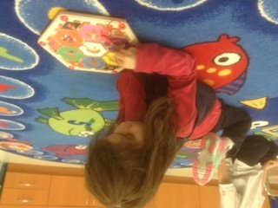
Skills progression

Slide 14
To go further: Continue to explore other skills with students who have already acquired the essential skills
Handling small objects (e.g. small blocks, buttons, puffballs, paper clips, pins).
Properly using the tools available ( e.g. scissors, glue, pencils, pen for drawing on the interactive whiteboards [IWB]).
Moving to avoiding obstacles.
Experimenting with active indoor and outdoor play (e.g. dancing, swinging, running).
Spontaneously using equipment that allows active play.
Repeating a newly learned action to facilitate consolidation.
Naming personal preferences and food preferences.
Discovering activities that allow them to expend energy.
Using caution when moving and handling certain objects (e.g. scissors, tablets).

Slide 15
Ask yourself: Observe the skills of the child with potential special needs
4 years
Cannot get up and down stairs without help.
Cannot balance on one foot.
Is unable to catch a ball.
Still has difficulty riding a bike or tricycle.
Has difficulty climbing on playground equipment.
Has difficulties with scissors and is unable to cut
in a straight line.
Pencil grip has not fully developed
(places all fingers on the pencil).
Does not favour one hand over the other yet.
Unable to copy a cross or a square.
5 years
Cannot go up and down the stairs alternating feet.
Cannot balance on one foot.
Cannot jump forward with feet together.
Cannot catch a ball with both hands.
Still has difficulty riding a bike or tricycle.
Is unable to cut out a square.
Has a lot of difficulty handling scissors.
Unable to copy a square or diagonal lines.
Cannot colour within the lines.

Slide 16
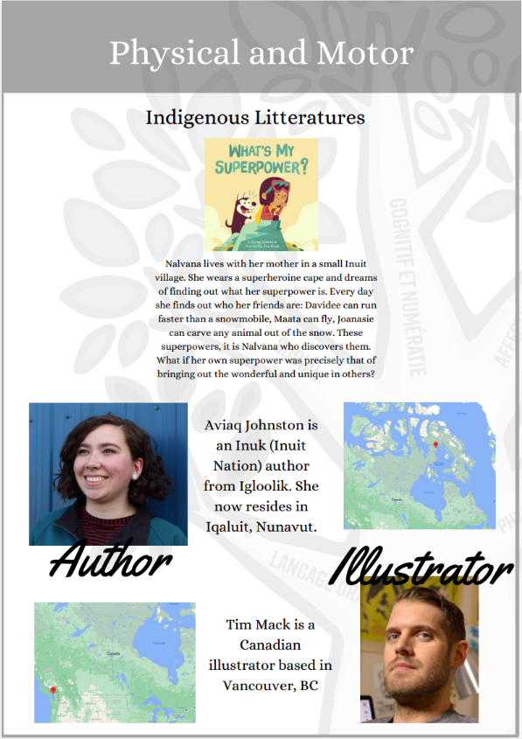
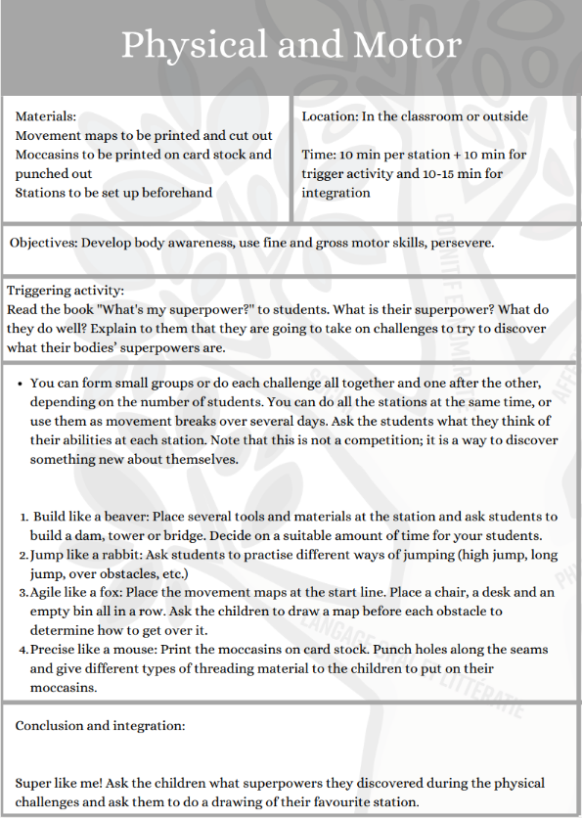
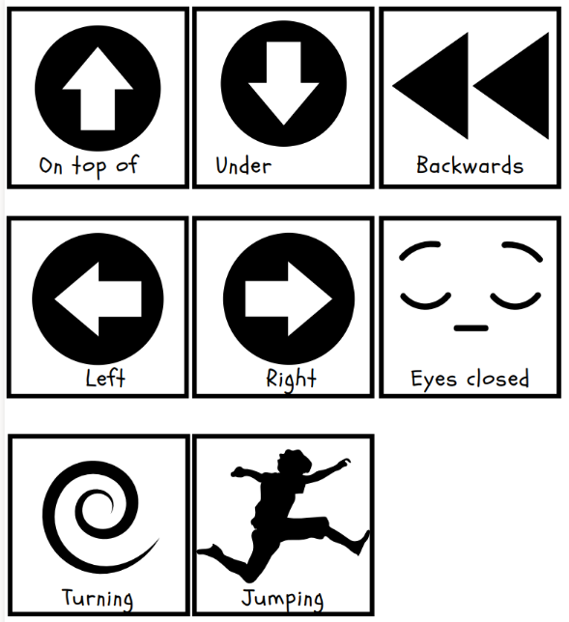
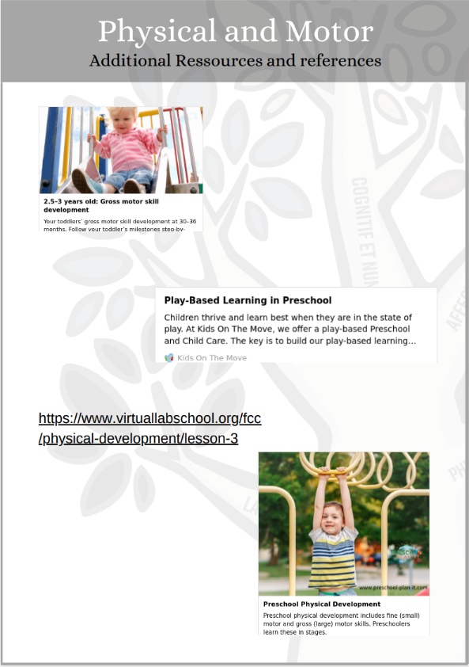
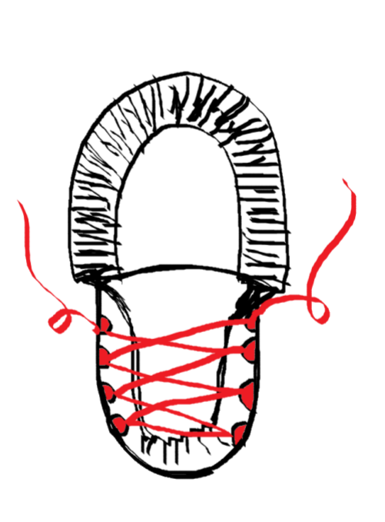
Activity workbook

Slide 17
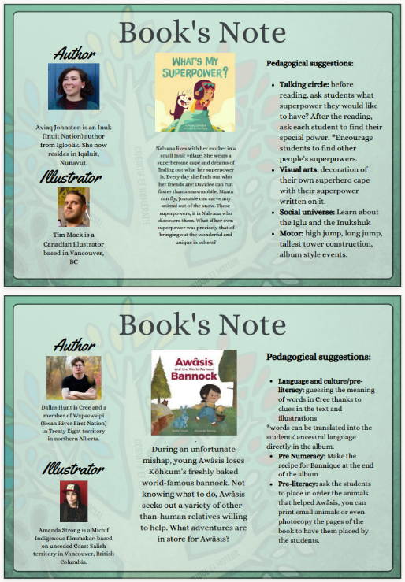
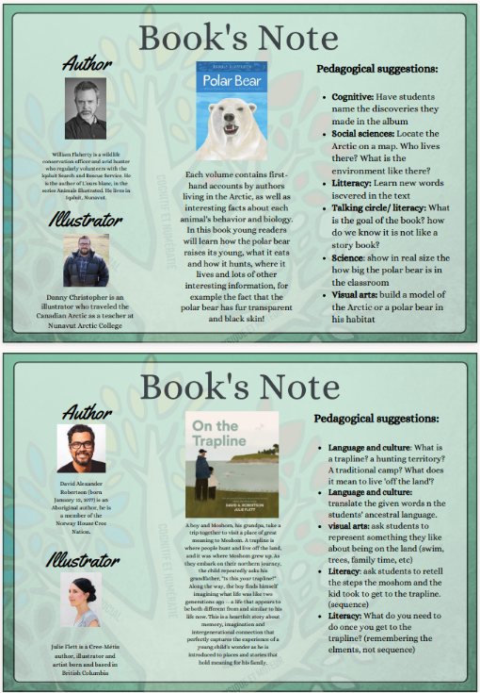
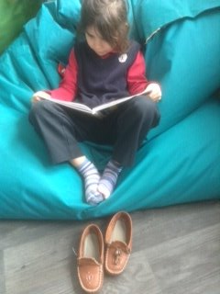
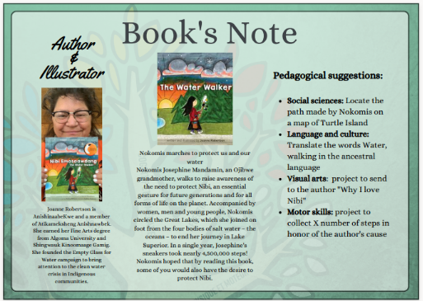
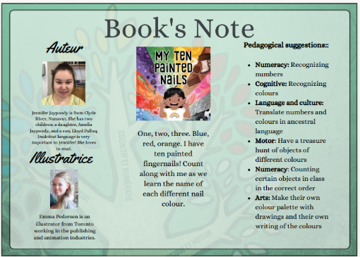
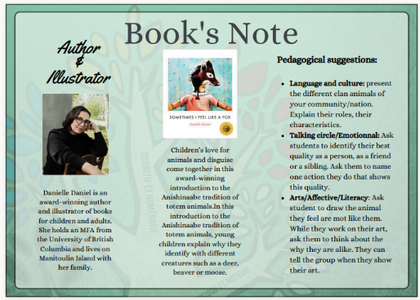
Literacy Boxes

Slide 18
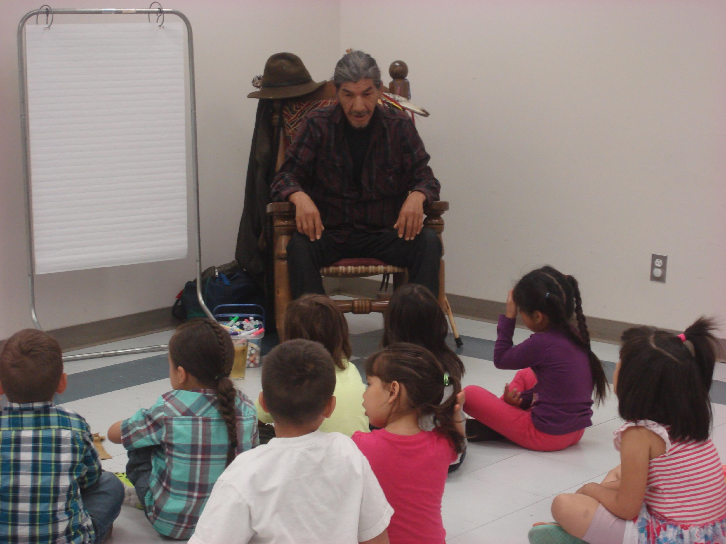
Learning Journey
Observations
Two versions available
Level of autonomy
Information mobility

Slide 19
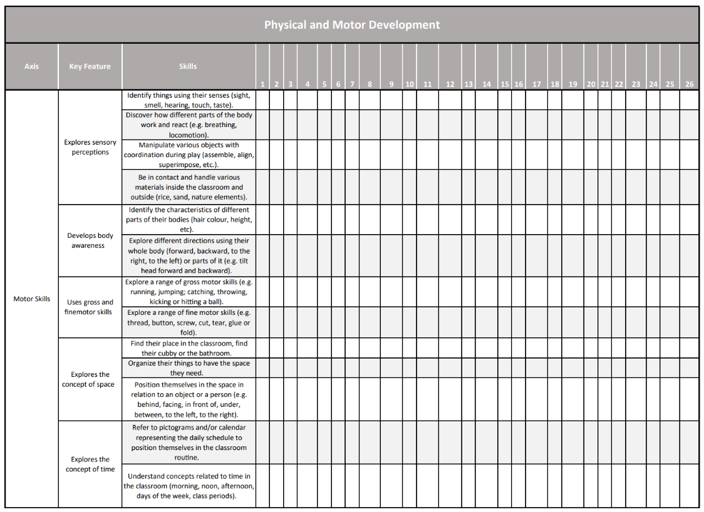
Observation sheets

Slide 20
Le déploiement du programme-cycle dans la communauté Atikamekw de Manawan
Notes:
Anne-Marie
The community, the school and the preschool team
Language and territory

Slide 21
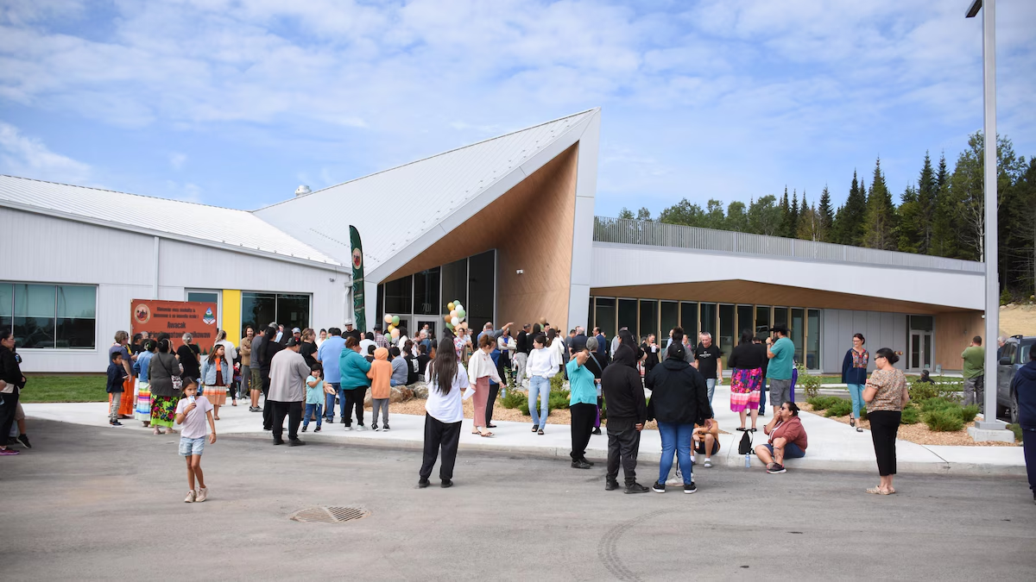
L’éducation préscolaire à Manawan
Mission des services éducatifs de Manawan
Assurer le développement intégral de l’enfant, en privilégiant particulièrement son instruction, sa réussite académique et sa socialisation afin qu’il devienne un citoyen autonome et responsable dans le respect, le maintien et la promotion de sa culture, sa langue et son identité atikamekw.
Ouverture en septembre 2024 de l’école primaire Awacak Okiskinohamatowikamikowaw
Photo: Ellie Moore, Radio-Canada, août 2024
Notes:
Anne-Marie
L’école des petits êtres de lumière

Slide 22
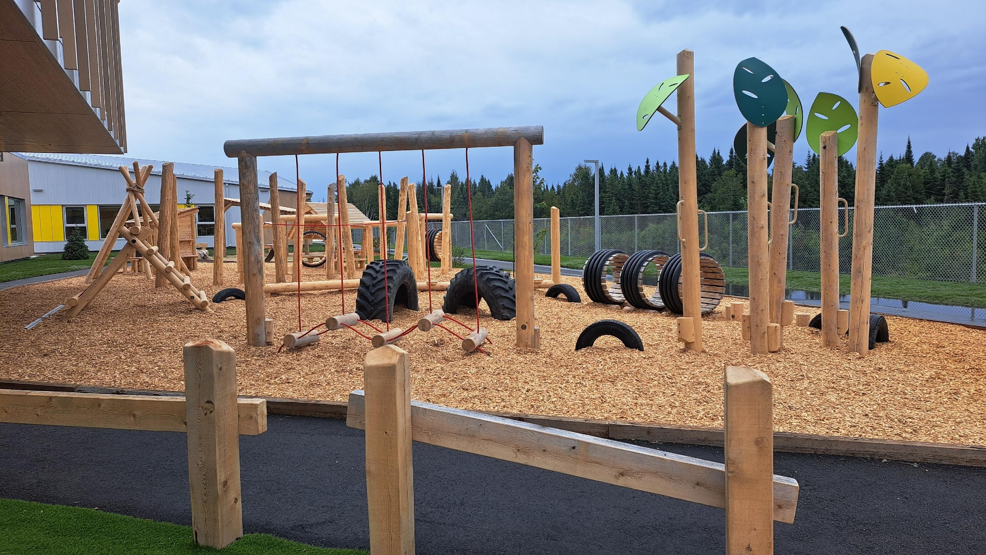
L’éducation préscolaire à Manawan
5 groupes de maternelle 4 ans
4 groupes de maternelle 5 ans
Enseignantes, aides pédagogiques et responsable pédagogique toutes originaires de la communauté
Expériences professionnelles variées
Langues d’instruction = atikamekw et français
Notes:
Anne-Marie
Pour l’équipe du préscolaire, c’est une opportunité à saisir!
Rassemble tous les groupes de maternelle 4 ans et 5 ans dans un même milieu
Installations innovantes
Favorise la collaboration et l’intégration de la culture dans le développement des compétences

Slide 23
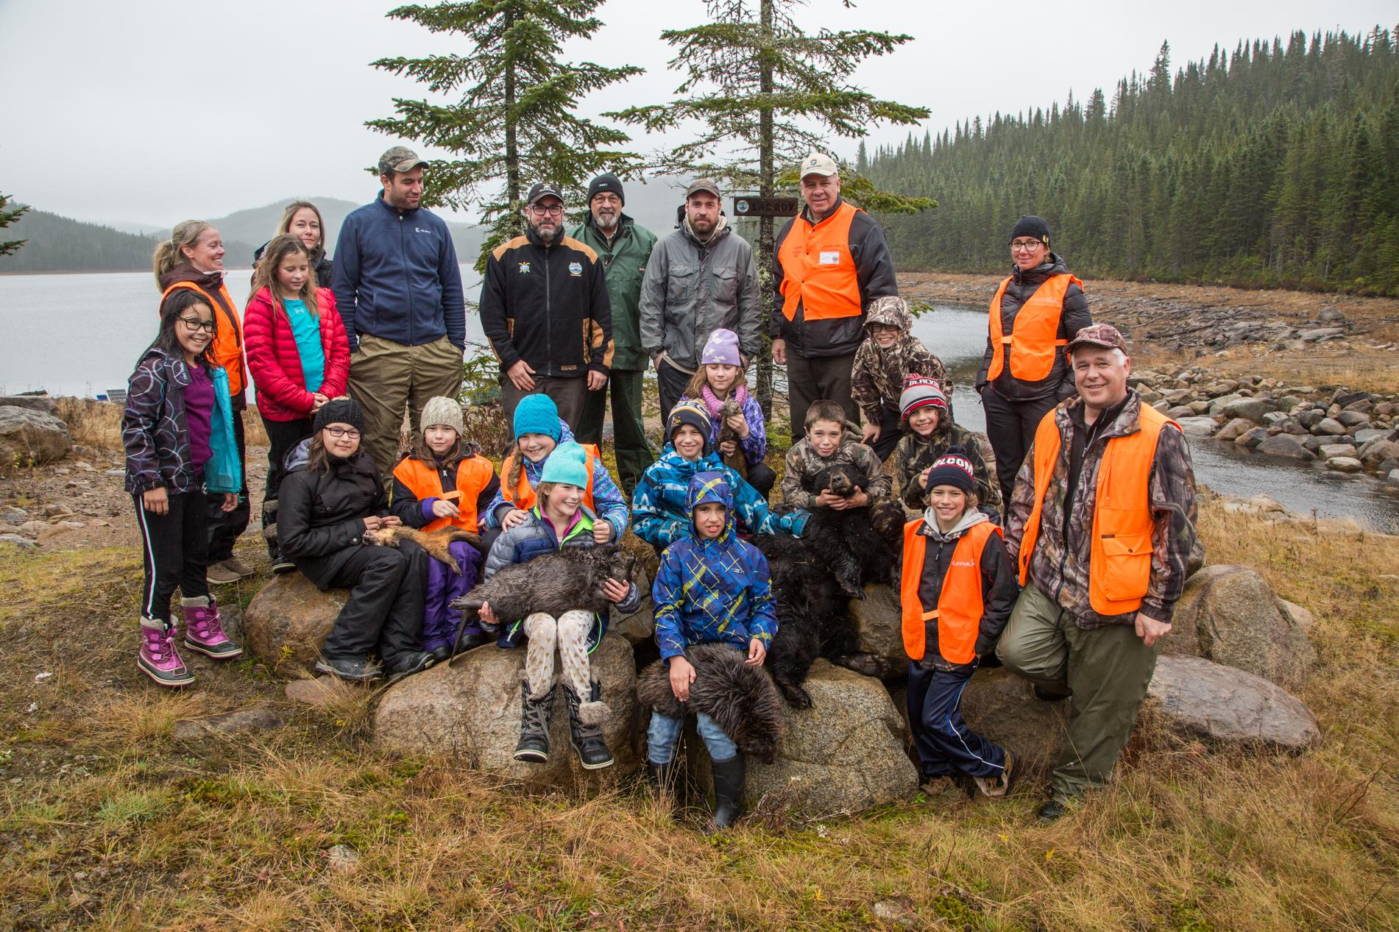
Planification annuelle culturellement signifiante
Étape 1: Établir un calendrier culturel
Territoire
Langue
Savoirs traditionnels
Littérature orale
Culture scolaire
Culture occidentale
Droits humains

Slide 24
Étape 2: Sélectionner des activités pédagogiques en lien avec les activités culturelles.
Étape 3: Lier les activités aux éléments du programme.
Étape 4: Explorer les ressources disponibles et développer les activités.

Slide 25
La chasse au castor
Mois | Activité culturelle | Activités pédagogiques | Domaines de développement | Éléments observables
Namekosi pisimw (Octobre) | Chasse au castor | Cuire la viande sur la braise | Domaine physique et moteur Saines habitudes de vie Domaine affectif Connaissance de soi | Explorer le monde alimentaire Observer, sentir, toucher et goûter des aliments Se sensibiliser à la sécurité Reconnaître des situations ou des éléments qui peuvent être dangereux Nommer certaines règles de sécurité Reconnaître ses besoins Demander de l’aide

Slide 26
Journée internationale des droits de l’enfant
Mois | Activité culturelle | Activités pédagogiques | Domaines de développement | Éléments observables
Atikamekw pisimw (Novembre) | Journée internationale des droits de l’enfant | Explorer ses droits avec le livre Mes droits et moi | Domaine social Habiletés sociales Domaine langagier Langage oral | Créer des liens avec les autres Se montrer sensible et respectueux à l’égard des émotions, des idées, des limites des autres Démontrer sa compréhension Démontrer par ses actions sa compréhension des messages verbaux Suivre les échanges ou y participer Élargir son vocabulaire Démontrer de la curiosité à l’égard des mots.

Slide 27
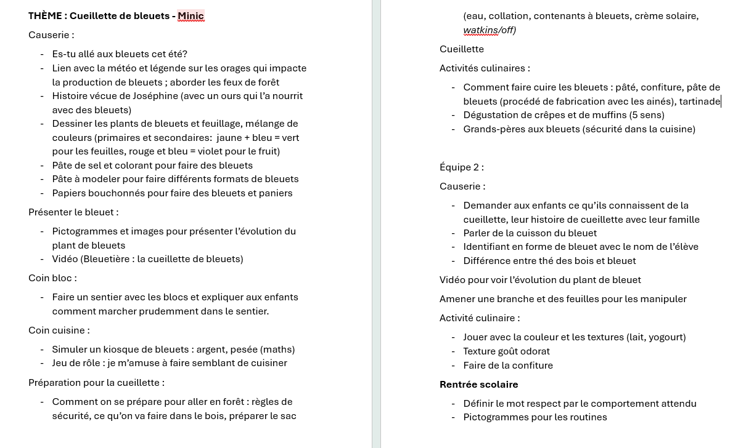
Tempête d’idées pour la rentrée!
Notes:
Créer une comptine en atikamekw sur le bleuet!

Slide 28
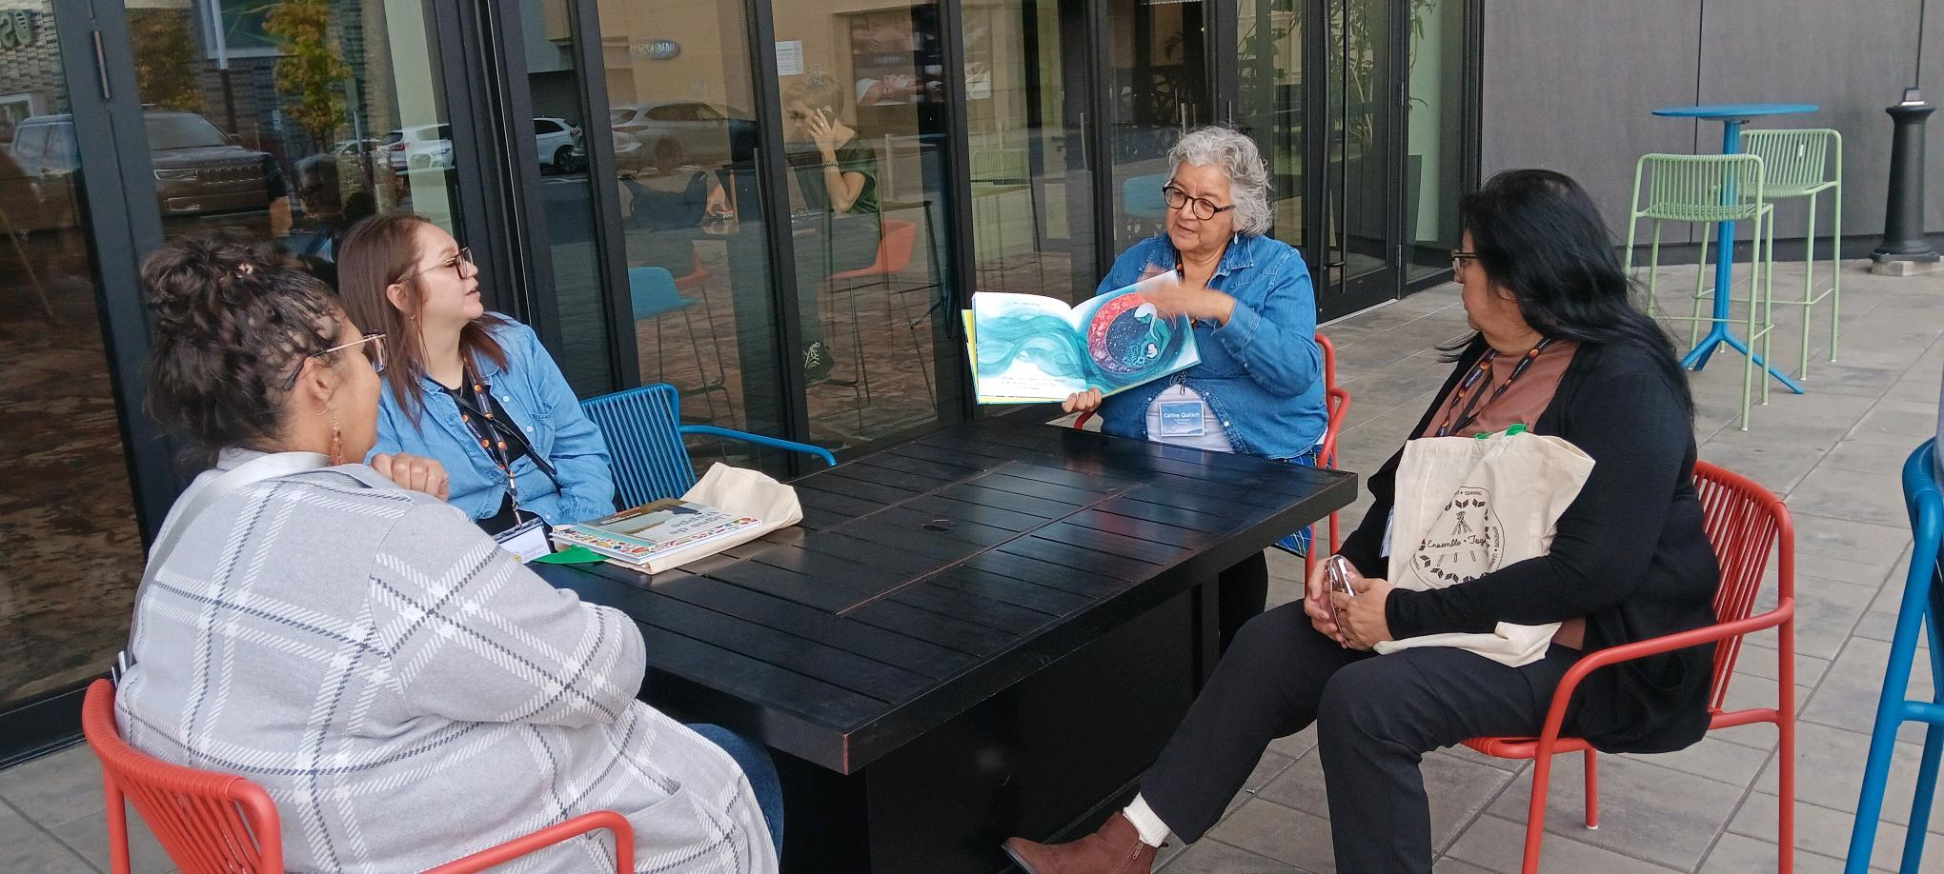
L’équipe en pleine action!

Slide 29
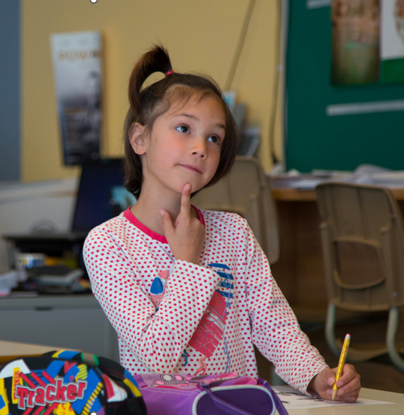
Et l’autonomie professionnelle, dans tout ça?

Slide 30
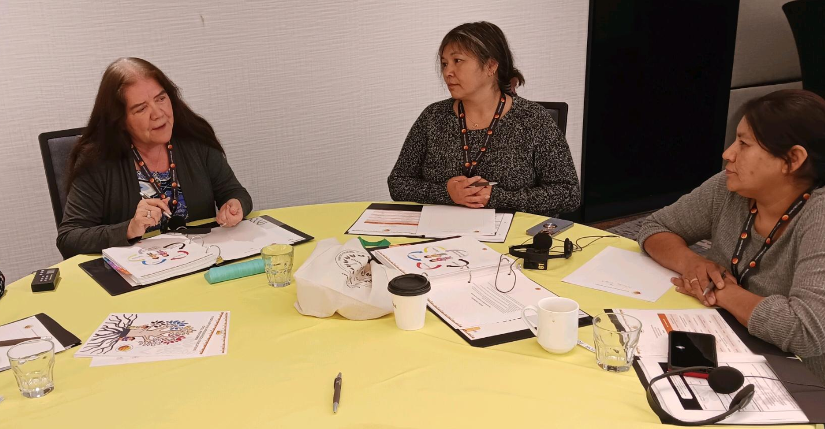
Le déploiement du programme se poursuit…
Partage de la planification de Manawan avec les communautés membres lors du Rassemblement préscolaire.
Utilisation de la démarche de planification culturellement signifiante par trois écoles:
Niska (Opitciwan)
Kateri (Kahnawà:ke)
Kitiganik (Barriere Lake)
Version 2.0 du programme-cycle à venir en 2026
Protocole d’inclusion des ainé.e.s
Formations variées

Slide 31
Discussion
Notes:
Anne-Marie
The community, the school and the preschool team
Language and territory

Slide 32
