Slide 1
A Virtual Dialogue with First Nations
Assembly of First Nations, Lands Sector
June 2024

Slide 2
Presentation Overview
Introductions
Background
Co-Development Update
Addressing Arbitrary Limits on Financial Compensation
Next Steps
Discussion

Slide 3
Webinar Purpose
The purpose of this webinar is to seek feedback directly from First Nations on experiences and challenges in seeking equitable compensation for their specific claims.
Feedback received will assist the AFN in its advocacy efforts and its ongoing specific claims co-development work with Canada.

Slide 4
Background
For generations, First Nations have called for a fully independent process to resolve their specific claims against the Crown.
AFN planned and carried out a comprehensive engagement process in the fall of 2019 with First Nations nationally seeking input into what a fully independent specific claims process should look like.
This engagement led to the development of a draft AFN Proposal based on First Nations input and rigorous peer review. The AFN published the finalized Proposal on the AFN website in May 2022.

Slide 5
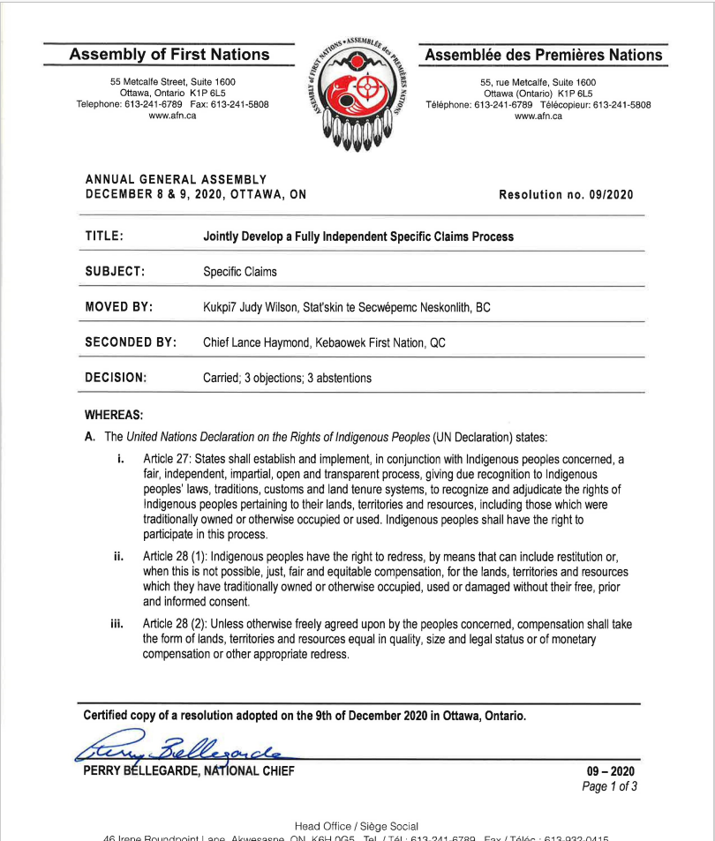
AFN Mandate: Co-Development
AFN Resolution 09/2020, Jointly Develop a Fully Independent Specific Claims Process directs the AFN to work jointly with Canada to develop a fully independent specific claims process consistent with the United Nations Declaration on the Rights of Indigenous Peoples and the following principles:
The Honour of the Crown
Full Independence of all Aspects of Claims Resolution
Recognition of Indigenous Laws
No Arbitrary Limits on Financial Compensation

Slide 6
Background (Continued)
In November 2022, the Government of Canada and the Assembly of First Nations held a public ceremony to initiate the joint development an Independent Centre.
The Government of Canada’s commitment to the establishment of an Independent Centre is included in the United Nations Declaration National Action Plan.
The Specific Claims Implementation Working Group (SCIWG) is responsible for co-developing options for consideration by federal Cabinet and First-Nations-in-Assembly. The SCIWG is composed of technical experts and senior officials from AFN and Canada.

Slide 7
Co-Development Update
Since November 2022, the AFN and Canada have met regularly to co-develop an Independent Centre.
The AFN and Canada have reached alignment on the main functions of the Independent Centre – a Registrar, a Funding Division, a Resource Hub, an Alternative Dispute Resolution Body, and access to the Specific Claims Tribunal.
The AFN and Canada have a generational opportunity to transform the resolution of specific claims by establishing an Independent Centre. However, the upcoming election poses a challenge to the passage of required legislation.

Slide 8
Elements of an Independent Centre: AFN/Canada Discussion Paper
In February 2024, the SCIWG conducted a three-day co-development session with an independent facilitator to resolve issues and arrive at consensus to form a joint document for the purpose of consultation and engagement
This led to the recent publication of the AFN-Canada Discussion Paper that describes the main functions of an Independent Centre.
The discussion paper also sets out the areas where AFN and Canada do not have alignment. These include how to address the $150 million cap on financial compensation at the Specific Claims Tribunal.

Slide 9
Addressing the Tribunal Cap on Financial Compensation

Slide 10
The Specific Claims Tribunal Act
The Specific Claims Tribunal Act was jointly developed between the Assembly of First Nations and the Government of Canada in 2008 and resulted in the creation of the Specific Claims Tribunal (the Tribunal).
The Tribunal remains the only independent mechanism that may rule on the validity of a specific claim and award compensation. However, the Tribunal is limited by the statutory cap of $150 million limit on financial compensation.
This limit exists despite the Tribunal’s “distinctive task of adjudicating [specific] claims in accordance with law and in a just and timely manner”.

Slide 11
Process for Claims above the Cap
Claims valued over $150 million that meet the definition of specific claims are not considered a new type or category of claim under the Specific Claims Policy and process. However, these claims require the Minister to obtain a discrete mandate prior to being accepted for negotiation.
The process for resolving these claims is difficult, lacks transparency, and does not meet the minimum standards in the UN Declaration.
For negotiations involving claims above $150 million, the Government of Canada may apply significant risk discounting to account for the fact that the First Nation cannot access the Tribunal.
If First Nations pursue their claims in the Courts, the Government of Canada can and has applied technical defences based on statues of limitations and the common law doctrine of laches.

Slide 12
AFN Mandate: Financial Compensation
First-Nations-in-Assembly passed AFN Resolution No. 53/2022, Fair Resolution of Claims over $150 million:
Direct the AFN to urge the Government of Canada to remove the $150 million limit on financial compensation at the Specific Claims Tribunal and ensure that all resolution mechanisms are equitable and consistent with the United Nations Declaration.
Direct the AFN to work jointly with Canada to establish principled mechanisms to resolve all specific claims regardless of value through a new, fully independent specific claims process.

Slide 13
The UN Declaration
In June 2023, the Government of Canada passed the United Nations Declaration Act and the United Nations Declaration Action Plan that requires the Government of Canada take all measures necessary to align its laws and policies with the UN Declaration.
Article 28 of the United Nations Declaration on the Rights of Indigenous Peoples states:
Indigenous Peoples have the right to redress, by means that can include restitution or, when this is not possible, just, fair and equitable compensation, for the lands, territories and resources which they have traditionally owned or otherwise occupied or used, and which have been confiscated, taken, occupied, used or damaged without their free, prior, and informed consent

Slide 14
Domestic Legal Principles
Key decisions from the Tribunal and the Supreme Court of Canada have dramatically changed the landscape for specific claims compensation. This means that many claims are above the $150 million compensation limit the Tribunal may award.
Specific Claims Tribunal compensation case law: Huu-Ay-Aht, Beardy’s and Okemasis and,
Supreme Court of Canada decisions in Williams Lake and Southwind

Slide 15
Real Value of $150 Million

Slide 16
Next Steps
Following AFN advocacy, the Senate of Canada adopted an Order of Reference that the Senate Committee on Indigenous Peoples inquire on specific claims compensation, including the $150 million compensation limit at the Tribunal
The House of Commons Committee on Indigenous and Northern Affairs (INAN) released its land restitution study, We Belong to the Land: The Restitution of Land to Indigenous Nations which clearly calls for the removal of the $150 million cap on financial compensation.
The AFN will continue to call for the removal of all arbitrary limits to financial compensation.

Slide 17
Discussion Questions
What has your experience been in seeking compensation for large value specific claims?
What is your perspective on First Nations having to estimate the value of their claim in the absence of funding to undertake expert compensation analysis prior to filing with the Tribunal?
How would the removal or adjustment of the $150 million cap on compensation support your First Nation in resolving your claims?
What would a transparent, UN Declaration compliant, and accountable mechanism look like in negotiation for claims over $150 million?

Slide 18
Discussion Questions
Currently the Minister of Crown Indigenous Relations may approve settlement agreements up to a value of $150 million. Would increasing the Minister’s authority to approve settlements be beneficial?
Would increasing the original $150 million limit for inflation and regularly raising the limit be beneficial to First Nations?
What other changes could be made to the Specific Claims Policy and Process to ensure that First Nations have access to fair and equitable compensation?

Slide 19
Questions / Discussion

Slide 20
Thank you! Please feel free to contact us if you have further questions/comments: Aaron Asselstine, Director, Lands Sector – aasselstine@afn.ca Jesse Donovan, Associate Director, Lands Sector - jdonovan@afn.ca

