Slide 1
Advancing First Nations’ Environmental Leadership
Room 512AB, Palais des Congrès de Montréal
July 8, 2024
3:00pm – 5:00pm ET

Slide 2
Overview
Opening Prayer
Opening Remarks – Regional Chief Kluane Adamek
Introductions
Climate Leadership: First Nations Climate Leadership Agenda
Conservation Leadership: National Biodiversity Strategy and Action Plan & Nature Accountability Act
Environmental Health: Right to a Healthy Environment Implementation Framework & Environmental Justice Strategy
Impact Assessment
Discussion

Slide 3
Climate Leadership
Graeme Reed, Strategic Advisor, Environment, Lands and Water Branch
Mel White, Policy Analyst, Environment Sector

Slide 4
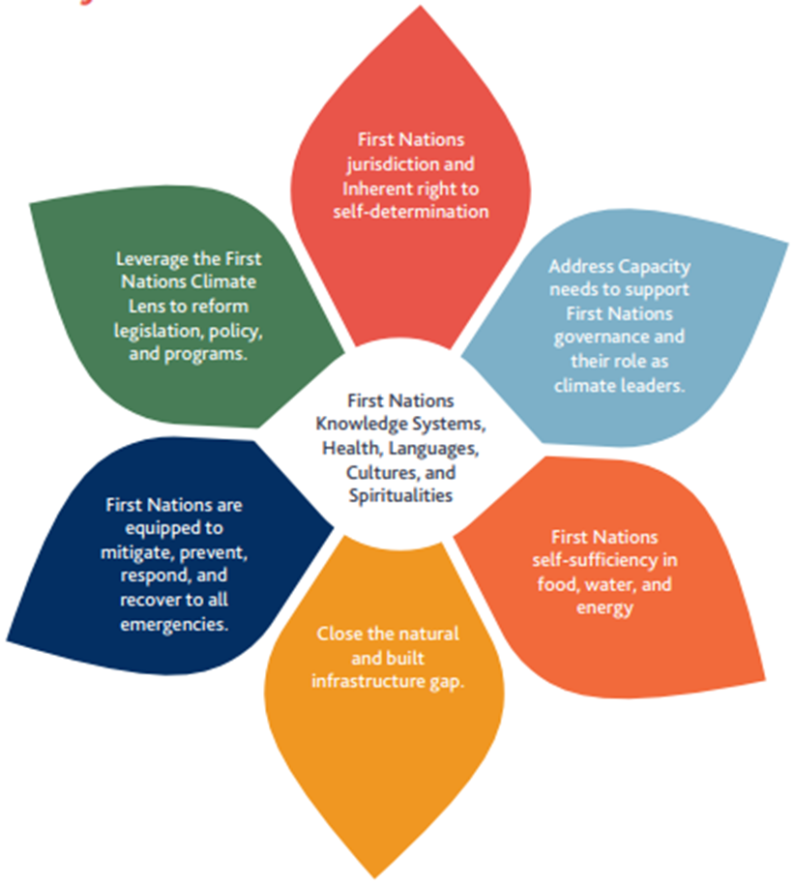
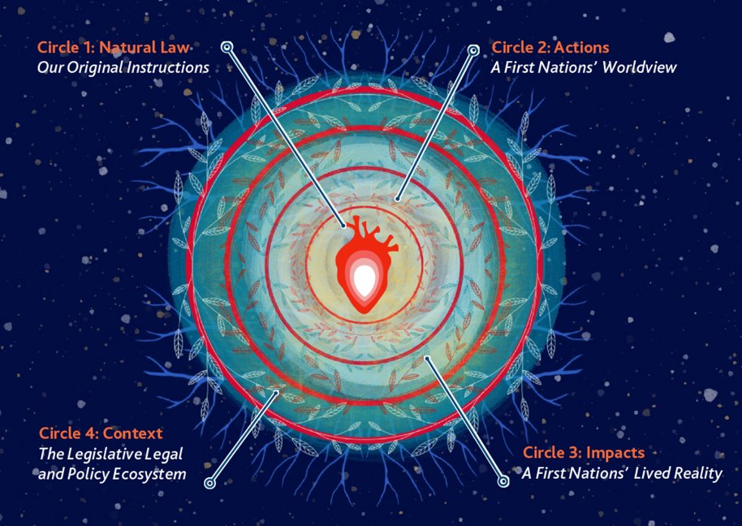
Climate Leadership: AFN National Climate Strategy

Slide 5
Climate Leadership: First Nations Climate Leadership Agenda – Where are we?
Original funding for Indigenous Climate Leadership was $29.6 million over three years (2022-23 to 2024-25), led federally by Environment and Climate Change Canada (ECCC) and Crown-Indigenous Relations and Northern Affairs Canada (CIRNAC)
Funding has been directed to First Nations governments and organizations, known as "Regional Leads".
Hosting discussions within their regions and territories to develop distinctions based, regional recommendations to advance their own climate action and leadership.
Hosted Technical (May 2023 and Feb 2024) and Leadership (June 2024) meetings between Regional Leads and relevant federal Ministers
One more Technical Meeting and Leadership Meeting will be hosted before the outputs

Slide 6
Climate Leadership: First Nations Climate Leadership Agenda – National Technical and Leaders' Meetings
Throughout the process, three Leaders' Meetings were committed to take place to ensure political accountability and continue the advancement of the FNCL-A.
The first Leader's meeting was held between Regional Chief Adamek and Minister Guilbeault in 2023, with the second Leaders' meeting having taken place in Ottawa on June 19th, bringing together First Nations leadership and federal Ministers to discuss priorities, actions and solutions to address climate change priorities. A third Leaders' Meeting will be held in Fall 2024.
In addition to the Leaders' meetings and to further support collaborative dialogue on the FNCL-A, two separate national level technical meetings were held to bring together First Nations Regional Leads, and representatives from the AFN and the Government of Canada. A third technical meeting is scheduled to take place in late Summer 2024.

Slide 7
Climate Leadership: First Nations Climate Leadership Agenda – Outputs
Outputs have been framed in two parts:
A Memorandum to Cabinet to be introduced in Fall 2024
A First Nations Climate Leadership Agenda (FNCL-A) stand-alone document is being developed and led by First Nations, and is to be annexed to the MC.
The FNCL-A annexed to the MC will include interim recommendations. The final document will be finalized in Spring 2025, containing First Nations national and regional recommendations to uplift and advance self-determined First Nations Climate Leadership.
Political advocacy is needed to keep Canada accountable to the recommendations from First Nations regions.

Slide 8
Resolution 50/ 2024: Advocating for an ambitious, fully funded and implemented First Nations Climate Leadership Agenda
THEREFORE-BE-IT-RESOLVED, the First Nations-in-Assembly:
Call on the Government of Canada to ensure the full, direct, transparent, and unfettered participation of First Nations in the finalization of the First Nations Climate Leadership process, including in the Memorandum to Cabinet.
Call on all relevant departments in the Government of Canada to commit to fully implementing and funding the recommendations identified in the First Nations Climate Leadership Agenda, including regional-specific recommendations, ensuring stable, adequate, and long-term funding for First Nations rights, title, and treaty holders to implement their own climate priorities and strategies.
Direct the Assembly of First Nations (AFN), where appropriate, to support First Nations Regional Leads and First Nations leadership, in the design, development, and articulation of the First Nations Climate Leadership Agenda, building on regional priorities and the priority elements outlined in the AFN National Climate Strategy.

Slide 9
Resolution 50/ 2024: Advocating for an ambitious, fully funded and implemented First Nations Climate Leadership Agenda
THEREFORE-BE-IT-RESOLVED, the First Nations-in-Assembly:
4. Direct the AFN to work with First Nations rights- and title- holders to break-down siloes to ensure all relevant departments in the Government of Canada take a whole-of-government approach to implement the recommendations outlined in the First Nations Climate Leadership Agenda in federal climate policy.
5. Direct the AFN to provide an update to the First Nations-in-Assembly on the implementation progress on the First Nations Climate Leadership Agenda.

Slide 10
Conservation Leadership
Gerben Deinum, Senior Policy Analyst, Environment Sector

Slide 11
Conservation Leadership
First Nations-led conservation and climate action are examples of the active assertion of self-determination, Inherent rights, title and jurisdiction (eg. Indigenous Protected and Conserved Areas and Guardians).
First Nations and Indigenous Peoples have been repeatedly recognized both domestically and internationally as critical and consequential leaders in achieving positive conservation outcomes (eg. IPBES 2019 Global Assessment Report).
There is an important opportunity for legal tools and mechanisms including Canada's National Biodiversity Strategy and Action Plan to meaningful recognize and position First Nations as rightful leaders in achieving international and domestic conservation commitments.

Slide 12
Conservation Leadership National Biodiversity Strategy and Action Plan
Canada's Commitments to the Convention on Biological Diversity (CBD):
At COP 15 (2022), Canada committed to halting and reversing biodiversity loss through its support for the adoption of the Kunming-Montreal Global Biodiversity Framework.
The KMGBF included strengthened Rights-based language.
This led to the development and pending implementation of Canada's National Biodiversity Strategy and Action Plan.
The Strategy was drafted from October 2023 - April 2024
Contains 23 targets and 4 over-arching goals to 2030 and beyond
AFN involvement
The AFN is mandated by the First Nations-in-Assembly to advocate for First Nations’ priorities in terrestrial and marine biodiversity-based work both domestically and internationally.
Resolutions 03/2019 and 07/2019

Slide 13
Conservation Leadership National Biodiversity Strategy and Action Plan
AFN involvement
Since October 2023, the AFN has provided technical feedback on 3 draft NBSAP versions released for public input
AFN contributed a First Nations in-text Section of the Strategy in addition to a First Nations Annex

Slide 14
Conservation Leadership National Biodiversity Strategy and Action Plan
NBSAP Identified Concerns
1) Absence of Real Transformative Change(s): | People and businesses must prioritize nature, biodiversity, and sustainability in decision-making Requires societal shift
2) Lack of Bridging the Gap Between Terrestrial and Marine Indigenous-led Conservation (land and water): | Closing the gap, lacks language and direction
3) Lack of mechanisms for Indigenous leadership and inclusion: | Indigenous-led conservation, Guardians, Traditional Knowledge

Slide 15
Conservation Leadership National Biodiversity Strategy and Action Plan
NBSAP Identified Concerns
4) First Nations' Culture, Knowledge, and Language: | Links between cultural and biological diversity, Indigenous knowledge, revitalization
5) Governance Barriers: | Indigenous-led conservation, Guardians, Traditional Knowledge
6) Implementation: | Cross- sector coordination and collaboration, reporting mechanisms, Funding and capacity building outcomes

Slide 16
Conservation Leadership National Biodiversity Strategy and Action Plan
NBSAP Key High-Level Recommendations
Inclusion of specific language that references First Nations’ rights and culture in relation to land, water, ice, and biodiversity
Targets within the current systemic and colonial processes may maintain the status quo; the need for transformative change of systems to action targets under NBSAP

Slide 17
Conservation Leadership National Biodiversity Strategy and Action Plan
NBSAP Key High-Level Recommendations
3. Policies, programs, and initiatives may be insufficient to achieve the targets, and halt and reverse biodiversity loss; rather, systemic changes and disruptive policies, programs, and initiatives must be devised to change the current trajectory
4. Progressive language is not enough – language and intent are meaningless without full and effective participation of First Nations throughout the design, planning, and implementation of the NBSAP

Slide 18
Conservation Leadership National Biodiversity Strategy and Action Plan
First Nations Annex
Provide contextual lens regarding how First Nations view the content of the NBSAP
Address gaps between Canada and First Nations' understanding of the NBSAP processes

Slide 19
Conservation Leadership National Biodiversity Strategy and Action Plan
First Nations Annex
Uplift First Nations-led conservation as critical to NBSAP achievements
IPCAs, Guardians, Indigenous-led Conservation.
Knowledge, Culture, and Language Revitalization, among others.
Holistic, interconnected, multi-faceted approach required.
First Nations' worldview and relationship with Mother Earth is the transformation necessary to change how we collectively approach conservation.
Informed by the First Nations Climate Strategy and Climate Lens
Conservation is Climate action

Slide 20
Conservation Leadership National Biodiversity Strategy and Action Plan
Nature Accountability Act (NAA)
Intended to legislate Canada to portions of its commitments in the NBSAP.
The Bill will also mandate transparent reporting processes on Canada’s efforts to meet its nature commitments.
Due to limited time to provide feedback, the AFN submitted an Informal Technical Review of the NAA in May 2024
KMGBF is the Why NBSAP is the How NAA is the Legislative Backing

Slide 21
Resolution 52/2024: Ensuring the Full and Effective Participation of First Nations throughout the Implementation of the NBSAP and Nature Accountability Bill
To continue in its advocacy and technical work, AFN Environment is seeking a Resolution to directly mandate these streams of work:
Full and effective participation of First Nations in NBSAP implementation
Recognition and protection of First Nations inherent and Treaty Rights and jurisdictions within the NAA
Continued advocacy direction, including the development of a First Nations Conservation Strategy and hosting of a First Nations Conservation Gathering

Slide 22
Resolution 52/2024: Ensuring the Full and Effective Participation of First Nations throughout the Implementation of the NBSAP and Nature Accountability Bill
THEREFORE BE IT RESOLVED that the First Nations-in-Assembly:
Call on the Government of Canada to ensure the full involvement of First Nations, including the First Nations Nature Table, in future the development and implementation of Canada’s National Biodiversity Strategy and Action Plan, and broader Nature Agenda.
Call on the Government of Canada to ensure that the Nature Accountability Act provides for the full recognition and safeguarding of First Nations inherent and Treaty rights, knowledge systems, and jurisdiction, as well as alignment compliance with the UN Declaration on the Rights of Indigenous Peoples.
Direct the Assembly of First Nations’ (AFN) to continue advocacy on First Nations leadership in conservation, including in affirming that the conservation of land and water cannot be divided, the creation of a First Nations Conservation Strategy, and the hosting of National First Nations Conservation Gatherings.

Slide 23
Environmental Health
Curtis Scurr, Director, Environment Sector

Slide 24
Right to a Healthy Environment (RTHE)
RTHE is a new provision introduced to the amended Canadian Environmental Protection Act (CEPA) through Bill S-5.
An obligations on the government to develop, within 2 years of the amendment coming into force, an implementation framework to set out how this right will be considered in the administration of CEPA.
Conducting series of engagement and information session, including Indigenous specific engagements.
AFN’s participation mandated through Resolution 65/2018 Closing the Environmental Protection Regulatory Gap on First Nation Lands.

Slide 25
RTHE Framework Requirements
The Framework must set out how the Right will be considered in administration of CEPA
The Framework must also elaborate on:
Principles to be considered (such as environmental justice – including the avoidance of adverse effects that may disproportionately affect vulnerable populations,)
Research, studies, monitoring in support of the Right
Reasonable limits - relevant factors to be taken into account when interpreting and applying the Right
Mechanisms to support protection of Right

Slide 26
Timelines

Slide 27
Why is RTHE Important to First Nations?
Strong ties with First Nations’ self-determination, lifeways, environmental protection, and overall well-being.
Concerns that the RTHE implementation framework will not appropriately consider the impact on First Nations rights, self-determination, knowledge systems, and priorities, including how it would address environmental injustices and the environmental protection regulatory gap faced by First Nations.
Assertion of First Nations rights and knowledge systems
Hold Canada accountable on matters relating to:
Inherent and Treaty Rights,
Environmental racism,
Pollution,
Climate action,
Conservation and loss of biodiversity,
Indigenous food systems, and
UNDRIP/UNDA implementation.

Slide 28
Current Status
February 8th, 2024 - RTHE Discussion document was published for public comment and feedback
February 13th, 2024 - with representatives from various industry associations and companies
February 15th, 2024 - GoC-led workshop with representatives from Indigenous organizations, civil society, non-governmental organizations, youth, and academia.
March 19th, 2024 - a follow-up engagement workshop, with representatives who attended the February workshops.
Concerns that the RTHE implementation framework will not appropriately consider the impact on First Nations rights, self-determination, knowledge systems, and priorities, including how it would address environmental injustices and the environmental protection regulatory gap faced by First Nations.
The AFN submitted a Technical Written Submission to outline concerns, and perspectives on the Discussion Document.
The AFN Technical Submission highlights key areas such as First Nations conceptualization of a healthy environment, a holistic approach to RTHE, and the need to uphold First Nations rights, honor commitments to reconciliation, and integrate First Nations knowledge systems.

Slide 29
Resolution 51/ 2024 Ensuring First Nations Full and Effective Participation in the Development of a Right to a Healthy Environment Implementation Framework and an Environmental Justice Strategy
THEREFORE BE IT RESOLVED that First Nations-in Assembly:
Call on the Government of Canada to acknowledge the intersecting, cumulative, and gender-based impacts of environmental racism, as well as its intersections with colonialism and the proposed Implementation Framework of a Right to a Healthy Environment, on First Nations.
Direct the Assembly of First Nations (AFN) to work with the Minister of Environment and Climate Change Canada and the Minister of Health to ensure the full and effective participation of First Nations in the development and implementation of a Right to a Healthy Environment framework, including:
the integration of First Nations knowledge systems,
protection of First Nations rights and self-determination, implementation of the United Nations Declaration on the Rights of Indigenous Peoples Act, fulfillment of reconciliation commitments, and
the identification of dedicated resources to enhance First Nations capacity and leadership in the entire process.
Direct the Assembly of First Nations to urge Parliament to pass Bill C-226 as soon as possible and call on Canada to work in full partnership with First Nations, especially those that have faced environmental racism, to develop a First Nations-led environmental justice strategy to address the intersecting, cumulative, and gender-based impacts of environmental racism and injustices faced by First Nations.
Direct the AFN, with the leadership of the Advisory Committee on Climate Action and the Environment (ACE), to work with the relevant federal departments to establish a bilateral mechanism between the AFN and the Government of Canada for bringing forward the environmental health and protection concerns and priorities of First Nations to the attention of the Prime Minister of Canada, the Minister of Environment and Climate Change Canada, and the Minister of Health.
Direct the AFN to work with the appropriate federal departments to expand First Nations environmental health and protection research and communication efforts, including appropriate opportunities for enhanced First Nations environmental health monitoring and the integration of First Nations perspectives, concerns, and knowledge systems into environmental protection risk assessment, management, and decision-making.

Slide 30
Impact Assessment
Andrea Lesperance, Senior Policy Analyst, Environment Sector

Slide 31
Impact Assessment:
Supreme Court of Canada (SCC) Amendments to the Impact Assessment Act (IAA)
SCC released its opinion that the IAA was, in part, unconstitutional
Bill C-69 Budget Implementation Act 2024 proposes to amend IAA
AFN appeared at Senate Standing Committee for Energy, the Environment and Natural Resources (ENEV) to advocate the IAA be strengthened for First Nations
Project List Regulation - 5 Year Review
Legislated timeline for reviewing Project List regulation
Agency will release a Discussion Paper imminently, 90-day comment period
AFN will advocate for the inclusion of projects that impact First Nations' and their Rights, as directed by resolutions

Slide 32
Impact Assessment:
Indigenous Co-Administration Agreement Regulation and Policy Approach
S. 114 IAA enables Minister to enter into agreements with Indigenous Governing Bodies, but self-imposed limitation that requires a regulation be adopted to recognise First Nations and Indigenous Governing Bodies (IGBs) for the purposes of such agreements
Agreements would allow First Nations to administer parts of the IAA, including potentially decision-making
Agreements do not necessarily enable First Nation-led assessments in line with Indigenous Legal Orders
Indigenous-led Assessments
First Nations have Inherent authority to undertake their own analysis of a proposed project under their Indigenous Legal Orders, and utilize these to provide or withhold free, prior and informed consent
Some mechanisms within governments to recognise such First Nation-led assessment
More needs to be done to ensure that governments respect these First Nation-led assessments

Slide 33
Discussion

Slide 34
Upcoming Event: September 20, 2024 Ottawa River Unceded Algonquin Anishinaabe Territory

Slide 35
AFN Water Walk: September 20, 2024 | Ottawa River
AFN Resolution 58/2022 Support for Annual AFN Water Walk
Raise national awareness about critical state of our water
Uplift roles of women, gender-diverse individuals, and youth in water protection
Contact Jamie Lavigne, AFN Director of Water: jlavigne@afn.ca

Slide 36
REGISTER NOW! October 7-10, 2024 Calgary TELUS Convention Centre, Calgary, Alberta AFN 3rd National Climate Gathering Catalyzing First Nations Climate and Conservation Leadership for Transformative Change For more information, please contact climategathering@afn.ca

