Slide 1

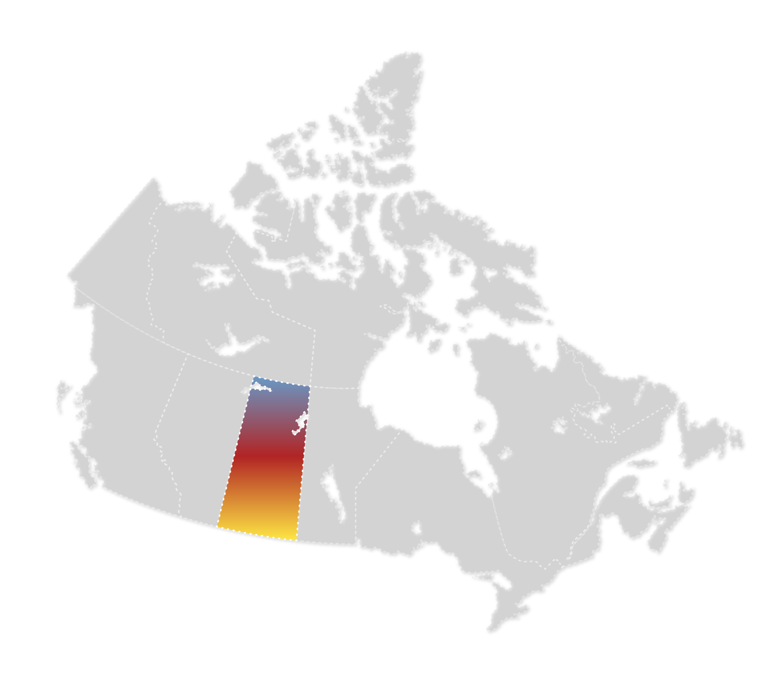
Alert Sovereignty with Anonymous Peer Support
...................................................................................
Assembly of First Nations - 2nd National Emergency Management Forum
March 7, 2024

Slide 2





..............................................................................
About Talking Stick
Program administered by the Federation of Sovereign Indigenous Nations,
developed and operated by TryCycle Data Systems and funded by Indigenous Services Canada.

Slide 3
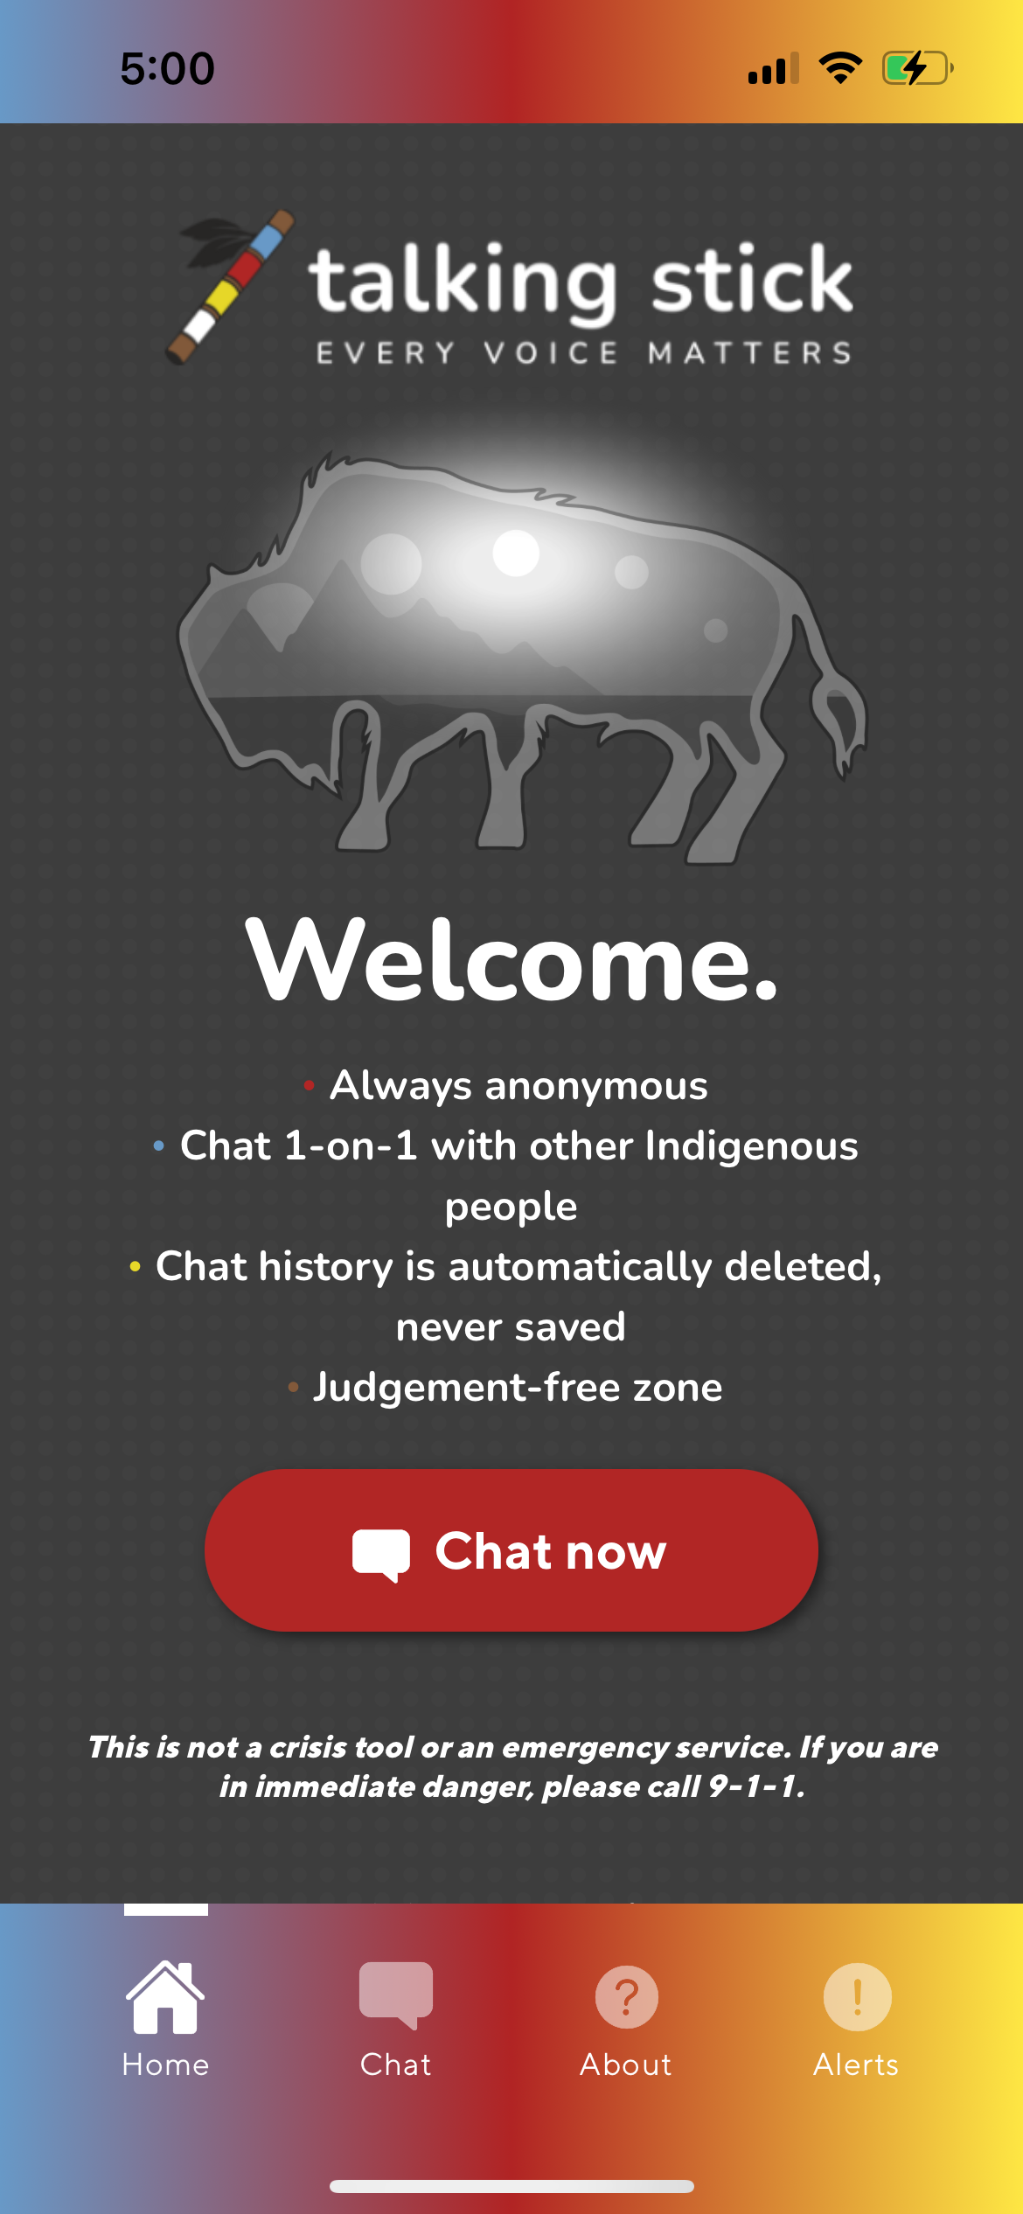
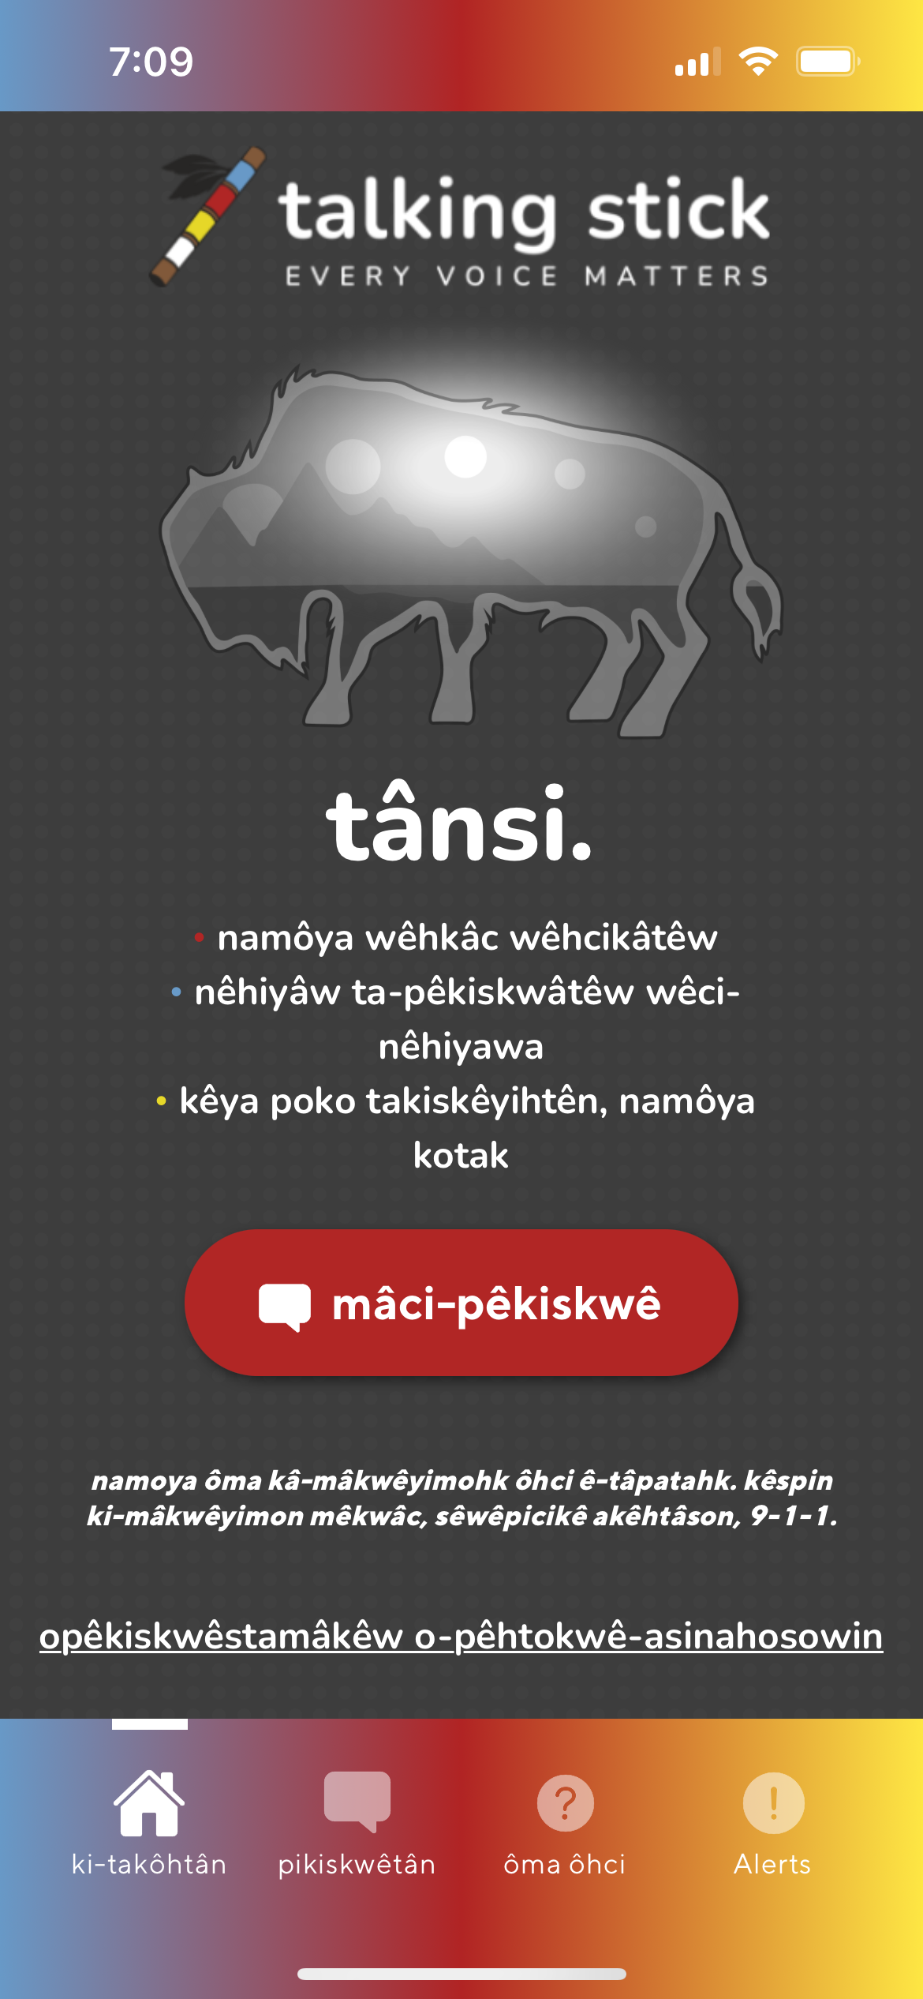
..............................................................................
Launched June 2022
By Indigenous, For Indigenous
Anonymous peer support
Available 24/7
13 language options
Lived Experience Indigenous Peers
Judgement-free, virtual safe space
my.talkingstick.app

Slide 4

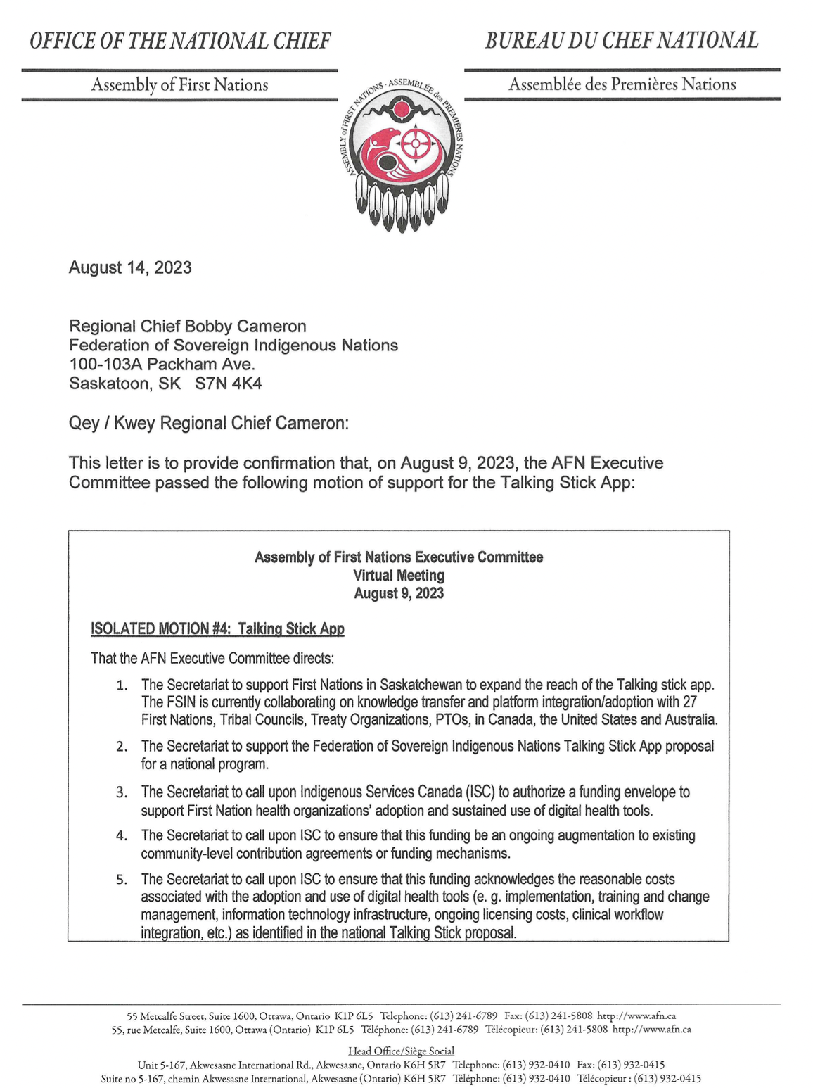
Motion of Support
August 2023
Talking Stick
National Program

Slide 5
200 New Jobs Created for Indigenous people in the province | 600+ Waitlist People who have applied to be a peer advocate | 89% Retention Rate Post-Secondary Practicum Student Placements
13,270 Total Chats Average response time to be connected to a peer advocate | 220,742 Total Messages Sent from anonymous guests in chats | 24K Visitors Unique chat page visitors (website and app combined)
25% Total Chats Average response time to be connected to a peer advocate | 31.5 Seconds Average response time to be connected to a Peer | 45% Loneliness Chats are from individuals feeling alone or lonely
Talking Stick
Program Impact

Slide 6
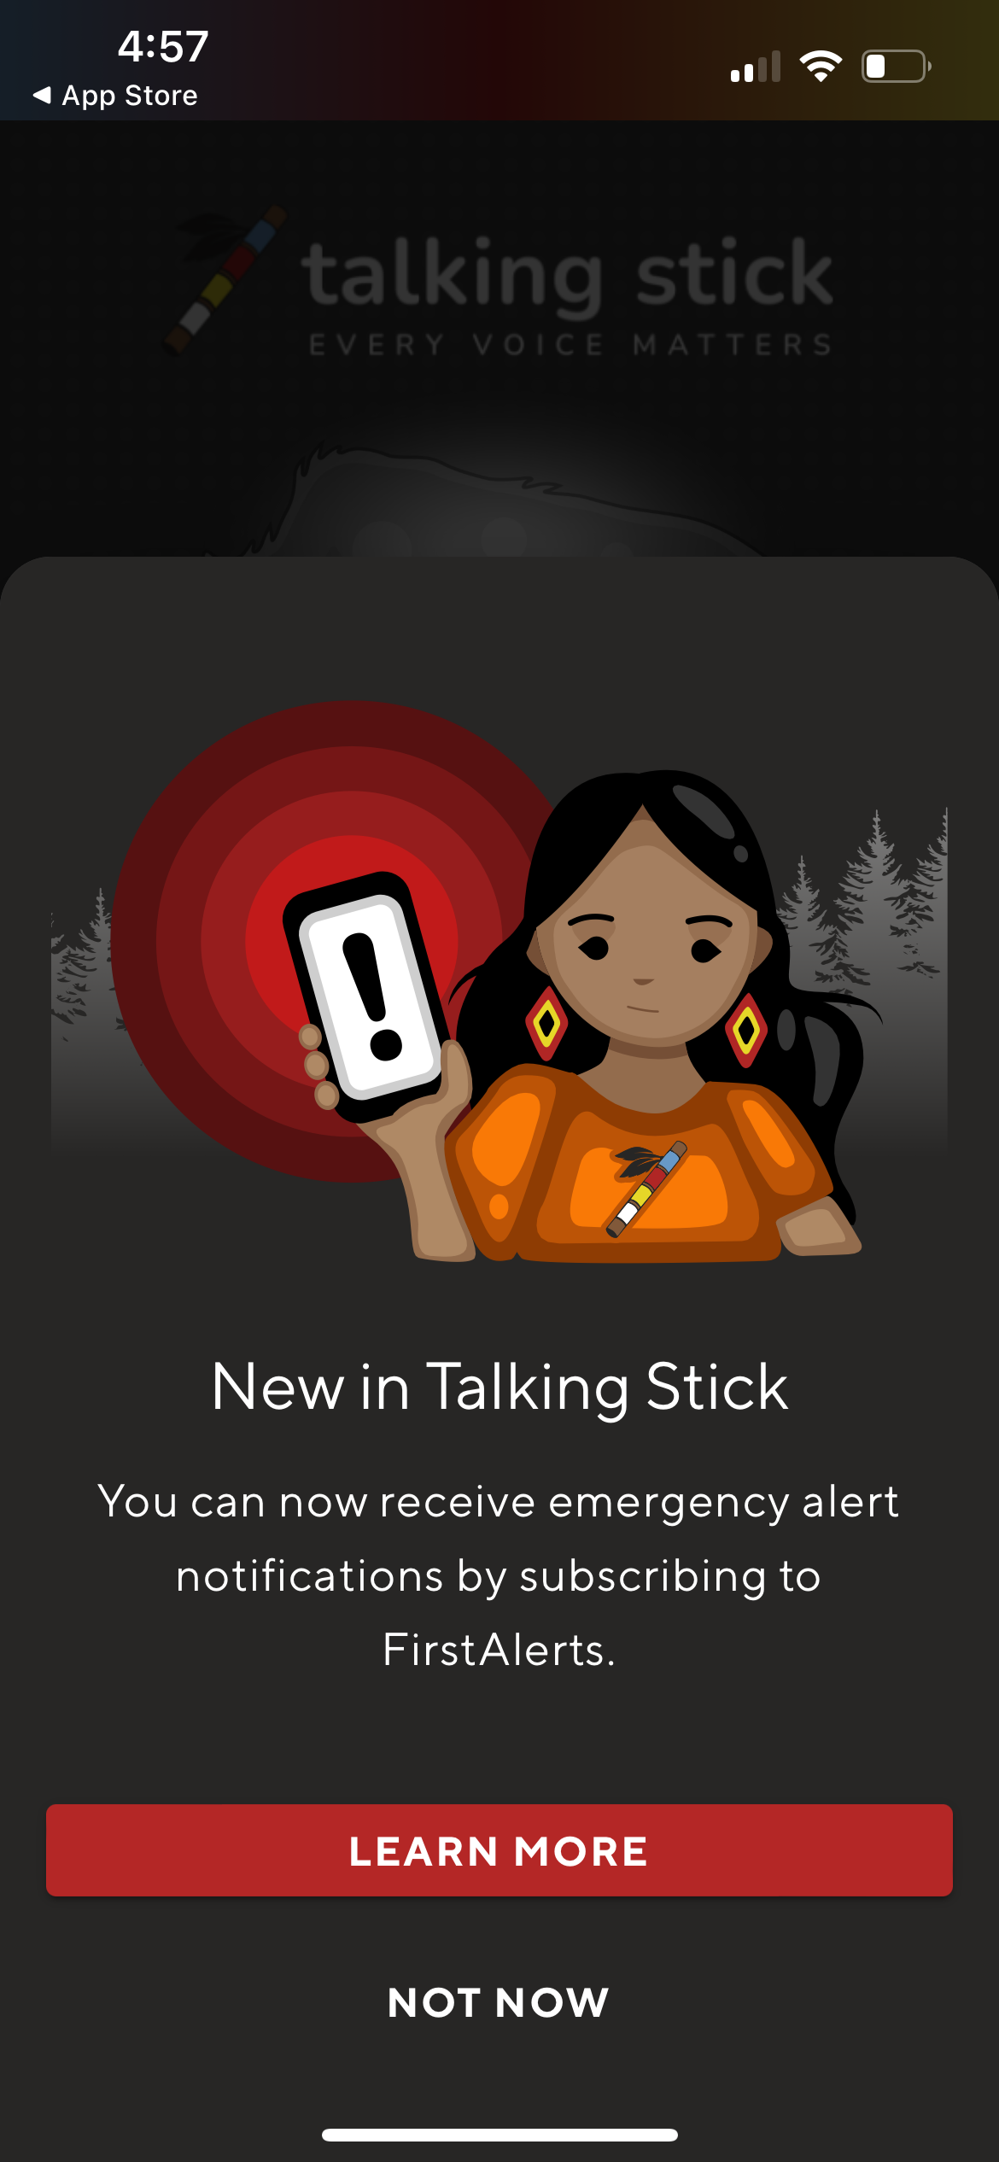



..............................................................................
Exclusive to Talking Stick
Public Safety
Missing Persons
Natural Disasters

Slide 7
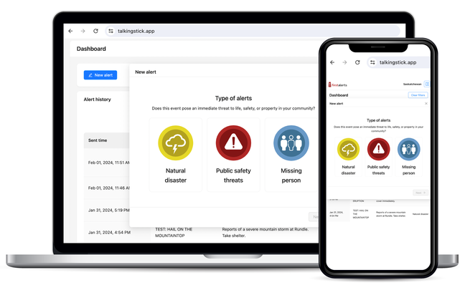
..............................................................................
Sovereign access to your own FirstAlerts Dashboard
Community-led and operated
Free to Use
Alert Autonomy
Send Alerts & Instructions In Seconds
Stay Informed, Stay Safe

Slide 8
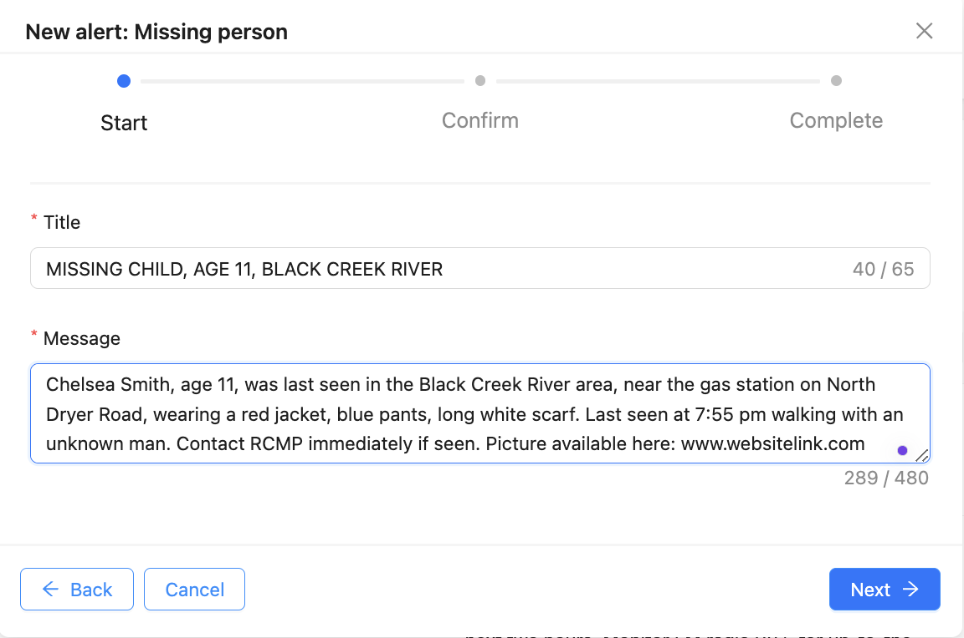
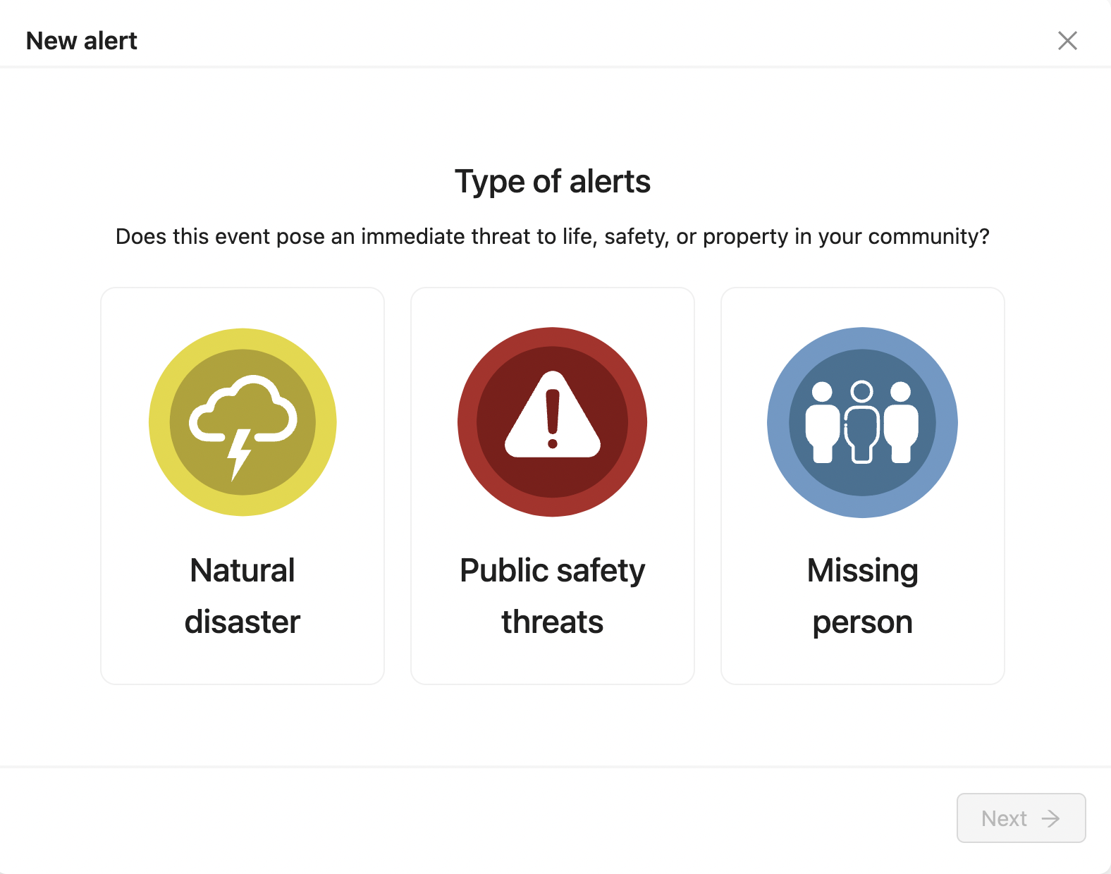
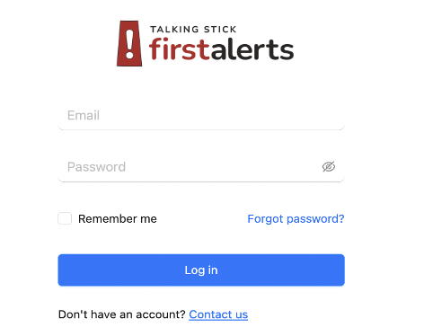
..............................................................................
How it Works
Community Leaders & EMT
Enter tailored messages in seconds, preview, and send in seconds
Login to YOUR Community Dashboard
Select the
Alert Type

Slide 9

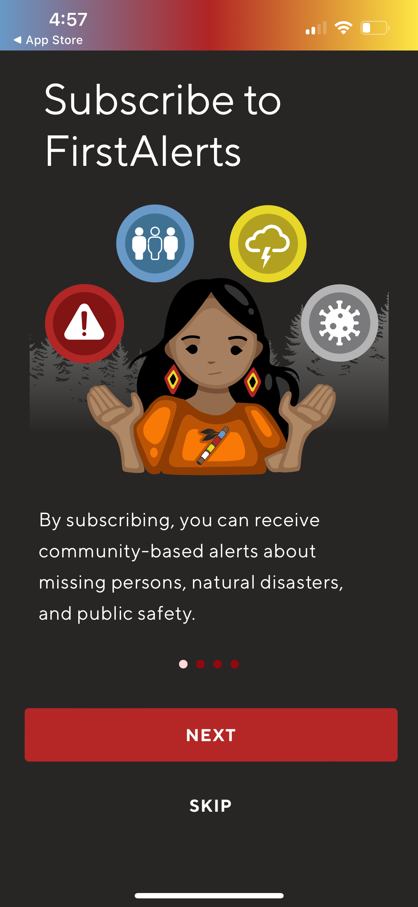
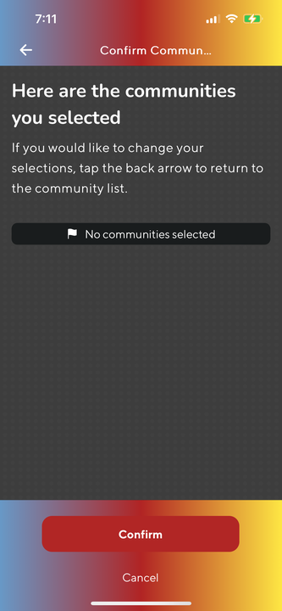

..............................................................................
How it Works
Community Members
  Chelsea Smith, age 11, was last seen in the Black Creek River area, near the gas station on North Dryer Road, wearing a red jacket, blue pants…
By Nation
By Tribal Council
By PTO

Slide 10
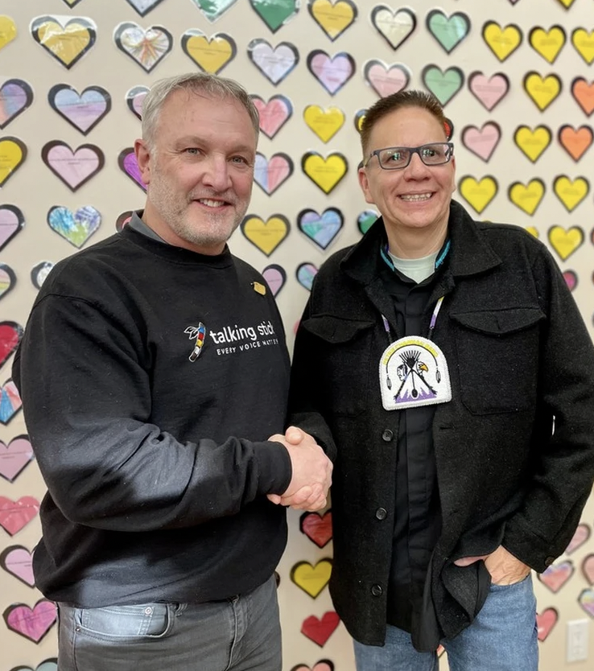
..............................................................................
February 14, 2024
“On James Smith Cree Nation, our members are going to be feeling more safe and secure. The FirstAlerts app will be another layer, to provide safety and security. For leadership, it means we can respond in real-time to immediate threats within the community.”
Chief Robert Head, Peter Champman Band

Slide 11
..............................................................................
29 Communities in 20 Days
James Smith Cree Nation |  | Mistawasis First Nation
James Smith Cree Nation - Chakastaypasin Band |  | White Bear First Nation
James Smith Cree Nation - Peter Champman Band |  | George Gordon
Wahpeton Dakota Nation |  | Kawacatoose First Nation
Lac La Ronge Indian Band |  | Northern Village of Pinehouse
Lac La Ronge Indian Band - Stanley Mission |  | Yorkton Tribal Council
Lac La Ronge Indian Band - Grandmothers Bay |  | Cote First Nation
Lac La Ronge Indian Band - Sucker River |  | Keeseekoose First Nation
Lac La Ronge Indian Band - Hall Lake |  | Beardy’s and Okemasis First Nation
Peter Ballantyne Cree Nation - Pelican Narrows |  | Fishing Lake First Nation
Peter Ballantyne Cree Nation - Sturgeon Landing |  | Onion Lake First Nation
Peter Ballantyne Cree Nation - Sandy Bay First Nation |  | Thunderchild First Nation
Peter Ballantyne Cree Nation – South end |  | Piapot First Nation
Peter Ballantyne Cree Nation – Deschambault Lake |  | Island Lake (Ministikwan Lake) Cree Nation
Peter Ballantyne Cree Nation - Denare Beach

Slide 12

..............................................................................
Holistic Approach to Community Safety
Alert Sovereignty
Anonymous Peer Support
Emergency
Alerts in Seconds
“The Place to Go To Know”

Slide 13

Visit our Website: my.talkingstick.app
Contact us: info@trycycle.ca
Carey O’Soup
FSIN Emergency Management
carey.osoup@fsin.com

