Slide 1
Supporting First Nations Border Mobility
Natasha Beedie, Director of Rights and Governance, AFN

Slide 2
Overview
AFN Mandates
AFN Activities
Border Rights
Interim Measures
Future Legislation
Next Steps

Slide 3
Introduction
The Canada-United States border affects First Nations’ daily movements, traditional practices, economic opportunities, and their family and cultural ties with Native Americans from the United States. The United Nations Declaration on the Rights of Indigenous Peoples affirms First Nations’, particularly those divided by international borders, have the right to maintain and develop contacts, relations and cooperation, including activities for spiritual, cultural, political, economic and social purposes, with their own members as well as other peoples across borders.
Canada and the United States share the worlds longest border of about 8,900 kilometers with 120 land ports-of-entry. Any changes to border security and the cross‐border flow of persons, goods, and information have serious implications for First Nation citizens living and working on both sides of the international border. The rights of Indigenous peoples to cross the border and trade across the border freely must be recognized and affirmed by Canada.

Slide 4
Introduction
Article 36 (1). Indigenous peoples, in particular those divided by international borders, have the right to maintain and develop contacts, relations and cooperation, including activities for spiritual, cultural, political, economic and social purposes, with their own members as well as other peoples across borders. 2. States, in consultation and cooperation with indigenous peoples, shall take effective measures to facilitate the exercise and ensure the implementation of this right.
Since its creation, the AFN has undertaken information-sharing and engagement with First Nations affected by border issues to support the advocacy and the implementation of their inherent and treaty rights- including the Jay Treaty.
The AFN advocates that First Nations border mobility rights are implemented and consistent with the United Nations Declaration on the Rights of Indigenous Peoples. The Treaty of Amity, Commerce, and Navigation of 1794 known as the Jay Treaty, recognizes the inherent right of all First Nations in Canada and the United States to pass freely through their own homelands.

Slide 5
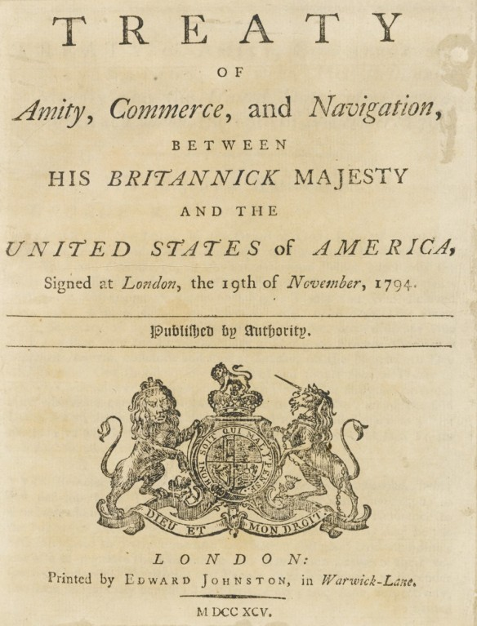
Border Rights
Jay Treaty
In 1794, the United States and Great Britain signed the Treaty of Amity, Commerce, and Navigation, also known as the Jay Treaty, to resolve issues resulting from the independence of the United States in 1776. Article III of the Treaty states that Great Britain and the United States would allow First Nations people to live on either side of the newly established border and to freely cross the border.

Slide 6
Border Rights
UNDA Action Plan #52
Pursue legislative amendments to the Immigration and Refugee Protection Act, amendment to relevant Regulations and revisions to policies in order to address complex border crossing and migration challenges faced by Indigenous peoples divided by Canada’s international borders, including options to amend Canada’s right of entry provision, and work and study permit requirements.
Engagement with Indigenous peoples and their representative organizations to implement the action plan measure is being initiated in 2023, with a view to advancing amendments and policy reforms in 2024. In parallel, the Government of Canada will continue discussions with international partners on Indigenous border crossing issues. (Canada Border Services Agency and Immigration, Refugees and Citizenship Canada)

Slide 7
AFN Mandates
73/2016 Explore Practical Solutions for Canada – U.S. Crossing by First Nations Citizens
Seek resources from the Canada to develop solutions for border crossing by First Nations
Develop a strategy and a Chiefs Committee to enable development of secure Indigenous border security ID cards
Report back to Chiefs-in-Assembly at 2017 SCA on progress of all work and discussions
20/2010 Support for Recognition of Nationhood of Iroquois Haudenosaunee Confederacy and the Validity of Indigenous Passports
Solidarity with Iroquois Confederacy to preserve their status as Indigenous Nations using their own passports for international travel
Canada to work with First Nations to establish a system of secure ID that does not require First Nations to declare they are Canadian
Support all First Nations who wish to strengthen their own treaty rights to border-crossing base on their own nationhood
59/2009 Support for Border Identification Cards
Demand that the identification cards that are developed by INAC.
That the border security features on the identification card be used separately by the First Nations Governments in Canada and that the First Nations be the ones in authority to distribute the cards to their members according their membership.

Slide 8
AFN Mandates
78/2008 Secure Status Card Initiative
AFN to advocate to the United States for the approval of the new Indian and Northern Affairs Canada (INAC) Secure Certificate of Indian Status (SCIS) card as an acceptable Western Hemisphere Travel Initiative (WHTI) travel document, as an interim measure, until such time as First Nations develop their own Nation card.
AFN to advocate for appropriate resources to support First Nations efforts to communicate, monitor, and research on SCIS ad the development of Nations cards and related border management issues
AFN to work with regional organizations and First Nations to ensure resources are available to support Indigenous ID card as a travel document
01/2006 Unified Strategy on Cross Border Identity Requirements
AFN to work with NCAI and develop a strategy to addressing ID cards and other border issues including the transport of sacred possessions
AFN to secure resources for developing a strategy to address border concerns and support the work of the joint AFN/NCAI technical team
Secure the participation of the federal government in a multilateral process involving Indigenous Peoples, Government of Canada and the U.S. to make an action plan to address border issues of concern
Proved a progress report on these efforts at next AFN AGA in 2006

Slide 9
International Indigenous Cross Border Security Summit (IICBSS)
In 2006 the AFN, NCAI, the Mohawk Council of Akwesasne, the St. Regis Mohawk Tribe, CBSA and the U.S. DHS held a summit with the outcome to have joint work where all Indigenous People can access the border without burdensome requirements in the spirit of recognizing Treaty rights.
At the time, the context was related to the U.S. Western Hemispheric Travel Initiative (WHTI) as a response to 9/11. Passports were required to cross the border which would inhibit First Nations to freely cross the border highlighting a need for a card meeting requirements of a passport.
September 2014 a second summit was organized to support dialogue and multilateral engagement on border crossing issues.
Border issues included recognition and protection of Indigenous border crossing rights, ID systems, policing, public safety and emergency management. Other issues included a proposed employment and employer verification requirements, intertribal trade and commerce, cross border child welfare, cultural property and sacred items. Impacts of the U.S. and Canadian federal bilateral initiatives such as the Border Action Plan, WHTI and the CIS.

Slide 10
Border Chiefs Committee
2010 Border Chiefs Committee meeting held at the AFN office in Ottawa with over 30 participants from First Nations and Indigenous and Northern Affairs Canada (INAC).
The position of the AFN was the processing and the distribution of CSIS should be under First Nations control.
Other First Nations added the importance of having Indigenous ID cards such as in Akwesasne and Haudenosaunee
Chiefs stressed the need to move forward in recognizing First Nations border crossing rights based in First Nations jurisdiction and nationhood. ID cards accepted at the border is a fundamental issue that should be resolved based on First Nations nationhood, rights, and citizenship.

Slide 11
Beyond the Border Working Group (BBWG)
Established by the Governments of the United States and Canada that examined ways to streamline border security and improve border travel for citizens.
First Nations provided submissions to the working groups outlining the First Nation context of border mobility. Citing the UN Declaration and the Jay Treaty.
The submission listed 13 recommendations related to adequate engagement, rights implementation and trade.

Slide 12
Canada-U.S Legislation and Enforcement
IRCC Right of entry of citizens and Indians
19 (1) Every Canadian citizen within the meaning of the Citizenship Act and every person registered as an Indian under the Indian Act has the right to enter and remain in Canada in accordance with this Act, and an officer shall allow the person to enter Canada if satisfied following an examination on their entry that the person is a citizen or registered Indian.
Right of entry of permanent residents
(2) An officer shall allow a permanent resident to enter Canada if satisfied following an examination on their entry that they have that status.
CBSA
The Canada Border Services Agency (CBSA) facilitates the flow of legitimate travellers and trade. The agency also enforces more than 100 acts and regulations that keep our country and Canadians safe.
U.S. Customs and Border Protection
Detect and prevent the illegal entry of individuals into the United States. Together with other law enforcement officers, the Border Patrol helps maintain borders that work, facilitating the flow of legal immigration and goods while preventing the illegal trafficking of people and contraband.
United States-Mexico-Canada Agreement (USMCA) entered into force on July 1, 2020, replacing NAFTA as the free trade agreement for North America.

Slide 13
Interim Measures
Temporary measures to reunite families across the Canada–US border will allow eligible Indigenous people whose family members live in Canada to:
work or study in Canada with some requirements waived
extend their stay for up to three years (for those who are already in Canada)
Effective October 10, 2024
Applicants must apply in advance before they travel to Canada.
Those who are already in Canada can also apply from inside Canada.
Applications can’t be made at the border (port of entry).

Slide 14
Future Legislation
New legislation and amendments to existing legislation could:
move Indigenous border mobility out of the Immigration and Refugees Act (IRPA) and into a new act
provide right of entry to members of certain First Nation, Inuit and Métis collectives in Canada
provide the ability to work and study without a permit
ensure that Indigenous persons with a right of entry are no longer considered ‘foreign nationals’
as a result, inadmissibility provisions under IRPA would no longer apply
for persons previously found inadmissible, there would be processes to promptly resolve findings

Slide 15
Unaddressed First Nations Concerns
Restrictions on trade and personal goods
Review of the restrictions on traditional medicine and artifacts and improper handling by CBSA officers
ID cards.
Jay Treaty is a symbol of rights recognition. Implementing provisions can resolve most, if not all border issues.

Slide 16
AFN Draft Resolution
Support for the Advancement of First Nations Self-Determined Solutions at the Canada – United States Border
THEREFORE BE IT RESOLVED that the First Nations-in-Assembly:
Direct the Assembly of First Nations (AFN) to call on the Government of Canada to affirm First Nations treaty and inherent rights, title and sovereignty with respect to Border Mobility.
Direct the AFN to call on the Government of Canada to meaningfully engage with First Nations on the development and implementation of legislative, policy or regulatory amendments related to Action Plan Measure #52 from the United Nations Declaration on the Rights of Indigenous Peoples Act National Action Plan. .
Direct the AFN to seek resources from the Government of Canada to co-develop permanent solutions for Canada – United States border crossing by First Nations for endorsement by First Nations-in-Assembly.

Slide 17
Next Steps
Funding Proposal submitted to the IRCC to support work on engagement with First Nations, policy development, and analysis
Resolution mandating AFN on direction concerning border issues

Slide 18
Discussion Questions
What are the primary challenges First Nations experience when crossing the Canada-US Border?
What additional supports are needed for First Nations to engage in this work?
Are there additional policies or legislation required to be introduced/ repealed/ or amended to support First Nations border mobility?

Slide 19
Contact
Natasha Beedie, Director of Rights and Governance, Assembly of First Nations- nbeedie@afn.ca

