Slide 1
Canadian Earthquake Early Warning System
Henry Seywerd
Program Manager EEW
2024.03
Seconds save lives!

Slide 2
Earthquakes Background
How to prepare and respond
Earthquake Early Warning

Slide 3
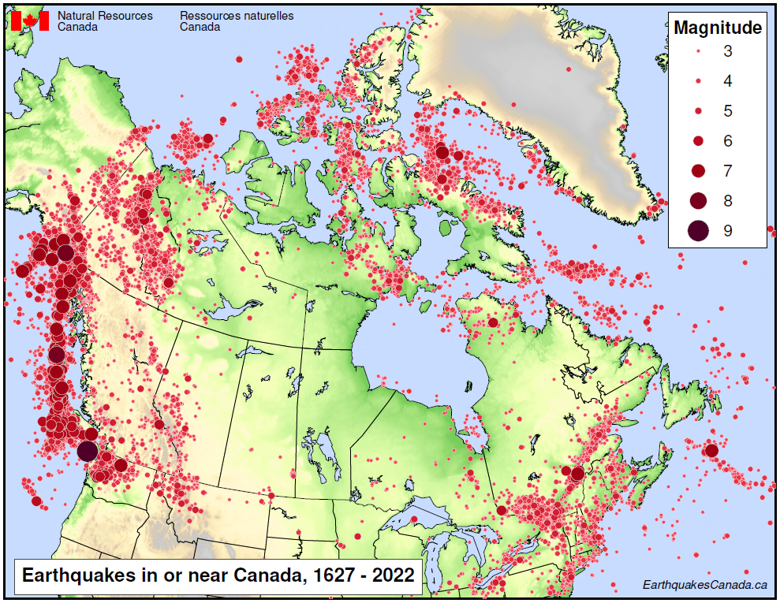
Earthquakes in Canada
Indigenous histories of earthquakes over past centuries
Seismic monitoring since 1898
~5,000 earthquakes located each year in Canada
Largest earthquakes occur along west coast of BC
Significant earthquakes also in ON, QC, & YT
Notes:
- Indigenous history of earthquakes going back hundreds/thousands of years
- Instrumental monitoring since 1898
- modern network records ~5,000 earthquakes each year
- greatest seismic risk (earthquake hazard, plus populations & infrastructure) is in western BC, eastern ON, & southern QC

Slide 4
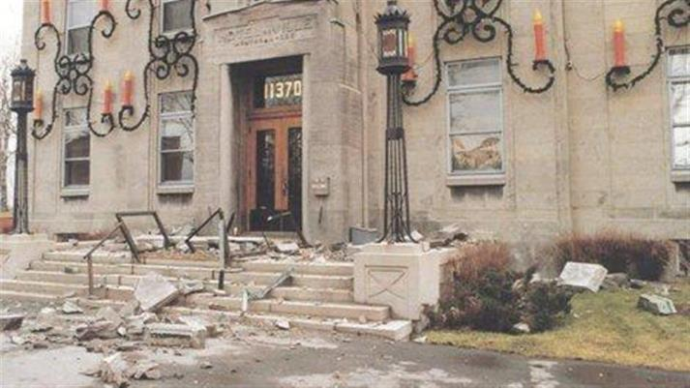
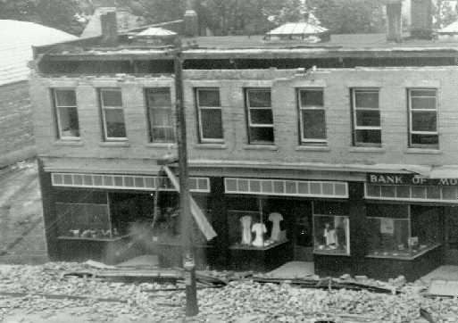
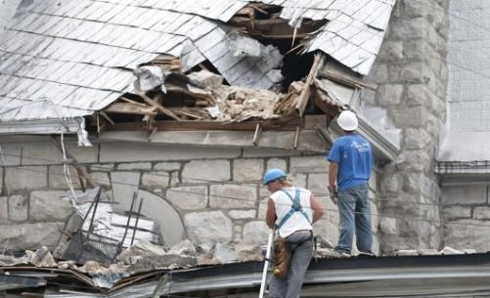
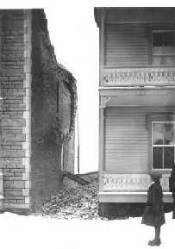
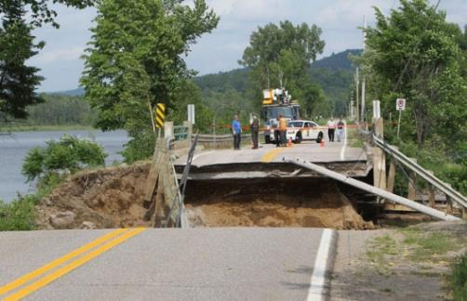
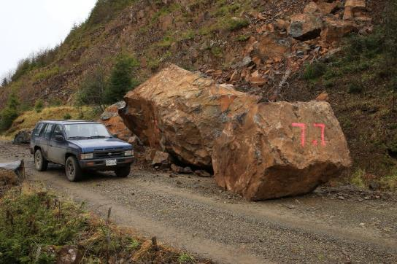
Damaging Canadian Earthquakes
Vancouver Island 1946 M7.3
Saguenay
1988 M5.9
Val des Bois 2010 M5.0
Greg Brooks, NRCan
Charlevoix
1925 M6.2
Jean Levac, Ottawa Citizen
Haida Gwaii 2012 M7.8

Slide 5
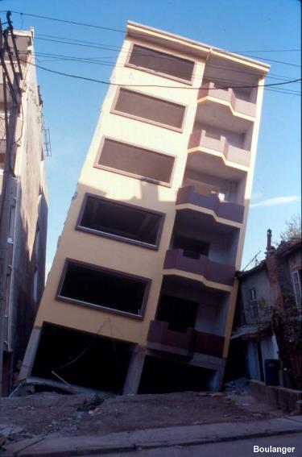
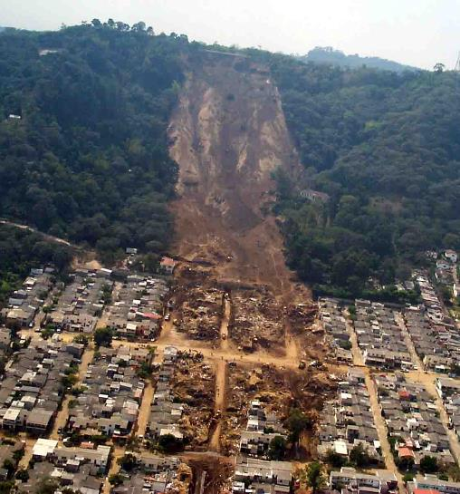
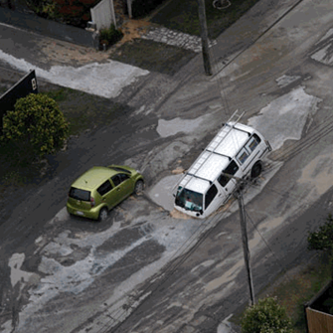
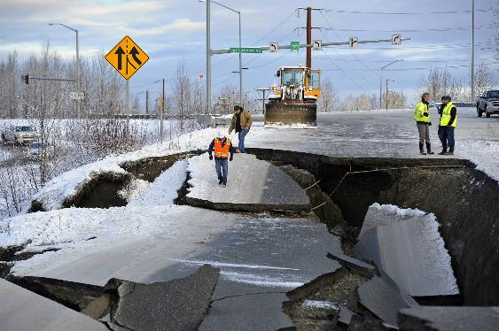
Landslides & Liquefaction
USGS; Boulanger
Notes:
Earthquakes can trigger secondary hazards, such as:
- landslides (there were innumerable landslides triggered on Haida Gwaii as a result of the 2012. M7.8 earthquake
[image from San Salvador eq, where little damage from shaking, but l.s. destroyed several blocks]
- slumping and liquefaction, which can damage roadways and cause buildings to sink slightly or tilt
[images: centre = Alaska eq caused slumping – roadway damage; right-top: liquefied soils caused bldg. to tilt in Turkey from KokaeIi eq; right-bottom: liquefaction in Christchurch damaged many roadways & liquefied sands covered many gardens]
- and tsunami…

Slide 6
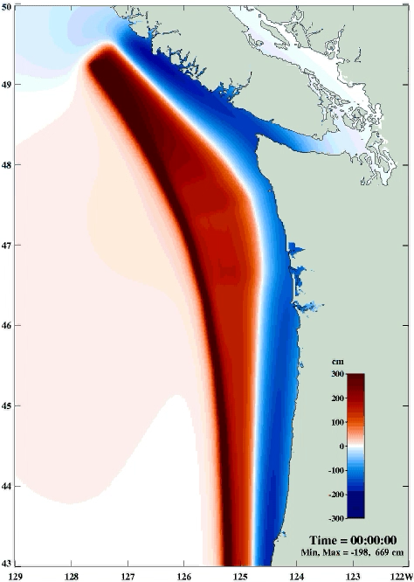
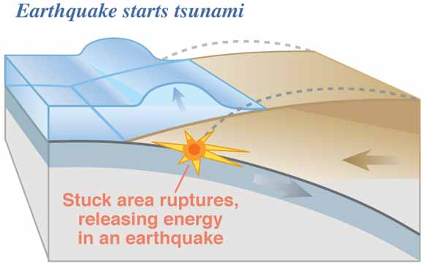
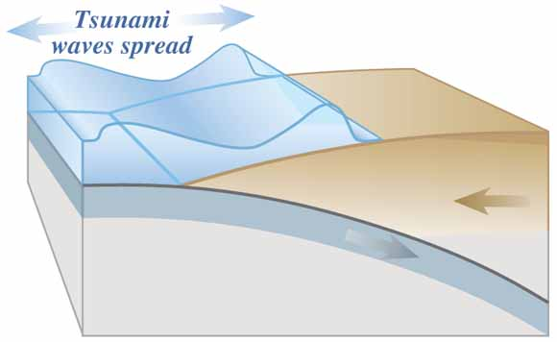
Tsunami
a series of ocean waves generated by:
subduction style earthquake (~90%),
landslide (coastal or submarine – occasionally triggered by earthquake),
other phenomena (e.g., volcanic eruption, meteor impact)
USGS
CHS
Department of Fisheries and Ocean’s CSZ model does not show how far inland waves travel
the first wave is usually not the highest
Notes:
[N.B. video of tsunami model does not show true height nor inundation – simply timing and relative heigh of waves.]
- re. “the first wave is usually not the highest” – initial wave in Chile only ~20cm, but 3rd wave was 2.4m – stay evacuated high up!
[N.B. people often come down to watch subsequent waves, but are swept away by higher waves.]

Slide 7
Earthquake Background
How to prepare and respond
Earthquake Early Warning

Slide 8
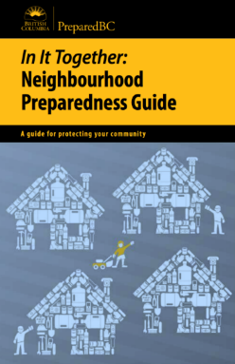
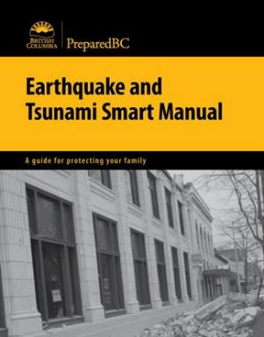
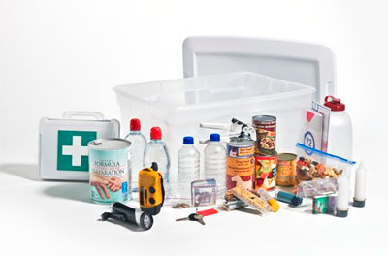
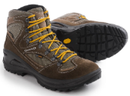

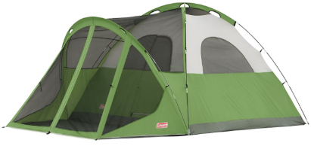
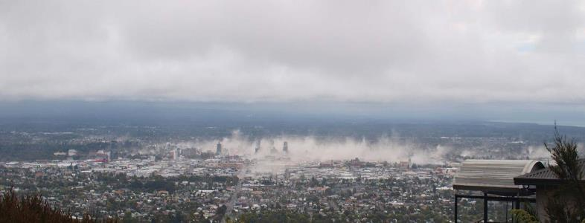

Before: Prepare
kit + plan (for two weeks)
www.getprepared.gc.ca
shoes & flashlight
under bed
secure your space
heavy items
stored low
N-95 masks
Notes:
Before:
Create an emergency kit; this is crucial, especially if you are on an island or in a remote region; the new recommendation is for ~2 weeks
Camping equipment makes a good base kit; simply add non-perishable food (which you like) and other necessities
Keep a pair of sturdy shoes and a flashlight under your bed; if the earthquake occurs at night, there will likely be no electricity and there will probably be broken glass and other debris.
Have a plan, with your family and your workplaces (and be familiar with the plan for children’s school); include a way to meet up without communications
Out-of-province contact which will be contacted preferably via text

Slide 9
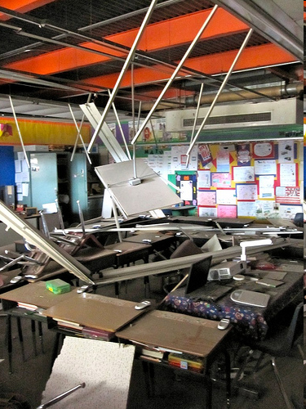
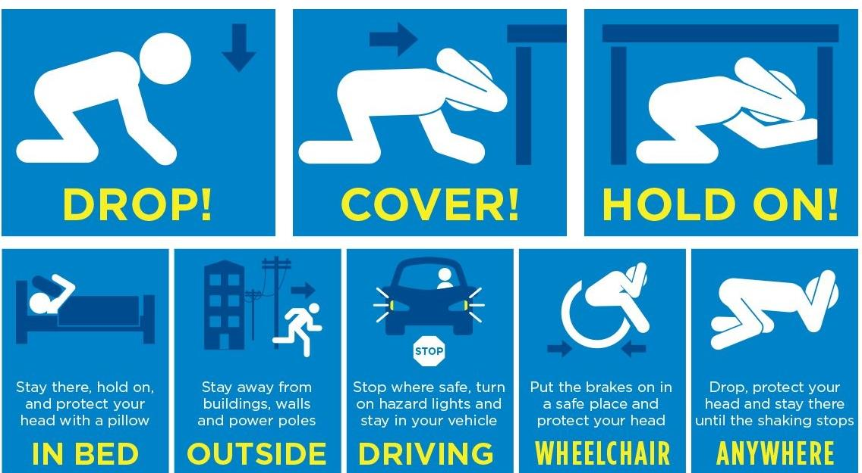
During: Protect Yourself
Annual ShakeOut earthquake drill – practice the safe response to earthquakes
if inside, under sturdy tables or desks, or in corners of rooms
practise what to do at work, at school, and in each room of your home
Notes:
Practise what to do in an earthquake:
Drop to the ground
Get under a desk, table or other sturdy furniture
Hold onto the furniture with one hand and cover your head and neck with the other
If there is nothing to get under in that room, move to an interior corner, squat down low, and protect your head and neck.
By doing the “DCHO”, you are creating muscle memory, so that during an earthquake you will react appropriately, and not run outside (which is instinctive, and probably the worst response as while you are running through a building, things could be falling on you, and the most dangerous place, as shown earlier, is the outer edge of a building)

Slide 10


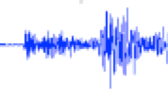
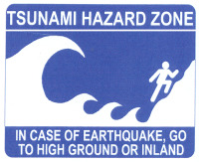
After
use your plan
do NOT use phone (only text)
expect aftershocks
get away from the coast,
  if shaking strong (difficult to stand)
  & long (more than a minute)
Notes:
10
After:
Calmly execute plan.
Do NOT use the ‘phone; only those needing emergency services should be using the ‘phone.
If need be, please communicate via text messaging.
Aftershocks can almost be guaranteed, so stay away from damaged buildings.
In a strong event, please evacuate the coast and keep roadways clear.

Slide 11
Earthquake Background
How to prepare and respond
Earthquake Early Warning

Slide 12
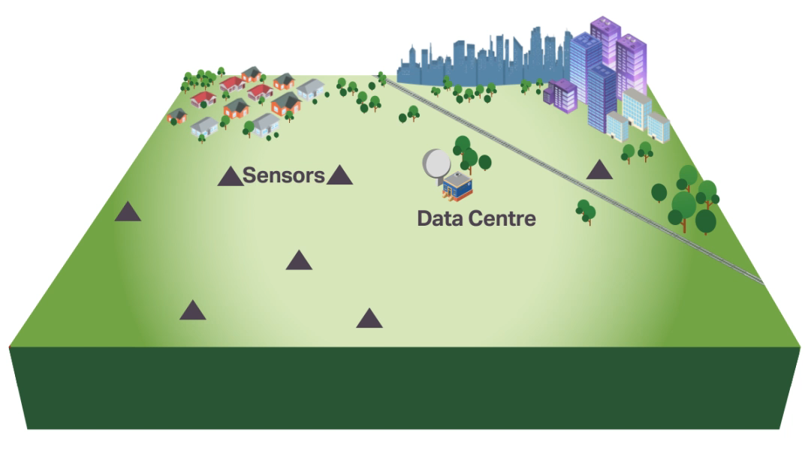
Earthquake Early Warning
EEW has proven successful in other countries
Detects P-wave and sends alert to people and systems
Provides seconds to tens-of-seconds of warning
Protective actions can be taken to reduce impacts and injuries
Notes:
- implemented in other countries, including Japan, Taiwan, Mexico, and, more recently, in California, Oregon, and Washington States.

Slide 13
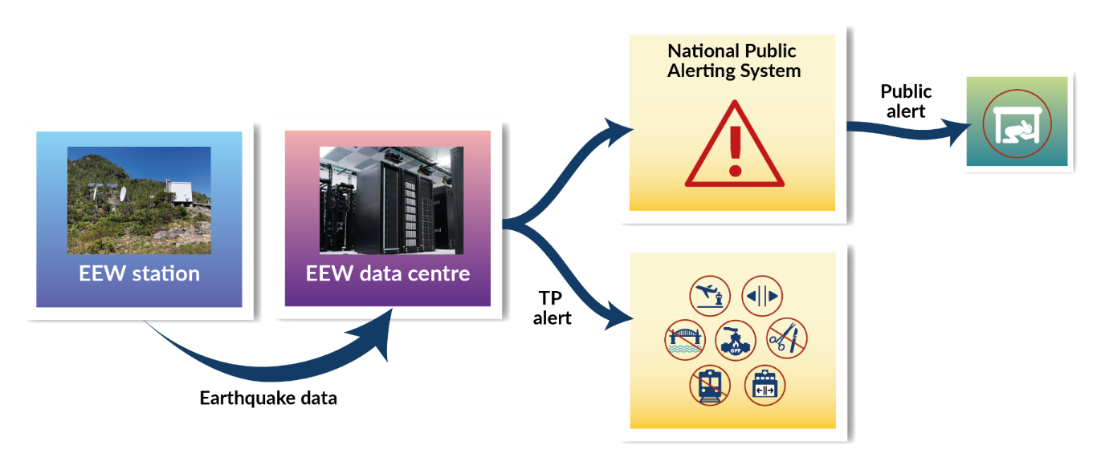
EEW System Considerations
Dense networks of specialized sensors
High speed communications (Internet, cellular, and satellite)
Multiple data centres for redundancy
Cross border interoperability, using USGS’s software
Cybersecurity a necessity (ITSG-33)
Reliable, particularly under adverse circumstances
Notes:
- Dense networks of specialized sensors
- High speed communications (Internet, cellular, and satellite)
- Multiple data centres for redundancy
- Cross border interoperability, using USGS’s software
- Cybersecurity a necessity (ITSG-33)
- Reliable, particularly under adverse circumstances
- Alerting to the Public and to Technical Partners (critical infrastructure operators and EEW automated technology providers)

Slide 14
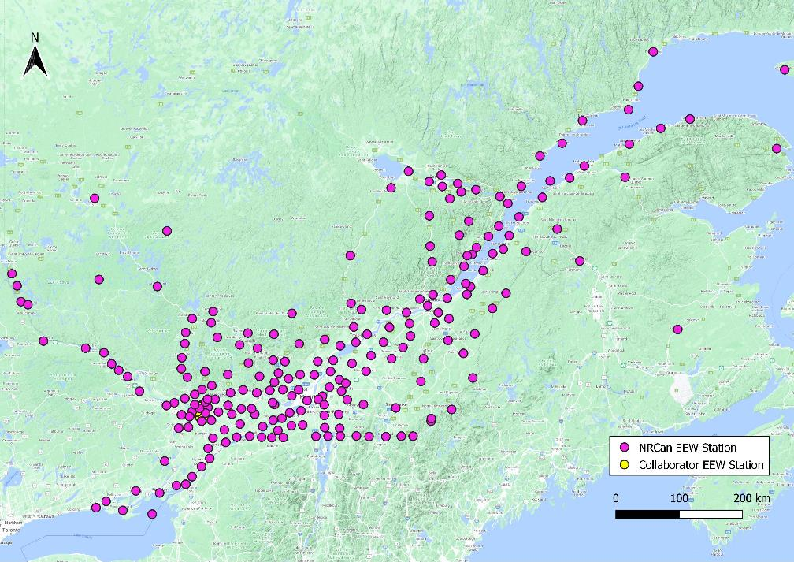
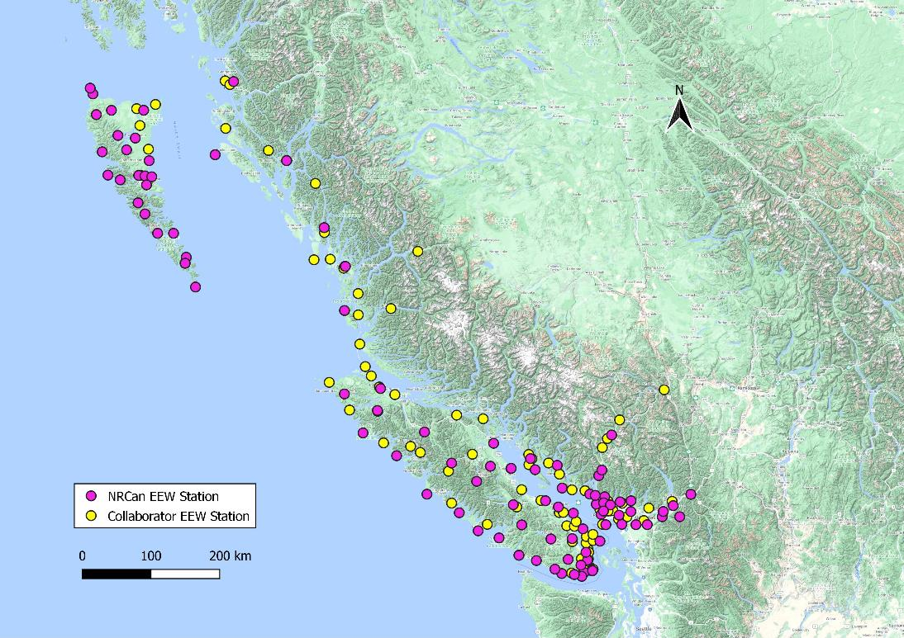
EEW Network
EEW stations:
BC: 96 core + 96 extended network = 192
(with 24 core stations on land of the Haida Nation
& funding for Coastal First Nations’ 8 extended
network stations)
ON & QC: 224 core + 15 extended network = 239
Total: 320 core + 111 extended network = 431
Notes:
- Focused on areas with earthquake hazard plus large populations and/or critical infrastructure (e.g., transportation, utilities, medical facilities)
- For optimal performance, stations have a dense (~20km) spacing of sensor stations
- Map shows Core and Extended Network stations together (different symbol)
BC: 96 core + 96 ext net = 192
ON&QC: 49+173 + 2 = 224 core + 15 ext net = 239
Total: 320 core + 111 ext net = 431 EEW stations

Slide 15
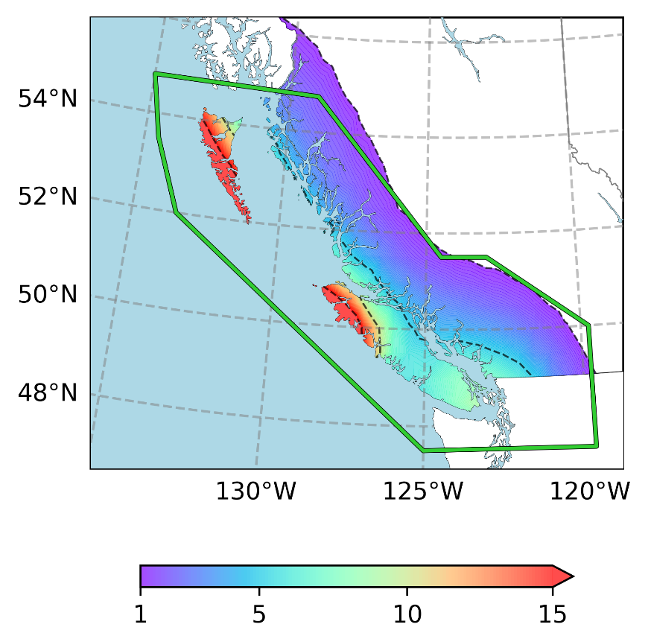
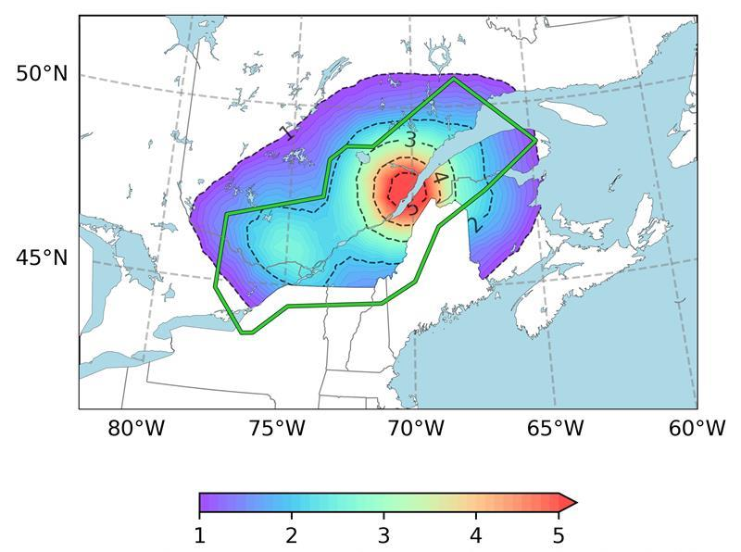
EEW Coverage
Coverage: areas with moderate-to-high earthquake hazard plus large populations and/or critical infrastructure (e.g., transportation, utilities, medical facilities)
Annual chance (%) of an EEW alert
Annual chance (%) of an EEW alert
Notes:
"The Canadian EEW system will reliably initiate public alerts for all earthquakes exceeding the magnitude and intensity thresholds and with an epicentre within the Coverage Area.“
- While the magnitude describes the size of the earthquake, the intensity describes the strength of shaking at some distance from that earthquake
- Earthquakes have one size but can have many intensities

Slide 16
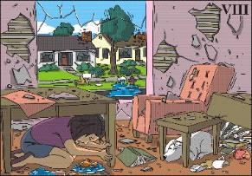

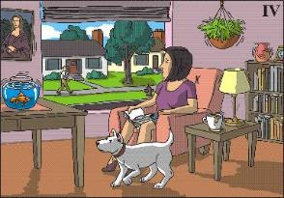

EEW Alerts
Alert Thresholds, based on:
Magnitude (M; size of earthquake) and
Intensity (MMI; strength of shaking)
Alerts only for potentially harmful earthquakes
~100 km
~300 km
~600 km
M6.5
(size of earthquake)
Notes:
- most stations in urban areas are indoor installations (easier, cheaper, and less prone to issues)
- outdoor stations mostly in rural areas and challenging, remote locations

Slide 17
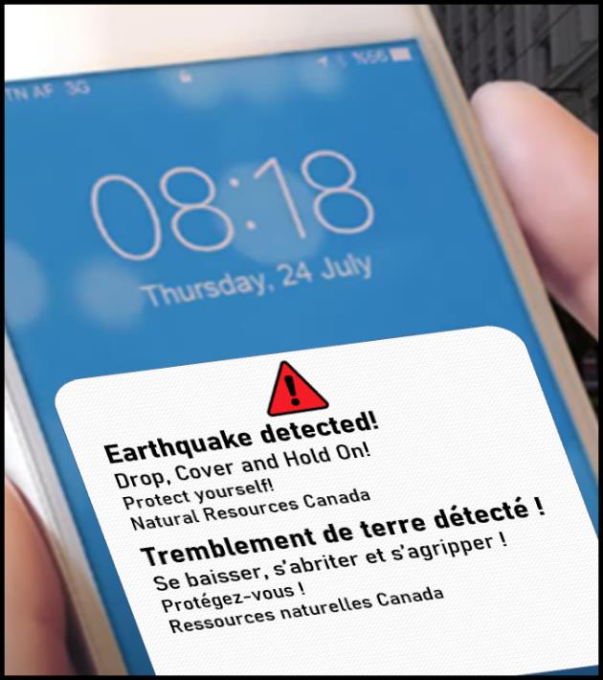

Public Alerting
Alerts to public are sent via National Public Alerting System
Currently used for severe weather, Amber, etc.
Distribution through cell, radio, and television
M>5; MMI>IV
Adaptations are possible for other situations (e.g., when in bed, outside, whilst driving, in a wheelchair)
Public education to build awareness around earthquakes, preparedness, and EEW
Notes:
- Public alerts distributed through the National Public Alerting System are sent at the Census Subdivision level
- Public are urged to Drop, Cover, and Hold on to protect themselves from falling debris and objects

Slide 18
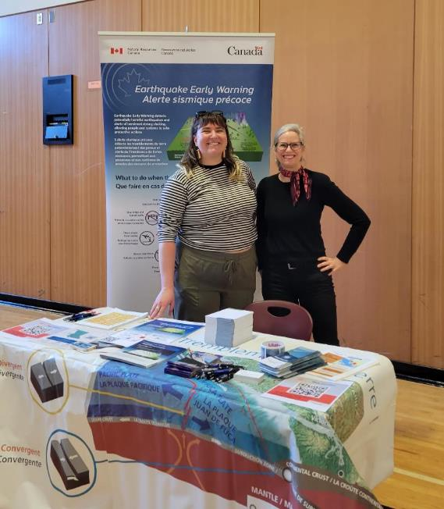
Earthquake and EEW Awareness
Inclusion of Indigenous-specific content in Public Safety and Emergency Management sector materials
Collaboration with EMCR (British Columbia) to create materials to engage Indigenous communities & children
In-person engagement, including briefing Councils, plus hosting booths and giving presentations at Indigenous events (e.g. EM workshops & powwows)
Collaboration on an “Earthquake & EEW” display for the Haida Gwaii museum & visitors’ centre

Slide 19
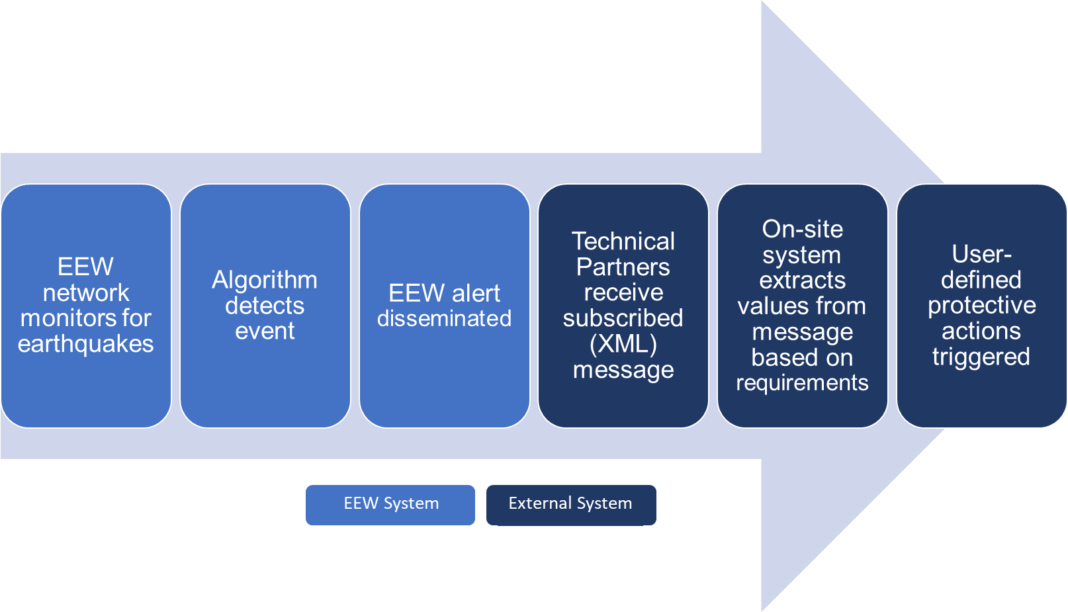
Alerting to Technical Partners
Alerts sent directly to Technical Partners: critical infrastructure operators (transportation, utilities, health, etc.) and other technical users
Direct alerting through message broker
EEW messages provide location, magnitude, MMI, Peak Ground Velocity (PGV), and Peak Ground Acceleration (PGA) for TP’s locations
M>4; MMI>III
TP-

Slide 20










TP Alerting: Automated Responses
Divert aircraft from landing
Halt trains
Close valves
Stop traffic onto bridges or into tunnels
Sound alarms to halt surgery
Park hard-drives
Stop elevators at nearest floor & open doors
Open doors
Ready generators
Secure cranes & dock equipment

Slide 21
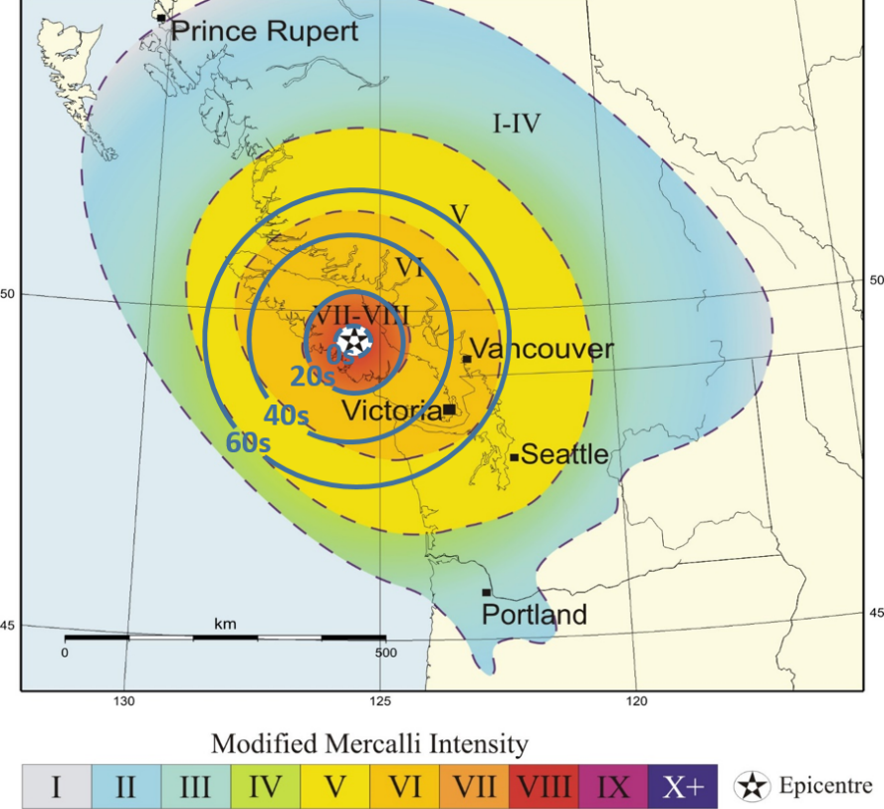
Southwestern BC
Example of system performance based on station distribution, and system design
Vancouver Island, BC
1946 – Magnitude 7.3
Warning Time | Location
~40 s | Vancouver
~50 s | Victoria
0 s | Cumberland (within Late Alert Zone)
Notes:
- Example of EEW system performance using historic event as a scenario.

Slide 22
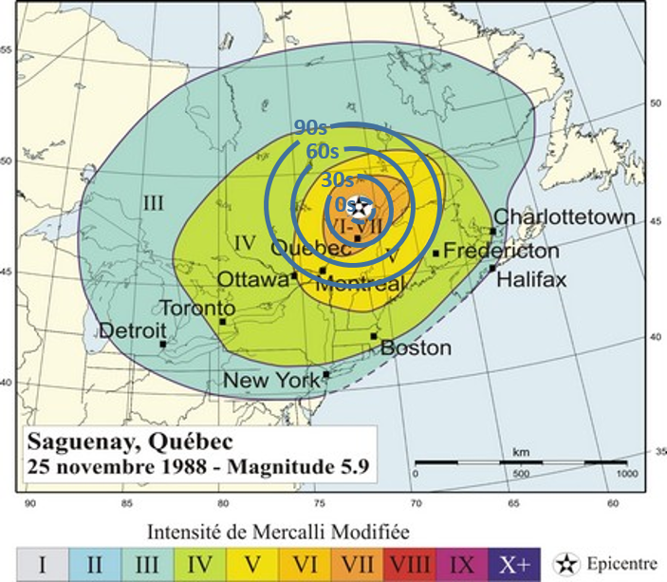
Southern Quebec
Example of system performance based on station distribution, and system design
Warning Time | Location
29 s | Québec City
84 s | Montréal
>90 s | Ottawa and Fredericton
Saguenay, QC
1988 – Magnitude 5.9
Notes:
- Example of EEW system performance using historic event as a scenario.

Slide 23
EEW Considerations
Most alerts received seconds to tens-of-seconds before strong shaking
Late-Alert-Zone: close to epicentre, alert may be received after strong shaking
False & missed alerts are inevitable, due to the need for the system to be automated and include rapid analysis of data
EEW is only effective if people and systems take appropriate protective actions

Slide 24
Summary
Earthquake Early Warning will provide up to tens-of-seconds of warning of strong shaking to at-risk communities
EEW can reduce the impact of major earthquakes in Canada, when people and systems take protective action
The Canadian EEW system will be operational in BC in April 2024, and in Ontario and Quebec in autumn 2024.

Slide 25
SUPPLEMENTAL SLIDES

Slide 26
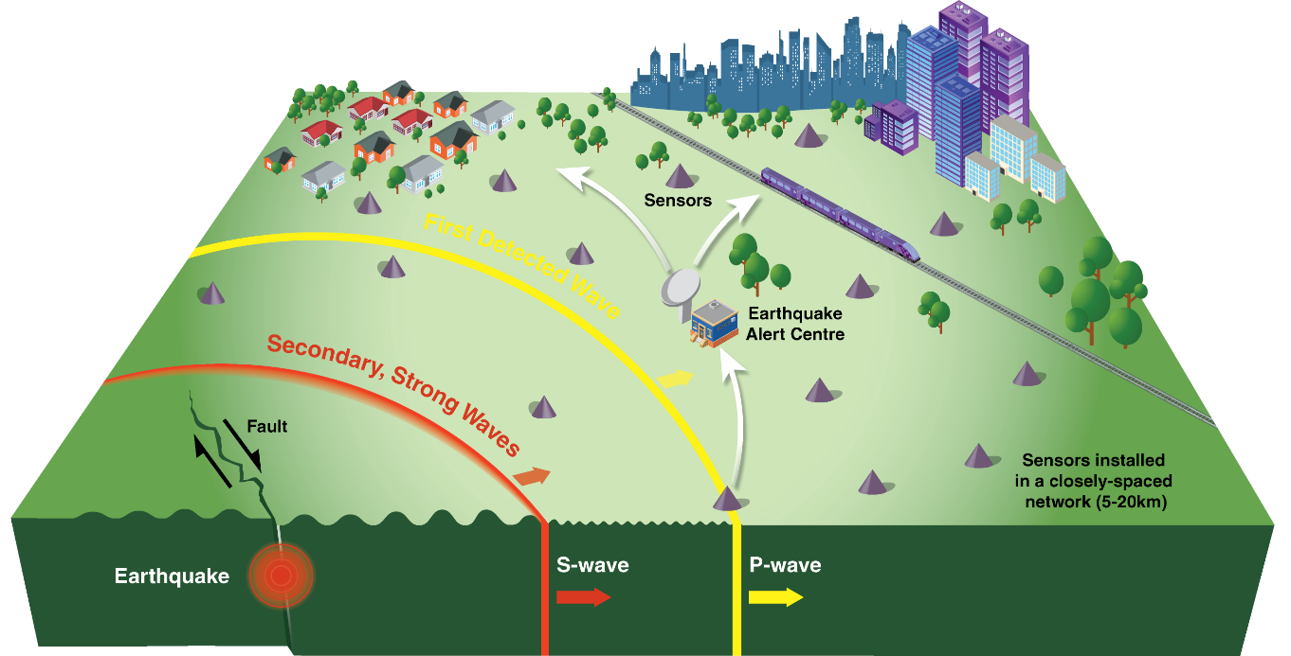
Earthquake Early Warning
EEW has proven successful in other countries
Detects P-wave and sends alert to people and systems
Provides seconds to tens-of-seconds of warning
Protective actions can be taken to reduce impacts and injuries
Notes:
- implemented in other countries, including Japan, Taiwan, Mexico, and, more recently, in California, Oregon, and Washington States.

Slide 27
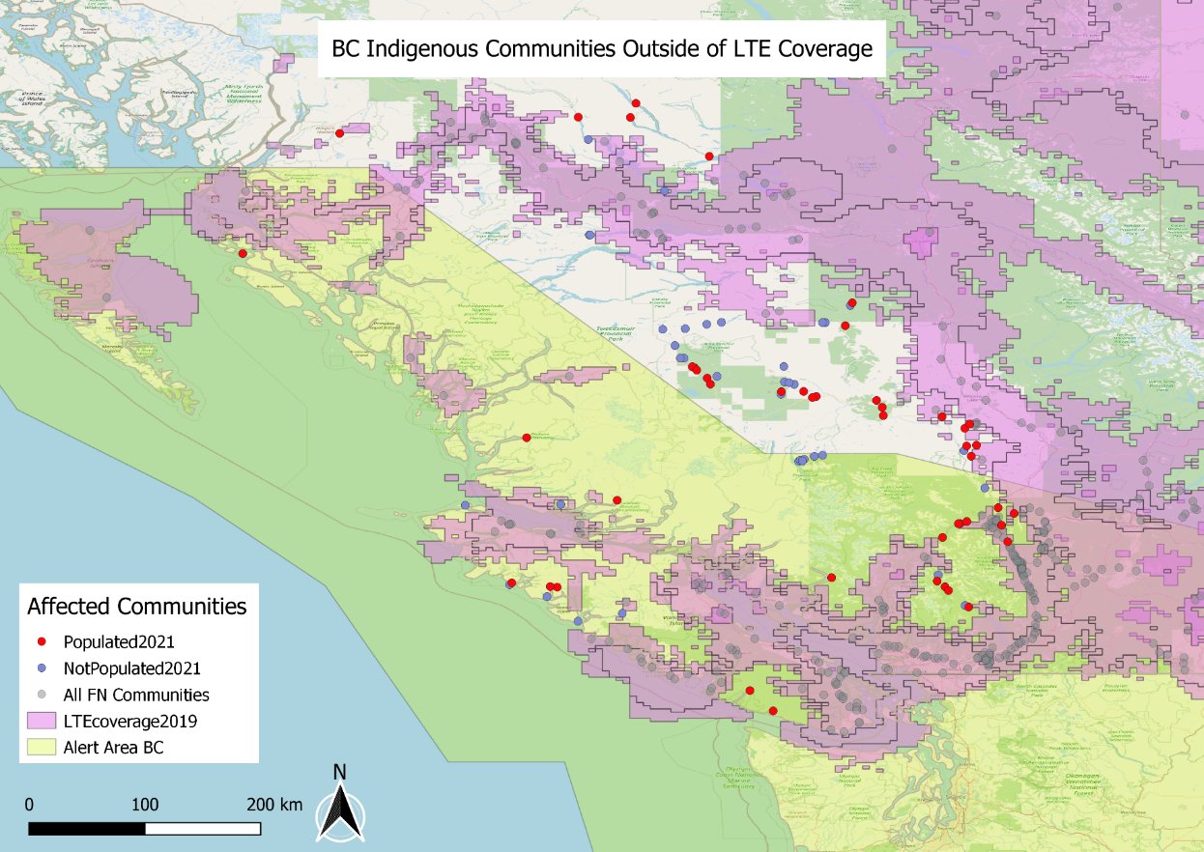
Alerting within western EEW Coverage
21 communities are within EEW coverage area, but without LTE:
Nation | Name | Population 2021
Gitxaała | Kitkatla | 295
Tsal'alh |  | 215
Ditidaht | Malachan (balaats’adt) | 178
Ka:’yu:’k’t’h’/ Che:k’tles7et’h’ | Houpsitas | 157
N'Quatqua | N'Quatqua | 155
Dzawada̱ʼenux̱w | Gwayi (Kingcome Inlet) | 111
Ts'kw'aylaxw |  | 97
Ehattesaht | Ehatis | 91
Pacheedaht |  | 79
Wuikinuxv | Wuikinuxv Village (Katit) | 77
Xa'xtsa | Port Douglas | 66
Samahquam |  | 50
Ts'kw'aylaxw |  | 48
Skatin | Skatin (Skookumchuck) | 30
Nuchatlaht | Oclucje | 29
shíshálh |  | 21
Tsal'alh |  | 19
Xaxli’p | Xaxli'p (Fountain Valley) | 10
Lytton |  | 10
Tsal'alh |  | 5
Samahquam |  | 5
 | Total | 1,748

Slide 28
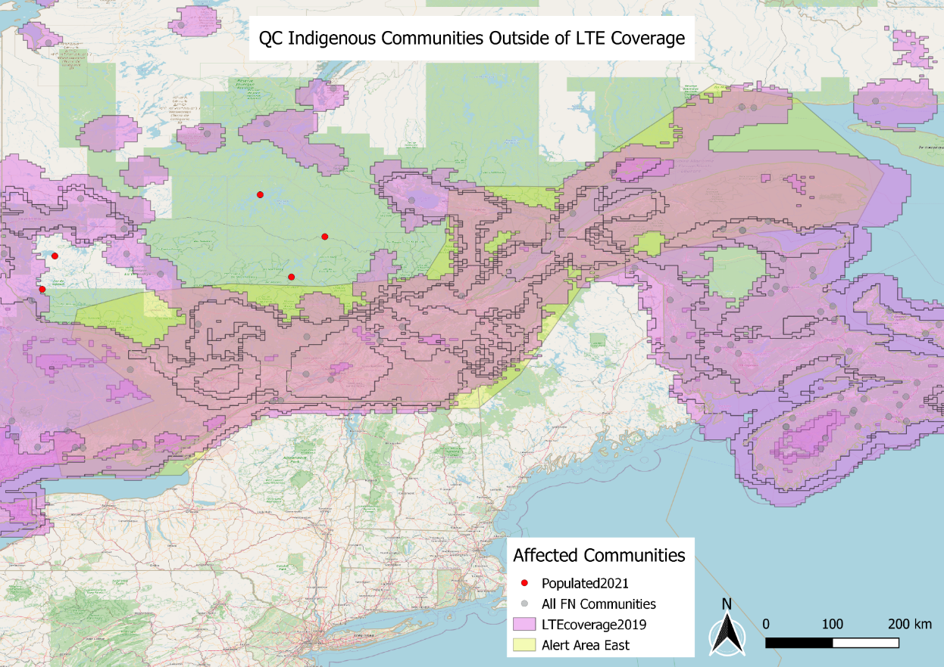
Alerting within eastern EEW Coverage
In eastern Canada there are no communities within the alert area and outside LTE coverage.
There are, however, 5 communities in Quebec without coverage that are near the alert area.

Slide 29
Reducing Earthquake Risks
Insurance Board of Canada study* shows large, plausible earthquakes could result in total direct losses of $62 billion in the west and $49 billion in the east
EEW operating successfully in other countries, including western U.S. (California, Oregon, & Washington)
EEW in Canada:
  Will enter operation in west - spring 2024; east - autumn 2024
  In partnership with all levels of government and Indigenous groups
*Insurance Bureau of Canada, Study of Impact and the Insurance and Economic Cost of a Major Earthquake in British Columbia and Ontario/Québec, 2013
Notes:
[N.B. updated versions of the graphic have been requested from Chris; he will be back in the office on Monday]
- Public alerts distributed through the National Public Alerting System are sent at the Census Subdivision level

Slide 30
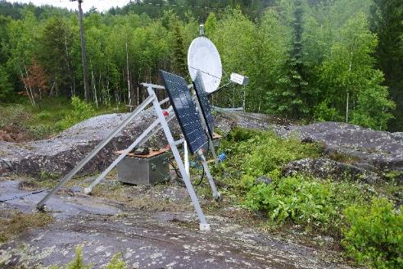
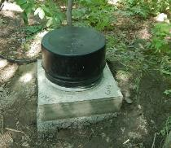
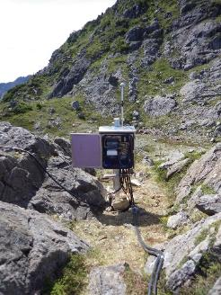
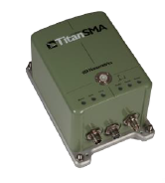
EEW station
Indoor & Outdoor Installations
Strong motion sensors with digitiser
Power with back-up
High-speed communications: Internet, cellular, satellite
Cyber and physical security
Notes:
- most stations in urban areas are indoor installations (easier, cheaper, and less prone to issues)
- outdoor stations mostly in rural areas

Slide 31
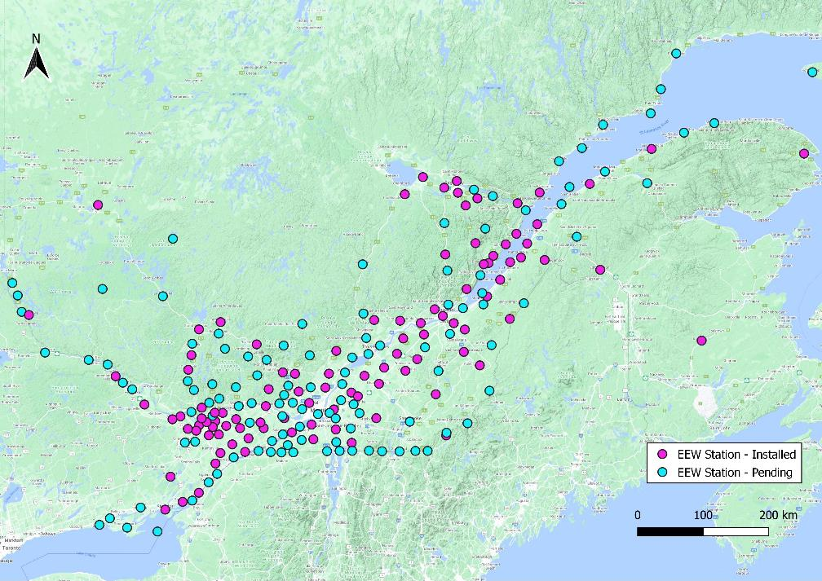
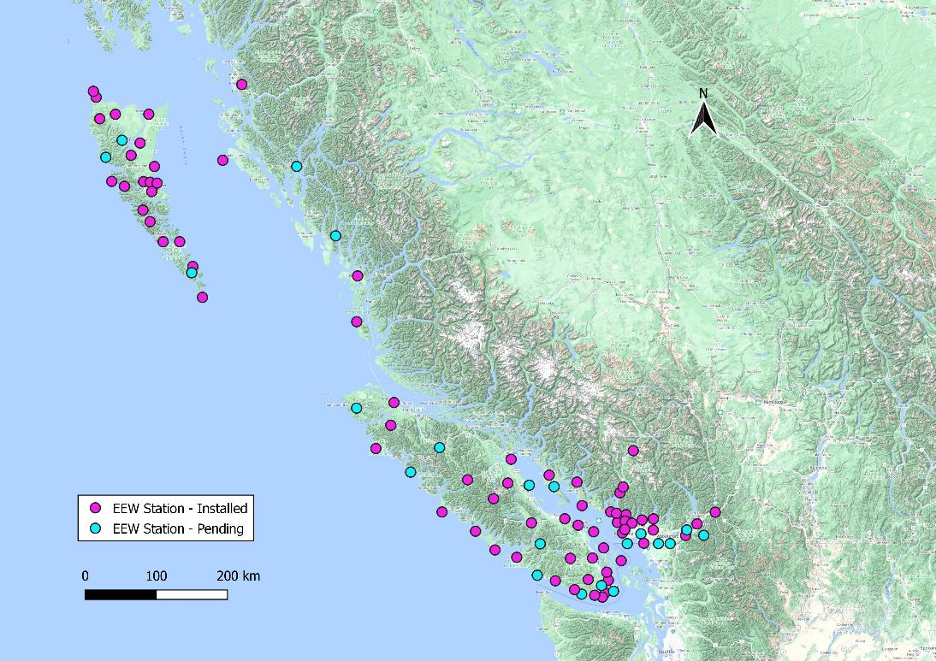
EEW Network
Notes:
[updated!]
- Focused on areas with earthquake hazard plus large populations and/or critical infrastructure (e.g., transportation, utilities, medical facilities)
- For optimal performance, stations have a dense (~20km) spacing of sensor stations
- Map shows Core Network stations only, with colour denoting status
BC: 96 core + 50 + 8 + 25 + 13 = 96 ext net = 192
ON&QC: 49+173 + 2 = 224 core + 15 ext net = 239
Total: 320 core + 111 ext net = 431 EEW stations

Slide 32
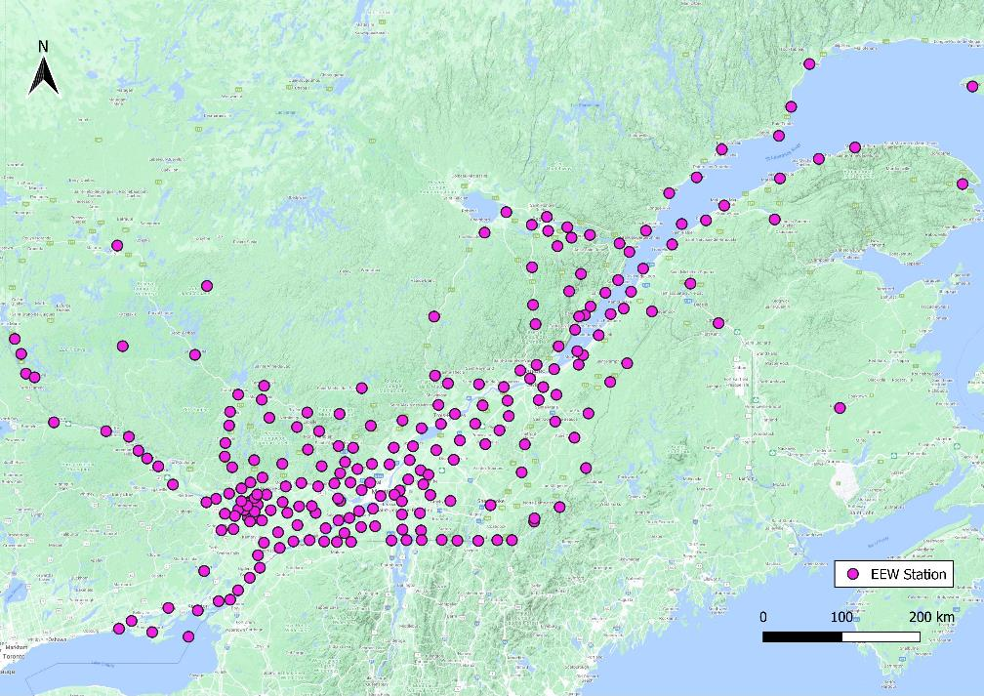
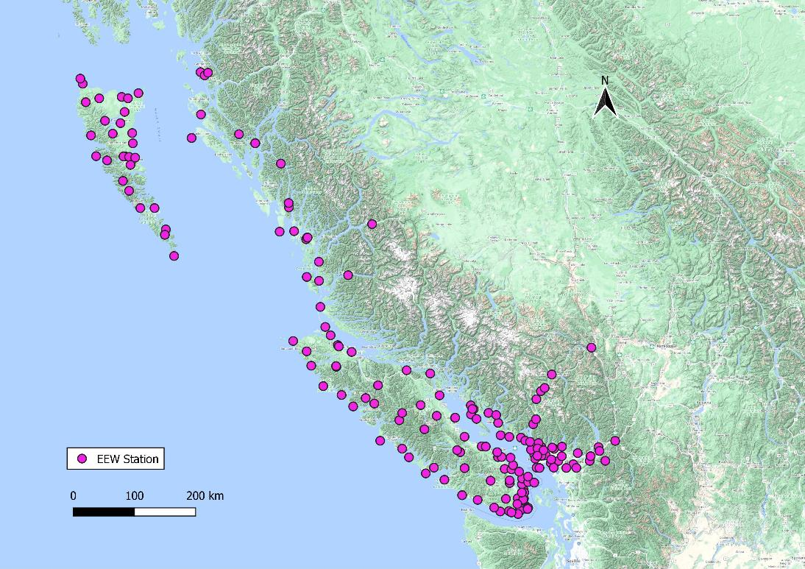
EEW Network
Notes:
[updated!]
- Focused on areas with earthquake hazard plus large populations and/or critical infrastructure (e.g., transportation, utilities, medical facilities)
- For optimal performance, stations have a dense (~20km) spacing of sensor stations
- Map shows Core and Extended Network stations together (same symbol)
BC: 96 core + 96 ext net = 192
ON&QC: 49+173 + 2 = 224 core + 15 ext net = 239
Total: 320 core + 111 ext net = 431 EEW stations

Slide 33
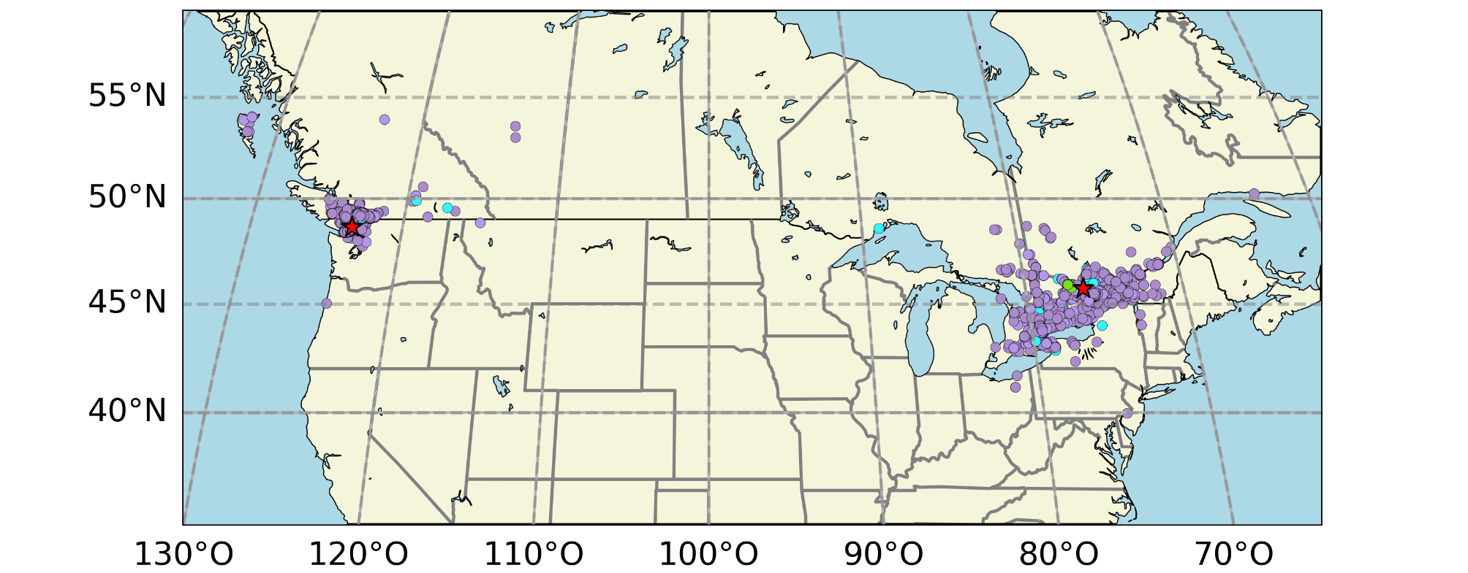
East versus West
Earthquakes are felt more strongly in eastern than in western Canada
M4.7, 2015 Sidney, BC
M4.6, 2013 Shawville, QC
Notes:
- Region of coverage same as for the public, but alerting conducted at lower thresholds

Slide 34
Coming Earthquake Products
Earthquake
2
Public Alert
Location
Magnitude
“Drop, Cover and Hold On!”
NPAS
Early Warning
(seconds)
5
Earthquakes Canada
1
Technical User Alert
Estimated shaking level and area affected
Secure communications
Event information, felt reports, Twitter
ShakeMap; Interpolated shaking intensities
Prompt Notification
(minutes)
3
Accelerograph Data
6
Asset Impact Assessment
Actual ground motion at stations
FDSN web services
Estimation of impact on client assets
Various types of client notifications
4
Processed Intensities
Peak acceleration, velocity and spectral accelerations
Notes:
- EEW will provide more timely information to the public and technical users.
- EEW will also augment NRCan’s existing earthquake products.

