Slide 1
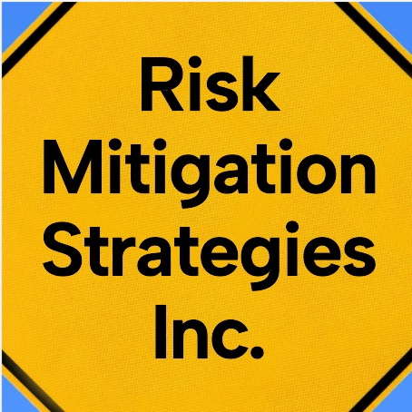
AFN Emergency Management Forum
First Nations Home Flood Insurance Needs:
HOW TO LEVERAGE INSURANCE FOR EMERGENCY MANAGEMENT
March 2024
Kevin Smart
Risk Mitigation Strategies Inc.

Slide 2

First Nations Home Flood Insurance Needs Initiative
Project sponsored by the Assembly of First Nations (AFN) and Indigenous Services Canada (ISC) to establish a baseline understanding of insurance on-reserve.
David Diabo, Special Advisor AFN, led the Steering Committee and oversaw the work.
Research led by Dr. Annette Chretien and Dr. Brenda Murphy as Coach House Enterprises Inc. with insurance expertise provided by Kevin Smart of Risk Mitigation Strategies Inc.
  Stage 1 in-depth interviews with insurance professionals
  Stage 2 engaged 71 First Nations communities to understand their lived experiences regarding home insurance for property damage
Final Report issued June 2022
2022 Emergency Management Exemplary Service Award – Resilient Communities, by Public Safety Canada

Slide 3
Key Insurance Findings from the Report
I acknowledge the presence of RMSI on the traditional territory of many nations including the Mississaugas of the Credit, the Anishnabeg, the Chippewa, the Haudenosaunee and the Wendat peoples

Slide 4
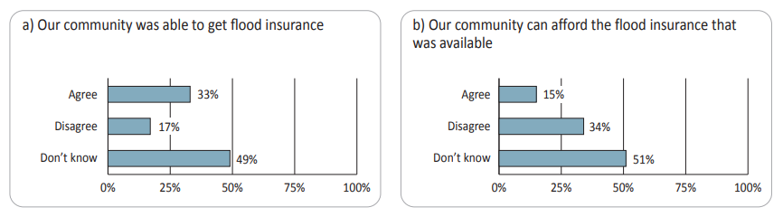
FLOOD INSURANCE IS USUALLY NOT PURCHASED FOR ON-RESERVE HOMES
It is not available for areas with very high flood risk
When available, the additional cost is often unaffordable.
” …on an annual basis, we probably have about three to four major weather events that affect our
infrastructure and our assets. So, in reality, we wouldn’t be able to even afford flood insurance.”
”So, about four years ago, we had some major flooding … I think we were categorized in the red zone and it’s difficult or we cannot get flooding insurance now...I was part of the flood mitigation team, and we did do some flood mitigation, but in the end, we still can’t get it. I don’t know why.”

Slide 5
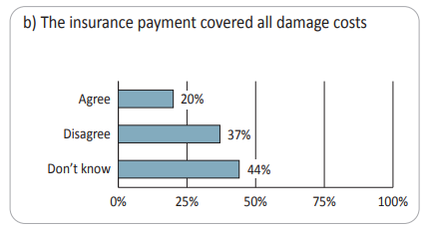
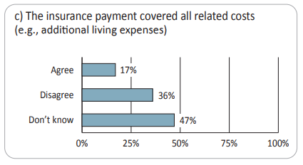
WHEN FLOOD INSURANCE IS AVAILABLE AND PURCHASED
The claim payment may be inadequate to repair damage resulting from flood.
There may be no coverage for damage to the personal belongings of residents.
There may be no coverage for additional living expenses of residents during repair of the damage, or due to evacuation because of a flood.

Slide 6
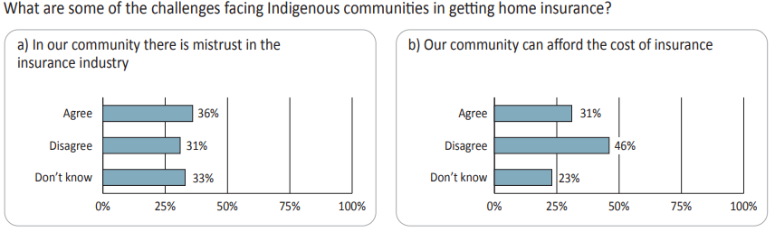
FIRST NATIONS EXPERIENCE WHEN SEEKING INSURANCE
Insurance providers do not make any effort to become familiar with the current risk conditions of the First Nations community or of the individual residents.
Insurance providers appear too quick to assume that individuals from a First Nation have higher risk
In many communities, there is nobody coming in to promote insurance, so many residents are not aware they need insurance.

Slide 7
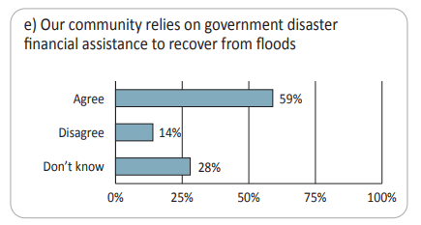
IMPACTS ON EMERGENCY MANAGEMENT
Most on-reserve people do not have any home insurance. Some hope the community will pay for any damages from fire or flood or will arrange for insurance.
Most on-reserve communities do not have adequate insurance to pay for damages to homes.
Therefore, communities must rely on government disaster assistance to recover from flooding damages.

Slide 8
HOW TO LEVERAGE INSURANCE FOR EMERGENCY MANAGEMENT
Community leaders can work with an insurance broker to get 2-3 insurance offers every year for community owned property, to get the best coverage value for cost.
Raise awareness to residents of personal home insurance options such as Tenants Package available for purchase online or by telephone from insurance brokers and direct insurers.
Personal home insurance usually pays the full cost to replace damaged property and claims are settled faster than disaster assistance.
During an emergency evacuation, inform any residents with personal insurance to check for “Additional Living Expenses” coverage
  Usually pays up to $2,500 or more for shelter, food or clothing.
  Evacuation must be ordered by a civil authority
  The insured home does not need to be damaged
  Applies for fire, including wildfire.
  Does not apply for flood or earthquake, unless that coverage was also purchased.
Meegwitch / Thank you!

