Slide 1
2nd National Emergency Management Forum
March 5-7, 2024, Gatineau, Quebec
Climate Change & Emergency Preparedness and Response.
Are First Nations Ready?

Slide 2
What you do today determines our collective future.
Thank you, creator, for the gifts of life and choice.
Thank you to the original custodians of the lands and waters on which we are all situate on today.
Thank you, Assembly of First Nations and Indigenous Services Canada for bringing us together so we can listen, share and learn.
Thank you, participants, for your time.
2020 AFN Video: The Next Thousand Years
https://www.youtube.com/watch?v=6md2Ld5lChw

Slide 3
Canada’s Indigenous people Diverse yet similar.
Communities living here on what is now known as North America before world explorers arrived.
Each community has their own language, culture, relationship to the land and contact and colonisation story.
Today, Canada has 633 distinct First Nations.
Today, BC as more than 200 distinct First Nations communities.
Diversity
Canada’s first people have similarities and differences in world view.
Life and Lifestyle
Prior to contact, indigenous people were self-determining, self-sufficient and had been so for thousands of years.
Here then, here today, here tomorrow
Indigenous peoples survived contact, colonisation, the Indian Act, Residential School and 1982’s patriation.
Emergency Management
10,000 years of community emergency preparedness and response.
2023 AFN Video: Preserving our Environment, Lands, and Waters for Future Generations
https://www.youtube.com/watch?v=GopjanDZycw

Slide 4
Nlaka'pamux (the people here)
Shuswap
Stl'atl'imx
Lillooet
Kamloops
Stories of indigenous use and occupation from time immemorial.
Archaeology confirming 10,000+ years.
Who and where the Nlaka’pamux was well known by the surrounding First Nations.
First contact occurred at “Camchin” in 1808 (now known as Lytton) where the Thompson River and Fraser River meet.
1846 Saw the 49th Parallel extended bisecting Nation Lands.
1876 Indian Act amalgamated 69 Nlaka’pamux communities into 15 Indian Bands.
This is the first known Nation map from around 1900.
Camchin
Okanagan
Sto Lo
Sto Lo
Tulalip Tribes (USA)

Slide 5
Nlaka’pamux Culture, law, governance and history
Time Immemorial.
The meaning of life.
Those who get ready for winter, survive the winter.
As a community, we survive.
1857-1858 – The Fraser Canyon War
1878 Nlaka’pamux reject the Indian Act.
1910 Letter to Sir Wilfred Laurier: www.tru.ca/__shared/assets/memorial-to-sir-wilfrid-laurier58605.pdf
1967 Lament for Confederation: https://monova.ca/chief-dan-georges-lament-for-confederation/
1992 Natural Resources Sharing Agreement.
2010 Memory, Loss and Sorrow….: www.kanakabarband.ca/files/memory-loss-and-sorrow-written-first-in-2010.pdf
2016 Clean Energy Opportunity Analysis: www.kanakabarband.ca/files/document-clean-energy-oppurtunity-analysis-february-10-11-2016.pdf

Slide 6
TL’Kemstin (Lytton First Nation)
2100 members
56 reserves spread over 60 km of the Fraser River
Chief and Council on a 2-year term
Active participant in AFN, BCAFN and Union of BC Indian Chiefs
2015 Economic Development Plan
2016 Land Use Plan
2023 Comprehensive Community Plan
2024 LFN adopts Land Code

Slide 7
Section 91(24) of Canada’s constitution reads that Indians and Land reserved for Indians are the responsibility of the National state. Article 32(2) of UNDRIP reads that states shall get the free prior informed consent of indigenous peoples before issuing land or resource uses. TRCC Section 92 says corporations should also incorporate UNDRIP.
A AAA little Canada and BC History
1806 Simon Fraser arrives and names the mainland “New Caledonia”.
1812 Britain and US war over North American land interests.
1846 Britain and US extend the 49th parallel across the continent.
1849 Vancouver Island declared as a British Colony.
1858 Fraser Canyon War is fought followed by British Declaration of the Mainland colony of British Columbia.
1866 Vancouver Island and BC colonies amalgamate as one, BC.
1867 Dominion of Canada is created with 4 provinces and 1 National government.
1871 BC joins Canada as a Province.
1876 First National Indian Act.
1967 Lament for confederation.
1973 Calder Decision.
1982 Constitution affirms 1867 division of powers with an adder:
Section 35. Aboriginal rights are hereby recognised and confirmed (without definition) and Aboriginal includes First Nations, Inuit and Metis.
1992 Sparrow decision.
1997 Delgamuukw decision.
2007 United Nations declaration on the rights of Indigenous Peoples
2014 Tsilhqot’in decision.
2016 Canada removes objection to UNDRIP
2019 BC passes UNDRIP into law.
2021 Canada passes UNDRIP into law

Slide 8
Some Suggested Readings Hope flows from Action (June 2023): https://climateinstitute.ca/publications/hope-flows-from-action-rebuilding-with-resilient-foundations-fraser-canyon-region/

Slide 9
Is Climate Change Real?
Climate change is the long-term shift in the Earth's average temperatures and weather conditions.
Over the last decade, the world was on average around 1.2C warmer than during the late 19th Century.
It has now been confirmed that global warming exceeded 1.5C across the 12 month period between February 2023 and January 2024.
That followed 2023 being declared the warmest year on record.
Prime Minister Justin Trudeau told the world at COP26
that Canada is warming twice as fast as the rest of the world.

Slide 10
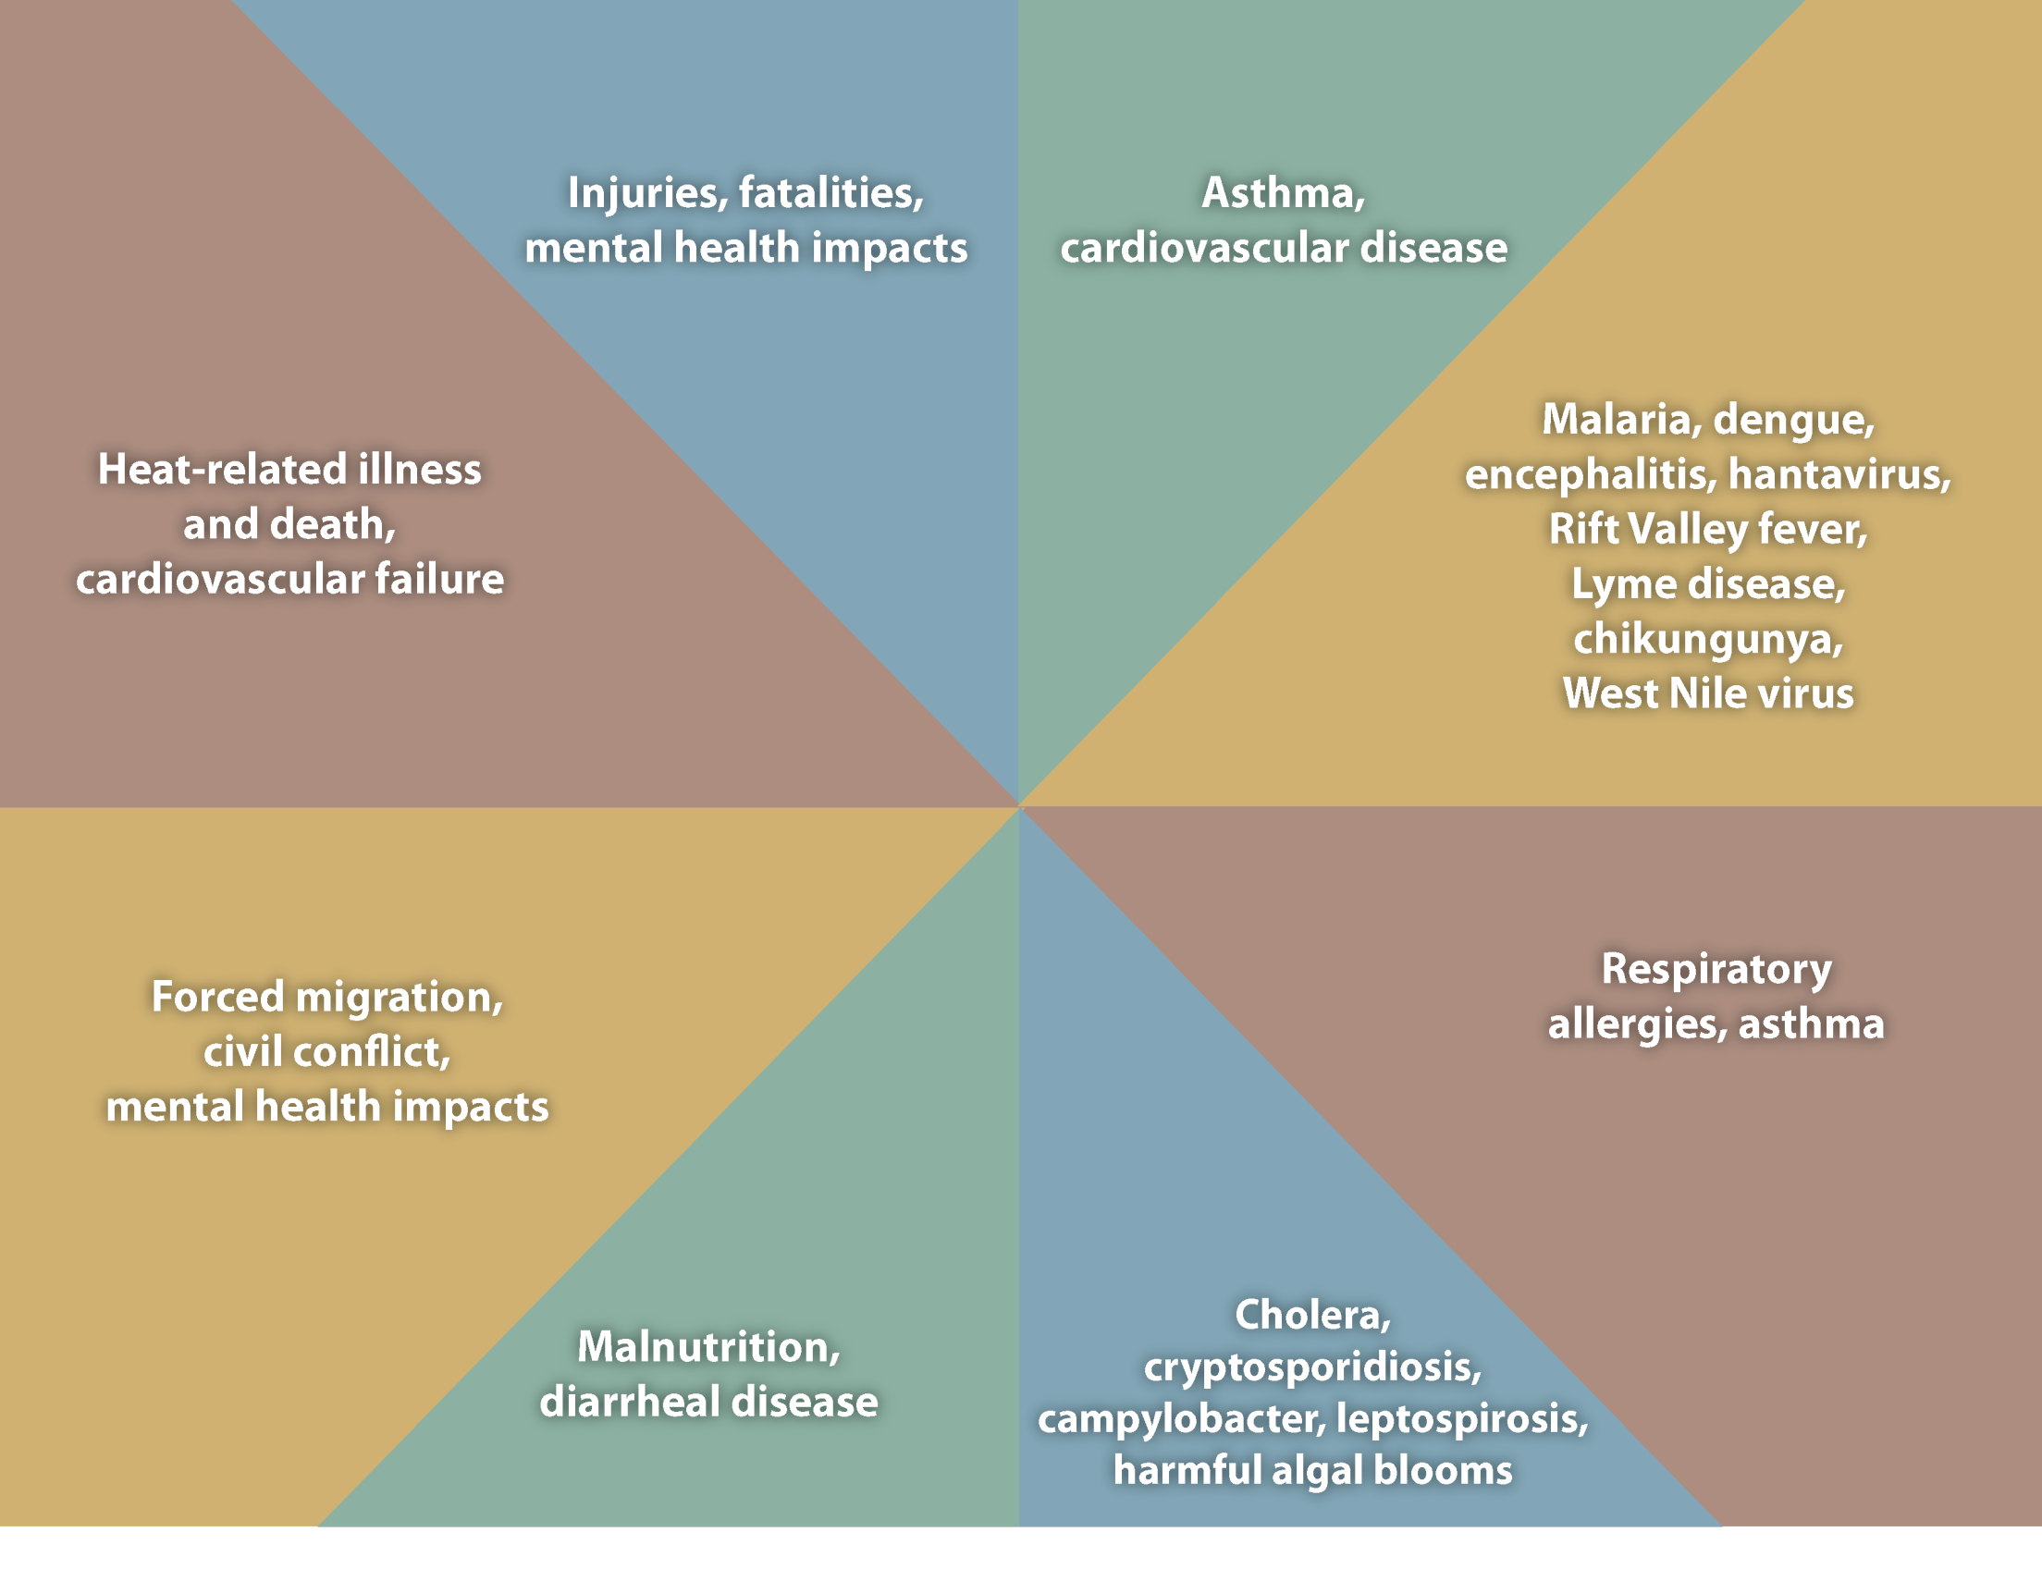
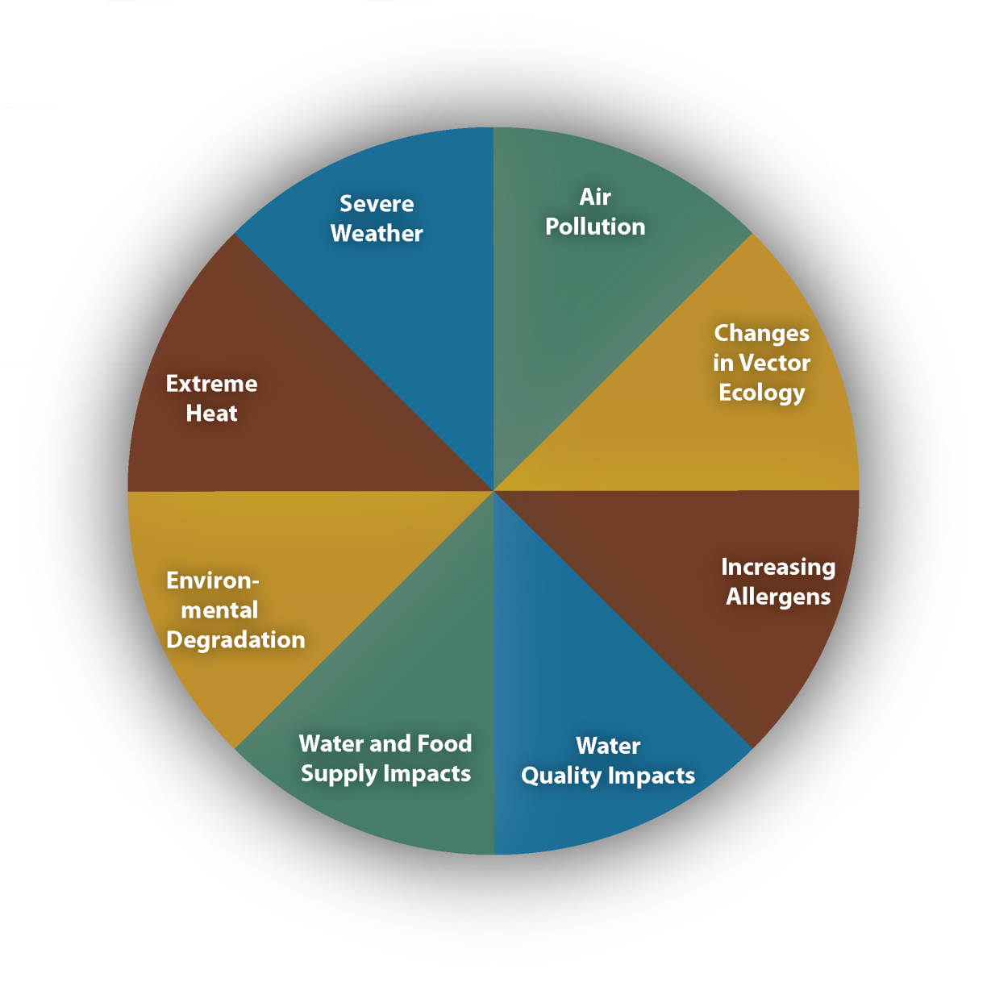
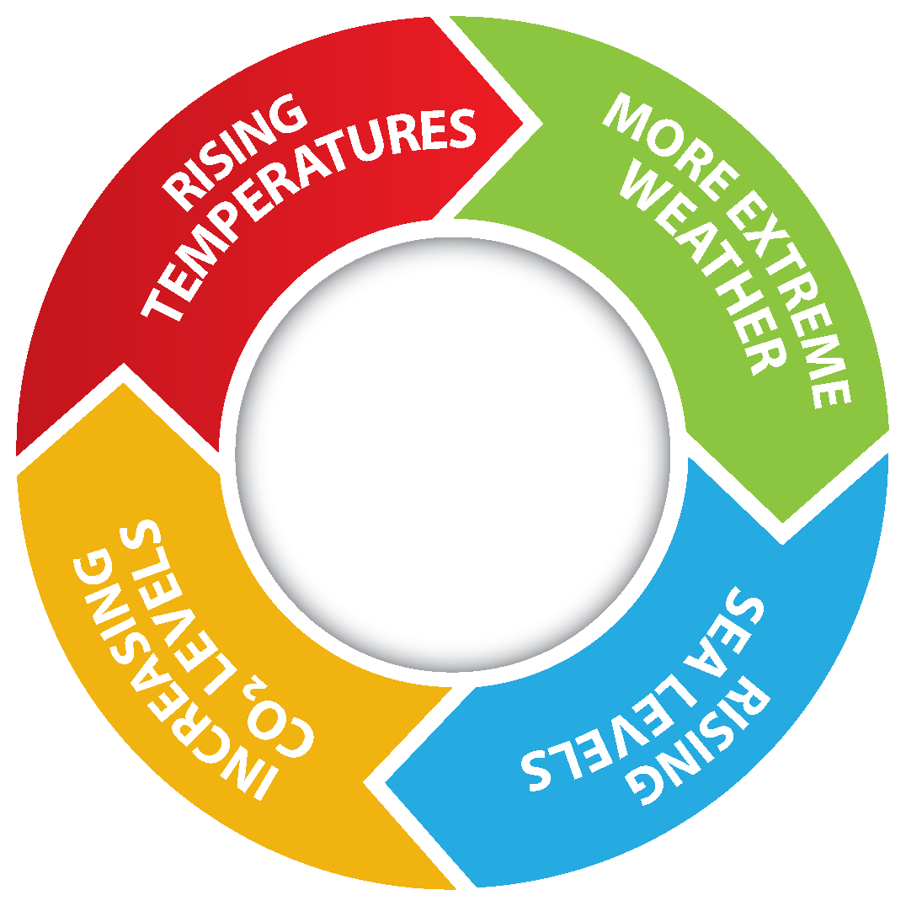
Notes:
Climate change impacts a wide-range of health outcomes. This slide illustrates the most significant climate change impacts (rising temperatures, more extreme weather, rising sea levels, and increasing carbon dioxide levels), their effect on exposures, and the subsequent health outcomes that can result from these changes in exposures.

Slide 11
We are not dealing with the emergencies of yesterday.
GHG traps heat in the atmosphere.
Human beings emit GHG.
Earth’s air, land and water is heating up at an unprecedented rate.
Resulting in Extreme Weather (heat, wind, rain and cold) with devasting air, land and water affects.
Video: Climate Change’s wolves: https://www.youtube.com/watch?v=2aRQ9DbNhY4&t=34s
Catastrophic, Prolonged and Compounding….
Temperature swings, drought, derecho, wildfires, smoke, crop failure, power outages, building collapse, road closures, land erosion, ice road failures, flooding, ecosystem shifts and human displacement.
Occurring in greater frequency, duration and intensity.

Slide 12
June 30, 2021 Video: Lytton, the town that burned in a day! https://www.bbc.com/news/av/world-us-canada-59227915
Let us Unite to do what's Right!

Slide 13
June 30, 2021
We are no longer planning for future events; we are living them!
Unprecedented but not unexpected
Drought, extreme heat, wind and then a spark.
followed by a November atmospheric river
then a December cold and snow never experienced before.
Its no longer if, its when.
No one is immune.
Is your family and community ready?

Slide 14
LFN Newsletter: Rebuilding from the Ashes Recovery and Rebuild
December 2023 Newsletter: https://acrobat.adobe.com/id/urn:aaid:sc:va6c2:40a17eab-3060-48db-8982-118c7cbd5062
January 2024 Newsletter: https://acrobat.adobe.com/id/urn:aaid:sc:va6c2:e9577bb4-b205-4477-aa2f-2686360a9e70

Slide 15
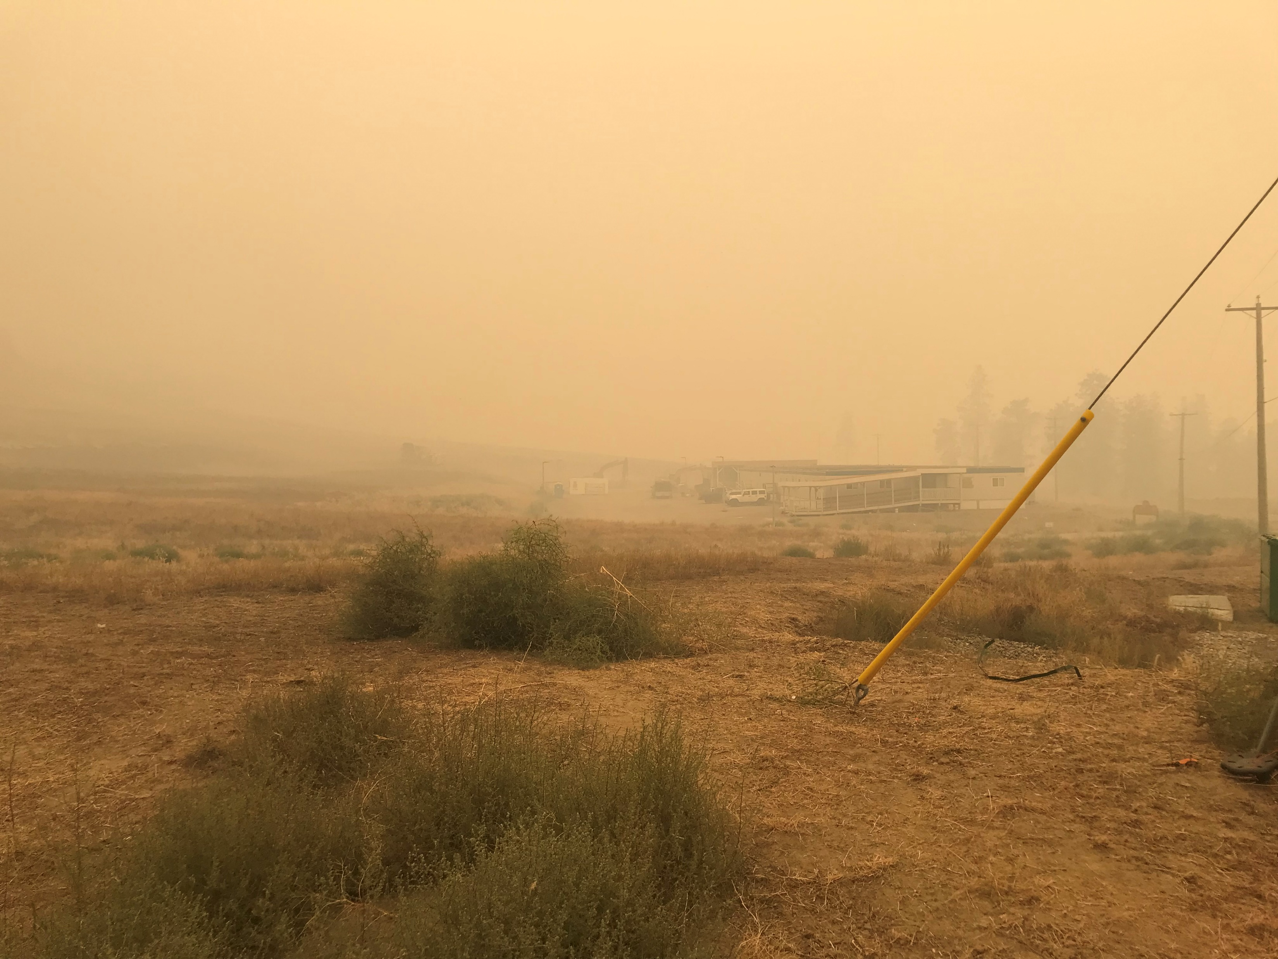
Lytton First Nations Recovery Since June 30, 2021
LFN runs its own ESS and EOC
LFN established its own Emergency Preparedness and Response Department
LFN sits at the municipal, regional, provincial and federal tables.
38 displaced families are out of hotels and into modular homes
10 Serviced RV sites
Donation Centre
Essential food and clothing
Café
Store
Ambulance Relocated
Medical Clinic Relocated
RCMP Relocated
Temporary Community Hall
Temporary Band Office
Community Hall and Café – August 21, 2023

Slide 16
Rebuild (Permanent)
80 replacement homes starting 2024
Highest standards for external fire rating, thermal transfer and durability
cool in summer and warm in winter
low electricity consumption
solar and battery storage where can
Y’kem Food Hub under construction
Processing and storage of family, community and regional meat, fruit and vegetables by drying, freezing, canning, smoking and salting.
Surplus available for sale.
New Cultural Space has started
Commencing community engagement on the location of permanent band office and community hall
Gathering information, storing information and transferring information

Slide 19
Planning for the future Made by LFN, For LFN at LFN
New Comprehensive Community Plan (October 2023):
https://img1.wsimg.com/blobby/go/b36deeac-db85-436e-a591-703af6b42d25/Tl'kemtsin%20Comprehensive%20Community%20Plan_Octobe.pdf

Slide 20
Coming in 2024 Made by LFN, For LFN at LFN
Climate Resilience Plan
Outline climate hazards facing our community today and into the future, the risks they pose, and how we can adapt to become more resilient to them.
Housing Plan
Identify the types of permanent housing our community needs and where they could be built. ·
Infrastructure Plan
Investigate the need for additional infrastructure and servicing upgrades in preparation for building permanent housing and facilities.
Tl’kemtsin Design Plan
An illustrated design vision and concept plan showing where new housing and community facilities could be developed on our core reserves and potentially the Village of Lytton.

Slide 21
It is our collective responsibility to ensure that First Nations are involved in, contribute to, and lead
the prevention/mitigation
preparedness
response, and recovery efforts
for their families and which are appropriate and essential for the safety, security, and physical and mental well being of their communities.
Northwest Territories Regional Chief Gerald Antoine, AFN Portfolio Holder for Emergency Management
Since time immemorial, there has been continuity of possession, and we will be here tomorrow too. IN 2021, we got our families to safety and then we looked after our land and resources.
LFN Chief Niakia Hanna
We are not alone in prevention, preparedness, recovery and rebuild and we thank all those who have supported and provided resources to our community so that our future generations will have a life and a quality of life.
LFN Rebuild Director, Patrick Michell

Slide 22
Wisdom for the Generations Together we will be ok.
VIDEO
Feb 24, 2023: Nature of Things – True Survivors
https://www.cbc.ca/documentaries/the-nature-of-things/we-have-an-extraordinary-ability-to-adapt-and-survive-sarika-cullis-suzuki-1.6748120
Physiological Foundations
Water, food, shelter, energy, communications and transportation
You need to make the investments now though.
Gift of life and choice
Everything you say or do matters
Choose wisely
Our children and grandchildren are worth it.

