Slide 1


Path to Ending Canada’s Discrimination
Assembly of First Nations
December 4, 2024| Presented by Cindy Blackstock

Slide 2

What is the CHRT case about?
Stop Canada’s discrimination against First Nations children, youth and families now and forever in:
First Nations Child and Family Services
Jordan’s Principle

Slide 3
Keeping all the parts of the CHRT case straight
Compensation is finished at the CHRT and is now part of a class action headed by class action lawyers and a Settlement Implementation Committee (Stuart Wuttke, Derek Nepinak, and Duke Peltier). No public plan for supports for victims
Jordan’s Principle: The CHRT has jurisdiction. The non-compliance motion v. Canada is scheduled for September 10-12, 2024. FSA negotiations have not started but are planned with AFN, Canada, COO and NAN.
First Nations Child and Family: The CHRT has jurisdiction. The FSA is one way some CHRT parties are trying to address the discrimination and stop it from happening again.

Slide 5
AFN Resolutions 2024/60 and 2024/61
Reset the negotiation process so it:
Is open, inclusive and accountable to First Nations
Focused on Canada’s responsibility to end discrimination towards children across generations per the CHRT
Respects First Nations and First Nations children and families as rights holders
Informed by evidence and First Nations experts
Reset the negotiation content so it:
National master agreement with regional variation
Builds upon the existing CHRT orders and preserves right to litigate
Ensures Canada’s accountability
Focuses on setting First Nations and service providers up for success

Slide 6
Informal Technical Working Group
February 8, 2024: AFN ceased calling National Advisory Committee Meetings to fulfill the mandate in Resolution 40/2022
May of 2024: An informal working group of technicians begins meeting
Open and growing circle coordinated by the Caring Society
Meet virtually and occasionally in person
No funding - volunteers

Slide 7
Informal Working Group Technical Support for Children’s Chiefs Committee (Res. 60 and 61)
Expert Advisory Committee Terms of Reference
Draft National Advisory Committee Terms of Reference
Negotiation Draft Terms of Reference
Children’s Chiefs Commission Draft Terms of Reference

Slide 8

Key next decision
Complete
Complete regional appointments to Children’s Chiefs Commission (currently 8 appointments)
Approve
Approve the Children’s Chiefs Commission draft terms of reference
Approve
Approve the Negotiation Team draft terms of reference

Slide 9

20th Anniversary of Jordan’s Principle: May 10, 2025
Bear Witness Day
Spiritual ceremonies to honour Jordan and all children hurt or lost
Teddy bear parades, tea parties
Screen Spirit Bear and Children Make History and Jordan River Anderson the Messenger
Let elected leaders know you support Jordan’s Principle

Slide 10

Key findings: Nov. 21, 2024 CHRT order
Backlogs inconsistent with previous CHRT orders and must be immediately addressed
Approved cases must be approved in a timely manner to avoid hardship
Urgent case definition can be reviewed but Canada’s requested change in timelines was denied
Coordination of federal services
Referrals permissible but no service gaps, long delays or other unforeseen hardships for children
Independent complaints mechanism required

Slide 11
Non-compliance Timeline and the AIP
2018 Caring Society regularly reporting concerns and suggesting solutions “Concerns Document”
2021 AIP Workplan for Canada to comply with Jordan’s Principle
AIP primary goal to end discrimination and prevent recurrence
AIP included a provision that no party could bring non-compliance orders
Canada breached the AIP workplan and did not respond to AIP remedies
AFN Resolution 40/2022
Included a provision that Parties ought to be able to file non-compliance orders
AIP not updated to reflect 40/2022
November 2023
After waiting 7 months Canada gets new mandate to negotiate FSA
December 2023
Harms to First Nations children flowing from Canada’s non-compliance so severe that Caring Society files the non-compliance order
Caring Society writes to all parties indicating ongoing commitment to negotiations
Negotiation Participation limited to unamended AIP
Caring Society not at the table and posted its positions online

Slide 12

ISC: Behaving their way into non-compliance
Canada chose not to implement multiple recommendations and solutions to improve compliance since 2018
Canada did not implement back to basics properly (i.e.: ensuring professional letters).
Canada did not disclose the backlogs until January 2023
Canada did not engage the Jordan’s Principle Operations Committee (JPOC), National Advisory Committee (NAC) or Expert Advisory Committee (EAC) to address its non-compliance

Slide 13
Tribunal Reporting Dates
10 Dec. 2024
Report to Tribunal
Sufficient staff to determine urgent requests;
Sufficient resources for First Nations delivering Jordan’s Principle
Reimburse approved requests in a timely manner; and
Report on ISC progress coordination of federal programs.
9 Jan. 2025
Report to Tribunal
Plan to end backlogs
22 Feb. 2025
Report to Tribunal
Options for complaints mechanism

Slide 14

Analysis of ISC Jordan’s Principle data (IFSD, 2022):
Requests increased 625% between 2017 and 2021
50% increase between 2019-20
Only 10% of that increase due to COVID
Over 50% of requests were for under 5K -majority between $100-999
Significant Regional Variation – Alberta has highest rates of denials (34%)
Plugging shortfalls in federally funded programs
Read the IFSD data Report at: https://www.ifsd.ca

Slide 15
Jordan’s Principle Long Term Reform
IFSD interviews with First Nations and First Nations experts on Jordan’s Principle nearing completion
Canada delayed in providing necessary data
Report expected in early 2025 to inform long term negotiations
Caring Society recommendations include:
  Proper funding for First Nations in education, health and other areas that Jordan’s Principle is now filling;
  Presumptive approvals for requests under $500 with a professional letter under 500
  Increased data collection to track outcomes and ensure compliance

Slide 16

What are the key problems we need to solve in child and family?
The drivers of child maltreatment
Stop Canada’s discrimination and ensure substantive equality
Stop provincial discrimination and ensure substantive equality
Accountability to children and youth

Slide 17

The problems child welfare cannot solve
Multi-generational trauma
Addictions
Poverty
Housing crisis
Domestic violence
Political indifference/complicity

Slide 18
Structural Problems Affecting
Child Welfare
First Nations Children 17.2 times more likely to be placed in child welfare care
72% of all First Nations Children in Care are off reserve
Child Welfare reform often codifies government
lack of attention to structural risks as child welfare failures
Most Child Welfare reform measures focused here
Child welfare system implements child welfare legislation
very limited control over structural risks
Statutory Definitions of Child Neglect: parent unable or unwilling to provide necessities of life –
Codifies structural risks as parental failure
Services: Fed/Prov. Funding and community delivery Family chooses to accept help if it is available
Locus of Control
Mental Health, Addictions, Domestic Violence, Poverty, Poor Housing
Structural
Drivers
Colonialism and lack of substantive equality for First Nations in public services on and off reserve
Root Causes

Slide 19
Status of Research for Child and Family Services Long Term Reform
IFSD Phase 3 for Agencies largely complete (implementation tools pending)
  Requires National Advisory Committee (NAC) to reconvene to complete technical review
  Regional experts also to review
IFSD Unaffiliated to a First Nations (Completed)
  Requires NAC to reconvene to conduct review
  Regional review to be completed
Caring Society study on small populations
  Nearing completion to safeguard small population First Nations from discrimination
  Results will be made public
  More in depth research likely needed over longer term

Slide 20
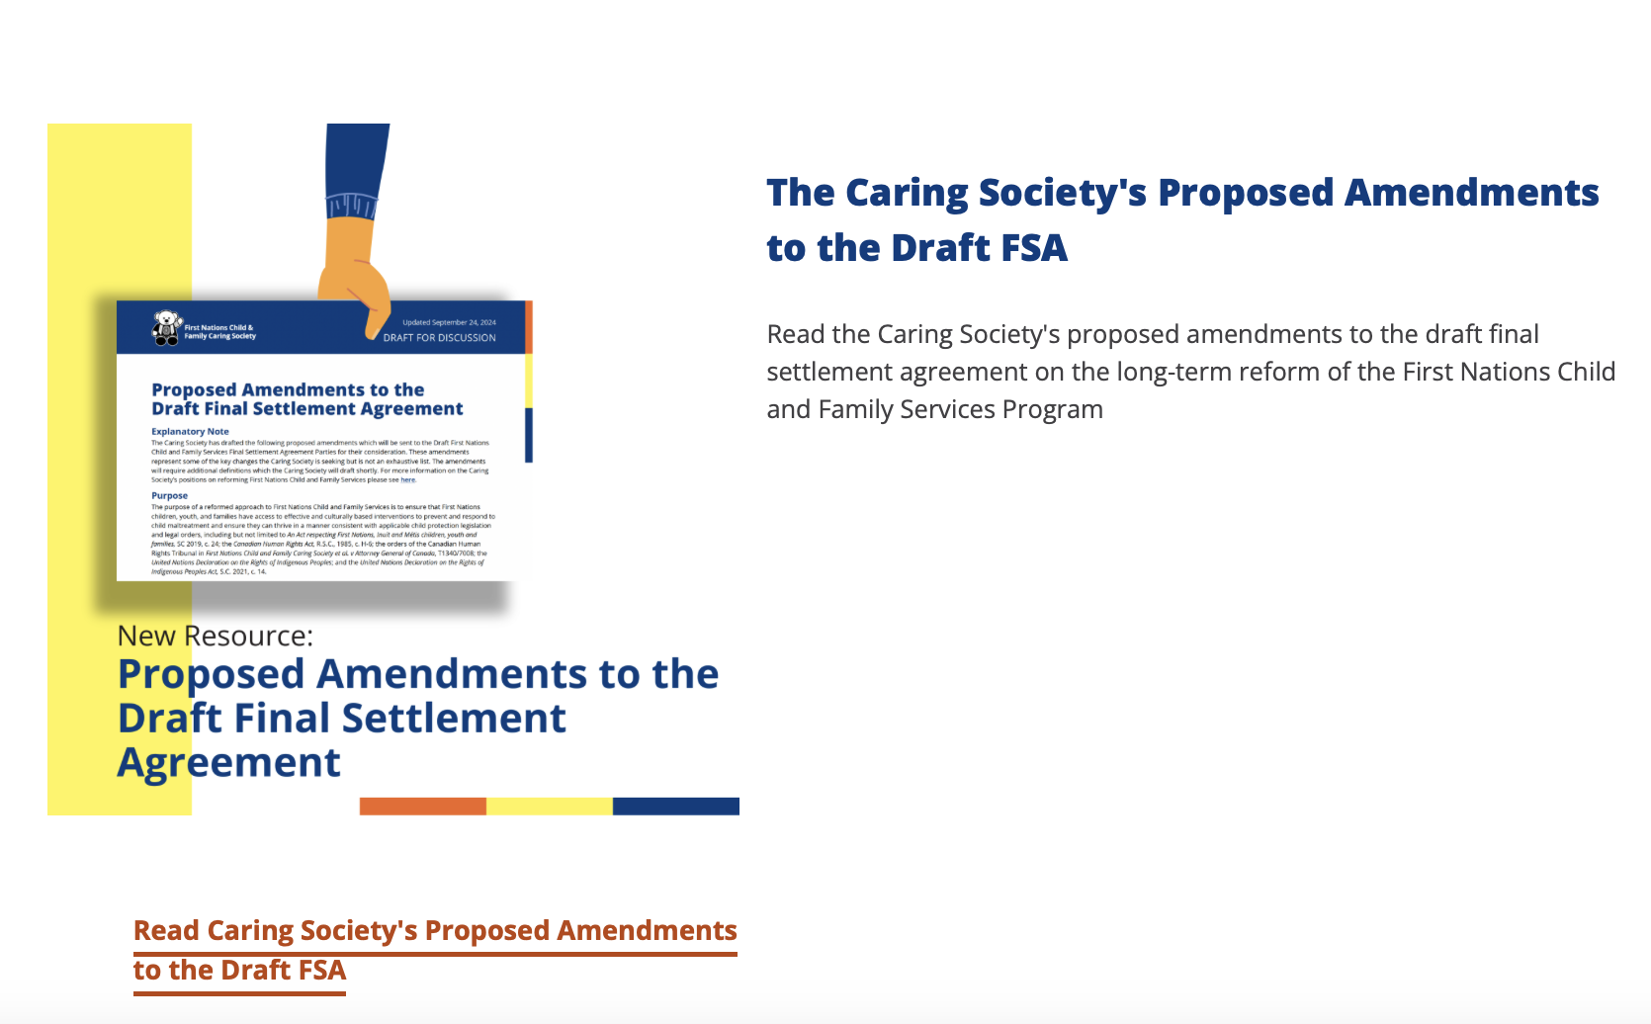
Making it Right for Kids
Your feedback invited and welcomed

Slide 21

Caring Society Recommended Amendments
Restore First Nations as decision makers informed by their child and family service experts on the ground, regionally and nationally
Hold Canada accountable for its discrimination toward our kids
Eliminate secrecy in decision making
Include Elders, Knowledge Holders and Young People
National master agreement to stop the discrimination nationally.
Regional variations and agreements for distinct circumstances and cultural diversity
Retain Tribunal jurisdiction and orders and adapt to change going forward
Binding and Effective ADR

Slide 23
Coming soon: Caring Society recommended amendment
Delete Paragraph 383 that gives Canada wide discretion on the provision of funding each year
Para 383. Any and all funding commitments by Canada or amendments agreed to by the Parties in this Final Settlement Agreement remain subject to annual appropriation by the Parliament of Canada or other necessary approval processes required by the Government of Canada.

Slide 24
What you can do
Call on Canada to return to the negotiation table with a mandate aligned with Resolutions 2024/60 and 2024/ 61
Call on Canada to implement latest CHRT decision and not appeal
Provide input into the Caring Society positions and proposed amendments
Support implementation of Resolutions 60 and 61

Slide 25

fncaringsociety.com
@CaringSociety
CaringSociety
fncaringsociety
spiritbearandfriends
@SpiritBear

