Slide 1


First Nations Home Flood Insurance Needs: Implications for Allyship and Emergency Management
Assembly of First Nations 2024 Emergency Management Forum
March 4-5, 2024
Dr. Brenda Murphy and Dr. Annette Chretien

Slide 2
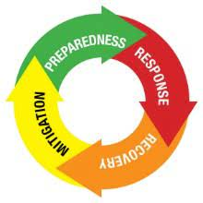
Emergency Management, Climate Change and Insurance
First Nations Home Flood Insurance Needs
  Increasing Extreme Weather Events With a Changing Climate
  Need for Increased Proactive Risk Mitigation and Preparedness
  Difficulties of Obtaining Home Flood Insurance Identified as a Major Barrier
We acknowledge the presence of CoachHouse Enterprises Inc. on the traditional territories of the Neutral, Anishinaabe, Wendat and Haudenosaunee peoples. This acknowledgement gives rise to an obligation to pursue decolonization and to establish honourable treaty relations.

Slide 3

Values Guiding Project
Working Towards Allyship/Accomplice
  Acting in Solidarity with First Nations Peoples
  Centering First Nations Worldviews, Knowledge and Objectives
    Projects Must Benefit First Nations
  Decolonizing Settler Views, Knowledge, Research Methods
Two-Eyed Seeing
  Viewing the World Through Both Indigenous and Western Viewpoints
  Privileging Indigenous Knowledges, Methodologies, Worldviews
  Promoting Equitable and Collaborative Relationships
  Strengths-Based Approach Emphasizing Resilience

Slide 4
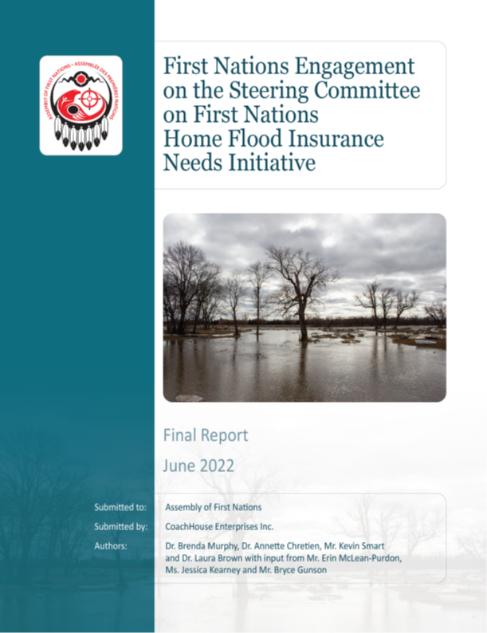
Values Influence on the Project
Ethics
  Focus on Benefits to First Nations
  Team Self-Reflection, Humility, Curiosity
All Research Adhered to OCAP Principles (Ownership, Control, Access and Possession)
Proceeded After AFN and ISC Approval
Information Collection Tools Used Western and Indigenous Approaches
  Interviews, Survey, Talking Circles

Slide 5


Values Influence of the Project
AFN-led Research in Partnership with Coachhouse Team
  Coachhouse – 50-50 Indigenous/Social Science
Elders Opened and Closed Talking Circles
Employed Liaisons Familiar With Regional Contexts
  6 Regions Across Canada (Including North)
Employed First Nation Emergency Management Specialist to Lead Talking Circles
Assured Team Members had OCAP Training

Slide 6
Climate Change Adaptation and Risk Reduction in First Nations Communities are Supported by:
Accessing Indigenous Knowledge and Fully Engaging the Community in Assessing Risk and Developing Plans
Combining Indigenous and Western Ways of Knowing when Undertaking Flood Resilience Planning
Strong Social Ties During Times of Crisis
“We’ve seen major changes since 2007….it’s been increasing….we’ve had sewer backups…floods…rainfalls…ice jams…lightning strikes…we’ve had so many [projects] going over the years. So we were working with the province. We were working with our own community and with engineers to figure out what we could do….”

Slide 7
Adaptation and Risk Reduction in First Nations Communities are Hampered by:
The Intensity, Frequency and Wide Range of Flood Risk Events
Lack of Funding For Risk Mitigation (Current and Future Risk)
Ongoing Historic Trauma, Colonization and Systemic Racism
  Reduces Trust
  Increases Dependency
  Undermines Fair and Equitable Flood Mitigation and Insurance Access
” …on an annual basis, we probably have about three to four major weather events that affect our infrastructure and our assets. So, in reality, we wouldn’t be able to even afford flood insurance.”
Due to past confrontations with the Canadian army, the community mistrusts these authorities and declines their help even in emergency situations.

Slide 8
First Nations Need Short and Long Term Information About Climate Change Flooding Events and Impacts:
To Gather Information About Future Risks and Mitigation Strategies
  Pair Traditional Knowledge of the Land and Important Cultural Sites With Western Historical Records, Mapping, and Climate Projections
  Information Gathering Must Adhere to OCAP Principles
Information Must be “Downscaled” and Locally-Relevant
“More and more as the science is confirming that the indigenous knowledge is right, we should have listened to them. We know the land. There’s thousands and thousands of years of knowledge. So I think these insurance companies and also the governments, they need to listen to the people that have that knowledge.”

Slide 9
Conclusions
Making Values and Ethics Explicit Sets the Tone and Keeps the Project Accountable to First Nations
Flood Risk Mitigation and Adaptation Could be Increased with Timely, Culturally Appropriate Decision Making Processes and Adequate Funding
Further Reading
  Obtain Copy of Flood Insurance Study From the AFN
  Read More on Two-Eyed Seeing:
    Wright, A.L., C. Gabel, M. Ballantyne, S. M. Jack, and O. Wahoush (2019) Using Two-Eyed Seeing in Research With Indigenous People: An Integrative Review, International Journal of Qualitative Methods, 18, 1-19. https://doi.org/10.1177/1609406919869695 (open access article)

Slide 10
Coachhouse.enterprises.inc@gmail.com

