Slide 1
Closing the Infrastructure Gap:
Connectivity
Zack Frawley
Jr. Policy Analyst, AFN

Slide 2
Connectivity
Access to the digital space.
Includes wired access and wireless access.
Wired access: Fibre-to-the-home (FTTH).
Wireless access: Mobile connectivity including LTE and 5G mobile technology.
  Requires Spectrum wavelengths (radiowaves) to transmit the data.

Slide 3
Overview- Objective on the CTIG
To identify the cost of closing the Connectivity gap on First Nations.
Infrastructure needed on each First Nation includes:
  Fibre backbone: Connection between the major network to a First Nation’s point-of-presence (POP) access point.
  Fibre-to-the-home (FTTH): Last mile between the POP and a household.
  Mobile connectivity (5G) within the First Nation and in the households.

Slide 4
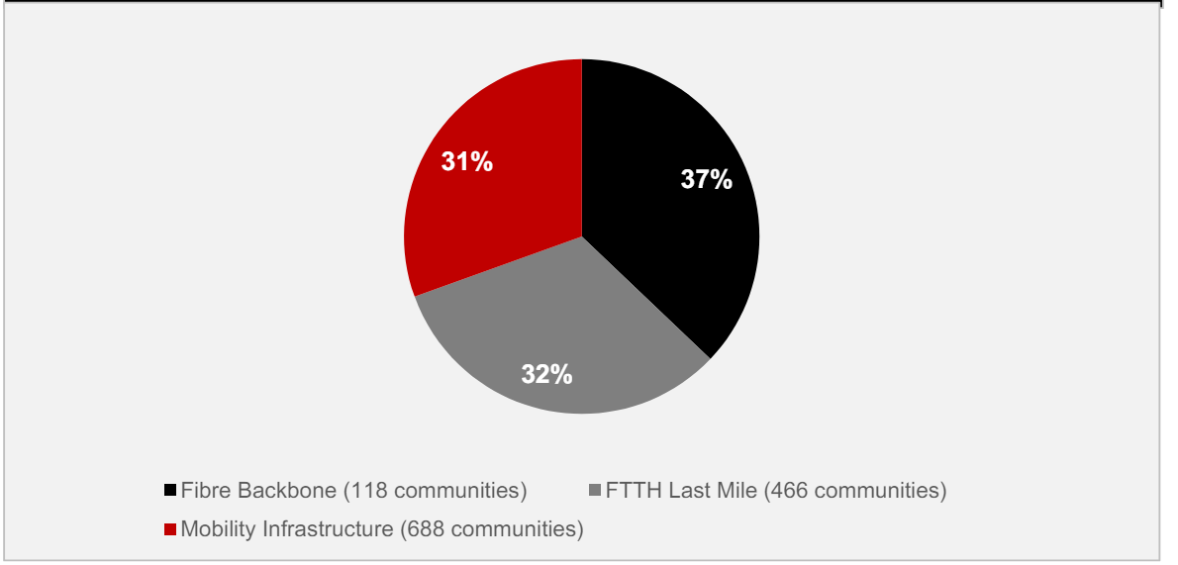
Infrastructure Gap- Connectivity
Analysis based on publicly available data.
$5.2 billion is required to close the connectivity infrastructure gap by 2030.
  37% toward Fibre Backbone
  32% toward FTTH Last Mile
  31% toward mobile connectivity

Slide 5
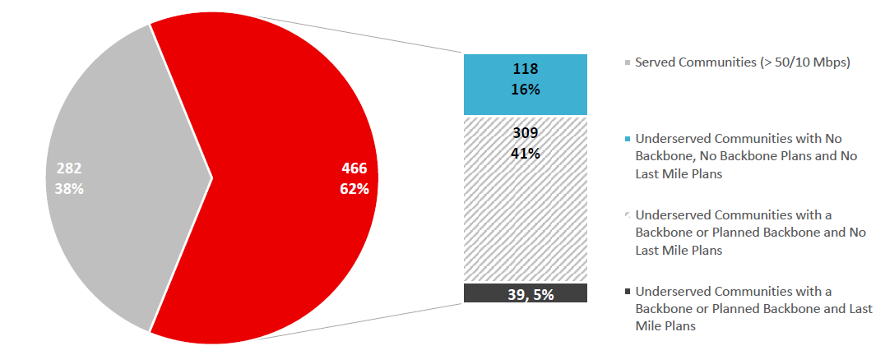
50/10 Broadband Wired Access
62% of First Nations are without high-speed internet access.
The lack of internet access impacts First Nations access to healthcare, education, economic opportunities, community, and governance.

Slide 6
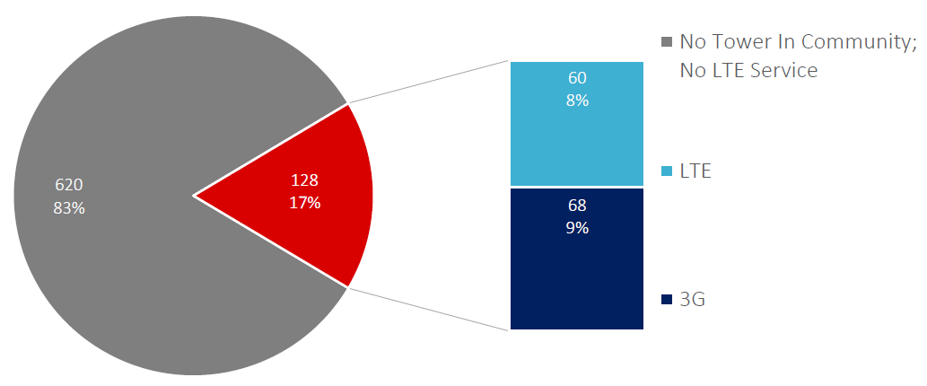
Wireless Mobile Connectivity
83% of First Nations have limited access to mobile connectivity.
Only 8% of First Nations have LTE (4G) capabilities or higher.

Slide 7
Spectrum
A natural resource also known as electromagnetic spectrum.
Currently governed and administered by Innovation, Science and Economic Development (ISED) through spectrum licenses.
Licensing is distributed through auctions or other assignments that provide few benefits or revenues to First Nations.
  The auctions can require millions of dollars to gain a license.
It is used for wireless data transferring (mobile).

Slide 8
Spectrum
In February 2024, the AFN sent a letter to the Honourable François-Philippe Champagne, the Minister of Innovation, Science and Industry.
  The letter requested a moratorium on spectrum licensing to be placed until consultations can take place with First Nations on the licensing processes.
Spectrum for First Nations reduces barriers to accessing mobile connectivity.

Slide 9
Next Steps
Long-term funding commitments to First Nations to close the connectivity infrastructure gap.
Co-developed funding programs and training opportunities for First Nations.
  For capacity building required to operate and maintain connectivity infrastructure.
  To reduce barriers in accessing funding programs.
Reviewing and redefining spectrum licensing processes to remove barriers for First Nations in accessing spectrum and to uphold their rights over natural resources within their Nations.

