Slide 1
Health, Wellness and Culture in Emergency Management
The First Nations Health Authority Approach
Shalyn Pigeon
Manager, Health Emergency Management, Interior Region
Jodie Millward
Director, Health Emergency Management

Slide 2
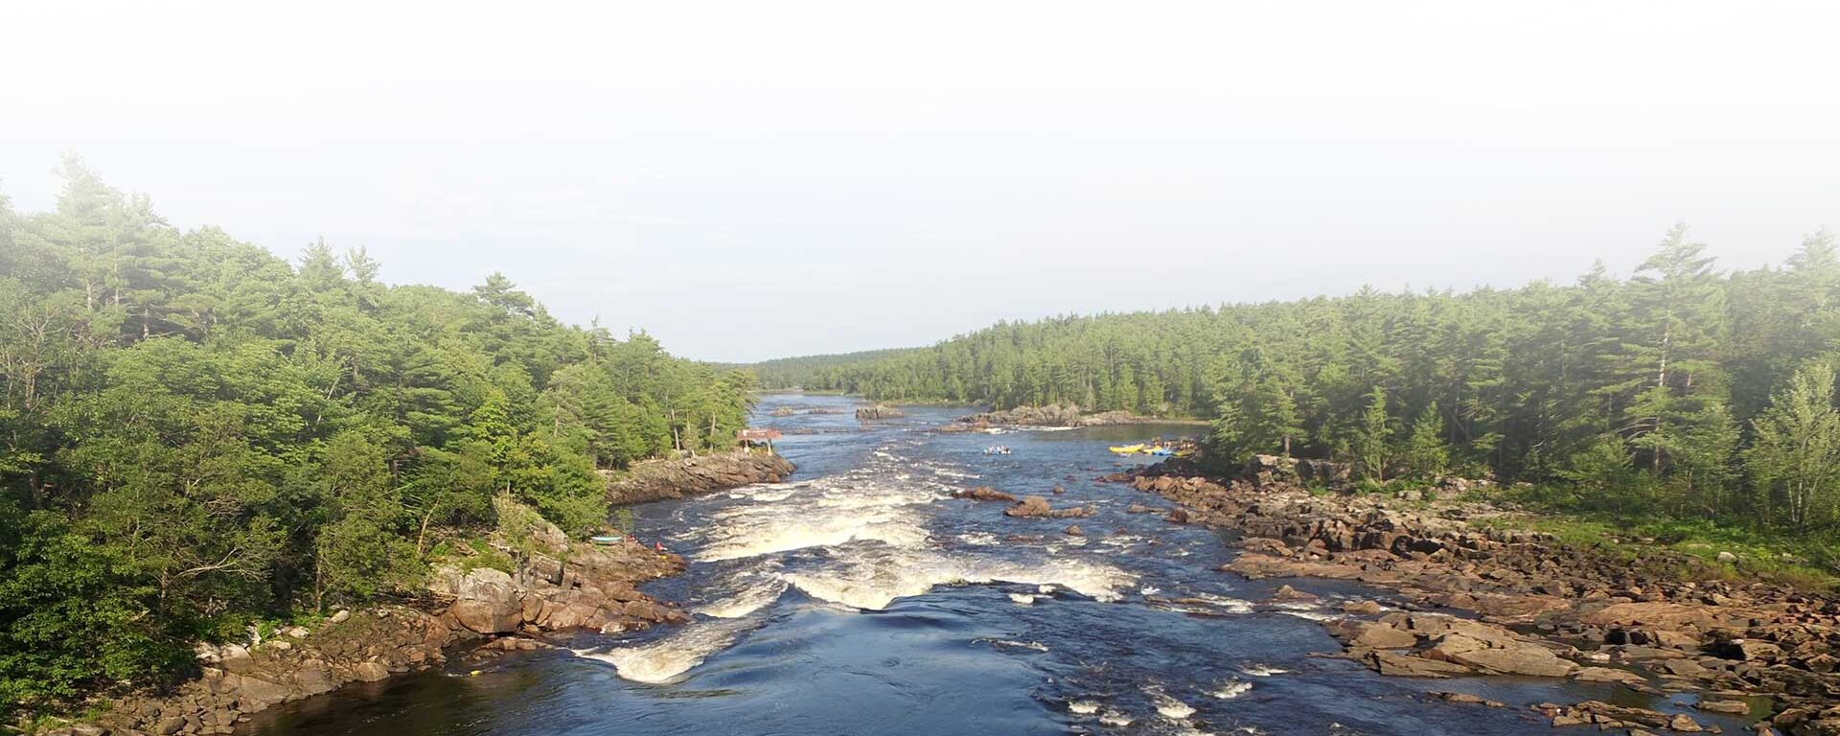
We are honored to be here on the traditional lands of the Algonquin and Anishinabek, caretakers of the lands and waters

Slide 3

First Nations Health Authority (FNHA)
Who are we?
Established in 2013
Responsible for programs and services formerly delivered by Health Canada
Represents a new era in BC First Nations health governance and health care delivery
In 2011 BC First Nations voted to take control of
First Nations health services
Our Vision: Healthy, Self-Determining and Vibrant BC First Nations Children, Families & Communities
Notes:
The first and only provincial Indigenous health authority in Canada, the FNHA was created by First Nations for First Nations to advance a holistic First Nations Perspective on Health & Wellness In 2011, First Nations in BC chiefs and leaders voted to take control of First Nations health services and advance a wholistic First Nations Perspective on Health and Wellness.
And ten years ago in 2013, the FNHA was established.
Represents the first and only provincial Indigenous health authority in Canada.
Works to transform the way health care is delivered to First Nations people in BC.
That includes addressing service gaps through new partnerships, closer collaboration, health systems innovation all aimed at reforming and redesigning health programs and services for individuals, families, communities and Nations.

Slide 4
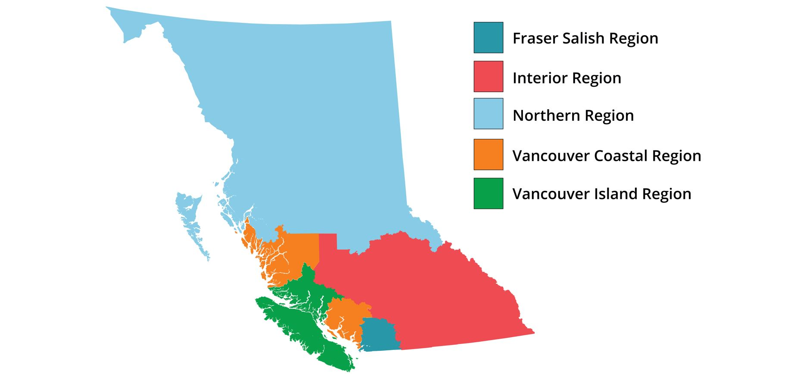
FNHA Across The Province
Over 200 distinct First Nations (or Bands)
26 Cultural Groups
34 Languages
Majority live urban and away from home (~72%)
51% of communities are small (≤500 residents)
41 communities isolated/remote
Notes:
This is based on Census 2021 data.

Slide 5
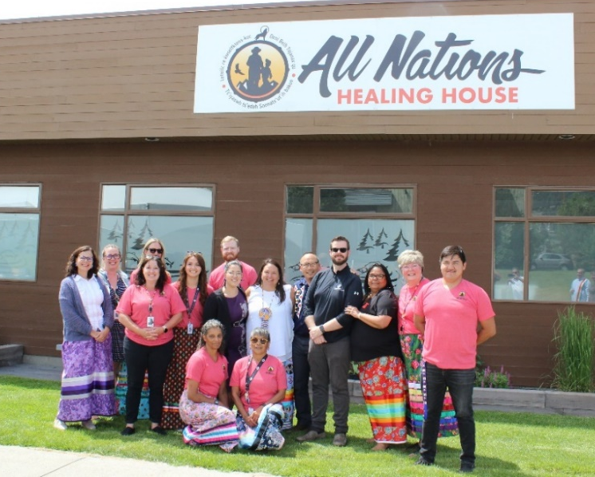

What We Do
The health and wellness partner to over 200 diverse First Nations communities and citizens across BC
Champions culturally safe practices throughout the broader health care system
The FNHA plans, designs, manages, and funds the delivery of First Nations health programs and services in BC
First Nations-led Primary Care in Williams Lake, opened October 2022
Notes:
The FNHA is the health and wellness partner to over 200 diverse First Nations communities and citizens across BC.​
The FNHA is a champion of culturally safe practices throughout the broader health care system - taking a leadership role, to actively work with its health partners to embed cultural safety and humility in to health service delivery and improve health outcomes for First Nations people.
It plans, designs, manages and funds the delivery of First Nations health programs and services in BC, including primary care –
This is a photo of the All Nations Healing House which opened last October in Williams Lake – as the second of 15 planned First Nations-led primary care centres being developed throughout the province in partnership with the Ministry of Health

Slide 6
FNHA Programs and Services
Primary Care- 130 medical centers and nursing stations, including First Nations Primary care sites
Health Benefits
Nursing and Clinical Services
  Communicable Disease Population & Public Health
  Home & Community Care
  Community Accreditation & Quality Improvement
Health Promotion and Disease Prevention
  Maternal, Child, & Family Health
  Mental Health & Substance Use
Environmental Public Health Services
Health Infrastructure Support
  Health Planning & Management
  Healthy Systems Transformation
  Health Emergency Management
Virtual Services
  Virtual Doctor of the Day
  Virtual Substance Use and Psychiatry Service
Notes:
The FNHA’s community-based services are largely focused on health promotion and disease prevention and include:
Primary care through more than 130 medical centres and nursing stations
Health Benefits
Dental (COHI)
Medical Supplies & Equipment
Medical Transportation
Mental Health
Pharmacy
Vision
Also manages MSP and ambulance bills
Nursing and Clinical Services
Communicable Disease Population & Public Health
Home & Community Care
Community Accreditation & Quality Improvement
Health Promotion and Disease Prevention
Maternal, Child, & Family Health
Mental Health & Substance Use
Environmental Public Health Services
Health Infrastructure Support
Health Planning & Management
Healthy Systems Transformation
Health Emergency Management
Virtual Services
Virtual Doctor of the Day
Virtual Substance Use and Psychiatry Service

Slide 7
What does
Health Emergency Management look like at FNHA
Health Environmental
Access to Primary Care
Communicable Disease prevention and control
Mental Health supports
Toxic Drug Emergency
Traditional and Cultural Wellness
Debriefing/ learning/AAR
Food Security
Liaison and Partnerships
Training and Exercise
Climate Change and Health
HEM Operations and Reflections
Notes:
A pretty picture here

Slide 8
Structures that Support Response
First Nations Communities:
  Impacted communities activate their EOC
  Communities open their own evacuation centers
Regional teams:
  Health Emergency Management team
  Mental Health and Wellness teams
  Environmental Public Health Services team
  Sit in Provincial Regional Emergency Operations Center (PREOC) as liaisons
  Situational awareness of communities needs
Provincial teams:
  Access to various teams to support informed decision making
  deploy supports to teams in response, includes human resources, supplies etc.
  Situational awareness of provincial needs
  Sit in Provincial Emergency Coordination Center (PECC) as Liaison
  Escalation pathway to response quickly when needed
Partners:
First Nations Communities
Cultural and traditional support networks
BC Emergency Management and Climate Readiness
Indigenous Services Canada
Provincial Health Authority Services
  HEMBC
  Mental health supports
First Nations Emergency Support Services
Canadian Red Cross
Ministry of Health

Slide 9

Interior Region – Supporting Communities Through Emergencies

Slide 10
Health Emergency Management
2023 Wildfire Season
24 of 54 Interior region communities stood up EOCs at varying levels (monitoring, response, supporting)
Aug 18th 13 communities were on alert and/or order
3 communities with structural losses, one of which lost 1/3rd of homes
Over 700 evacuees in the Kamloops area from all Nations
Main sites for support in Kamloops: Mac Park ESS Site, Rayleigh Group Lodging, Sun Peaks Lodging, Tk’emlúps te Secwepemc Arbour

Slide 11
Health Emergency Management
Aug 25, 2023 IR EOC Example

Slide 12
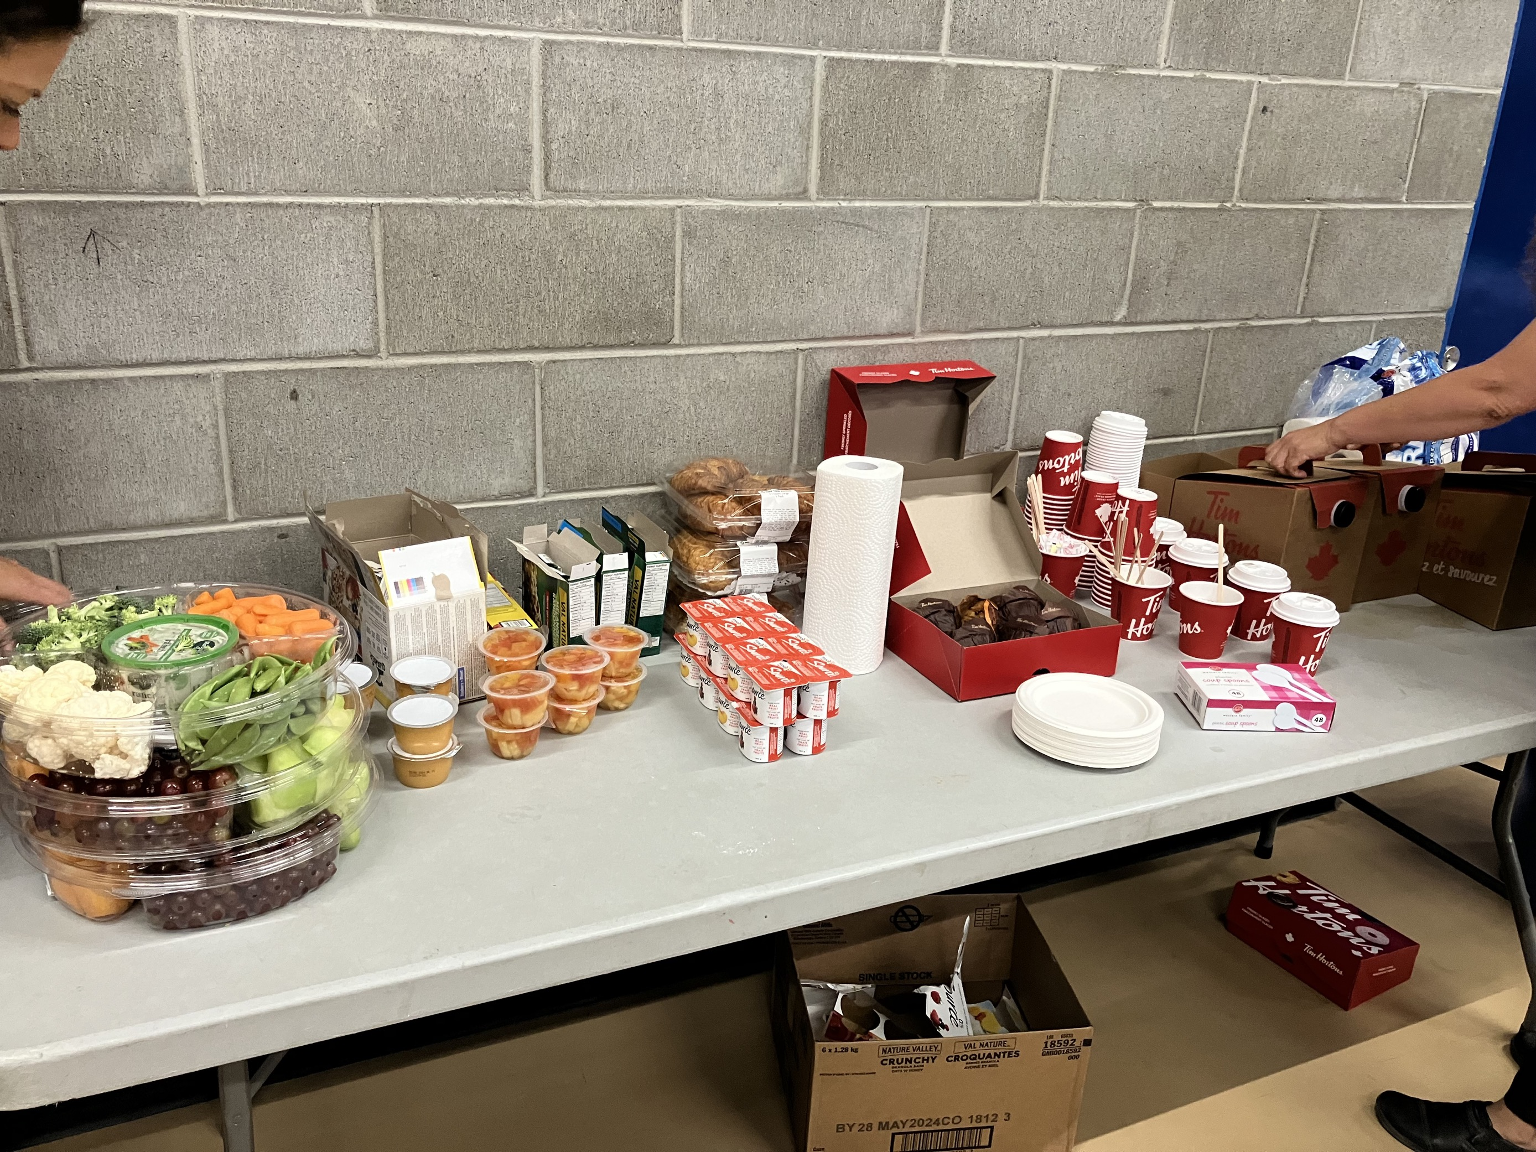
Health Emergency Management
On-Site Supports
On-site staff at multiple ESS reception centers for systems navigation support
Traditional Wellness Totes
If lodging in Community, EPHS assessments
Health Benefits
Mental health and traditional wellness
Harm reduction training (Naloxone) at Rayleigh site
Nursing
Awareness of cultural safety for system, contractors

Slide 13
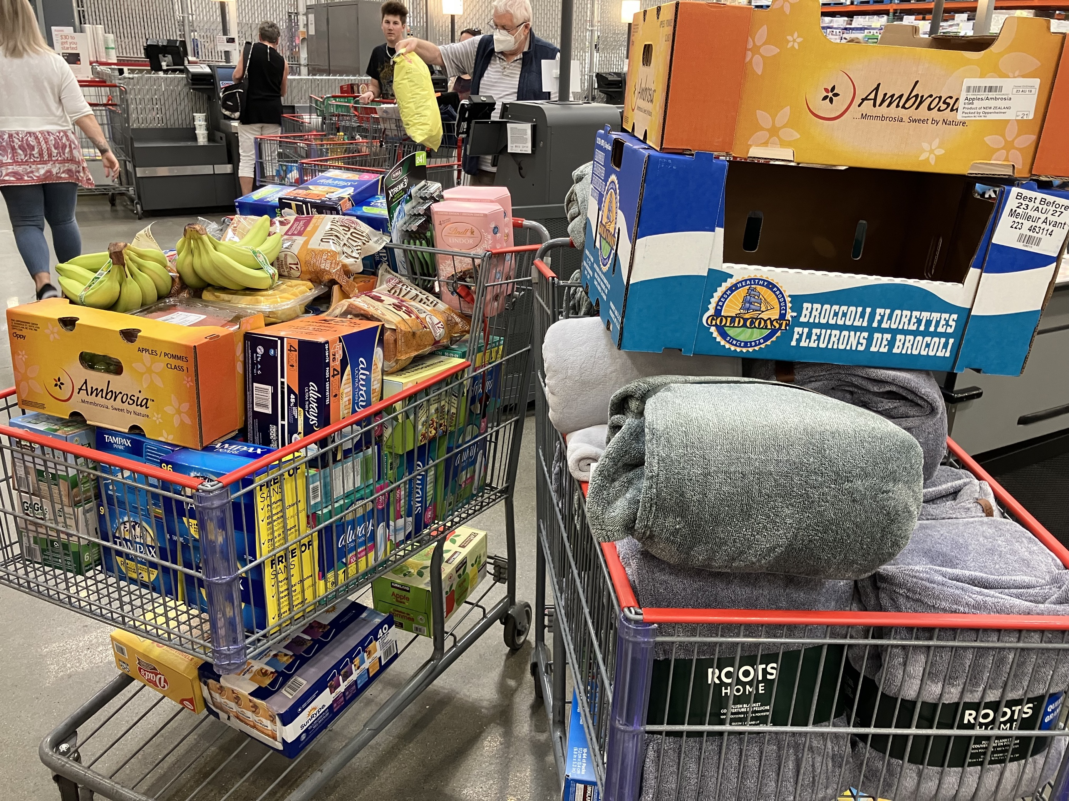
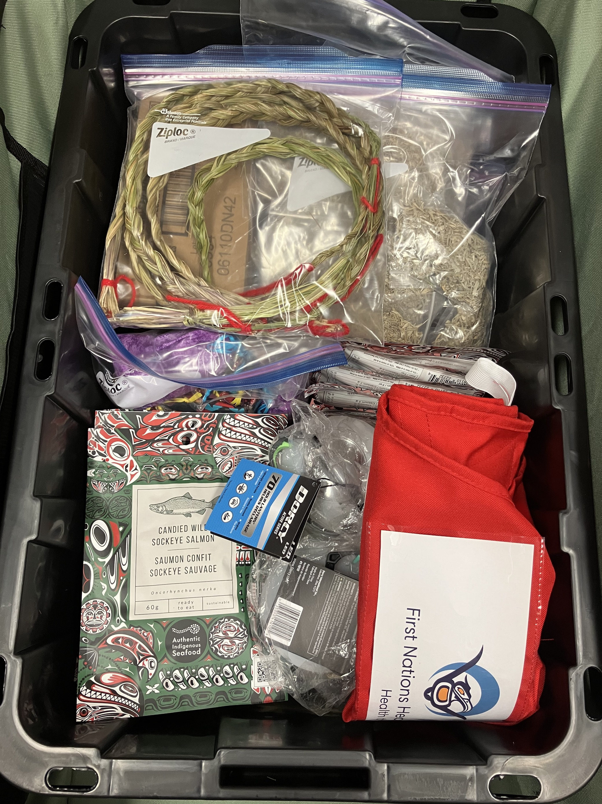
Health Emergency Management
Supply Drops
Traditional/cultural/wellness items (tobacco, sage, sweetgrass, hooshum, honey, jams, canned salmon, dried salmon, salves, teas, etc.)
Kids kits
PPE (gloves, masks, hand sani)
Red Cross hygiene kits
Blankets
Food
Women’s hygiene products

Slide 14
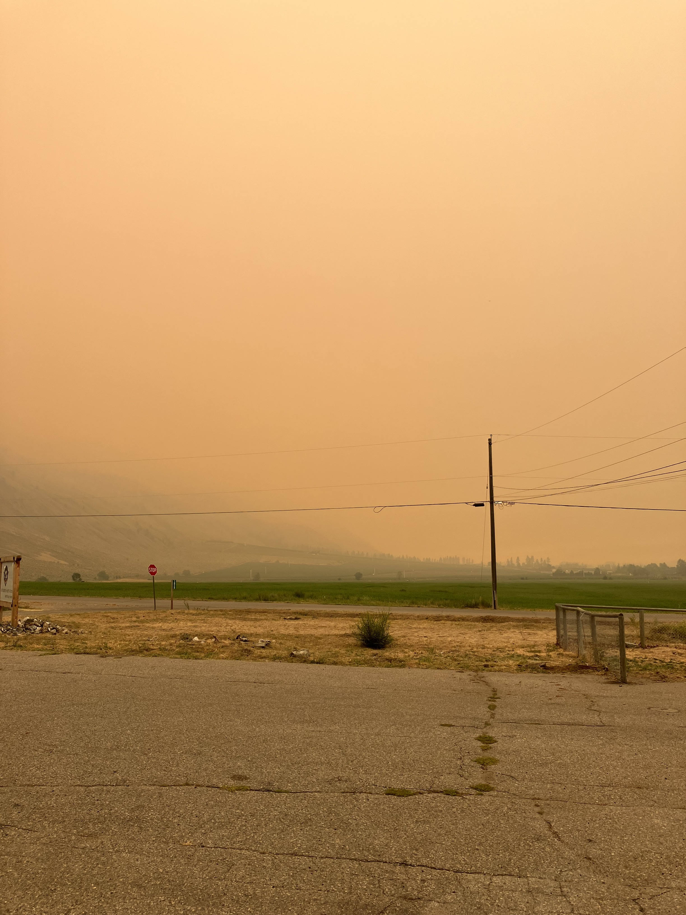
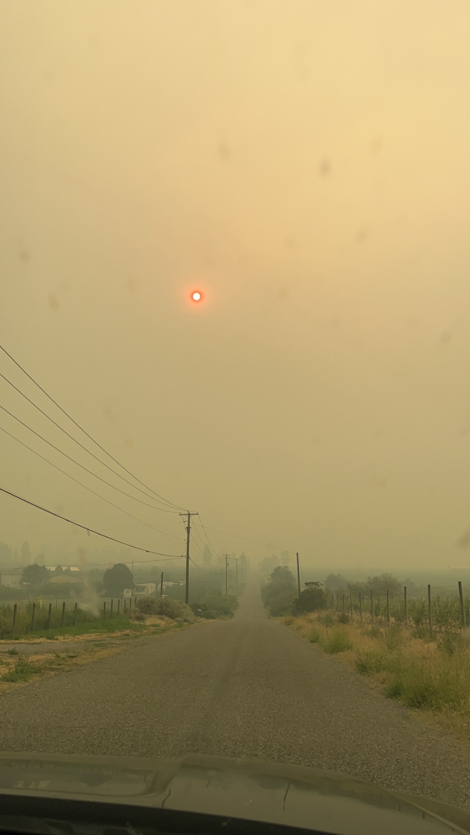
Health Emergency Management
Air Purifiers
467 purifiers delivered to 20 IR communities
Ashcroft Indian Band
Cawston

Slide 15
Health Emergency Management
Community EOC Supports
Supported on-site community EOCs when needed/requested
Support with Expense Authorization Form (EAF) writing
Support with liaising Community with various partner agencies including PREOC, Indigenous Service Canada and Interior Health
Recovery supports from EHO team
FNHA Interior Region

Slide 16
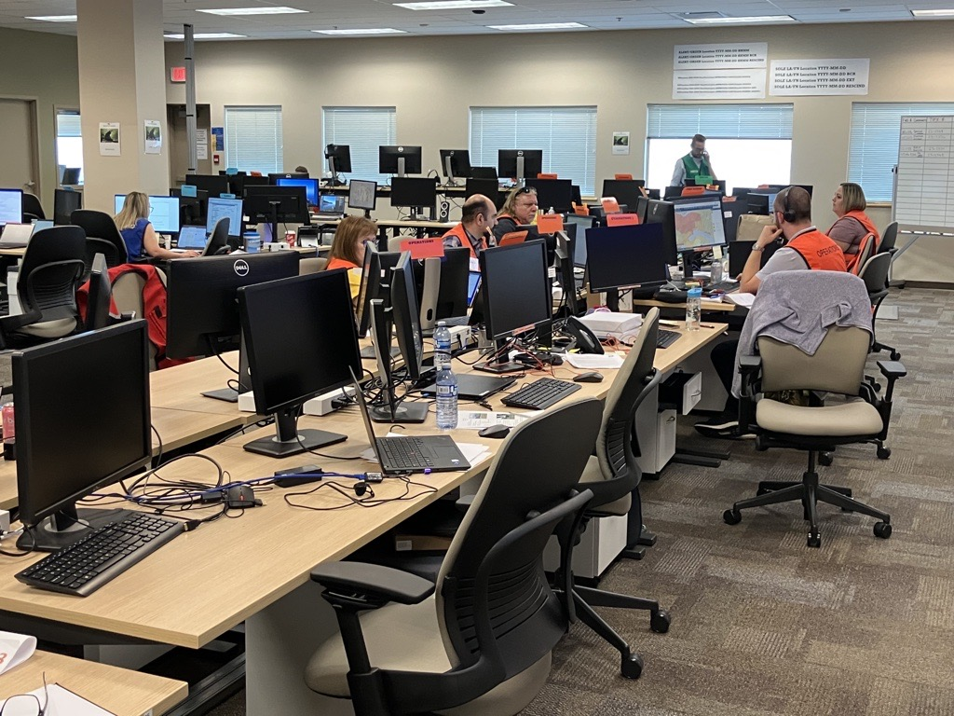
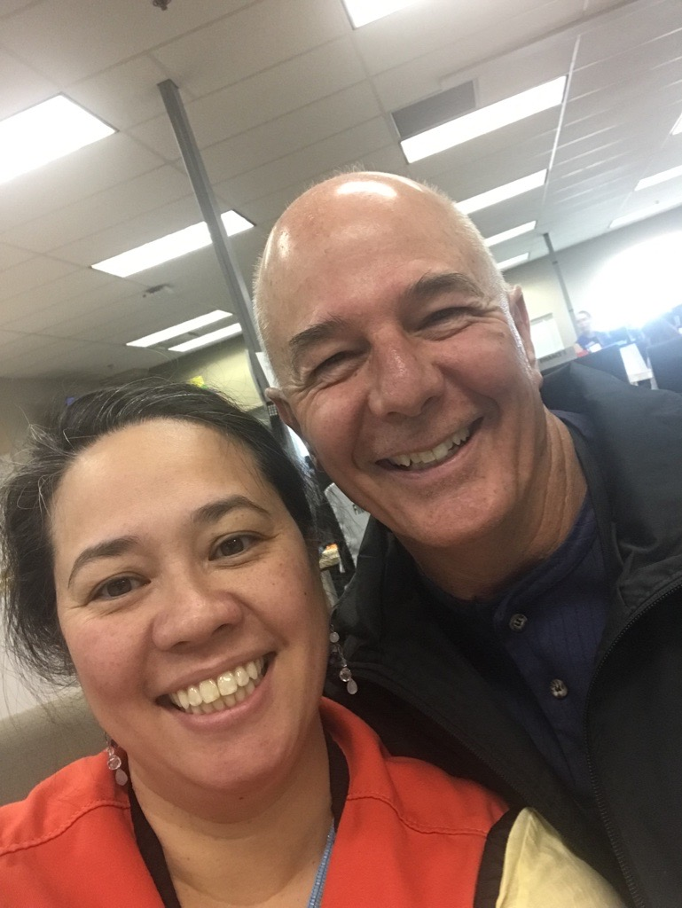
Health Emergency Management
PREOC
FNHA IR team staff embedded in PREOC

Slide 17
Health Emergency Management
OTHER
Immediate needs gift card support for gas & groceries
Coordinating supports from other organizations, including New Gold, United Way, Telus, etc.
Coordinating a 3-day pop up status card renewal with ISC
Attending community meetings and coordination calls
Continuing supports for Communities with long-term evacuees

Slide 18
Health Emergency Management
NEXT STEPS
Continue to support impacted communities
After-Action review led by staff debriefing activities
Supporting capacity building / training at the Community/Nation level
Advocacy work

Slide 19
Thank you!
Gayaxsixa (Hailhzaqvla)
Huy tseep q’u (Stz’uminus)
Haa’wa (Haida)
Gila’kasla (Kwakwaka’wakw)
Kleco Kleco (Nuu-Chah-Nulth)
Snachailya (Dakelh)
Kw’as ho:y (Halq’eméyem)
Huy ch q’u (Hul’qumi’num)
Kʷukʷstéyp (Nlaka’pamux)
HÍSW̱ḴE (Senćoŧen)
Mussi Cho (Kaska Dena)
Tooyksim niin (Nisga’a)
Kukwstsétsemc (Secwepemc)
Čɛčɛhaθɛč (Ayajuthem)
Sechanalyagh (Tsilhqot’in)
T’oyaxsim nisim (Gitxsan)

