Slide 1
Closing the Infrastructure Gap
by 2030
A Collaborative and Comprehensive Cost Estimate Identifying the Infrastructure Investment Needs of First Nations in Canada
July 2024

Slide 2
Land Acknowledgement
I want to acknowledge that I am located on the the Haundenosaunee Confederacy, of which the Kanien'kéha Nation is a part, and the Anishinaabeg peoples

Slide 3






Special Contributions
The information prepared in the report was produced by a multidisciplinary team led by the Assembly of First Nations with support from Indigenous Services Canada. We would like to acknowledge the contributions of the First Nations Engineering Services, BTY Group, Associated Engineering, Planetworks Consulting, and Yalleedesigns for their contributions to the development of the information and reports associated with this presentation.

Slide 4

Special Contributions
The 2023 RICS Awards – Americas:
Americas Awards 2023 – Shortlist of Nominees
We are proud to announce the shortlist of nominations for the inaugural Royal Institute of Chartered Surveyors - Americas Awards 2023. This is the first time we can officially celebrate the achievements of individuals, teams and organizations within the Americas and showcase their great work on the world stage.
BTY Group - Closing the Infrastructure Gap by 2030 (CTIG) Initiative

Slide 5

Special Contributions
Studies, Software, and Special Services – Alberta:
Showcase Awards 2024 – Award of Excellence
We are proud to be the winner of the Award of Excellence for the “Studies” category.
Associated Engineering - Closing the Infrastructure Gap by 2030 (CTIG) Initiative

Slide 6
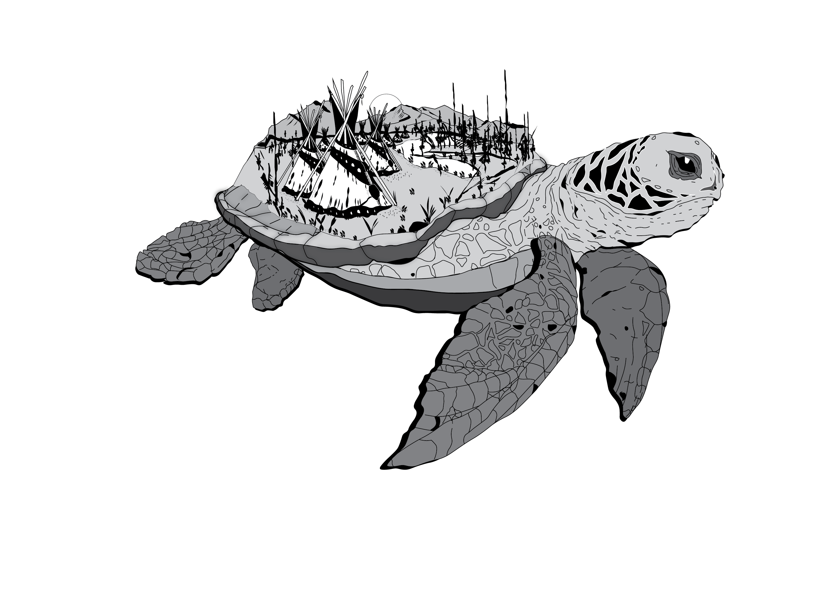
Proposal Description
HOW WAS DATA GATHERED AND HOW DID WE GET TO THE FINAL COSTS?
Based on years of AFN technical studies, First Nations engagements, and decades of ISC records, including:
  AFN Housing Report: Cost Analysis of Current Housing Gaps
  and Future Housing Needs in First Nations
  AFN Infrastructure: National First Nations Assets Needs Study
  AFN Education: First Nations Education Infrastructure
  Capital Needs Assessment
  AFN Education: First Nations Education Infrastructure
  Operation and Maintenance Needs Assessment
  ISC-led initiative with 401 First Nations Direct Asks
  AFN selected industry experts to complete specific
  studies on missing elements and perform peer-reviews

Slide 7
Regional Impacts
NUMBER OF COMMUNITIES PER REGION BY ZONE TYPE
Region | First Nations Population On-Reserve | Zone 1 Communities | Zone 2 Communities | Zone 3 Communities | Zone 4 Communities | Subtotals
Atlantic | 21,625 | 22 | 11 | 0 | 1 | 34
Quebec | 42,755 | 17 | 11 | 6 | 6 | 40
Ontario | 59,390 | 45 | 60 | 1 | 33 | 139
Manitoba | 65,030 | 5 | 39 | 0 | 19 | 63
Saskatchewan | 56,525 | 10 | 55 | 2 | 3 | 70
Alberta | 59,437 | 22 | 23 | 0 | 3 | 48
BC | 87,500 | 79 | 78 | 11 | 31 | 199
Yukon | 3,300 | 2 | 9 | 6 | 1 | 18
NWT | 9,300 | 6 | 6 | 1 | 13 | 26
Totals | 404,862* | 208 | 292 | 27 | 110 | 637**
*see back-end data for off-reserve figures
**varies from 634 due to 3 Nations being counted individually rather than collectively in ISC data

Slide 8









Summary Recap
Closing the
Infrastructure Gap 2030
An Infrastructure Needs Report to Build Towards Reconciliation, Resilience, Achieving Net-Zero Goals, Connectivity, and Unlocking First Nation Economic Capacity.
Participation from 401 First Nations communities.
Creates economic
opportunities for First Nations and non-Indigenous workers
and businesses.
Promotes a self-governed asset management approach by First Nations to Close the Infrastructure Gap by 2030.
A collaborative and historic attempt to quantify the infrastructure and housing gap with the co-operation of the Assembly of First Nations and Indigenous Services Canada.
Advances First Nations’ socioeconomic outcomes by fulfilling the Government of Canada's existing fiduciary, legal, and public commitments to
First Nations.
Notes:
What does closing the gap have to do with Jordans Principle
-Closing the First Nation infrastructure gap entails closing the federal funding gap to First Nations when in comparison to the per capita spending
-Closing the gap ensures there is underground civil services to support essential community buildings
-Facilities to support social programming
-Or in-community medical facilities so people like Virginia Rivers, Jordans mother, doesn’t have to travel 800km to receive medical services.
-Closing the Digital connectivity infrastructure gap – ensuring kids can access online learning materials or simply play video games with friends and family like any other kid

Slide 9
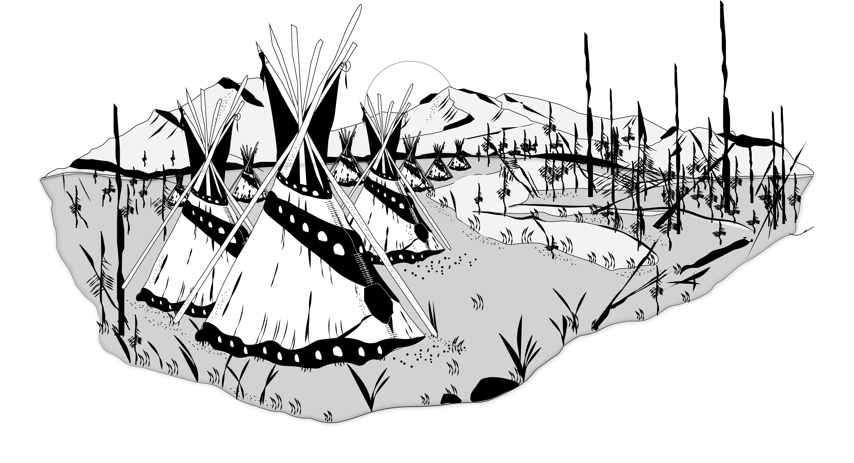
Rationale
WHAT IS THE GAP AND WHY DO WE NEED TO CLOSE IT?
Canada’s federal government has a legal and fiduciary responsibility to First Nations peoples
Canada already supports infrastructure investments in non-Indigenous regions
Access to safe water: long- and short-term drinking water advisories and insufficient pressure
Emergency facilities: First Nation children 86 times more likely to die in a fire
Social service facilities: 53.8% of children in public care are First Nation or Indigenous
Education facilities: First Nations in their early 20s (on IR) - 48% high school & 10% bachelors
Care home facilities: Elders travel hundreds of kilometers away from their homes and families
Housing: Some regions report 68% of shelter users are First Nation or Indigenous
First Nation Girls: Make-up 62% of the Indigenous youth in custody
First Nation suicide and overdose rates are 3-6x & 5-9x higher
MORE ACCESS TO ESSENTIAL INFRASTRUCTURE SERVICES

Slide 10

Costing
Education: $12.6 billion
$349.2 Billion
Closing the Infrastructure Gap by 2030
Housing: $135.1 billion
All Season Road Access: $35.5 billion
Infrastructure: $59.5 billion
Climate Adaptation: $30.9 billion
First Nations Direct Asks: $ 55.4 billion
Net Zero Carbon: $12.7 billion
Connectivity: $5.2 billion
Accessibility: $1.6 billion
Drinking Water Advisories: $ 0.7 billion

Slide 11
Costing
To Close the Infrastructure Gap by 2030: $349.2 Billion

Slide 12
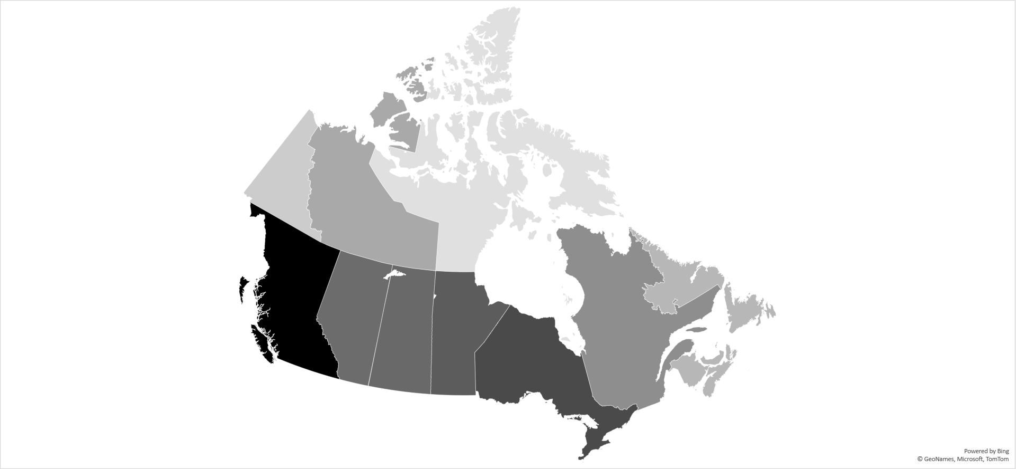
CTIG 2030 Investment (Capital and O&M)
Northwest Territories
Capital : $14.7 billion
O&M : $3.1 billion
First Nations: 26
Alberta
Capital: $40.9 billion
O&M: $8.4 billion
First Nations: 48
Yukon
Capital: $8.8 billion
O&M: $1.8 billion
First Nations: 18
Saskatchewan
Capital: $42.2 billion
O&M: $8.6 billion
First Nations: 70
Manitoba
Capital: $39.8 billion
O&M: $8.2 billion
First Nations: 63
Quebec
Capital: $23.3 billion
O&M: $4.8 billion
First Nations: 40
British Columbia
Capital: $58.4 billion
O&M: $12.3 billion
First Nations: 199
Ontario
Capital:$49.0 billion
O&M: $9.9 billion
First Nations: 139
Atlantic Canada
Capital: $12.4 billion
O&M: $2.6 billion
First Nations: 34

Slide 13





Investment Needs By Asset Category:
Infrastructure by 2030
Based on the AFN's National First Nations Asset Needs Study, March 2022
Defines the Capital and O&M investment for on-reserve
assets for renewal, upgrades and population growth
Assets include:
Data from ISC’s Asset Condition Reporting System
Developed Capital Replacement Values
Adjusted for Regional and Zonal Factors
Applied contingencies (design, construction, escalation)
Buildings
Ports
& Wharfs
Transportation Infrastructure
Utilities Infrastructure
Fleet Service
Vehicles

Slide 14
Investment Needs By Asset Category:
Housing by 2030
housing
Based on Housing report by IFSD, and up-to-date housing costs for On-Reserve Housing
Data from First Nations Information Governance Centre survey of 498 First Nations
Existing housing needs data focused on addressing overcrowding, on-reserve migration, unit replacement, servicing new lots, repair needs, and population growth
Regional Factors
Adjustment Factors by Zone
Region | Factor
British Columbia | 1.00
Alberta | 0.95
Saskatchewan | 0.93
Manitoba | 0.90
Ontario | 1.05
Quebec | 0.98
Atlantic Canada | 0.93
The North (Yukon & NWT) | 1.22
Zone | Capital Factor | O&M Factor
G1 | 1.00 | 1.00
G2 | 1.20 | 1.00
G3 | 1.60 | 1.60
G4 | 2.00 | 2.75

Slide 15
Investment Needs By Asset Category:
Housing by 2030

Slide 16
Investment Needs By Asset Category:
First Nations Direct Asks by 2030
An Indigenous Services Canada-led Process
Information provided directly by representatives from First Nations communities through correspondence with ISC
Direct Asks are documented by asset category
and zone
Asset categories include:
Community Accessibility Assets
Recreation Assets
Community Assets
Social Programs
Cultural Assets
Transportation Infrastructure
Economic Development
Water, Wastewater, and Utilities
Education and Training
Health
Electronic Connectivity
Housing
Emergency Services
Solid Waste and Recycling

Slide 17


Investment Needs By Asset Category:
Education by 2030
Based on AFN's First Nations Education Infrastructure Capital Needs Assessment, August 2021; and AFN First Nations Education Infrastructure Operation and Maintenance Needs Assessment, January 2022.
Includes investment needs organized under Planning & Design, Additions, and New Construction.
Education assets include:
Schools
Including provision for outdoor learning
Teacherages
Including on-reserve accommodation for
teaching staff

Slide 18





Investment Needs By Asset Category:
Critical Drinking Water Advisories
Based on best-practice and sustainable solutions comprising Feasibility Studies,
Project Development, Construction, Maintenance, Training & Support,
Operations & Maintenance
Supply chain for clean drinking water involves:
Source Waters
Surface water, groundwater
Abstraction
Wells, surface water intakes
Treatment
Filtration
Storage
Tanks, reservoirs, cisterns
Transmission & Distribution
Piped and trucked

Slide 19

Investment Needs By Asset Category:
All Season Road Access by 2030
Based on Associated Engineering’s All-Season Road Access for First Nations discussion paper dated November 2022
Explores the boundaries of Canada’s present
Winter Road network
References the proposed 1969 Mid-Canada Corridor boundary, as well as highlighting modern proposals to expand this boundary to meet needs of First Nations
Various road projects are proposed to improve the physical connectivity between First Nations, including:
Road Network Projects
Ring of Fire
(Ontario) 450km
Norman Wells
(NWT) 321km
TASR Project
(NWT) 97km
Tibbet Lake
(NWT) 415km
Tuktoyaktuk
(NWT) 138km
Shoal Lake
(Manitoba) 24km

Slide 20
Investment Needs By Asset Category:
Climate Change Adaptation by 2030
Based on information from Associated Engineering’s Climate Adaptation discussion paper from October 2022
Quantifies high-level costing to implement 197 potential adaptations to various asset classes in various locations to manage risks associated with climate change from 2030, 2050, and 2080.
Asset categories include:
Buildings
Recreational
Transportation
Administration
Utilities
Bridges
Institutional
Electrical Power Supply and Distribution System
Road
Housing
Solid Waste Collection and Disposal System
Building Utility
Residential
Water Supply
Operative
Waste Collection and Disposal Collection
Emergency Preparedness

Slide 21



Investment Needs By Asset Category:
Net Zero Carbon by 2030
Information from Associated Engineering’s Towards Net Zero Infrastructure paper dated October 2022
Explores the Canadian Government’s reduction target of 40% below year 2005 levels of carbon emissions by 2030
Highlights the importance of Closing the Infrastructure Gap 2030 and its potential contributions to GHG emissions reduction
Several asset categories, specific to First Nations infrastructure, are evaluated. Areas where energy efficiency improvements can be made include:
Non-residential Buildings
First Nation Housing
Vehicles and Fleet Infrastructure
Utilities

Slide 22
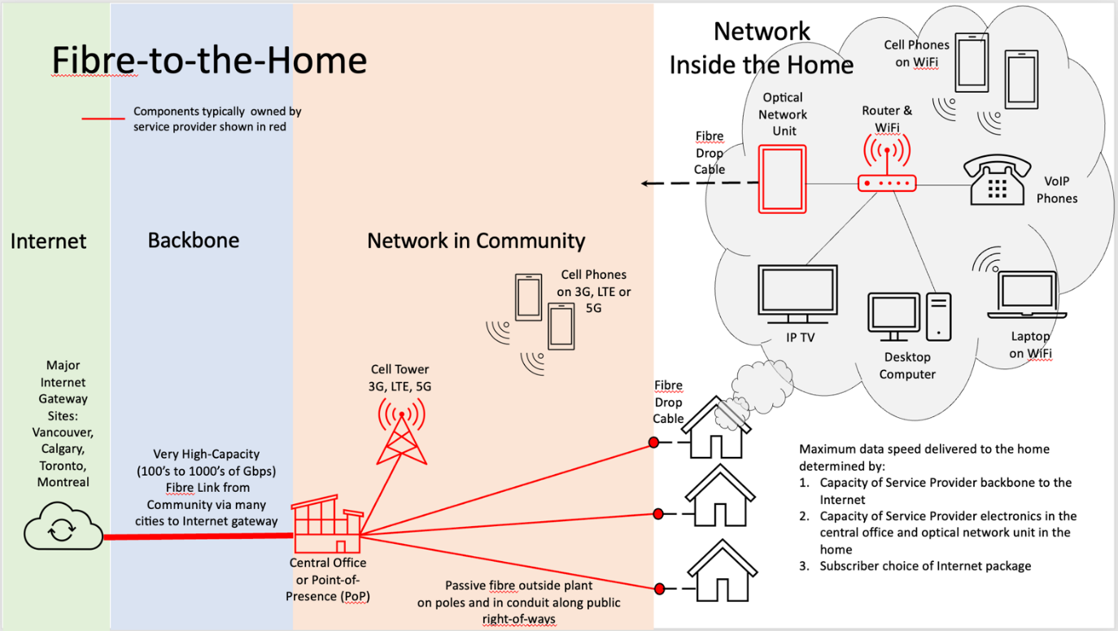
Investment Needs By Asset Category:
Connectivity by 2030
457 First Nation communities (61%) of 748 studied did not have highspeed internet and no FTTH
Analysis determined extent of the wired and mobility wireless infrastructure gaps which need
to be addressed so that every First Nation has:
    A fibre backbone to the Internet
    Fibre-to-the-home (FTTH) last mile
    LTE or 5G mobility services

Slide 23

Investment Needs By Asset Category:
Connectivity by 2030
363 First Nations communities across Canada are still unserved and have no access to 50/10 infrastructure or celluar

Slide 24
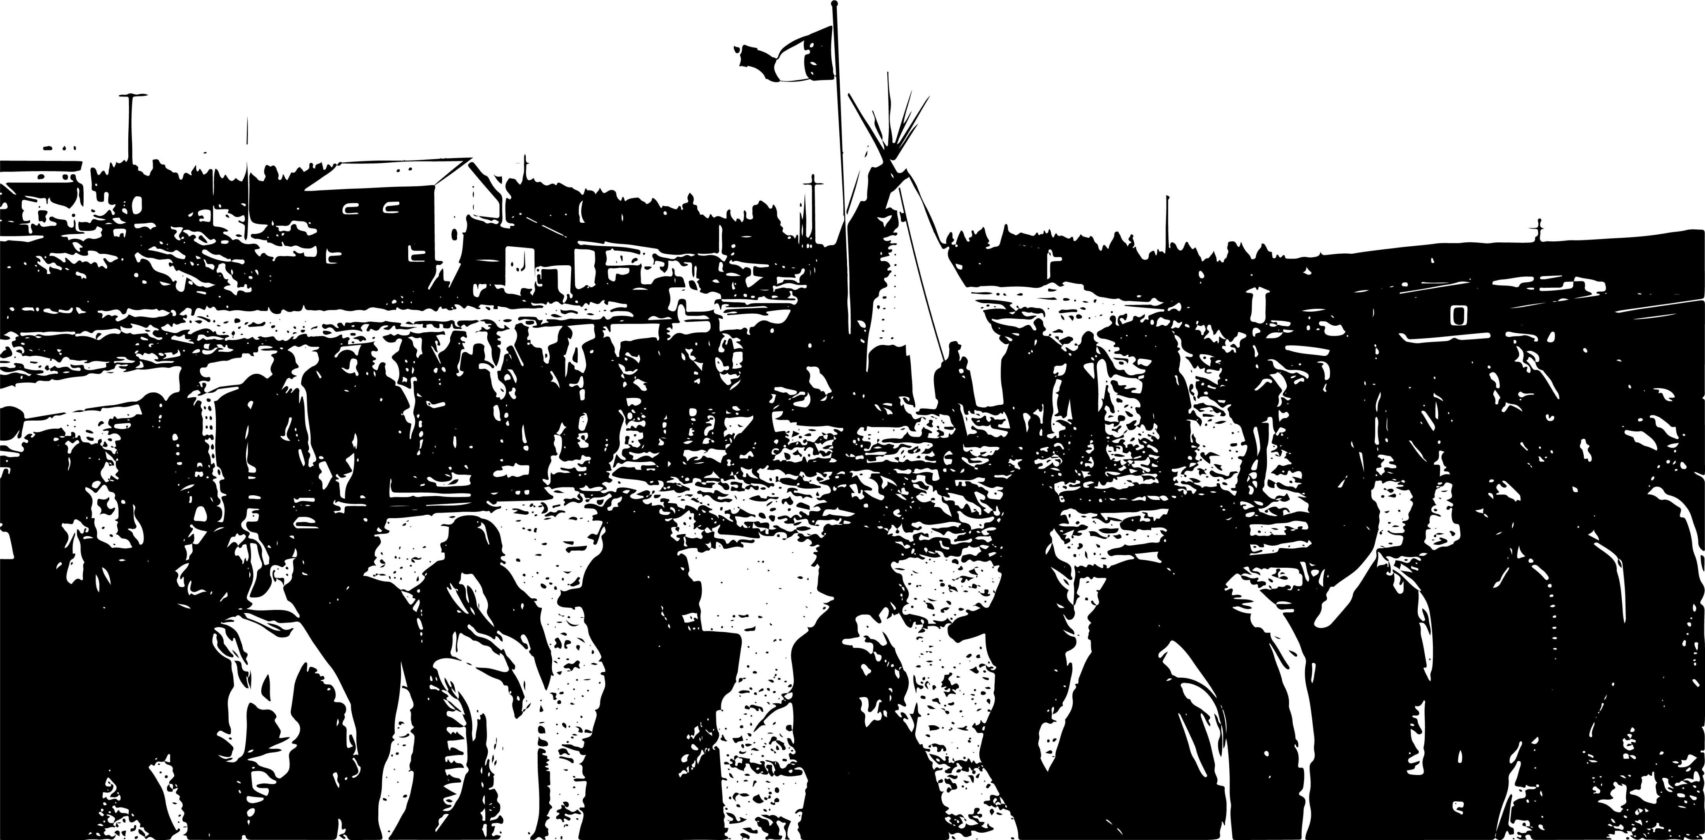
Investment Needs By Asset Category:
Accessibility by 2030
Derived from Associated Engineering’s Addressing Accessibility discussion paper from October 2022
Highlights the challenges that individuals with disabilities face for conventional building configurations
Outlines the cost of retrofitting existing infrastructure to accommodate modern accessibility standards

Slide 25



Canada’s Natural Resources
Extraction vs. CTIG
WHERE’S THE MONEY GOING TO COME FROM?
Program cost comparison of CTIG vs. various categories of spending by the Government of Canada between 2015 to 2021
Canadian Natural Resource and Downstream Exports
$1.81 Trillion
Closing the Infrastructure Gap Proposal
(2023 to 2030)
$349.2 Billion
Statistics Canada. Table 38-10-0285-01 Natural resources satellite account, indicators (x 1,000,000)

Slide 26










CTIG 2030 Program $349.2 billion
Closing the
Infrastructure Gap
The Cost of Inaction
CTIG Extended to 2040
$527.9 billion (+51.17%)
The gap remains:
The Government of Canada’s 2023 Federal Budget and Fall Economic Statement made no investments towards its public commitments to “Closing the Infrastructure Gap.”
Experts estimate that due to Government of Canada inaction, the timeline to close “The Gap” is expected to be delayed to the year 2040 — that is 16 more years of inadequate access to infrastructure, housing, and digital connectivity — basic essential services enjoyed by Canadians each day.
Housing: $135.1 billion
Increases to $201.5 billion (+49.1%)
Infrastructure: $59.5 billion
Increases to $104.8 billion (+76.1%)
Education: $12.6 billion
Increases to $23.6 billion (+87.3%)
First Nations Direct Asks: $55.4 billion
Increases to $62.6 billion (+12.9%)
Accessibility: $1.6 billion
Increases to $2.0 billion (+25%)
Connectivity: $5.2 billion
Increases to $9.9 billion (+90.4%)
Net-Zero Carbon: $12.7 billion
Increases to $15.4 billion (+21.3%)
Climate Adaptation: $30.9 billion
Increases to $51.5 billion (+66.7%)
All Season Roads: $35.5 billion
Increases to $54.1 billion (+52.4%)
Drinking Water Advisories: $0.7 billion
Increases to $2.5 billion (+357.1%)

Slide 27
Canada’s Natural Resources
Extraction vs. CTIG
Statistics Canada. Table 38-10-0285-01 Natural resources satellite account, indicators (x 1,000,000)

Slide 28
Canada’s Spending on Foreign Aid
vs. First Nations Direct Asks
Statistics Canada. Table 10-10-0024-01 Canadian classification of functions of government, by general government component (x 1,000,000)

Slide 29
Canada’s Spending on
Military Capital & O&M vs. CTIG
$379.7 Billion
$349.2 Billion
$379.7 Billion
New spending announcements by the Government for the purchase and maintenance of 88 F-35 fighter jets, 15 frigates, and military aid to Ukraine
Billion in O&M Costs
Recent spending commitments to military could have funded the entire Closing the Infrastructure Gap by 2030 investment need with an excess of $30.5 billion left for further military expenditures
Billion in Capital Costs
Billion in Capital Costs
Notes:
Say thesis for every slide

Slide 30
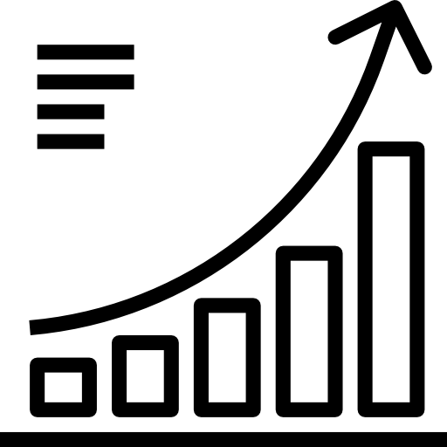


Next Steps
Jordans Principle Implications
2024/2025 research project looking at specific infrastructure and housing investments related to Jordans Principle
“Making the Business Case” to Close the First Nation Infrastructure Gap Project
In partnership with Conference Board of Canada, looking at net benefits to the non-Indigenous business sector: job creation, GDP incremental increases, industry sector impacts, and potential migrations to rural areas due to increased livability and affordability – economic modelling
Closing the Infrastructure Gap (CTIG) – Press Conference
Release of the reports to the public – see website
Launch of the CTIG website at AFN.ca
National Chief Press Conference
Advocacy for the 2024 Fall Economic Statement and Federal Budget 2025 release

Slide 31
Closing the
Infrastructure Gap by 2030:
A Government of Canada Mandate
“Let’s close the gap together… Anookeetaa!”

Slide 32
Q&A Period
Email: infrastructure@afn.ca
for any further questions
See AFN Website:
https://afn.ca/economy-infrastructure/infrastructure/closing-the-infrastructure-gap/

