Slide 1

First Nations Child and Family Services and Jordan’s Principle
Compensation Information

Slide 2
February 2007: The AFN and the Caring Society submitted a complaint to the Canadian Human Rights Act alleging Canada was discriminating against First Nations Children via the on-reserve FNCFS Program and Jordan’s Principle.
September 2019: Historical decision made!
The CHRT ordered Canada to pay the maximum compensation for those discriminated against.
January 2016: Landmark decision!
The Canadian Human Rights Tribunal (CHRT) finds the Canadian government is racially discriminating against 165,000 First Nations children.
December 2021: The AFN, the Government of Canada and Moushoom/Trout signed an Agreement-in-Principle that outlined $20 billion in compensation.
April 2023: The First Nations-in-Assembly unanimously approved the Final Settlement Agreement on Compensation, valued at $23.34 billion.
March 2025: The first two of nine Claims Processes opened.

Slide 3
Compensation Classes
Removed Child Class:
First Nations individual who, as a child, were removed from their home on-reserve and placed in care between April 1, 1991 and March 31, 2022
Base compensation: $40,000
Enhancements to compensate class members who experienced additional harms include: age at first removal, time in care, age at exiting care, removed to receive an essential service, removed from a northern or remote community, number of spells in care
Removed Child Family Class:
Caregiving parents or grandparents of Removed Child Class Members at the time of their removal
Base compensation: $40,000 (may be multiplied for additional children removed)

Slide 4




The Claims Period for the Removed Child and the Removed Child Family Class opened March 10, 2025.
Anyone who was over the age of majority on launch day, will have three years to submit a Claim.
Once a Claimant reaches the age of majority in their province or territory, they have three years to submit their Claim.
Minors can submit a claim up to two years before they’ve reached the age of majority; however, if eligible, they will not receive Compensation until they have reached the age of majority in their province or territory.
How to Apply:
Online via the Portal
Mail-in
Fax
Email

Slide 5
Claims Helper
Administrator (Deloitte):
Telephone: 1-833-852-0755
Email: generalinfo@contact.fnchildclaims.ca
Website: www.Fnchildclaims.ca
Assembly of First Nations:
Telephone: 1-888-718-6496
Email: fnchildcompensation@afn.ca
Website: www.fnchildcompensation.ca
What are Claims Helpers?
Claims Helpers offer one-on-one assistance at no cost to Claimants, which can include:
Help you understand the Settlement and claims process.
Explain what documents and identification you might need.
Help you complete your Claim Form.
Show you how to get government-issued ID.
Share information about local cultural, community and wellness supports.

Slide 6
If you have questions legal questions, please contact the Administrator at 1-833-852-0755 or Generalinfo@Contact.FNChildClaims.ca.
You do not need to hire a lawyer

Slide 7
Compensation Classes
Essential Service Class:
First Nations individual who, as a child, experienced a delay, denial or service gap in receiving an essential service for a confirmed need from Canada between December 12, 2007 and November 2, 2017
Base compensation: up to $40,000
Jordan’s Principle Class:
Essential Service Class members who experienced the highest level of impact
Base compensation: $40,000 plus potential enhancements (to be determined with experts)

Slide 8
Compensation Classes (cont’d)
Trout Child Class:
First Nations individual who, as a child, experienced a delay, denial or service gap in receiving an essential service for a confirmed need from Canada between April 1, 1991 and December 11, 2007
Base compensation: $20,000 plus potential enhancements for highest level of impact, or up to $20,000 for other claimants
Jordan’s Principle & Trout Family Classes:
Caregiving parents/grandparents of Jordan’s Principle, Essential Service and Trout Class members at the time of the delay, denial or service gap for those who experienced the highest level of impact
Base compensation:
  Jordan’s Principle Family: $40,000
  Trout Family: To be determined by Settlement Implementation Committee

Slide 9
Compensation Classes (cont’d)
Kith Child Class:
First Nations individual who, as a child, was removed from their home on-reserve and placed with a kith caregiver off-reserve between April 1, 1991 and March 31, 2022
Base compensation: $40,000
Kith Family Class:
Caregiving parents or grandparents of Kith Child Class Members at the time of their removal
Base compensation: $40,000 (may be multiplied, based on number of approved claims received)

Slide 10
Administrator:
1-833-852-0755
Email:
Claims@Admin.FNChildClaims.ca
Website:
www.Fnchildclaims.ca
Assembly of First Nations:
1-888-718-6496
Email: fnchildcompensation@afn.ca
Website:
www.fnchildcompensation.ca
Hope for Wellness:
1-855-242-3310
Website:
www.hopeforwellness.ca
Hours of Operation: 24/7
Offers service in a variety of Indigenous Languages
Kids Help Phone:
1-800-668-6868
Or TEXT to 686868
Website:
www.kidshelpphone.ca
Hours of Operation: 24/7

Slide 11
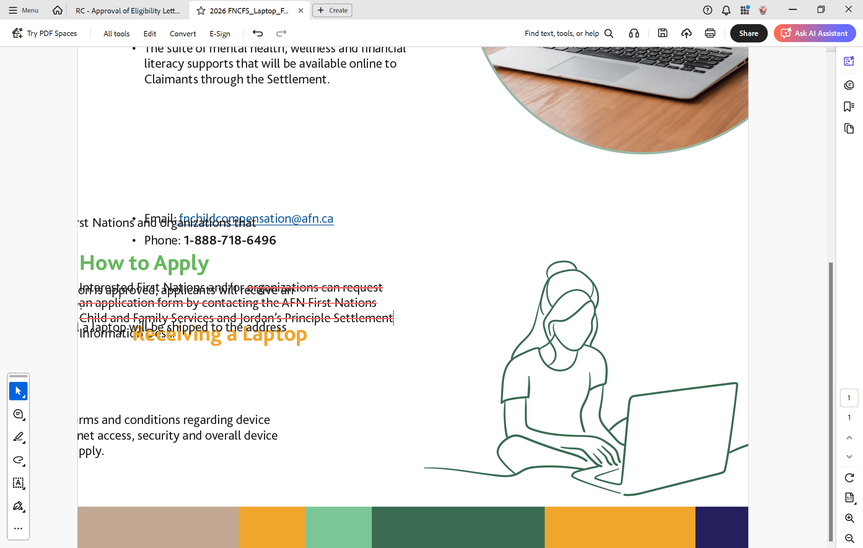
How to Apply for a Laptop
Interested First Nations and/or organizations can request an application by contacting the AFN Information Desk:
Email: fnchildcompensation@afn.ca
Phone: 1-888-718-6496

Slide 12
Thank you

