Slide 1
First Nations Climate and Conservation Leadership Dialogue Session:
AFN National Climate Strategy
July 10, 2023
3:00pm – 4:30pm AST

Slide 2
Overview
Mandate
AFN National Climate Strategy
First Nations Climate Lens and Priority Areas
Resolution

Slide 3
Context
“…climate change constitutes a state of emergency for our lands, waters, animals, and peoples”
Resolution 05/2019, Declaring a First Nations Climate Emergency

Slide 4
Mandate
Resolution mandate:
Declaration of a First Nations Climate Emergency (2019)
Ending Reliance on Diesel Power in rural and remote First Nations (2019)
Advancing First Nations Clean Energy Leadership for Economic Development and Action on Climate Change (2019)
Support for First Nations Climate Leadership, Food Sovereignty, Environmental Protection, Stewardship and Conservation (2020)

Slide 5
Timeline
Annual General Assembly
Declaring a First Nations Climate Emergency
July 2019
March 2021
1st National Climate Gathering – Whitehorse, YT
Global Pandemic declared by the World Health Organization
March 2021
Summer–Fall 2021
National Survey
Regional and National Webinar Series
Fall 2021–2022
Summer 2022
Wednesday Webinar Series
2nd National Climate Gathering – Fredericton, NB
Fall 2022
Spring 2023
Technical Webinars with ACE, Councils, and AFN Secretariat
Annual General Assembly
AFN National Climate Strategy Resolution (for adoption)
July 2023

Slide 6
AFN National Climate Gathering – Whitehorse (2020)

Slide 7
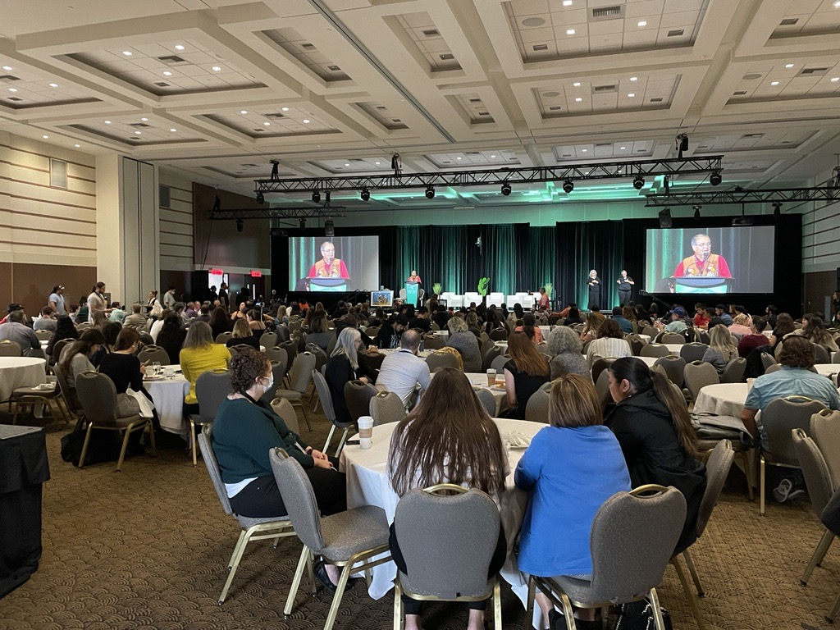
2nd AFN National Climate Gathering – Fredericton (2022)

Slide 8
AFN National Climate Strategy
Guiding Vision: Elders’ Statement
Introduction
First Nations Climate Leadership (including the First Nations Climate Lens)
Priority Areas
Conclusion

Slide 9
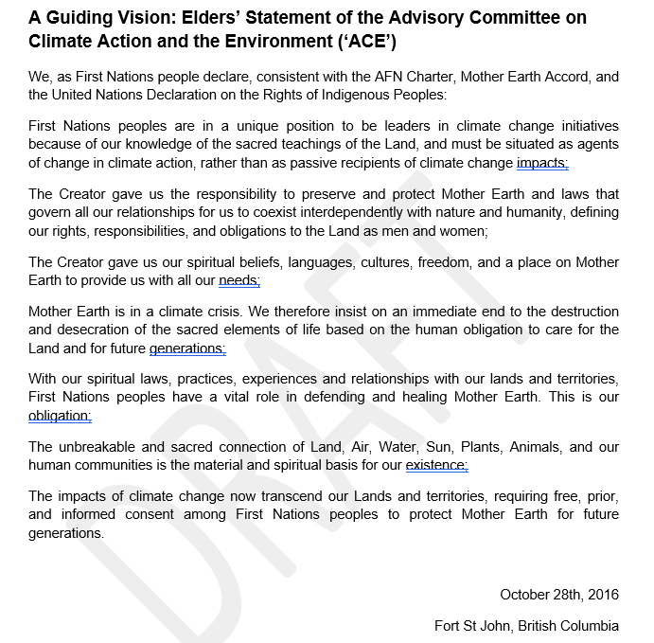
Elders’ Statement

Slide 10
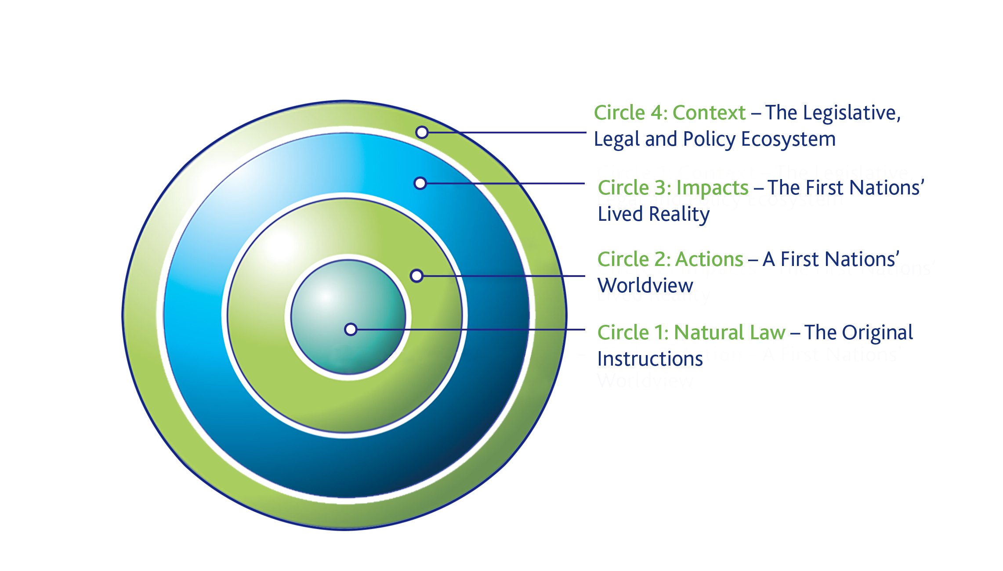
First Nations Climate Lens

Slide 11
Priority Areas
First Nations jurisdiction and Inherent right to self-determination
Leverage the First Nations Climate Lens to reform legislation, policy, and programs.
Address Capacity needs to support First Nations governance and their role as climate leaders.
First Nations Knowledge Systems, Health, Languages, Cultures, and Spiritualities
First Nations are equipped to mitigate, prevent, respond to, and recover from all emergencies.
First Nations self-sufficiency in food, water, and energy
Close the natural and built infrastructure gap.

Slide 12
Draft Resolution 31 TBIRs(…)
Reaffirm the declaration of a First Nations Climate Emergency, calling for:
Recognition that the climate crisis constitutes a state of emergency for our lands, waters, animals, and peoples;
Local, national, and international communities, governments, organizations, and movements to safeguard the inherent, Treaty and constitutionally protected rights of First Nations, respect First Nations knowledge systems, and uphold Treaties and other constructive arrangements between First Nations and the Crown; and
Federal, provincial, and territorial governments to take urgent and transformative climate action that meets the requirements outlined in the reports by the Intergovernmental Panel on Climate Change and Canada’s Changing Climate Report (2019) to reduce emissions in Canada by 60% below 2010 levels by 2030 and reach net-zero emissions by 2050.

Slide 13
Draft Resolution 31 TBIRs(…)
Fully endorse the AFN National Climate Strategy and its key priority areas of action:
Prioritize First Nations Knowledge Systems, health, languages, cultures, and spiritualities
Recognize, respect, and position First Nations Inherent jurisdiction and right to self-determination as central to climate decision-making at all levels.
Address capacity needs to support First Nations governance and their role as climate leaders.
Ensure First Nations self-sufficiency in food, water, and energy.
Close the natural and built infrastructure gap.
Ensure First Nations are equipped to mitigate, prevent, respond to, and recover from all emergencies.
Leverage the First Nations Climate Lens to reform federal, provincial, and territorial legislation, regulation, policy, and programs.

Slide 14
Draft Resolution 31 TBIRs(…)
Call on the federal, provincial, and territorial governments to work directly, and in full partnership with, First Nations rights- and title- holders to implement self-determined First Nations climate priorities, including, but not limited to, those outlined in the AFN National Climate Strategy.
Direct the AFN to work with First Nations rights and title-holders to advocate to the federal, provincial, and territorial governments for full funding to First Nations to implement their own strategies in a manner consistent with Article 39 of the United Nations Declaration on the Rights of Indigenous Peoples.
Direct the AFN to use the AFN National Climate Strategy in national and international contexts as an advocacy tool, including with the United Nations Framework Convention on Climate Change (UNFCCC) and the Intergovernmental Panel on Climate Change.

Slide 15
Path Forward
Finalize the AFN National Climate Strategy, plan a formal release with guidance from the Advisory Committee on Climate Action and the Environment (‘ACE’).
Implement the AFN National Climate Strategy.

