Slide 1
First Nations K-12 Education Transformation Review and Cost Analysis
Renee St. Germain, Acting Senior Director, Social Branch
Dakota Edwards, Senior Policy Analyst, Languages and Learning
AFN Education Forum
February 19-20, 2025

Slide 2
Overview
About the AFN
Background
Project overview and methodology
Presentation of findings
Findings: Interim Regional Funding Formula
Findings: Regional Education Agreements
K-12 Education Transformation: Key Challenges
Sample costing
Conclusions and Recommendations
Questions

Slide 3
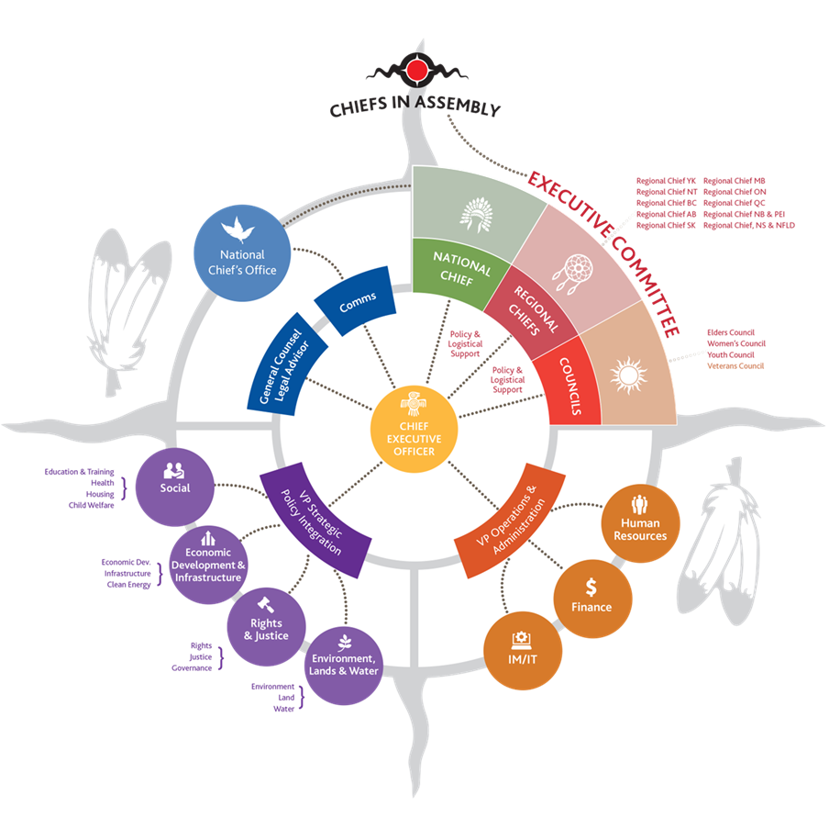
About AFN
The AFN is an advocacy organization, taking direction and fulfilling mandates as directed by First Nations-in-Assembly through resolutions.
The AFN seeks to advance First Nations Inherent and Treaty Rights through the development policy, public education and where applicable, the co-development of legislation to build First Nations capacity.
The various policy areas the AFN engages in are determined by First Nations-In-Assembly, which meet twice a year to pass resolutions that decides the mandate of the organization. These mandates include advancing First Nations priorities such as education, language revitalization and infrastructure.

Slide 4
Background
First Nations Policy Proposal - Transforming First Nations Education (2017)
In 2019, and in co-development with AFN, the federal government transformed First Nations education on reserve
Transformation replaced outdated, inefficient, and inadequate proposal-based education programs with more predictable core funding
Transformation has two phases:
Implementation of Interim Regional Funding Formula (IRFF)
Development of Regional Education Agreements (REAs)

Slide 5
Project Overview and Objectives
The Assembly of First Nations (AFN) contracted MNP to conduct a study on the costs associated with Regional Education Agreements (REAs) and the challenges and successes of First Nations K – 12 Education Transformation implementation.
This study is intended to inform future federal budget asks, guide First Nations in their REA negotiations and reinforce AFN’s advocacy by providing recommendations to Canada.

Slide 6
Methodology
1
2
3
4
Secondary research
Engagement
Development of costing samples
Results report and presentation
Review of funding formulas and publicly available reports and data
Interviews with First Nations organizations, Indigenous Services Canada (ISC), and other Subject Matter Experts (SMEs)
Development of anonymized costing samples for a small isolated First Nation vs. a large urban First Nation
Summarizing information into a final report

Slide 7
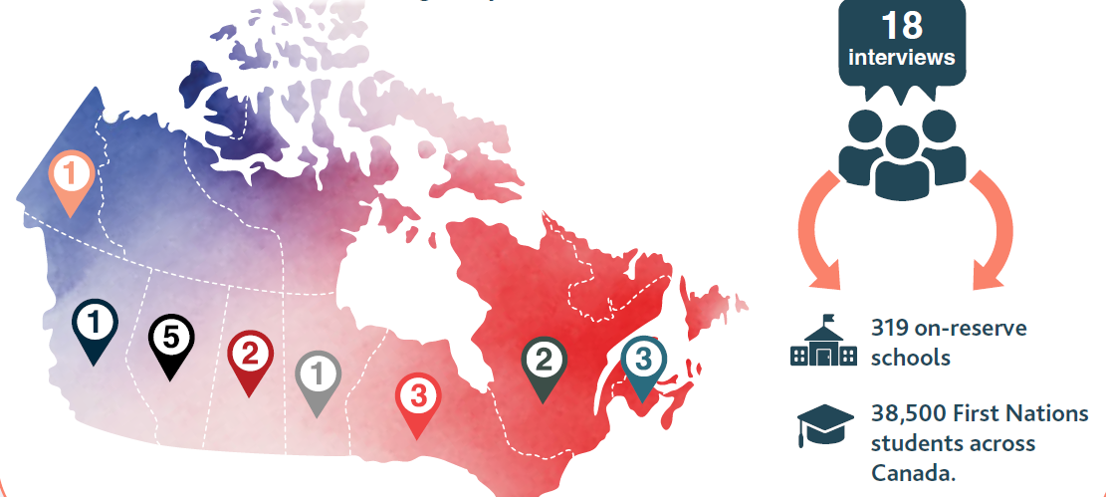
Engagement
In addition to 18 interviews with First Nations and First Nations Organizations, MNP conducted five interviews with government representatives and AFN SMEs.

Slide 8
Findings: Interim Regional Funding Formula
Successes
Overall, the implementation of the Interim Regional Funding Formula (IRFF) resulted in significant funding increases for most First Nations.
IRFFs helped create greater funding equity.
Elimination of nominal roll attendance compliance requirements.
Elimination of funding disparity between block vs. non-block First Nations, large/high-capacity vs. small/remote First Nations.
There have been notable improvements to the IRFFs over the past five years.
Country-wide improvements (e.g. before and after school funding, private home placement funding, student support funding, transportation funding.)
Region-specific improvements (e.g. remoteness adaptation for fly-in communities in Ontario.)

Slide 9
Findings: Interim Regional Funding Formula
Challenges/Criticisms
“Side-by-sides” (funding breakdowns) are confusing, not user-friendly, and difficult to understand.
Lack of transparency around underlying funding formulas.
Misinformation about funding for second-level services.
Errors within calculations.
Feedback/recommendations from First Nations on enhancements to IRFFs were not actioned.
Requests to update special education funding.
Requests to implement remoteness adaptations.
IRFFs do not allow for substantive equality.
First Nations are starting from a very different starting point; we cannot assume that comparability in funding will be sufficient to achieve comparability in outcomes.

Slide 10
Common Gaps in IRFFs
Language and Culture funding | Nutrition funding
Inclusive Education funding | Funding for third-level services
Operations and maintenance and minor capital | Teacher pension
Additional funding to recognize extreme remoteness/isolation | Administration funding
Targeted funding for small schools/school authorities | Targeted funding to address outcome gaps
Proposal-driven funding remains a go-to source for addressing the above gaps.
While Jordan’s Principle funding has been beneficial, First Nations participants noted that it is still unreliable, inconsistent, and creates a significant administrative burden for staff.

Slide 11
IRFFs do not allow for substantive equality
“Reaching provincial comparability under the IRFF is not nearly enough to provide services that the students need. Education is health and culture—all the services we provide to students above learning. The child’s needs must be met to pay attention in school.”
“They are looking at provincial equity in terms of funding, but not outcomes. Because we have had long-term inequity, we require more funding to get to par.”
“If Canada wants to achieve a true transformation, it must address other aspects influencing educational outcomes. The solutions need to be systemic. This includes providing adequate living conditions and housing and providing adequate opportunities for sports and recreation (hockey arenas, gyms, basketball courts). Kids cannot come to school ready to learn if they live at homes with 20 people and take turns sleeping on a bed.”

Slide 12
Findings: Positive Impacts of REAs
Separation of education operations from politics
Increased economies of scale
Improved access to Education Partnership Program (EPP) Funding

Slide 13
Findings: REA Key Challenges
Lack of change management (stakeholder engagement, communications and training.)
Lack of understanding of REA components and process (costing, government budget cycle, negotiations process and participants, outcome reporting requirements, and REA legalities.)
Lack of meaningful collaboration and dialogue.
Constant turnover and lack of capacity on both sides.
Limited incremental funding available to support First Nations Education.
In addition to developing needs-based REAs, ISC officials also communicated risks related to increases in nominal roll and maintaining provincial comparability.

Slide 14
Funding as Part of the REAs
Outcomes to Date
For most REA holders, “comprehensive funding arrangements” are based on the IRFFs (i.e., provincial comparability) rather than the actual needs and education costs of their First Nations.
Only the First Nation Education Council (FNEC) reported receiving needs-based education funding designed to address cost drivers unique to FNEC member First Nations, which is not rooted in provincial comparability.
Additionally, two agreements signed prior to the transformation, while not entirely needs-based, contain several funding enhancements to the provincial funding formulas:
1. BCTEA: transportation capital funding, language and culture funding, special education funding, and funding for third-level services.
2. MESC: language and culture funding, as well as minor capital funding.

Slide 15
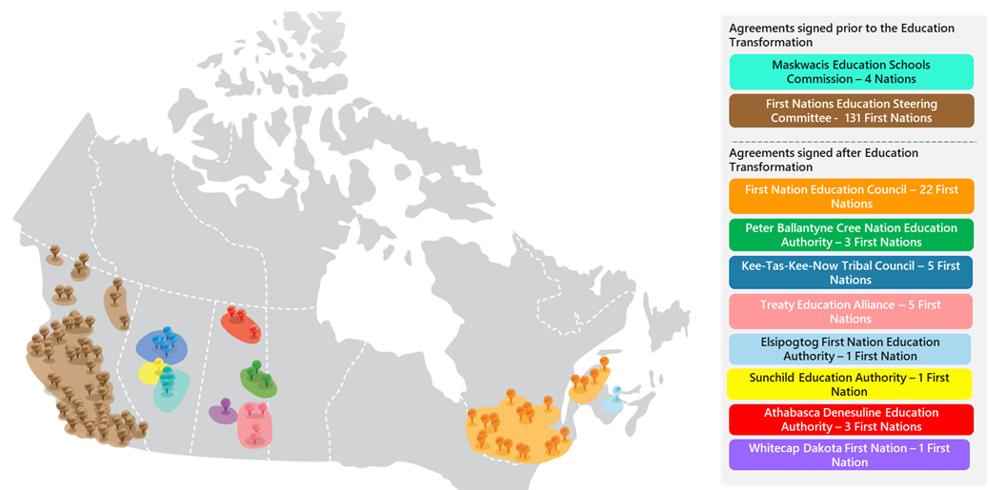
Signed Regional Education Agreements
The BC Tripartite Education Agreement (BCTEA) and Maskwacis (MESC) Transformation Agreement have been signed prior to Education Transformation and are technically not considered REAs.
Also, Whitecap Dakota First Nation has recently signed their self-government agreement and received a notice from ISC that their REA is no longer in effect and that the funding will be determined based on the provisions of the self-government agreement.
15

Slide 16
REA Tables in Progress
In addition to the signed agreements, there are 14 active negotiation tables.
While some progress is being made, 10 First Nations groups that initially indicated willingness to pursue an REA have either officially withdrawn or suspended the process.
The status of 29 additional REAs is unknown, suggesting that those First Nations may have paused their efforts due to internal challenges or diminished confidence in the outcomes of negotiations.

Slide 17
Quotes from Interview Participants
“Canada is eager to meet; they will attend meetings and send representatives from HQ. However, it often feels as though it’s just about checking the box and saying, ‘we’ve done consultations.’ After the meetings, nothing is happening; there is no follow-up, and action items seem to stall.”
"We submitted our funding request four years in a row…We cannot wait when it comes to student safety and student well-being."
“We’re basically getting a little tired of explaining our circumstance to ISC. You never talk to the same person longer than a year.”

Slide 18
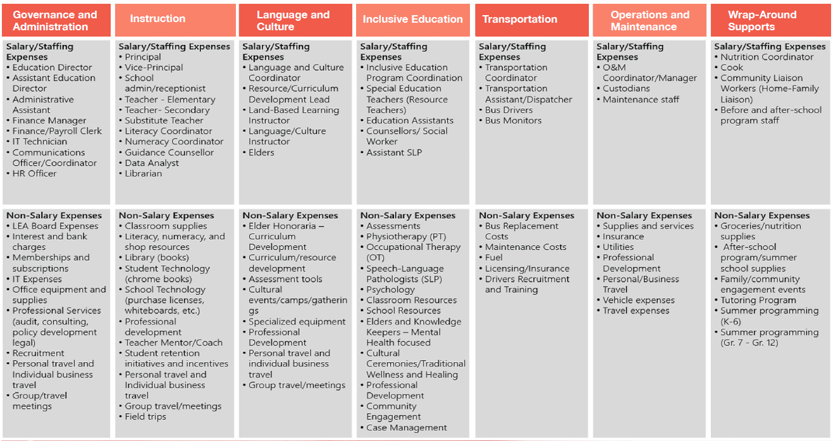
Sample Costing: REA Cost Structure

Slide 19
Sample Costing
To demonstrate the range of costs associated with the delivery of K- 12 education services, two sample First Nations communities were selected:
A small fly-in First Nation in Ontario with one school and 145 students.
A large urban First Nation in Alberta with three schools and 450 students.

Slide 20
Sample Cost per Student by Category

Slide 21
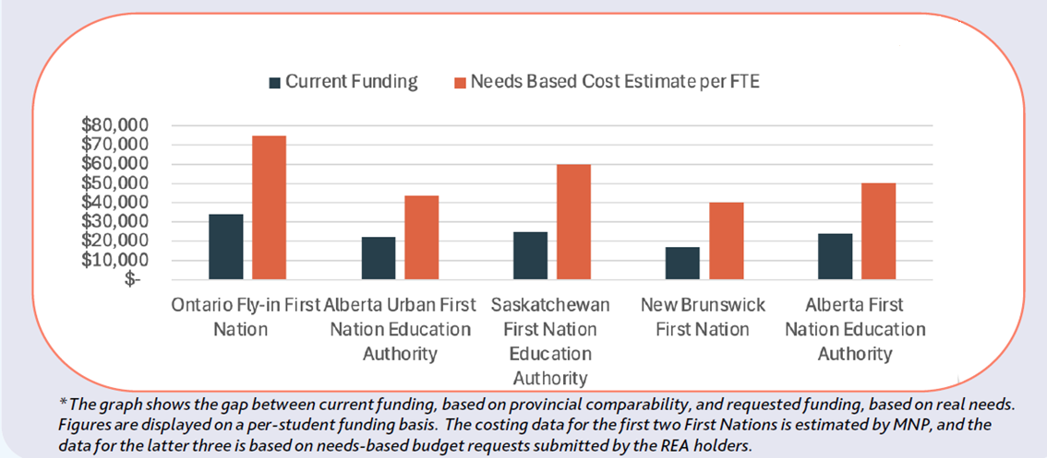
Comparison of sample costing (left) vs. actual costing submitted by REA holders (right)
The actual need is more than twice the amount generated by the IRFF.

Slide 22
Recommendations: Indigenous Services Canada
Improve the readability of funding information packages with First Nations.
Provide a detailed overview of the Interim Regional Funding Formula, including transparent calculations.
Release funding information before the new fiscal year.
Develop accurate enrollment projections with First Nations.
Create a framework for Regional Education Agreements (REAs).
Develop an REA guidebook.
Offer training or ISC regional staff on IRFF changes and REA negotiations.
Implement funding enhancements in key areas.
Include Jordan’s Principle expenses in core funding.
Explore incremental funding for needs-based federal budget submissions through REAs.

Slide 23
Recommendations: First Nations
Secure community support before discussions with ISC.
Obtain an MOU with ISC for the REA structure.
Connect funding requests to educational improvements using data
Collaborate with regional First Nations for common tools.
Involve education and legal experts.
First Nations should lead agenda and documentation.
Plan for transition post-REA signing.

Slide 24
Next Steps
Research Publication
The full report is published online in English and French.
The report summary is published online in English and French.
Advocacy
On January 17, 2025, the AFN National Chief issued a press release calling on Canada to address the shortcomings of K-12 Education Transformation highlighted by this research.
The AFN produces a Pre-Budget Submission every year, which outlines the funding requests to the government and will be based on the most up-to-date costing in this research.
The Sector will work with the National Indian Education Council, Chiefs Committee on Education and Indigenous Services Canada to co-develop changes that reflect the recommendations as directed by First Nations.

Slide 25
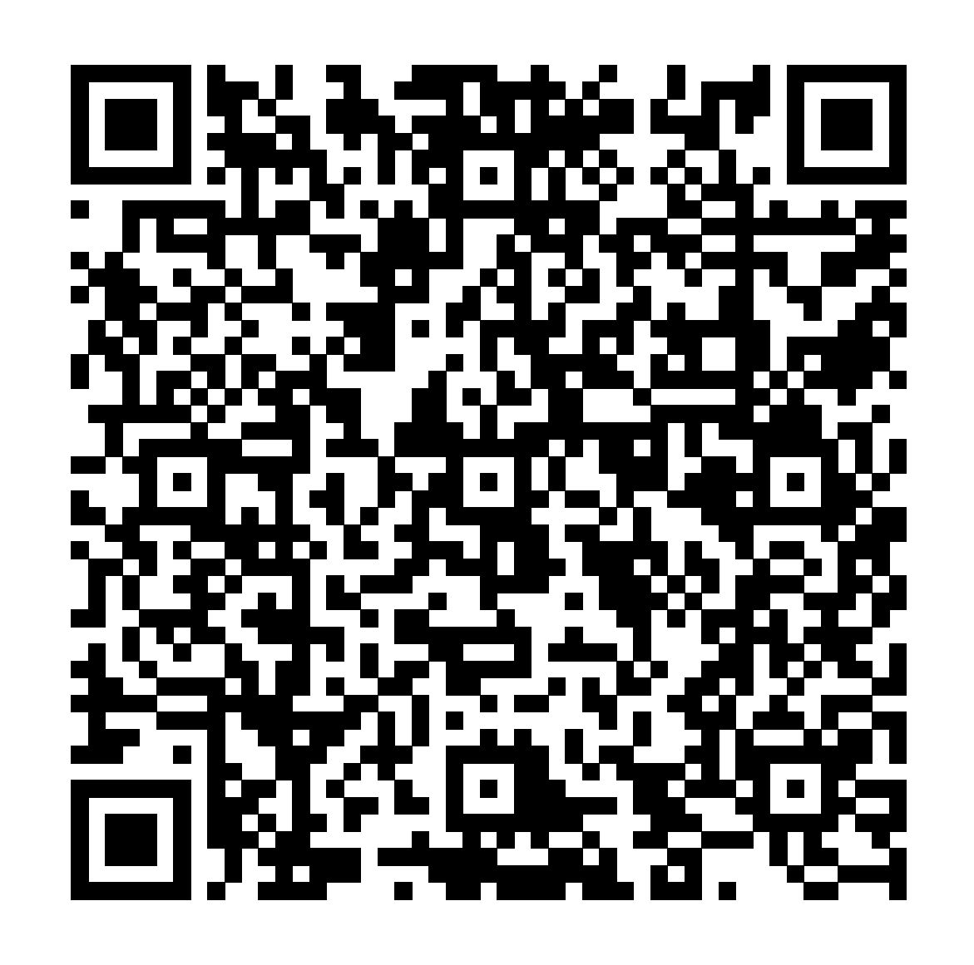
Questions? Rstgermain@afn.ca dedwards@afn.ca ←Access the full report →

