Slide 2
Enhanced Service Coordination

Slide 3
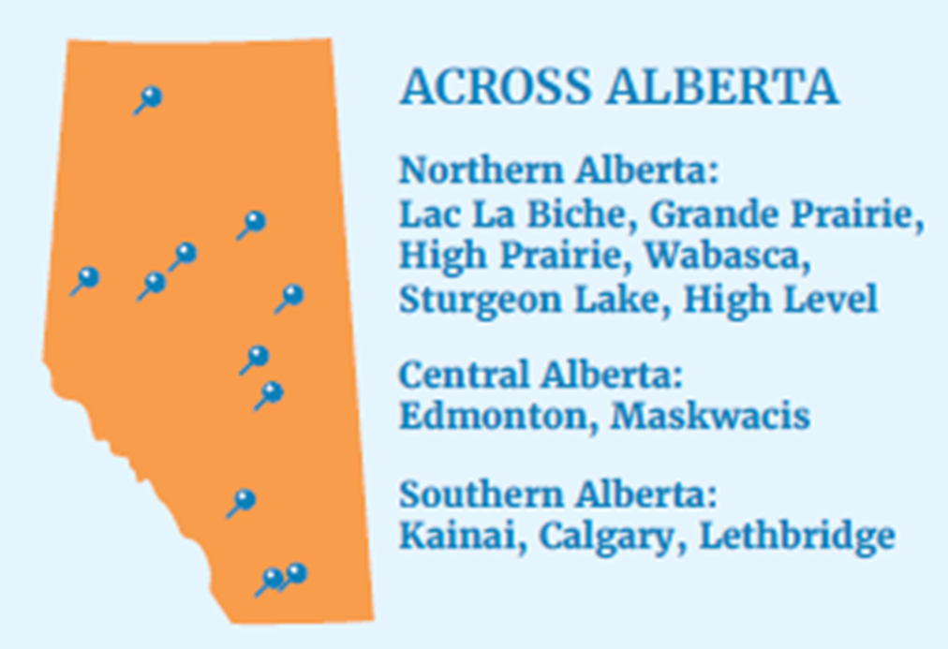
Enhanced Service Coordination: OUR TEAM
Competent, compassionate, multidisciplinary team with experience in Health, Social and Education
Live & work in our communities, speak our Native tongue & family led
Adaptability & flexibility
Relationship with ISC Region & service providers
Excellent advocacy & referral services
Robust Database & IT Security Measures

Slide 4
Challenges
Dynamic Challenges
Solutions
High intakes and caseload for staff
Employee Burnout
External Factors (economy)
Requestors double applications (ISC/FNHC)
Urgent/Time Sensitive classification
Backlog of applications leads to frustration with families.
Adaptability and flexibility as the landscape is ever changing
Revisit and streamline processes where we can
Self Care
Support the ongoing working relationship with ISC.

Slide 5
SARF SERVICES
Jordan’s Principle is a child-first principle meant to prevent First Nations children from being denied essential public services or experiencing delays in receiving them. One area of delays was payments processed to vendors or services and payments to families that paid out of pocket and waiting for reimbursement.
In 2019 was 1 staff member and in 2024 there are currently 9 staff members and growing
SARF department processes payments for individual approvals in Alberta and only on a few group requests. With the success of our department other regions have reached for assistance regarding payments in urgent situations (BC, Sask., North Region & Ontario).
There is no other initiative that focuses specifically at the three areas of Health, Education and Social for First Nation Children under one umbrella. With this designation, it is to be expected not to be structured, implemented and operate with simplicity.

Slide 6
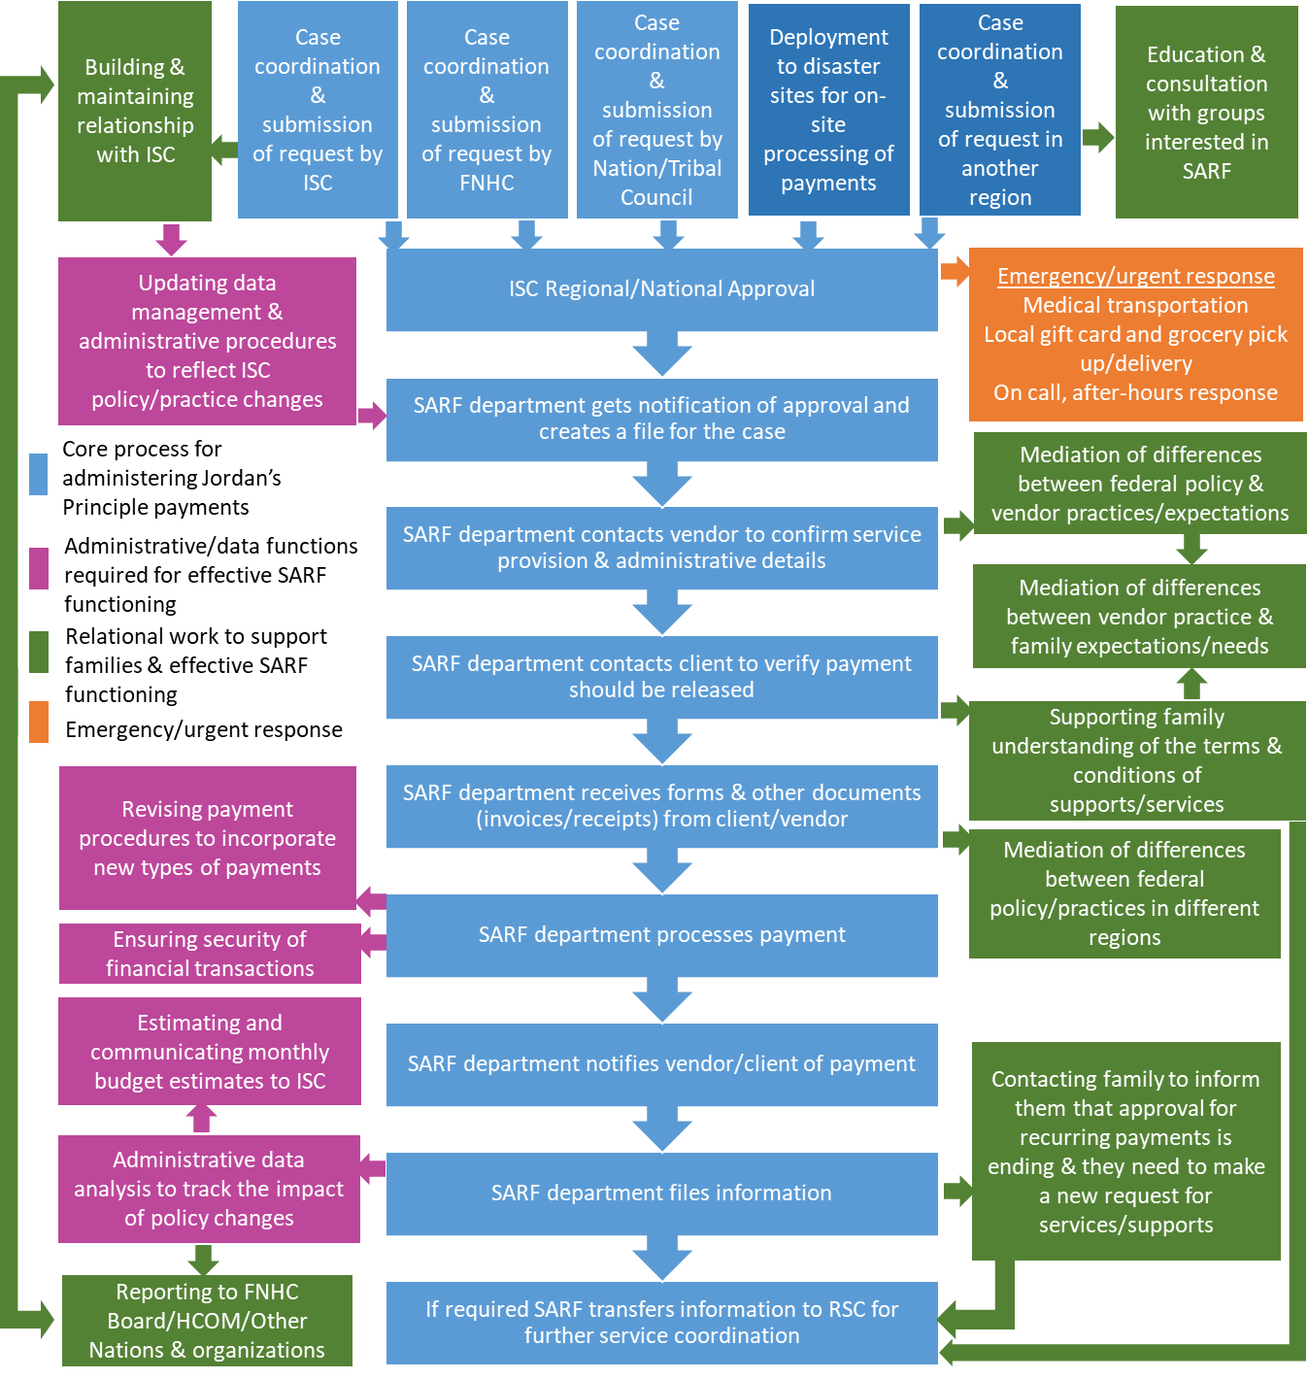
SARF ADMINISTRATION – A VIEW FROM THE GROUND
The complexity of operations developed over time.
One of the major contributing factors of the success is our partnership with ISC. There is communication and understand that the focus is the children.

Slide 7
Challenges
Dynamic Challenges
Solutions
New CHRT rulings
Election(s)
Supply and Demand (vendors and growth)
Agreement(s) meeting the T & C’s
High Caseload
Foundation always changing
Vendors/Client concerns (fraud)
Liability/Cyber Security/Phishing Emails
Continue to build/support new and current relationships with families, vendors and partnerships
Revisit and streamline processes where we can. Example is gift cards
Ensuring fiduciary responsibility
Diligent IT Support, Monitoring & Updates of Software

Slide 8
Examples of Data Collection

Slide 9
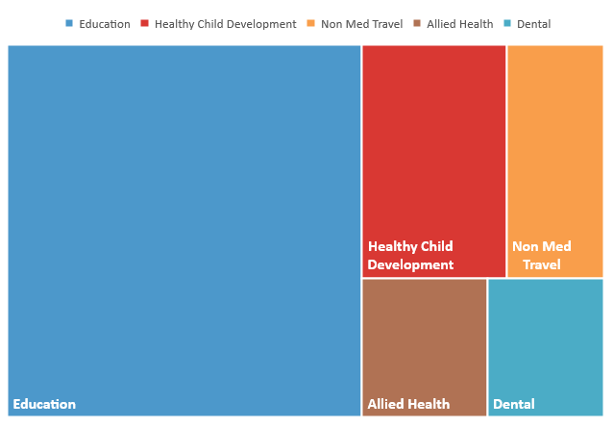
Examples of Payment Data Collection

Slide 10


How to Access our Service
Enhanced Service Coordination
The link between the child & the needed program, service, supplies, equipment & supports
Call toll free and speak to an Access Worker
1-844-558-8748
Visit our website and start an intake
www.abfnhc.com
Email us and
request support
nochild4gotten@abfnhc.com

